Slide 1
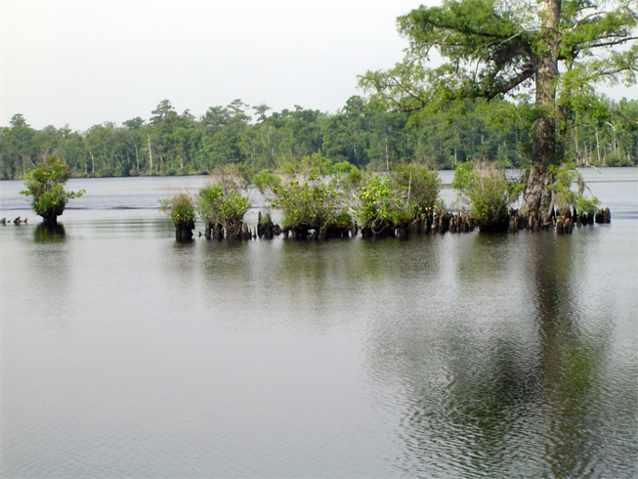
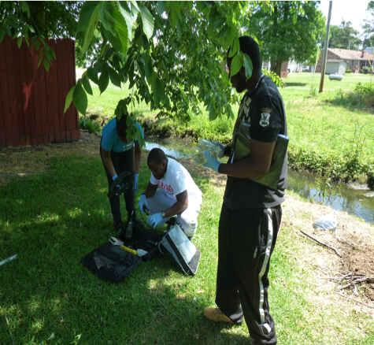
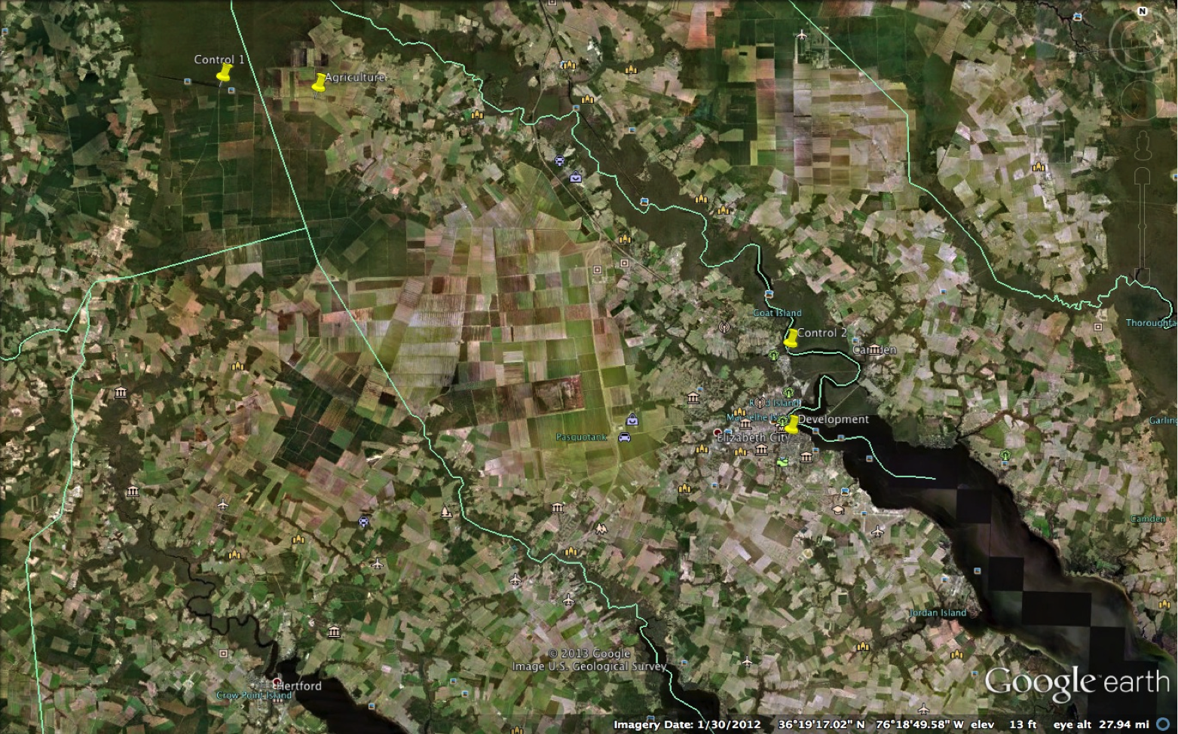
The Watermark Project: Human Actions Impacting the Quality of Water
Field Work
We tested the sample water for different water quality components. The YSI Professional plus Multi-Parameter Meter was used to measure the water's temperature in degrees Celsius, the barometric pressure, the dissolved oxygen in percent, the dissolved oxygen concentration (milligrams per liter), the specific conductivity, and the pH. To obtain these measurements we placed the meter in the water deep enough where all probes were submersed and also made sure the meter was not touching the bottom. We waited for approximately 1 to 5 minutes to insure the readings were stabilized. We repeated this step three different times moving the probes slightly to make sure that our readings of the water were accurate. Then we collected three water samples from each location for further lab work. We sampled two locations for macroinvertebrates one was a vegetative area and the other was a muddy area. Using a D-Net we gathered samples along the shoreline. Our method for the vegetative area was shaking the D-net in and under the vegetation to collects specimens for five seconds. Our method for the muddy area was dragging the D net along the waters bottom for five seconds. We withdrew the D-net with an upward motion to avoid losing macroinvertebrates and emptied it into a secure zip-lock bag. Then we added a small amount of the location water and stored all samples in a cooler until further testing in the lab. After that we collected three water samples from each location for further lab work.
Lab work
Once in the lab we filtered the samples using a sive in order to collect all of the macroinvertebrates. Then we sorted and identify the samples by using a dissecting microscope and the naked eye. Each macroinvertebrates has a certain amount of pollution that it can tolerate this information can be located on a macroinvertebrates identification key.
Researchers
Mentor
Michael Cobb
Chemistry
Elizabeth City State University
Dorothy Brice
Mathematics
Virginia Union University
Robin Brice
Biology
Fayetteville State University
Kelechi Onyiriuka
Pharmaceutical Science and Biology
Elizabeth City State University
Anthony Lynn
Computer Science
Winston-Salem State University
Prof. Jeffrey Schloss
Center for Freshwater Biology
University of New Hampshire
Watershed Watch 2013
Elizabeth City State University
Problem Statement
Humans impact the quality of water in numerous capacities; farming, foresting, as well as developments, play a major role in decreasing the quality of water.
Our project measured:
Temperature- Temperature physical quantity that is a measure of hotness and coldness on a numeric scale and a measure of the thermal energy per particle of matter or radiation. It is measured by a thermometer, which can have various temperature scales, Celsius, Fahrenheit, Kelvin and etc.
Dissolved Oxygen (D.O.)- D.O. is a relative measure of amount of oxygen that is dissolved or carried in a given medium. It can be measured with a dissolved oxygen probe such as an oxygen sensor or an optode in liquid media, usually water. The standard unit is milligrams per liter (mg/L) or parts per million (ppm).
Turbidity- Turbidity measures the cloudiness or haziness of a fluid caused by individual particles that are generally invisible to the naked eye.
pH- The a measure of the activity of the hydrogen ion is known as pH. It is measured on a scale 0 to 14, anything closer to 0 being acidic and anything closer to 14 being alkaline.
Ammonia- Ammonia is a pollutant that can be very toxic, lowering reproduction and growth, and in some cases it can even cause death. The neutral form of ammonia (NH₃) is toxic to fish and other aquatic life.
Nitrate/Nitrite -High levels of nitrates and nitrites are likely the result of human activities When excessive amounts of these compounds enter our water systems, and foods, they can pose a serious health threat.
Macro invertebrate Index- a series of numbers used to assess water quality based on the macro invertebrates present in the streams or rivers.
Results:
Table 1 shows the results of the water quality test. Graph 1 show the turbidity results with impacted sites having highest turbidities. Graph 2 shows the same for ammonia . We only had one positive result for nitrite at the agricultural site. Table 2 show the comparisons of the Water Quality Indexes and the Macro-invertebrate Index. For all indices the higher number is the better water quality condition.
For turbidity we expected the control sites to have the lowest numbers and that is what occurred.
Ammonia levels were expected to be low in the controls, than developed, and the highest in agriculture. We were correct about the controls, but the levels in the developed area were the highest instead
Specific Conductivity was low in control 2, high in developed, and control 1 and agriculture were close.
Developed pH was the highest and control 2 was the second most favorable. Starting water from the development stream comes from ground water, which can cause pH to be neural
Dissolved oxygen percentage was high in the development stream do to shallow water and less debris on the stream bottom. Also the wind can contribute to adding oxygen
Control 1 was a swamp area so the dissolved oxygen percentage was low this can be caused by the decaying debris at the swamp bottom also the dark color pigment makes it hard for sunlight to penetrate the bottom.
Agriculture had no macro-invertebrates this could be of the local pesticide run off. While collecting samples we noticed that no insects were flying around.
Introduction and background
About 70% of the earth’s surface is covered with water. Water is essential to life; it is estimated that the average American uses about 80 gallons of water per day. Most people look at water as something of an indefinite abundance, but in all actuality it is the complete opposite. On a day-to-day basis, humans impact the quality of water in numerous capacities; farming, foresting, as well as developments, play a major role in decreasing the quality of water. Farming can be responsible for certain water quality depleting factors because of its uses of pesticides, fertilizers, and other farming methods that are unfavorable when it comes to preserving the quality of water. Logging and land clearing can be a catalyst to erosion, which can lead to sediment run-off directly into some bodies of water. The development of cities, buildings, and other structures leads to more toxic materials that also find their way into the water system.
A healthy environment is one in which the water quality supports a rich and varied community of organisms and protects public health. Measurements of indicators such as, macro invertebrate index (M.I. index), ammonia concentrations, nitrate and nitrite concentrations, dissolved oxygen, and other factors, can be used to determine, and monitor changes in water quality. These measurements are also important in determining whether certain water is suitable for the health of the natural environment and the uses for which the water is required. If water quality is not maintained, it is not just the environment that will suffer - the commercial and recreational value of our water resources will also diminish.
Hypothesis
Farming is responsible for certain water quality depleting factors because of its uses of pesticides, fertilizers, and other farming methods that are unfavorable to the quality of water.
The development of cities, buildings, and other structures leads to more toxic materials that also find their way into the water system.
ABSTRACT
We investigated local stream water quality to determine the impacts of agriculture and development. We selected four sites two controlled sites, one agricultural site, and one developmental site. We tested the water’s temperature, dissolved oxygen levels, pH, and specific conductivity with a multi-parameter meter. We also collected water samples to analyze the ammonia, nitrite, and the turbidity. Macro invertebrates were also sampled in vegetative and muddy areas at each sample site.
As we expected the control sites had lowest turbidity levels. Ammonia levels were highest in the developed and agricultural areas but we were surprised that the highest levels occurred in the developed area. Dissolved oxygen was moderate in most sites with the control 1 area at the swamp having lower values than other sites. Specific conductivity was high in the developed area and low in the second control site (river tributary) but there was little difference between control 1 and agriculture. Surprisingly pH was the highest in the developed site. This is most likely due to the headwater source for the developed site being ground water.
There were no macro invertebrates at the agricultural site. The second control site had more tolerant macro-invertebrates than other sites. We calculated Water Quality Index (WQI) scores and Macro-invertebrate Index (MI) scores. Our initial results for WQI had the developed site obtaining the highest score (better quality) but removing pH from the index resulted in a more accurate result with controls having the better water quality. This was consistent with the MI results. Reasons for removing pH from WQI are due to the expectation that even pure swamp water would have low pH naturally.
Methodology: Materials and Procedures
Site location:
We selected four sites. One control was located in a natural wetland upstream from an agricultural site. The second control site was in a tributary to the Pasquotank River closer to our developed site
Field Work
We tested the sample water for different water quality components. The YSI Professional plus Multi-Parameter Meter was used to measure the water's temperature in degrees Celsius, the barometric pressure, the dissolved oxygen in percent, the dissolved oxygen concentration (milligrams per liter), the specific conductivity, and the pH. To obtain these measurements we placed the meter in the water deep enough where all probes were submersed and also made sure the meter was not touching the bottom. We waited for approximately 1 to 5 minutes to insure the readings were stabilized. We repeated this step three different times moving the probes slightly to make sure that our readings of the water were accurate. Then we collected three water samples from each location for further lab work. We sampled two locations for macro invertebrates one was a vegetative area and the other was a muddy area. Using a D-Net we gathered samples along the shoreline. Our method for the vegetative area was shaking the D-net in and under the vegetation to collects specimens for five seconds. Our method for the muddy area was dragging the D net along the waters bottom for five seconds. We withdrew the D-net with an upward motion to avoid losing macro invertebrates and emptied it into a secure zip-lock bag. Then we added a small amount of the location water and stored all samples in a cooler until further testing in the lab. After that we collected three water samples from each location for further lab work.
Lab work
Once in the lab we filtered the samples using a sieve in order to collect all of the macro-invertebrates. Then we sorted and identify the samples by using a dissecting microscope and the naked eye. Each macro-invertebrates has a certain amount of pollution that it can tolerate this information can be located on a macro-invertebrates identification key. We collected water samples form our study sites, and then we used an Ammonia test kit and Nitrite test kit (Aquarium Pharmaceuticals) to determine the levels of Ammonia and Nitrite in our sample. We added a reagent to the water sample to determine the levels of Ammonia and Nitrite in the water sample. We then waited for 5 minutes for the water to change color and finally, we compared the colors form the water samples to the Fresh Nitrite color card and the Freshwater Ammonia color card. We insured accuracy by analyzing the water samples form each sites. We carefully reviewed our data and begin to calculate water quality, using a Water Quality Index, of dissolved oxygen (percent), specific conductivity (converted to Total Dissolved Solids), pH, turbidity, and ammonia (converted to N-NH4x100) for each site. We calculated a combined WQI using the standard weighting factors. (www.water-research.net/waterqualindex/index.htm) Finally, after individually gathering that information we added the indices together for each location to further calculate the overall water quality index for each locations as a whole.
AGRICULTURE
CONTROL 1
CONTROL 2
Discussion:
Our initial results for WQI had the developed site obtaining the highest score (better quality) but removing pH from the index resulted in a more accurate result with controls having the better water quality. This was consistent with the MI results. Reasons for removing pH from WQI are due to the expectation that even pure swamp water would have low pH naturally.
Reference
www.water-research.net/waterqualindex.index http://go.water.usgs.gov/edu/earthhowmuch.html
www.ncsu.edu www.vasos.org www.waterboard.ca.gov
www.ourlake.org
http://bnc.boulder.co.us/basin/data/NEW/info/SC.html
http://epa.gov
ELIZABETH CITY
DEVELOPMENT

