Slide 1
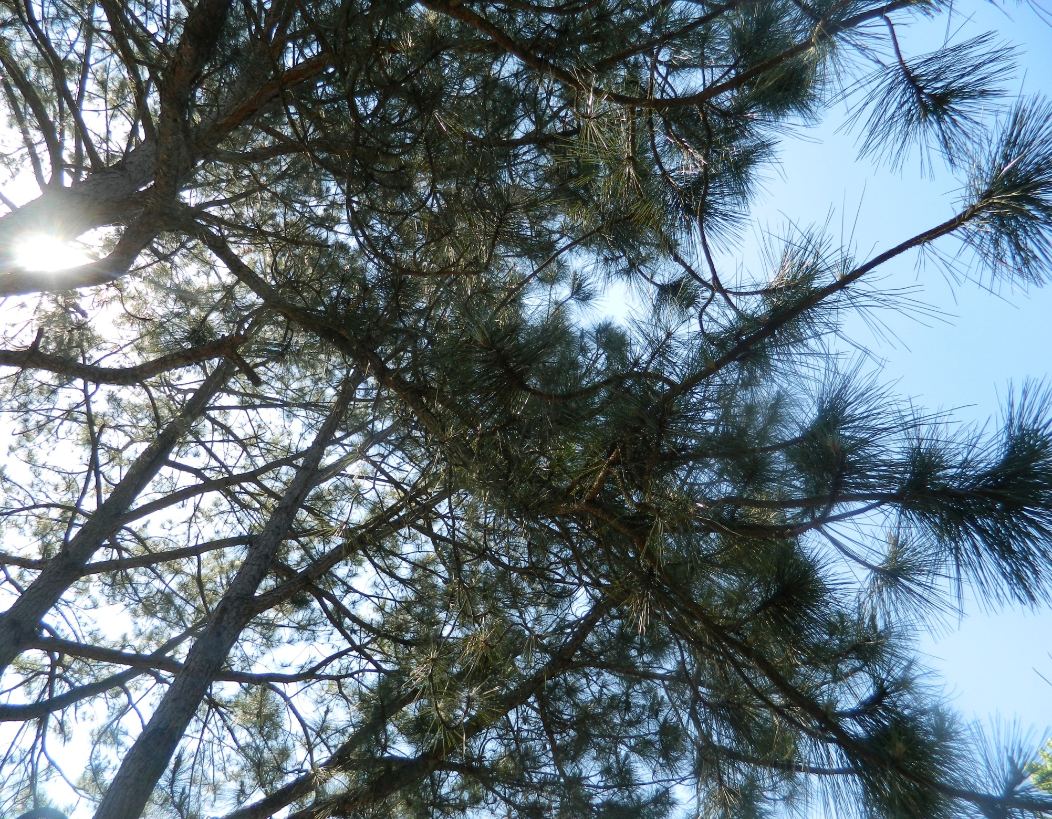
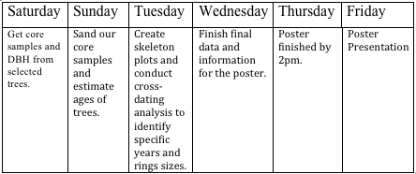
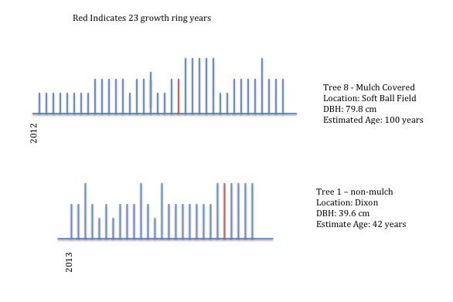
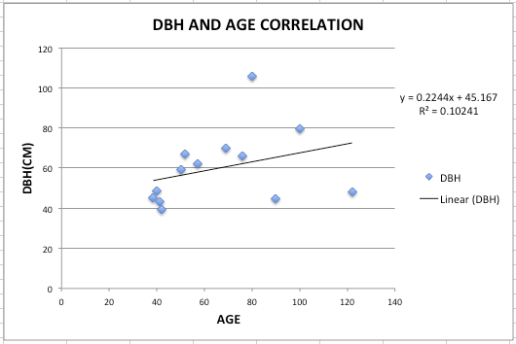
Analyzing Factors That Influence Loblolly (Pinus taeda) Pines at Elizabeth City State University
Researchers
Mentor
Kalyx McDonald
Computer Science
Mississippi Valley State University
Courtney Farmer
Mathematics
Elizabeth City State University
Jazette Johnson
Computer Science
Spelman College
Malcolm McConner
Elementary Education
Elizabeth City State University
Alicia Reynolds
Math Education
Elizabeth City State University
Watershed Watch 2013
Elizabeth City State University
Barrett Rock, Ph. D,
Forestry/Botany/Remote Sensing
University of New Hampshire
Methods
A total of seventeen tree cores were selected based upon various criteria (e.g., seven surrounded in mulch, one covered in Poison Ivy and Wisteria, one with Poison Ivy only and two Wisteria vines, and six control trees). After surveying the are research was conducted concerning the climate changes over time and to gain a greater knowledge of environmental factors(e.g., rainfall versus drought conditions) and humanistic factors (e.g., disturbances in natural habitats). Once the data was gathered, tree core samples were taken from thirteen trees. The other four tree cores were already taken and used as a part of the control group. The cores were glued to wooden trays, sanded and then analyzed to compare the growth rings to determine the estimated age, tree health, and the developmental patterns. Skeleton plots were conducted for each core sampled using graph paper. Once the plots were completed pointer years for small groups were found and compared to the pointer years of the entire group using the a cross dating observation method. For the trees that share common pointer years a different analyses will be used to address each hypothesis.
Results
Results (continued)
Effects of Vines: Wisteria & Poison Ivy
After analyzing the growth rings of the trees with wisteria and the bare tree near the softball field. We have concluded that the trees with wisteria vines did not have a negative impact on the growth of the loblolly pine. We traced back the growth rings of both trees with Wisteria vines back to 1987 and during the trees younger years, it produced wide growth rings indicating that the tree experienced good growth conditions. Tree 7, which has a Wisteria vine wrapped around it, became present in 2000, hence the development of narrow growth rings. However, in 2005 the tree started to produce the regular to wide growth rings consistently to 2012. Tree 6 was another loblolly that has a Wisteria vine wrapped around. This tree was not hindered by the growth of the vine since it continued to produce regular and wide growth rings even after the presence of the vine.
Bare Tree
The bare tree showed a consistency of small growth rings. We believe this is in result of competition with the other loblolly trees in the same vicinity. The last year the bare tree produced a wide growth ring was 1988, which was a pointer year in the skeleton plot for all of the trees near the softball field displaying wide growth rings. The loblolly trees with the Wisteria and/or Poison Ivy are absorbing more water and nutrients then the bare tree.
Effects of Climate: Rainfall & Heat
The process of skeleton plots and cross dating was used to distinguish the pointer years. Pointer years are years where the skeleton plot used different length lines that indicates if growth rings were normal, wider or narrower. In this study the pointer years are 1983, 1990 ,1993 ,1998 ,2002, and 2007. When analyzing the cores for the effects of precipitation the main months we observed were May and June because in May the tree produces early wood and in June the tree produces latewood, in those months if the precipitation findings are high the tree would produce wider rings because the tree has more water, which produces good growing conditions. In 1990, 1993, and 1998 the average days with precipitation in May was 12 days and in June the average was 14 days. In years where the growth rings were narrower, 2007 and 1983, the average days with precipitation in May was 10 days and in June was 8 days.
These recordings show that in 1983 and 2007 there was not enough precipitation to produce wider growth rings. According to research, findings also show that for every tree analyzed in the year of 1983 had the smallest growth ring. Based on NOAA data 1983 was an El Nino year [2]. El Nino years are years where the ocean temperatures are unusually warm in the Equatorial Eastern Pacific. The La Nina years are the years were the oceans temperatures are unusually cold. The El Nino years are separated into three categories: weak, moderate, and strong. 1983 was an El Nino year that was considered to be strong, which causes the air and land to be very dry years[1].
ABSTRACT
Trees are very important to the environment as they provide oxygen to living organisms, uptake carbon dioxide, improve air quality by absorbing potentially harmful pollutants (e.g., carbon monoxide, sulfur dioxide), produce carbohydrates (sugars ,cellulose, starch, etc.) and serve as an climate indicator (e.g., precipitation). In the Southern United States, loblolly pine trees (Pinus taeda) are the most essential and widely produced trees. It is extensively used for lumber and pulpwood. We extracted tree cores from the loblolly pines across the campus of Elizabeth City State University and compared the correlation of diameter at base height (DBH) and tree age. Once we collected the cores, we calculated the estimated age and determined the overall health condition of the trees, by analyzing the growth rings in each core. We also determined what variables contribute to the positive or negative growth of a tree (e.g., mulch, vines).
INTRODUCTION
This research aimed to analyze different methods (e.g., dendrochronology, dendroclimatology, cross dating) to determine the impact of factors such as competition, rainfall, and the presence of mulch and vines on loblolly pines on the campus of Elizabeth City State University (ECSU). Dendrochronology is defined as a science that uses tree rings dated to their exact year of formation to analyze the width of growth rings between rings. Dendroclimatology focuses on the tree ring patterns to study past and present climate change. This is useful to our research because differences in growth rings represent seasonal changes (narrower rings show drought conditions, wider rings show more normal conditions).
Timeline
Correlation Between Age and Diameter at Breast Height
Twelve Loblolly pines and one long leaf pine were apart of the data set used to compare tree age and diameter at breast height (DBH). Trees were sampled from across the campus of Elizabeth City State University, from around Dixon Hall, on the side of the road near the softball field, and from the plots of Sigma Gamma Rho and Kappa Alpha Psi. After coring these trees and calculating the estimated age using the diameter at breast height (DBH), it is clear that these two variables show little to no correlation. The oldest tree from our data set was estimated to be 122 years old with a DBH of 48.7cm while the youngest tree, approximately 38 years, had a DBH of 45.3cm. Even though these trees were only about 3cm apart in diameter their ages are close to 84 years apart. The hypothesis was that the older trees would have more narrow growth rings than the younger trees which would have wide growth rings. After looking at the two cores this hypothesis was in fact true. After creating a scatter plot comparing DBH and age we noticed that a majority of the trees we sampled were between 35-80 cm in diameter and 35-70 years old.
Effects of Mulch
We can conclude that mulch does affect the growth rings but not to a large amount. There were years when non mulched trees had smaller growth rings while the mulch covered trees had normal size rings or exceeded the normal for the same years. From 2004-2012 our non mulched trees had the least amount of growth rings. During this time about 2 growth rings per mulch covered tree also did not have a normal growth ring. In a test with 4 Mulch trees and 3 non mulched trees, the non mulched trees were almost 30 years or more older than the mulch covered trees. The DBH for non mulched trees were greatest at 79 cm and decreased gradually although they were around the same age. The mulched covered trees all had a lower DBH which was approximately 50 cm or lower. Mulch is beneficial to tree growth depending on who you ask but it does not solely depend on it.
Heating Day Record for the Pointer Years
Pointer Years | Average | Max
1983 | 8 | 53
1990 | 6 | 28
1993 | 9 | 40
1998 | 8 | 36
2002 | 8 | 37
2007 | 8 | 47
Precipitation Record for the Pointer Years
Pointer Years | Average (inches) | Wet Day in May | Wet Days in June | Sum Rain in May/June (inches) | Size of Growth Rings
1983 | 0.05 | 10 | 6 | 9.99 | Narrow
1990 | 0.02 | 12 | 8 | 0.97 | Wide
1993 | 0.02 | 11 | 10 | 0.96 | Wide
1998 | 0.08 | 15 | 11 | 6.52 | Wide
2002 | 0.15 | 9 | 12 | 5.37 | Narrow
2007 | 0.08 | 10 | 10 | 6.19 | Narrow
Figure 3:Heating Records
Figure 4: Precipitation Records [3]
Materials
Conclusion
13 wooden trays
Wood glue
Soda straw
Tape measure (D-Tape)
Aluminum foil
Two increment Corers
Sandpaper
Coarse 60
Medium 120
Fine 320
1 Longleaf pine
Fraternity Plot, girdled
16 Loblolly Pines
4 vines (along road beside softball field)
1 with Poison Ivy & Wisteria and 1 with Poison Ivy only
2 with Wisteria
6 with mulch
1 from Sigma Gamma Rho plot
1 from Fraternity plot
4 from the side of Dixon Hall
6 control tress (behind Dixon Hall and from the outdoor classroom)
After compiling our research and the tree cores collected from trees across Elizabeth City State University (ECSU) we came to the following conclusions. Only early wood was produced in 2013, this can be in result of a late spring in Elizabeth City, NC; this made calculating tree age easier. Using the calculated age and recorded diameter at breast height (DBH) a scatter plot was made which showed there was no a correlation between the DBH of the trees and the age. Also there was a very aged tree was also discovered on the ECSU campus (Estimated age of 152 years). The timing of rainfall was important particularly between the months May and June, which was beneficial to our data collection and its impact on comparing growth rings. Research showed that the impact of El Niño/La Nina winds impact trees worldwide. Pointer years were found using skeleton plots which is a way of cross dating tree cores. Some of these pointer years were worldwide dry years while others were specific to this area. One tree in particular showed promising results. A girdled tree on the Kappa Alpha Psi fraternity was still living after about 20 years of having a chain wrapped around it to support a swing. One hypothesis was to investigate the impact of mulch, this proved to be beneficial to the tree, however, and the tree did not depend on the mulch, which is also a positive finding. Our final hypothesis was to analyze the effect of poison ivy versus wisteria vines and see if the vines were strangling the trees as it appeared. After looking at the growth rings and comparing them to trees without vines is was concluded that the vines did not have a negative effect on the growth of the trees. Over our entire hypothesis turned out to be close to correct and it was a rewarding process to see the data reflect our assumptions.
Hypotheses
Vines negatively affect the growth of tress (narrower growth rings)
Mulch is beneficial to tree growth (large growth rings)
Rainfall directly correlates to the size of the growth rings of a trees
Tree diameter at breast height (DBH) is not directly related to tree age
Figure 2: Mulched vs Non-Mulched Skeleton Plot –A Skeleton Plot allows you to compare differences using a method of lines ranging from shortest to tallest depending on the growth width of the tree rings.
Figure 1: Diameter at Breast Height vs Age Scattered Plot
References
"El Niño and La Niña Years and Intensities.”, 10 Jan 2013. Web. <http://ggweather.com/enso/oni.htm>.
2) "El Nino.”Web. <http://www.pmel.noaa.gov/tao/elnino/la-nina-story.html>.
3) "Weather History for Elizabeth City, NC.”. Web. <http://www.wunderground.com/history/airport/KECG/2007/5/1/CustomHistory.html?
dayend=30&monthend=6&yearend=2007&req_city=NA&req_state=NA&req_statename=NA&MR=1>.
Acknowledgments
We would like to thank Dr. Linda B. Hayden Principal investigator of CERSER, University of New Hampshire Watershed Watch Project, Dr. Barrett Rock of University of New Hampshire, the National Science Foundation for funding this research and Elizabeth City State University.

