Slide 1
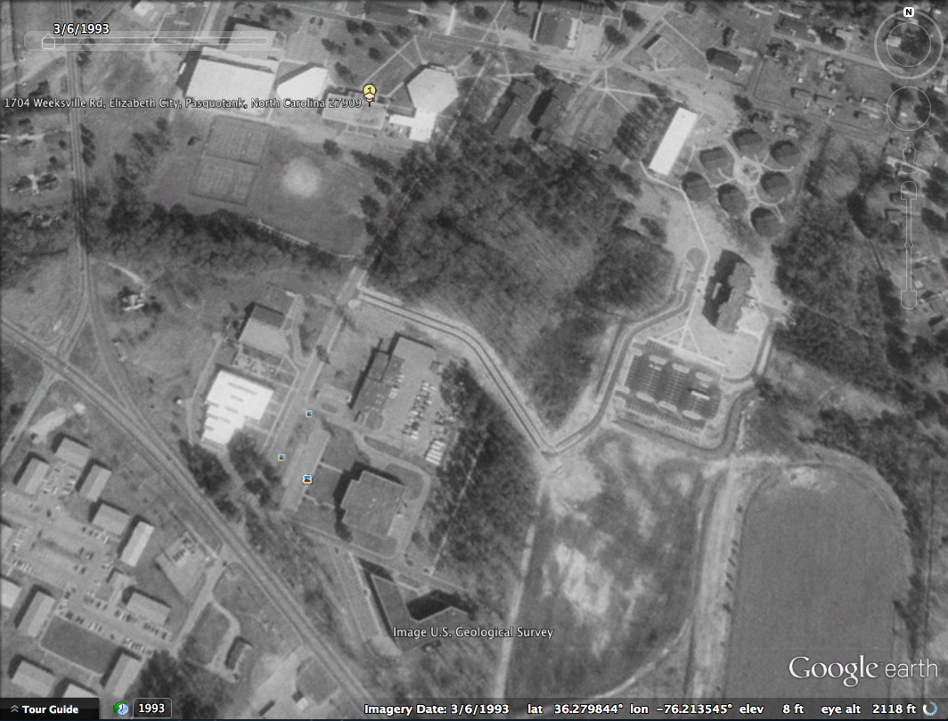
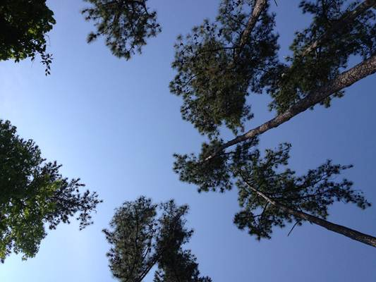
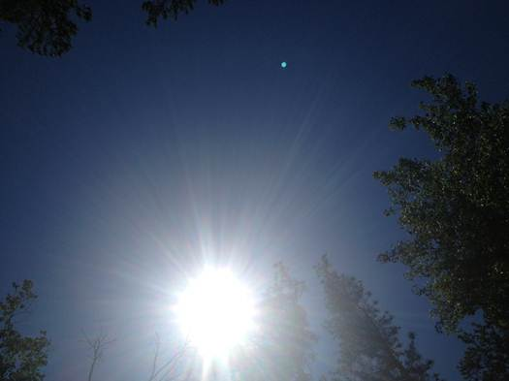
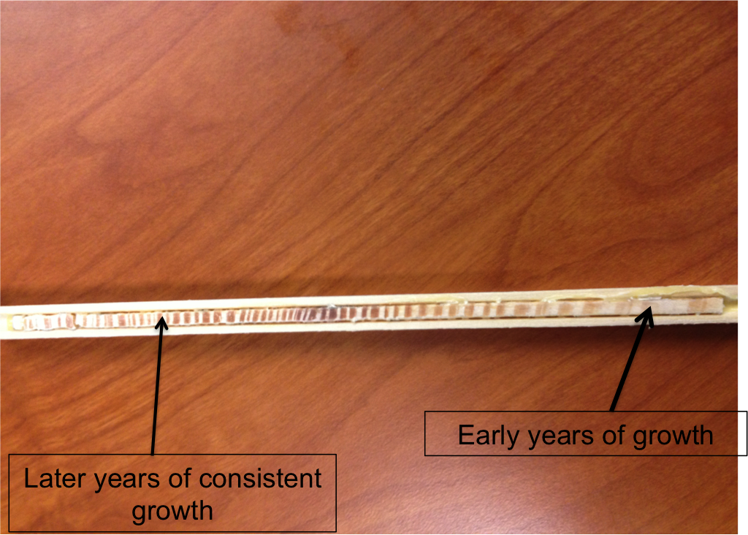
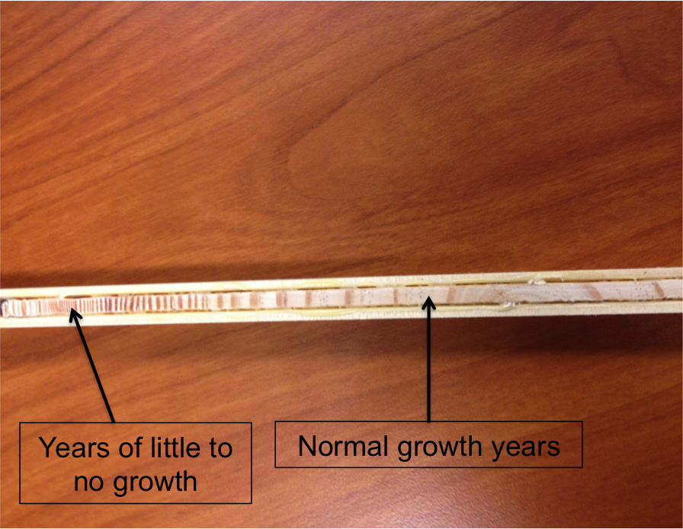
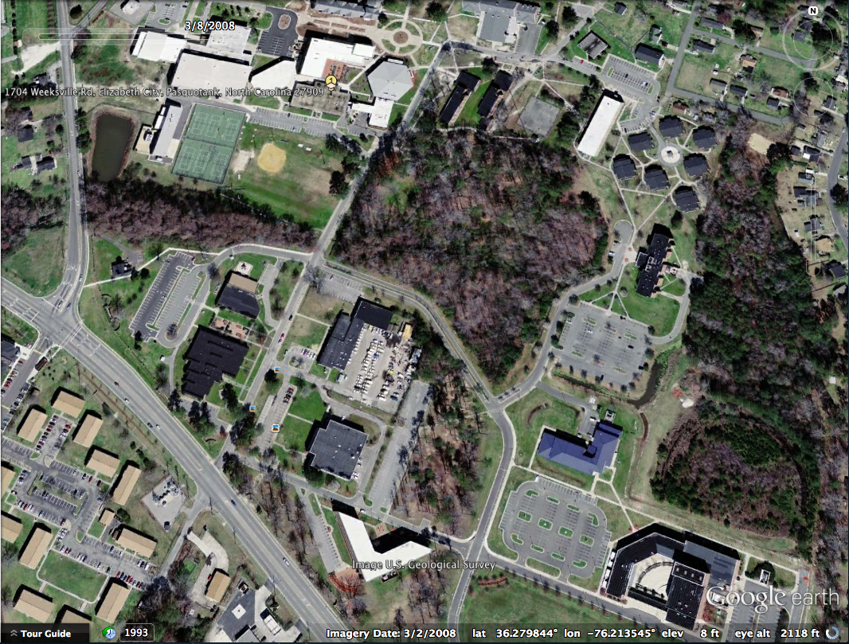
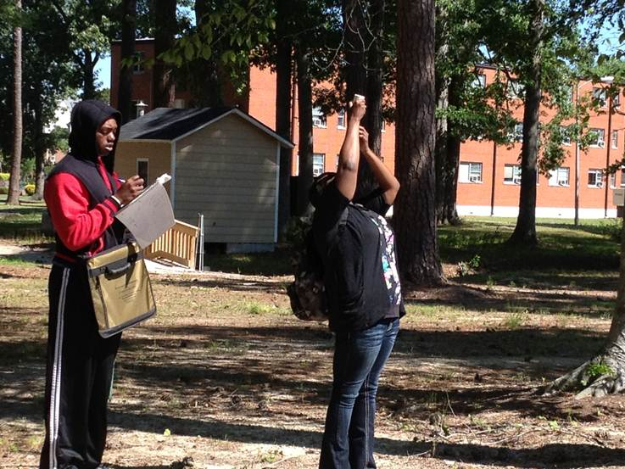
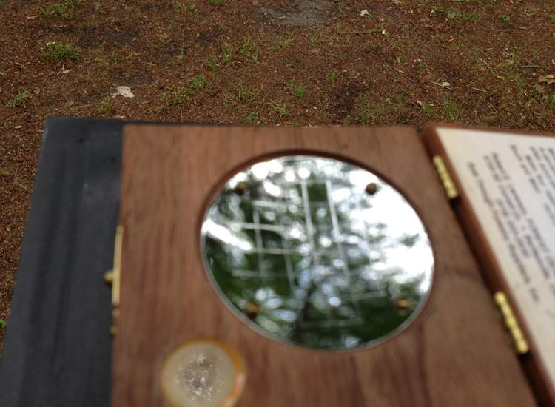
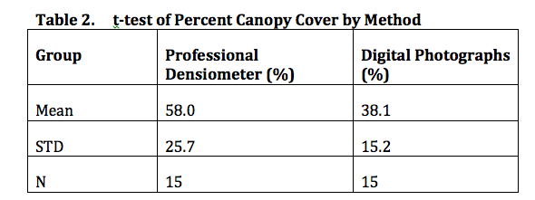
How Campus Development Affects Forest Growth
ABSTRACT
Canopy cover is the percent of a fixed area covered by layers of branches and foliage at the top of a forest's trees. It is an indicator to how healthy the trees are in an area. We hypothesize that using canopy cover would be effective to compare forested areas on campus in undeveloped areas (such as the Outdoor Classroom) and areas surrounded by roads and parking lots. We also wanted to test different methods of measuring canopy cover. Trees are important in developed and urban areas as sources of shade, and other factors. Based on earlier research we knew that trees needed room to grow and could be deprived of oxygen and water due to competition from other trees. Also we understand that the tree’s roots need a source above the ground to collect water
Plot 3 : Behind Dixon Original and Masked Canopy Cover
1
Ricky Dixon
Mathematics Education
Mississippi Valley State University
Jessica Hathaway
Mathematics Education
Elizabeth City State University
Mentors
Dr. Annette Schloss
Earth Systems Research Center
University of New Hampshire
Dr. Barry Rock
Earth Systems Research Center
University of New Hampshire
Hypotheses
We hypothesized that the trees closer to developed sites on campus will have less canopy cover than those undisturbed. The creation of new roads and buildings can also take away from ground nutrients, water, and oxygen in the soil. We also wanted to determine if digital pictures could be used to accurately measure canopy cover.
3
Plot 2: Behind Dixon Original and Masked Canopy Cover
2
Location of Plots
Outdoor Classroom-Built October 17, 1974
Behind Dixon Hall-Built February 1978
Behind Police Station-Built October 1977
Location of plots found using Google Earth.
Methods
We laid out the 30m by 30m plots with 42m diagonals using Foresters tape, with the corners facing N, S, E, and W. A GPS reading was taken at the center of each plot. Observations of canopy cover were made at the center of the plot and halfway down each diagonal, for a total of 5 observations per plot. Observations were made with a digital camera and a professional densitometer. Additional observations were taken along the diagonals using a handmade densitometer. A set of 9 pictures was taken using the Picture Post [1] at the center of each plot to create a panorama of the plot. For all pictures and densitometer readings, a tripod was set up at a height of 1.35m to match diameter at breast height (DBH).
Densiometer readings were taken using the procedure described in Pleus & Schuett-Hames, 1998 [2]. Handmade densitometer readings were taken along each diagonal using the Forest Watch method [3]. Analyzing Digital Images software [4] was used to estimate canopy cover from the digital pictures. A mask was created to separate the canopy from the sky. Data were compared with that taken with the densitometers.
Percent canopy in the digital picture was determined as:
% Canopy cover = canopy pixels / total pixels * 100
Results
Effects of development on tree growth and canopy cover: Based on the research that we conducted, both of our hypotheses were supported. After calculating the canopy cover of the three plots we saw that the trees closer to the construction areas had less canopy cover. We compared the photographic data from all three plots using Analysis of Variance (ANOVA, Table 1). The test told us that there was a significant difference in canopy cover among the three plots (p < 0.001). We also studied tree cores from two trees in each developed plot, to look for signs of damage from roads, parking lots, and sidewalks. Trees near the developed areas showed an extended amount of time where there was little to no growth and they were significantly weaker than those that were near the center of our plots.
Comparison of methods of measuring canopy cover: We compared digital pictures and professional densitometer readings using a paired t-test (Table 2). Canopy cover by the digital photographs was always lower than that taken by the densitometer (p < 0.003). The differences were between 66% and 71% lower, which shows that the digital photograph is more sensitive to small patches of sky between leaves and branches and that the differences were consistent. In contrast, the handmade densitometer did not give consistent readings with the other methods (Table 3).
1
Additional Information and Discussion
To further support our hypothesis we took cores of trees in different areas. The two trees that we chose were in Plots 2 and 3, behind the police station and Dixon hall. While observing the two cores we noticed distinct differences. Tree #1 was skinnier and was very close to a sidewalk that separated Plots 2 and 3 and was also in close proximity of three other trees. Tree #2 was wider and was closer to the center of Plot 3. While retrieving the cores we noticed that it was much easier to core tree #1 than tree #2. Initially we thought that this came from the sheer size difference of the trees but once we analyzed the cores we saw that that wasn’t the case. While looking at the core of tree #1 we noticed that the growth rings were significantly lighter than that of tree #2. After seeking the help of Dr. Rock, we learned that the darker the growth rings, the stronger the tree would be. We also noticed that at some point later in it’s life tree #1 had practically no growth whereas tree #2 had continuous growth throughout its life. These results indicate that along with the competition of other trees, the laying of the sidewalk on the path of the roots of tree #1 may have caused a decline in growth. The pressure of the weight of the cement could have possibly constricted the roots giving them less room to grow. Also with the sidewalk on top of the path of the roots, it could have taken away from the water that could get to the roots.
3
2
Conclusion
Upon the completion of our research we have made three conclusions. First, areas of forestry that are not disturbed by developmental projects will have a greater percentage of canopy cover than that of an area near developmental projects. Our second conclusion is that it is possible to gain knowledge of canopy cover using a variety of methods. Lastly, trees furthest away from sidewalks, roadways, and parking lots will grow more consistently and efficiently opposed to trees closer to them.
REFERENCES AND RESOURCES
Picture Post http://picturepost.unh.edu/
Pleus, A & D Schuett-Hames, Method Manual for the Reference Point Survey, TFW-AM9-98-002, 1998.
Measruing Protocols, Forest Watch, http://forestwatch.sr.unh.edu
Analyzing Digital Images software, Digital Earth Watch (DEW), http://dew.globalsystemsscience.org
Kocher, Susan D., and Richard Harris. "Tree Growth and Competition." University of California, 2007.
"LTRR | Laboratory of Tree-Ring Research." LTRR | Laboratory of Tree-Ring Research. http://ltrr.arizona.edu/
Watershed Watch 2013 :: Elizabeth City State University

