Slide 1
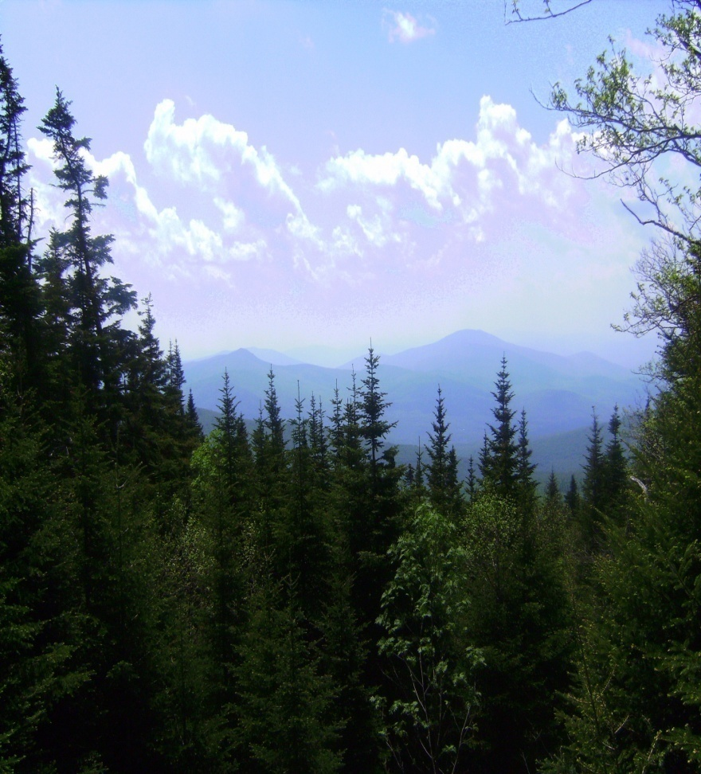
Tree Coring at Different Elevations
Lakeshia Reid
Liz Shaheen
Mentors: Barry, Mike, and Danielle

Slide 2
Introduction
The topic we chose to study is the effect that different elevations have on tree health and growth.
location where did our research was Mt. Moosilauke.
The two species of trees we studied were Red Spruce (Picea rubens) and Balsam Fir (Abies balsamea).
The three different elevation points were 2,500 feet, 2,800 feet, and 3,300 feet.

Slide 3
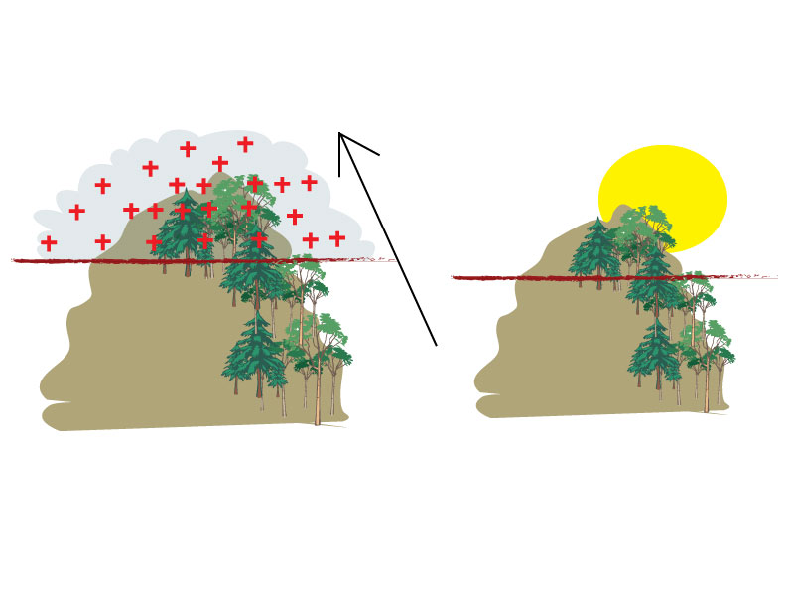
Hypothesis:
Tree growth rates as an indicator of health will decline as you increase along an elevational gradient.

Slide 4
Factors Affecting Tree Growth
Above 3,000 feet is an area known as the atmospheric sewer. Acidic cloud events are a common occurance. The presence of ozone, sulfur oxides (SO_{x}), nitrogen oxides (NO_{x}), and other pollutants may adversely impact tree health.
Nutrients are limited at high elevations.
Climatic conditions are much harsher such as high winds, snow, and ice.

Slide 5
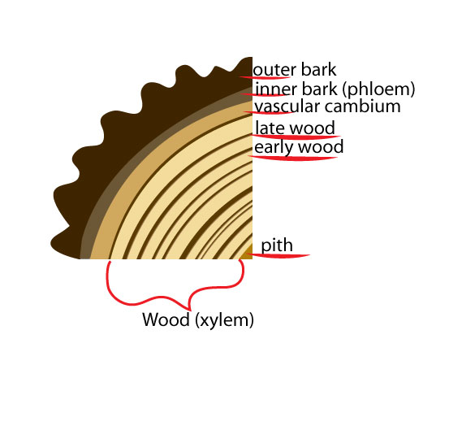
Objectives
Collect tree core samples from a Red Spruce and a Balsam Fir at three designated elevation sites. (2,500 ft., 2,800 ft., 3,300 ft.)
Record growth in years - based on number of rings.
Determine overall health - based on space between each ring (recorded in millimeters).

Slide 6
Materials Needed
McDonald’s Straws
Mounting Trays
Multiple Tree Corers
Cooler
Blue Ice
.22 Rifle Gun Cleaning Kit
Permanent Markers
Masking Tape
Data Sheets
Dissecting Scopes
DBH Tape
Coarse Sand Paper
Elmer’s Wood Glue
Ziplock Bags
Paper Towels
Fine Sand Paper

Slide 7
Results
Our research did not yield the results we had hoped it would. This was due to various factors such as small sampling size, and unknown precipitation information. What we did find, however, was a negative correlation between the Balsam Fir and the Red Spruce.

Slide 8
Competition Advantage

Slide 9
What does it mean?
Our findings show that there was a direct correlation between the Balsam Fir and the Red Spruce. When one was growing well the other suffered and vice versa. There were also other factors that had a great effect on our data. These were things such as a 1960 drought, hurricane, climate change, industry boom and the creation of the lodge in 1938 which wiped out the majority of the mountain’s Red Spruce. When the hurricane knocked the tall Balsam down, the Spruce were able to grow well because the Balsam weren’t blocking the sun.

Slide 10
References
Boggs, Johnny L.; McNulty, Steven G.; Gavazzi, Michael J.; Myers, Jennifer Moore. 2005 “Tree Growth, Foliar Chemistry and Nitrogen Cycling Across a Nitrogen Deposition Gradient in Southern Appalachian Deciduous Forests” Canadian Journal Forest Resource. 35: 1901-1913.
Watershed Watch Notebook
Pg. 10-11 Measuring tree height, live crown height, and sample height
Pg. 26-27 Tree Cores
Pg. 28-31 How to Core a Tree

