Slide 1
Do strain rates determine the spatial density of crevasses on the Greenland Ice Sheet?
Brandon Scott
Saint Augustine’s College
Mentor: Kristin Poinar
University of Washington

Slide 2
Abstract
To compare spatial crevasse density with an existing strain rate dataset, a Fast Fourier Transform (FFT) algorithm was used to create a one dimensional spatial crevasse density map from a 2.25 km² area on the western flank of the Greenland Ice Sheet (GIS). Although we find a poor correlation between crevasse density and longitudinal strain rates, the correlation improves significantly when the crevasses are projected five years upstream. This suggests that the crevasse patterns are relicts of strain rates the ice felt five years ago, and that it takes five years for crevasses in the study area to open fully. The stress required to create these crevasses, 111 ± 47 kPa, compares well to the existing body of literature on tensile strength. The average total crevasse life span of twelve years in the study area region was found to vary greatly from those in the Worthington Glacier in Alaska, where crevasses persist for only one to two years.

Slide 3
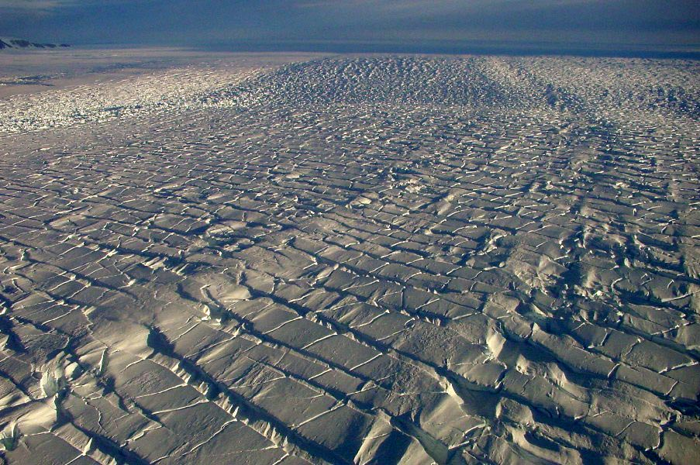
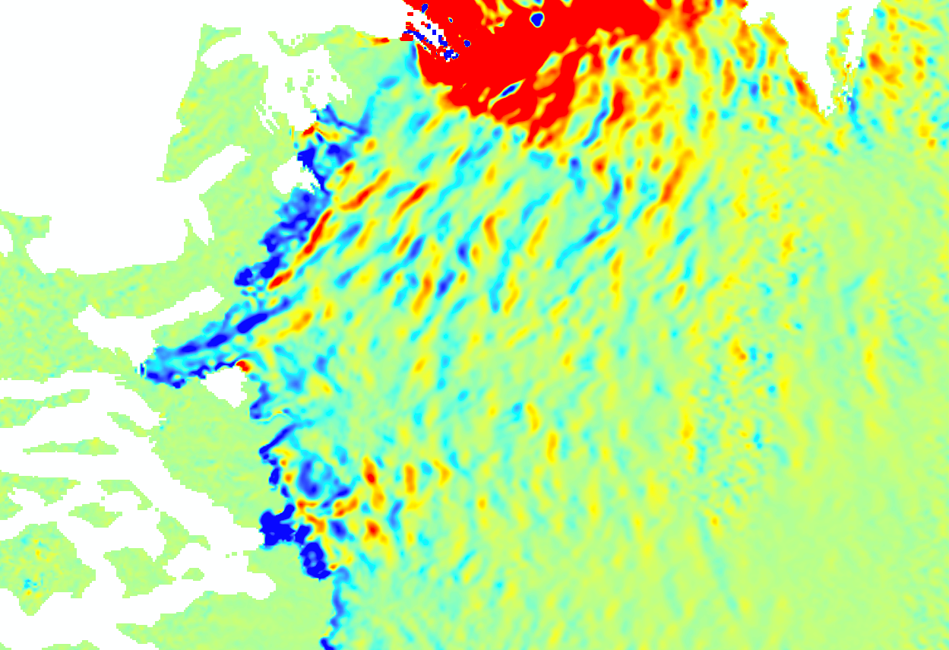
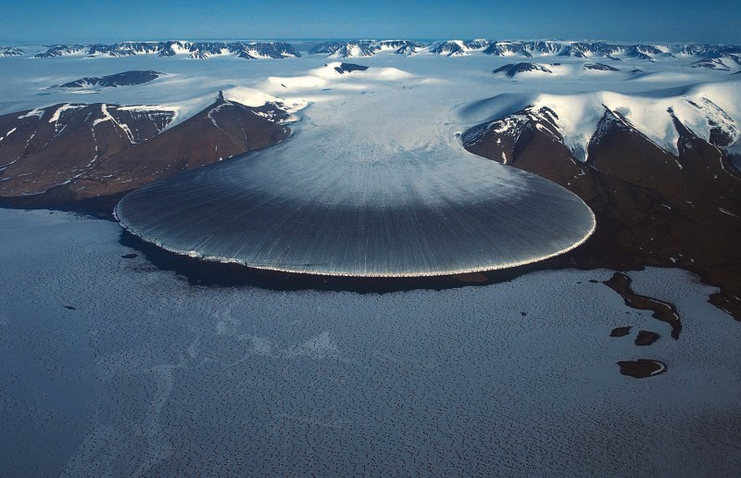
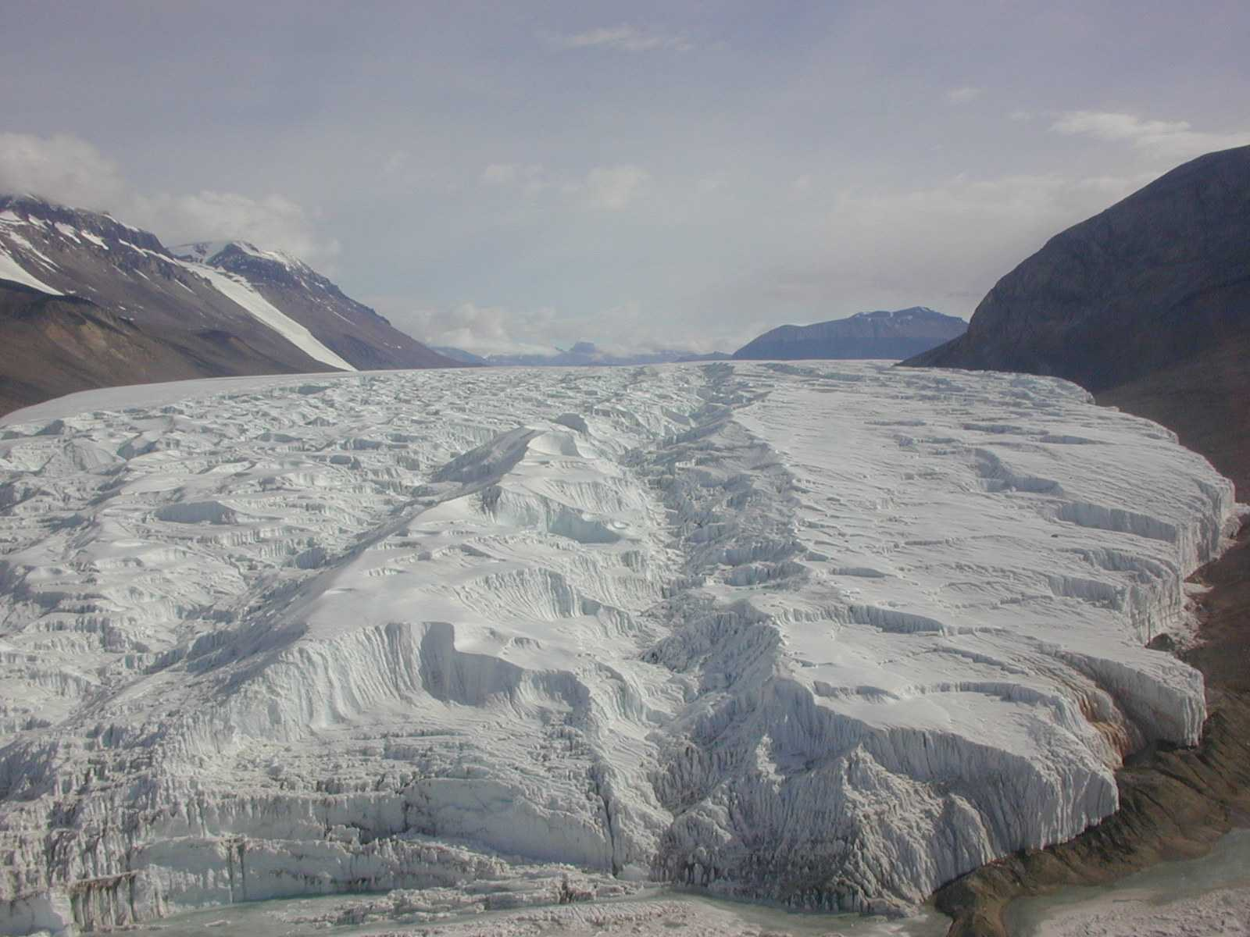
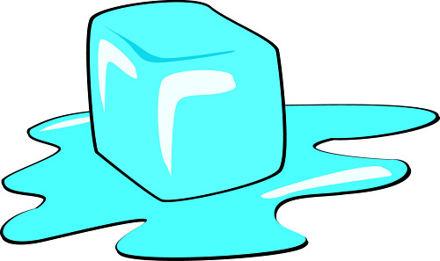
Introduction crevasses and strain rates
Stress
Converges and Diverges
What are crevasses and
strain rates?
Strain Rates measure
gradients of deformation

Slide 4
Introduction Purpose
Strain Rates
Spatial Crevasse Density

Slide 5
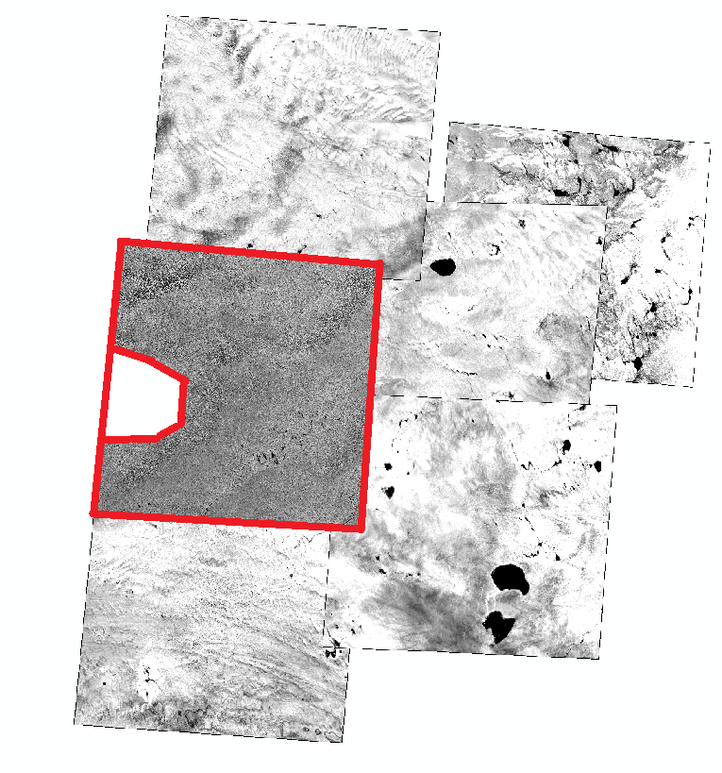
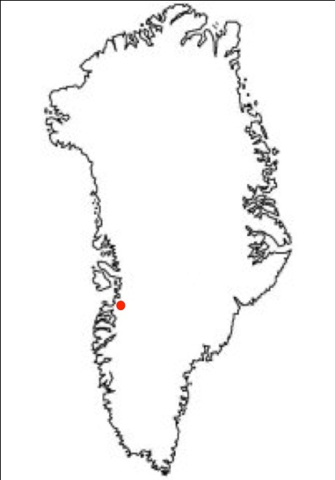
Methodology selecting the area
Obtained Images of western flank of Greenland Ice Sheet: approximately 50 km southwest of the calving front of Jakobshavn Isbrae.
Picked image with the least amount of interferences
Image had:
Few Clouds
Clearly Defined Crevasses
Few Melt Water Lakes

Slide 6
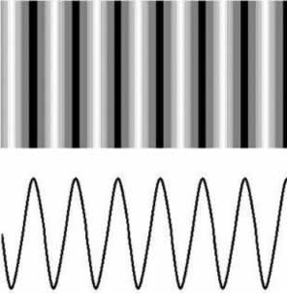
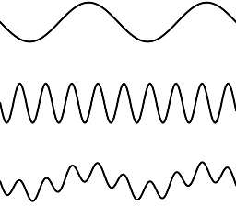
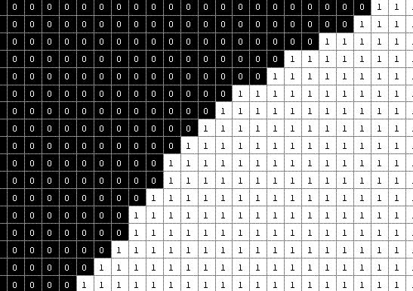
Methodology Fourier Transform
Fourier Transform Decomposes any wave into the fundamental waves that create it.
Every image has pixels with intensity values (light and dark)
The Fast Fourier Transform (FFT) algorithm will process values into spatial waves.
Returns wave that represents the most variance.

Slide 7
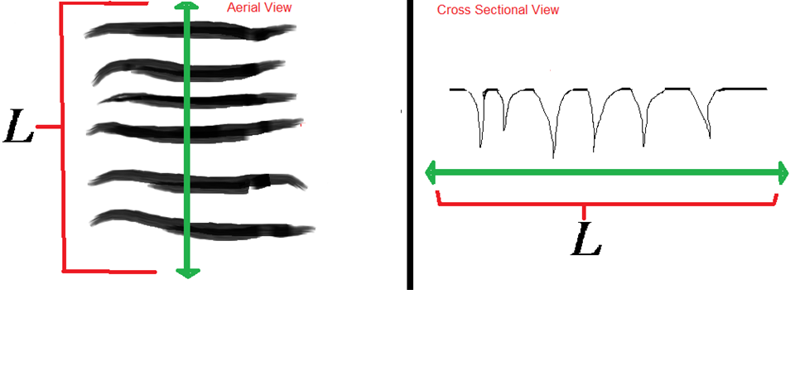
Methodology Measuring Spatial Crevasse Density
$$D_{1}=\frac{Q_{c}}{L}$$
Manual
$D_{1}=\frac{Q_{c}}{L}$
$D_{1}:one dimensional spatial crevasse density$
$Q_{c}$: Quantity of Crevasses along a transect
$L$: Length of the transect

Slide 8
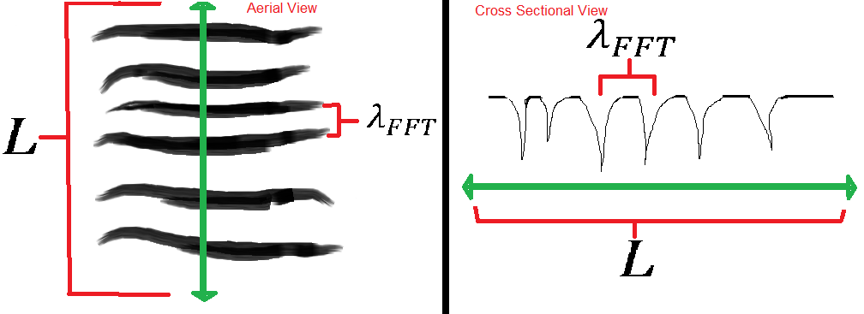
Methodology Measuring Spatial Crevasse Density
Automatic
FFT algorithm returns $λ_{FFT}$, the wavelength of a wave that represents the most variance in pixel intensity.
$Q_{c}=\frac{L}{λ_{FFT}}$
$D_{1}=\frac{\frac{L}{λ_{FFT}}}{L}=\frac{1}{λ_{FFT}}={λ_{FFT}}^{−1}$
$$D_{1}={λ_{FFT}}^{−1}$$

Slide 9
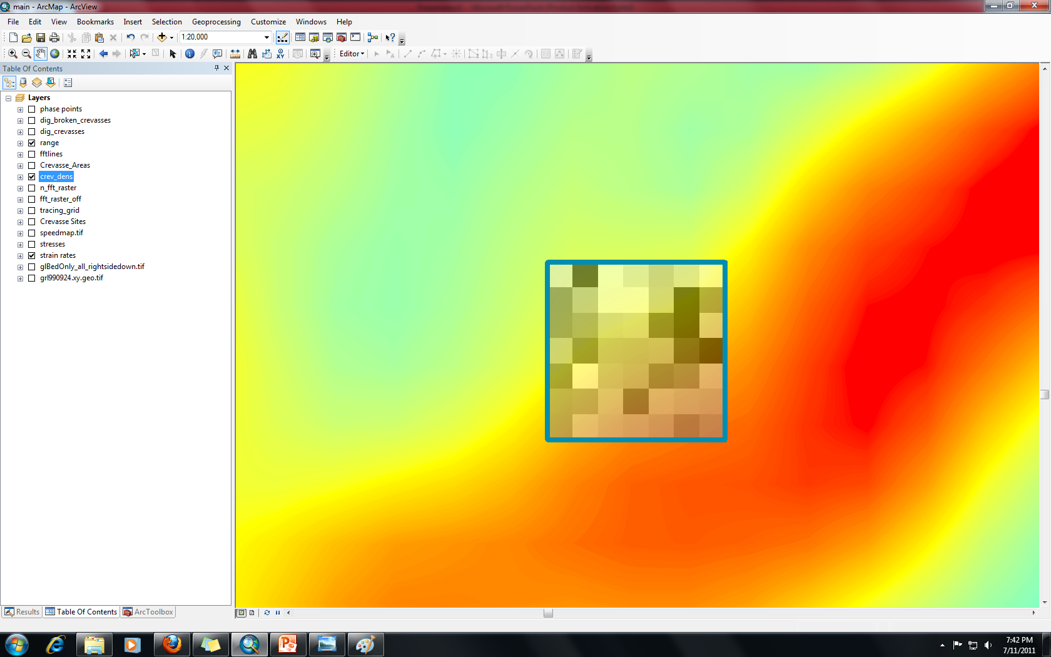
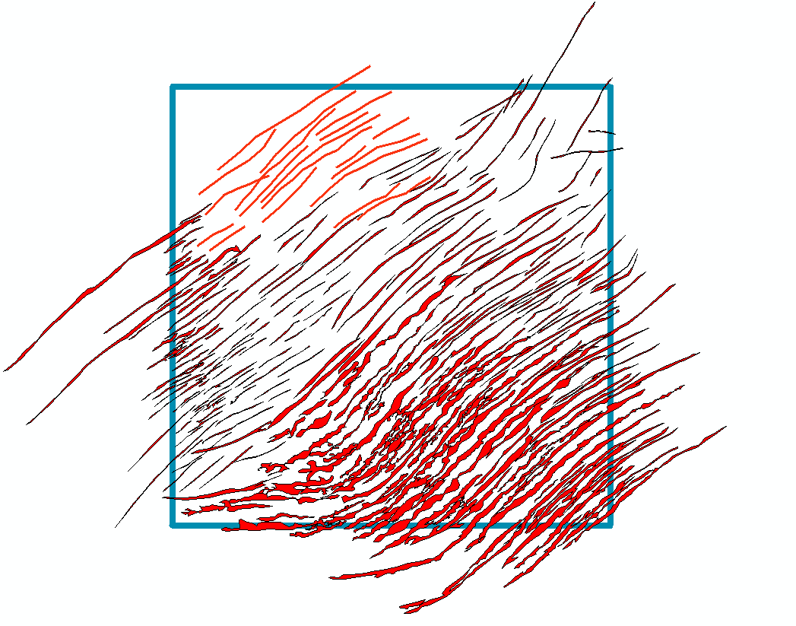
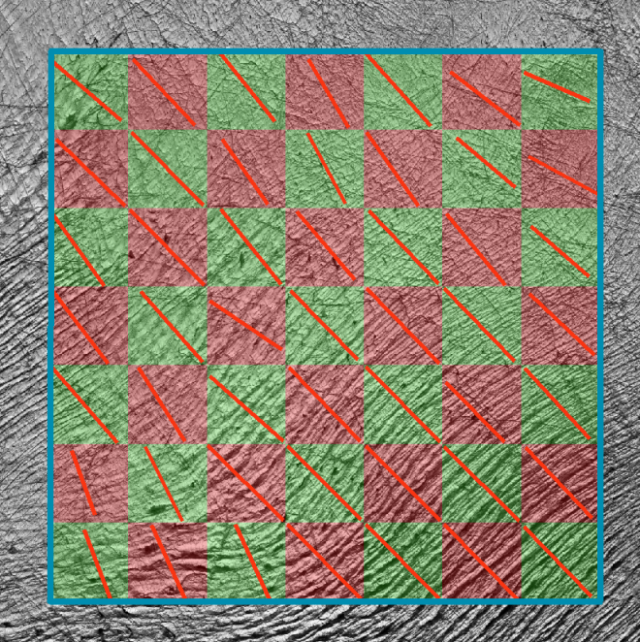
Methodology creating density map
Divided Study area into cells with transects in each cell.
Extracted information from lines
Used Matlab to create a Spatial Crevasse Density Map
VS.

Slide 10
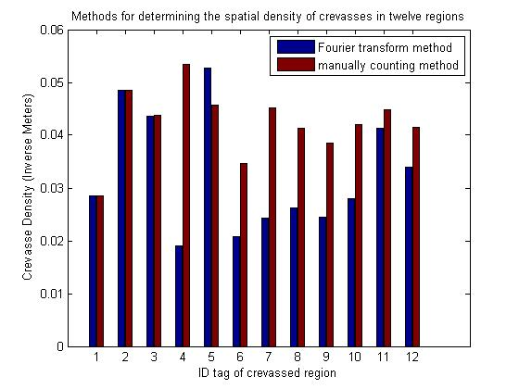
Results FFT Algorithm Accuracy
systematically underestimate the crevasse density by 22%
$$D_{1}=\frac{Q_{c}}{L}$$
$D_{c}={λ_{FFT}}^{−1}$

Slide 11
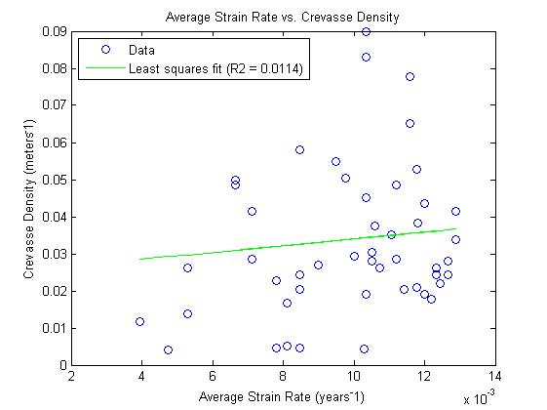
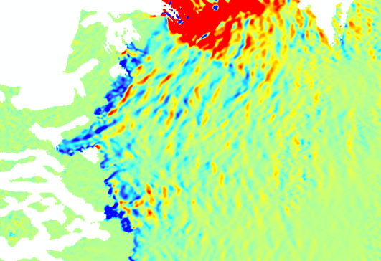
Results Spatial crevasse density vs. Strain rate map
Although correlation between the two were very poor, it improved significantly with strain rates projected 5 years upstream.

Slide 12
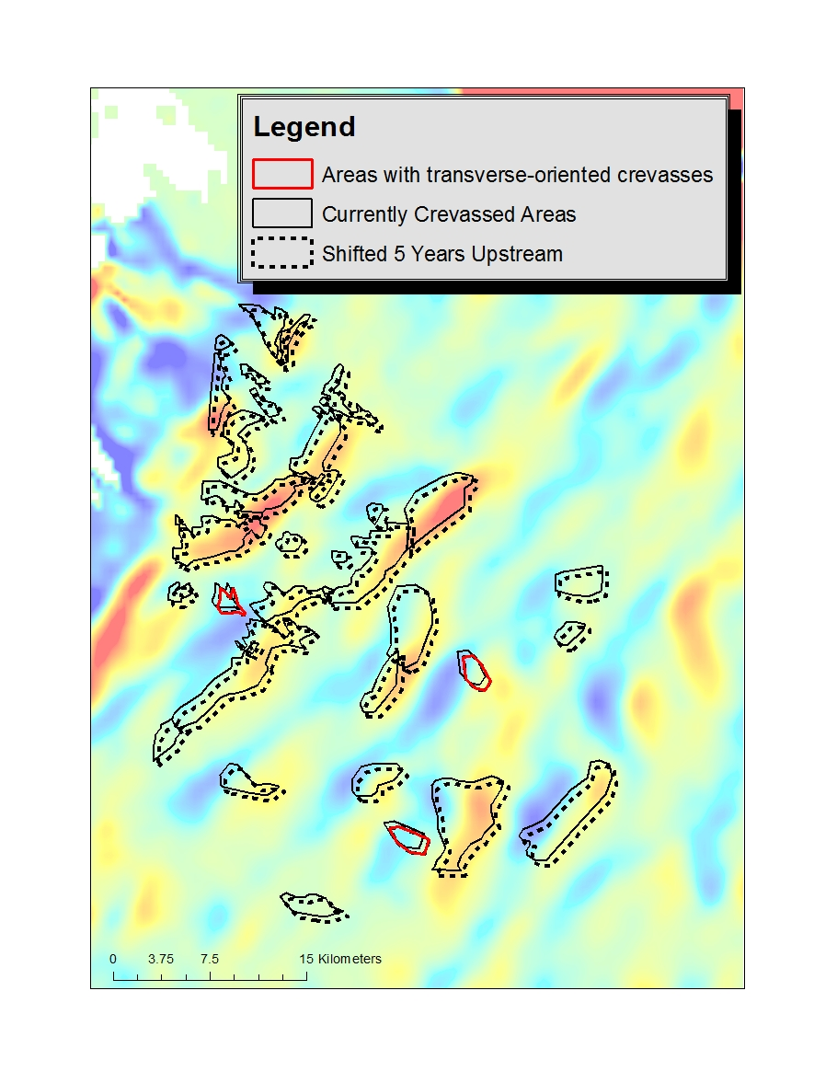
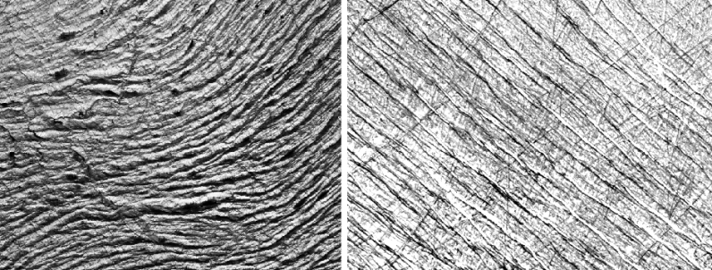
Results Spatial crevasse density vs. Strain rate map
This means that crevasses are relicts of strain rates experienced 5 years ago upstream.
It takes 5 years for crevasses to fully open.

Slide 13
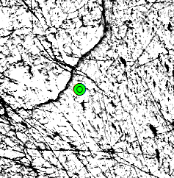
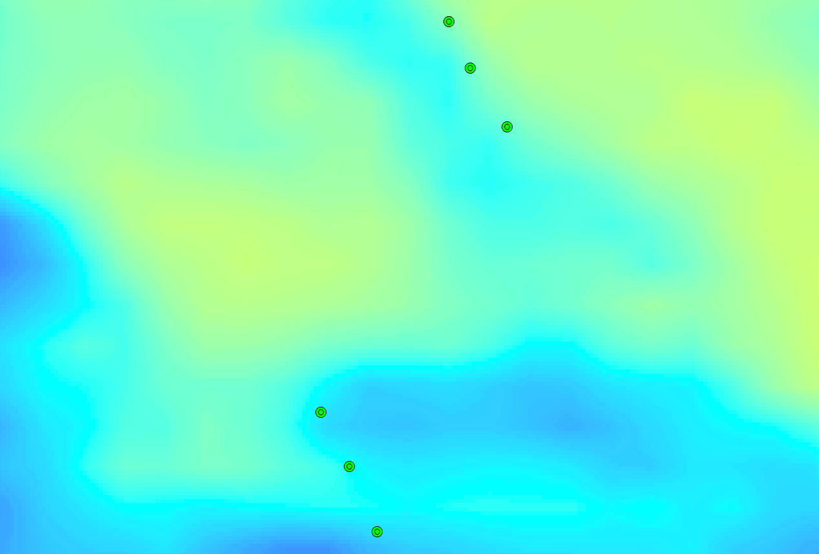
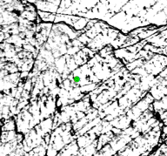
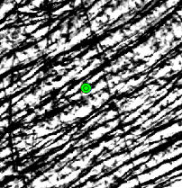
Methodology calculating crevasse life span
Noticed these features in a sequence along the ice’s flow line:
well-defined crevasses (crisp edges)
poorly defined crevasses (blurry edges)
Areas of no crevasses
Transition of crevasse through different phases of life
$$\frac{Total Distance between Area 1 and Area 3}{Average Ice Velocity}=Life Span$$
Calculated in 5 areas

Slide 14
Results Crevasse Life Span
Averages to 12 years
Differs from Worthington Glacier: 1-2 years
Explanation: difference in topography of both areas
Alpine regions have rugged steep slopes
Polar regions have smoother bed rock topography and moderate slopes
Crevasse Families | Location (Latitude Longitude) | Descriptions/Tags | Velocity (Meter/Year) | Life Span (years)
Family 1 | 49°53'9.73"W 68°41'10.476"N | Well-defined | 152 | 11
 | 49°53'46.323"W 68°41'35.368"N | Vaguely defined | 144
 | 49°54'22.114"W 68°41'55.76"N | Non-existent | 148
Family 2 | 49°51'26.437"W 68°43'54.905"N | Well-defined | 136 | 6
 | 49°52'11.839"W 68°44'17.061"N | Vaguely defined | 134
 | 49°52'39.287"W 68°44'34.777"N | Non-existent | 130
Family 3 | 50°2'21.913"W 68°37'49.074"N | Well-defined | 155 | 15
 | 50°1'16.622"W 68°37'19.933"N | Vaguely defined | 157
 | 50°0'0.877"W 68°36'50.865"N | Non-existent | 157
Family 4 | 49°44'10.772"W 68°41'59.67"N | Well-defined | 132 | 10
 | 49°44'48.519"W 68°42'16.963"N | Vaguely defined | 123
 | 49°45'17.305"W 68°42'31.966"N | Non-existent | 115
Family 5 | 49°40'11.809"W 68°37'45.311"N | Well-defined | 142 | 17
 | 49°41'39.407"W 68°38'2.485"N | Vaguely defined | 121
 | 49°42'59.407"W 68°38'23.118"N | Non-existent | 129

Slide 15
Methodology Tensile Stress
Tensile Strength is the maximum amount of stress an ice sheet can endure before it cracks and forms crevasses.
What is the tensile strength in this region of GIS?

Slide 16
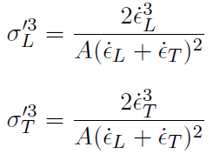
Methodology Equations
Used ArcGIS and these equations to calculate the tensile strength of the crevassed regions.

Slide 17
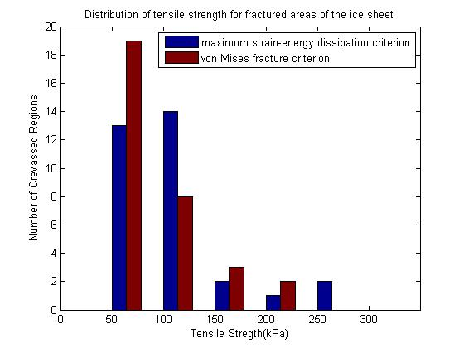
Results Tensile Strength
Tensile Strength: 111 ± 47 kPa
Compares well to the existing body of literature on tensile strength

Slide 18
Conclusions
The average tensile strength, 111 ± 47 kPa, can now be added to the compilation of tensile strengths in various areas.
First ever Tensile Strength in GIS.
Difference in crevasse lifespan indicate ice behaviors in various regions. Polar vs. Alpine.
Crevasses in the our study region are relicts of strain rates projected 5 years upstream.

Slide 19
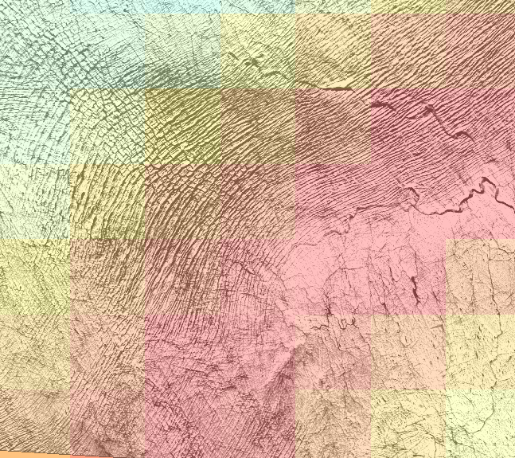
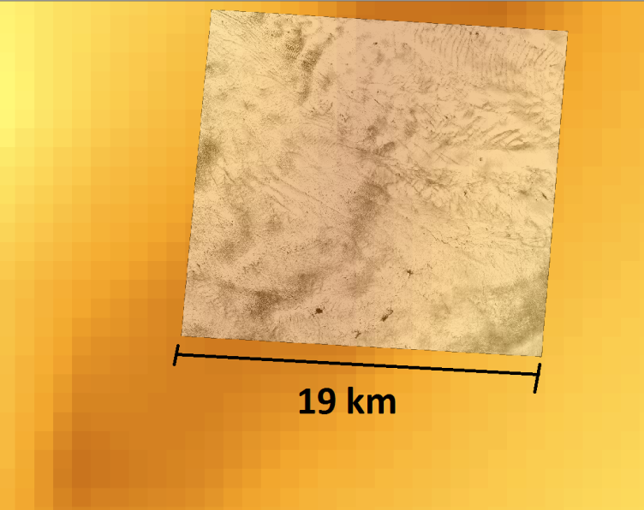
Future Works
Higher Resolution of Strain Rates
Higher Resolution of Bed Rock Topography
Exploring more crevasses in different areas of the GIS

Slide 20
References
J. Harper, N. Humphrey, W. Pfeffer, " Crevasse patterns and the strain-rate tensor: a high-resolution comparison," Journal of Glaciology, Vol. 44, no. 146, 1998.
D. Vaughan, " Relating the occurrence of crevasses to surface strain rates," Journal of Glaciology, Vol. 39, no. 132, 1993.

