Slide 1
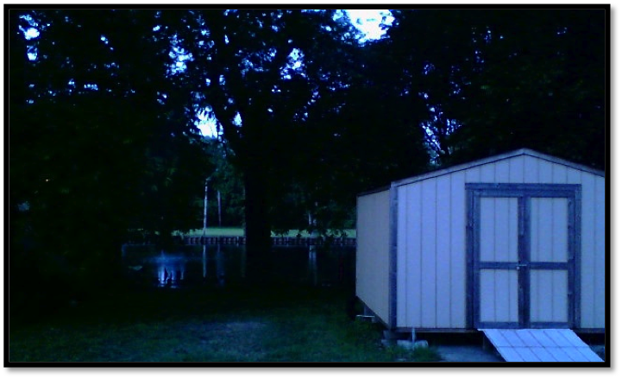
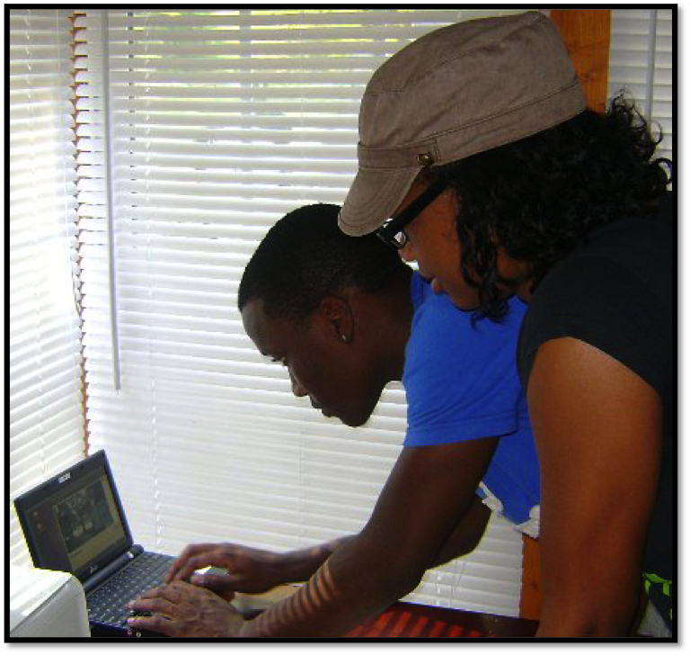
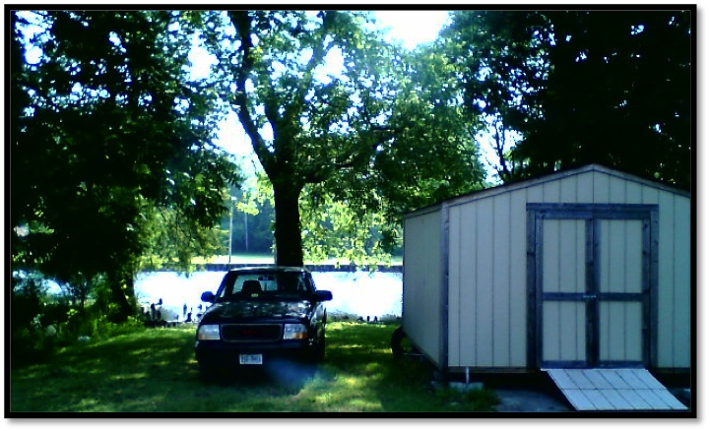
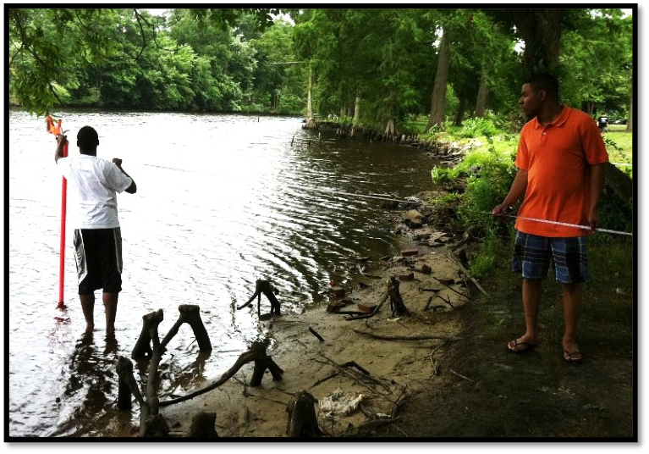
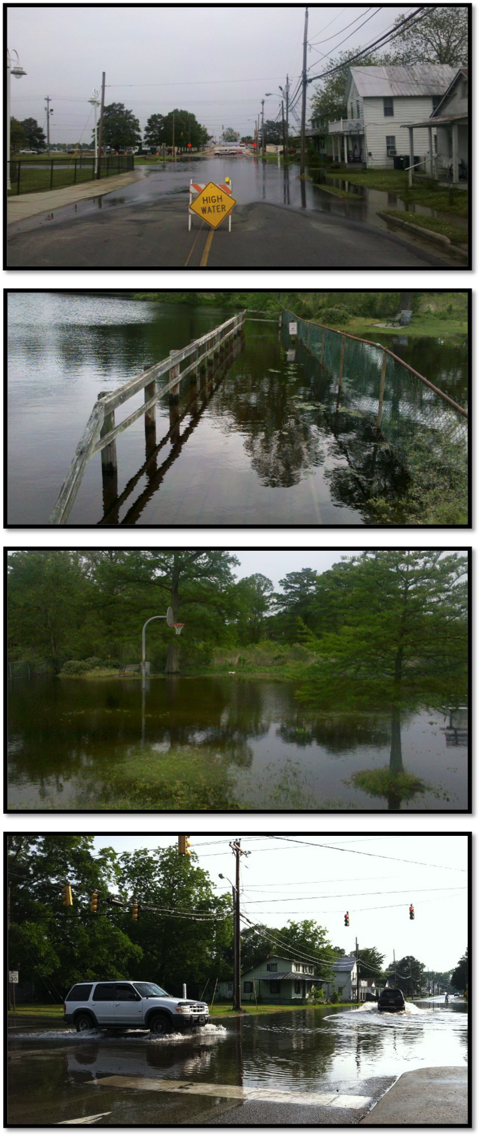
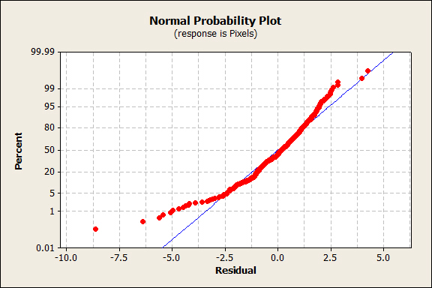
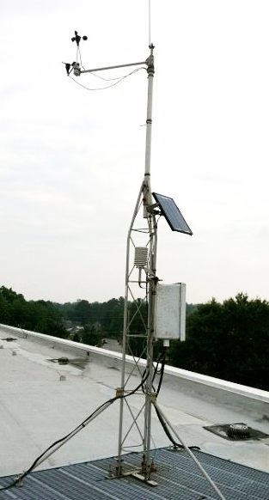
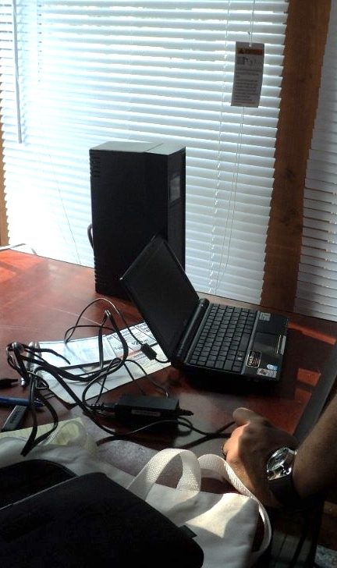
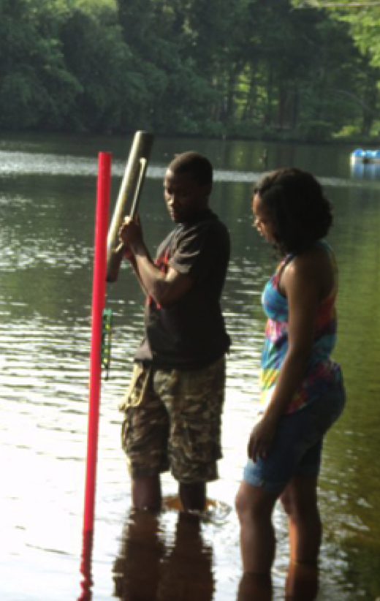
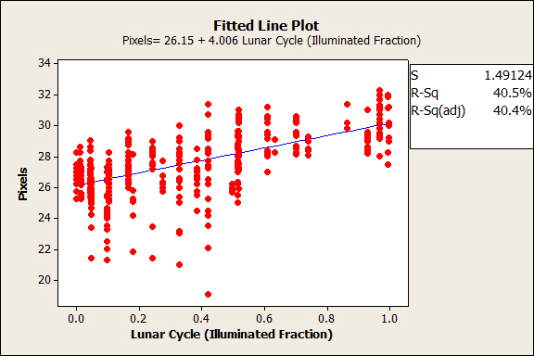
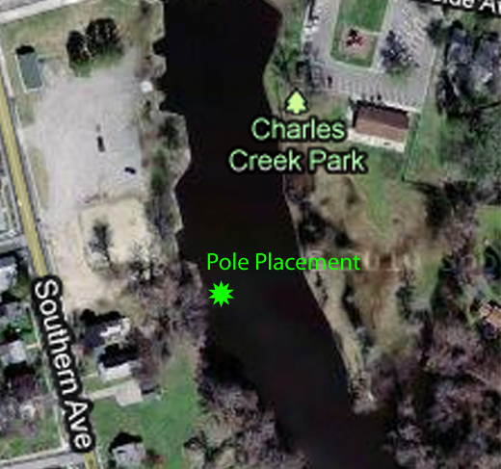
Charles Creek Flood Zone Modeling: A Correlation Study of Environmental Conditions
Versus Water Level in the Pasquotank Watershed
Nartezya Dykes (Spelman), Lekedrick Easley (MVSU) Mentors: Mr. Je’aime Powell (ECSU), Mr. Jerome Mitchell (Indiana University) Principal Investigator: Dr. Linda B. Hayden (ECSU), 1704 Weeksville Rd, Box 672, Elizabeth City, North Carolina 27909
Abstract
The Charles Creek area in Elizabeth City, NC experiences frequent flood conditions seemingly unrelated to rain fall amounts. The purpose of this study was to compare barometric pressure, lunar cycles, wind directions and wind speeds with water depth readings of Charles Creek (a tributary of the Pasquotank River). A static remote imaging system was used to measure water depth through pixel enumeration and referencing through remote sensing techniques coupled with custom image processing software. Environmental data was collected through Elizabeth City State University’s National Renewable Energy Laboratory Weather Monitoring Station. The data was correlated using MINITAB® to find an equation that approximated the model of the rise of the creek’s water level based upon environmental conditions. The regression equation had a coefficient of determination of 42%; this means that there was a 42% probability that the model was useful at predicting the pixel count based on environmental variables.
Methodology: Materials
Most of the hardware involved in data collection was not complex compared to the advanced software used in data processing. The remote imaging system was installed inside a local resident’s home. The install location was befitting in that the creek was directly in the backyard. Positioned in the window, the web camera model used to capture images was a Creative Live Cam Socialize HD (VF0610) with a resolution of 5.7 Mega Pixels, focal length of 10 mm, width of field of 19.89°, and a height of field of 14.97°. It was attached to an ASUS EEE personal computer. The laptop had a 1.6 GHz processor, 1GB of RAM, and 160 GB of hard drive space. With the Windows 7 professional operating system installed, the laptop was connected to power and used both the internal battery as well as a Tripplite® Battery Backup for backup power. The battery and laptop are shown in Figure 2.
The 1.0.7 version of ChronoLapse was used as the software to take time-lapse images to be viewed later in ENVI®, a specialized image processing software. A seven-foot aluminum-fencing pole was obtained and painted with fluorescent pink spray paint so the object would contrast against colors in nature as shown in Figure 3.
Dropbox® was used as a cloud based image storage for all images taken as a backup to flash drives. Additionally, Google® Docs was used to store all documents, facilitating the use and revision of all reports by team members and mentors. When fieldwork was conducted, a standard tape measurer including metric units of measurement was used as a tool to measure the visible height of the pole. Most importantly, the Minitab statistical software served as a means to create a linear regression of the data.
Methodology: Delimiters
Factors eliminated from research and data collection include:
Pressure gauges (barometer / tide gauges)
The contribution of rainfall and/or runoff
Hydraulic Models
Night Captures (Figure 4)
Glints from sunlight in images (Figure 5)
Results
In the beginning of data collection, it was noted a few of the images were light at times of the day when it should have been dark outside. The program Camorama, showed an error message but the file names were all unique. Therefore, the same picture would be used for several different files with duplicate images. On June 20, 2011, the software was changed from Camorama to ChronoLapse after testing the program in the lab by capturing images every 15 seconds for a period of 90 minutes. A Google® supported code, ChronoLapse, is a tool used for capturing photos in series on Windows operating system using screen captures [17]. It is capable of taking screenshots or webcam captures at user-defined intervals [17]. Each piece of the software’s functionality was created to work along with making the program more versatile [17]. Other features to come with this software includes: dual monitor support and picture in picture [16].The operating system platform was also changed from Ubuntu to Windows 7 Professional. As a result, an abundance of data was lost from the time between setup and discovering the error.
To facilitate the processing of the images, the team initially attempted to create an automated image processing algorithm using MATHWORKS MATLAB ®. The focus was to create a system, which would automatically recognize the pole in the images based on pixel colors and the location in the image. The drawback to the system was the MATLAB ® Image Processing Toolbox was unavailable at the time of research. In the same fashion, the MATLAB® Statistical Toolbox was unavailable to perform a multiple regression, which resulted in the use of Minitab®, application software.
The regression equation derived to model the water level of the creek based on the recorded environmental conditions is listed in Figure 6.
Equation 1
Pixels= 33.5- 0.0067* (Barometric Pressure in mBars)
-0.00194* (Wind Direction degrees from North)
-0.122* (Wind Speed in m/s)
+4.29 * (Lunar Cycle Illuminated Fraction Percentage)
Based on the given R2 value there was 42% coefficient of determination explained by the four different independent variables, meaning there was a 42% probability the model was useful at predicting the pixel count based on given values for barometric pressure, lunar cycles, wind speed, and wind direction. The chart with the trend line is show in Figure 6.
Lunar Cycles, alone had the greatest contribution to the model with a R2 value of 40.5%. The regression model plotted with outliers is shown in Figure 7.
Lunar Cycles and wind direction jointly had the second highest variance of 41.5%. Lastly, the two other independent variables with a significant prediction value were Lunar Cycles and Wind Speed at 41.2%.
Conclusion
In conclusion, the flood zone modeling project purpose was to find the cause of flooding in Charles creek in Elizabeth City, North Carolina. The procedure to do so was to create a model to test each environmental variable individually and combined to see which variable had the greatest effect on the rise of water level in Charles Creek. Throughout the project the data analysis and step-by-step procedure presented answers to the sub-questions throughout the research paper. The barometric pressure placed inside of the model creation by the flood zone modeling team showed it had very little correlative relation with the Charles Creek water level. Barometric Pressure only had a coefficient of determination value of 2.5% aside from other predictor variables. Furthermore, the data analysis did show the lunar cycle variable, individually, placed in the model showed greater effect on the water level of Charles Creek than others with a coefficient of determination of 40.5%. The R2 value for wind direction was 0% and 2.1% for wind direction. Although wind direction and wind speed had some effect on the total prediction capability of the model, it was not enough to state they were sufficient predictors. Ultimately, the environmental variables placed inside the model together showed the greatest effect on the Charles Creek water level at a 42% probability. The equation modeled the interaction between the water level and environmental variables are shown in Equation 1. Finally, visual methods proved to be helpful in capturing images in order to measure water levels in Charles Creek and facilitated the team’s procedures and derive a meaningful model from the data analysis.
Methodology: Procedures
Upon arriving onsite to collect images the first task was to clean the optics to ensure the images would continue to be clear. After doing so the pictures were saved to a removable disk and the laptop was checked for any malfunctions. A few force captures were also made, causing the times to not remain on the same 30-minute interval. To load the file names for the pictures onto the Google® Docs spreadsheet a bash script was created by Jerome Mitchell (Indiana University). To execute the script, [. /epoch. sh] was typed into the command line of a UNIX terminal. The script took the UNIX Time Code (UTC) timestamp from the photos to give the time and date of the picture. After copying the file names temporarily into a Microsoft Excel spreadsheet for sorting, they were then transferred into Google® Docs. (Prior to the creation of the script, adding the image information was done manually through the Epoch Converter website.)
To obtain the height in pixels of the pole pixel enumeration was conducted using ENVI®. By selecting the proper folder containing the pictures in Dropbox, it allowed the team to load RGB images into the program. The measurement tool was used on the zoomed in image to select the top of the pole and lowest visible point on the pole to obtain the actual height of the visible poleto four significant digits. From this point, the team could estimate the height of the sea level. This information was then added to the Google® Docs spreadsheet.
Monitored independent variables, for environmental conditions were collected online either using the Elizabeth City State University Weather Station or the Brian Casey Artifact Page. On the ECSU weather station site, the information was found within the “Daily Plots and Raw Data Files” under the time frame beginning with April 1, 2004 to the current date. After selecting the desired date along with station pressure, wind speed and, wind direction as the 5-minute interval ASCII text, all information was loaded for recording into a spreadsheet in Google® Docs. Pictures captured after 7:20 pm and before 4:50 am were clear enough to conduct pixel enumeration were assigned hourly data readings due to limitations of the ECSU website. The Brian Casey Artifact website only required input dates to present the illumination percentage of the moon as it related to lunar phases. All information was then added into the master Google® Docs spreadsheet.
Figure 4
Figure 5
Research Questions
Does barometric pressure have a correlative relationship with the Charles Creek water level?
Which environmental variable had a greater effect on the Charles Creek water level?
Can a visual method be used to capture images in order to measure water levels in Charles Creek?
What is the equation that can model the interaction between the water level and environmental variables?
Future Work
The future goal of this project is to create a program to facilitate automated image processing in MATLAB ® or another high level programming language. By doing so, it will speed up the time it takes to get the pixel count in photos as well as provide a more accurate count of the pixels. Another advantage to having the program to run on the files means a greater number of images can be processed. Therefore, instead of having the remote imaging system take pictures on a 30- minute interval, it could be increased to match weather station measurements of five-minute intervals. As a result, this would improve the data set and increase the prediction capability of the model. A lighting system could also be used to illuminate the pole so pictures could be captured at night.
The use of a cloud-based image storing system with an Internet connection at the site would eliminate much of the fieldwork of manually saving photos. Altogether for some variation, in the future, a pressure gauge could be used as a comparison to pixel enumeration to validate the imaging method.
Methodology: Initial Setup
Installation
June 8, 2011
North 36° 17.678’
West 76° 13.042’
10.248m from imaging system to pole
7 feet below sea level
Ubuntu Linux
Camorama
Figure 6
Figure 1
Figure 2
Figure 7
Location and installation of pole in Charles Creek
Figure 3
Examples of Charles Creek flooding
References
For a full reference listing, please see: http://nia.ecsu.edu/ureomps2011/teams/flood/FinalResearchPaper.pdf

