Slide 1
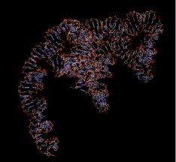
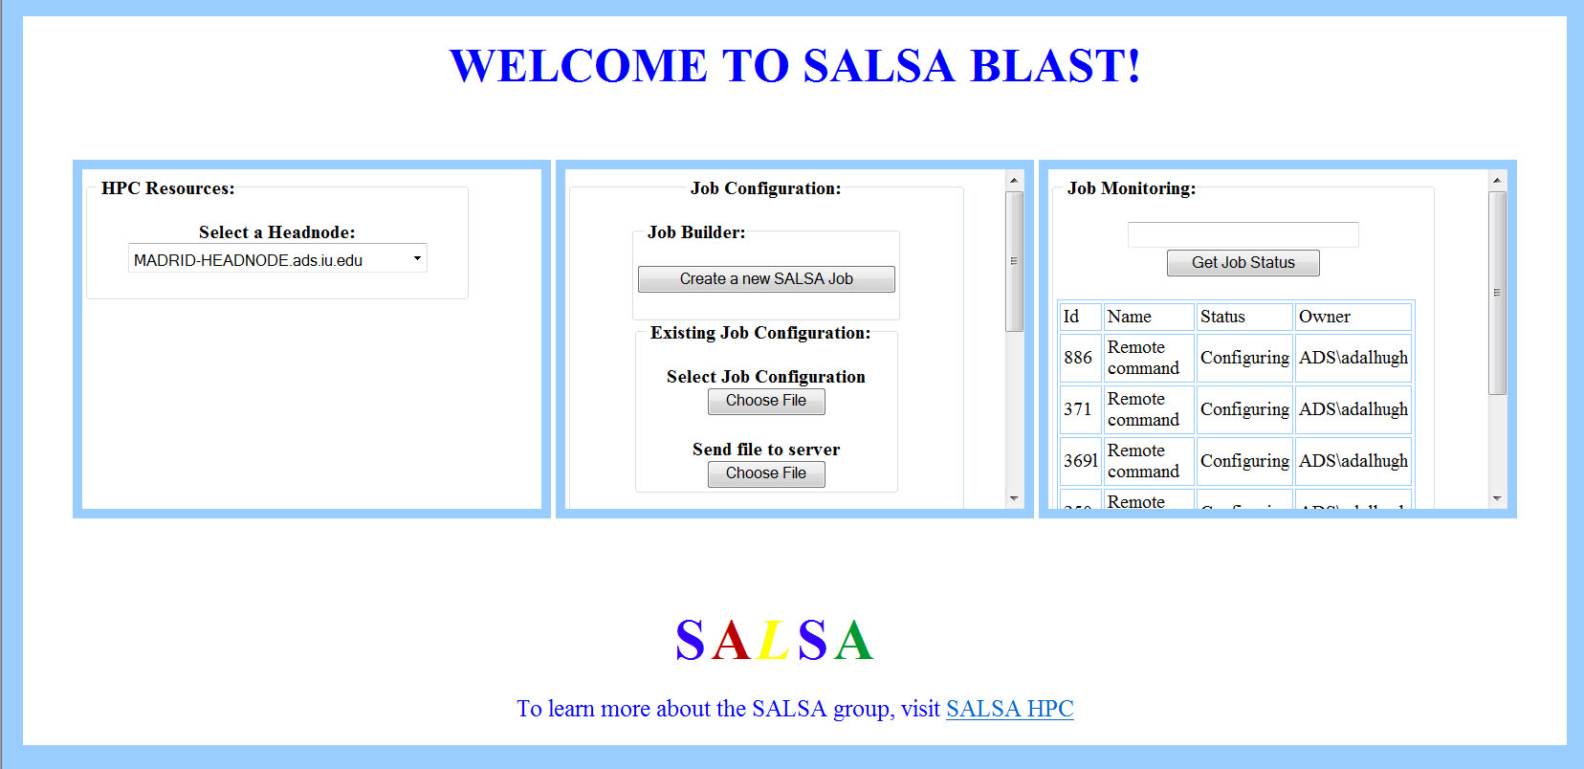
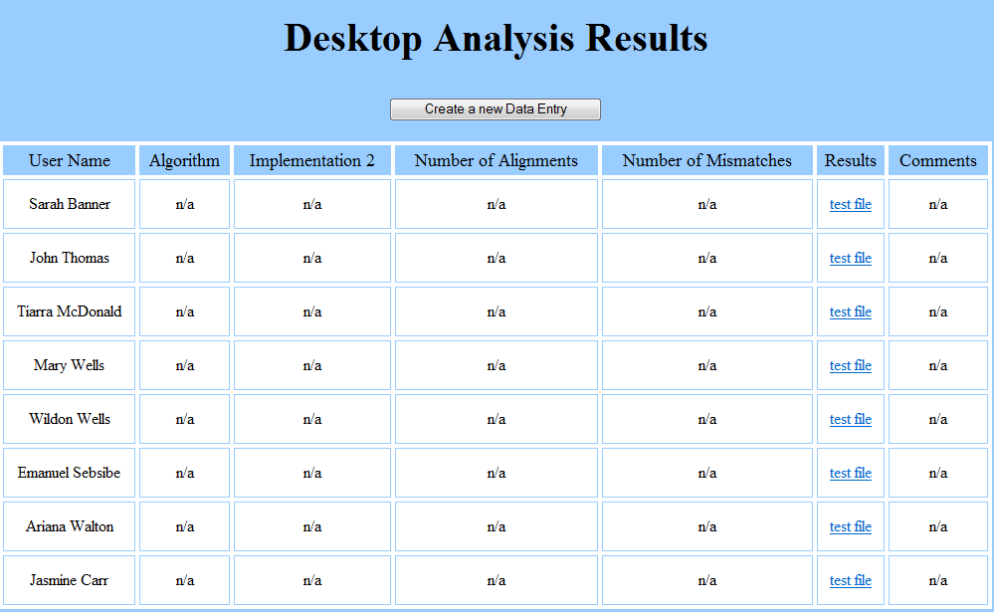
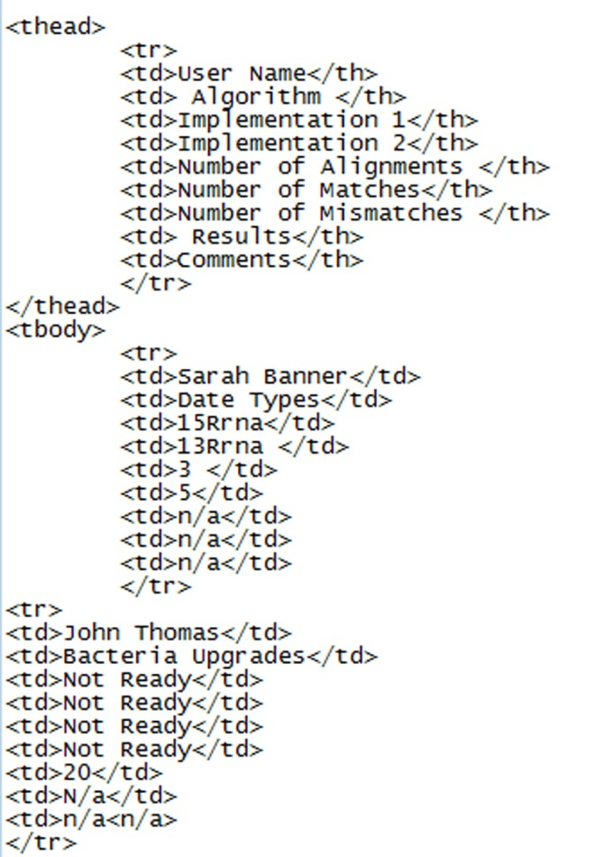
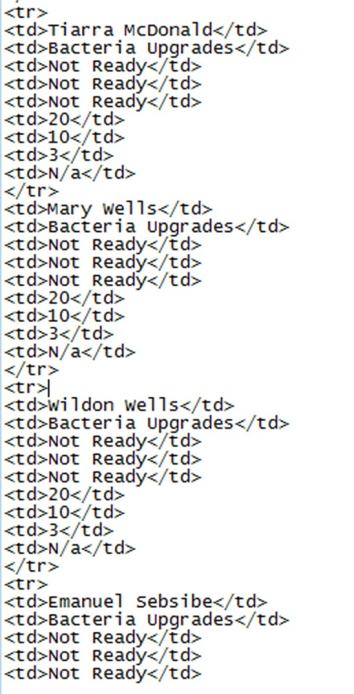
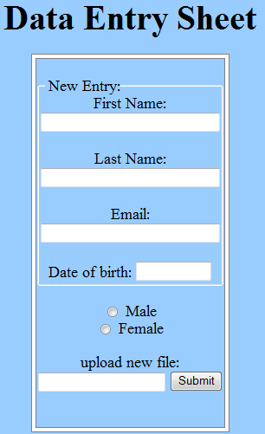
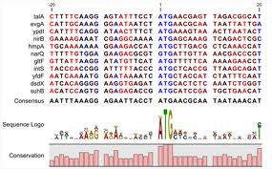
Web Interfaces for Bio Sequence Desktop Analysis
Lakesha Wells PI: Adam Hughes
Introduction
Results
Modern scientists are conducting research to study complex bacterial populations from clinical samples. Modern pyro sequencing techniques have made this type of study possible. I am particularly interested in those scientists who are studying the genome bacteria 16S rRNA. These types of experiments generate huge amounts of data and demand accurate, fast and robust algorithms and software systems to conduct the analysis. Therefore I created a website interface that allows them to collect and track the results of their detailed results.
After completing my portal page and desktop analysis table. My desktop analysis page links to their txt results and a new data entry page. I then created a new data entry page. I used fields and forms to finish it. The data entry page will allow users to enter their new analysis.
Procedure
I began by creating the portal page of the website. To create the website, I am utilizing Hyper Text Markup Language (HTML) and Cascading style sheets (CSS). An important aspect of this project is that I and my coworker are using similar cascading style sheets.

