Slide 1
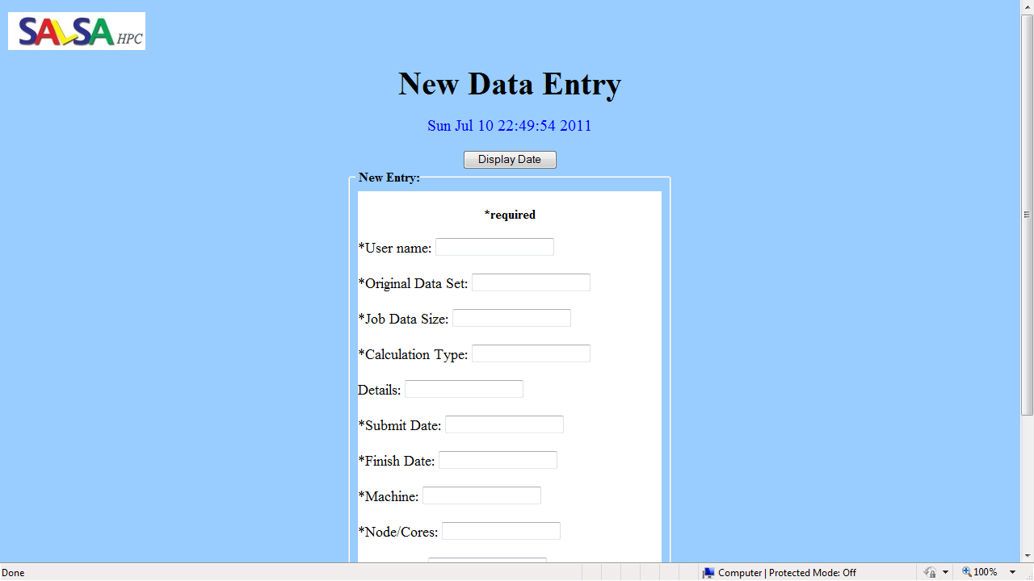
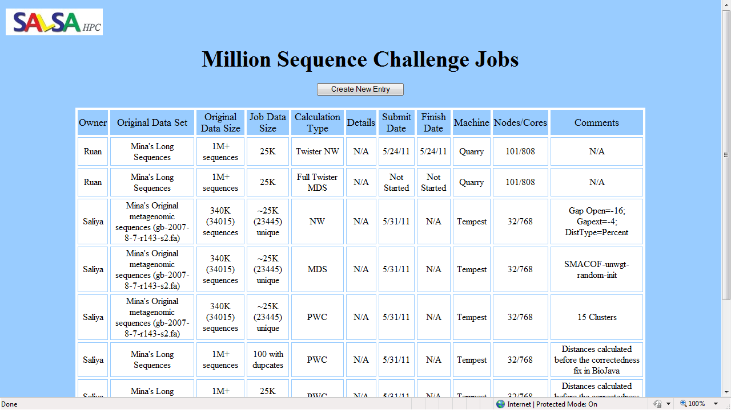
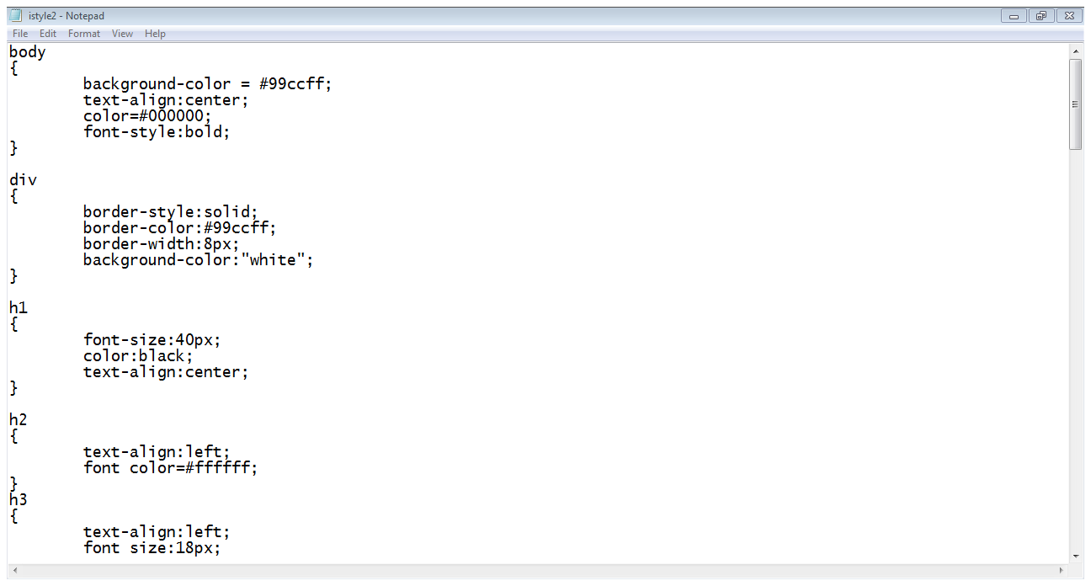
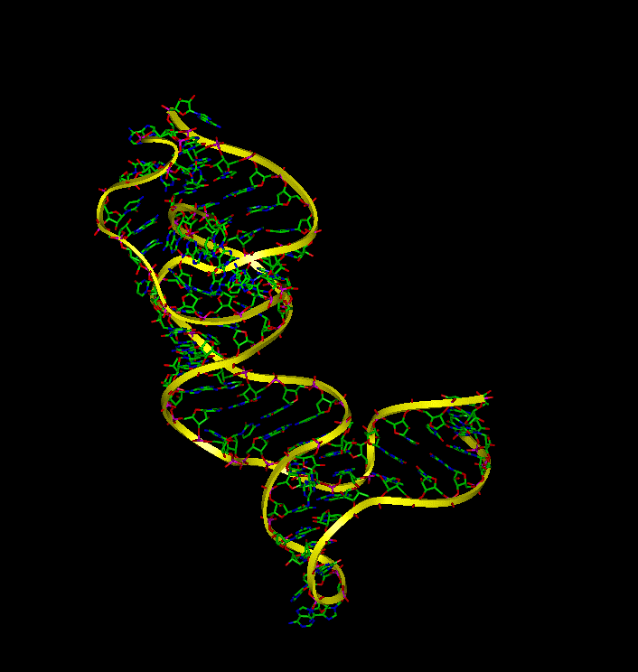
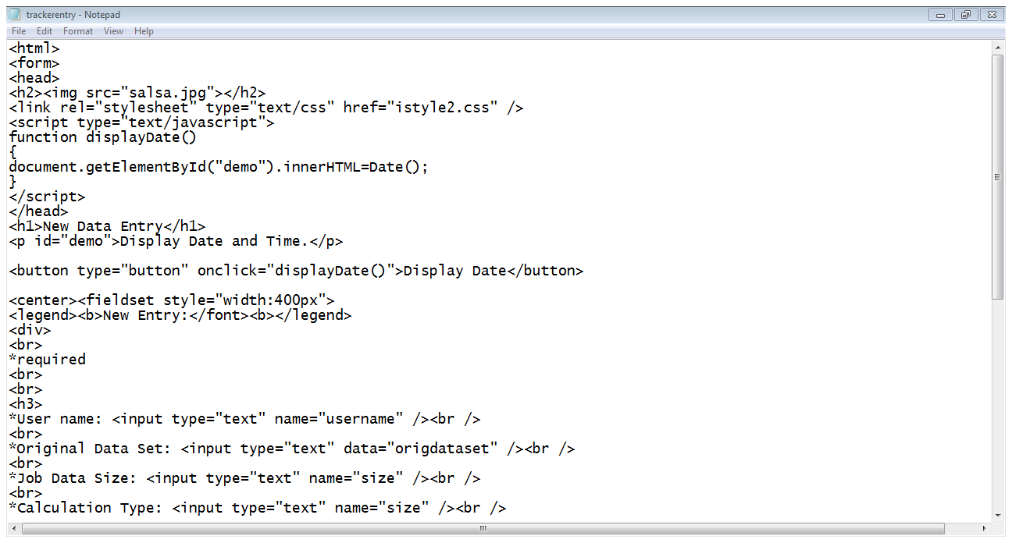
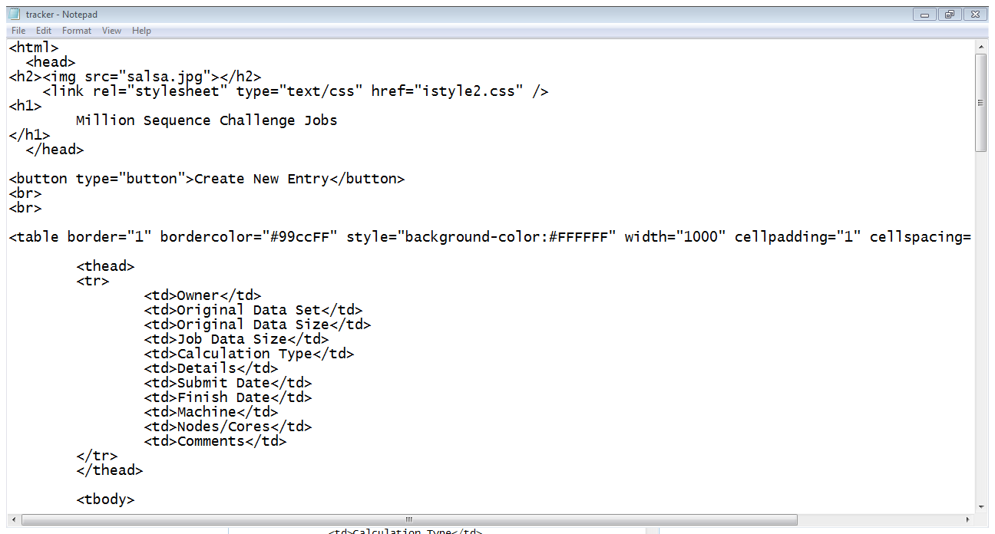
Tracking High-Performance Biosequence Clustering Jobs Using Common Web Interfaces
Franshetta Hibbler, Mississippi Valley State University
Mentor: Adam Hughes , Indiana University
Abstract
Results
Contemporary methods have allowed for the study of complex bacterial populations, such as 16S rRNA, directly from environmental or clinical samples. Alignment of data sets of 100,000+ sequences is necessary to identify potential gene clusters and families. Consequently, there is a demand for accurate and effective software systems and algorithms to conduct analysis. My mission was to create a simple, yet efficient webpage that will track computational jobs on several platforms and catalog results. To complete this task, I used Hyper-Text Markup Language (HTML) and Cascading Style Sheets (CSS) as my primary resources. HTML permitted me to format and display documents on the web, while CSS will allowed me to brand the work of this particular lab and maintain a common, coherent web look.
User can create and display a new entry.
Methodology
User can easily track computational jobs on a wide variety of platforms.
Create a Cascading Style Sheet
Create style elements that will be used repetitively
Future Goals
Apply CSS design to existing site
Give users a way to edit existing entries
Tie webpages to a database that would store information
(2) Create a Data Entry webpage using HTML
Must allow user to create a new entry
Must require certain information pertaining to job
http://www-lmmb.ncifcrf.gov/~bshapiro/images/molecularDynamics/movie.gif
Contact Information
Franshetta S. Hibbler BS Computer Science, Dec 2013 Mississippi Valley State University MVSU #5656 14000 Hwy 82W Itta Bena, MS 38941 franshetta.hibbler@mvsu.edu franshettahibbler92@gmail.com cell: (662)392-1703
(3) Create a Webpage that will track current job information
Acknowledgements
This research was made possible by
(4) Abstract all style elements into CSS using custom IDs or classes

