Slide 1
THE CAROLINA BAYS: AN INVESTIGATION OF NORTH AMERICA’S POST LAST- GLACIAL MAXIMUM ENVIRONMENT (LGM)
Cedric Hall (ECSU), LaEsha Barnes (MVSU)
Dr. Dewayne Branch, Dr. Malcolm LeCompte

Slide 2
Abstract
Buried beneath the East Antarctic Ice Sheet is a mountain range similar to the European Alps whose age estimates range from 35 to 500 million years. Expeditions during the International Polar Year are seeking to reveal the sub-glacial topography of the range and obtain hints to solve the mystery of their formation. The tools they are using include a combination of ice-core samples and ice penetrating RADAR.
During the Last Glacial Maximum (LGM), North America’s Laurentide Ice Sheet, reached its maximum extent approximately 20,000 years ago. Its south-easternmost margin penetrated deeply into Pennsylvania. There is no evidence that this or other glaciations went further, but it is believed that evidence for the harsh climatic conditions that prevailed during each glacial episode can be seen in topographical features that remain visible far to the South. Prominent among the features often attributed to glacial climate are numerous elliptically shaped, shallow depressions called collectively Carolina Bays, hypothesized to have been formed by “blow outs” of loose sediment by the strong, sustained winds characteristic of glacial epochs.

Slide 3
Abstract (cont.)
Approximately 13,000 years ago, the Laurentide Ice Sheet’s retreat was interrupted by a return to glacial climatic conditions that persisted for over 1,000 years. The events precipitating the dramatic, millennial long climatic cooling, known as the Younger Dryas (YD), remain both a mystery and the subject of debate. It has recently been hypothesized that a fragmented comet or asteroid might have simultaneously initiated the YD and formed the Carolina Bays. However, Carbon 14 dating and pollen analysis indicates an earlier genesis. While this research does indicate the bays were formed during prior glacial epochs, the bays also appear to be repositories of a significant amount of material considered evidence of an extraterrestrial impact including carbon and magnetic spherules and nanodiamonds.

Slide 4
Abstract (cont.)
If created during or before the LGM, the bays would have experienced episodic post-formation modification due to cold, dry, windy periods alternating with warm, moist and calmer climatic conditions. In this event, Carolina Bays would episodically fill with wind-blown or water-borne sediment or water.
To understand the processes that created the bays, it is helpful to probe their interior structure. Analogous to the Gamburtsev mountain research, sedimentary core samples and a ground penetrating RADAR survey were used to probe the interior of the bay to collect evidence consistent with either the terrestrial or extraterrestrial formation theory.We also used soil processing techniques to extract carbon spherule and magnetic material from soil samples at Sandra Kimbel Bay. These samples were extracted by the Younger Dryas Impact Study team from the Undergraduate Research Experience in Ocean, Marine, and Polar Science (URE OMPS) in the Summer of 2008. By analyzing these extractions we built data charts that represented the characteristics of Sandra Kimbel Bay. The data charts were then compared to previous studies conducted on the Carolina Bays and their correlation to the Younger Dryas period. The research paper contains an in-depth summary of the investigation of theories on how and when the Carolina Bays were formed.

Slide 5
Keywords
Katabatic winds-a wind that carries high density air from a higher elevation (typically an ice sheet) down a slope under the force of gravity
Periglacial-places near the edges of glaciated areas
Carolina Bays-shallow, SE-NW oriented, elliptical depressions (may
or may not be wetlands or lakes) surrounded by a low rim.
Nano diamond- nanometer sized diamonds believed to be formed during the extreme conditions that exist during a comet or asteroid impact on Earth.
Carbon spherule- small carbon sphere formed from heated, aerosolized tree sap formed by intense forest fires.
Ground Penetrating RADAR- device used to view subsurface layers
Slurry- mixture of soil samples and water
Epoch- a moment in time chosen as the origin of a particular era
Stratigraphy- study of rock layers and layering

Slide 6
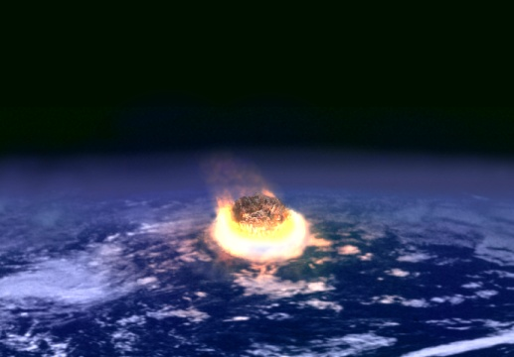
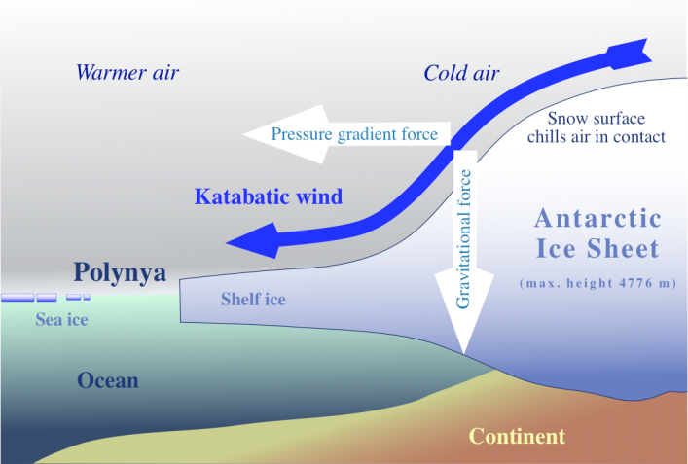
Competing Theories
The Carolina Bay depressions were formed due to a fragmented asteroid or comet impact precipitating the Younger Dryas climate change.
(Prouty, 1952, Firestone, et al, 2007)
The Carolina Bay depressions were formed during the harsh, cold climate of the LGM. Any land on continental North America free of ice became a “cold, windy desert.” Sustained hurricane force winds excavated loose sediment creating depressions, a process called “blowouts”.
(Johnson,1942 and Kaczorowski, 1977)

Slide 7
Statement of the Problem
According to Whitehead (1981), depth-correlated carbon 14 dating and pollen analysis indicate that Rockyhock Bay is much older than the Younger Dryas.
According to Firestone et. al (2007),Carolina Bays contain evidence suggesting their formation by an extraterrestrial impact at 12,900 years Before Present (B.P.) that precipitated the return to glacial climatic conditions called the Younger Dryas; persisting for 1,500 years.
Did Whitehead penetrate the bottom of the bay?

Slide 8
Method of Investigation
If so, where is the bay bottom?
Do impact markers reside on the bay bottom?
Sediment core-sampling and constituent analysis are methods used to examine the stratigraphy of a bay, illuminating the processes that have formed it.
Ground Penetrating RADAR (GPR) is used to view the stratigraphy of a bay and examine its subsurface structure including depth.
Using a combination of core-sampling, soil analysis, and GPR surveying, we investigated two Carolina Bays.

Slide 9
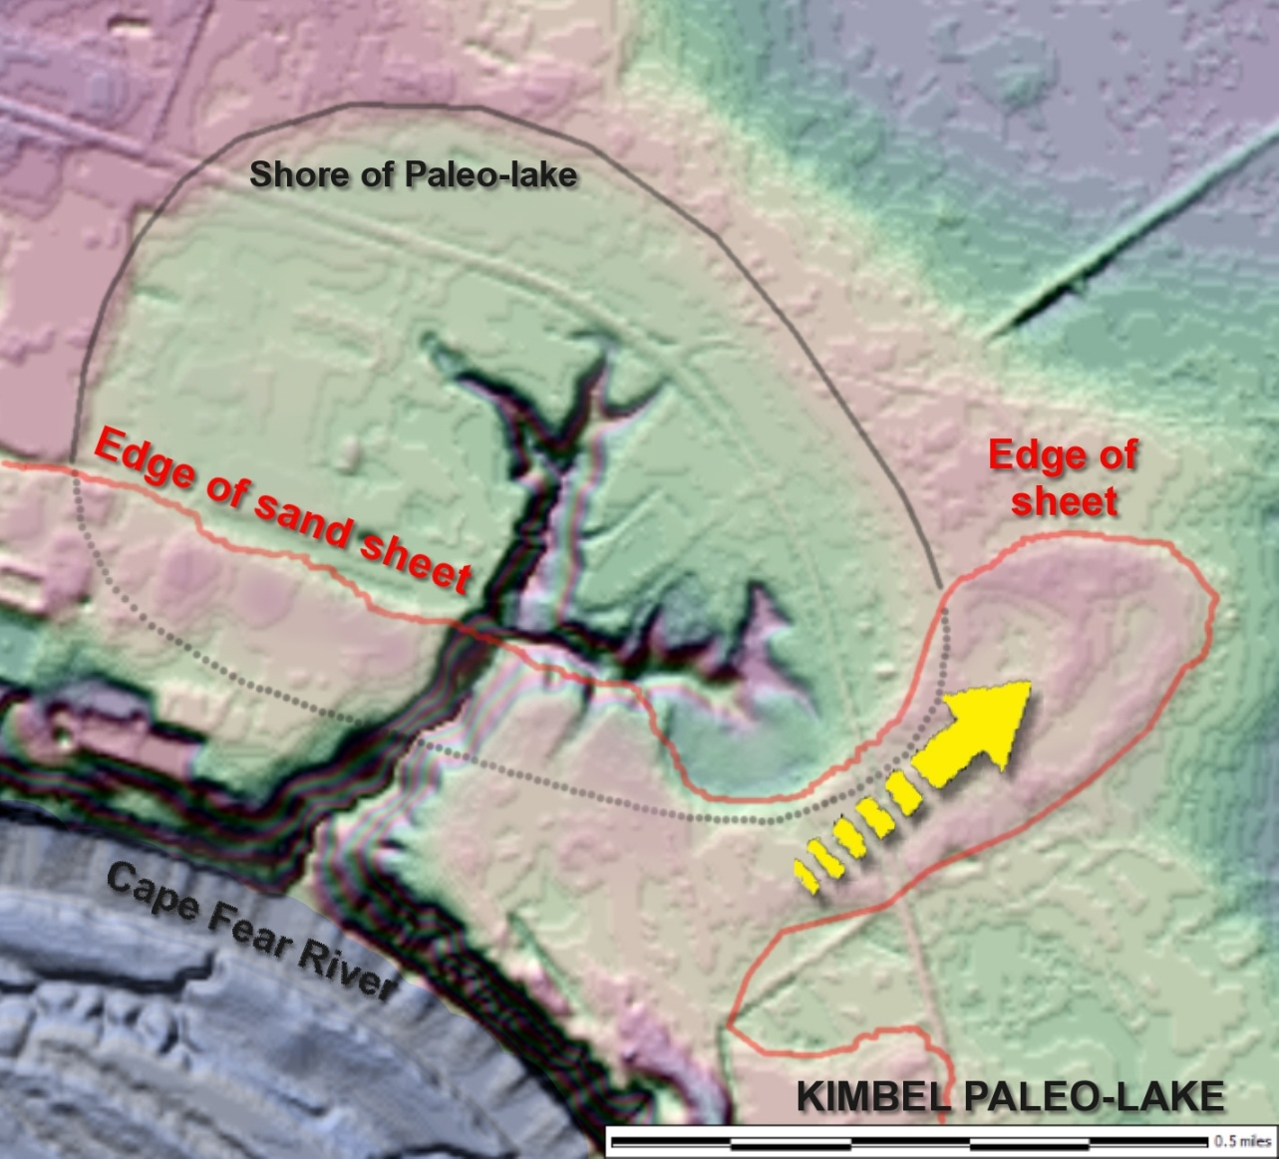
Sandra Kimbel Bay (SKB)
The pink corresponds to Kimbel Bay’s elevated rim
Hog Pen Core Sample Site

Slide 10
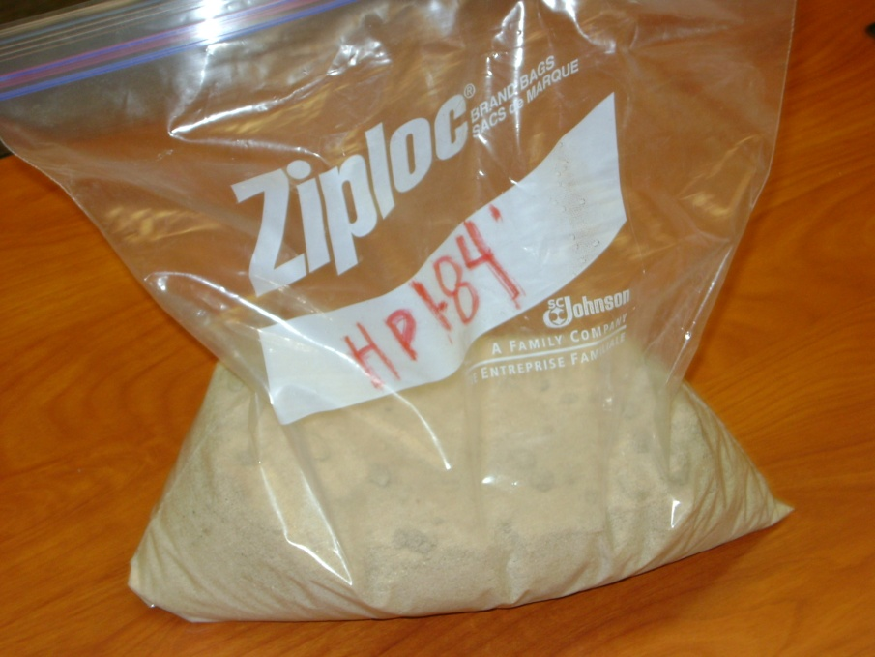
Soil Analysis
Soil analysis was performed to detect and extract impact related markers such as carbon spherules, magnetic grains, charcoal, and glass-like carbon.

Slide 11
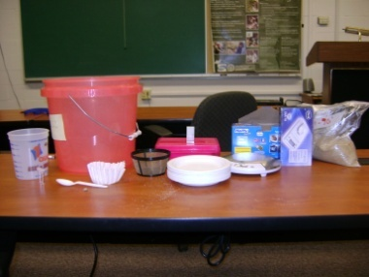
Soil Processing Materials
NDB Magnet
Hefty Bags
20μ Coffee Filters
3 Gallon Buckets
2 Liter Buckets
45x & 180x Microscopes
3 kg. & 10 g. Scales
Paper Sample Plates

Slide 12
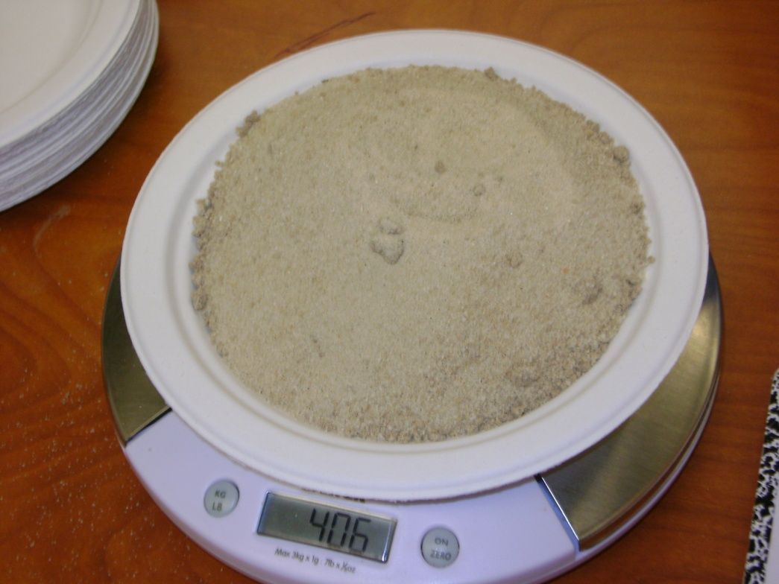
Soil Processing
Soil samples at specific depths were weighed on a scale to the amount of 400 grams.
*Note that all soil samples were taken from Sandra Kimbel Bay, Hog Pen 1.

Slide 13
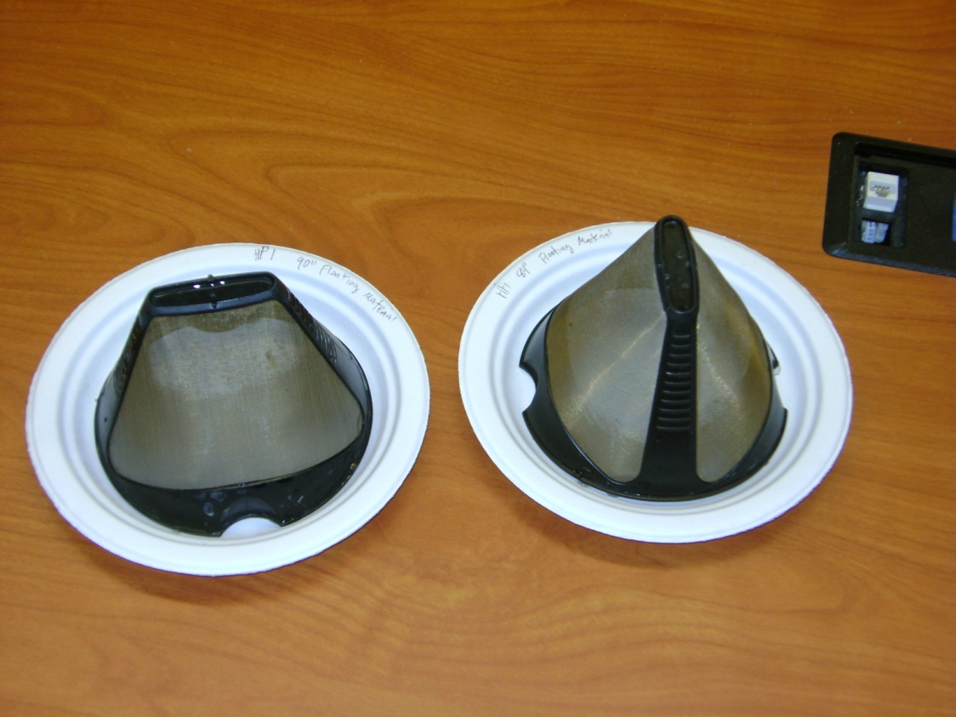
Carbon Spherule Extraction
A 400 gram soil sample was placed in a 3 gl. Bucket.
Water was added to the bucket to create a “slurry.”
Carbon spherules floating on the slurry surface were captured in a filter as slurry was poured into an empty bucket.
The filter was placed on a plate to dry.

Slide 14
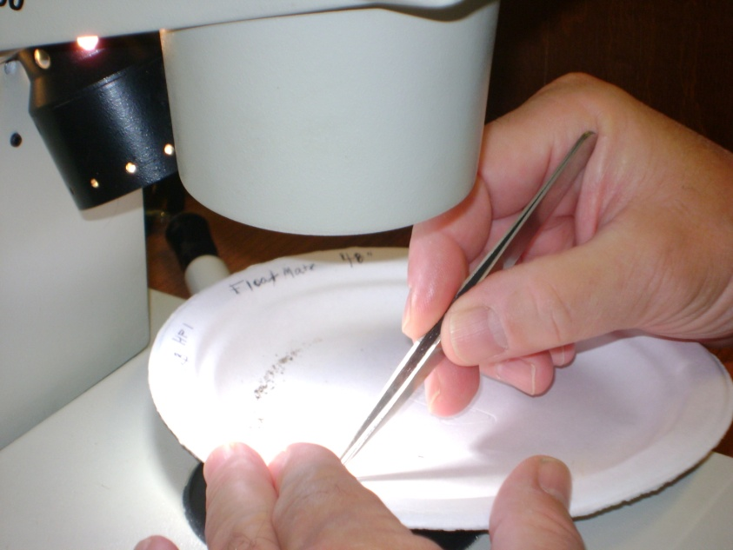
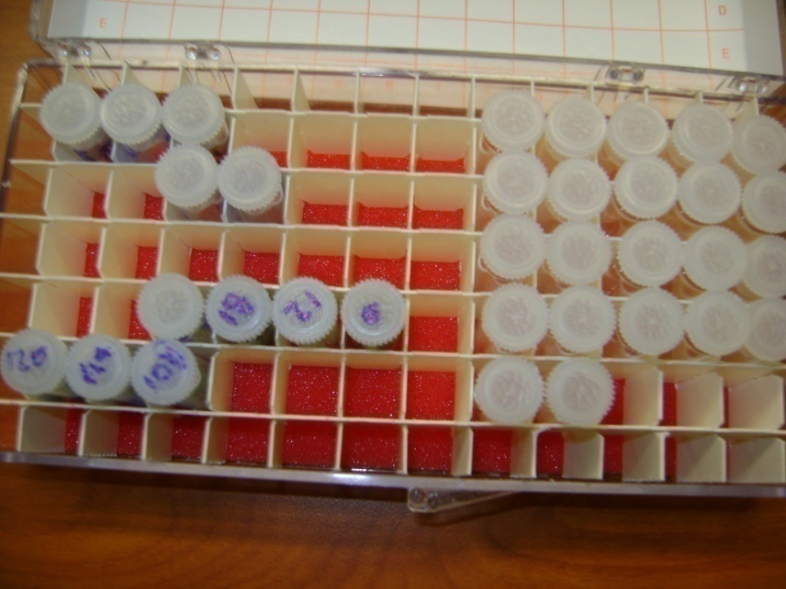
Carbon Spherule Extraction (Continued)
The dried, filtered material was examined under a microscope to identify carbon spherules.
The carbon spherules were collected, counted, and placed in a vial.

Slide 15
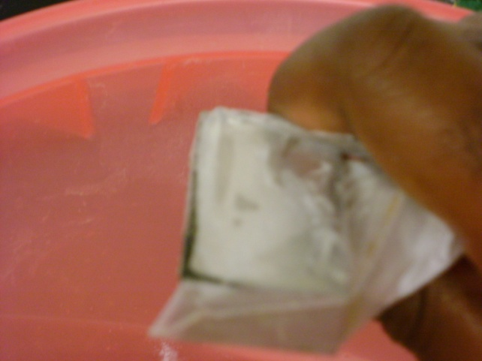
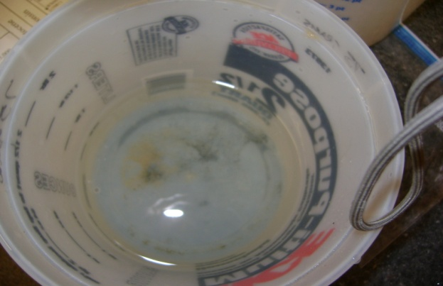
Magnetic Grain Extraction
An NDB super magnet was placed into a sealed Hefty bag and was used to extract magnetic grains from the slurry.
The bagged magnet was dipped into the slurry and moved slowly through the mixture.
Magnetic grains drawn to the magnet were released into a small bucket of clean water by withdrawing the magnet from the bag.
The process was repeated to rinse the excess sediment.

Slide 16
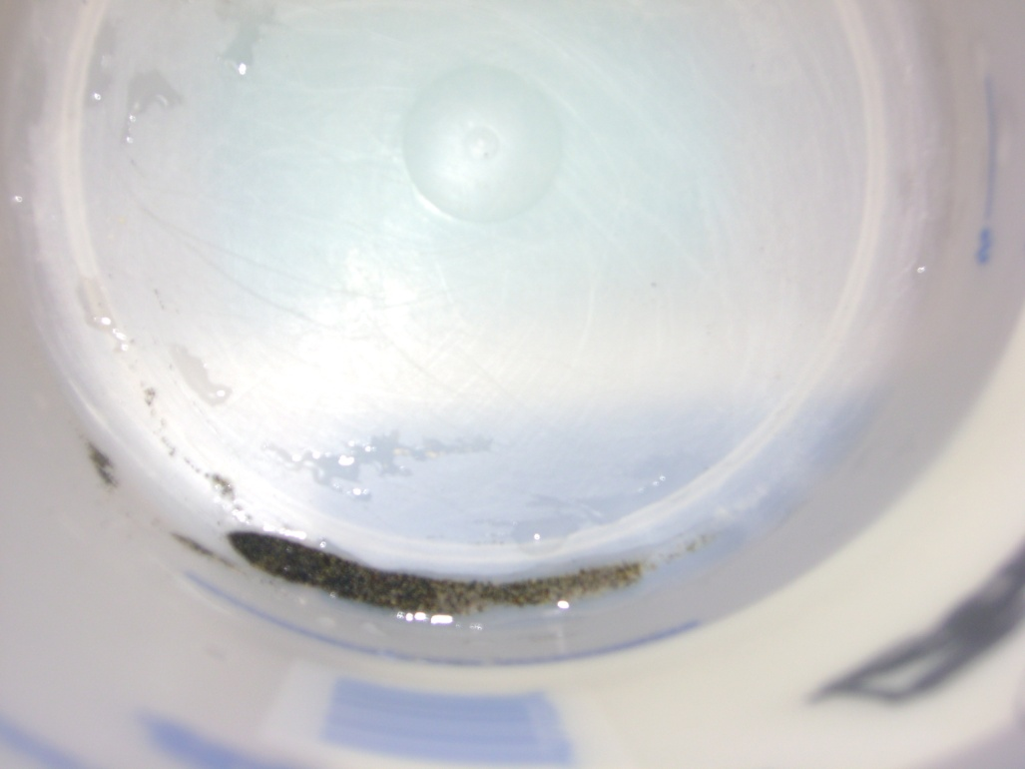
Magnetic Grain Extraction (Continued)
Heavy magnetic grains sank to the bottom allowing the water to be drained through a filter to collect any residual grains suspended by surface tension.
The magnetic material was allowed to dry.
Dried magnetic grains were placed on a plate.

Slide 17
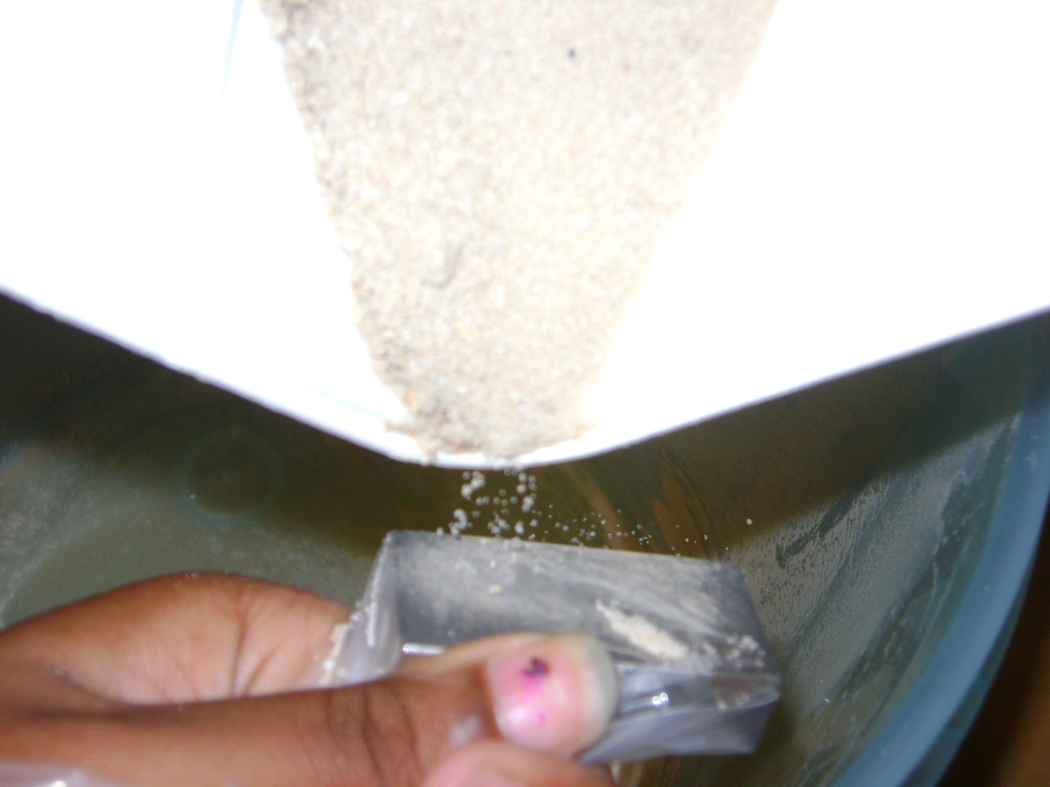
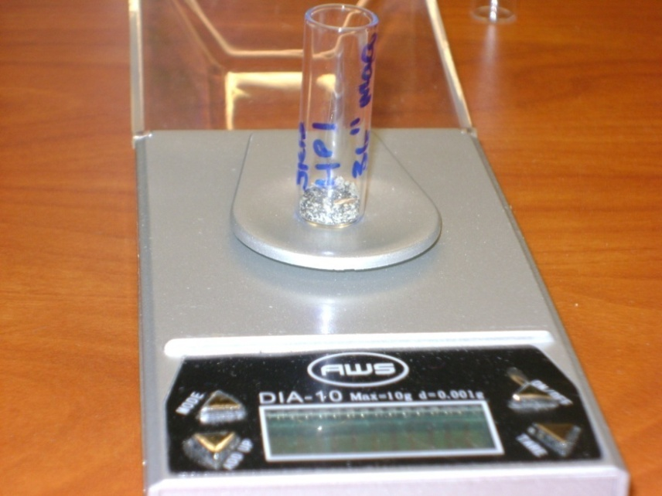
Magnetic Grain Extraction (Continued)
The bulk sediment sample was dried and residual magnetic material was extracted by pouring the dry sediment over the bagged magnet.
The magnetic material was gathered, placed in a vial, and weighed.

Slide 18
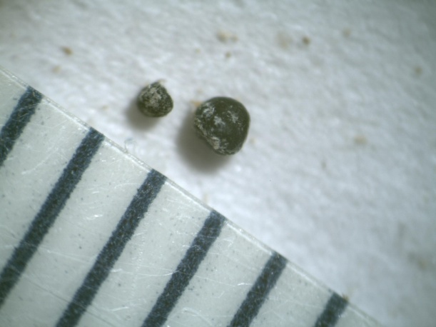
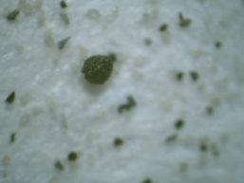
Analysis of Soil Samples
From the samples processed, stratigraphic profiles of carbon spherules and magnetic grains were developed.
While no magnetic spherules were discovered, a number of magnetic spheroids were found.

Slide 19
Summary of Soil Analysis
Analysis resulted in stratigraphic profiles of potential impact markers. (Carbon spherules and Magnetic grains)
The following tables represent the amounts of carbon spherules and magnetic grains extracted from samples taken at 6 inch intervals from Sandra Kimbel Bay near Fayetteville, North Carolina.
Results of GPR survey of Sandra Kimbel Bay performed July 2008 were inconclusive.

Slide 20
Carbon Spherule Depth Profile
Depth (Inches) | CS/kg
6 | 225
12 | 177.5
18 | 107.5
24 | 32.5
36 | 0
48 | 22.5
60 | 20
72 | 25
84 | 17.5
90 | 10
96 | 39.6
102 | 30
108 | 17.5
114 | 7.5
120 | 13.3
Sample Depth (inches)

Slide 21
Magnetic Grain Depth Profile
Depth (Inches) | g/kg
6 | .755
12 | .278
18 | .670
24 | .845
36 | 1.265
48 | 1.310
60 | .853
72 | 4.420
84 | 1.495
90 | 1.275
96 | 1.775
102 | .930
108 | .560
114 | 1.493
120 | 4.478
Sample Depth (inches)

Slide 22
Comparison of Firestone et. al.(2007), Results with SKB Results
The table below shows the comparison between our study on Sandra Kimbel Bay and the the results of Firestone et. al. (2007).
NOTE: “The dramatic difference in these results appears to be due to differences in the point of extraction.” (David Kimbel-personal communication, July 28, 2009)
Studies | Min CS/kg | Max CS/kg | Min Mag. g/kg | Max Mag. g/kg
Firestone et. al. (2007) | 142 | 1458 | 0.5 | 17
SKB Study (2009) | 0 | 225 | .278 | 4.478

Slide 23
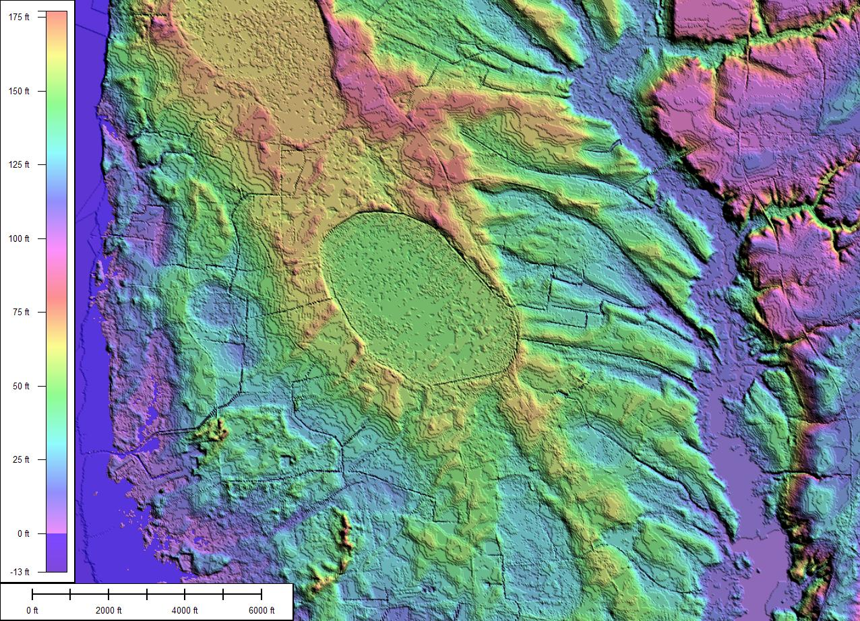
RockyhockBay
In order to get a more in-depth understanding of the features and stratigraphy of the bays, our team took a look at RockyhockBay in Edenton, North Carolina.
The site was previously described by D. Whitehead (1981) citing carbon 14 and pollen analysis to correlate depth with age.
The present study used a Ground Penetrating Radar (GPR) survey and stratigraphic samples to examine the bay.
LIDAR Digital Elevation Map

Slide 24
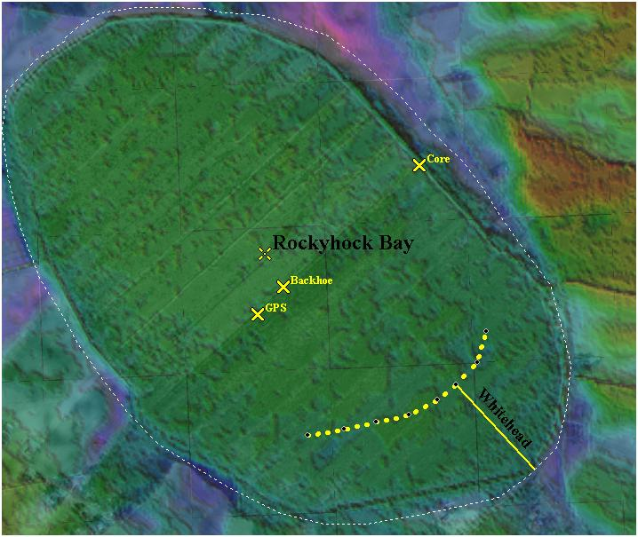
Rockyhock Bay (Continued)

Slide 25
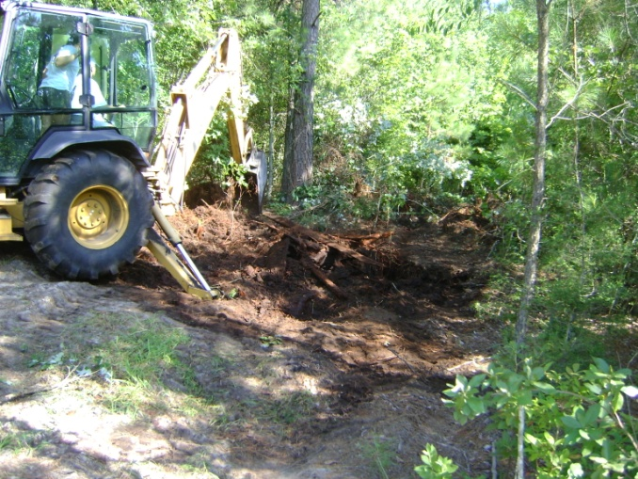
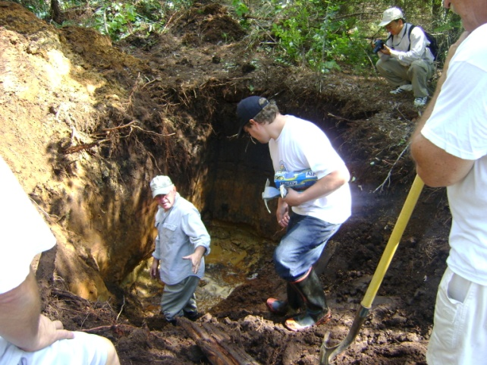
Rockyhock Bay (Continued)
We gathered soil samples near a road bisecting the bay.
In order to obtain the stratigraphy of the bay, a backhoe was used to dig a pit providing a clear view of the stratigraphy.

Slide 26
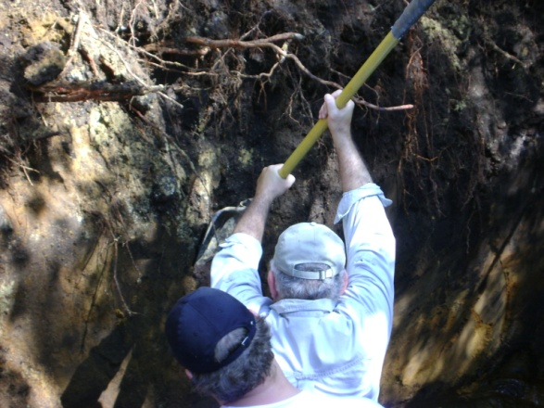
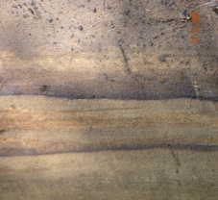
Rockyhock Bay (Continued)
The side exposure was shovel-shaved to obtain a clear view of the stratigraphy.
Two horizontal layers of iron stone three inches apart were evident and indicators of deposition in a former lakebed.
Layers were consistent with either aeolian or lacustrian processes.

Slide 27
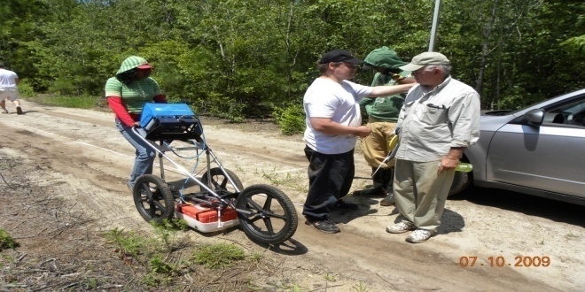
Ground Penetrating RADAR
The Ground Penetrating RADAR provides an image of what is beneath the surface in high resolution.
GPR transmits microwave electromagnetic energy into the ground, creating an image based on variations in the round trip time it takes for the reflected energy to return.

Slide 28
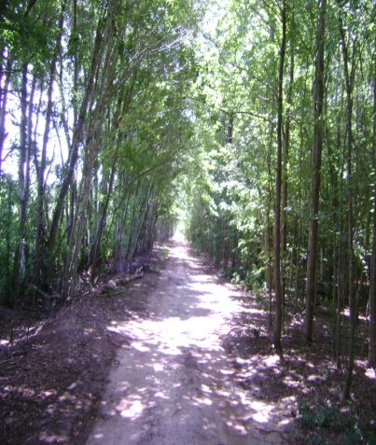
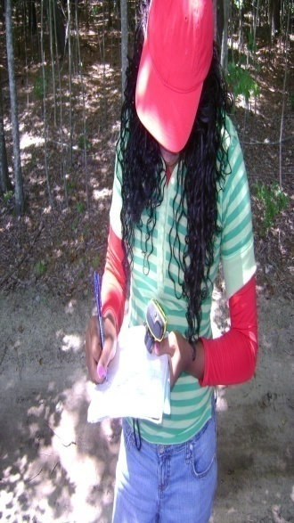
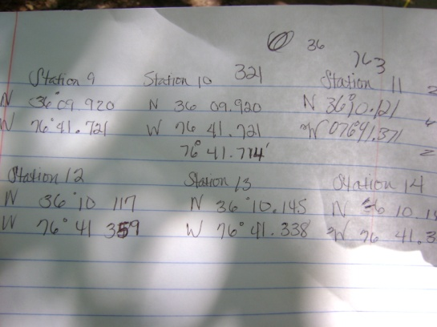
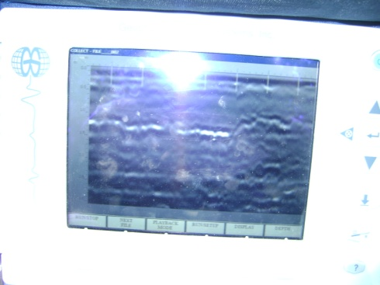
Ground Penetrating RADAR Continued
A compacted dirt road provided a path for a GPR survey along the bay’s semi-minor axis.
The survey consisted of a quarter mile transect running from the middle of the bay to its outer rim.
We recorded the GPR location every 100 feet with GPS.

Slide 29
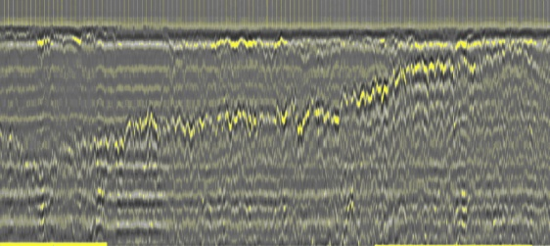
GPR Survey
The GPR transect revealed the shape of the bottom of the bay mirrored in the reflection from the uppermost iron layer. (Uncalibrated vertical scale ~2.5 meters maximum depth)
Bay Midpoint
Bay Rim

Slide 30
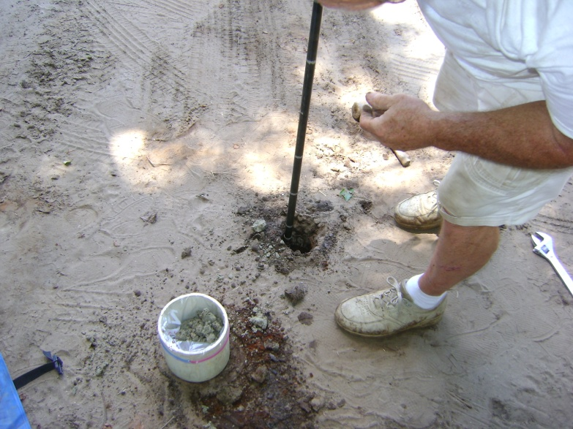
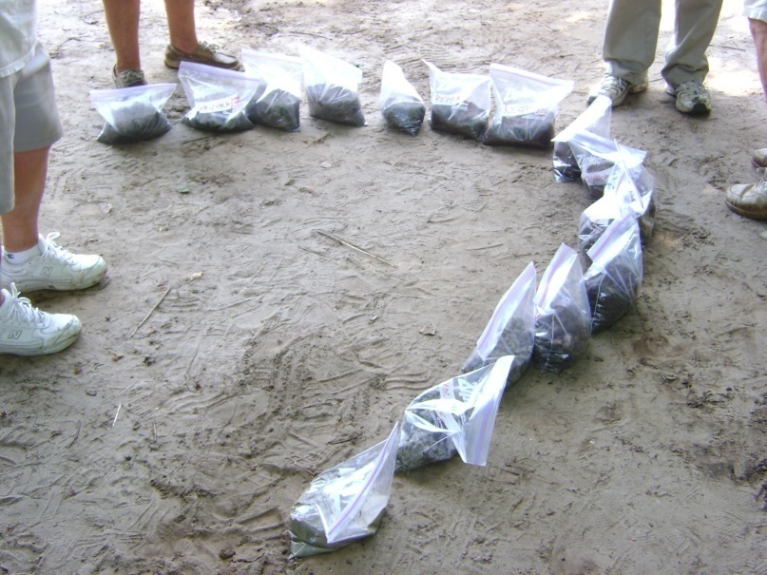
Coring
Coring is the process of obtaining a vertical soil sample in order to get a profile of the soil sediments to a desired depth. This effort’s soil sampling went as deep as 112 inches and got soil samples at six inch intervals. Samples were taken from the center of the bay as well as at the rim of the bay. However, because of time, the processing of soil samples taken from Rockyhock Bay was not completed.

Slide 31
Conclusion
The Carolina Bays were formed either as a result of an extraterrestrial impact or by blowouts due to sustained hurricane-force winds during the last glacial maximum.
The Kimbel Bay soil sample analysis is inconclusive. Neither of the two theories can be eliminated with the information obtained.
However, the data gathered at Rockyhock Bay seems more consistent with the second theory. Our GPR scans only viewed 2.5 meters beneath the surface (roughly 98 inches). GPR was unable to definitely detect the bay bottom. The iron layer, roughly 1 meter below the surface, appears to conform to the shape of a deeper bay bottom.
According to Whitehead(1981), a depth of 2.5 meters corresponds to an age of approximately 11,000 years, but is only half the total depth of the bay.
Thus, it would appear that Rockyhock Bay was formed prior to advent of the Younger Dryas.

Slide 32
Future Work
The soil samples analyzed within the team’s current research were taken from Sandra Kimbel Bay in the year 2008. These samples have been analyzed for magnetic and carbon spherules. In the future, the carbon spherules will be examined through a Transmission Electron Microscope (TEM) for nano diamonds.
Future analysis will be performed on soil samples taken from the center and rim of Rockyhock Bay.
The soil and stratigraphy of smaller bays will be investigated for a relationship between bay size and evolutionary history.

Slide 33
Acknowledgements
The Gambit Team thanks Dr. Linda Hayden for making the research possible through the Undergraduate Research Program in Ocean, Marine, and Polar Science, Dr. Dewayne Branch for being an outstanding mentor and exposing us to new experiences, Dr. Malcolm LeCompte for taking the time to share his wealth of knowledge, for sharing his research techniques with us, and also being an outstanding mentor, David Kimbel for his insights and help with the art of core sampling, Donald, Megan and Jonathan Bass, for access to Rockyhock Bay, their backhoe expertise, their help and sustenance, geophysical consultants: Dr. Allen West and University of Delaware’s Mr. Mark Dimitroff for sharing their wealth of knowledge. Without these individuals, our research efforts would not have been as successful.

Slide 34
References
John A., Brooks, Mark J., Taylor, Barbara E., “New constraints on the evolution of Carolina Bays from ground-penetrating radar” in Geomorphology, 22, 1998, 325-345.
R.B. Firestone, A. West, J.P. Kennett, L. Becker, T.E. Bunch, Z.S. Revay, P.H. Schultz, T. Belgya, D.J. Kennett, J.M. Erlandson, O.J. Dickenson, A.C. Goodyear, R.S. Harris, G.A. Howard, J.B. Kloosterman, P. Lechler, P.A. Mayewski, J.Montgomery, R. Poreda, T. Darrah, S.S. QueHee, A.R. Smith, A.Stich, W. Topping, J.H. Wittke, and W.S. Wolbach, “Evidence for an extraterrestrial impact 12,900 years ago that contributed to the megafaunal extinctions and the Younger Dryas cooling”, in PNAS , vol . 104 no. 41, 2007, pp 2-4
Whitehead, Donald, “Late-Pleistocene Vegetational Changes in Notheastern North Carolina,” in Ecological Mongraphs, 51(4), Ecological Society of America, 1981, pp. 451–471.
Bennett. S.H. Nelson J.B., “Distribution and Status of Carolina Bays in South Carolina” in Nongame and Heritage Trust Publications, Vol. 1. South Carolina Wildlife and Marine Resources Department, Columbia SC 1991, pp 88.
Johnson, D.W, “ The Origin of Carolina Bays”, in Columbia University Press, New York ,1942,pp 341
Prouty, W.F., “Carolina Bays and their Origin” in Geology Society of America, ed. 63, Bull 1952, pp 167-224
Kaczorowski, R. T., “The Carolina Bays: a Comparison with Modern Oriented Lakes Technical Report” no. 13-CRD, Coastal research Division, Department of Geology, University of South Carolina, Columbia, South Carolina.1977, pp.124

