Slide 1
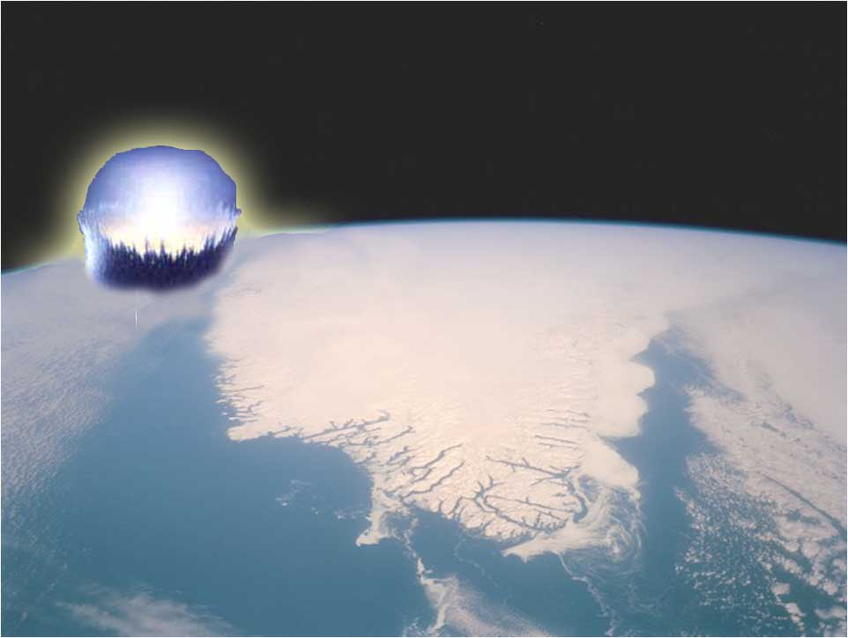
Younger Dryas Impact Study
Undergraduate Research Experience 2008
Elizabeth City State University
Dr. Malcolm LeCompte
MyAsia Reid
Leroy Lucas
Devina Hughes

Slide 2
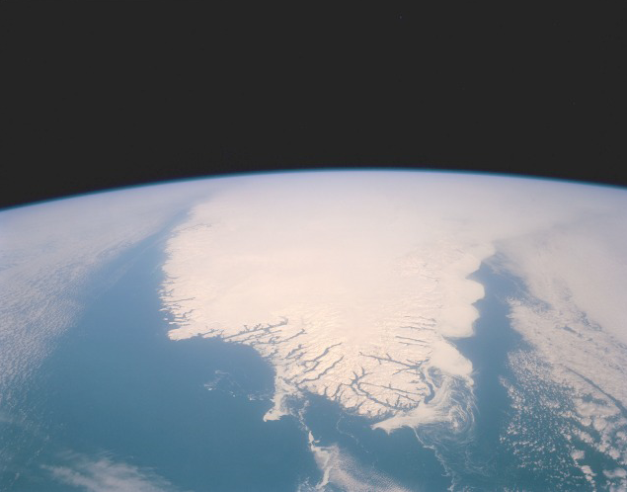
Abstract
"Younger Dryas Impact Study”- Summer 2008
The events precipitating the dramatic, millennial long climatic cooling known as the Younger Dryas, that occurred approximately 13,000 years ago remain a mystery. Recent evidence suggests an extraterrestrial impact on the Laurentide ice sheet may have provided the trigger for a massive influx of fresh glacial melt water theorized to have flooded the North Atlantic and shut down the Thermohaline circulation that moderates climate in the northern hemisphere.The apparent absence of an easily identified impact crater has focused the search for evidence of an impact on a search for extraterrestrial markers embedded in the Earth’s sedimentary record.
Association of an impact with coincident reduction in the numbers of megafauna species and human population of North America has suggested a strategy for the search for evidence of the impact. If an impact is responsible for initiating the onset of the Younger Dryas, the ultimate disappearance of megafauna species and the decline in human population, then the evidence should lie at the sedimentary boundary (YDB) separating the Younger Dryas from the preceding Bolling-Allerod at a depth corresponding to 12,900 years before present.
Some of these evidential markers (magnetic grains and spherules, charcoal, and glass-like carbon) was relatively easy to extract and identify while others (nanodiamonds and fullerenes) required great care, expensive instrumentation and considerable training. Fortunately, the vessels (carbon spherules) containing the more challenging markers were identified and extracted during the soil processing for magnetic spherules and charcoal. The research project also included an investigation of local paleo-lake depressions known to harbor impact markers and whose stratigraphy could have revealed a clearer understanding of the processes that shaped the coastal topography during the Younger Dryas. The research was carried out using a combination of Ground Penetrating RADAR (GPR) and sample coring to probe the subsurface deposits of selected depressions.

Slide 3
What Happened 12, 900 Years Ago?
That resulted in the near extinction of many species of Megafauna
That led to the apparent disappearance of the Clovis Paleo-Indian culture?
That filled Greenland ice cores with evidence of massive forest fires across the globe?
That led to glacial melt water flooding the North Atlantic, disrupting salinity and interfering with ocean circulation patterns that warm Northern latitudes,
And returned the Earth’s climate to its previous Ice Age conditions?

Slide 4
What Do You Believe?
Many theories exist to explain the Megafauna species disappearance:
Some believed the “Clovis People” killed the animals for food. (KILL)…
but who killed CLOVIS?
Climate Change caused the animal’s food to disappear. (CHILL)…
but COLD never killed them before!
A plague wiped them out. (ILL)…
All the species killed by the same FLU?
The most recent proposal:
A Comet (or comet fragments) hit North America 12,900 years ago.

Slide 5
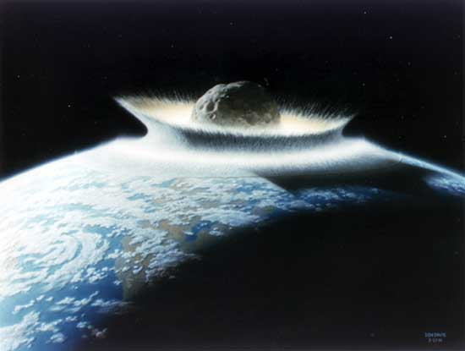
If So…
This might have been the impact of the small comet or asteroid, which exploded in the upper atmosphere, or hit the Laurentide Ice sheet forming an ice walled crater, which subsequently melted leaving no primary evidence.
Causing massive forest fires across North America
Soon enough, the atmosphere was filled with soot, and dust, blocking outSolar radiation for a long period of time, which resulted in a “nuclear winter”.
Then snowfell, and glaciers reformed, and freezing temperatures persisted for centuries.

Slide 6
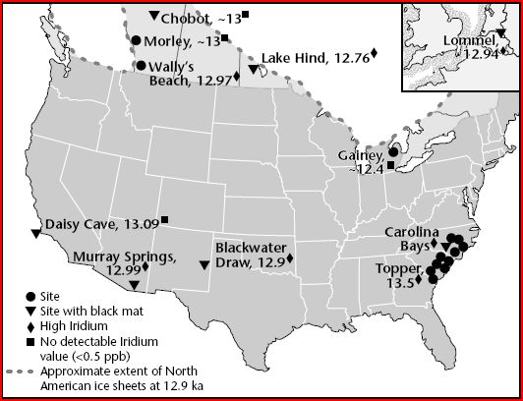
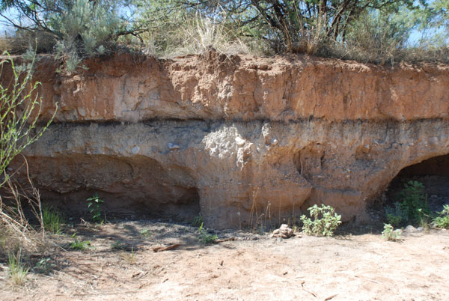
Clovis Sites
Clovis sites provide a reference date.
No evidence of Clovis culture lies above the 12,900 year YDB.
There are 50 known Clovis sites in North America that contain dark organic deposits, also known as “black mats” which mark the end of the Clovis Era.
Black Layer

Slide 7
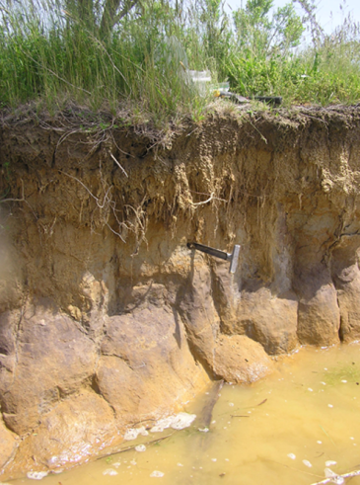
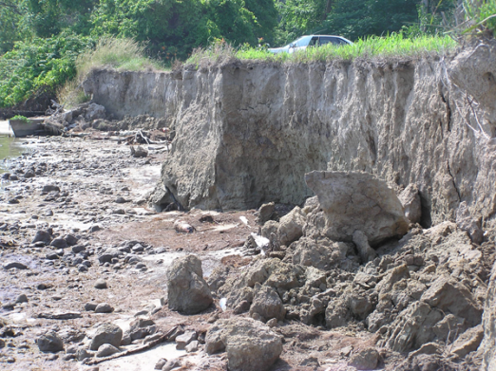
Searching for Evidence of an IMPACT!
Soil Sample Analysis Approach
Miles Point, Chesapeake Bay, MD
Identify a site with dated, vertical, stratigraphic exposure (e.g. River Bank, Cliff Face, Road Cut).
Clovis artifacts provide a reference date, the Younger Dryas Boundary (YDB).
Carbon 14 dating
Collect soil samples above, at, and below the dated reference soil layer (YDB).
Miles Point, Chesapeake Bay, MD
Eure Farm, Cross Neck Rd., Hertford, NC
Process soil samples to collect Impact Markers
Convert soil to slurry with water
Plastic bag covered super magnet used to extract magnetic particles
Organic material floats and is skimmed from slurry surface.
Eure Farm, Cross Neck Rd., Hertford, NC

Slide 8
Impact Markers
Goal
Our goal was to detect impact markers in any of the 4 samples collected from Miles Point:
Magnetic Grains (found)
Magnetic Spherules (not found)
Carbon Spherules (found)
Glass-like Carbon (found)
Charcoal (found)
Nano-Diamonds (found)

Slide 9
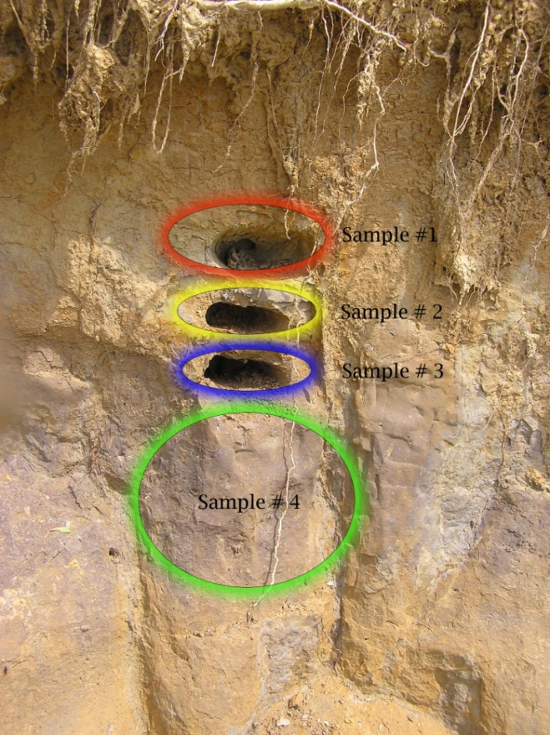
Miles Point, Chesapeake Bay, MD
Miles Point, Chesapeake Bay, MD:
Soil samples collected by Dr. Malcolm LeCompte on May 14th, 2008 processed and analyzed.
One of the known Clovis Sites
Results of Magnetic extraction
Eure Farm, Hertford, NC:
Soil samples collected July 18th, 2008 but unprocessed.
*trace- barely measurable.
Sample | TMass (g) | Depth in. (cm) | Total mass of Magnetic grains (g) | Magnetic grain Fraction
1 | 263.5 | 22.5 (57.15) | <0.01 | Trace*
2 | 185.5 | 24.5 (62.23) | <0.01 | Trace*
3 | 258 | 26.5 (67.31) | 0.01 | .00004
4 | 467.5 | 27-37 (68.6-94) | 0.03 | .00006

Slide 10
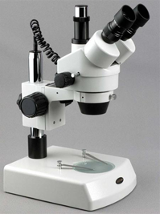
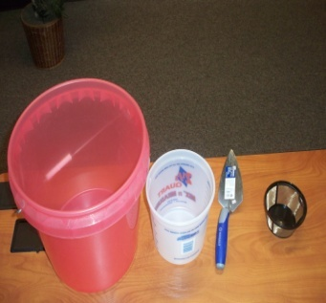
Materials
Materials
Super Magnets
Hefty plastic bags
Coffee Filters (150 μm)
Large Buckets
Small Bucket
Microscope
Vaseline
Metal Chute
Soil Samples

Slide 11
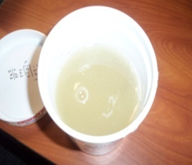
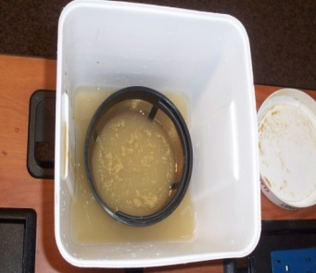
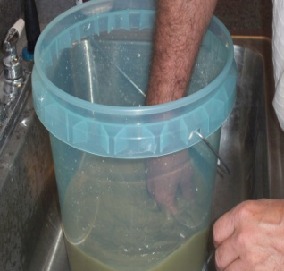
Soil Processing
The first step to processing sticky or clay sediment was to add adequate water to each sediment sample to create a slurry and to put it aside for a few days
We use the magnet to catch them. The sediment was then poured into a filter, and transferred into another bucket.

Slide 12
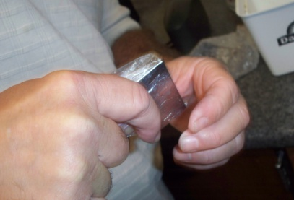
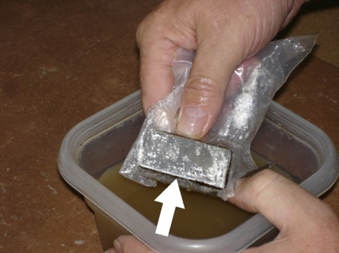
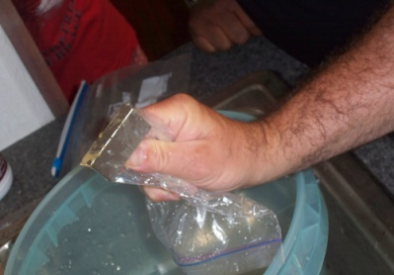
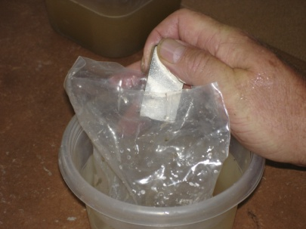
Soil Processing
The magnet, was tightly stretched in a Hefty plastic bag, and then immersed in the mixture NOTE: The magnet was moved slowly and gently, to avoid dislodging grains.
The magnetic fraction withdrawn from the water. The bag, magnet, and grains were then immersed in a second container of clean water. Withdrawing the magnet from the bag released the grains into the water.

Slide 13
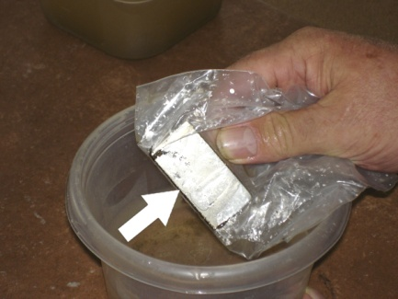
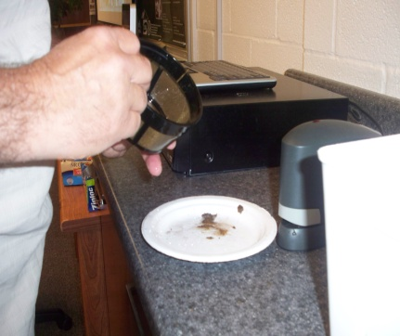
Soil Processing
This process was repeated until only minimal additional grains were extracted. Next, in order to separate excess dirt from the magnetic grains, the bag and magnet were used to retrieve the magnetic fraction from the second container.
After removing the magnet, the wet grains stuck to the bag and were transferred onto a small plate.
After Drying, the magnetic fraction was weighed, catalogued, and analyzed.

Slide 14
Extraction of Magnetic Fractions
To find micro spherules, the magnetic fraction is extracted. To identify the micro spherules, it is necessary to clean the magnetic fraction with water.
To find micro spherules, we dusted the magnetic grains lightly across a white background microscope slide, making it easier to distinguish the spherules.
NO MAGNETIC SPHERULES WERE FOUND!

Slide 15
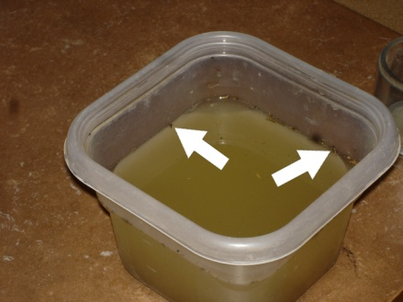
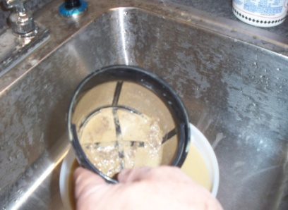
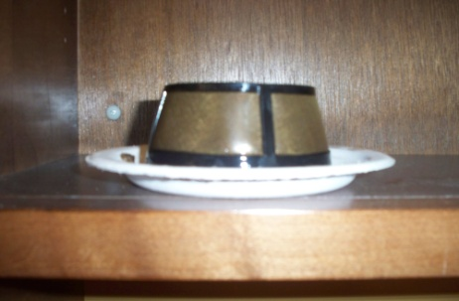
Extraction of Carbon Spherules,
Glass-like Carbon,
And Charcoal
Carbon spherules have a low specific gravity, so water floatation was used to separate them. Ample water was used for dilution, and the slurry was agitated to free the floating fraction (ARROWS)
The floating fraction was captured with a filter.
The floating fraction was then placed onto a plate to dry.
This was repeated until all floating fractions were removed.
To recover the less buoyant fraction of carbon that did not float, the remaining slurry was rinsed and agitated repeatedly. This stratified the sediment and brought the remaining non-floating carbon fraction to the surface of the sediment sample, but beneath the water. Obvious carbon, which included charcoal and glass-like carbon, was separated manually.

Slide 16
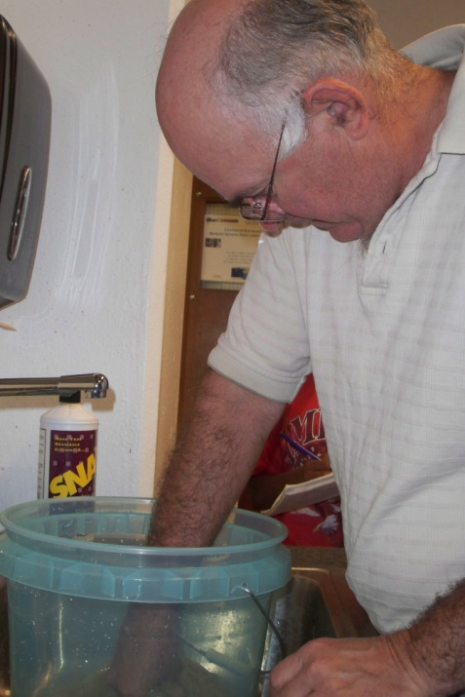
Analysis of Individual Soil Samples
Sample 1
The markers revealed from our analysis of sample 1 taken from Miles Point; at a depth of 22.5 inches (57.15 cm) and above the YDB, included:
Magnetic Grains (not found)
Magnetic Spherules (not found)
Carbon Spherules (found)
Glass-like Carbon (not found)
Charcoal (not found)
Nano-Diamonds (found)

Slide 17
Analysis of Individual Soil Samples
Sample 2
The markers revealed from our analysis of sample 2 taken from Miles Point; at a depth of 24.5 inches (62.23 cm) and above the YDB, included:
Magnetic Grains (found)
Magnetic Spherules (not found)
Carbon Spherules (found)
Glass-like Carbon (not found)
Charcoal (not found)
Nano-Diamonds (Un-evaluated)

Slide 18
Analysis of Individual Soil Samples
Sample 3
The markers revealed from our analysis of sample 2 taken from Miles Point; at a depth of 26.5 inches (67.31 cm) and approx. at the YDB, included:
Magnetic Grains (found)
Magnetic Spherules (not found)
Carbon Spherules (found)
Glass-like Carbon (not found)
Charcoal (found)
Nano-Diamonds (Un-evaluated)
In addition to the above expected markers, analysis of the magnetic material extracted from this sample revealed an unexpected marker whose full significance is now being investigated at the University of New Hampshire by Botanist Dr. Barry Rock using Scanning Electron Microscopy (SEM).
7. Magnetite Impregnated scorched Wood Fragments (possibly pre-fossilized)

Slide 19
Analysis of Individual Soil Samples
Sample 4
The markers revealed from our analysis of sample 2 taken from Miles Point; at a depth of 27-37 inches (68.6-94 cm) and approx. at or below the YDB, included:
Magnetic Grains (found)
Magnetic Spherules (not found)
Carbon Spherules (found)
Glass-like Carbon (found)
Charcoal (found)
Nano-Diamonds (Un-evaluated)
Magnetite Impregnated scorched Wood Fragments (possibly pre-fossilized) (found)

Slide 20
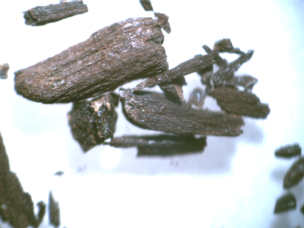
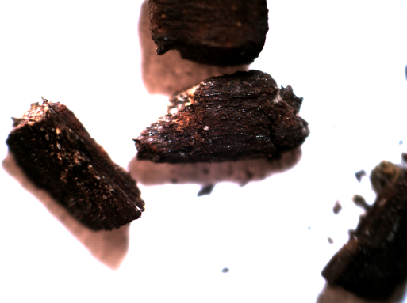
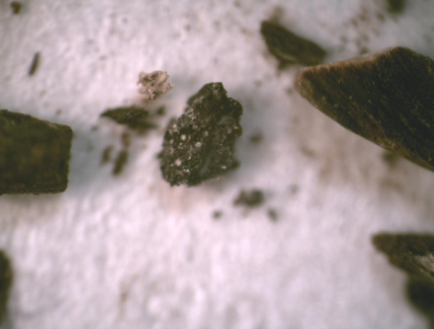
Results
Impact Markers
Magnetite impregnated wood fragments
Scorched magnetite, pre-fossilized wood fragments
Magnetite impregnated and nearly fossilized wood fragments that appear to show some evidence of scorching to the point of becoming charcoal.
Charcoal fragments
Glass-Like Carbon fragments

Slide 21
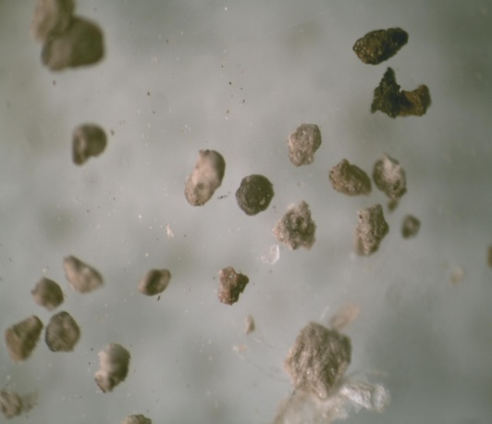
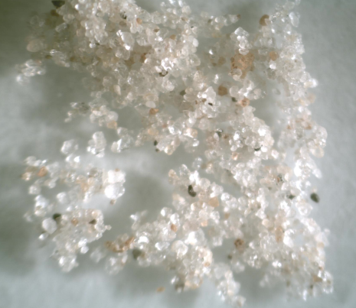
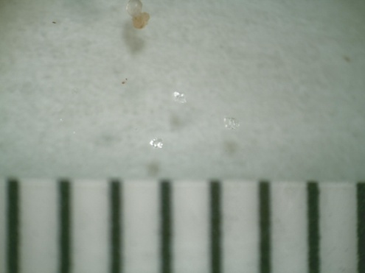
Results
Impact Marker
Carbon Spherules
Carbon Spherules (probably droplets of melted tree sap) in a variety of colors ranging from pearl to dark gray.
Nano-diamonds presumably created in an environment of intense heat and pressure (shown with a millimeter scale)
Nano Diamonds
Closer Look at Nano Diamonds

Slide 22
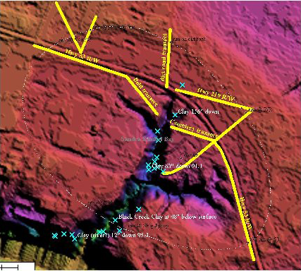
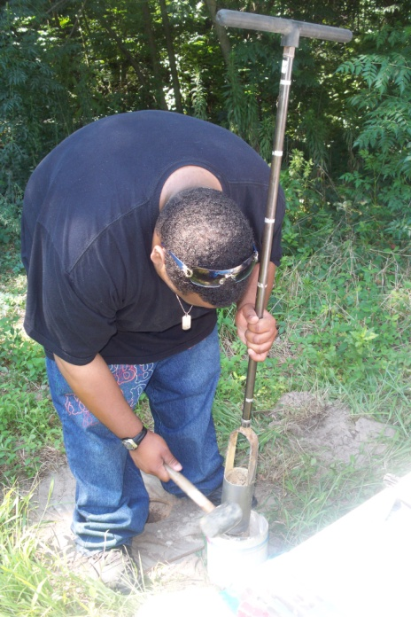
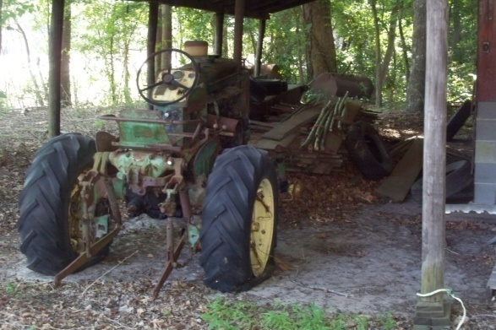
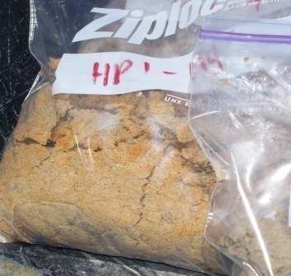
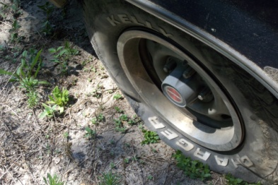
Coring at Kimbel Bay, NC
Purpose
Give full vertical sedimentary profile of 126 inches underground.
We know that markers came out of the Kimbel bay
So we collected soil samples to process in future work.
We were going to use the GPR at the core site, but 3 flat tires prevented it.

Slide 23
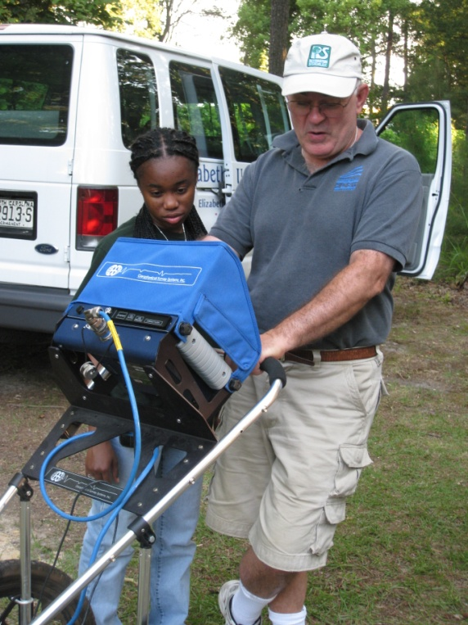
Ground Penetrating Radar
Purpose
To see what was beneath the lake bed.
To see if there was any indication that the bay was caused by an impact (e.g. Multiple Rims or Paleo-depressions)
Multiple Rims

Slide 24
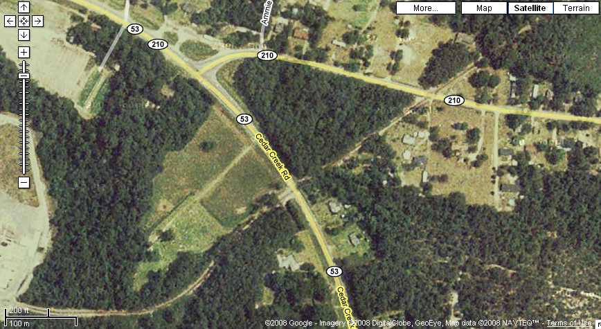
Ground Penetrating Radar Results
Image 1
Image 3

Slide 25
Acknowledgements
Special Thanks to:
Dr. Linda Hayden
Dr. Malcolm LeCompte
Allen West
David Kimbel
George Howard
Bob Langenburg
Suntzu “Team Mascot”
Audience

Slide 26
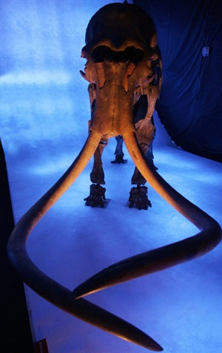
Conclusion
The hypothesis that the Younger Dryas (YD) was triggered by an (extraterrestrial) ET impact appears to be confirmed by our results. Our research revealed a number of constituents that support the comet impact hypotheses from soil samples extracted from the bank of the Chesapeake Bay at Miles Point, MD. Most of these constituents, including charcoal, glass-like carbon, carbon spherules (possibly melted tree sap), and scorched wood fragments suggest major forest fires preceded the YD cooling. The carbon spherules were discovered in all the samples, while the rest of the markers were concentrated in samples 3 and 4.
Magnetite discovered embedded in the scorched wood fragments may have been a direct result of the impact or normal mineralization due to the process of fossilization. Magnetite spherules were found embedded in downed trees at the site of the Tunguska, Siberia impact in 1908.
Samples of the Miles Point scorched wood fragments have been forwarded to Dr. Barry Rock at the University of New Hampshire for further testing to determine whether or not the wood fragments are pre-fossilized.
Microscopic examination revealed traces of nano-diamonds in soil samples 3 and 4, which are direct evidence of an ET impact.
Taken together these markers suggest that a significant environmental calamity occurred 12,900 years ago with many of the expected characteristic side effects characteristic of an ET Impact.

Slide 27
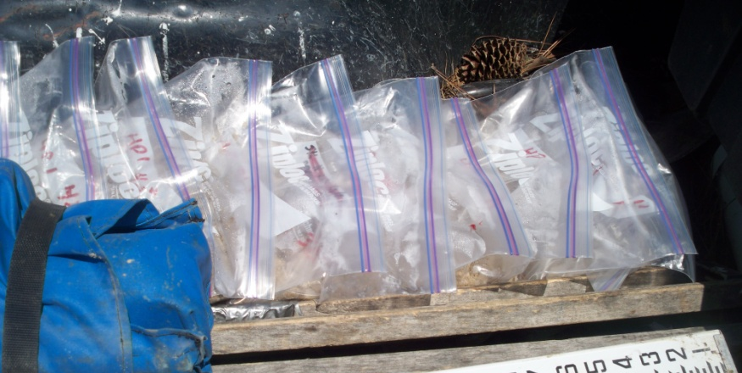
Future Work
Processing and Analyzing of Stratigraphic soil samples collected at Eurefarm, Cross Neck Road, Hertford, North Carolina.
Collection and Analysis of additional Stratigraphicsoil samples from at or near Miles Point Maryland.
Continued Analysis of Ground Penetrating Radar data from the Kimbel Bay.
Processing and Analyzing soil core samples collected at the Kimbel Bay.
More GPR surveys of other Carolina Bays.

Slide 28
References
http://allendale-expedition.net/publications/comet.pdf
http://allendale-expedition.net/publications/Comet-PNAS.pdf
Curtis, Erin. “Clovis in the Southeast Conference 2005”. Mammoth Trumpet. Vol. 21. No.2, pp. 1-3 12. 2006.
Ellis, C., A.C. Goodyear, D.F. Morse, and K.B. Tankersley. “Archaeology of the Pleistocene-Holocene Transition in Eastern North America. “ Quaternary International, Vol.49/50 pp.151-166. INQUA/ Elsevier Science Ltd. 1998
Firestone, R.B., A. West, J.P. Kennett, L. Becker and others. “Evidence for an Extraterrestrial Impact 12,900 Years Ago that Contributed to the Megafaunal Extinctions and the Younger Dryas Cooling.” Proceeding National Academy Sciences. Vol. 104 No. 41, pp. 16016-16021. 2007.
Forman, Steve. “Luminescence Dating of Quaternary Sediments, New Methods for Dating Archaeology Components.” Mammoth Trumpet, Vol. 18 No. 3, pp. 10-13. 2003.
Goodyear, A.C. “Evidence of Pre-Clovis Sites in the Eastern United States” PaleoAmerican Origins: Beyond Clovis, pp.103-112. Re-edited 2005.
Goodyear, A.C. “Recognizing the Redstone Fluted Point in the South Carolina PaleoIndian Point Database.” Current Research in the Pleistocene, Vol. 23, 100-103. 2006.
Goodyear, A.C. “The Early Holocene Occupation of the Southeastern United States: A Geoarchaeological Summary.” Ice Age Peoples of North America. Re-edited 1999.
Kawamura, K., Ozawa, S., and Endo, H. “Volume expansin of glass-like carbon upon high temperature heat treatment.” Elsevier, Vol. 41 No.1 pp. 191-194. 2003.
Largent, Floyd. “The Clovis Comet, Part I: Evidence For a Cosmic Collision 12,900 Years Ago.” Mammoth Trumpet, Vol. 23 No.1, pp. 1-4. 2008.
Marshall, Eliot. “PreClovis Sites Fight for Acceptance.” Science Vol. 291, pp. 1730-1732. 2001.
Szuch, Ryan Paul. 2004. “Application of Ground Penetrating Radar to Map Stratigraphy of a Drained Carolina Bay and Aid its Wetland Restoration.” Soil Sci. Raleigh. 2004

