Slide 1
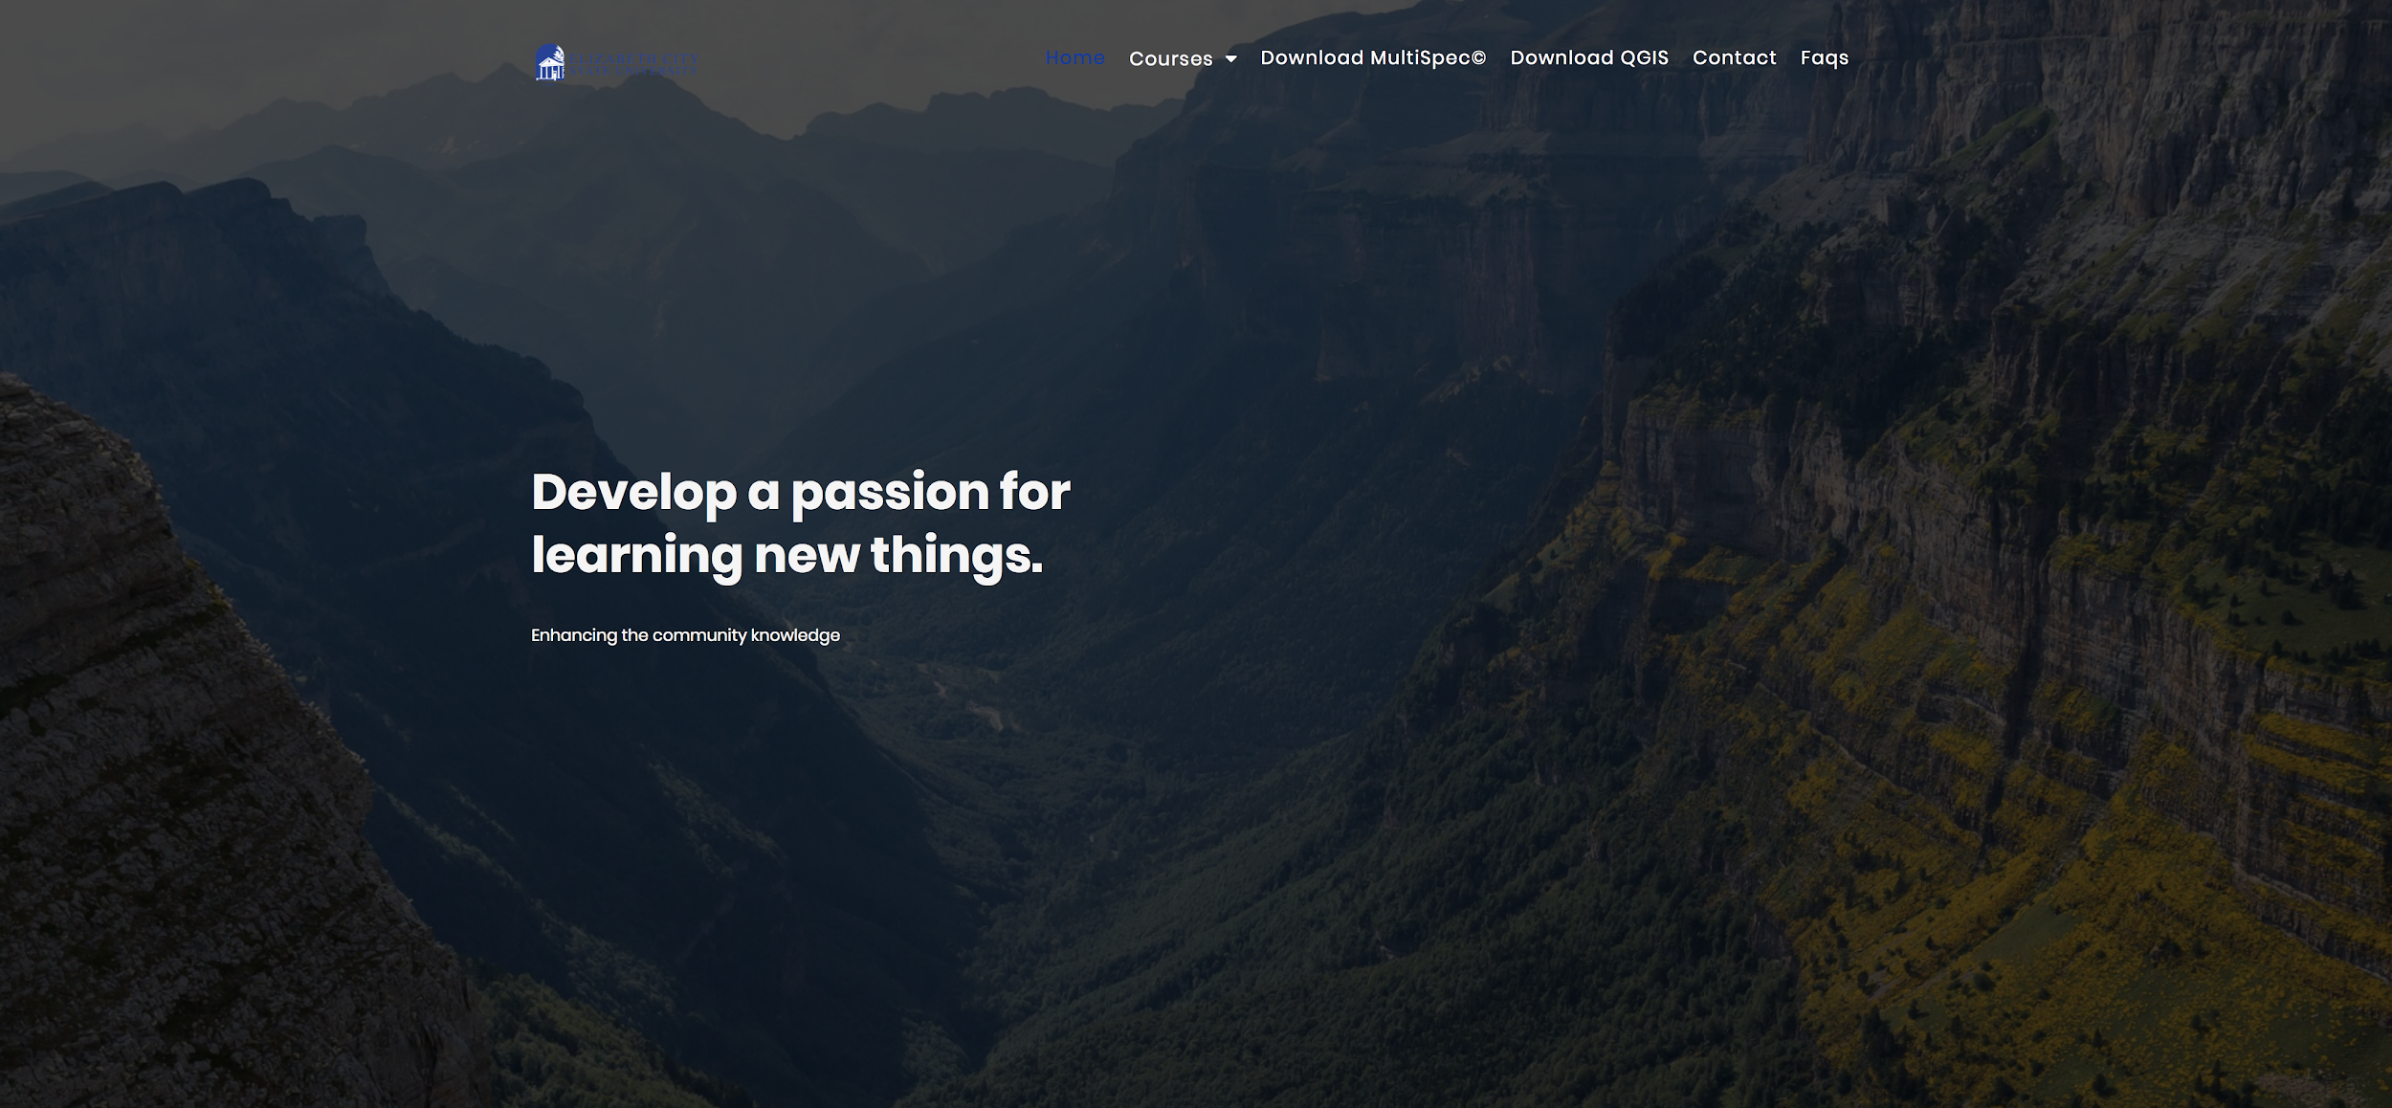
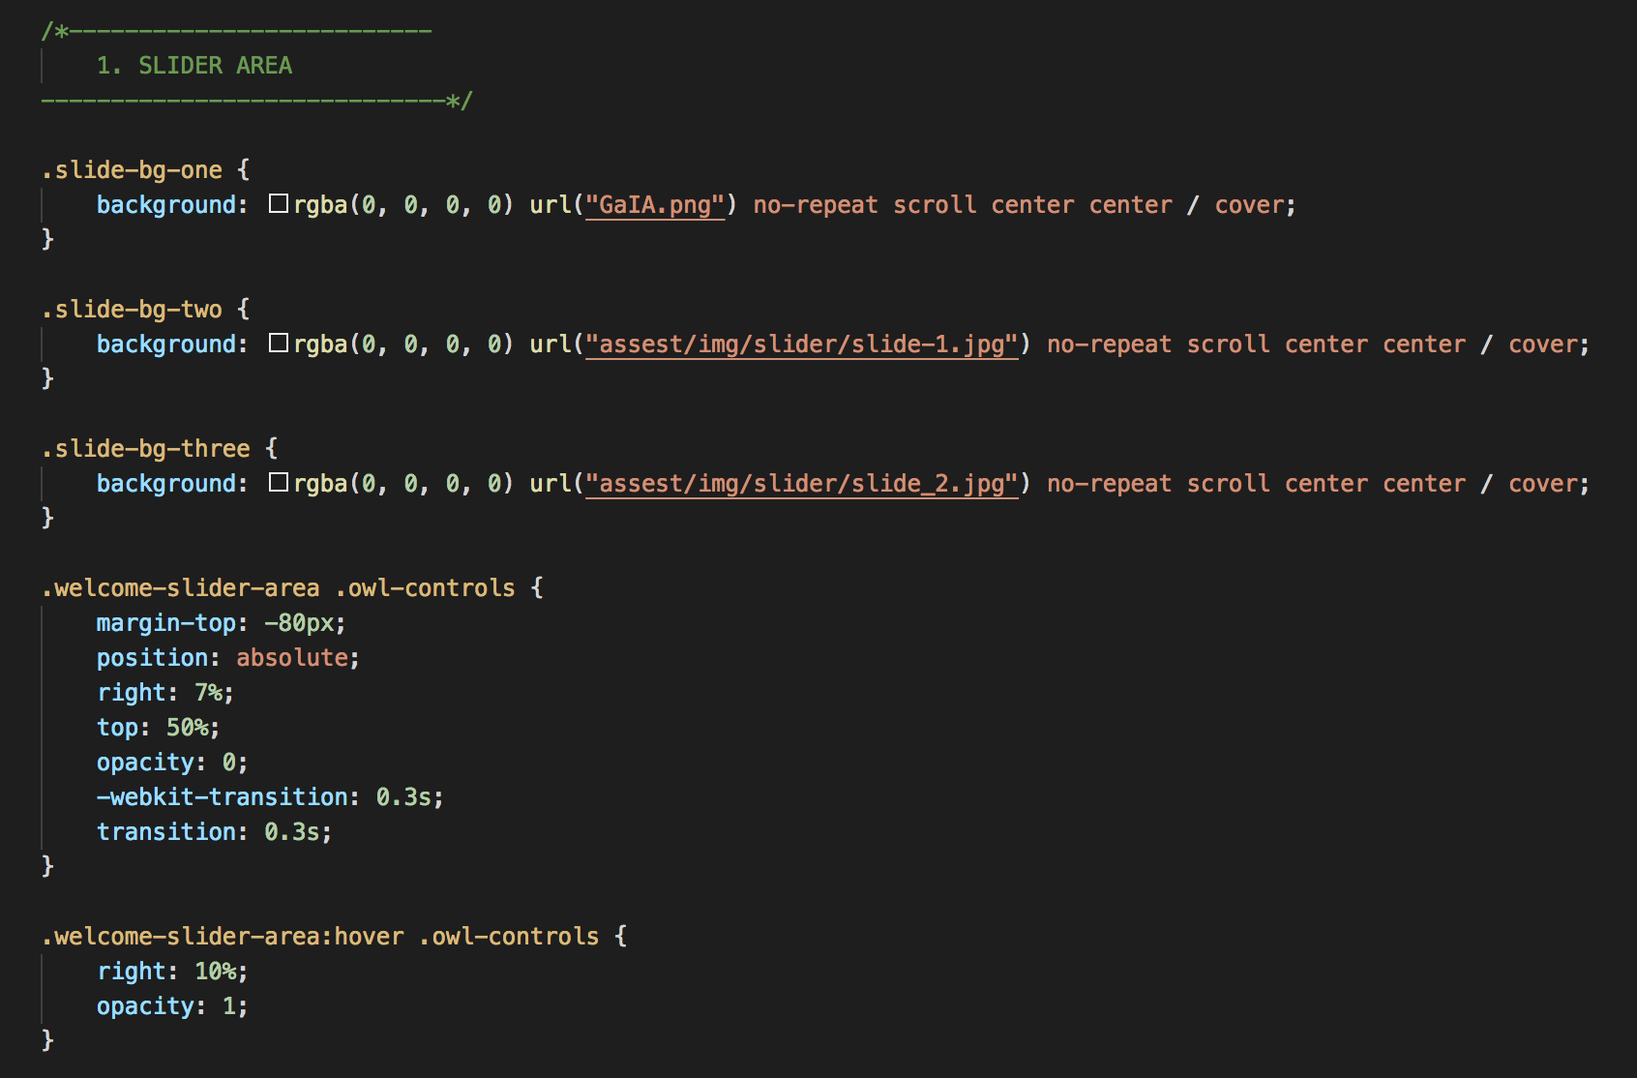
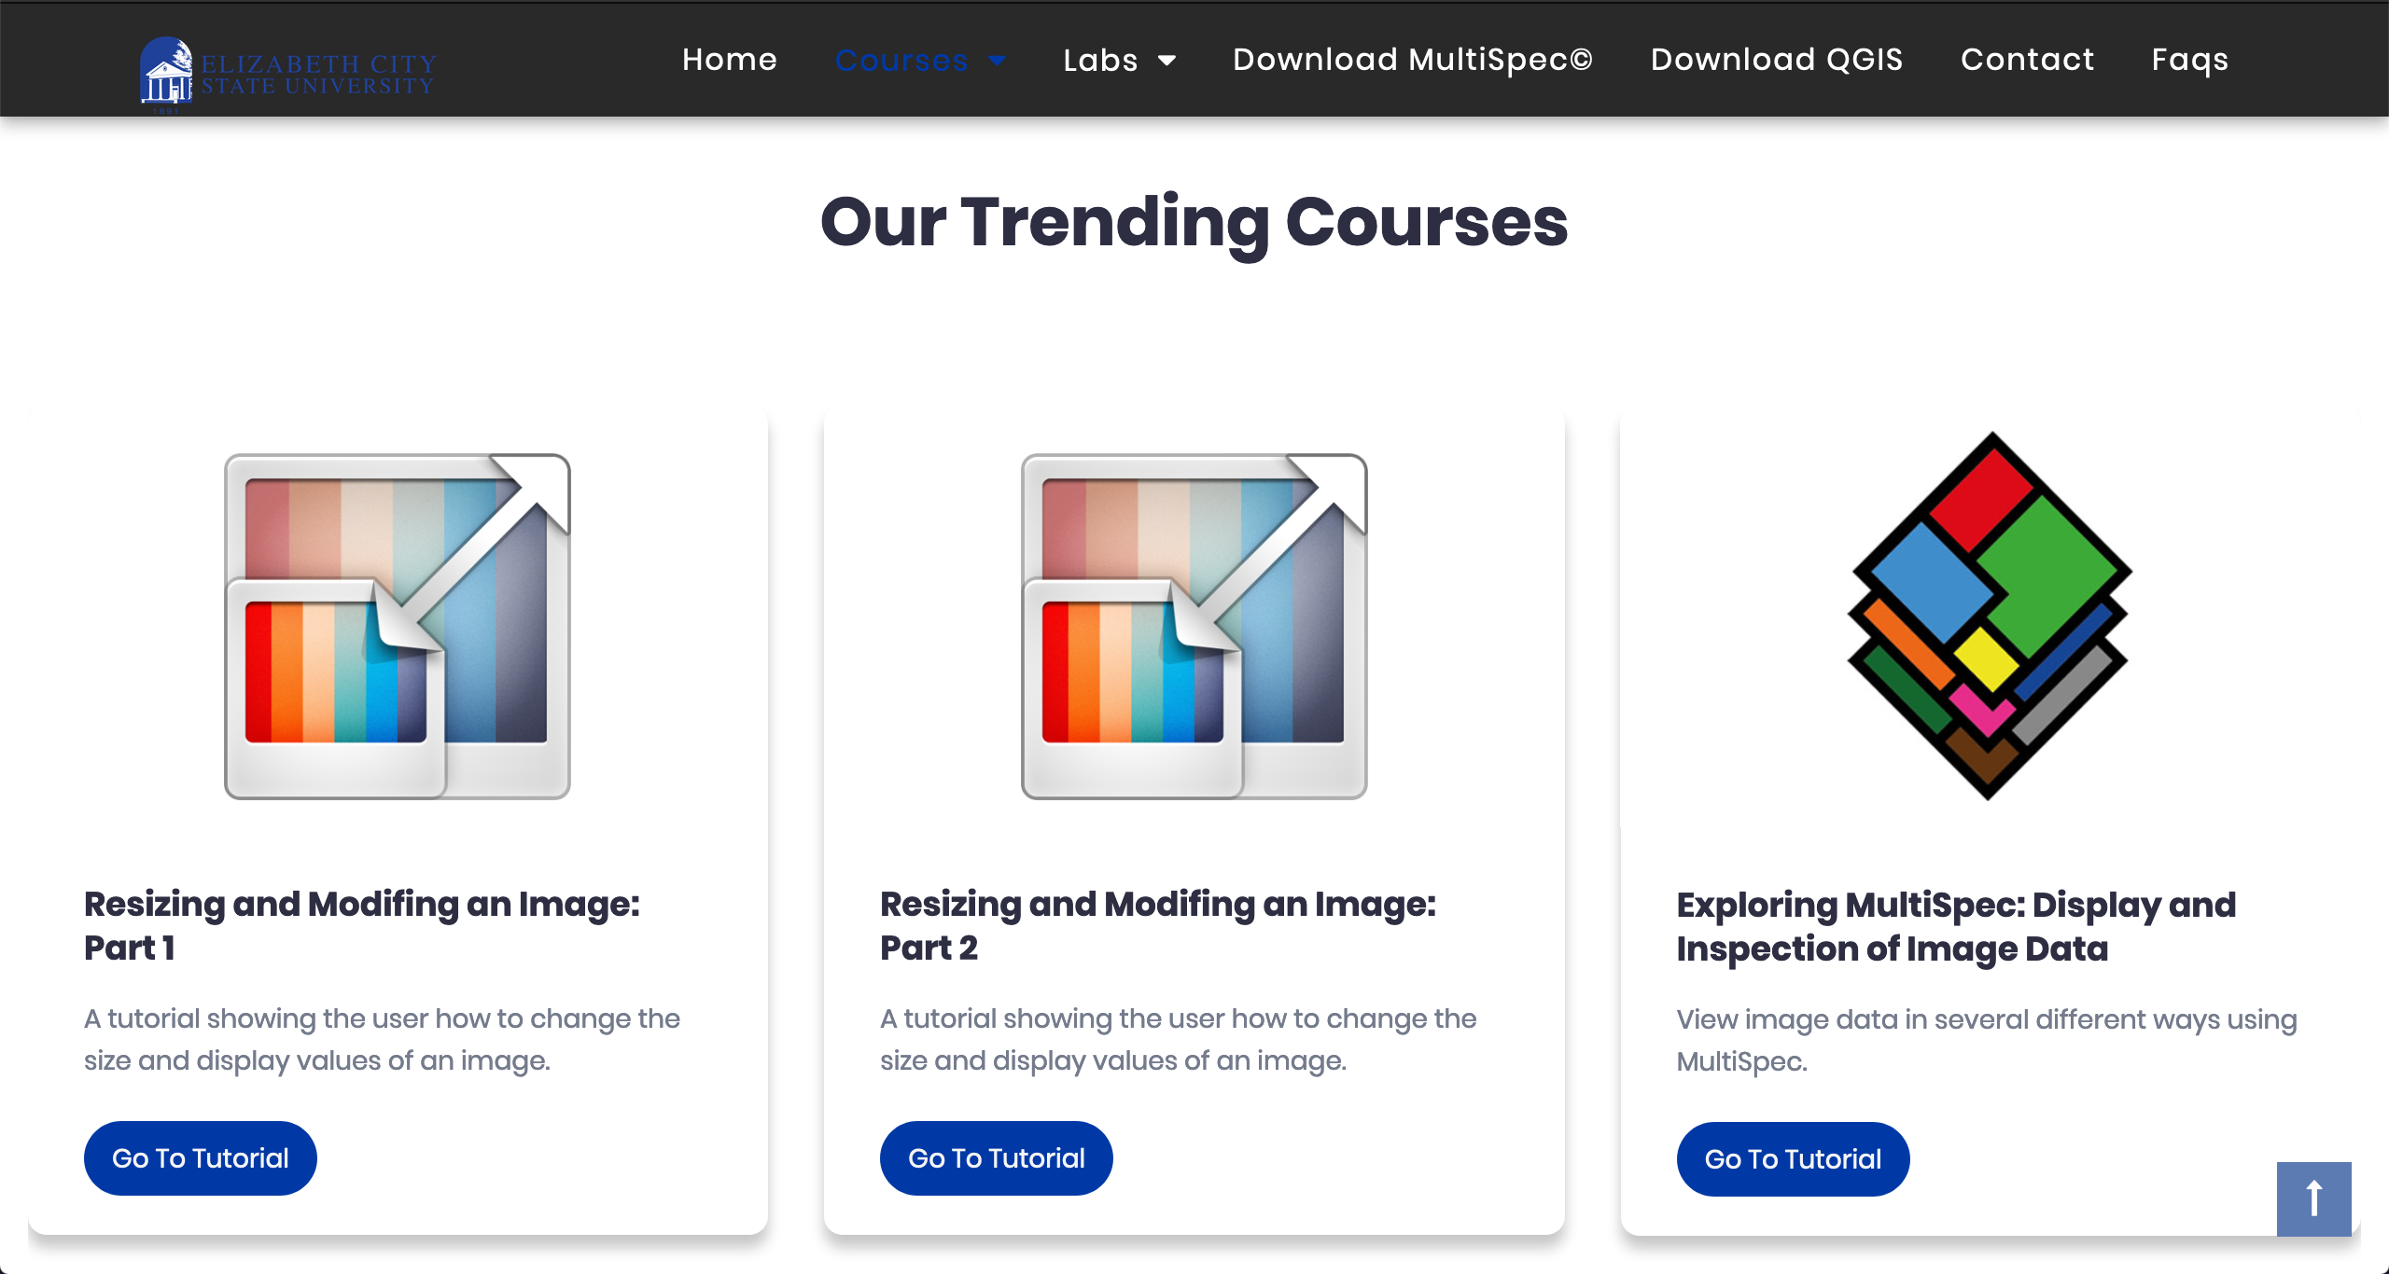
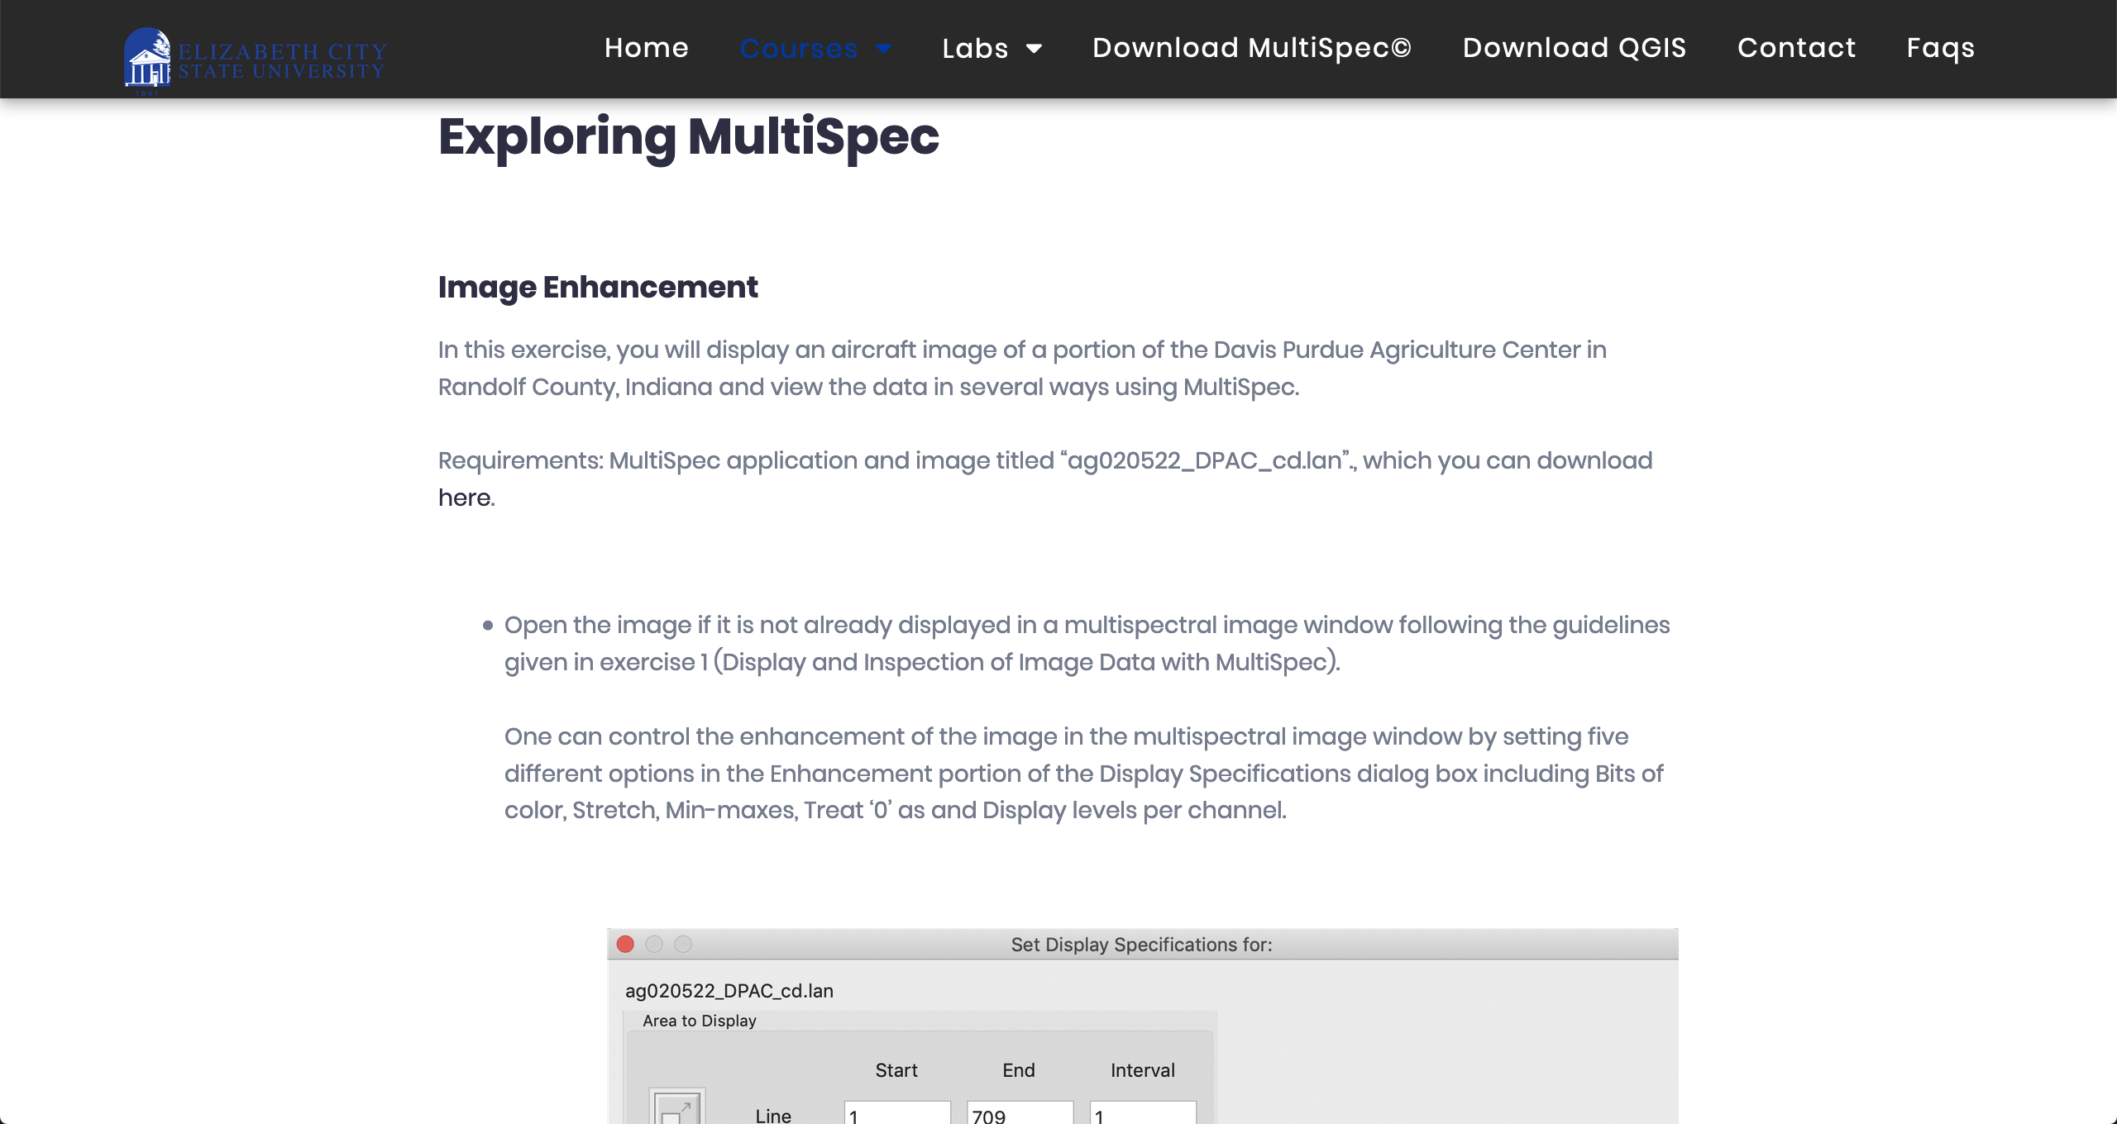
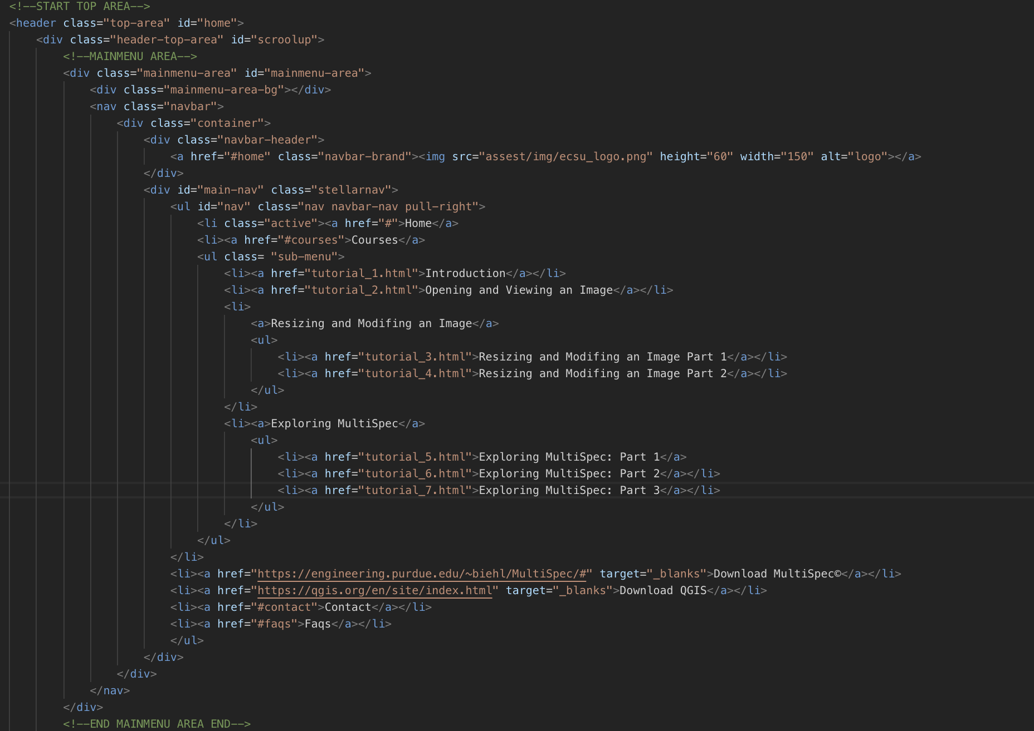
Developing an Educational Web Application for Student Training in Geographical Information Systems (GIS)
Derek Morris Jr. , Edsel Norwood , Disaiah Bennett
What is GIS?
Who uses GIS tools?
Source Code
GIS manages and analyze data, and can determine patterns, relationships, and situation that help users make intellectual decisions. GIS enhance the way people modify and approach geographic information such as maps. People been using GIS maps for numerous of years. GIS maps helps users exploit their work and organization on the internet. Maps gives a basic setting since they are both creative and analytical. They sustain a general appearance, coherence, and structure to the world. Maps enable you to explore your information and to uncover and clarify patterns. “GIS allows students to collect and visualize authoritative data about the question of interest, adding their own data to the map before performing a wide range of analyses on the data in question.”
Geographical Imagery Systems (GIS) are used in hundreds of ways in today's world. Schools across the world use GIS in ways that enhance the learning environment, such as creating interactive maps that help students better understand subjects as math, environmental science, and history.
The code featured in figure 1 is contained in the style.css file. CSS is used to define styles within web pages, including design, layout and variations in display for different devices and screen sizes. Condensing all of these attribute settings into a single file helps keep everything organized.
Software
Figure 1
MultiSpec
Quantum Geographic Information System (QGIS)
Languages
Our Approach
Python 2.7
HTML
CSS
JavaScript
When a user uses the web GIS, it will allow the user to share data universally; in addition, GIS provide usage and access of their tools on smartphones and tablets. With the use of the web-based GIS tools, the already established education for individual classes are able to be provided for students in K-12. Preparing students for early college with the assistance of GIS, introduces the students to more STEM related areas of research, and provides a higher awareness of these subjects. The tools that have been applied have been shown to not only “enhance teacher awareness”, but also “allow them to best communicate and demonstrate geographical awareness and capabilities that even simple spatial analysis might bring about topics dealing with population, history, and other areas.
Figure 2 refers to the menu bar located at the top of the webpage. This contains the “Courses” tab which houses the links for each individual tutorial. It also contains links to download MultiSpec and QGIS, both of which are required for the tutorials.
Figure 2
What is our goal?
Conclusion
Create a user friendly interface for both teachers and students
Modernize the pre-existing tutorials to better fit today’s technology
Receive feedback from users once the platform is live
Create a user friendly interface for both teachers and students
Modernize the pre-existing tutorials to better fit today’s technology
Receive feedback from users once the platform is live

