Slide 1
Using Tensorflow to Detect Objects in an Image
Reginald Kelley, Thomas Johnson III, Edsel Norwood II, Taeyonn Reynolds

Slide 2
Abstract
The abundance of various types of satellite imagery has created a challenge with processing and analyzing data into useful information. In this project, we explored the development, implementation, and evaluation of a machine learning algorithm, specifically a neural network, to automate the detection of ships to track traffic in a desired port or region. We also used a graphical approach to computation using TensorFlow, which offers easy massive parallelization and deployment to the cloud. The final result is an algorithm, which is capable of receiving images from various sources of imagery at various resolutions and be able to identify the appropriate objects within the image.

Slide 3
Methodology
ShipsNet is a labeled training dataset consisting of image chips extracted from Planet satellite imagery. It contains hundreds of 80x80 pixel RGB image chips labeled with either a "ship" or "no-ship" classification. Machine learning models can be trained against this data to classify any given input chip into either one of these classes.
With an accurately trained model, this classification process can be extended to a full ship image dataset scene by using a sliding window technique. A 80x80 pixel window is moved across each pixel position in the image, extracted, and classified by the model. Neighboring window positions that are classified as "ship" are then clustered into a single detection. These detections are highlighted with a bounding box in a copy of the original ship scene.

Slide 4
Software
Languages
Python Version 3.5+
Libraries
Numpy Version 1.13.0+mkl
Pillow Version 4.1.1
Scipy Version 0.19.0
Tensorflow Version 1.2.0
Tflearn Version 0.3.1

Slide 5
What is Tensorflow?
TensorFlow is an open source software library for high performance numerical computation. Its flexible architecture allows easy deployment of computation across a variety of platforms. It comes with strong support for machine learning and deep learning, and the flexible numerical computation core is used across many other scientific domains.

Slide 6
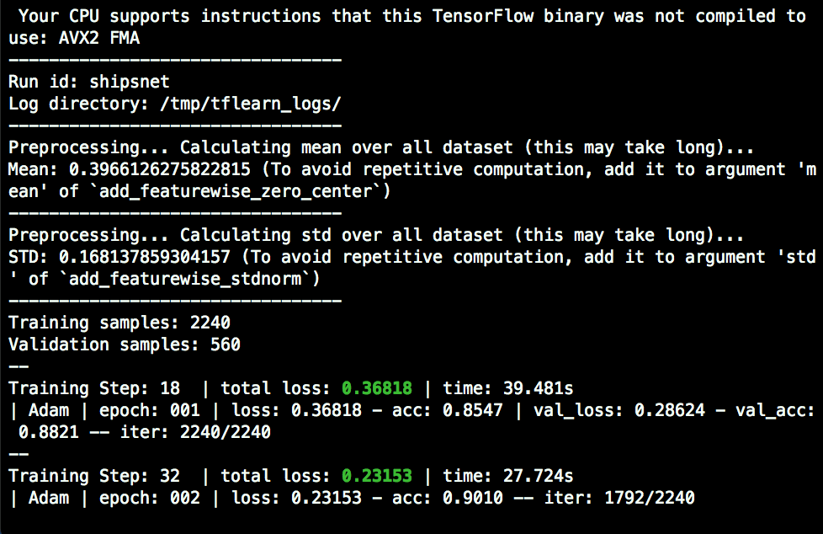
Training the Program
Before being able to efficiently identify objects in the provided images the program needs to be trained using a series of sample images on what it should be looking for. The command responsible for beginning this training is python3 train.py "shipsnet.json" "models/model.tfl". Training is done in separate sessions or “epochs”.

Slide 7
Processing the image
Once the training is done one can begin to detect objects in an image using the command python3 detector.py "models/model.tfl" "images/scene_1.png".

Slide 8
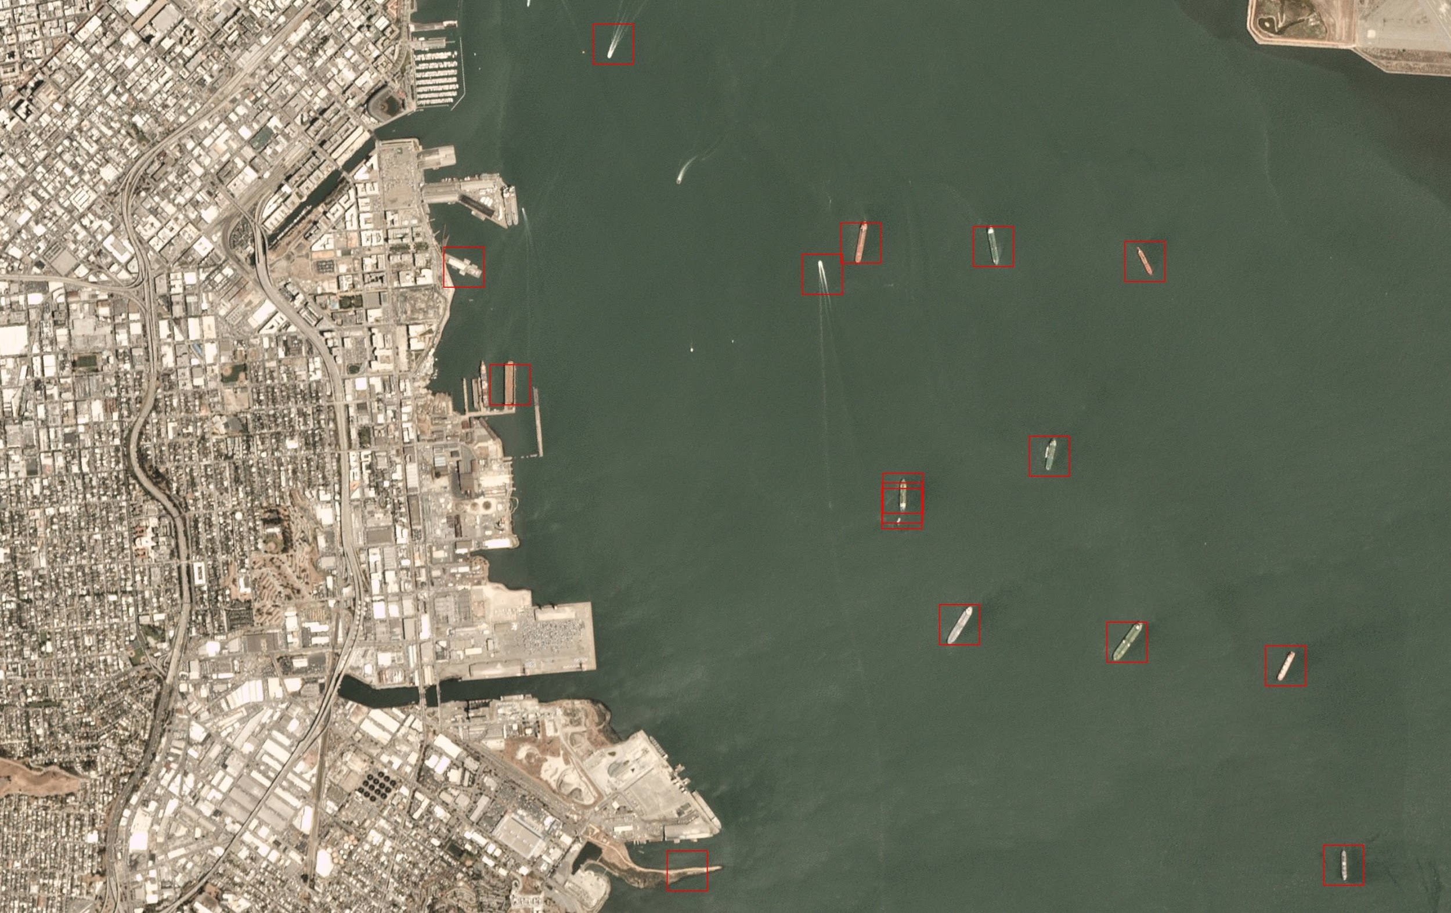
Results
The final result was an algorithm, which is capable of receiving images from various sources of imagery at various resolutions and able to accurately detect most of the ships within the image.

Slide 9
Conclusion
In conclusion the developed algorithm was not 100% adequate in the fact that the model had three mistakes. It missed one ship and classified two non-ship objects as ships. Although the algorithm had errors the Center of Excellence in Remote Sensing Education and Research (CERSER) program at Elizabeth City State University can benefit from the use of the algorithm. The algorithm can be modified and re-trained to detect any object the user wishes with the correct dataset.

Slide 10
Future Work
In the future one can improve the efficiency of the algorithm. Lessening the run time and making it easier for users to see results in a timely manner. Also modifying the code to be able to better indicate if an image displays a ship or not.
Altering the neural network model in its various details, such as the layers to see if there are significant shifts in the accuracy of the models developed in the training.

Slide 11
Acknowledgements
The team wishes to recognize :
Jerome Mitchell for his guidance, contributions, and help with completing this research.
Dr. Linda Hayden for the research opportunity that was made possible through the CERSER program.

Slide 12
References
TensorFlow, TensorFlow, 2018. [Online]. Available: https://www.tensorflow.org/. [Accessed: 22- Apr- 2018].
A. Karpathy, CS231n Convolutional Neural Networks for Visual Recognition, Cs231n.github.io, 2018. [Online]. Available: http://cs231n.github.io/convolutional-networks. [Accessed: 22- Apr-2018].
Burachonok, V. and Galkissa, M. (2018). Ships in Satellite Imagery | Kaggle. [online] Kaggle.com. Available at: https://www.kaggle.com/rhammell/ships-in- satellite-imagery/data [Accessed 23 Apr. 2018].
TensorFlow: Large-Scale Machine Learning on Heterogeneous Distributed Systems, 2018. [Online]. Available : https://arxiv.org/abs/1603.04467.[ Accessed: 22- Apr-2018].
TensorFlow: Biology’s Gateway to Deep Learning, 2018 . [Online]. Available: https://www.sciencedirect.com/science/article/pii/S2405471216000107. [Accessed 22- Apr-2018]

Slide 13
References Cont.
Abadi, M., Barham, P., Chen, J., Chen, Z., Davis, A., Dean, J., Devin, M., Ghemawat, S., Irving, G., Isard, M., Kudlur, M., Levenberg, J., Monga, R., Moore, S., Murray, D., Steiner, B., Tucker, P., Vasudevan, V., Warden, P., Wicke, M., Yu, Y. and Zheng, X. (2016). TensorFlow: A System for Large-Scale Machine Learning. USENIX Symposium on Operating Systems Design and Implementation, [online] 12, pp.264-283. Available at: https://www.usenix.org/conference/osdi16/technical-sessions/presentation/abadi [Accessed 24 Apr. 2018].

Slide 14
Questions?

