Slide 1
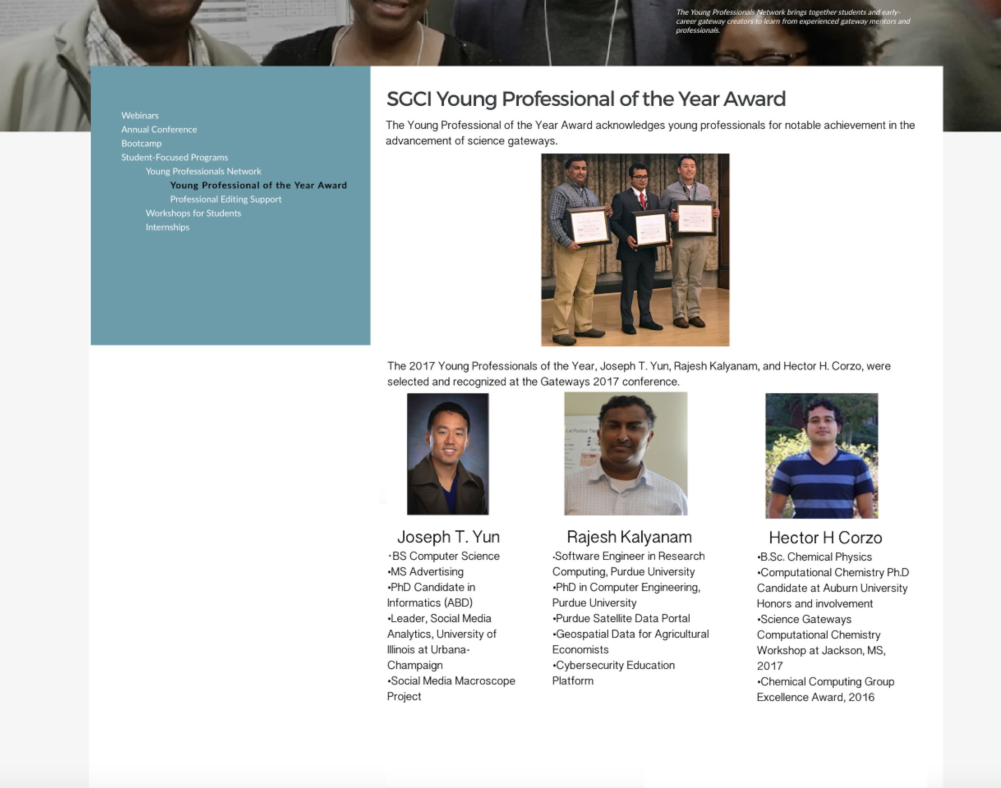
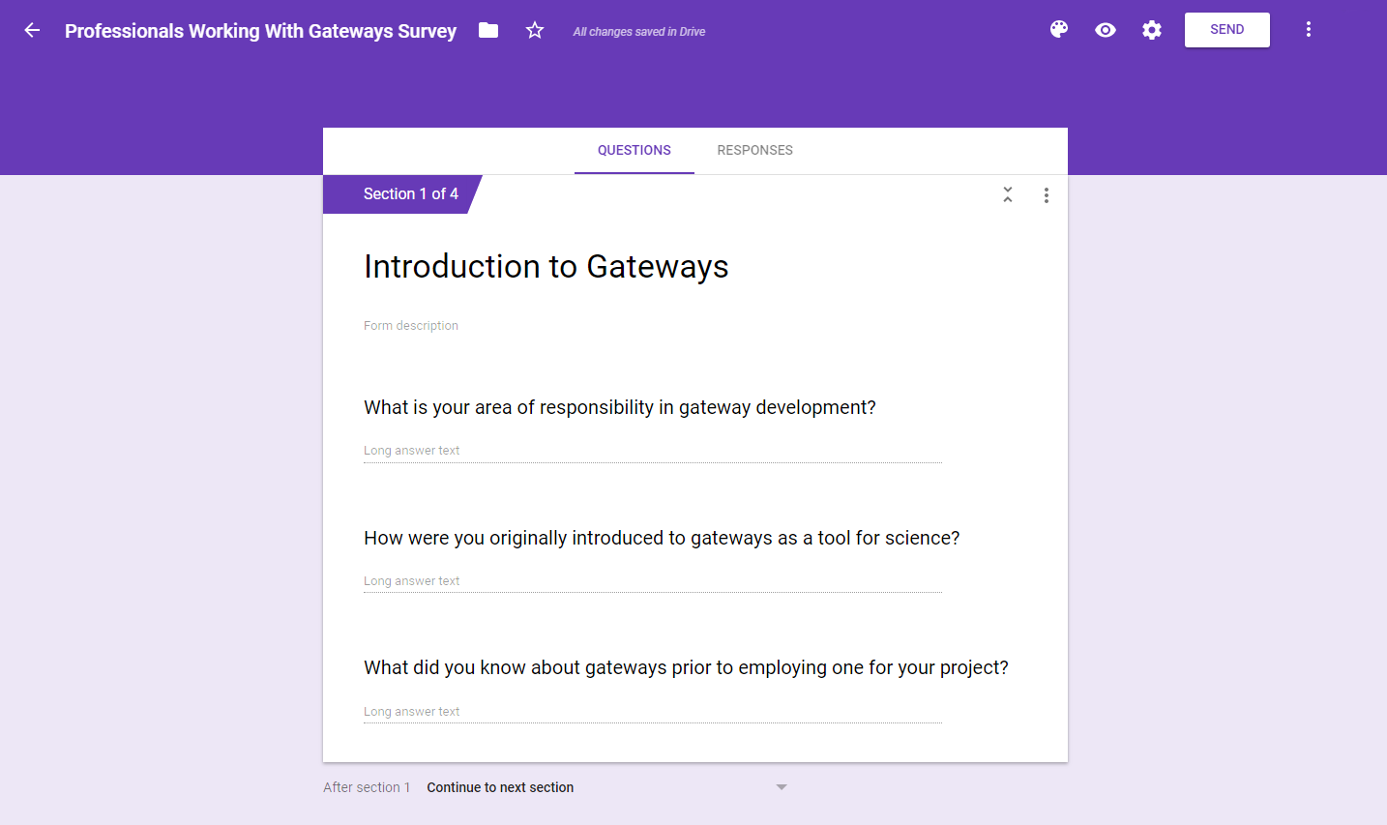
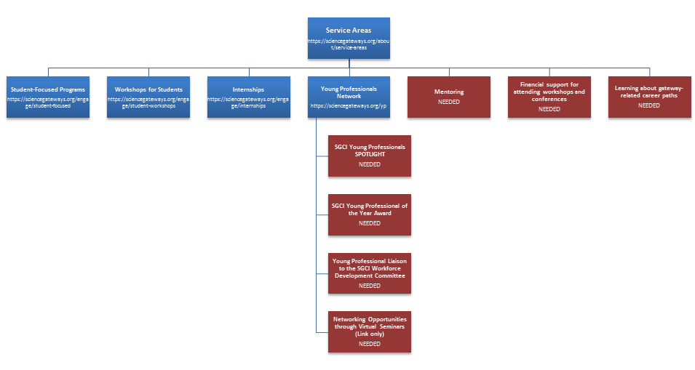
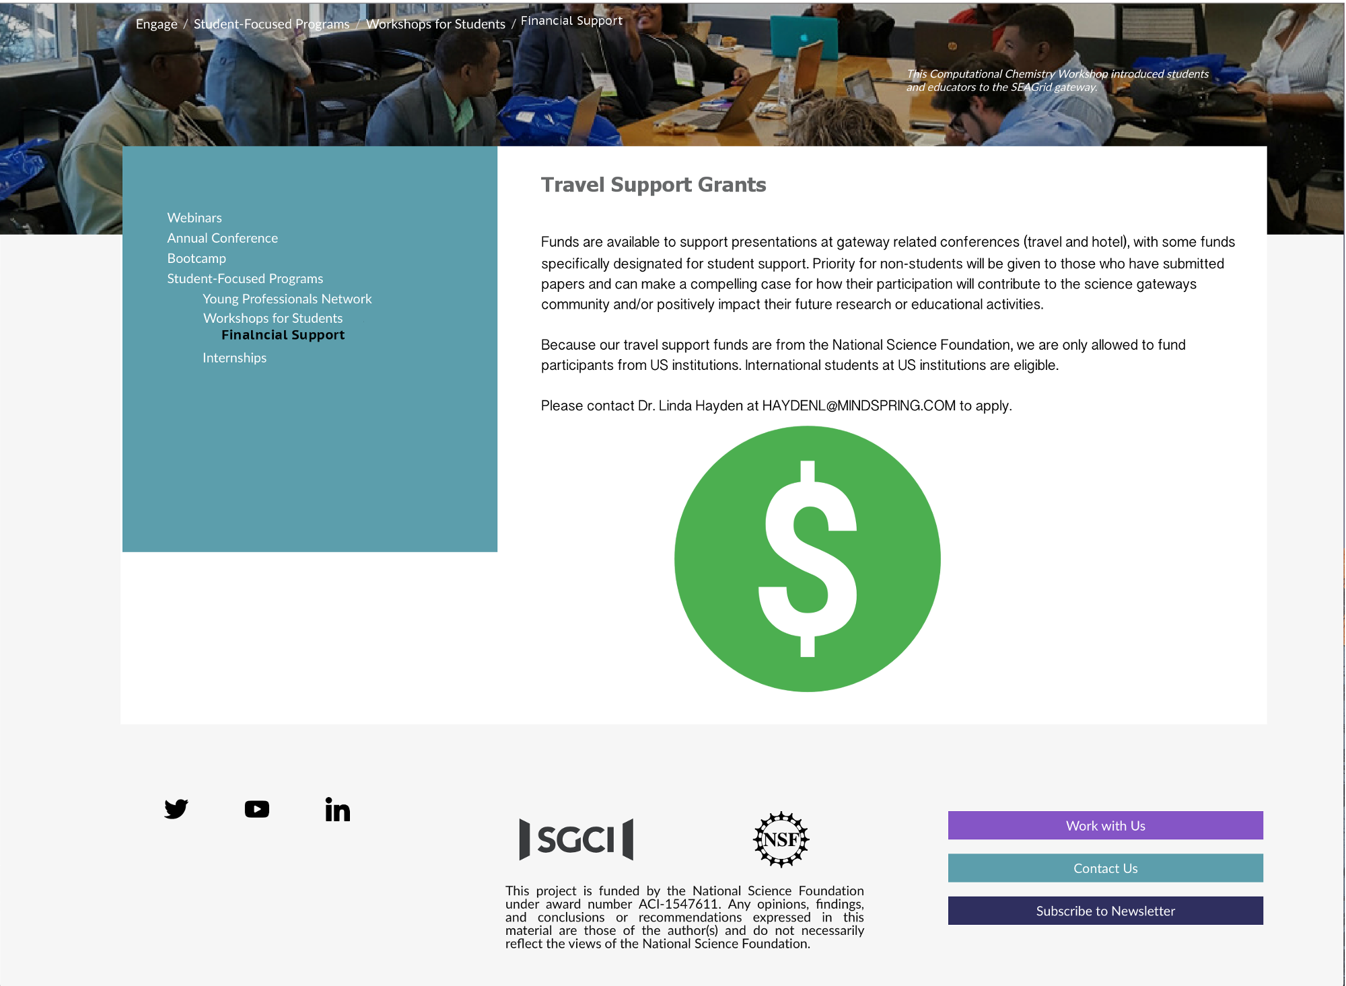
Establishing paradigms for modifying and developing the Workforce Development section of the new Science
Gateways Community Institute site
2017-2018 :: Alma Salisbury, Sincere Ponton, Hagen Hodgkins :: Mentor: Mr. Jeff Wood :: Dr. Linda B. Hayden, SGCI Workforce Development :: Center of Excellence in Remote Sensing Education
ABSTRACT |
METHODOLOGY |
Analysis |
The Center of Excellence in Remote Sensing Education and Research (CERSER) program on the campus of Elizabeth City State University is currently partnering with the Science Gateways Community Institute (SGCI) which is led by the San Diego Supercomputing Center (SDSC). SGCI is divided into five sections to support members of the gateway community: Incubator, Extended Developer Support, Scientific Software Collaborative, Community Engagement & Exchange, and Workforce Development. Dr. Linda Hayden, the CERSER Principal Investigator, leads the Workforce Development Section. The Workforce Development goals are to increase the development pipeline of science gateway young professionals and educators with an emphasis on increasing involvement of students from underrepresented groups.
As science today grows increasingly computer based, it poses challenges and opportunities for researchers. Scientists and engineers are turning to gateways to allow them to analyze, share, and understand large volumes of data more effectively. The existence of science and engineering gateways and the sophisticated cyberinfrastructure tools together can significantly improve the productivity of researchers. Most importantly, science gateways can give uniform access to the cyberinfrastructure that enables cutting-edge science.
The goal of the science gateways team was to increase the interactivity of the SGCI Workforce Development section of the SGCI web site to attract potential members and publicize needed information. SGCI had recently converted to the web platform Liferay from WordPress which necessitated the need to learn a new platform and its capabilities. The pages on the SGCI server were not able to be accessed during this project due to design and team coordination efforts. The proposed modifications for this project were completed utilizing HTML, CSS, and graphical modeling.
Introduction
This research sought to establish a paradigm by which the Workforce Development sections of the SGCI website could be updated. This site was designed and is currently maintained by the Texas Advanced Computing Center (TACC) personnel. Minor modifications have been completed by personnel at the University of Michigan up to this point, but Elizabeth City State University has lacked a method of performing updates and modifications.
Unfortunately, due to design requirements of SGCI standards and software limitations, the team was not able to fulfill this task. In place of this goal the team proposed to analyze the current site and create or modify pages as necessary for future teams to add to the SGCI site when site access becomes available. While content was available for several pages, the team was required to research new material and create a survey to gather further information.
Overview
The team analyzed the SGCI site seeking first to create a flowchart and storybook of site pages. The opening page of the site contained over 70 links making this course of action too involved to complete. The team then chose to focus on what pages and links were needed for the Workforce Development section only. The flowchart in Figure 1 below illustrates the pages that are currently part of the Workforce Development section of the website in blue and pages or links that are needed in red.
Young Professionals of the Year
The Young Professionals of the Year award was presented to three individuals at the 12th Gateway Computing Environments Conference sponsored by the Science Gateways Community Institute (SGCI) which took place at the University of Michigan in Ann Arbor, Michigan. One of the parts of this award is “...a website highlight.” This portion of the award has not been completed yet. The team took biographical information along with photos to create a model for the page to be created on. Figure 5 below illustrates a portion of that modeled page.
The primary goal of this project was to establish a method of updating the Workforce Development section of the SGCI site. While the team was not able to reach this goal, the groundwork was laid with the SGCI staff for beginning the steps to updating and creating content on the SGCI site.
Where coding was not applicable, content was gathered and arranged as a model for TACC developers. In this case, text and images would be supplied for a page to be developed as in the “Young Professionals of the Year award” page in the methodology section.
In other cases it would be feasible to develop the content utilizing HTML and CSS so that formatting could be completed on the Workforce Development side and handed off to the developers. Both of these cases involve having TACC or the University of Michigan update and create the Workforce Development pages.
CONCLUSION |
Modeling of pages under development is a basic tenet in website creation. Whether through coding or graphical methods, storyboarding is necessary to build a coherent site. The team project produced models and HTML files for future pages to be added to the SGCI site once a method of updating has been established.
The Mentoring/Internship Resource page was assembled utilizing HTML and CSS coding. Basic DIV tags replaced the use of a table formatting and allowed the use of previously CSS classes developed by the TACC developers. Sample CSS styles were substituted for SGCI classes in order to view the assembled code in a browser. This process worked well for this type of page which was formatted as a listing with embedded HTML links.
The Young Professional of the Year and Financial Support pages were developed using graphical models rather than HTML to capture the essence of what the page would look like once changes had been implemented. The Gateways Career Path Page was primarily built around a survey intended for current gateways developers.
Figure 6: Survey Sample
Figure 5: SGCI Young Professional of the Year model
Gateway Career Paths
“Learning about Gateway Career Paths” was a difficult topic to cover as there are no set educational paths to enter the Science Gateway development field. After discussion with SGCI personnel who have a great amount of experience in this field, it was determined that the team needed to collect information from those who have entered the field either through degree programs or through certification and ad hoc instruction for particular projects.
Given this need the team developed a large set of questions and reduced the number to 14. The survey questions were then implemented in a Google Docs survey form so that once a method of updating the site is developed, the form can be inserted and disseminated to a select group of individuals who are. A screenshot of the survey can be found above in Figure 6.
Financial Support
The Workforce Development service area supports individuals who present at conferences and attend workshops which contribute to the development of science gateways. The team developed a model for this page based on text supplied by Dr. Linda Hayden, the Workforce Development director. This model can be seen in Figure 7 below.
Figure 1: Workforce Development flowchart
FUTURE WORK |
There are several projects that can be implemented by future teams. The first is a simple link addition from the “Networking Opportunities through Virtual Seminars” bullet on the Young Professionals page. SGCI has initiated a monthly webinar that fulfills the original intent of this subsection. Another page to develop should be the “Young Professionals Spotlight.” This page would highlight young professionals involved in science gateway development and education.
The survey for the Science Gateways Career Path should be implemented on a targeted audience. Results should be compiled and disseminated to students and educators to aid them in focusing their education and training on gateway development. Developers must also identify images for use as header images for the Workforce Development web pages. The images can then be identified in the ECSU NIA photo library which contains images of SGCI conferences and workshops.
The highest priority will be continuing to work toward a working paradigm for updating the SGCI Workforce Development web pages. This may be in the form of supplying changes and new pages to a designer at TACC after a review by the SGCI staff or directly accessing the Workforce Development section of the site. Future coordination with SGCI will take place in the spring of 2018 and will involve not only the practical methods of updating, but ensuring that the updates are in line with the website direction.
Mentoring
When SGCI personnel were contacted regarding future interns and mentors, they requested that resources be gathered to assist new mentors and interns as to what they should expect and how to succeed. The Science Gateways Team gathered over 90 links to sites that sought to encourage and inform those involved with internships. This group was reduced to 17 intern resources and 8 mentor resources through elimination of pertinent information. Some were too specific to a certain career field while others contained information that was too general.
The resources were then documented by source name, source URL, and description with the information being entered into a table. Once this was complet- ed, the team chose an SGCI page similar in construction to the intern /mentor resource list. The page contained multiple Cascading Style Sheet classes used to format the various “DIV” and “a” tags. These classes were added to the HTML code so that the developed code could be dropped into the SGCI pages and be implemented immediately. A graphical model of the code is illustrated in Figure 2.
INTRODUCTION |
SGCI Workforce Development Site Enhancements
The CERSER program, in partnership with SGCI has collaborated to develop a website for the purposes of providing support services and information to those working on or with gateway projects.
The goal of the Workforce Development is to increase the pipeline of young professionals and educators working with gateways. To this end SGCI has converted from the web development platform WordPress to Liferay. This resulted in the need to train those working on web development to become familiar with the new system and its capabilities. Texas Academic Computing Center (TACC) is leading the website development and maintenance. Currently minor changes to the Workforce Development portion of the site are made through submissions to the University of Michigan.
The focus of the Science Gateways team, overseen by Dr. Hayden, was to establish a method of creating and modifying information on the SGCI Workforce Development site. The Science Gateways team attempted to obtain modification capabilities to the Workforce Development section of the website, but was unable to during this research period. In place of this, alterations to the SGCI Workforce Development section were suggested and designed by the Science Gateways team and were created using HTML, CSS, and graphical modeling.
References|
[1] Sciencegateways.org. (2018). Young Professionals Network - Science Gateways Community Institute (SGCI). [online] Available at: https://sciencegateways.org/yp [Accessed 23 Apr. 2018].
[2] Sciencegateways.org. (2018). Welcome - Science Gateways Community Institute (SGCI). [online] Available at: https://sciencegateways.org/gateways2018 [Accessed 23 Apr. 2018].
[3] Sciencegateways.org. (2018). Workshops for Students - Science Gateways Community Institute (SGCI). [online] Available at: https://sciencegateways.org/engage/student-workshops [Accessed 23 Apr. 2018].
[4] Anon, (2018). [online] Available at: https://sciencegateways.org/engage/student-workshopshttps://sciencegateways.org/engage/internships [Accessed 23 Apr. 2018].
[5] Web.csulb.edu. (2018). [online] Available at: http://web.csulb.edu/committees/webcomm/hannonhill/Hannon_Hill_Content_Management_White_Paper.pdf [Accessed 23 Apr. 2018].
[6] Anon, (2018). [online] Available at: https://www.quora.com/What-is-Liferay [Accessed 23 Apr. 2018].
[7] Evontech.com. (2018). What is Liferay?. [online] Available at: http://www.evontech.com/what-we-are-saying/entry/what-is-liferay.html [Accessed 23 Apr. 2018].
[8] W3.org. (2018). Cascading Style Sheets, level 1. [online] Available at: https://www.w3.org/TR/1999/REC-CSS1-19990111 [Accessed 23 Apr. 2018].
Figure 7: Financial Support model
ACKNOWLEDGEMENTS |
Figure 2
We would like to thank Dr. Linda B. Hayden for her support during this project and the Science Gateway Community Institute for funding of this project.
Notes:
background color: rgb(74,134,232) -> cornflower blue
powerpoint: #4A86E8
complementary color:
White: rgb(255,255,255)
#FFFFFF

