Slide 1
Use of Python Scripts to Compare and Contrast Photo Images
Team members: Disaiah Bennet and Kevin Benton Jr
Mentor: Derek Morris Jr, Joel Santiago

Slide 2
Abstract
In python there is an ability to write python scripts for a variety of projects. For this project the python script was written to perform an image comparison. This was done with various libraries that are included in the python language. These libraries include Image, OpenCV, and etc. Thus, when importing these the program would ask the user for two images and the size for the images the program would display the pixel values for the images as well as display an image were if the pixels of the two images matched the image would be "black out" for that section. The team later found out that to compare the images the team needed to resize the two images as well as that to have the program run on different computer the necessary libraries needed to be on the new computer. Therefore, in the future the team decided that the program would need to be more robust and efficient.

Slide 3
Introduction
Libraries
PIL
OpenCV
Numpy

Slide 4
Methodology
Research For the Program
How to image process
Best ways to image process
What needed to be done to the images
Libraries needed for the program

Slide 5
Results
The image comparison process
Ask the user for the image name, extension, and size
Prints the pixel values for both images in descending order
Displays an image that "black out " zones of the image where the pixels of the image were the same

Slide 6
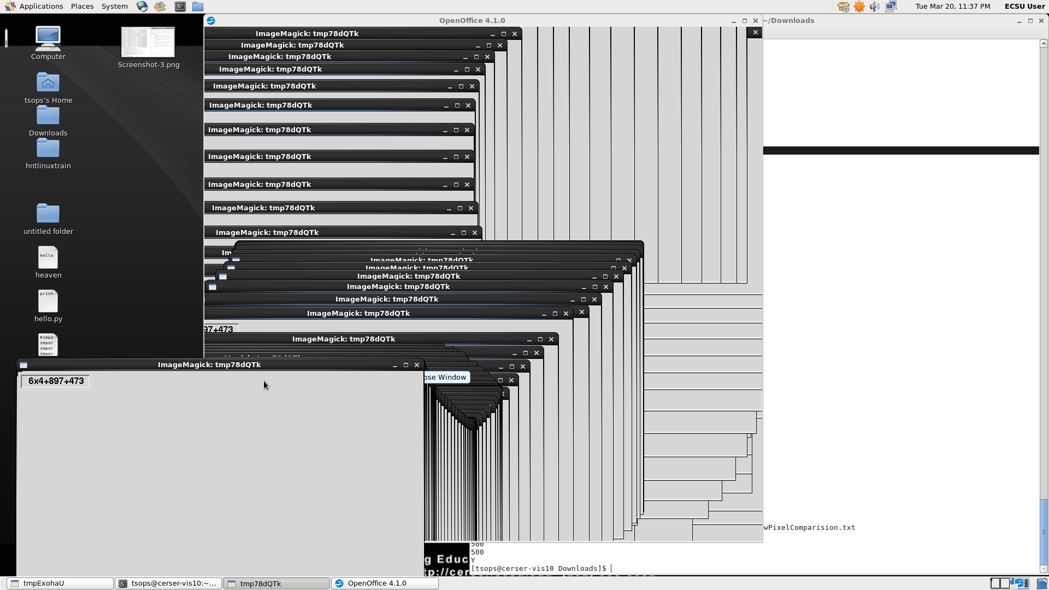
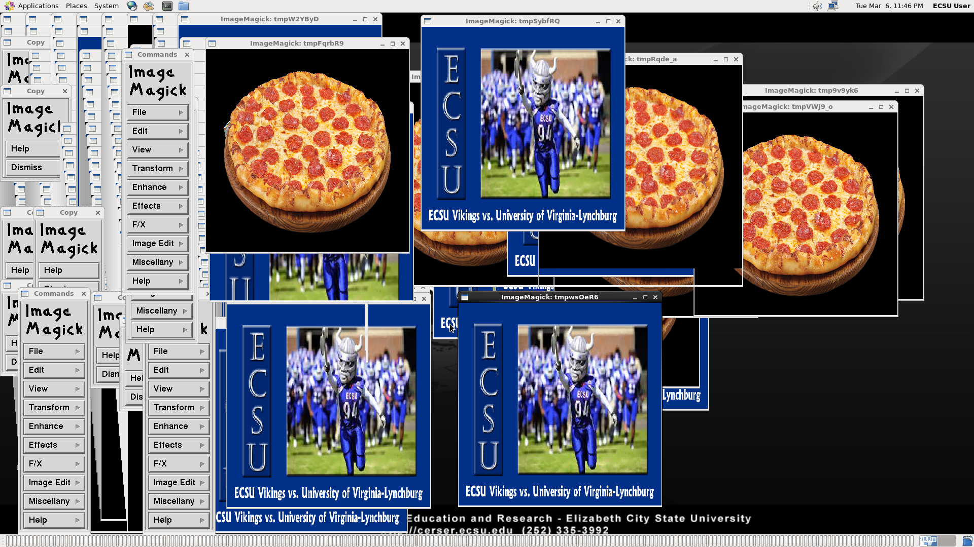
Results (Cont.)
Issues:
Infinite Loop
Ram limitations
Library Dependencies

Slide 7
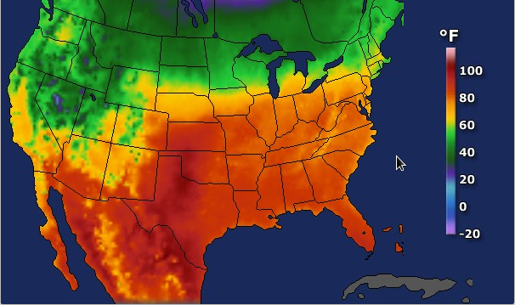
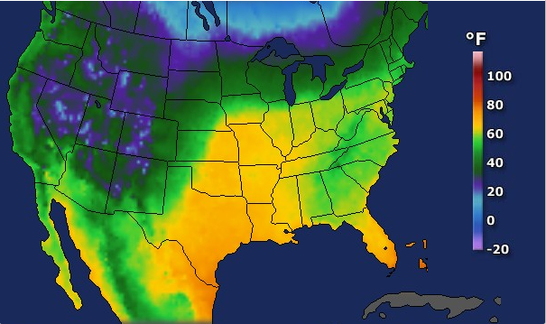
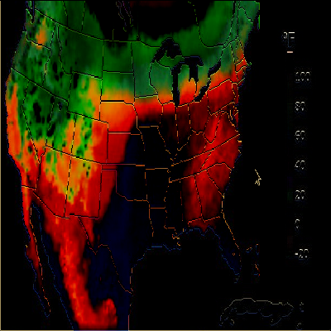
Results (Cont.)

Slide 8
Conclusion
Image re-sizing
The program will need to be re-written for different computers running different operating systems

Slide 9
Future Works
Multiple Images at once
More efficiency
Python Dependency Libraries
Incorporate more computing programs

Slide 10
Acknowledgements
We would like to thank Dr. Linda B. Hayden for her support during this project. The team would also like to thank Derek Morris, for his assistance and his guidance with the research and execution of the project.

Slide 11
References
[1]"What is Python? Executive Summary.", Python.org, (2018). [online] Available: https://www.python.org/doc/essays/blurb/.
[2]"EXTRACTING PIXEL VALUES OF AN IMAGE IN PYTHON - Akshay Pai", HackerEarth, 2018. [Online]. Available: https://www.hackerearth.com/practice/notes/extracting-pixel-values-of-an-image-in-python/.
[3]"NumPy — NumPy", Numpy.org, 2018. [Online]. Available: http://www.numpy.org.
[4]"OpenCV library", Opencv.org, 2018. [Online]. Available: https://opencv.org.
[5]"scikit-learn: machine learning in Python — scikit-learn 0.19.1 documentation", Scikit-learn.org, 2018. [Online]. Available: http://scikit-learn.org/stable/.

