Slide 1
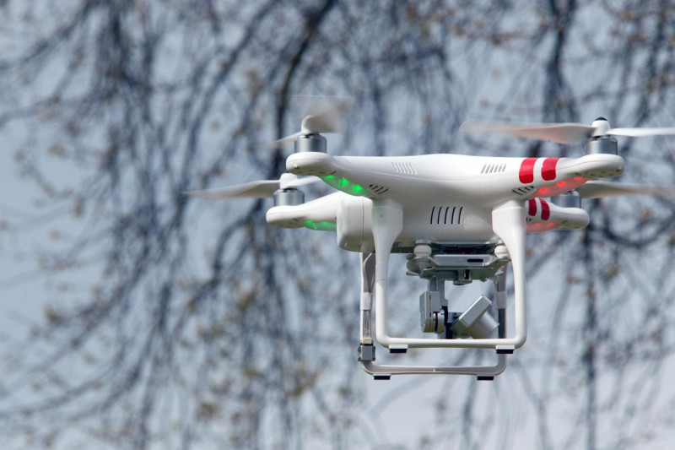
Measuring Shoreline Loss: Salmon Creek Case Study
Derek Morris Jr
Austin Ivins
Reggie Kelley
Clay Swindell (mentor)

Slide 2
Abstract
The effects of sea-level rise are measurable in historic maps and modern aerial imagery. Today, scientists are actively studying these changes along the shoreline of North Carolina
through a variety of multidisciplinary approaches. New technologies such as Unmanned Aerial Systems (U.A.S) are helping provide researchers with a cost effective and site specific platform for collecting remotely sensed data. In the past, multispectral imagery was acquired through expensive satellite and aerial platforms. Today, this data can be obtained through the use of small inexpensive drones equipped with imaging systems that provide current detailed data sets for very specific locations.

Slide 3
Abstract Cont.
The goal of this project is to identify how much of the shoreline along Salmon Creek in Bertie County, NC has eroded away over the last several hundred years. It is hoped that this information will help better understand what it may have looked like in the late 1500’s when English explorers first mapped the area. To measure changes since the 16th century we first analyzed the earliest known depiction of the creek made when English explorers intending to settle the region mapped the area. The map produced from these expeditions is both surprisingly accurate and detailed in its representation of the creek. This is made more obvious when it is directly compared with modern 20th century satellite imagery.

Slide 4
Abstract Cont.
To further assess changes since the 16th century, the project turned to the existing expertise at the Center of Excellence in Remote Sensing Education and Research (CERSER) in acquiring and analyzing imagery with U.A.S. CERSER researchers use these exciting new technologies on a variety of problems from creating 3D elevation and model datasets, to detailed analysis of photo-mosaic imagery to locate archaeological sites.
The results of this project demonstrate how dramatic changes to the 16th century shoreline of Salmon Creek is and show that once exposed to a significant rise in sea level, shoreline migration and impacts are permanent.
Finally, it is hoped that this project will further aid in the creation of specialized technologies and methodologies for future studies of shoreline loss at CERSER.

Slide 5
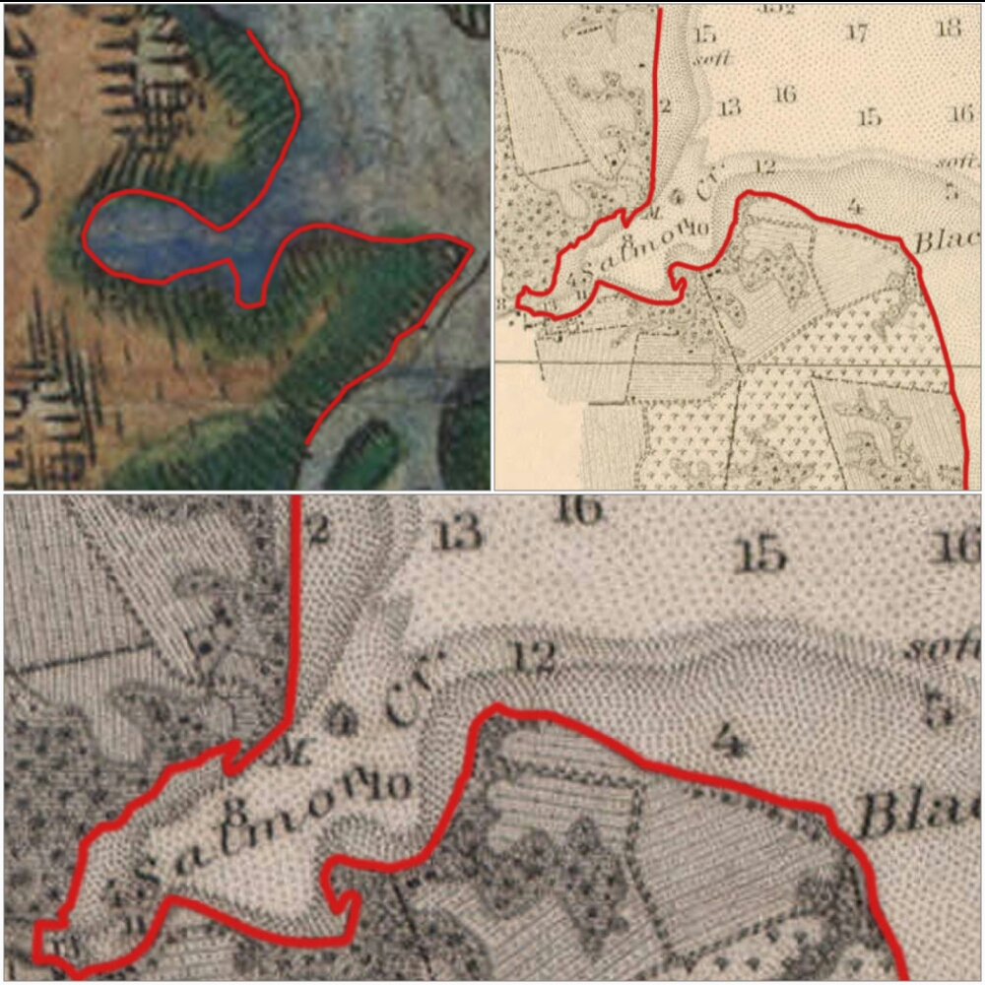
Objective
The goal of this research was to use UASs combined with historic maps and satellite imagery to measure the effects of sea level rise along the coastline of Salmon Creek in Bertie County, North Carolina. To achieve these objectives, The project made use of an UAS platform equipped with a visible light camera to produce a series of images that were uploaded directly to the team's cell phone.

Slide 6
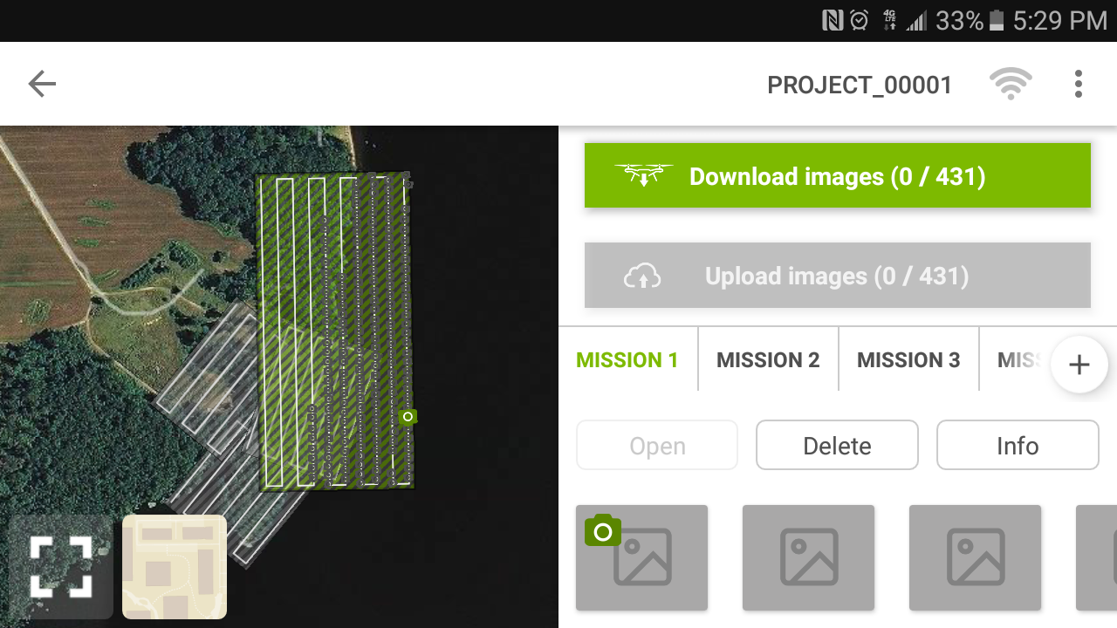
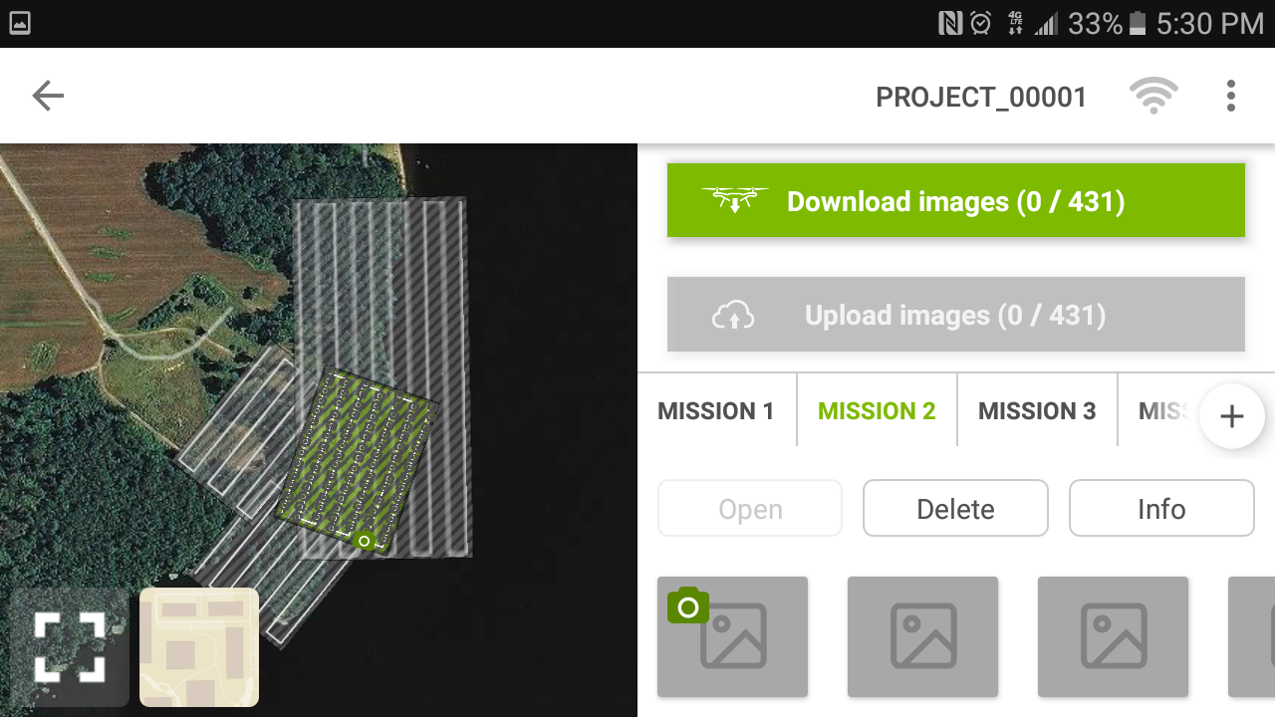
Developing a Flight Plan
Pix4d Android application was utilized on a Samsung J7
The parameters for the flights taken were 125 x 89 meters
A total of four aerial image flights were taken and There were 185 pictures taking during the four on-site flights.
Notes:
This overlap is necessary for the creation of the larger mosaic.
with the longest flight time recording at 12 minutes.
which is large enough to cover the area of interest .
for the creation of creating three flight plans.

Slide 7
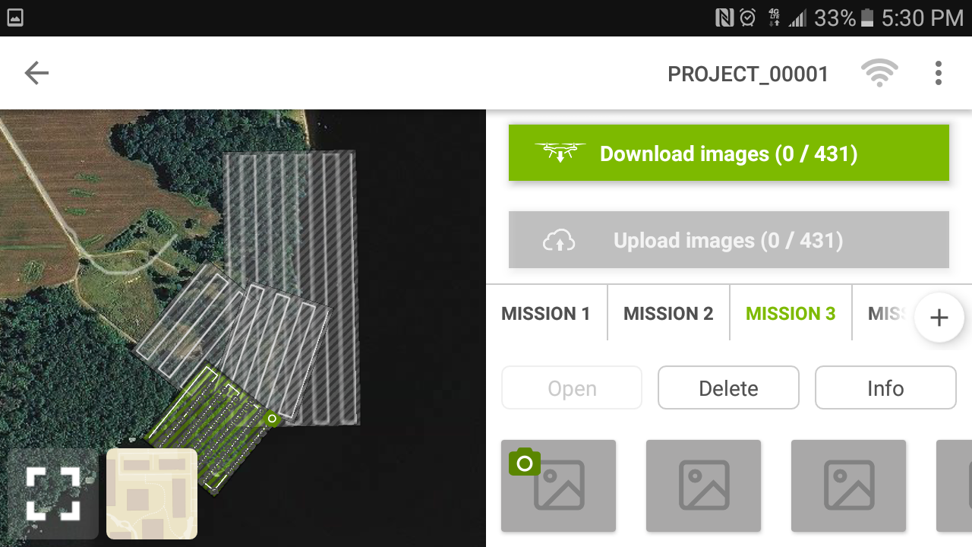
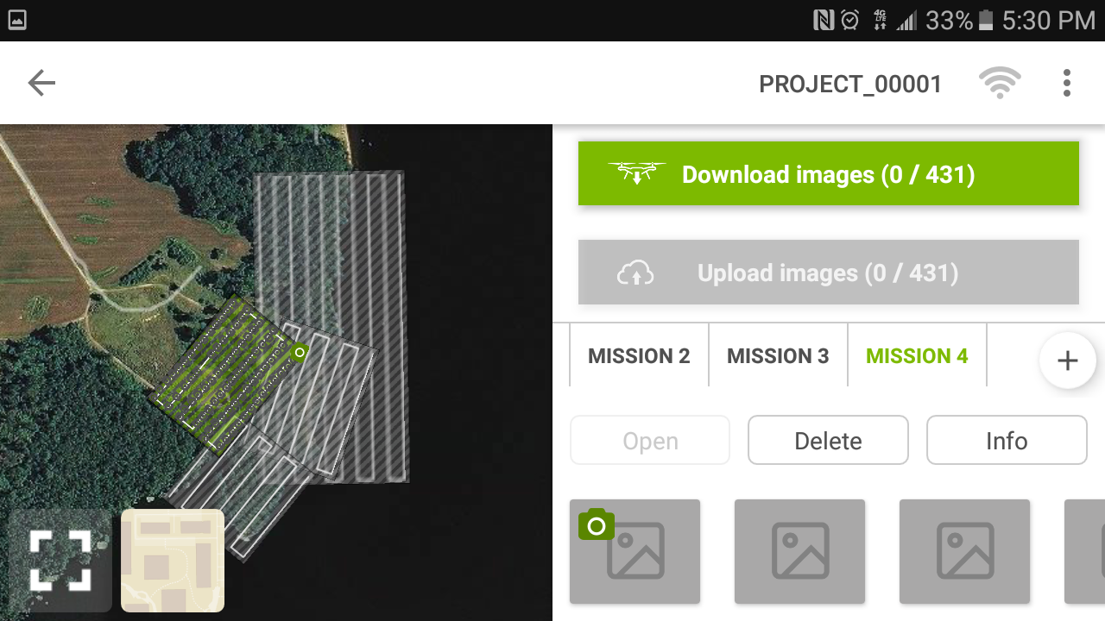
Flight plan cont.
Despite the U.A.S ability to fly missions on its own, it is still necessary to plot the linear transects prior to flight.
The team chose a location free of obstructions for take-off and oriented the transect grid over the AOI.
In addition to launching the flight from the area, the altitude of the flight was 50 meters to ensure no objects would be a threat to the flight plan.
Notes:
It is also important to plot out the mission onsite as obstacles such as trees and power lines pose a threat to successful flight operation.
There was a respectable location for the DJI Phantom 2 to take off and be clear of obstructions.

Slide 8
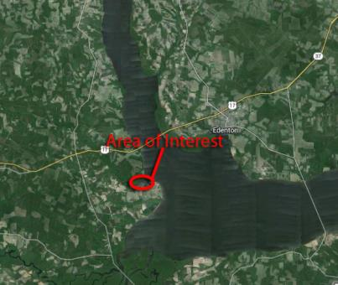
Area of Interest
Salmon Creek is Located at the western end of the albemarle sound near the merging of the Chowan & Roanoke Rivers.
It is located in the eastern portion of Bertie County, near Avoca Inc.

Slide 9
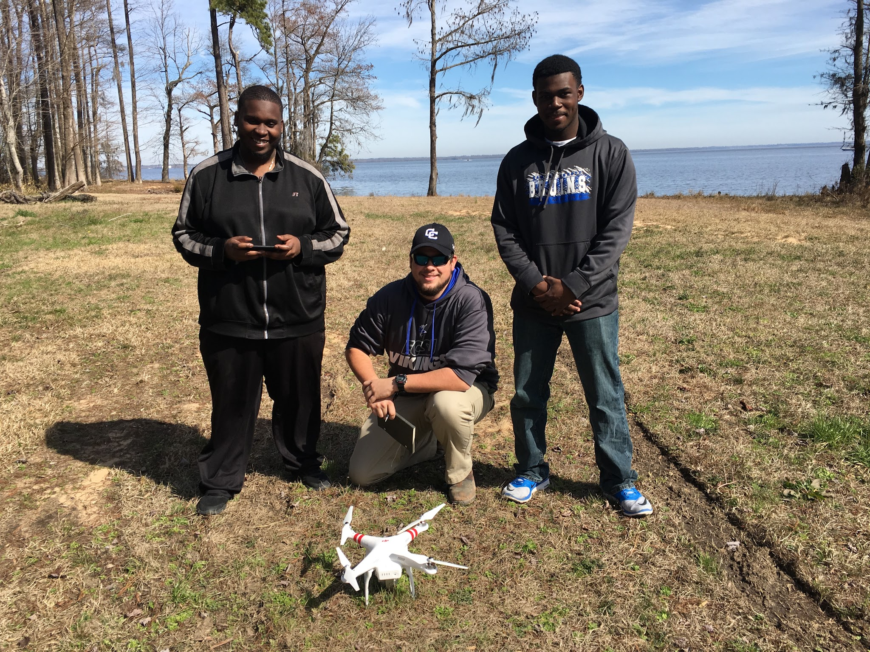
Equipment
DJI Phantom 2 Drone
built-in Naza-M V2 Flight Control System for Autonomous flight
integrated gimbal and 14 mp camera
Internal GPS and barometric Altimeter
Flight Time is approximately 25 minutes

Slide 10
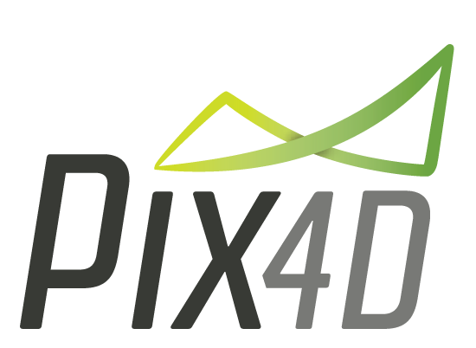
Software
Can process Multispectral Images
Build 3d Point Cloud from 2d Imagery
Can be Costly for full version but Alternative Pricing such as Educational License and free sample sessions are available
Mobile Application allows for flight planning

Slide 11
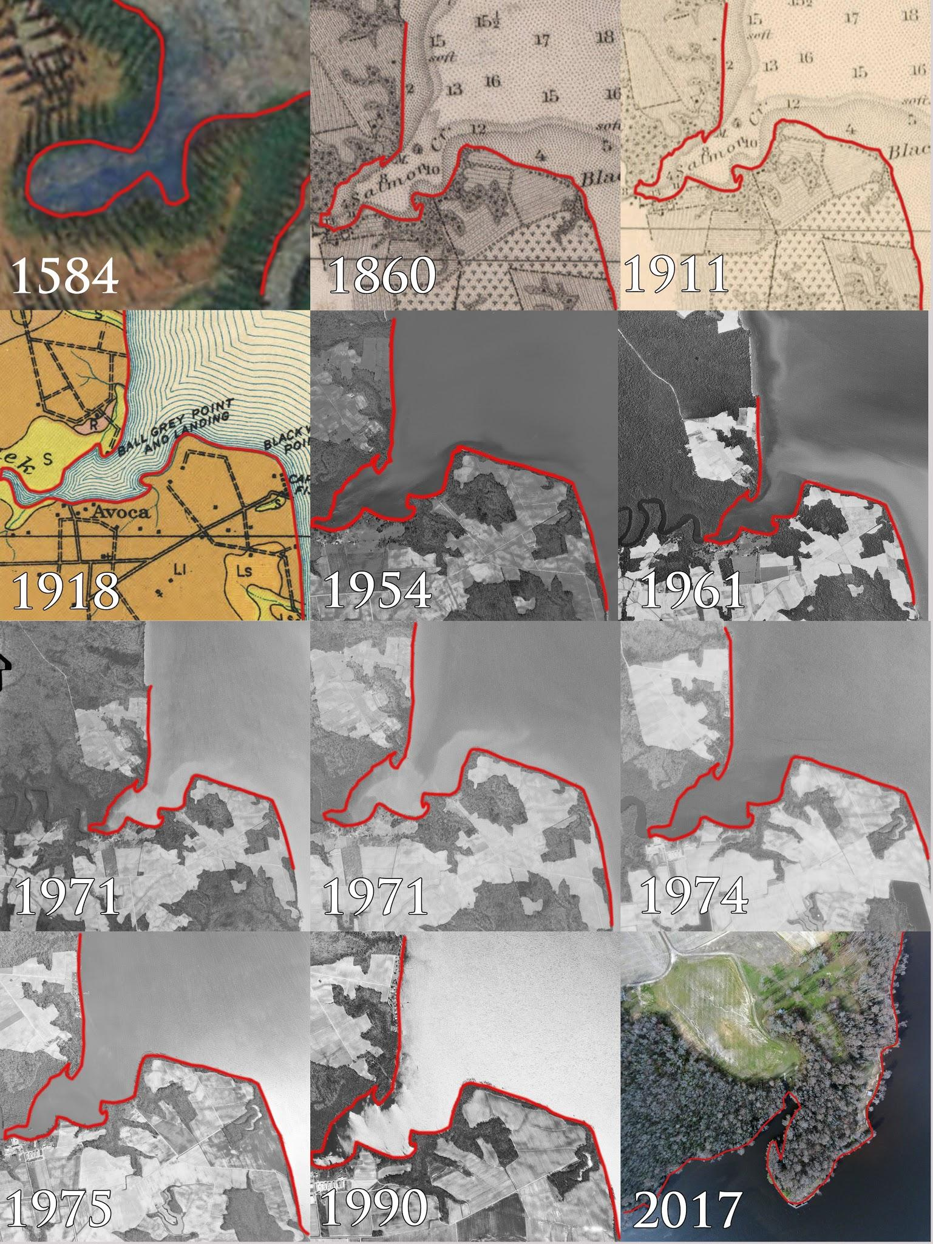
Results
Differences in the mappings of salmon creek from 1584 Compared to the current images generated from aerial photography and landsat satellite imagery.
we had to compare the sketches to modern images, which proved to be fairly accurate for the time period.
We were able to outline the shoreline from the various years using photoshop.
The outline of the shoreline shows how significant the erosion over the years has been.
Notes:
which were based on the most advanced technology of the time.
selected which highlighted significant changes in the shoreline making the overall analysis definable and measurable.

Slide 13
Conclusion
We were able to show a significant change in the shoreline from the 1580’s to current images, using both UAS and aerial photography technology.
We tested, developed, and acquired the needed technology to complete the task.
171 images were captured and stitched together to compare and contrast with the aerial photography and satellite imagery.
The CERSER program at Elizabeth City State University can benefit from this research by applying:
U.A.S. technology
methodology produced from this research to aid further remote sensing research.
Notes:
to make use of the images taken through the U.A.V. platform, aerial photography and satellite imagery to combine them to identify changes in the shoreline.
By evaluating the Salmon Creek site in Bertie County, North Carolina with the DJI Phantom 2 Vision+,

Slide 14
Future Work
From the years 1975 to the early 1990’s there is a gap in aerial photography, it is unknown why there was a lack of data in these years. With further research we believe we could uncover the reason and possibly acquire that imagery.
Acquire more advanced drone technology with a multispectral camera in order to take near infrared images which would allow the team to conduct more research into the reasons why the shore has eroded in the way it has by capturing vegetation information with a vegetation index.

Slide 15
Acknowledgment
The team wishes to recognize :
Clay Swindell for his guidance, contributions, and help with completing this research. D
Dr. Linda Hayden for the research opportunity that was made possible through the CERSER program.

Slide 16
Reference
1) Phantom 2 Vision+ User Manual, V1.6, DJI Co., Los Angeles, CA, 2016, pp. 5-12.
2) Digital globe, USDA Farm Service Agency Map Data (2016). Google Maps [Online]. Available: https://www.google.com/maps
3) Pix4D Co. (2016). Pix4D: simply powerful [Online]. Available: https://pix4d.com/
4) Matthew R. Laird, Ph.D, and Anthony W. Smith, M.A. ARCHAEOLOGICAL TESTING ASSOCIATED WITH A DRAINAGE INSTALLATION PROJECT AT Salmon Creek CHURCH (046-0024/44IW0271) ISLE OF WIGHT COUNTY, VIRGINIA. Williamsburg, VA: James River Institute for Archaeology, Inc., 2012. Print.
5) Swindell, E. et al. Remote Sensing Archaeological Sites Through Unmanned Aerial Vehicle (U.A.V.) Imaging. Elizabeth City, NC: Center of Excellence in Remote Sensing Education and Research, 2015. Print.

Slide 17
Questions?

