Slide 1
TeraScan Team 2017
Tori Wilbon, Kevin Benton, Ademola Adedeji, Hagen Hodgkins
Mentor: Andrew Brumfield

Slide 2
Abstract
According to the State Climate Office of North Carolina, since 2007 the northern coastal plain of North Carolina has been experiencing a long-term summer drought. The team’s objective was to analyze how long-term drought in summer months’ affected vegetation and land surface temperature in the Pasquotank, Perquimans, Camden and Gates county areas. The team collected imagery data through the SeaSpace TeraScan system in order to produce land surface temperature (LST) and normalized difference vegetation index (NDVI) products. The data products were averaged into monthly and yearly composites so that the team could use TeraVision to depict the differences of values for the products.
Notes:
KEVIN

Slide 3
Introduction
Analyze how long-term drought in summer months’ affected vegetation and land surface temperature in the Pasquotank, Perquimans, Camden and Gates county areas.
Teravision
Polar Orbit
TeraScan Rapid Environmental Extreme (TREX)
Teravault
Uninterruptible Power Source (UPS) Assy
Notes:
Kevin

Slide 4
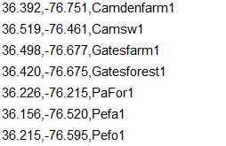
Defining our search area
Selection of the area of interest
Survey and collection of data points
Compilation of the data points into point files
Reformat of the point files to work with TeraVision and analysis
Combination of the point files into a singular file
Point file example here
Point file representing some Northeastern NC counties and Biomes
Notes:
DEMOLA: The previous research team selected several counties in Northeastern North Carolina to serve as the area of interest. Specifically, Perquimans, Pasquotank, Camden and Gates counties. The locations selected hosted a variety of biomes, such as grasslands, farmlands, swamps and forest. Several points for representing each biome were selected within each of these counties. The team then went on to put the locations of these point into point files. In order for this data to be useful to our team however, we needed to reformat the coordinates and names of the point files.
The point files contain the points of interest for this project. The files were stored on the “T-rex”. To correct point files the team copied the coordinates located in the .txt files provided from the previous team to a .csv file type. making sure to format the coordinates and name of each location as coordinates first and name of the location. These point files were then combined in order to ease the process of using it to evaluate the passes collected.

Slide 5
Initial restoration test runs
First 5 days of september 2016
Tested to give us an familiarity with the restoration process
46 passes in all were restored
11 passes yielded both LST and NDVI data
1 pass yielded NDVI data but not LST data
Successfully restored passes suffered from lack of AOI coverage or disruptive weather conditions.
Notes:
Hagen

Slide 6
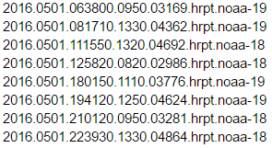
Weather evaluation of possible passes
Month & Day
Additional identifiers
File type
Developed a system of checking passes against weather records
The weather database used was weather underground
It was used to help filter the passes by the weather conditions
The time field in the pass file name is in GMT
The time field in for the weather underground in local time or EST
Difference from EST to GMT during the times the passes were taken is 4 hours
Year
Time
Satellite
Notes:
Hagen

Slide 7
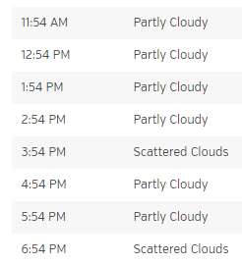
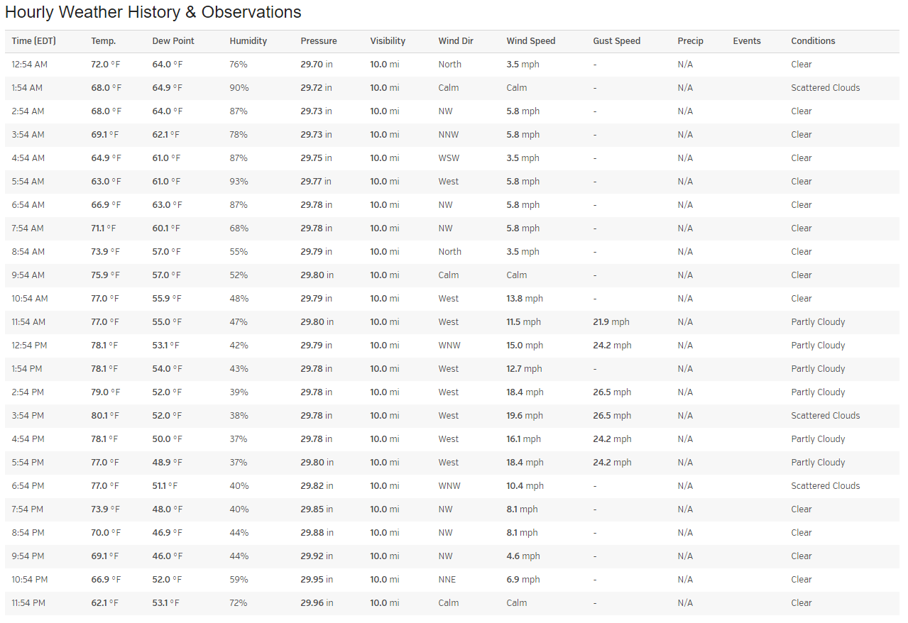
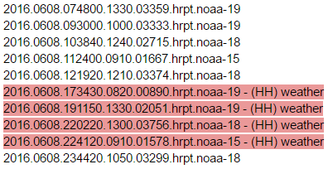
Poor weather conditions are defined as any period exceeding 2 hours in length that is recorded as being partly cloudy or worse.
This process was repeated on the passes of every month that the team intended to restore.
Notes:
Hagen

Slide 8
Formal restoration of passes
Connect to the T-Rex
Navigate to the directory where archived passes are stored
Select a pass and use the restore_pass command on it
Example: restore_pass 2015.0601.221950.0910.01940.hrpt.noaa-15
Enter the slot number on the pass disk you wish to use
Run the run_ingest command with the pass disk slot you picked
Example (assuming you pick disk slot 144): run_ingest 144
After several minutes check the LST and NDVI folders for results
Record the presence or absence of said results
Notes:
Hagen

Slide 9
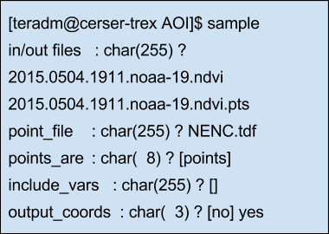
Sample
Why?
What’s Input?
What’s Output?
Notes:
Tori

Slide 10
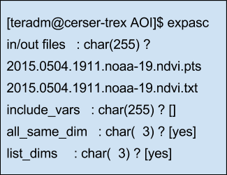
Expasc
Why?
What’s Input?
What’s Output?
Notes:
Tori

Slide 11
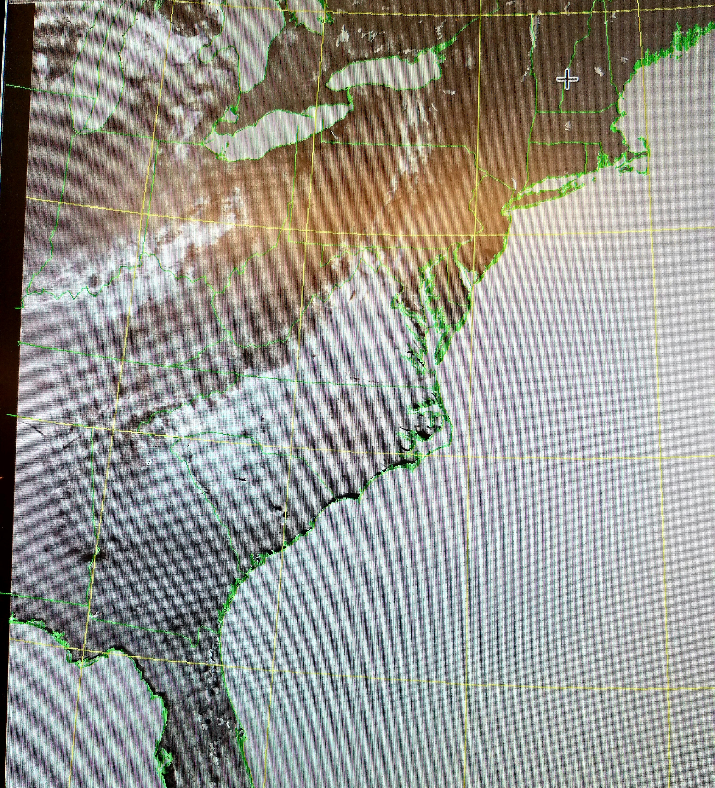
Results
Successful LST and NDVI data were retrieved by restoring passes and running ingest
The data was moved to the appropriate directory and saved in desired file formats
May 2015 and 2016 were completed
Sample and Expasc commands were used to convert the final data into the required file format
Typical NDVI image sample from retrieved NDVI data
Notes:
DEMOLA

Slide 12
Future Works
Finish the processing of the 2015 and 2016 into readable raw data
Create a Python program capable of interpreting the raw LST & NDVI data into a format compatible with analysis
Notes:
Tori

Slide 13
Acknowledgements
Our special and sincere thanks goes to Dr. Hayden for her continued help and relentless guidance to the undergraduate research experience program. We also want to thank the entire CERSER team for the coordination and all the assistance offered during the program.
Notes:
KEVIN

Slide 14
Questions?

