Slide 1
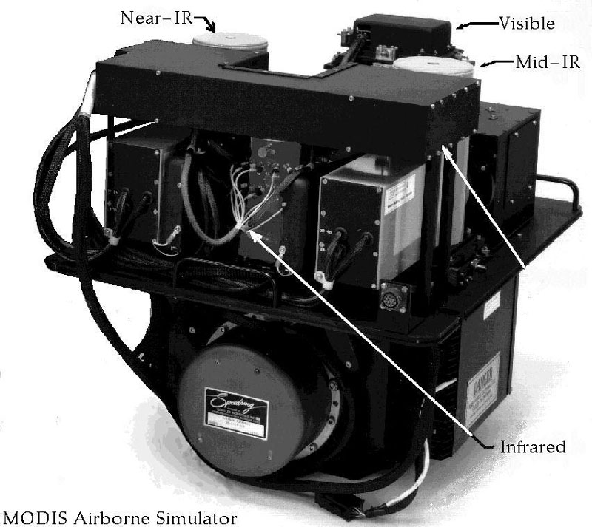
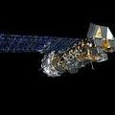
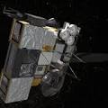
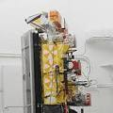
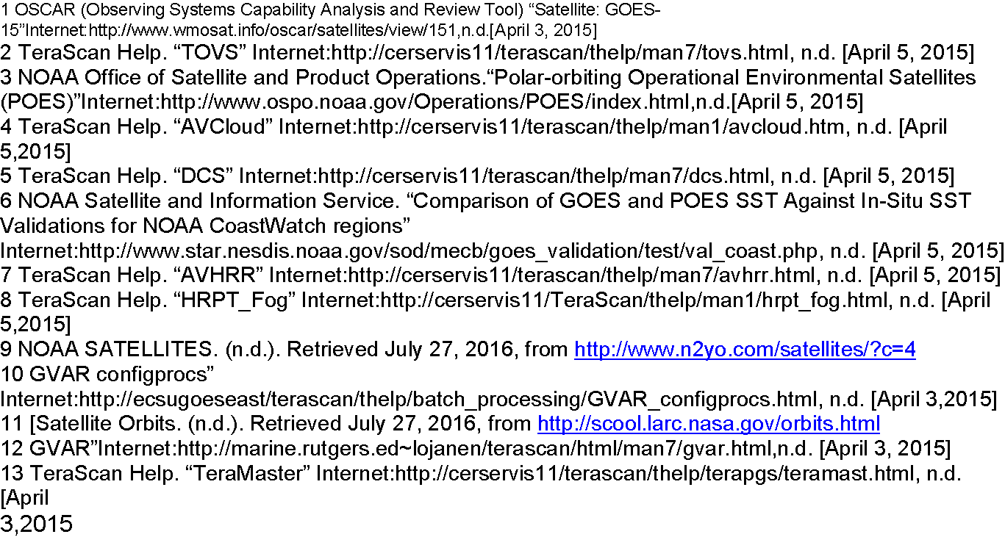
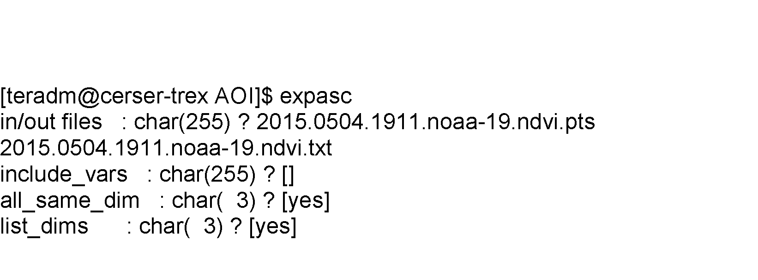
CONTINUATION OF ANALYZING LONG-TERM DROUGHT EFFECTS ON LAND SURFACE TEMPERATURE
AND VEGETATION USING NOAA SATELLITE DATA
AND VEGETATION USING NOAA SATELITE DATA
Team Members: Tori Wilbon (ECSU), Kevin Benton (ECSU) Hagen Hodgkins (ECSU) Ademola Adedeji (Research Volunteer) Mentor: Andrew Brumfield (ECSU)
METHOD
TeraVision is an embedded GUI portion of TeraScan in which the user can include annotations, overlays, and image enhancements to different parts of the image to manipulate the image in the form of TDF. During the study, the team downloaded data from the summer months with focus on June. Day time orbits data with minimum degradation were used. During the “ConfigProc” a series of file conversions were made from TXT and TDF to PTS. The TeraScan Data Format is the typical satellite data format. Calculations with the different channels were applied on the TDF files to generate both the LST and NDVI products. LST used level-2 and level-3 data in an algorithm designed specifically for the MODIS instruments as represented in Fig 2. The NDVI equation was equal to the quantity of the infrared channel minus the near-red channel divided by the quantity of the infrared plus the near-red channels (Tucker 1979 and Choudhury 1987). This equation made the product “greener” to differentiate the differences in dense vegetation and low vegetation. Fig 1 below represent the equation. Where NIR is near-red infrared channel , R infrared channel and where ρ is reflectance in the respective spectral bands.
The National Oceanic and Atmospheric Association NOAA is the polar- orbiting satellite used for our project with focus on NOAA-15, 18,19. We utilized Python programming language in this project to finally extract the point files that were created from the LST and NDVI data and comparing them by using linear and non-linear regression With the new hardware and software from SeaSpace recently acquired by Elizabeth City State University, images can be displayed on 24 “and 42” screens. TeraScan Rapid Environmental ExtremeTREX, is our processing environment and the TeraVault provided the desired storage. Finally, the uninterrupted power supply units were deployed by SeaSpace to ensure constant power supply incase of temporary outage.
Manipulating LST & NDVI
We utilized data from the National Oceanic and Atmospheric Administration (NOAA) Satellite with particular focus on the months of May, June, July, and August of years 2015 and 2016. For the data to be usable, the weather must be clear and after restoring pass and running ingest, the NDVI and LST values must be present. By utilizing weather data from wunderground.com, we were able to quickly identify clear weather; This helped a great deal to quickly complete that phase of the project. The existing point files from the previous research team was modified to a more usable format with coordinates first and names of location next. Fig. 2 The files were also converted to .txt to .csv format.
The point files contain the point of interest for the project and were stored in the /Desktop/ecsuure2016/ directory. The point files represented several location from the Perquimans, Pasquotank, Camden and Gates, and targeted grassland, farmland, swamp and forest locations within each of these counties.
The Sample and Expasc command were used to convert the TDF data to PTS and to TXT to give us a more compatible file format for the python language. The converted TXT files of the NDVI and LST were then moved to the data folder. To find a trend of LST /NDVI patterns in the summer months of May, June, July and August. The team will take the values at lat/long locations in Perquimans, Pasquotank, Camden and Gates County. By using the survey tool the team then use the "Go to Cursor" to position the mouse over the townships lat/long location and record the value into Excel to generate a graph shown in Figure 3.
ABSTRACT
According to the State Climate Office of North Carolina, since 2007 the northern coastal plain of North Carolina has been experiencing a long-term summer drought. The team’s objective was to analyze how long-term drought in summer months’ affected vegetation and land surface temperature in the Pasquotank, Perquimans, Camden and Gates county areas. The team collected imagery data through the SeaSpace TeraScan system in order to produce land surface temperature (LST) and normalized difference vegetation index (NDVI) products. The data products were averaged into monthly and yearly composites so that the team could use TeraVision to depict the differences of values for the products.
INTRODUCTION
TeraScan is a combination of hardware and software designed for automated reception of data from meteorological/environmental satellites and for processing the data into images and data overlays. The generated images and overlay are of a special format called TeraScan Data Format (TDF) and can be displayed with the TeraScan GUI called TeraVision. These data files can then be used to produce images in various formats. Different types of satellite data can be received from the TeraScan computer. These satellite data types include; X Band Data from Polar Orbiting Satellites, L/S Band Data from Polar Orbiting Satellites, and L Band Data from Geostationary Satellites. Droughts clog wells and fills them with water from the rain, which is harmful to grassland, farmland, and vegetation production. Without NOAA satellites, droughts could be hard to see and managed. In future works, efforts would be made to collect and analyze the effects of the long-term summer drought within the Northeastern counties of North Carolina.
Conclusion
At the end of the twelve weeks of research, we were able to process the data received from the Noaa satellite, converted them into usable formats and formated the extracted coordinates generated for use by the future research team
Fig 2. MODIS INSTRUMENT
FUTURE WORK
There are other objectives that the team can fulfill in this project to receive better results. A comparison over a longer period of time would better illustrate a distinct pattern.. Future works will also include using a python program to perform a Linear and Nonlinear Regression Graph using processed LST and NDVI values.
Figure 6: Image Of NOAA 18
Figure 3: Image Of NOAA 15
ACKNOWLEDGEMENTS
We, the research Team would like to give a special thanks to Dr. Hayden and The Staff at SeaSpace Corporation.
Thank you.
Figure 4: image showing usable lst & ndvi
Figure 7: Image Of NOAA 19
References
Figure 5: Image showing processed lst & ndvi data
Fig 4. Shows the command line used for file conversion

