Slide 1
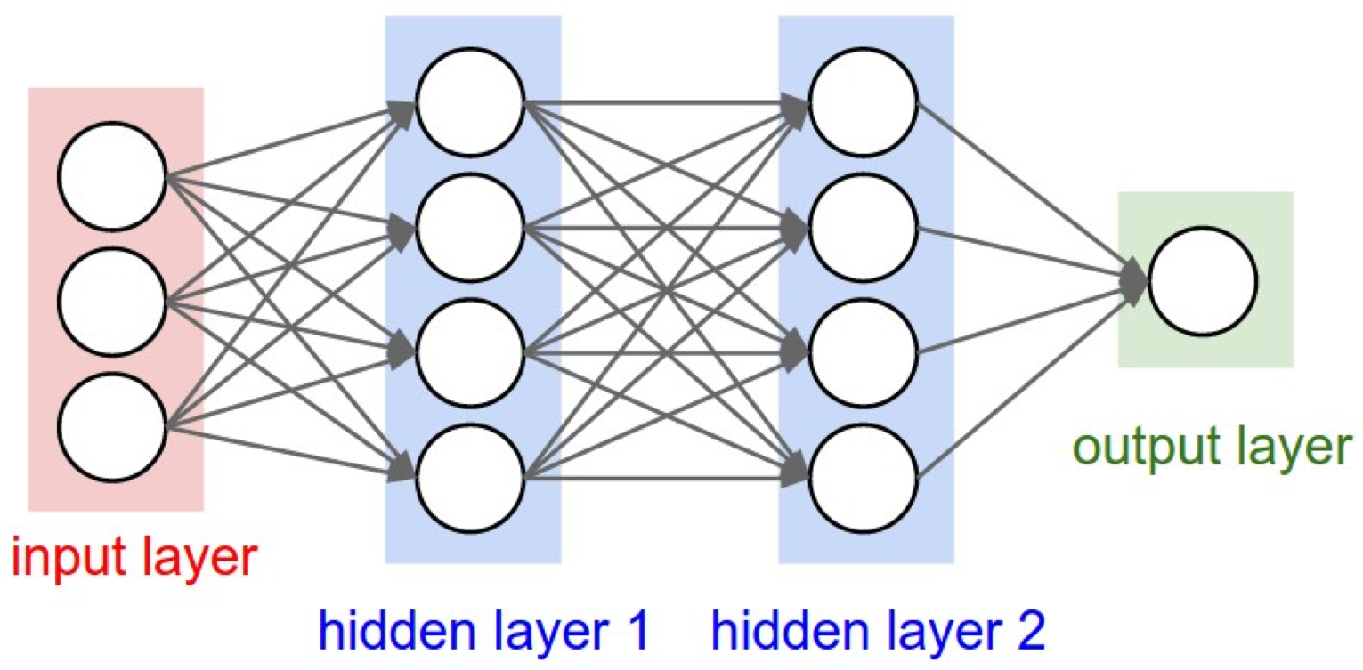
A Comparative Study of Neural Networks and Logistic Regression for High Energy Physics
Joel Gonzalez-Santiago¹, Thomas Johnson¹, Nigel Pugh¹ , Jerome Mitchell²
Elizabeth City State University, Department of Computer Science and Mathematics
Indiana University, School of Informatics and Computing
Abstract
Diagram of Neural Network
Methodology
Collisions at high-energy particle colliders are a traditionally source of particle discoveries. Determining these particles requires solving difficult signal-versus-background classification problems.
Other approaches have relied on ‘shallow’ machine learning models, which are limited in learning complex non-linear functions.
However, recent advances in neural networks provide a way to learn more complex functions and better discriminate between signal and background classes.
In this work, we study how a neural network can improve collider searches for unique particles and determine the performance using logistic regression as a baseline comparison.
The goal is to decide whether a data point represents signal “potential collision” - labeled 1 or "noise"- labeled 0
This is done from 8 features -- are "low-level" features
The two algorithms that will be utilized to execute the comparison study is Neural Network and Linear Regression
Conclusion
This work is ongoing and will perform performance tests comparing neural networks and logistic regression as a baseline
Introduction
Link to website: http://cs231n.github.io/neural-networks-1/
The project is comparing two forms of machine learning, neural networks and logistic regression to determine which model is more accurate in studying supersymmetry datasets.
Machine learning concerns algorithms that are capable of adapting to become more efficient through being trained on completing given tasks with large amounts of data.
Neural networks are machine learning models that are loosely based on the human brain and are utilized for classification purposes.
Logistic Regression is a statistical method for solving issues of a binary nature.
References
The model presented above is of a neural network. The neural network is constructed through three fundamental layers: the input layer, hidden layer, and output layer. Each layer stores a value that is then multiplied by a weight to be passed on to the next layer to be stored and repeat the process until the output layer is reached. The input layer consists of data which is loaded externally. The weights are initialized randomly. Once the results are stored in the output layer, backpropagation is initialized which goes backwards through the process to update the weights for the next iteration that the Neural Network is ran through. The updated weights are used in the next iteration to increase reduce the error from the classification of the data.
[1]Neural Network Model: http://cs231n.github.io/neural-networks-1/
[2]Sadowski, Peter, Julian Collando, and Pierre Baldi. "Deep Learning, Dark Knowledge, And Dark Matter". JMLR Workshop And Conference Proceedings 42. Irvine, California: Journal of Machine Learning Research, 2017. 81-97. Web. 12 Mar. 2017.
[3]Baldi, P., P. Sadowski, and D. Whiteson. "Searching For Exotic Particles In High-Energy Physics With Deep Learning". Nature Communications 5.4308 (2014): 9. Web. 13 Mar. 2017.
[4]O. Ohrimenko, F. Schuster, C. Fournet, A. Mehta, S. Nowozin, K. Vaswani and M. Costa, "Oblivious Multi-Party Machine Learning on Trusted Processors", in 25th USENIX Security Symposium, Austin, Texas, 2016, pp. 618-636.
Forward propagation and Backpropagation

