Slide 1
A Comparative Study of Neural Networks and Logistic Regression for High Energy Physics
Nigel Pugh, Joel Gonzalez-Santiago, and Thomas Johnson
Mentor: Jerome E. Mitchell

Slide 2
Abstract
-- Collisions particle colliders are a source of particle discoveries. However, determining these particles requires solving difficult signal-versus-background classification problems
-- Other approaches have relied on machine learning models, which are limited in learning complex functions
-- Recent advances (computation and data size) neural networks provide an opportunity to learn complex functions and better discriminate between signal and background classes
-- We study the design considerations for a neural network model and provide a comparative analysis with logistic regression

Slide 3
Machine Learning Problems

Slide 4
The Machine Learning Framework
y = f(x)
-- Training: given a training set of labeled examples {(x₁,y₁), …, (x_{N},y_{N})}, estimate the prediction function f by minimizing the prediction error on the training set
-- Testing: apply f to a never before seen test example x and output the predicted value y = f(x)
feature
output
prediction function

Slide 5
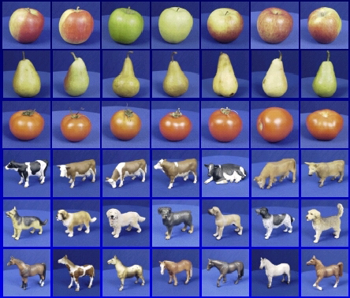
Steps
Training
Training Labels
Training Images
Features
Training
Learned model
Testing
Features
Learned model
Prediction
Test Image

Slide 6
Generalization
Training set (labels known)
Test set (labels unknown)
How well does a learned model generalize from the data it was trained on to a new test set?

Slide 7
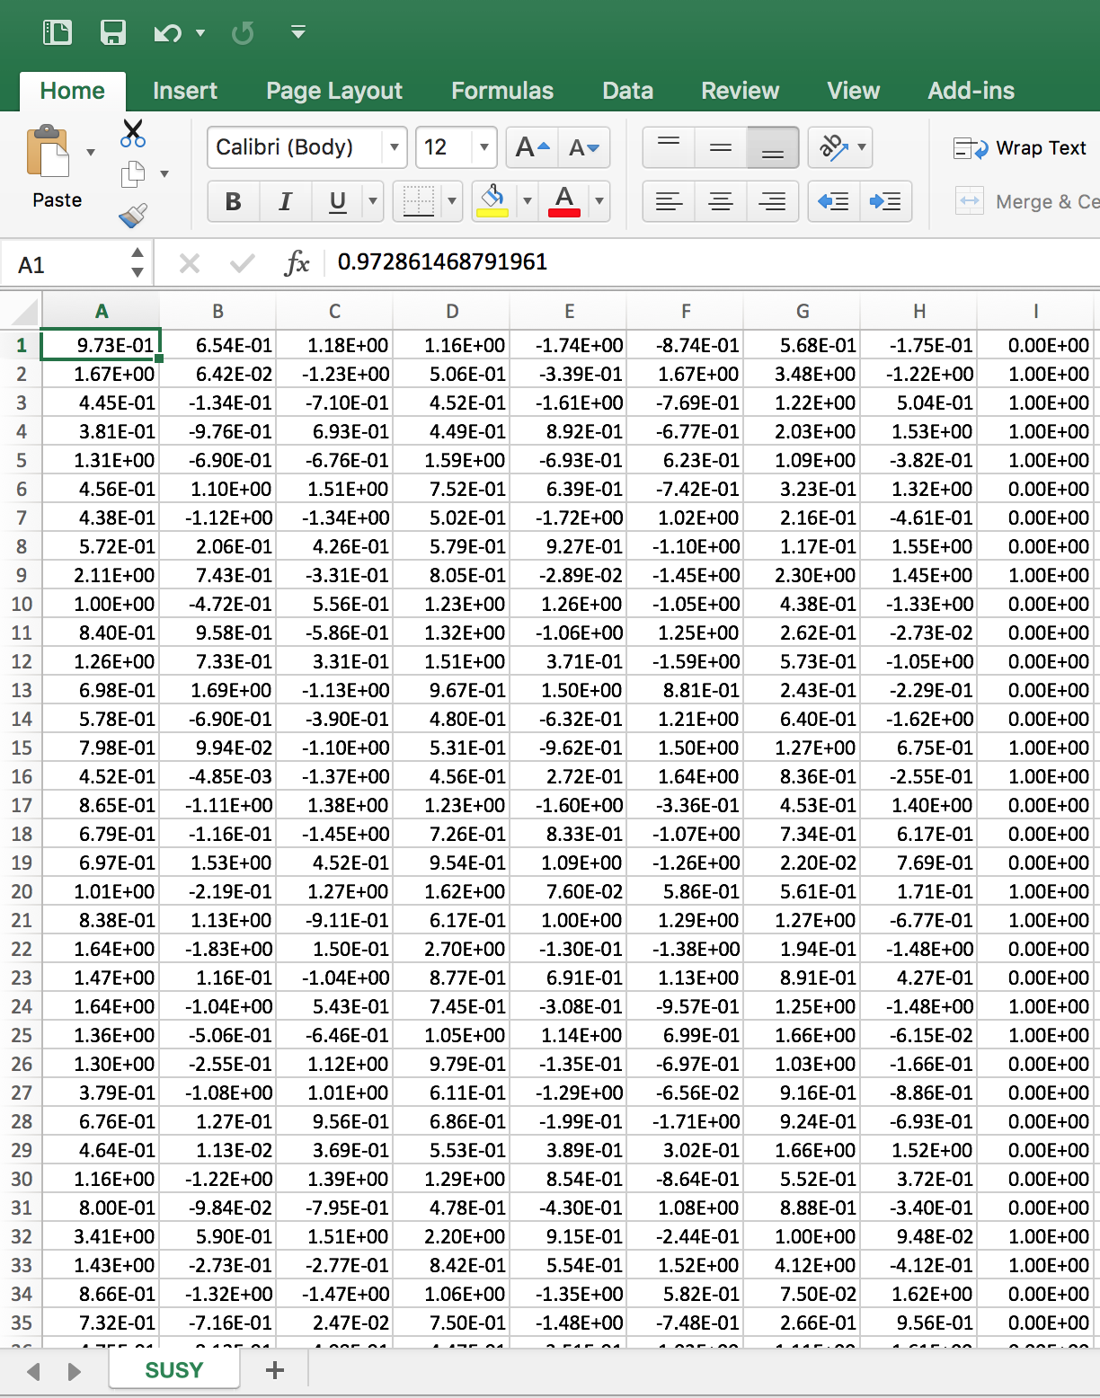
Our Data…
Classification problem to distinguish between a signal process to background for high energy physics
Features
Labels
Instances

Slide 8
Neural Networks
-- Neural networks are loosely based on the human brain
-- Utilized for classification purposes
-- Popularity of neural networks have increased
Weights
Neurons

Slide 9
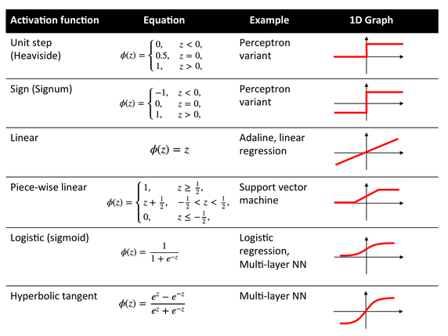
Backpropagation
-- Common Method used to train Neural Network
-- Supervised Learning Technique
-- Reduces error respective to weights
-- Activation function is utilized

Slide 10
Neural Networks
Netinput_{H1} = (IN1 * W1) + (IN2 * W3)
Netinput_{H2} = (IN1 * W2) + (IN2 * W4)
Netinput_{OUT}= Output_{H1} * w5 + Output_{H2} * w6 Output_{OUT} =$\frac{1}{1+e^{−NetinputOUT}}$
Output_{H1} =$\frac{1}{1+e^{−NetinputH1}}$
W1
H1
W5
IN1
W3
OUT
IN2
W2
W6
Output_{H2} = $\frac{1}{1+e^{−NetinputH2}}$
W4
H2

Slide 11
Backpropagation
Error = ½ (Target – Output_{OUT})²
$\frac{\text{∂}Error}{\text{∂}w1}$ = $\frac{\text{∂}Error}{\text{∂}OutputH1}∗\frac{\text{∂}OutputH1}{\text{∂}netinputH1}∗\frac{\text{∂}netinputH1}{\text{∂}w1}$
$\frac{\text{∂}Error}{\text{∂}w5}$ = $\frac{\text{∂}Error}{\text{∂}OutputOUT}∗\frac{\text{∂}OutputOUT}{\text{∂}netinputOUT}∗\frac{\text{∂}netinputOUT}{\text{∂}w5}$
= -(target – Out) * Out(1-Out) * Output_{h1}
W1
H1
W5
IN1
W3
OUT
IN2
W2
W6
W4
W5^{update} = w5 - $η ∗\frac{\text{∂}Error}{\text{∂}w5}$
H2
W1^{update} = w1 - $η ∗\frac{\text{∂}Error}{\text{∂}w1}$

Slide 12
Neural Network Design Considerations
-- What transfer function should be used?
-- How many inputs does the network need?
-- How many hidden neurons per hidden layer?
-- How many outputs should the network have?
There is no standard methodology to determinate these values. Even there is some heuristic points, final values are determinate by a trial and error procedure

Slide 13
Logistic Regression
Assumes the following form for P(Y|X):
Logistic function applied to a linear function of the data
Logistic function
(or Sigmoid):
logit (z)
Features can be discrete or continuous!

Slide 14
Logistic Regression Application
Vegetation along transect with reflectance
1
Is Vegetation
.5
0
Reflectance along Transect

Slide 15
Experiment : Our Neural Network Information
--1000 training examples
-- 100 test examples
-- 8 features
-- 3 Layer Neural Network
-- 10,000 training iterations
-- Hidden Nodes: Range from 1 – 100
-- Step size : .01

Slide 16
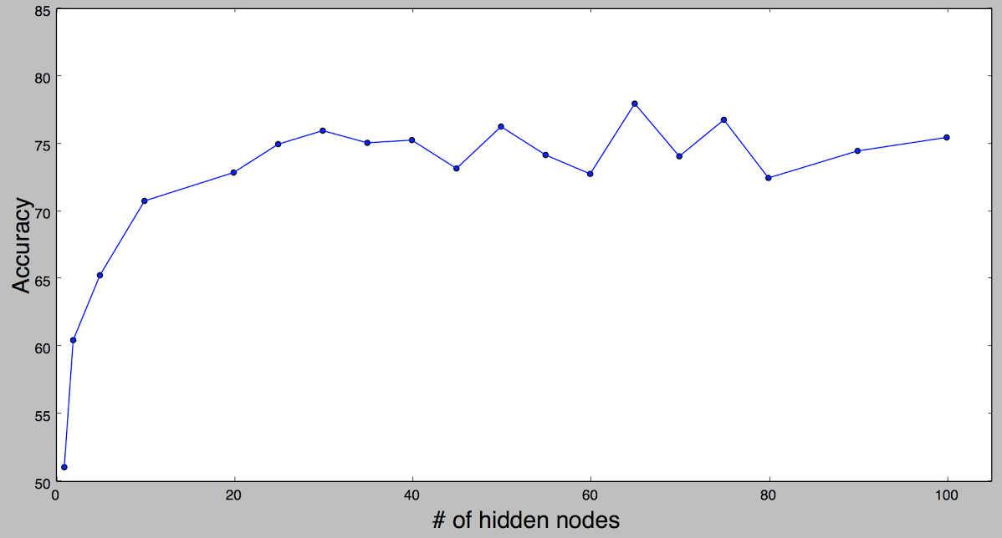
Results: Neural Networks
Best Accuracy: 78% # of hidden nodes: 65
Neural Network
Worst Accuracy: 51% # of hidden nodes: 1

Slide 17
Results: Best hidden node NN vs Logistic Regression
Logistic Regression
Neural Network

Slide 18
Conclusion
-- Neural Network with 65 hidden nodes provided better performance than our Logistic Regression model on all test cases
-- We conclude it is better to use a the Backpropagation algorithm to classify the High Energy Physics Data

Slide 19
Future Work
-- Increase the number of hidden layers, to determine if accuracy percentage will increase -- Compare against different machine learning algorithms against this same data, and determine which are more effective for classification.

Slide 20
References
Baldi, P., P. Sadowski, and D. Whiteson. "Searching For Exotic Particles In High-Energy Physics With Deep Learning". Nature Communications 5.4308 (2014): 9. Web. 13 Mar. 2017.
Sadowski, Peter, Julian Collando, and Pierre Baldi. "Deep Learning, Dark Knowledge, And Dark Matter". JMLR Workshop And Conference Proceedings 42. Irvine, California: Journal of Machine Learning Research, 2017. 81-97. Web. 12 Mar. 2017.
O. Ohrimenko, F. Schuster, C. Fournet, A. Mehta, S. Nowozin, K. Vaswani and M. Costa, "Oblivious Multi-Party Machine Learning on Trusted Processors", in 25th USENIX Security Symposium, Austin, Texas, 2016, pp. 618-636.
D. Marrón, J. Read, A. Bifet and N. Navarro, "Data stream classification using random feature functions and novel method combinations", Journal of Systems and Software, vol. 127, pp. 195-204, 2017.
D. Whiteson and M. Lichman, "UCI Machine Learning Repository: SUSY Data Set", Archive.ics.uci.edu, 2017. [Online]. Available: https://archive.ics.uci.edu/ml/datasets/SUSY. [Accessed: 03- Apr- 2017].

Slide 21
Acknowledgements
The team would like to acknowledge:
-- Jerome Mitchell, for his guidance, and contributions in completing this research project
-- Dr. Linda Hayden, who provided funding and opportunity of this project through the CERSER program

Slide 22
Questions?

