Slide 1
Enhancing Interactivity and engagement to the Science Gateway Community Institute Workforce Development Site
2017
Tatyana Matthews, Jefferson Ridgeway IV, Disaiah Bennett
Elizabeth City State University

Slide 2
Abstract
The Center of Excellence in Remote Sensing Education and Research (CERSER) on the campus of Elizabeth City State University is a founding member of SGCI led by San Diego Supercomputing Center and the Science Gateways Community Institute (SGCI). One of the five areas of SGCI is the Workforce Development led by Dr. Linda Hayden. Workforce Development aims to nurture the next generation of gateway users and developers and engage the potential of students from underrepresented groups.
Notes:
Disaiah

Slide 3
Abstract
As science today grows increasingly computer based, it poses challenges and opportunities for researchers. Scientists and engineers are turning to gateways to allow them to analyze, share, and understand large volumes of data more effectively. The existence of science and engineering gateways and the sophisticated cyberinfrastructure (CI) tools together can significantly improve the productivity of researchers. Most importantly, science gateways can give uniform access to the cyberinfrastructure that enables cutting-edge science.
Notes:
Disaiah

Slide 4
Abstract
The goal of the web development team was to increase the interactivity of the SGCI Young Professionals site to attract potential members and disseminate information. This was completed utilizing WordPress Widgets to provide graphical and interactive components. Bootstrap components (HTML, CSS, and JavaScript) were also researched for their inclusion into the current WordPress Content Management System (CMS) and the future Liferay CMS.
Notes:
Disaiah

Slide 5
Research Overview
Notes:
Taty

Slide 6
CERSER
+
San Diego Supercomputing Center and Science Gateways Community Institute
Enable researchers to analyze, share, and understand large volumes of data more effectively
Improve the productivity of researchers
Interactivity
Potential Members
Information
Workforce Development is one of five key areas within SGCI
Notes:
-Balloon1: CERSER on campus of ECSU has partnered with San Diego Computing Center in SGCI
-SGCI officially began in 2016
-San Diego Computing Center is the lead on this initiative
-Other partners include Purdue University, Indiana University, University of Michigan as well as many others
-Balloon2: Dr. Linda Hayden leads the Workforce Development area which strives to tap into the undeveloped potential of students from underrepresented groups and then increase the development of young developers
-Balloon3: science -> grows computer based -> provides opportunity for researchers -> scientists and engineers are turning to gateways to enable them to...
-Balloon4: gateways, tools and resources available through sites can...
-Balloon5: goal of web development team was to ... to SGCI site

Slide 7
Science Gateways Community Institute (SGCI)
The Science Gateway Community Institute (SGCI) Workforce Development Team is tasked with attracting professionals, faculty, and students to participate in conferences, workshops, and internships
Dr. Linda Hayden is the lead on this component of SGCI
Notes:
Taty

Slide 8
Workforce Development Page
Notes:
Taty

Slide 9
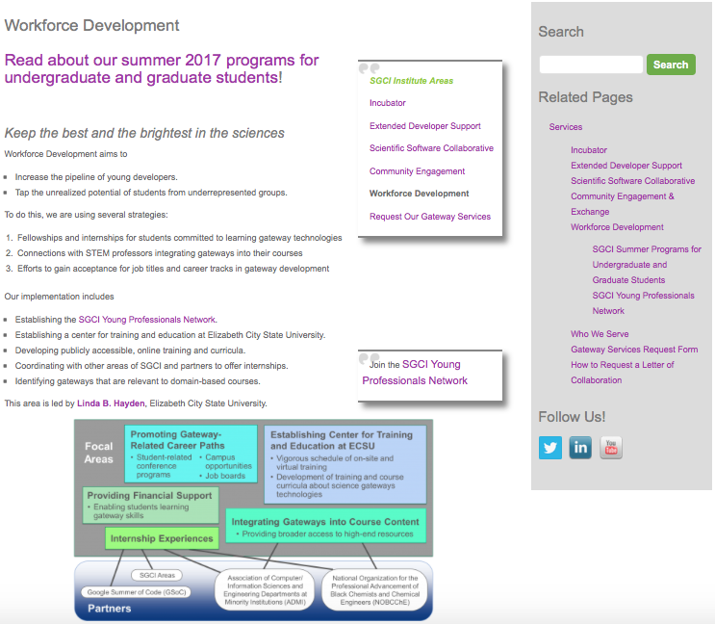
Original Site
Notes:
Taty
Red points, areas we focused on

Slide 10
Tools
Notes:
Jeff
- According to tatyana's previous slide, the original SGCI webpage uses a content management system

Slide 11
WordPress
“publishing platform that makes it easy for anyone to publish online, and proudly powers millions of websites”
Content Management System (CMS)
The SGCI site uses a WordPress theme, which controls its general look and feel
Notes:
Jeff
-CMS is a web application that enables multiple users with various permissions to manage content and data

Slide 12
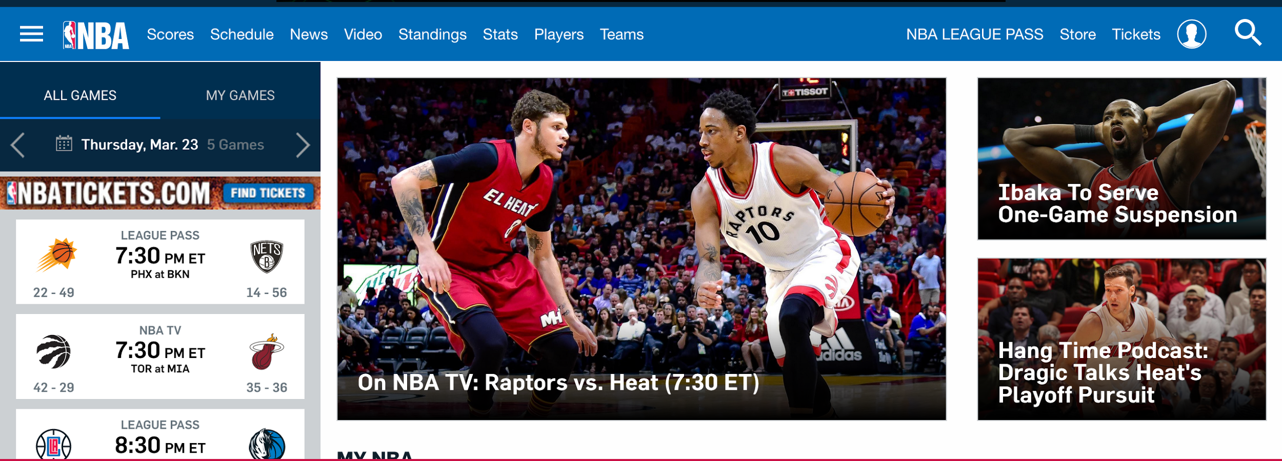
Bootstrap
“the most popular HTML, CSS, and JS framework for developing responsive, mobile first projects on the web”
Key Benefits
Components
Ease of Use
Open-Source
Navigation
Iconography
Dropdowns
Notes:
Jeff
- Another tool in web development that has become popular is bootstrap.

Slide 13
Goal
Notes:
Taty

Slide 14
Use Bootstrap components in WordPress to enhance the SGCI site
Notes:
Taty
Over-arching goal

Slide 15
Roadblock
Current site uses WordPress theme
Cannot use Bootstrap components unless using a Bootstrap theme in WordPress
Notes:
Jeff

Slide 16
Page Enhancements
Notes:
Jeff
-To compensate for the failure of bootstrap components and the incompatibility, team used the widgets available through wordpress

Slide 17
Original Site
Notes:
Jeff
Reminder of Original Site

Slide 18
Widget: Image Hover Effects
Notes:
Jeff

Slide 19
Widget: Image Hover Effects
Notes:
Jeff
-If one clicks the widget, it provides a link to the program’s page

Slide 20
Widget: Soliloquy
Notes:
Jeff

Slide 21
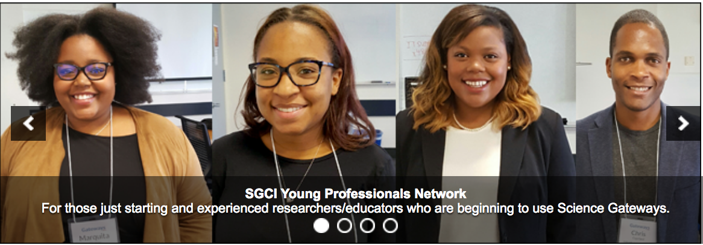
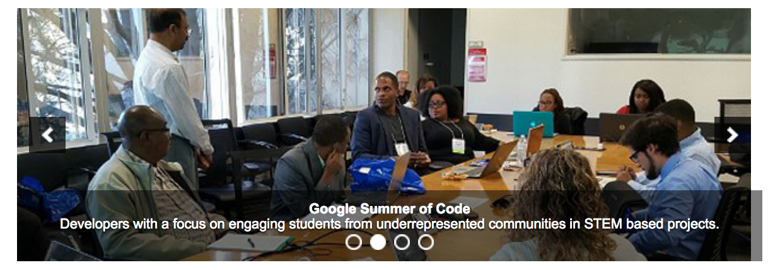
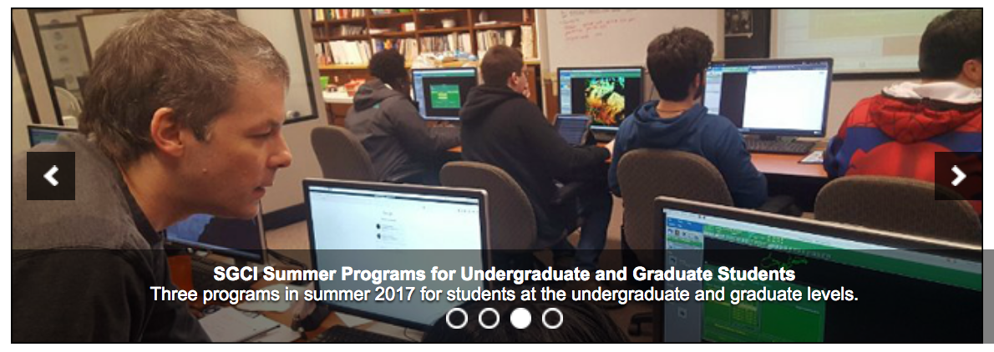
Widget: Soliloquy
Notes:
Jeff
-each image is linked

Slide 22
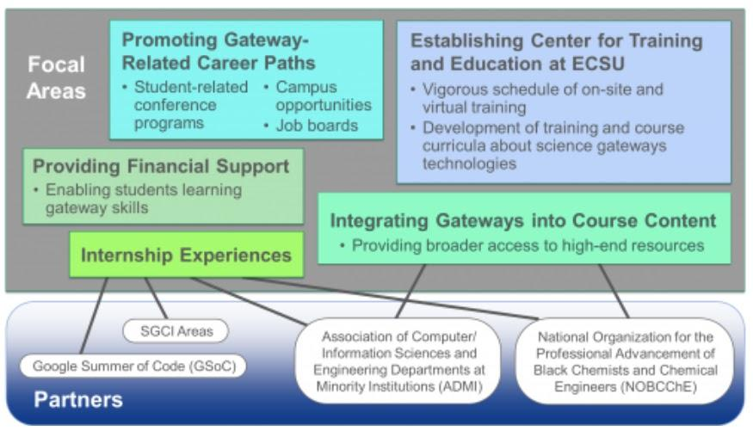
Notes:
Disaiah
-lastly team redesigned color scheme, difficult lines to follow.

Slide 23
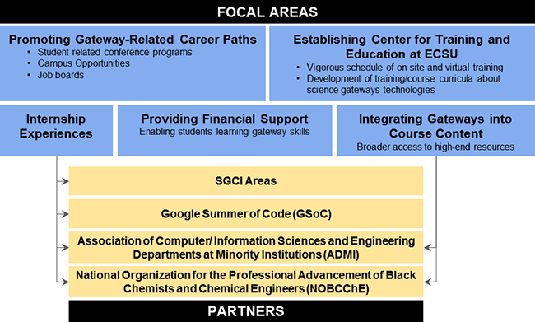
Notes:
Disaiah
-The new design on the page included resizing and arranging the boxes under the focal areas to present a more appealing design.
-The color scheme was also changed to present the content in a clearer method.
-The intersecting lines were redesigned for the user to differentiate the content between the focal areas and partering locations.

Slide 24
Demo
Notes:
Taty
Workforce Development Site Link: http://sciencegateways.org/services/workforce-development/

Slide 25
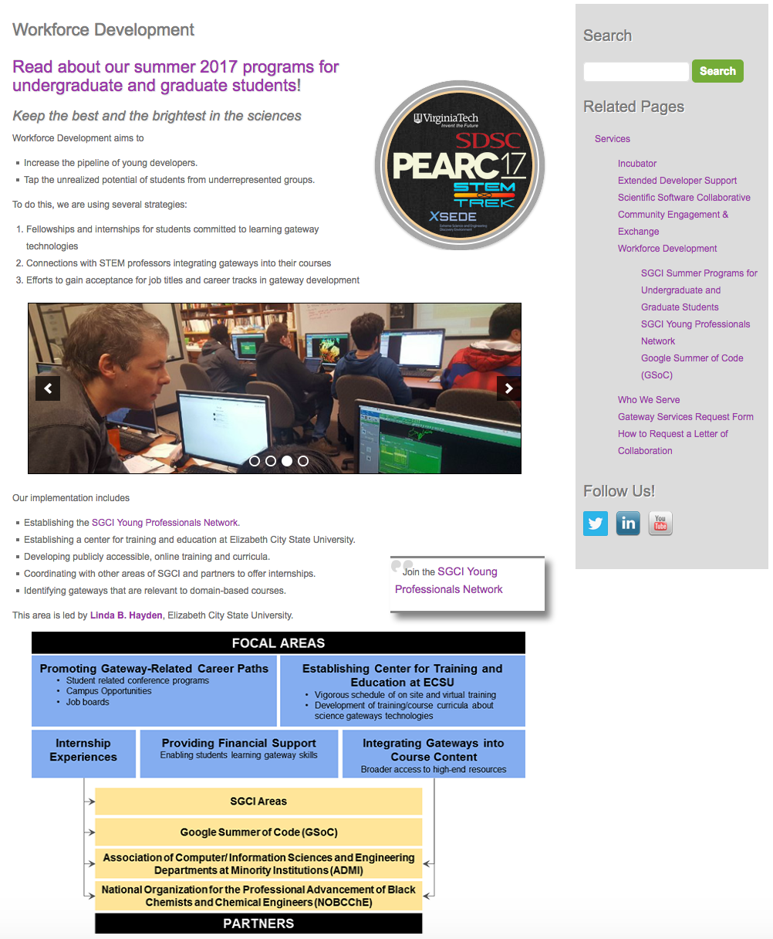
Current Site
Notes:
Taty
Current Site

Slide 26
Conclusion
Team was not able to use Bootstrap components with WordPress theme
Liferay components + WordPress widgets can fulfill some of the capabilities of Bootstrap components
Notes:
Taty
-Liferay is a CMS

Slide 27
Future Work
Future CMS of the SGCI site is Liferay
Bootstrap is compatible with Liferay
Long-term goals
Liferay offers “developers a complete platform for building web apps, mobile apps, and web services quickly, using features and frameworks designed for rapid development, good performance, and ease of use”
Develop CERSER’s current sites into responsive sites using Bootstrap
Create Facebook Group for Young Professionals to network
Notes:
Jeff
-Can use Bootstrap theme with Liferay
-Bootstrap rearranges the website so that it can be viewed on multiple platforms such as phones, tablets, or desktops
-embed the Facebook page within the young professional site

Slide 28
Acknowledgements
Dr. Linda Hayden of Elizabeth City State University
Science Gateway Community Institute (SGCI)
Notes:
Jeff

Slide 29
QUESTIONS
Notes:
Jeff

