Slide 1
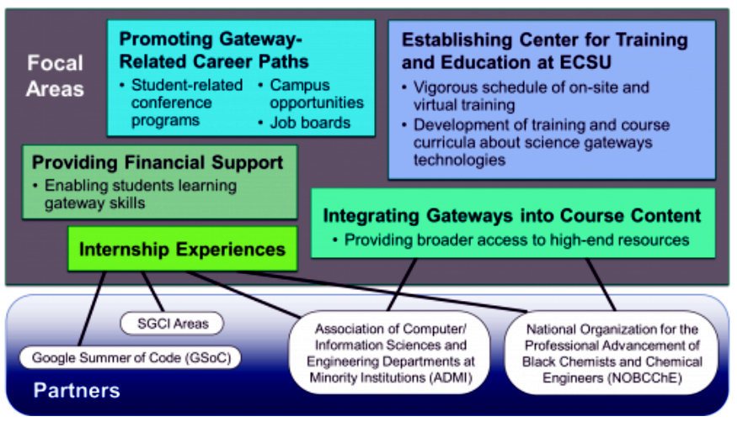
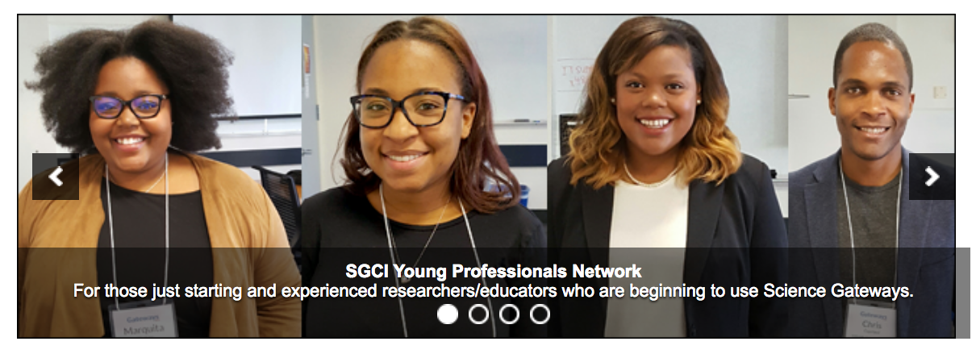
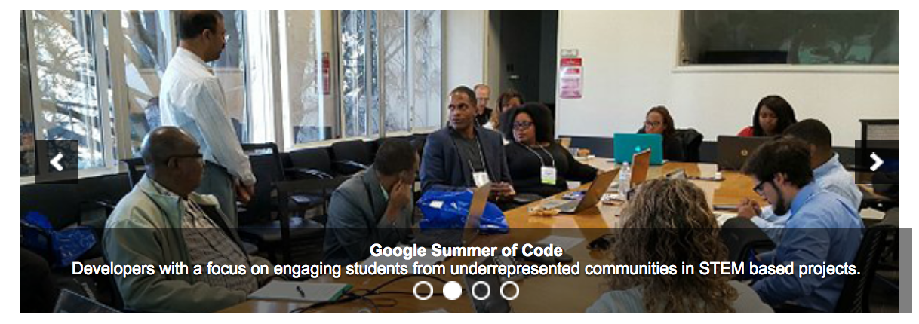
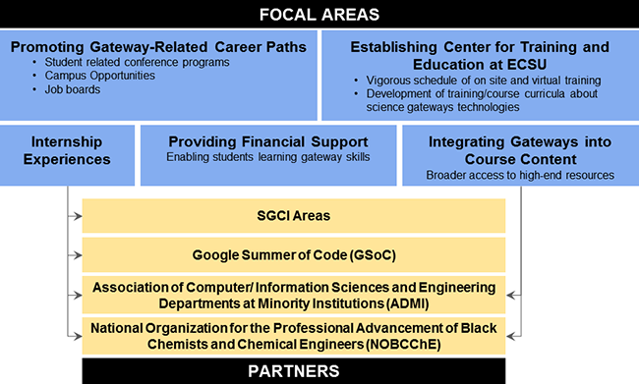
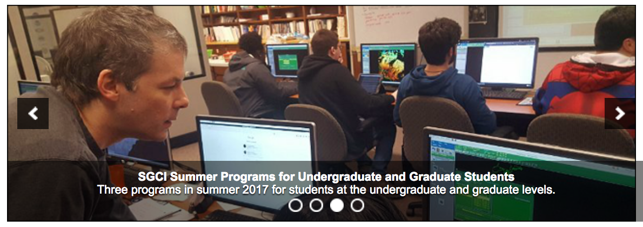
Enhancing Interactivity and engagement to the Science Gateway Community Institute Workforce Development Site
2016-2017 :: Disaiah Bennett, Tatyana Matthews, Jefferson Ridgeway :: Mentor: Mr. Jeff Wood :: Dr. Linda B. Hayden, SGCI Workforce Development :: Center of Excellence in Remote Sensing Education
ABSTRACT |
METHODOLOGY |
ANALYSIS |
CONCLUSION |
The Center of Excellence in Remote Sensing Education and Research (CERSER) on the campus of Elizabeth City State University is a founding member of SGCI led by San Diego Supercomputing Center and the Science Gateways Community Institute (SGCI). One of the five areas of SGCI is the Workforce Development led by Dr. Linda Hayden. Workforce Development aims to nurture the next generation of gateway users and developers and engage the potential of students from underrepresented groups.
As science today grows increasingly computer based, it poses challenges and opportunities for researchers. Scientists and engineers are turning to gateways to allow them to analyze, share, and understand large volumes of data more effectively. The existence of science and engineering gateways and the sophisticated cyberinfrastructure (CI) tools together can significantly improve the productivity of researchers. Most importantly, science gateways can give uniform access to the cyberinfrastructure that enables cutting-edge science.
The goal of the web development team was to increase the interactivity of the SGCI Young Professionals site to attract potential members and disseminate information. This was completed utilizing WordPress Widgets to provide graphical and interactive components. Bootstrap components (HTML, CSS, and JavaScript) were also researched for their inclusion into the current WordPress Content Management System (CMS) and the future Liferay CMS.
WordPress.org
In order to implement components from bootstrap, it was important to first develop a bootstrap theme. The first step is to then set up a server via either MAMP (for Macintosh operating systems), LAMP (for Linux operating systems), or WAMP (for Windows operating systems). The AMP represents, Apache, MySQL, and PHP. MAMP/LAMP/WAMP can be used as “local servers that are used while developing PHP sites. Using these servers, programmers can test a website locally before they upload it to the main server” [13]. MAMP was used for this research due to team members using a Macintosh operating system. One has to then download WordPress.org in order to install WordPress.org on their PC/laptop. Furthermore, the team members followed the tutorial provided by LyraThemes entitled, “How to develop a WordPress Theme Using Bootstrap (Part 1)” [3]. After setting up the MAMP server, the team had to download Bootstrap and place the Bootstrap CSS, JavaScript(JS), and font directories within the WordPress directory. After MAMP was properly configured and activated, the team members were able to see a live Bootstrap, responsive design WordPress blog post.
Soliloquy
Due to SGCI not utilizing a Bootstrap theme for WordPress.org, another method of implementing Bootstrap-like components in a WordPress theme was explored. Of all of the plugins that were researched that implemented bootstrap-like components, the plugin Soliloquy was used based on its ease of use and its previous installation provided by SGCI. Soliloquy is defined on the plugin website “as the best responsive image slider for WordPress…[and]...will always look great on all devices (mobile, tablet, laptop, and desktop)” [11].
Image Hover
Alongside the Soliloquy plugin, the team members also searched for a plugin that would replace the textual links on the SGCI Young Professional’s Network website and make it more inviting for users. The plugin found by the team was Image Hover Effects Pro. Image Hover Effects Pro allows the user “to add 40+ hover effects to images with captions” [4]. The installation and activation of the plugin is the same as Soliloquy. A shortcode was inserted within the WordPress post to observe the changes that were made by the Image Hover Effects Pro plugin.
Diagram
Lastly, the team redesigned the diagram seen in Figure 3 on SGCI’s Young Professional Workforce Development homepage. The diagram originally included content that was difficult to understand. The team decided that this diagram needed to be redesigned to communicate clearly the focal areas and partners who are within the SGCI Young Professional’s Network. This redesign initiative took the previous diagram and made the boxes for focal area wider placing them underneath the focal area title.
Implementation of the Bootstrap components was beyond the capability of this project as the WordPress theme was not based on a Bootstrap theme. Other methods of achieving the goal of enhancing the SGCI site were found in the utilization of WordPress widgets. There were many widgets available on the web for free and for purchase. This team used two widgets as a starting point to elevate the appearance of the site.
The first of these, Soliloquy, was previously loaded onto the SGCI site which made its use straightforward. The images were assembled and the options for the widget were reviewed followed by the implementation. The use of the two widgets during this project were routine with a great amount of versatility.
The second widget, Image Hover Effects Pro, was purchased due to the need to provide a link to a new tab or window. The free version of this widget did not provide this capability. The base image was developed, imported and the options selected.
The revision of the Focal Areas/Partners diagram was accomplished using the PowerPoint and Photoshop applications. Multiple versions were created in order to match the size allocated by the current site and to ensure the readability of the text within the diagram.
The research has shown that in order for the implementation of bootstrap components in WordPress.org to be used Bootstrap themes must be installed. As the team did not have the authority to change the site to a Bootstrap theme, the project was forced to utilize WordPress widgets for the enhancement. This worked well, but did not advance the use of the Bootstrap components.
The research into the future CMS platform, Liferay, yielded a great amount of information regarding the integration of bootstrap components. Liferay can be developed as a responsive site able to be viewed on various platforms (desktop, pad, phone). Once the migration from WordPress to Liferay has been completed, the new pages will be evaluated to determine if any enhancements are needed.
FUTURE WORK |
Liferay, the future SGCI platform is equivalent to the sites current WordPress platform. In order to make the transition to Liferay, research must be conducted in order to identify those Liferay components that are equivalent to WordPress widgets. For example, the equivalent of Soliloquy in WordPress is a Slider in Liferay. These components are necessary for enhancing content within Liferay’s editing platform, called Liferay Portal. As previously stated, Liferay Portal is a web application in which developers can build web apps, mobile apps, and web services quickly [5].
It is important to include components that encourage students to interact with the SGCI site. Several examples of these elements are blogs, video and photo libraries, survey and polls, and tutorials. It is suggested that future research investigate how to implement these interactive components in order to enhance the site’s connection with students.
Another potential feature would utilize a social media network, such as Facebook Groups as a method for students, faculty, and professionals to network outside of the SGCI site. The Facebook group would be closed, exclusively open to those affiliated with the Science Gateway Community Institute Young Professionals network. For any students, faculty, or professional that visits the Young Professional page, the individual would be invited to join the Facebook Group through an embedded Facebook page feature. A selected moderator will be needed to guide Facebook conversations in order that they may be beneficial to students, faculty, and professionals.”
Bootstrap is powerful web development tool because of its simple interactive components and responsiveness. Because of its capabilities it is recommended that Bootstrap components be utilized to make the current program sites at ECSU (nia.ecsu.edu and cerser.ecsu.edu) into responsive sites.
Before
After
ACKNOWLEDGEMENTS |
We would like to thank Dr. Linda B. Hayden for her support during this project, and also the Science Gateway Community Institute for their funding of this project.
Notes:
background color: rgb(74,134,232) -> cornflower blue
powerpoint: #4A86E8
complementary color:
White: rgb(255,255,255)
#FFFFFF

