Slide 1
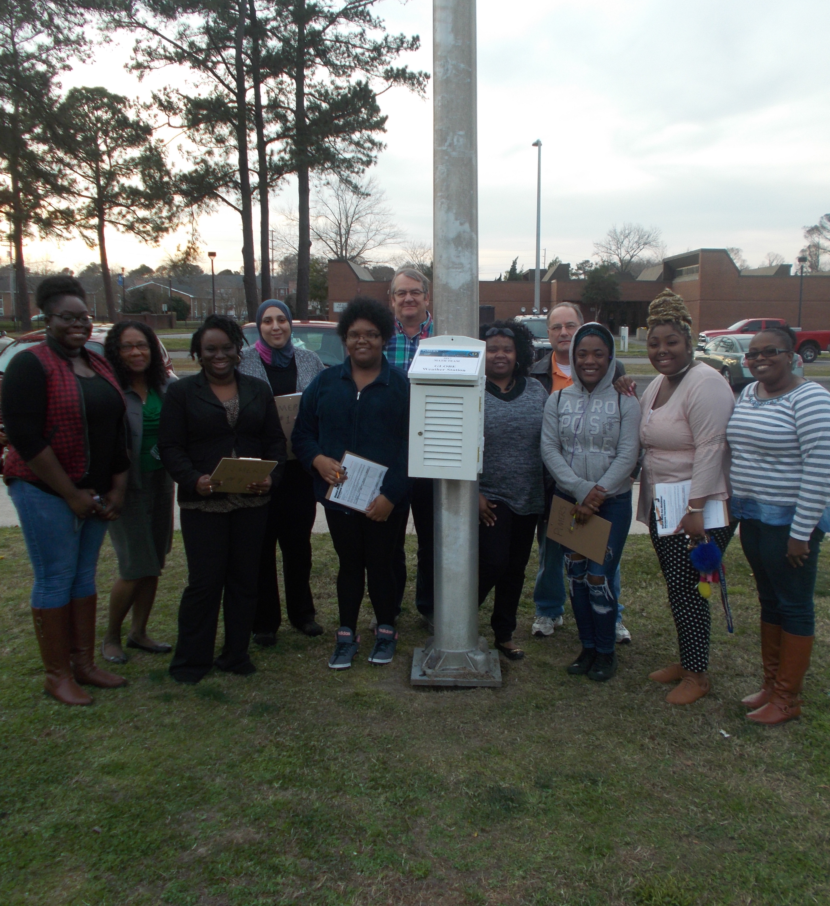
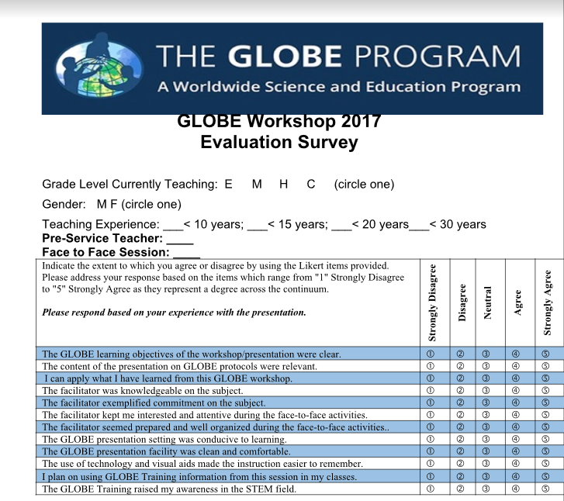
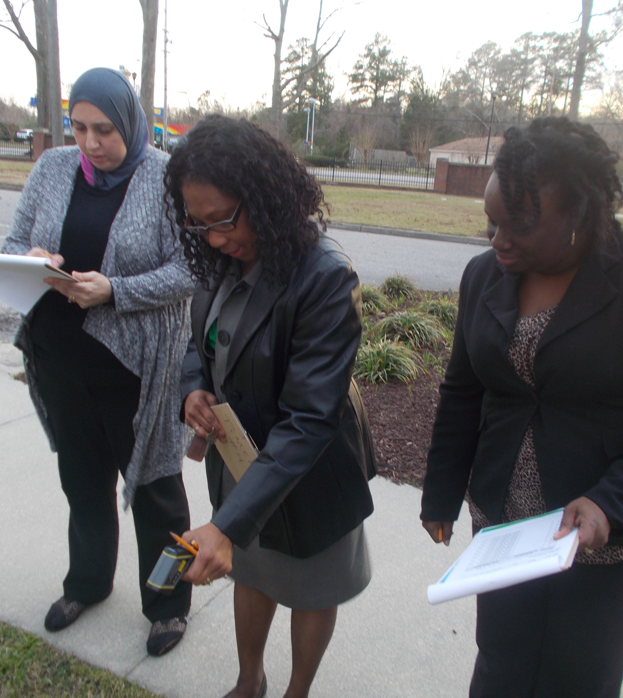
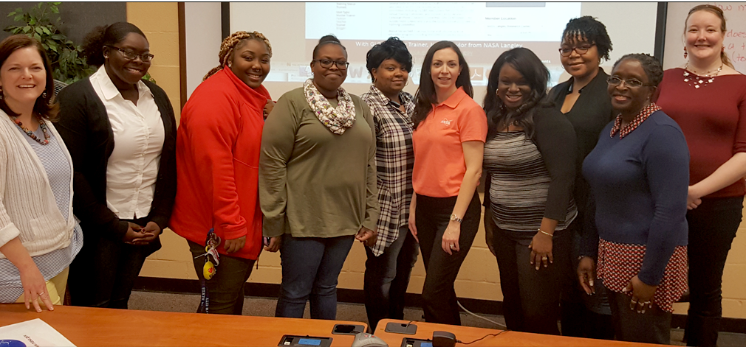
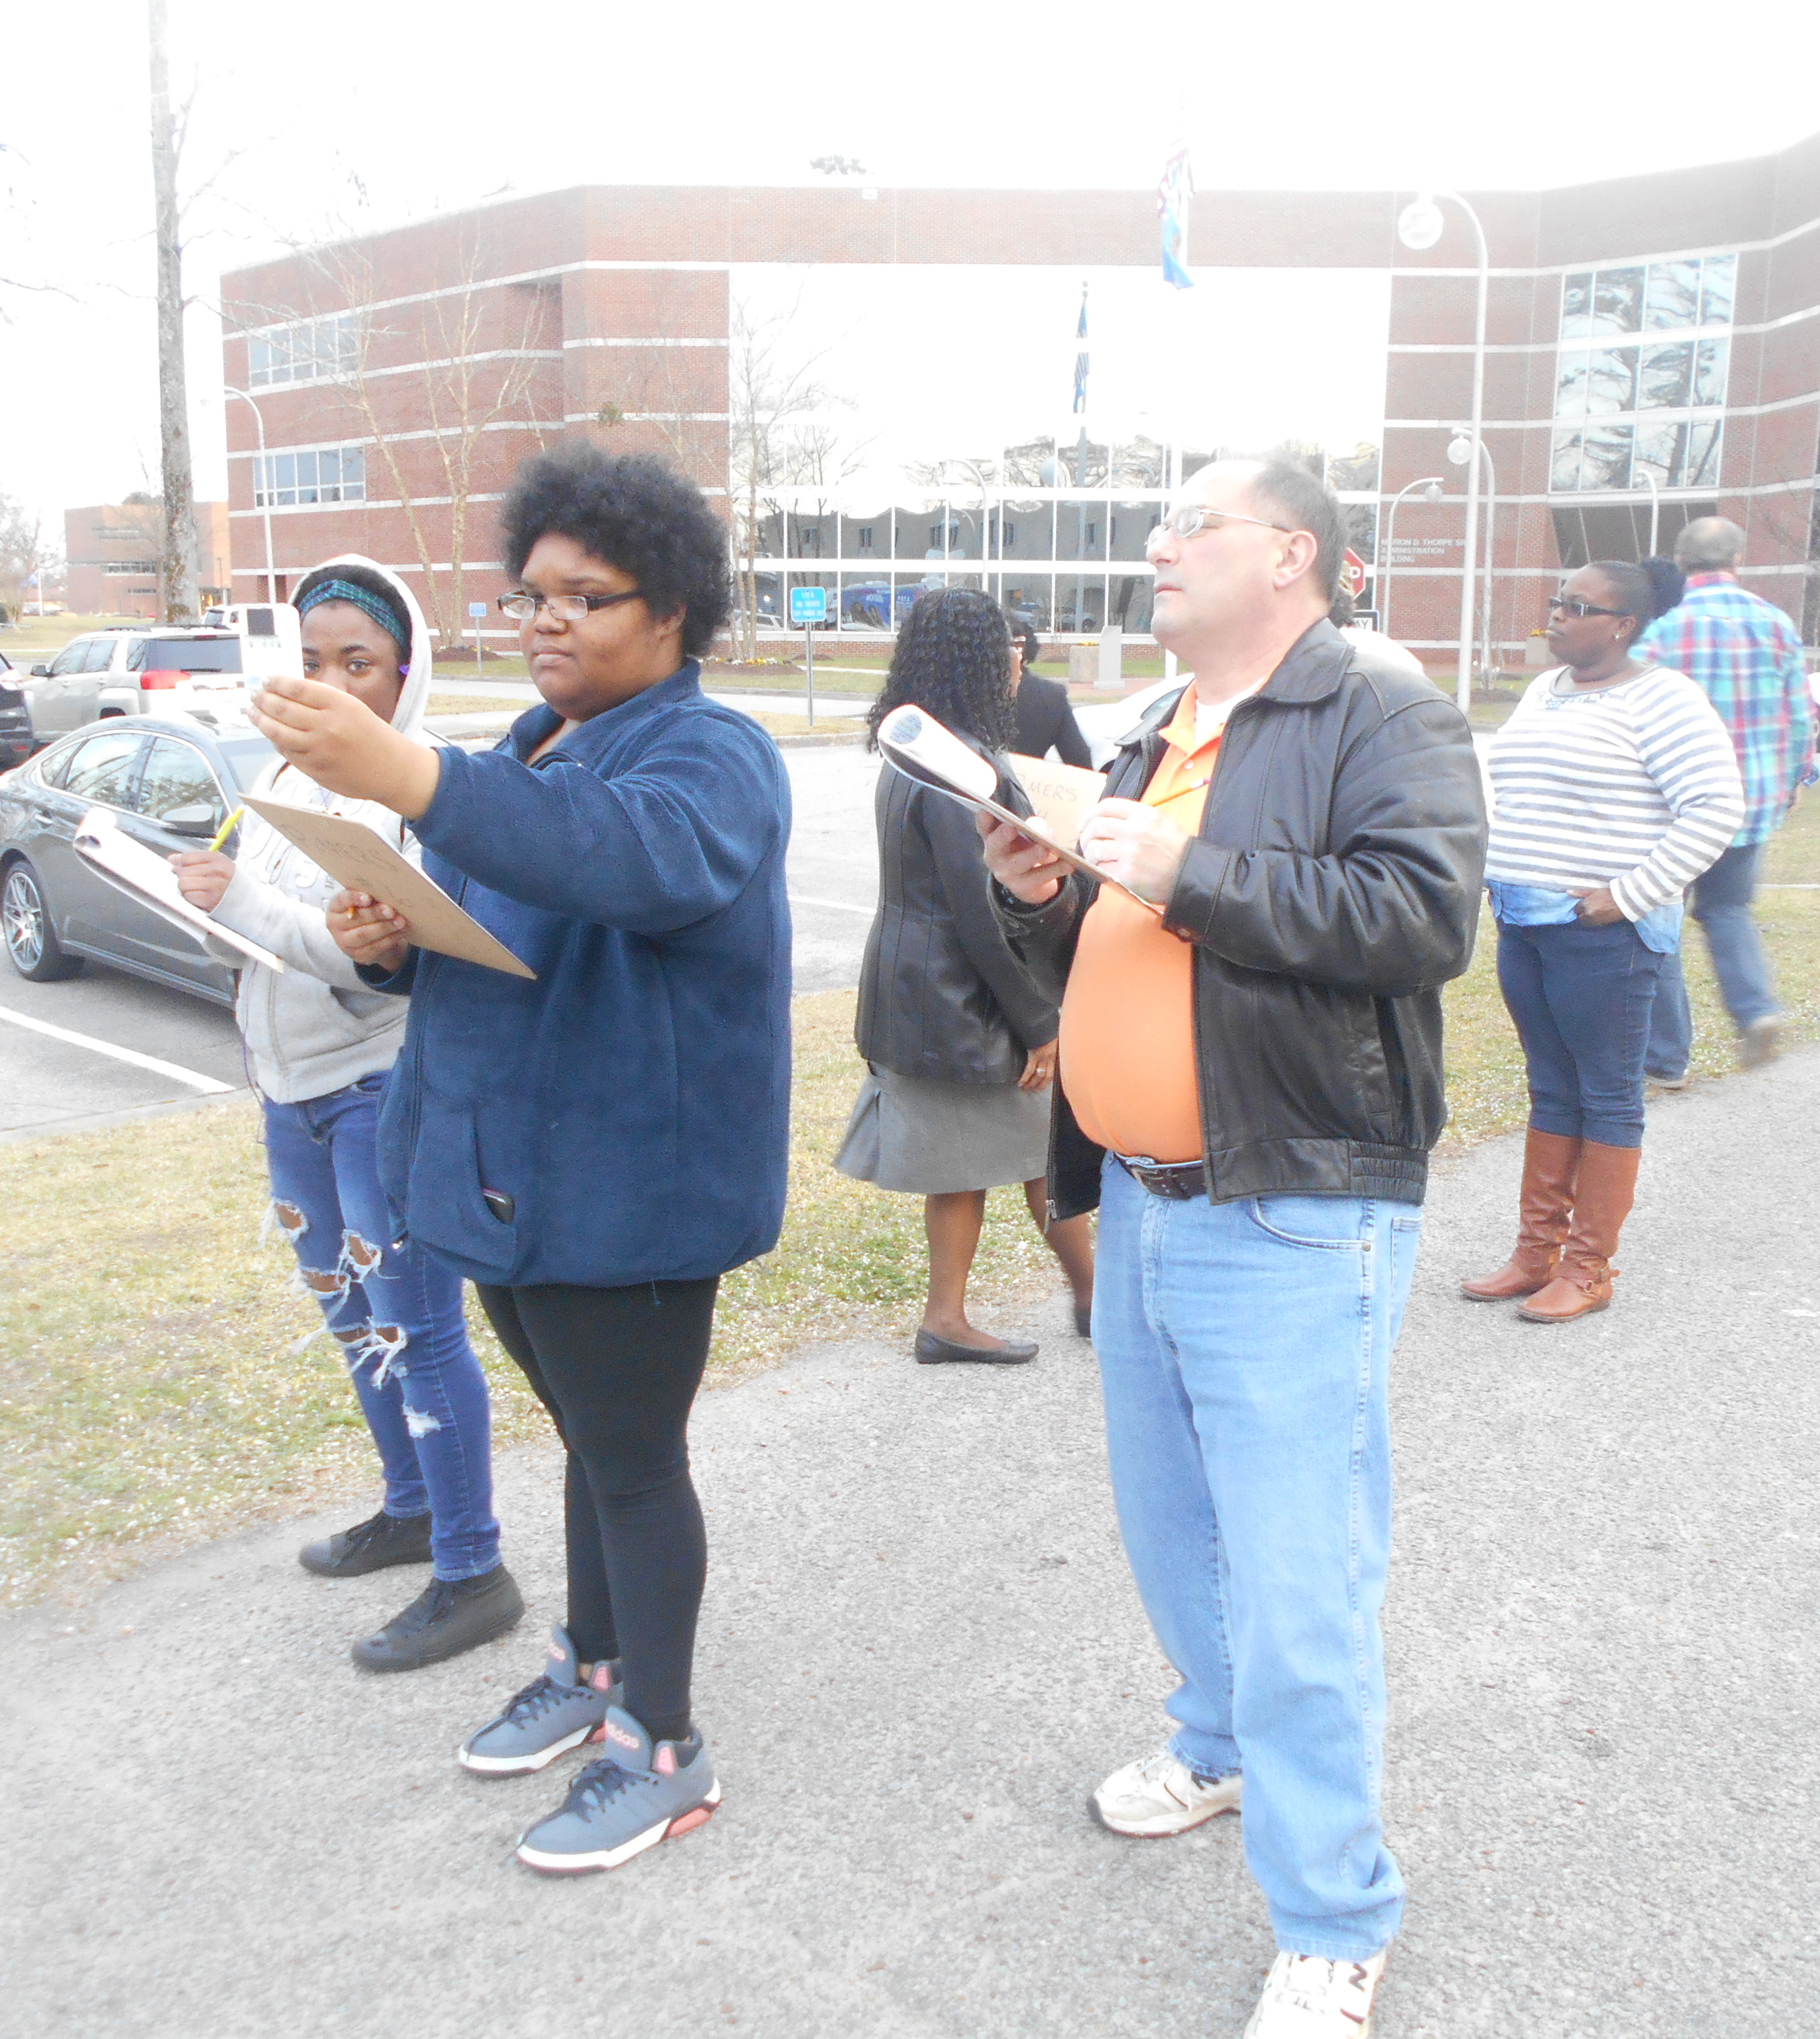
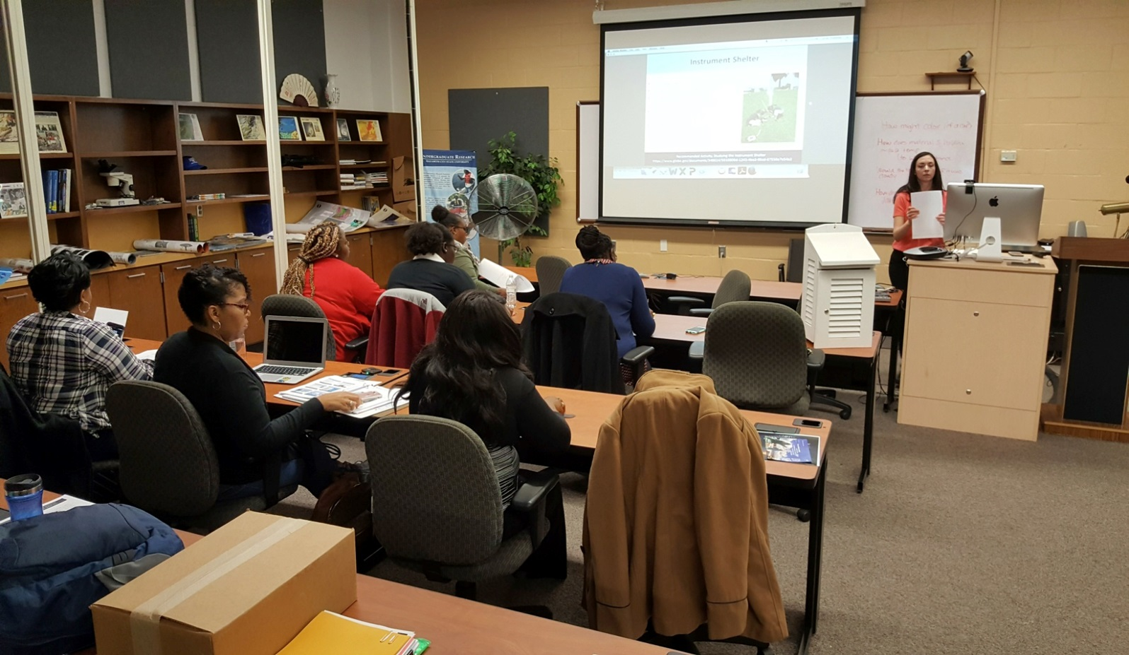
Globe Training for Preservice and Inservice Teacher Education at Elizabeth City State University
Principal Investigator: Dr. Linda B. Hayden (Elizabeth City State University ) Mentor: Dr. Darnell Johnson (Elizabeth City State University ) Joselyn Hathaway, Heaven Tate, Dana Poole, Jessica Hathaway, Dana Chandler (Elizabeth City State University )
ABSTRACT
Global Learning and Observations to Benefit the Environment (GLOBE) is a K-12 environmental education program supported by National Aeronautics Space Administration (NASA), National Oceanic and Atmospheric Administration (NOAA), and National Science Foundation (NSF). GLOBE is a powerful teaching tool that enables students to use hands-on, inquiry-based methods to gather and interpret scientific data. Pathways in Mathematics Education and Remote Sensing (PiMERS) represents a joint effort between Elizabeth City State University (ECSU) and NASA Langley Research Center (LaRC) which held a hybrid regional teacher inservice and student preservice workshop on GLOBE Protocols at on the campus of ECSU located in Elizabeth City, North Carolina in the northeastern region of the state. A Protocol eTraining took place in January 2017 and the face-to-face workshop was held in February 2017. Over a two-week period, students and teachers learned basic GLOBE protocols and formed questions concerning each of the assigned GLOBE topics. During the face to face workshop participants collected data in the field, performed data/laboratory analyses, and compared data submitted by various schools around the world on the GLOBE website. The participants learned about remote sensing and viewed/manipulated images using image-processing software, and were introduced to the study of GLOBE Protocols as applied in northeastern North Carolina as well. Teachers and preservice students were excited about this hands-on experience in GLOBE and stated that this new learning prepared them to pass on this newly acquired knowledge. GLOBE protocols used in the workshop were recommended for incorporation into the current preservice teacher education program at ECSU.
As a result of the GLOBE training, the 2017 PiMERS Mathematics Team at ECSU established three environmental sites on the campus of ECSU. With these three established sites, the research team conducted investigations for the following GLOBE protocols: Clouds, Air Temperature, and Surface Temperature. For atmosphere investigations of air and surface thermometers; minimum, and maximum temperatures were recorded from the area located near the front of the Dixon/Patterson Hall building and the softball field on the campus of Elizabeth City State University. With the newly installed weather station loaned by LaRC, IRT207 Infrared Thermometers and digital multi-day max/min/current thermometers were used to record measurements of air and soil temperatures. For cloud investigations, the total cloud/contrail cover, sky color and visibility, cloud levels: high, mid, and low, and surface conditions were observed and recorded from the open area located near the front of Burnim Fine Arts Complex on the campus of Elizabeth City State University. All cloud observations were done visually.
The collection of environmental data from these three sites around the ECSU campus that encompass these protocols were conducted by four preservice mathematics education students and one university mathematics instructor from the General Studies Program. The team gained a better understanding of Earth System Science, its relationship to mathematics, and interrelated cycles which comprise an integrated system. The mathematics team uploaded the collected environmental data to the GLOBE website and provided environmental data that enabled scientists to help in the study the earth's system. The PiMERS Mathematics Team collected and evaluated obtained data, and created graphical models to express data quantitatively using the GLOBE website data resources.
STATEMENT OF PURPOSE
The purpose of this research was to learn the importance of GLOBE, what this program does for inservice and preservice teachers, and how the protocols can be utilized. A webinar and online GLOBE workshop was hosted by Dr. Jessica Taylor from NASA in January. All participants were directed to complete the online training which introduced them to the GLOBE website and the wide variety of protocols. All of the protocols were based on subjects in the earth science system. In collaboration with Dr. Taylor, preservice and inservice teachers were able to experience face-to-face activities on the campus of ECSU and discover how to incorporate information in the classroom.
RESEARCH QUESTIONS
How can preservice and in-service teachers utilize the GLOBE protocols?
What are the benefits of GLOBE in the classroom?
In what role does Globe enhance critical thinking skills?
Why is GLOBE important for the global community?
CONCLUSION
From participants in the GLOBE workshops and training sessions, it was found that GLOBE training tended to be beneficial to both pre-service students and in-service teachers. GLOBE is not only for K-12 science classrooms, but for the purpose of educating the global community as well. This program has a variety of lessons that are flexible enough to be used on all grade levels. The online training aids in giving a detailed description of each protocol on the GLOBE website. Participants of the GLOBE workshops were allowed to conduct research in activities associated with protocols with a positive insight to science, science education, mathematics education, and research techniques.
GLOBE SURVEY
The 12-question survey was completed by both groups of workshop participants in the February and March workshops. This survey consisted of a series of 12 questions and was used to gauge what participants experienced from the work sessions. Responses were based on personal experience using likert scales from strongly disagree to strongly agree.
METHODOLOGY
This study was conducted at ECSU [7] with 14 participants and consisted of two sessions. The first session was lead by Dr. Jessica Taylor from NASA. During this workshop, she trained 3 inservice teachers and 4 preservice students on three GLOBE protocols: clouds, air temperature, and surface temperature. After becoming GLOBE certified, the PiMERS [5][6] mathematics education team lead the second session with a group of 7 participants. For both sessions, the same tools were utilized for collecting data. For the three protocols we used a cloud identification chart for the clouds, a max and min thermometer for the air temperature, and an infrared thermometer for the surface temperature. All of the participants were able to utilize these tools in order to collect data that would be added to the GLOBE database. At the end of each training session, all 14 participants were given a survey with a series of 12 questions. The questions were based on a likert scale from 1 to 5.
FUTURE WORK
The PiMERS Mathematics Team will use a weather station loaned from NASA LaRC. Materials stored in the weather station will be used collect data that can be added to the GLOBE database. The team plans to set up the weather station in a permanent location and conduct continual research during annual events such as PiMERS Middle School summer program, local school division training, and inservice teacher training. By doing so, the team and other researchers will be able to monitor the local environment and observe seasonal or daily changes. We also plan to present this information to the education department with the goal of having GLOBE become part of the curriculum.
ACKNOWLEDGEMENTS
The 2017 PiMERS mathematics education team would like to thank the CERSER principal investigator Dr. Linda B. Hayden, our mentor Dr. Darnell Johnson, Dr. Jessica Taylor from NASA, and the participants from the workshop and training sessions
CHI – SQUARED STATISTICAL TEST
The Chi-Squared Test showed a comparison of observed and expected values, which are listed above and concludes that the impact of the GLOBE program would be considered a positive factor to influence preservice and inservice teachers.
REFERENCES
"Home - GLOBE.Gov". Globe.gov. N.p., 2017. Web. 22 Mar. 2017.
"National Aeronautics And Space Administration". NASA. N.p., 2017. Web. 22 Mar. 2017.
"NSF - National Science Foundation". Nsf.gov. N.p., 2017. Web. 22 Mar. 2017.
"National Oceanic And Atmospheric Administration". Noaa.gov. N.p., 2017. Web. 22 Mar. 2017.
"Center Of Excellence In Remote Sensing Education And Research". Cerser.ecsu.edu. N.p., 2017. Web. 22 Mar. 2017.
"NASA Pimers :: ECSU". Nia.ecsu.edu. N.p., 2017. Web. 22 Mar. 2017.
"Elizabeth City State University". Ecsu.edu. N.p., 2017. Web. 22 Mar. 2017.
"North Carolina Public Schools". Ncpublicschools.org. N.p., 2017. Web. 22 Mar. 2017.
McClean, Phillip. "Mendelian Genetics". Ndsu.edu. N.p., 2017. Web. 3 Apr. 2017.
8.31529E-07 | 1.34802E-07 | 1.34802E-07 | 8.31529E-07
8.31529E-07 | 8.31529E-07 | 8.31529E-07 | 1.34802E-07
8.31529E-07 | 8.31529E-07 | 8.31529E-07 | 8.31529E-07

