Slide 1
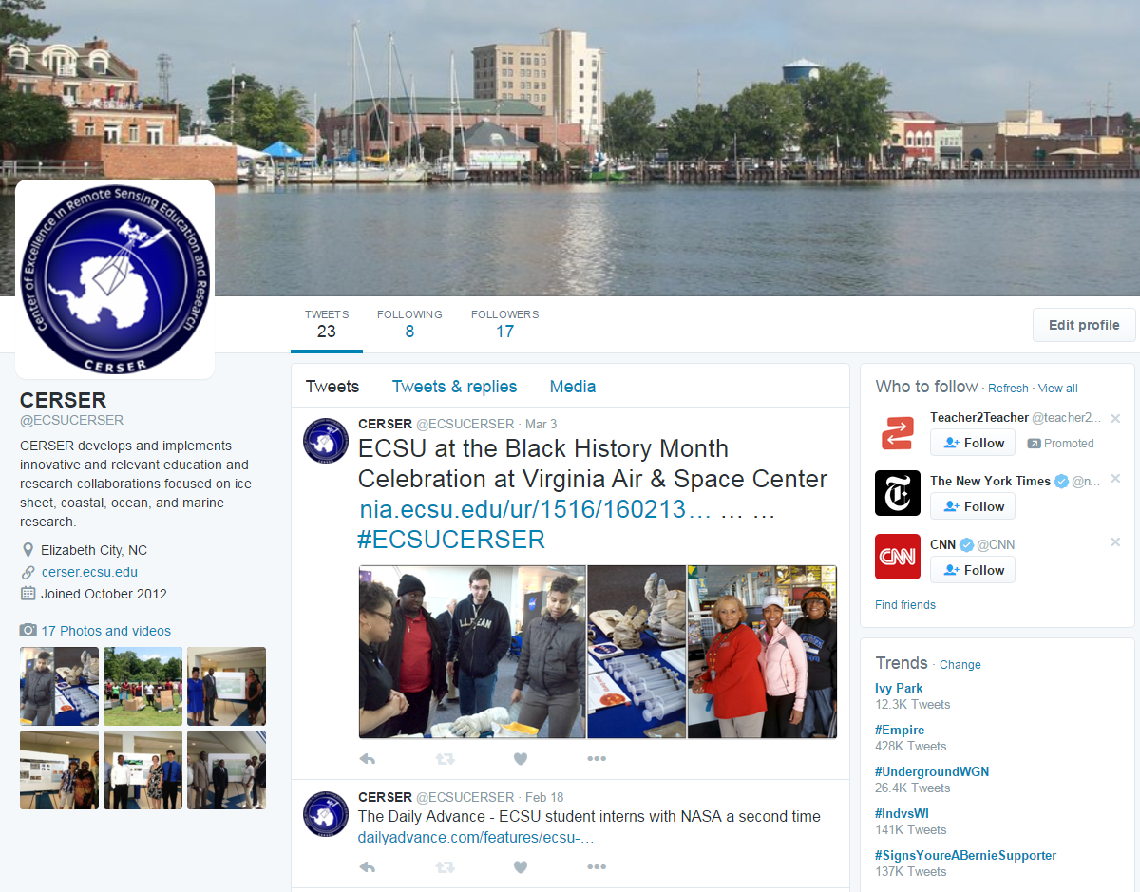
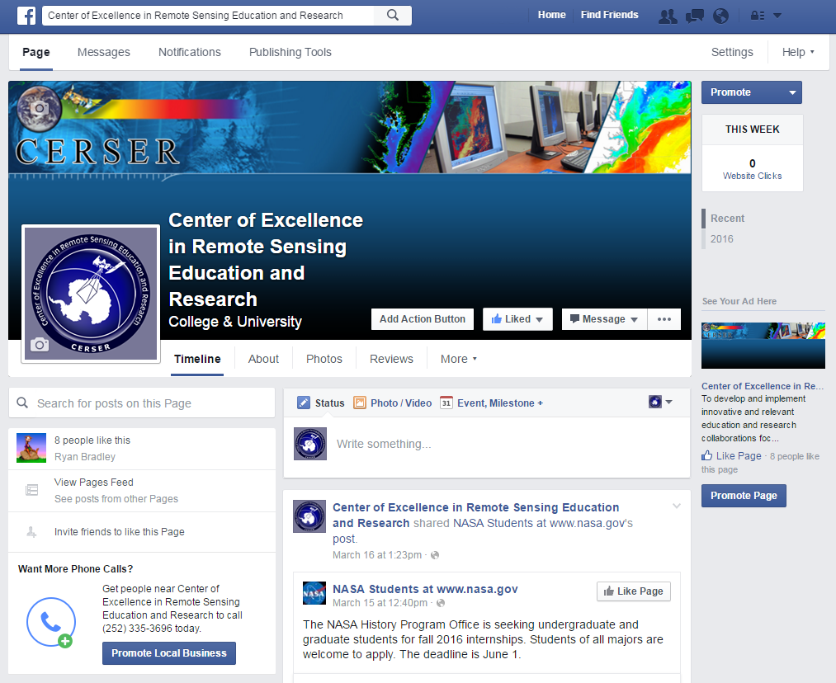
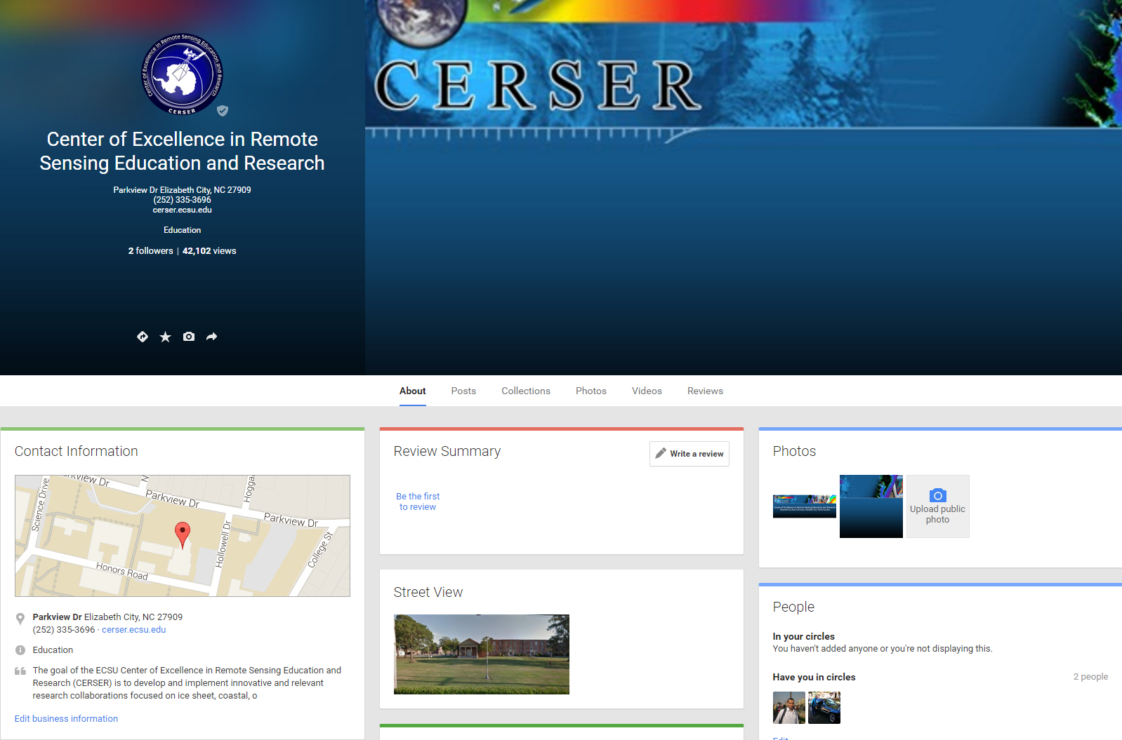
Implementation of Social Media for Dissemination of Research Activities at the Center of Excellence
in Remote Sensing Education and Research at Elizabeth City State University
2015-2016 :: Anissa Norman, Antonio Guion, Charles Hockaday Jr, Joel Gonzalez-Santiago Mentor Mr. Jeff Wood :: Center of Excellence in Remote Sensing Education and Research :: Elizabeth City State University :: Elizabeth City, North Carolina, USA
ABSTRACT
APPLICATIONS
METHODOLOGY
RESULTS
The Center of Excellence in Remote Sensing Education and Research (CERSER) at Elizabeth City State University (ECSU) was established in the spring of 2003 to develop innovative and relevant research collaborations focused on remote sensing applications to coastal, ocean, marine, and polar research. The program has supported various other projects through grants and collaborations with the National Science Foundation, Office of Naval Research, the National Aerospace and Space Administration, and other various government and educational entities.
CERSER has utilized the web site located at http://cerser.ecsu.edu to provide documentation of research activities to funding agencies, faculty, students, and event attendees from its inception. This site provides information regarding past, current, and future events as well as research conducted by students in the program and with affiliated universities or government agencies. The sister site located at http://nia.ecsu.edu is the original location used for documentation of information from previous and current research projects under this program and remains active today.
In order to reach out to a broader audience, the implementation of social media was explored during this project. The goal of this research was to establish a social media presence on Facebook, Twitter, Instagram, and Google+.
This project explored the implementation of each social media application and identified appropriate audiences and methods of disseminating information. The methods included what information to post, when to post it, and how often to share. Best practices were taken from both educational and commercial sources
I. Facebook
Facebook is a defined as a “free social networking website” that is available in 37 different languages. It accommodates different features such as the Marketplace so that users can post and read different ads. Groups is another feature that allows users with similar interests to put together and interact. Events allows users to create calendar events and publicize them, along with inviting people. Pages allows users to build pages within their own account and invite people to like them and promote it.
II. Twitter
Twitter is an online social networking service that enables users to send and read short 140-character messages called “tweets”. Registered users can read and post tweets, but those who are unregistered can only view them. Users access Twitter through the website interface, SMS, or mobile device app. Another feature individuals use on Twitter is called Direct Messaging. A Direct Message, also known as a DM, is used to privately send messages to another user. These messages will only be shown between the user and the person that the user is having the conversation with. Users can also upload images and images to their account.
III. Instagram
Instagram is an online mobile photo-sharing, video-sharing, and social networking serving service that allows users to take images and videos, and share them publicly or privately. Instagram is a free mobile application that is distributed through App Store and Google Play and is available for iPhone, iPad, iPod Touch, and Android, while other third party Instagram apps are available for BlackBerry and Nokia-Symbian Devices. In September 2015, Instagram version 2.0 became available and included new and live filters, instant tilt–shift, high resolution pictures, no mandatory borders, one click rotation, and an updated icon.
IV. Google+
Google+ is a social media site created by Google. A wide array of individuals currently use Google applications for functions such as internet searches, site summaries, and email. Google+ combines many of Google’s programs into one program.
Google+’s most common function is posting text and images. Both are created by clicking on the “What’s new with you” section on the new Google+ or by choosing the post function on the classic view. Each has privacy setting which can be edited while posting. It can range from posting public to posting so that one other user may see it. When images are accepted into the uploader they are resized to fit the Google+ format.
During this project accounts were created with Facebook, Twitter, Instagram, and Google+. Different methods were utilized with each to set up the accounts and configure them for the CERSER program use.
I. Facebook
Facebook users have the ability to create web style “Pages” inside of Facebook for uses such as promotions, small businesses, and advertisements.
The first step taken in creating the Facebook CERSER page was to log into the CERSER administrator’s Facebook account and go to the “Create Page” label on the left hand side of the page. The next task consisted of the user choosing the category of “Company, Organization, or Institution” and then the subcategory of Education. Next the administrator would type in the “Company Name”, and afterwards select the “Get Started” button. The administrator was directed to the next page which was titled “Set up Name”, this page consisted of three sections ( “About”, “Profile Picture”, and “Preferred Page Audience”). In the “About” section a brief description of the page was written and a unique web address was added. The web address for the CERSER Page is www.facebook.com/ecsucerser.
This project entailed many decisions that would not affect a basic user of these social medias. The fact that a Facebook account if required to be an individual and cannot be a group or organization led the researchers into Facebook Pages. This required the researching of the capabilities of Pages and their usage.
Twitter and Instagram were easily set up and required minimal input to get to a working state. A valid email and posting of logos and cover photos allowed the sites to come online quickly.
Google Plus held a variety of options, but each were dependent on obtaining a basic Google account first. One of the options was utilizing the Google My Business to add CERSER to searches and maps as well as supplying the interactivity of a standard Google Plus account. This option was utilized as a starting point for future research into this social media.
CONCLUSION
Entering the social media arena is a daunting task when taking on several sites at once. This did allow the team to compare capabilities between each and possible interaction between them. While Facebook has been the most used in the past, Instagram and Twitter are quickly gaining ground in usage. These three medias hold an advantage over Google+ in their interactive use and their simplicity. Google Plus also lacks the number of users that many social media sites currently have making its future unknown.
This project forms the basis for further research into the usage and interactivity of the four social media platforms implemented. Social media is a fluid dynamic with constantly changing faces making it an ever moving target.
III. Instagram
The process of creating an Instagram account was completed through a mobile device. The first step to creating the account for CERSER was to download the app through the Apple App Store or the Google Play Store. The CERSER web master’s email was used in the account registration. Instagram prompted the registrant to make a username, then set up a password for the account. Instagram further asked the user to input their full name. A privacy sitting can be set if it is not desirable for the name to be displayed. The CERSER logo was then added to the account. Once the process was complete, Instagram provided the chance to follow other accounts.
IV. Google+
In order to create the CERSER Google+ page, a Google account was created using the webmaster's email. Once the Google account is established, the administrator's name is then entered followed by the gender. Profile, logo, and cover images are then uploaded to the account. Much of the information needed is connected to the users Google account so entering of information is minimal.
FUTURE WORKS
INTRODUCTION
This project should continue to develop and be monitored for future events. The project will use google analytics to further examine others who use the social media sites. With Google analytical data, the developers could gather information about the viewer's age, gender, and more to determine if the social media content is being promoted correctly.
This research will also be included in events such as Celebration of Women in Mathematics, IGARSS, and Summer REU. In these events attendees will be able to create posts with the appropriate hashtag. Through the hashtags the project should also be able to concur information about the successfulness of the events, which events are most posted about, how to further improve events, and better ways to integrate social media to the events. The project should also be able to obtain content from the current students when they go to conferences and other school related activities.
Currently there are three major social media applications that CERSER is using. The project should be able to post to all three of these sites with automated applications for easier use. The accounts should be able to be linked to one another with ease and in a way that does not interrupt the privacy of the administrators.
Social media is defined as "a group of Internet-based applications that build on the ideological and technological foundations of Web 2.0 and that allow the creation and exchange of user-generated content."[1] Web 2.0 is a description of web sites that have client-developed content and are interactive. This is not a technical specification, but describes how pages are created and used.
Research institutions conduct research and publish their findings. Many institutions are able to publish, yet their research is not easily accessible to members of the public. The goal of this research project was to target solutions for research institutions trying to promote themselves and their research. The study consists of using social media in order to promote the Elizabeth City State University (ECSU) Center of Excellence in Remote Sensing Education and Research (CERSER). The research demonstrates how to properly use social media for effective communication, promotion, and usefulness. The research explored the social media applications Facebook, Google+, Twitter, and Instagram.
Many programs currently also allow users to easily share and promote their content. For this reason, this research focused on social media applications by implementing four of those which are the most popular. The constant changes social media applications undergo makes any study applicable for the time of the research. Therefore this research is based on the current time span in which the study was conducted.
II. Twitter
The first step in creating the CERSER Twitter account was to utilize the web master’s email address to create the account. The next step was to go to the Twitter website and select “sign up” at the top right of the page. Information was then entered: name, phone or email, and a password. Once all of that was entered a username was chosen for the account. The last step was to confirm the account by checking the CERSER administrator’s email and selecting the confirmation link sent by Twitter.
Once the administrator completed the account setup the homepage was then displayed. The administrator can now enter tweets at the top of the screen in the box labeled “What’s happening?” A tweet is information that the administrator is conveying and may take the form of text, images, and/or videos. Once the administrator finishes putting in the information, they select “Tweet” and Twitter will post the information to the timeline. The location of the administrator can be attached to the tweet.
ACKNOWLEDGEMENT
REFERENCES
We would like to acknowledge the assistance of Dr. Linda Hayden who has provided the funding and the opportunity for this projects completion.’
Extensive list of references available at:
http://nia.ecsu.edu/ut/1516/teams/social/i

