Slide 1
Implementation of Social Media for Dissemination of Research Activities at the Center of Excellence in Remote Sensing Education and Research at Elizabeth City State University
2016 ECSU Academic Year REU

Slide 2
Team Members
Antonio Guion
Charles Hockaday Jr.
Anissa Norman
Joel Gonzalez-Santiago
Mentor: Mr. Jeff Wood

Slide 3
Abstract
The Center of Excellence in Remote Sensing Education and Research (CERSER) at Elizabeth City State University (ECSU) was established in the spring of 2003 to develop innovative and relevant research collaborations focused on remote sensing applications to coastal, ocean, marine, and polar research. The program has supported various other projects through grants and collaborations with the National Science Foundation, Office of Naval Research, the National Aerospace and Space Administration, and other various government and educational entities.

Slide 4
Abstract
CERSER has utilized the web site located at http://cerser.ecsu.edu to provide documentation of research activities to funding agencies, faculty, students, and event attendees from its inception. This site provides information regarding past, current, and future events as well as research conducted by students in the program and with affiliated universities or government agencies. The sister site located at http://nia.ecsu.edu is the original location used for documentation of information from previous and current research projects under this program and remains active today.
In order to reach out to a broader audience, the implementation of social media was explored during this project. The goal of this research was to establish a social media presence on Facebook, Twitter, Instagram, and Google+.

Slide 5
Abstract
This project explored the implementation of each social media application and identified appropriate audiences and methods of disseminating information. The methods included what information to post, when to post it, and how often to share. Best practices were taken from both educational and commercial sources.

Slide 6
Introduction
Social Media
Web 2.0
Notes:
Social media is defined as "a group of Internet-based applications that build on the ideological and technological foundations of Web 2.0 and that allow the creation and exchange of user-generated content."[1] Web 2.0 is a description of web sites that have client-developed content and are interactive. This is not a technical specification, but describes how pages are created and used.

Slide 7
Publications
Research Purpose
Facebook
Twitter
Instagram
Google+
Notes:
Research institutions conduct research and publish their findings. Many institutions are able to publish; yet their research is not easily accessible to members of the public. The goal of this research project was to target solutions for research institutions trying to promote themselves and their research. The study consists of using social media in order to promote the Center of Excellence in Remote Sensing Education and Research (CERSER). The research demonstrates how to properly use social media for effective communication, promotion, and usefulness. The research explored the social media applications Facebook, Google+, Twitter, and Instagram.
Many programs currently also allow users to easily share and promote their content. For this reason, this research focused on social media applications by implementing four of those that are the most popular. The constant changes social media applications undergo makes any study applicable for the time of the research. Therefore this research is based on the current time span in which the study was conducted.

Slide 8
Facebook
Harvard University
1.59 Billion Users
Face Books
Platforms
Privacy
Notes:
Facebook is on online social networking site first developed for students at Harvard University.
There were 1.59 billion active Facebook users as of December 31, 2015.
The term Facebook is derived from the online directories at universities commonly known as “face books.”
Facebook is also available as an application for smartphones and tablets.
Facebook does have a range of privacy option for its users. Users have the option to make their own pages private, public, or for friends only.

Slide 9
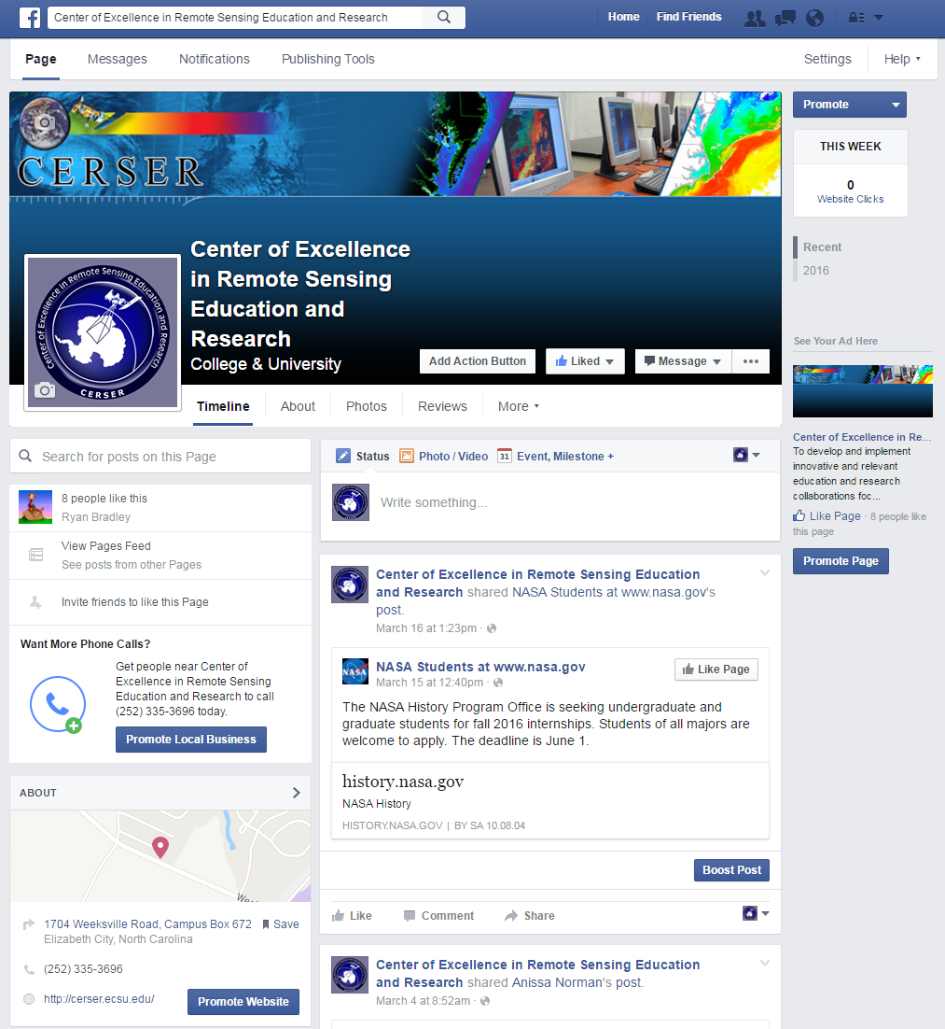
Facebook Usage
Profile
Status Post
Media
Limits
Notes:
Once a user is registered they then create a profile and connect with other users as “friends.” They can then exchange messages, photos, videos or create a general update known as a “status post” which can be viewed by anyone depending on certain parameters set by the user. Status updates can be in the form of videos, pictures, words, and music. Users can comment, like, and share the status updates making the application interactive. There is not a limit to how many pictures a user can post on Facebook. Users can also join or create groups based on common themes such as family, work, or school.

Slide 10
Facebook Features
37 Languages
Markets
Groups
Events
Pages
Presence Technology
Notes:
Facebook is a defined as a “free social networking website” that is available in 37 different languages. It accommodates different features such as the Marketplace so that users can post and read different ads.
“Groups” is another feature that allows users with similar interests to put together and interact.
“Events” allows users to create calendar events and publicize them, along with inviting people.
“Pages” allows users to build pages within their own account and invite people to like them and promote it. Lastly,
“Presence Technology” lets the user see if their friends are online or not. If a user is online, it is denoted by a green dot by their user name. If they are on their mobile phone, there will small phone icon beside their name.

Slide 11
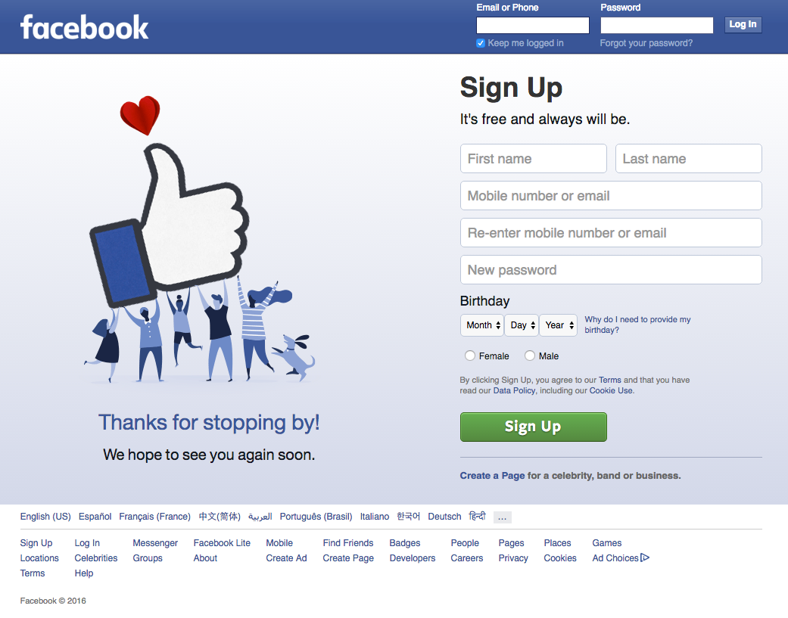
Facebook Sign-up
Signing up
Account settings
Pages
Notes:
In order to be a part of Facebook, users have to sign up using a valid email address or phone number. Then, users need to have a strong password to prevent hacking.
Once the account has been created, the user can go in and change to name of the account by going to their account settings.

Slide 12
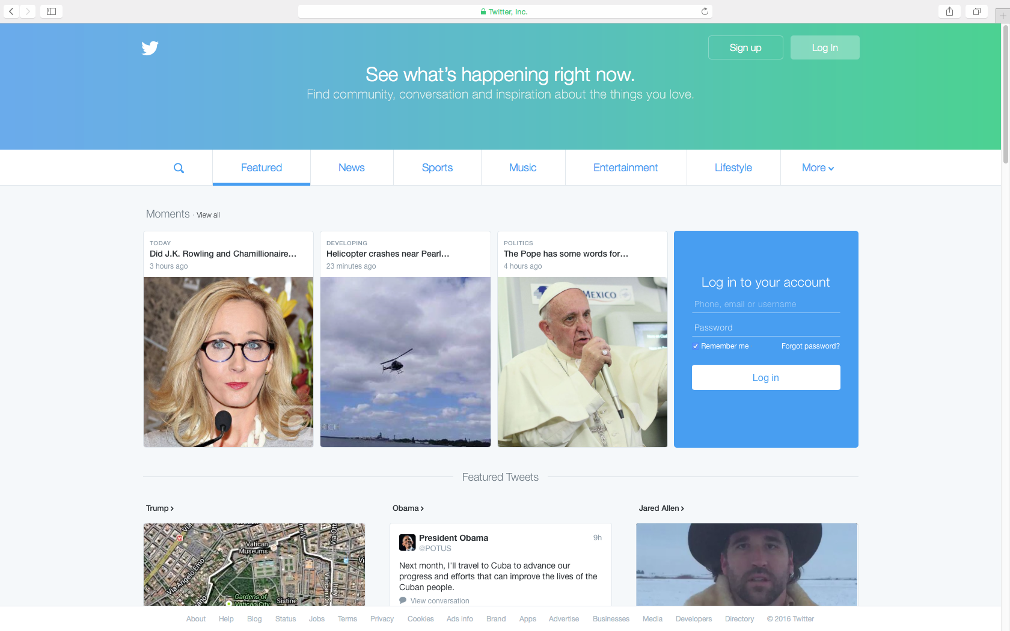
Twitter
Purpose
Users
Access
Twitter Inc.
Platform
Notes:
Twitter is an online social networking service that enables users to send and read short 140-character messages called “tweets”.
Registered users can read and post tweets, but those who are unregistered can only view them.
Users access Twitter through the website interface, SMS, or mobile device app.[10]
Twitter Inc. is based in San Francisco and has more than 25 offices around the world. [11]
The application can be used on both a computer and a phone.

Slide 13
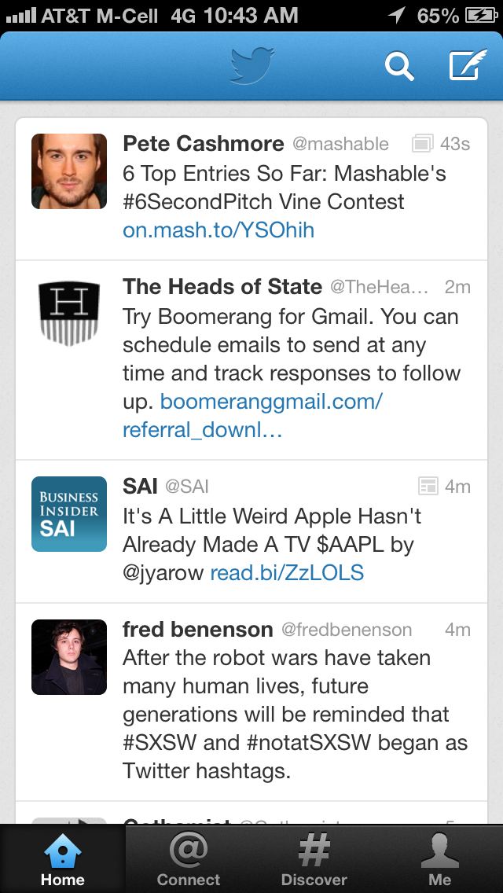
Twitter Beginnings
2006
Usage
Following
Tweets
Notes:
Twitter was developed in 2006.
When this software was created most of the users were in their late teens, but usage has spread to all ages at this time.
The website was created so that individuals could “follow” one another, which is comparable to Facebook’s method of “adding” individuals.
On Twitter individuals with accounts make posts titled “tweets”. When tweets are made, individuals are discussing what is going on at the moment or what is going on around where they are. They can take the form of text, image, or video. A tweet is also known as a status, where the user can place the user's thoughts or what the user is taking part in

Slide 14
Twitter Development
Odeo
2007 South by Southwest Festival
Notes:
Twitter was developed at the company Odeo, which consisted of Jack Dorsey, Biz Stone, and Evan Williams.
Twitter expanded greatly in 2007 when the company used a marketing plan to display Twitter messages on large plasma screens at the South by Southwest Festival. On that day, Twitter usage went from 20,000 tweets per day to 60,000 per day. During the event, Twitter won an award in the blog category.

Slide 15
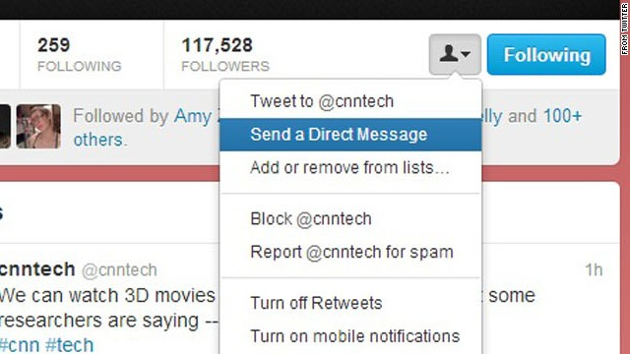
Twitter Features
Direct Messaging
Retweeting
Privacy
Notes:
Another feature individuals may use on Twitter is Direct Messaging. A Direct Message, also known as a DM, is used to privately send messages to another user. These messages will only be shown between the user and the person that the user is having the conversation with.
Users can also upload images and images to their account. These images or videos can be either labeled as a favorite or “retweeted” (forwarded) to another user. Retweeting enables information to spread across Twitter networks.
Tweets are made public by default and available to all users. Twitter has a privacy setting that allows you to protect your tweets so that they are only available to those who are “following” you.

Slide 16
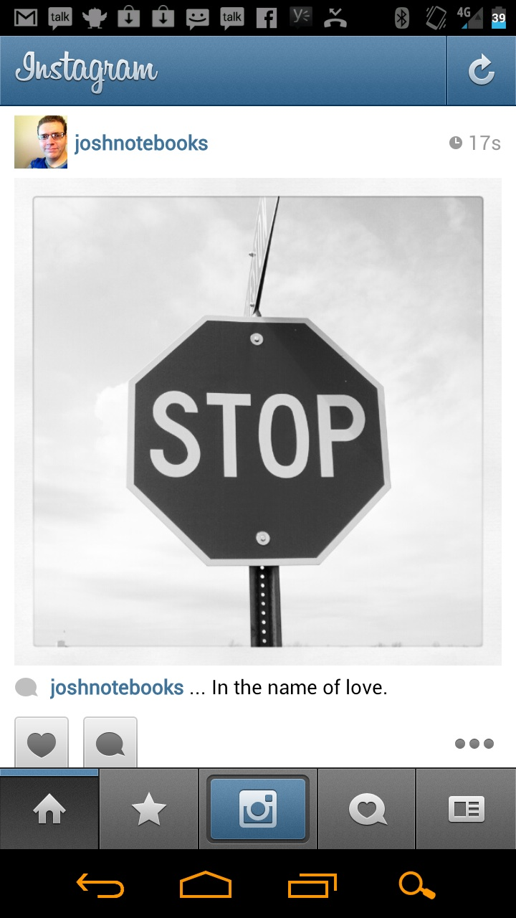
Instagram
Overview
Mobile App
Notes:
Instagram is an online mobile photo-sharing, video-sharing, and social networking serving service that allows users to take images and videos, and share them publicly or privately.
Instagram is a free mobile application that is distributed through App Store and Google Play and is available for iPhone, iPad, iPod Touch, and Android, while other third party Instagram apps are available for BlackBerry and Nokia-Symbian Devices.

Slide 17
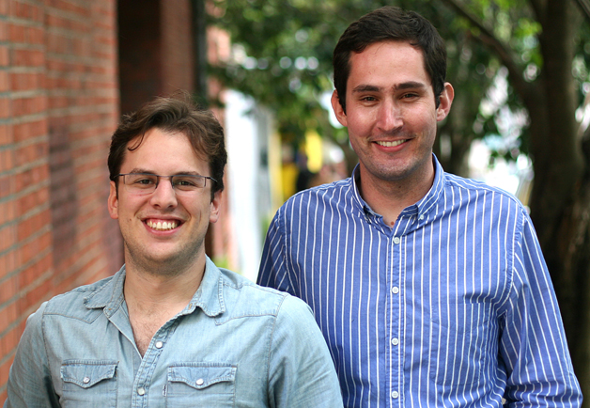
Instagram Development
Founders
Odeo
Burbn
Instant Camera + Telegram
Acquisition by Facebook
Notes:
Kevin Systrom and Mike Krieger founded Instagram, on October 6, 2010 as freeware, in twenty-five languages. [https://www.instagram.com/about/us/]
Before developing Instagram, Mr. Systrom was a part of the startup Odeo, which later became Twitter, and worked two years at Google dealing with programs such as Gmail and Google Reader.
The two were working on an HTML5 check-in project, Burbn, and decided to focus their development on mobile photography.
The term “Instagram” is a combination of “instant camera” and “telegram.”
In 2012 purchased Instagram

Slide 18
Google+
Overview
Development
Orkut, Wave, Buzz
Notes:
Google+ is a social media site created by Google. Many people already use Google for everyday electronic functions such as Internet searches, site summaries, and email. Google+ combines many of Google’s programs into one program.
Vic Gundotra created Google+ with a special Google team. The idea was to create a social media platform with Google’s vision of organizing the world’s information.
Google has had previous work with social media sites such as Orkut, Wave, and Buzz. Orkut was very popular in South America and India but did not become popular in the United States and Google terminated it. Mr. Gundotra left the company in 2014, yet the site continues to grow under the guidance of the vice president of engineering, David Besbris.

Slide 19
Google+ Features
Circles
Hangouts
Events
Polls
Notes:
Google Circles is a function that allows users to define categories to other users. This is a one-way relationship in which the user will categorize a second user under a certain circle such as family, friends, acquaintances, co-workers, or any other user defined category. The circles created make it easy to share information with specific users. The users may also be part of multiple circles you assign them to. If Joe is a personal friend and a co-worker he can be in both circles. He will receive both shared content for the co-workers and friends circle. Circles is a good solution to the Facebook’s friends system where everyone had priority on the user's wall.
Hangouts is a video chatting service that can be used for instant communication with family, friends, or coworkers. It provides teleconferencing functions such as sharing live video, text instant messaging, clear audio, and screen sharing. The program is free and integrated within the Google system. Therefore, users have access to Hangouts as its own application, within Google+, and on mobile devices.
Google Events is a function in which users create invitations for an activity. The user can view images for that event and can find the date the image/video was taken, organize by the groups or user, and by number of shares on the images. Adding images/videos can be performed by anyone who is in the event. If the creator of the event does not want users to post images/videos they can remove the privilege. Images can also be removed by deleting the image/video or reporting the image/video if it violates the terms and conditions provided by Google+.
Google Polls is available to be created on the Classic Google+ but can still be voted on the newer version of Google+. Polls are used to gather information from your circles or individuals that it was emailed to.

Slide 20
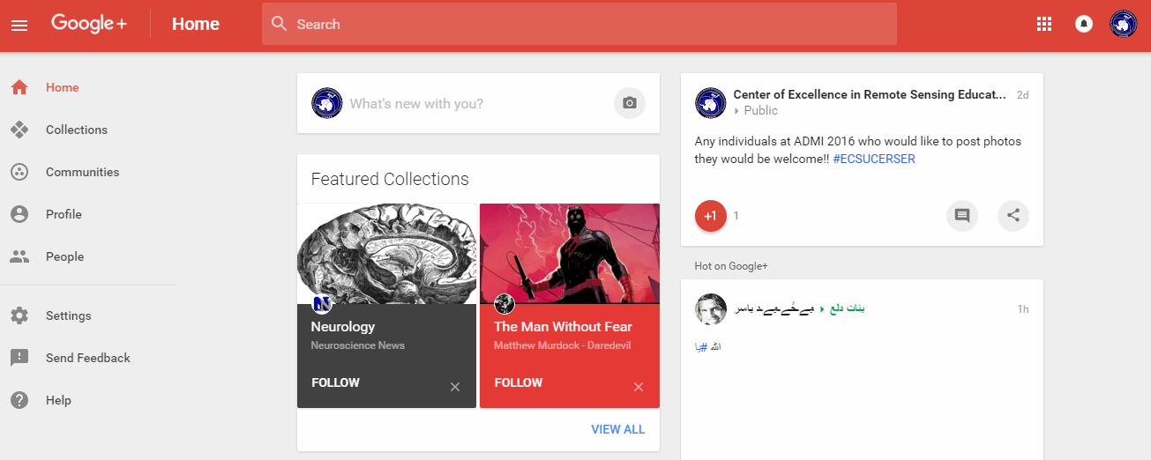
Google+ Posts
Posting
Privacy
Images
Notes:
Google+’s most common function is posting text and images. Both are created by selecting the “What’s new with you” section on the new Google+ or by choosing the post function on the classic view.
Each has privacy setting which can be edited while posting. It can range from posting public to posting so that one other user may see it.
When images are accepted into the uploader they are resized to fit the Google+ format. The number of images that can be stored on Google+ is unlimited, but must be separated into albums which can consist of no more than 1000 images.

Slide 21
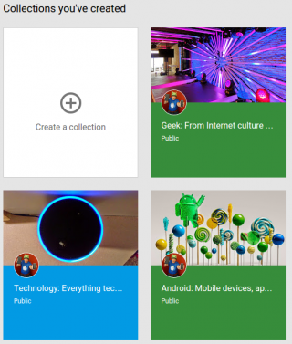
Google+
Collections
Communities
Ads
Classic
Notes:
Communities and collections are two aspects of Google+, which can be confusing.
Collections are created by one user and that user can post inside of the collection. Other users can “follow” the collection to view the content on their stream.
Communities are a collaborative page for multiple people. Anyone with permissions can post and share content into the community. It creates a collaborative section to Google+ in which many people can post, comment, and communicate with one another.
Unlike many other websites that sell user’s information to provide relevant advertisements Google+ does not have any advertisements. This is one of the benefits from having an all in one account from Google.
The new version of Google+ has removed many features of classic Google+. Therefore, by removing features, Google is creating a simpler Google+. The new layout focuses on information through one column. The menus are also simple and located on the left as a sidebar.

Slide 22
Hashtags
Overview
Etymology
Internet Relay Chat (IRC)
Comments
Notes:
A hashtag is a phrase after the pound symbol or hash mark that is used to categorize an Internet post.
They can be used to express an emotion, describe an object or event, or as a filler for the post.
The word hashtag is a combination of hash mark, describing the symbol, and tag, describing the grouping of posts.
Hashtags were designed for Internet Relay Chat originally and then implemented in Twitter, a social media application.
Today they have been implemented in many social media websites.
While originally meant to categorize social media posts, users also now include hashtags to make humorous comments such as: #awkward, #funny, and #happyfriday.

Slide 23
Facebook: Sign-up
Facebook.com
Screen Prompts
Submit
Profile picture
Notes:
Facebook
How to Sign Up
A user can sign up for Facebook by going to Facebook.com and scrolling down to the “Sign Up” section.
Follow the screen prompts such as “First Name”, “Last Name”, “email or mobile number”, “Re-enter email or mobile number” (this is used for confirmation purposes), “New Password” and lastly the user's birthdate.
Next, the user needs to select submit. After the user has signed up, they can upload a profile image.

Slide 24
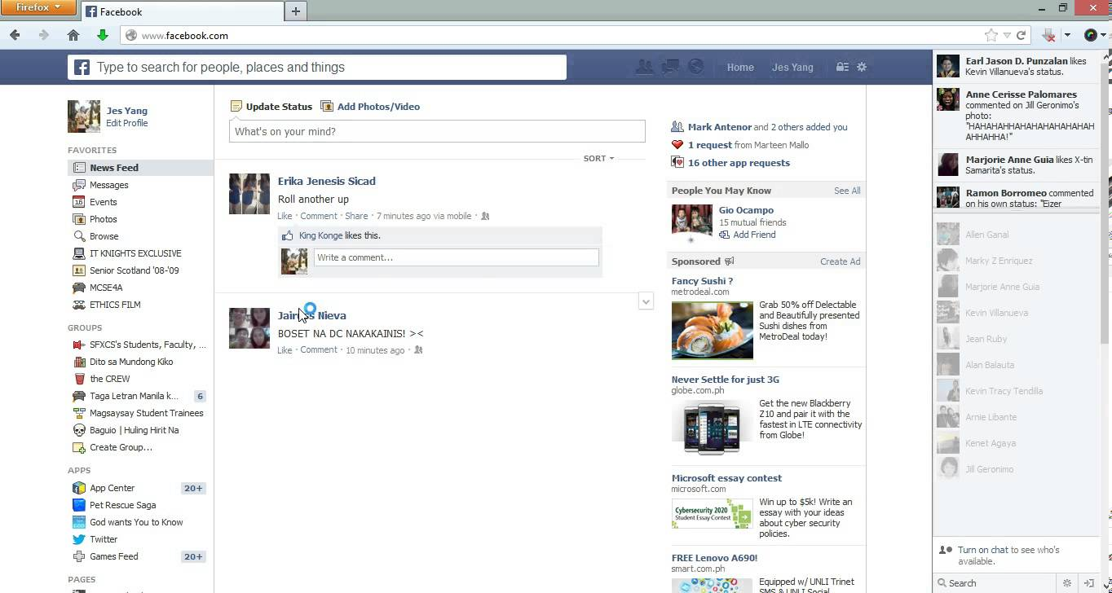
Facebook: Interface
News Feed
Menu Sections
Messenger
Presence
Notes:
Description of Interface
The next page that is displayed is the “News Feed”. Here, users can post statuses, which are in the form of words, images/videos, or any combination of the two.
The “News Feed” page is split up into three sections. On the left hand side of the screen there is the user’s name and profile image. Under that there is an option to edit the image.
The menu on the left has sections labeled “Favorites”, “Apps”, “Groups”, “Friends”, “Interests”, “Pages, “Developer”, and “Events”. These sections contain items with filters for posts and applications.
Within the “Favorites” section there are tabs labeled “News Feed”, “Messages”, “Events”, “Saved” (this is where the links that users want to save for later are stored), and lastly, “Sale Groups”.
The “Apps” section has tabs for applications, which can extend the capabilities of the page.
The “Groups” section has the groups that the user is in.
The “Friends” section has the friend groups such as “Close Friends”.
At the bottom of a Facebook page, is the Messenger. Messenger is used as a method of communication with others through Facebook. The box of the screen is labeled “Chat” and next to it is a number, and this number tells the user how many of their contacts are online. Another way to describe how messenger works is through the use of presence technology. Presence technology lets the user see if their friends are online or not. If a user is online, it is denoted by a green dot by their user name. If they are on their mobile phone, there will small phone icon beside their name.

Slide 25
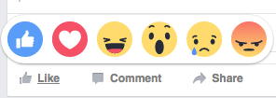
Facebook: Posting
Status
Like, Comment, Share
React
Comment
Share
Notes:
Posting Statuses
Users can post a status on Facebook. A status is information that can be displayed in the form of text or an image/video
This is done by selecting the “What’s on your mind?” box in the center of the screen. Here, the user can type in their desired text. Images can be uploaded to the page also.
After this is done, the user selects the “Post” button and a status has been made. This status can be found on the “News Feed” and on the user’s personal timeline. When users log on to Facebook, they can see the status also.
Users have the option to “Like”, “Comment”, and “Share” the status. They also can “react” to posts now.
Users also have the opportunity to comment on statuses also.
Sharing statuses is most common of Facebook users. Sharing is the reposting of a status, image, or a combination.

Slide 26
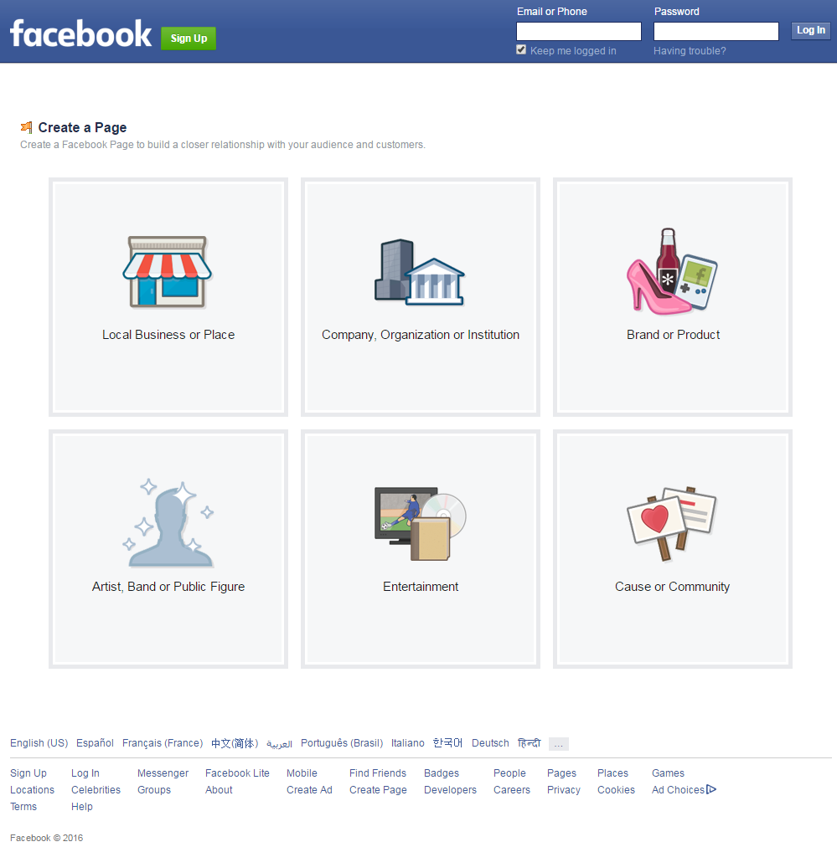
Facebook: Pages
Log in
Create Page
Category
Company Name
Notes:
Creating the a Facebook Page
Facebook users also have the ability to create their own pages inside of Facebook. These are called “Pages”.
Pages can be created for uses such as promotions, small businesses, and advertisements.
The first step taken in creating the Facebook CERSER page was to log into the CERSER administrator’s Facebook account and go to the “Create Page” label on the left hand side of the page.
The next task consisted of the user choosing the category of “Company, Organization, or Institution” and then the subcategory of Education.
Next the administrator would type in the “Company Name”, and afterwards select the “Get Started” button.

Slide 27
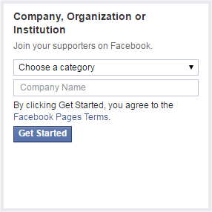
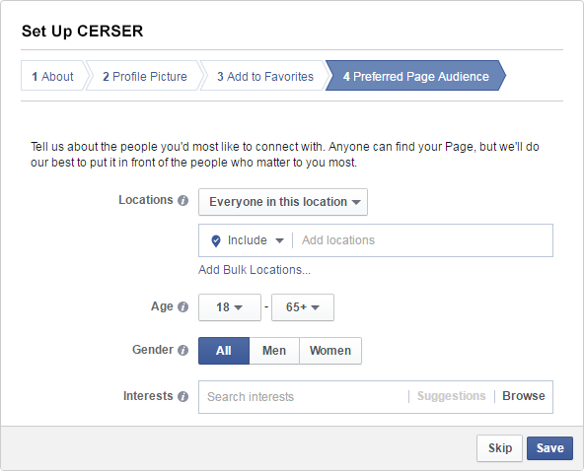
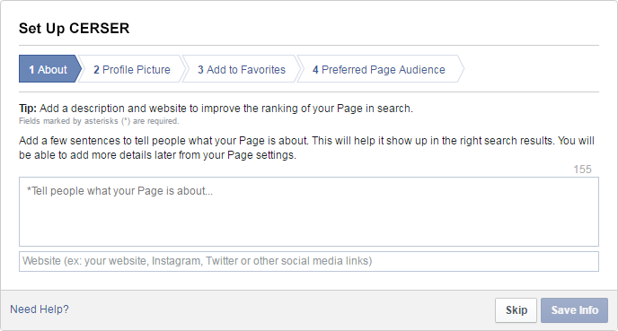
Facebook: Pages
Set up Name
Notes:
The administrator was directed to the next page which was titled “Set up Name”, this page consisted of three sections (“About”, “Profile Picture”, and “Preferred Page Audience”).

Slide 28
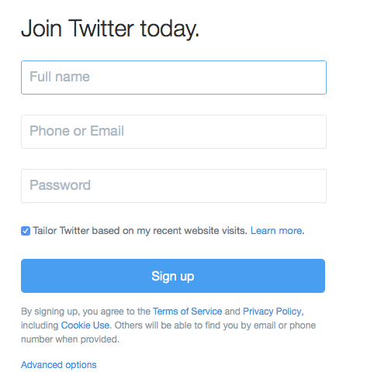
Twitter: Sign Up
Email
Sign Up
Name, Phone or Email, and a Password
Username
Confirmation
Notes:
The first step in creating the CERSER Twitter account was to utilize the web master’s email address to create the account.
The next step was to go to the Twitter website and select “sign up” at the top right of the page.
Information was then entered: name, phone or email, and a password.
Once all of that was entered a username was chosen for the account.
The last step was to confirm the account by checking the CERSER administrator’s email and selecting the confirmation link sent by Twitter.

Slide 29
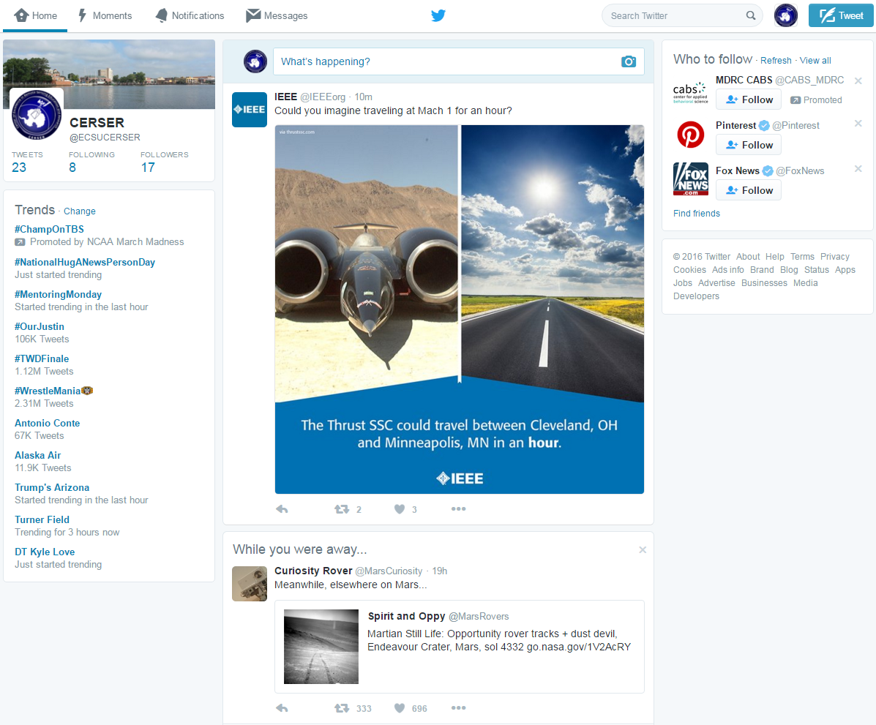
Twitter: Set Up
Tweets
Privacy
Mute
Block
Notes:
Once the administrator completed the account setup the homepage was then displayed.
To change the privacy settings, the CERSER administrator should select the profile picture at the top right and select settings from the drop down menu.
Mute is a feature that allows the administrator to remove an account’s Tweets from the CERSER timeline without unfollowing or blocking that account.
Block is another function that disables a user from following CERSER on Twitter.
To mute or block an account the administrator will go to the user’s homepage and select the three dots under the tweet that was placed on the CERSER timeline.

Slide 30
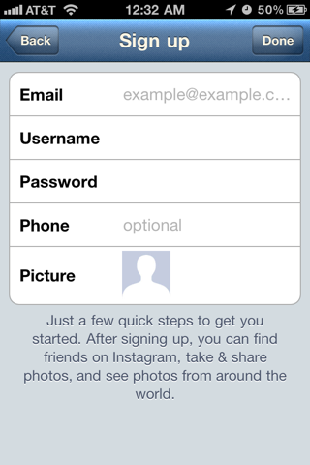
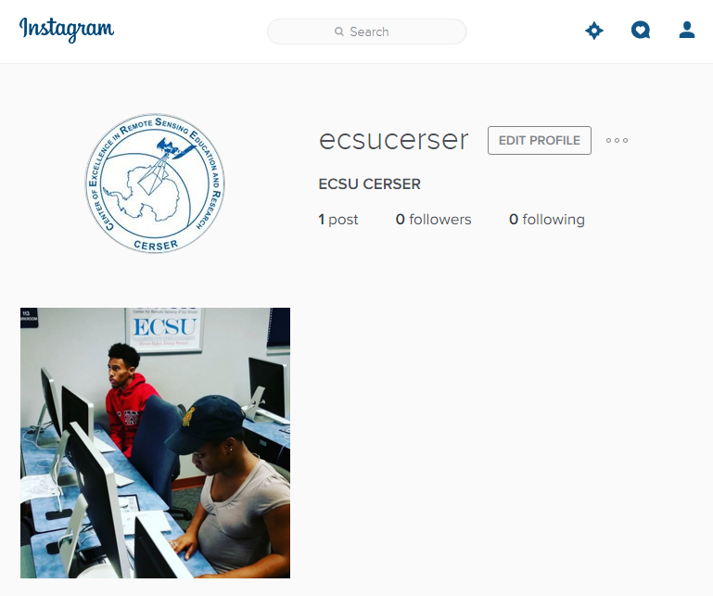
Instagram
Mobile
Download
Email
Username/Password
Privacy Setting
Logo
Posting
Notes:
The process of creating an Instagram account was completed through a mobile device.
The first step to creating the account for CERSER was to download the app through the Apple App Store or the Google Play Store.
The CERSER web master’s email was used in the account registration.
Instagram prompted the registrant to create a username then set up a password for the account. Instagram requested the user to input their full name.
A privacy sitting can be set if it is not desirable for the name to be displayed.
The CERSER logo was then added to the account. Once the process was complete, Instagram provided the chance to follow other accounts.
The CERSER admin can now post images and three to sixty second videos, and be able comment and use hashtags and tagging in posts.

Slide 31
Google+
Email
Information
Community
Notes:
In order to create the CERSER Google+ page, a Google account was created using the webmaster's email.
Once the Google account is established, the administrator's name is then entered followed by the gender. Profile, logo, and cover images are then uploaded to the account.
A CERSER Community was established in order to link program alumni with the current page. This will be a two information link allowing the alumni to view what is going on inside CERSER today and gives the program a method of following graduates through their continued instruction and careers.

Slide 32
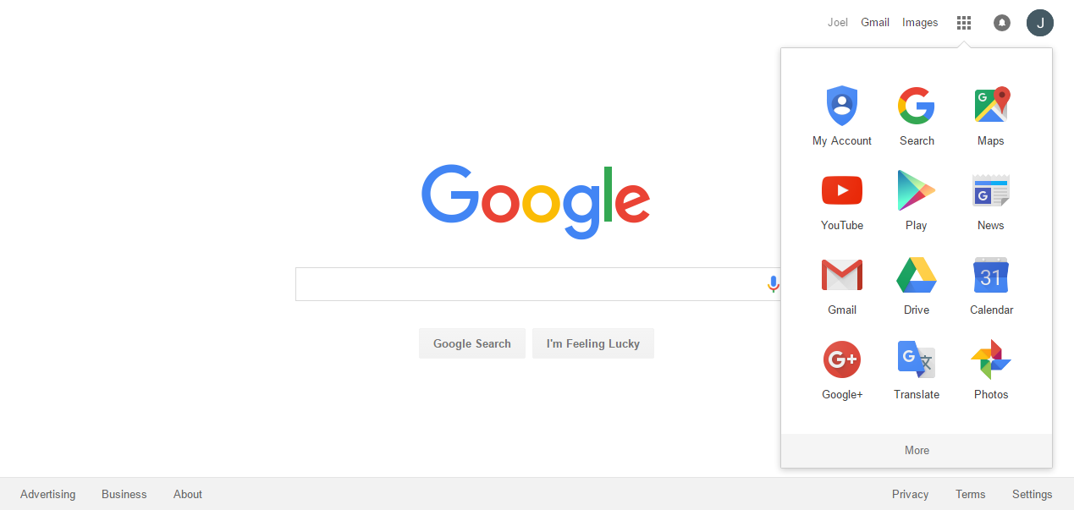
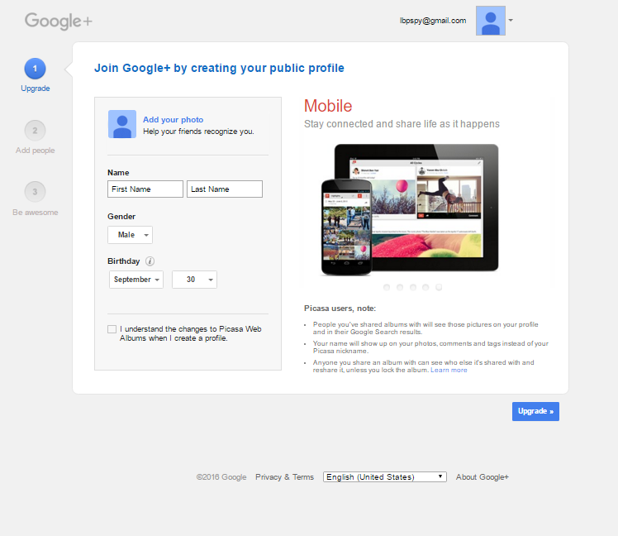
Sign up for Google+
Create an account
Log into account
Open more Apps
Click on Google+
Follow directions and upgrade your account
Notes:
Images are located in the Google+> Screen Shots folder.

Slide 33
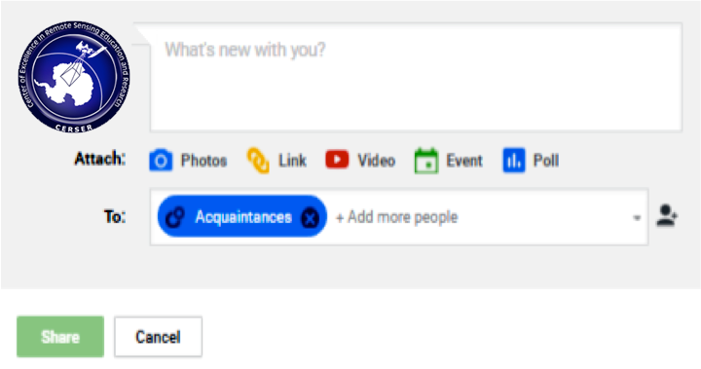
Creating a Post
Select text
Type the message
Add more content
Select circles or individual
Select share
Notes:
At the top of the stream select text
In the first text box type the message
The second section allows you to add more content
The “To:” section allows you to select your circles or individual to post to
Then click share

Slide 34
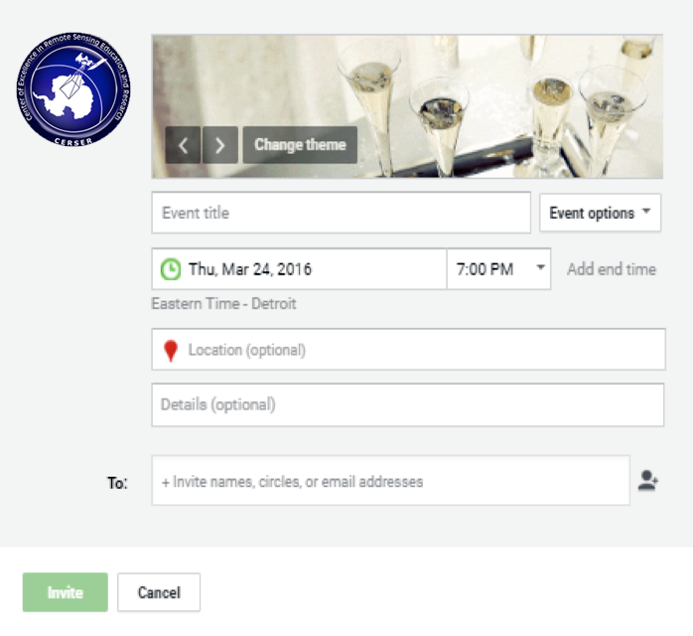
Creating an Event
Select event
Event Info

Slide 35
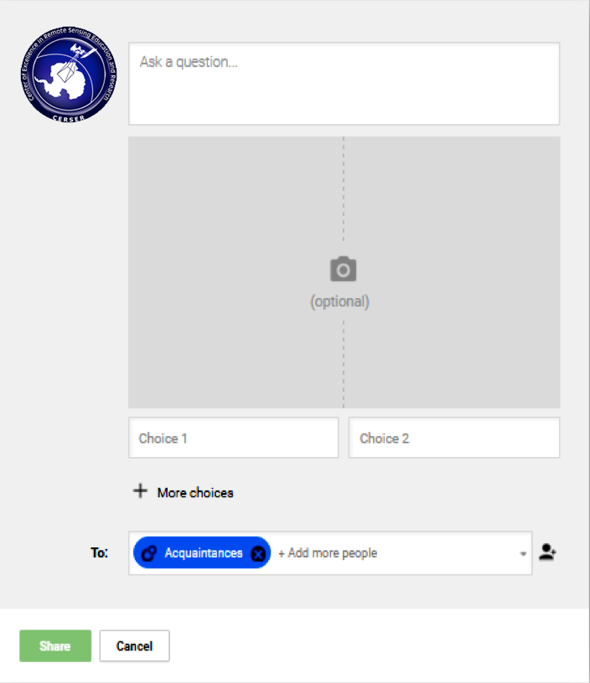
Creating a Poll
Select Poll
Ask the question at the top text box
Add image is desired
Add answers
Click more choices to add more choices
Select circles and then share

Slide 36
Google Circles
Menu button
Select People
Notes:
From the homepage, click the menu button at the top right
Select People

Slide 37
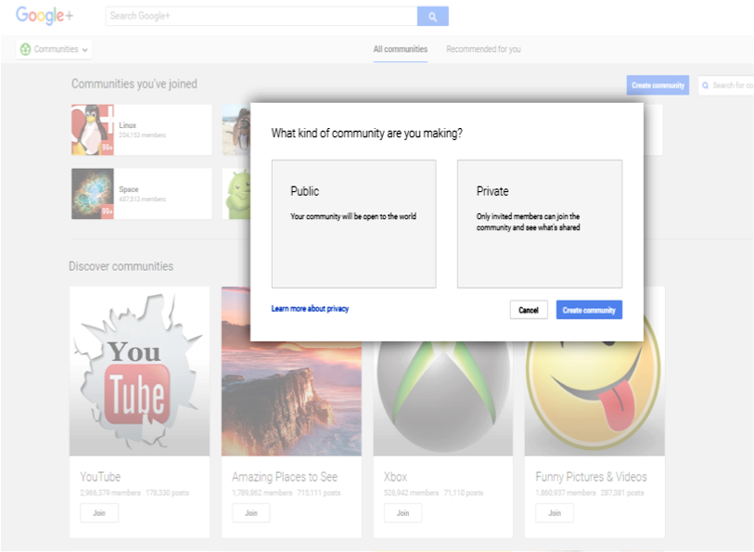
Create Community
Side menu
Community
Create community
Private/Public
Wizard
Notes:
Click on the side menu
Click on community
Create community
Choose whether private or public
Fill out the following wizard

Slide 38
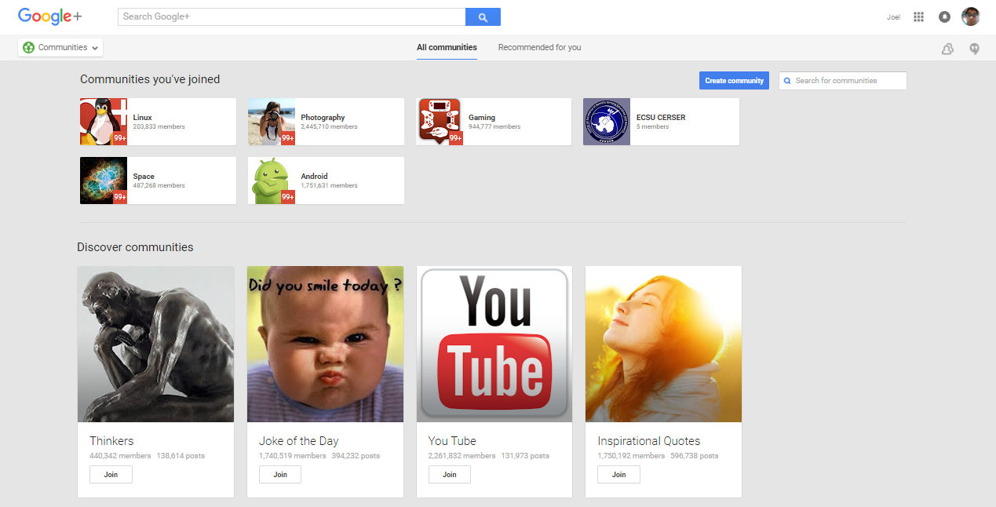
Join a Community
Click on the side menu
Click on community
Search for the community wanted
Click join

Slide 39
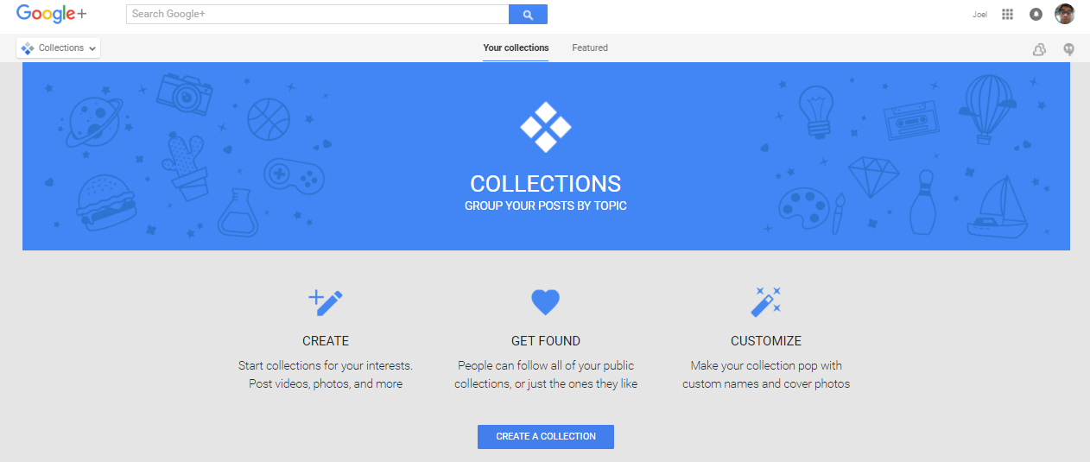
Creating a Collection
Side menu
Collection
Create Collection
Follow the steps
Notes:
Click on the side menu
Click on collection
Click create collection
Follow the steps that follow

Slide 40
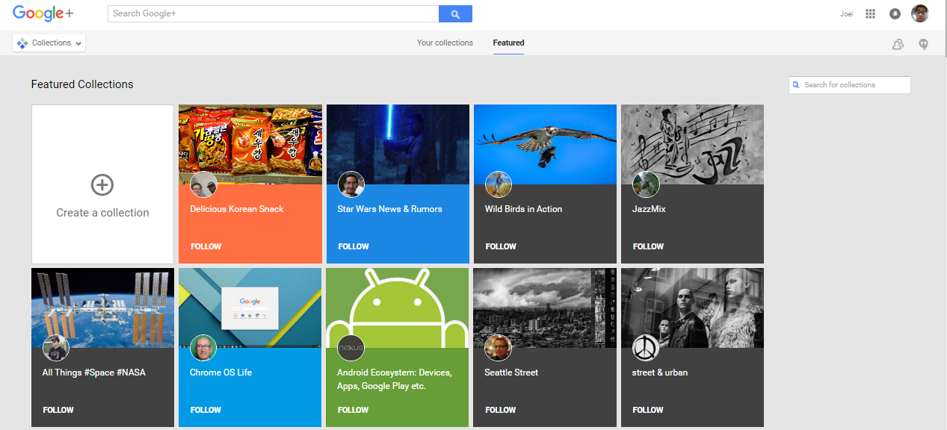
Following a Collection
Side menu
Collection
Featured tab
Search/Select Follow
Notes:
Click on the side menu
Click on collection
Select the featured tab
Search for specific collection and click follow

Slide 41
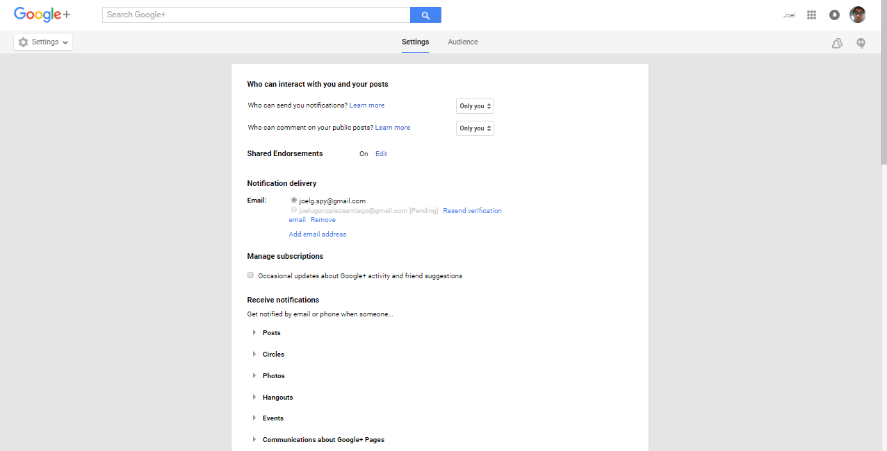
Settings
Side menu
Settings
Select the settings desired
Notes:
Click on the side menu
Click on settings
Scroll down and select the settings desired

Slide 42
Hashtags
Promotion
Number
Events
CERSER Gathering
Notes:
Hashtags should be used strategically to promote CERSER by including relevant hashtags to every post to social media.
With every post created, CERSER should have a maximum of three hashtags and a minimum of one.
On Twitter, certain hashtags can be created for the event attendees to use such as #ECSURW16 for the 2016 ECSU Research Week.
CERSER can view the tweets, or posts, made by both event organizers and attendees using the hashtag. This can be utilized to see photos, gather feedback, and promote certain events.

Slide 43
Results
Individual vs. Organization
Facebook
Twitter/Instagram
Google+
Notes:
This project entailed many decisions that would not affect a basic user of these social medias.
The fact that a Facebook account is required to be an individual and cannot be a group or organization led the researchers to use Facebook Pages.
Facebook Pages are used by many major universities such as Boston College, UC Berkley, and Michigan State University. [http://blog.hubspot.com/marketing/best-college-facebook-pages]
Twitter and Instagram were easily set up and required minimal input to get to a working state. A valid email and posting of logos and cover photos allowed the sites to come online quickly.
Google Plus held a variety of options, but each was dependent on obtaining a basic Google account first. One of the options was utilizing the Google Pages to add CERSER to searches and maps as well as supplying the interactivity of a standard Google Plus account. This option was utilized as a starting point for future research into this social media.

Slide 44
Conclusion
Comparison
Facebook vs Twitter/Instagram
Google+
Notes:
Entering the social media arena is a daunting task when taking on several sites at once. This did allow the team to compare capabilities between each and possible interaction between them.
While Facebook has been the most used in the past, Instagram and Twitter are quickly gaining ground in usage. Facebook still remains the most used and most versatile of the four social medias researched with its access to many applications for extending the capability of the page.
These three medias hold an advantage over Google+ in their interactive use and their simplicity. Google+ also lacks the number of users that many social media sites currently have making its future unknown.
This project forms the basis for further research into the usage and interactivity of the four social media platforms implemented.
Focused research on the individual usage of each media should be completed for greater skill in utilizing the sites to full potential. Social media is a fluid dynamic with constantly changing faces making it an ever-moving target.

Slide 45
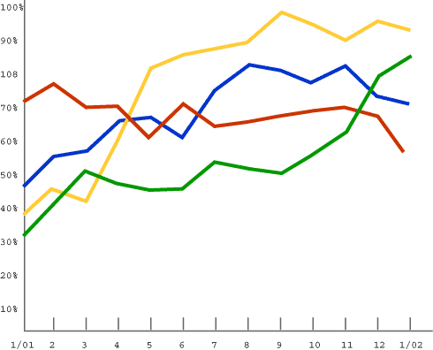
Future Works
Analytics
Event Usage
Interlinking
Notes:
This project should continue to develop and be monitored for future events. Once the CERSER Facebook Page reaches 30 likes, the Facebook analytic tool Insights will be available to monitor usage. Twitter and Instagram will need external analytic software that is available on the Internet to monitor their usage. Google+ uses Google Analytics to further examine others who use the social media sites. With Google analytical data, the developers could gather information about the viewer's age, gender, and more to determine if the social media content is being promoted correctly.
The social media sites established during this project should also be included in events such as the Celebration of Women in Mathematics, IGARSS, and Summer REU. In these events attendees will be able to post photos, videos, and relevant text to provide followers with instant feedback on their research and experiences. Through this interaction, future projects should be able to gather information about the successfulness of the events, which events are most posted about, how to further improve events, and better ways to integrate social media into future events. The project should also be able to obtain content from current students when they attend conferences and other program related activities.
Currently the social media applications Facebook, Instagram, and Twitter have the capability to be linked. This ability allows a user or administrator to post to one site and the information be displayed on the other two. Future research should focus on linking these accounts in a way that does not intrude into the privacy of the site administrators.

Slide 46
Questions

