Slide 1
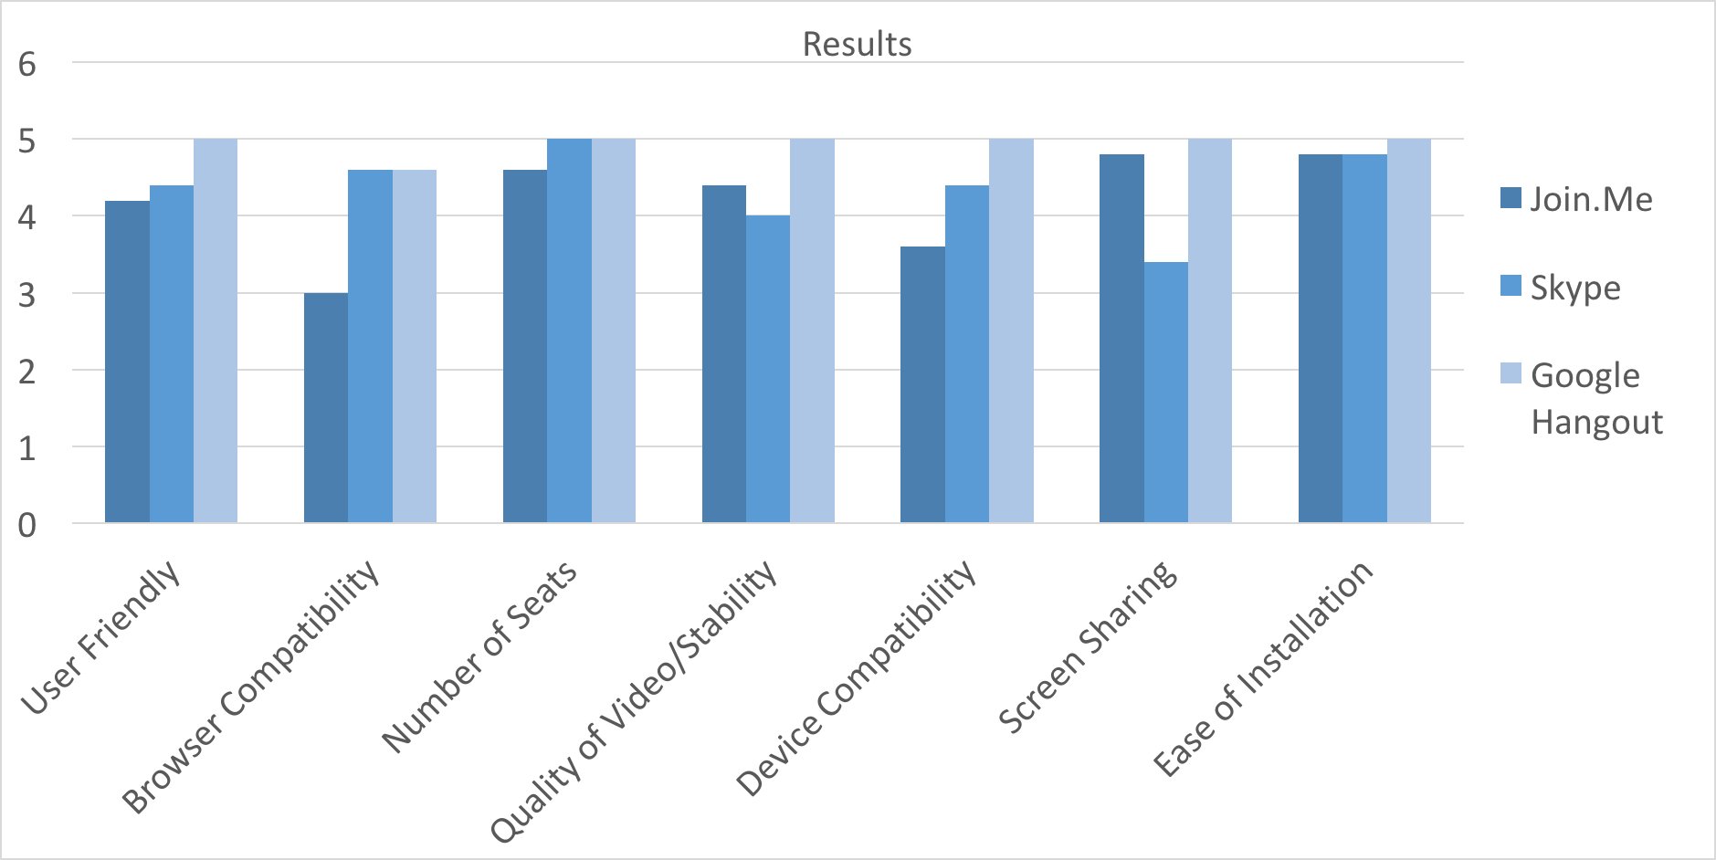
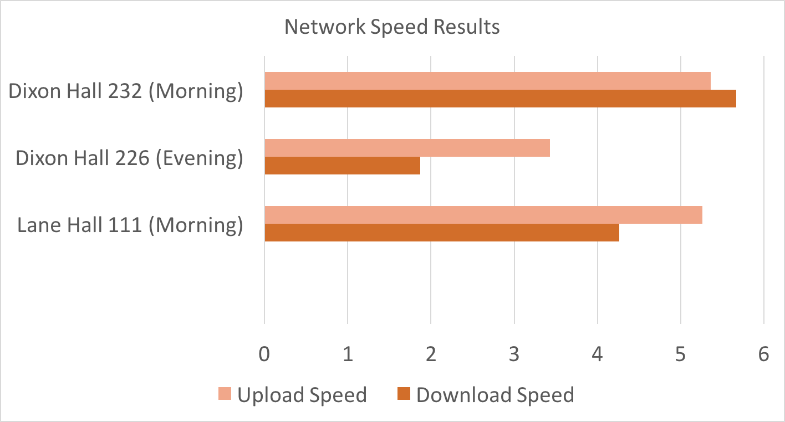
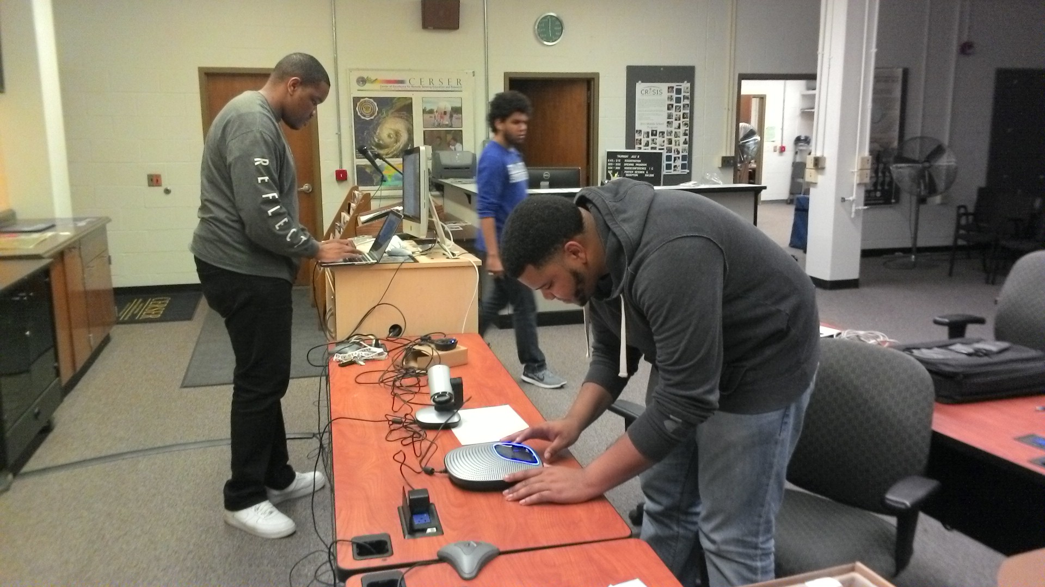
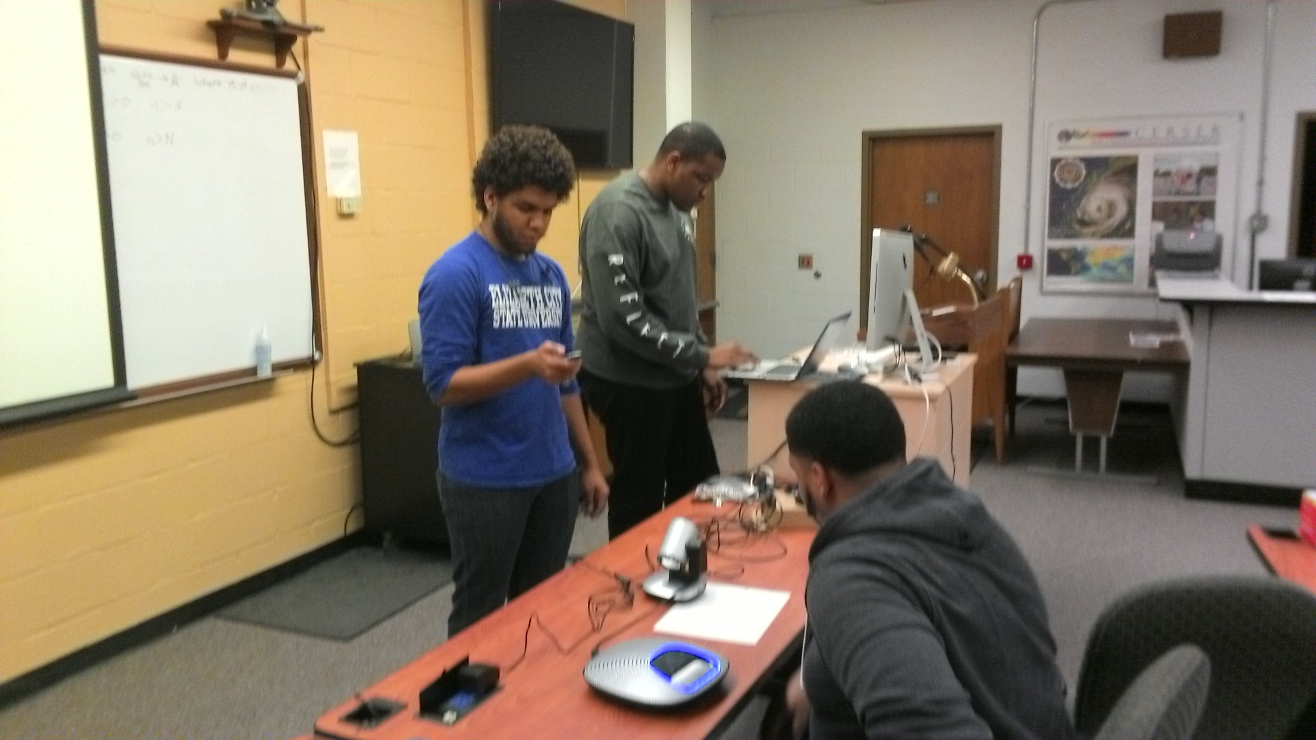
Design and Installation of a Video Conference Solution at the Center of Excellence in Remote Sensing Education and Research at Elizabeth City State University
2015-2016 Research Team :: Daquan Rascoe, Kevin Benton, Jefferson Ridgeway, Mentor Mr. Carlton Lamb :: Center of Excellence in Remote Sensing Education and Research :: Elizabeth City, North Carolina, USA
ABSTRACT
INTRODUCTION
OBJECTIVE
Testing Software
The team members were split into separate buildings and spaces, with having both wired connection to the internet and wireless connection. Also during the test, the team tested on smartphones as well. Combining all of the possible different scenarios, each software was rated based on the rating system.
In gathering the data to form Figure 1, it is apparent that Google Hangout was the best video conferencing software according to the criterion set by the team. Google Hangout not only ranked highest on the criteria, but it has been used previously in classes at ECSU, therefore there is already a familiarity with the software. It has been used before by classes in Dixon Hall 226 in the past semester, and the results further solidify why it should continue to be used within the different buildings of ECSU’s campus. Observing Figure 2, it could be seen that in the morning in Dixon Hall and Lane Hall, there were both higher download and upload network speeds. The results affirm the notion that in the morning and afternoon, there are higher download and upload speeds because the students and faculty are not all on the network fully. However, it can be seen that in Dixon Hall 226 from Figure 2, that late in the evening, the download and upload speeds are very low, meaning there is a higher usage within the population of the campus during the late time.
During the 2016 Spring Semester, the Research Experience Undergraduates Networking team project identified, evaluated, and implemented a video conference solution. The main objective was to establish a fully functioning video conferencing solution in four locations: Dixon-Patterson Hall, Rooms 226, 232 and Lane Hall, Rooms 111 and 119.
To understand and create the scope of work for the project, the team had to research/analyze the rigourous standards which are set in place by the International Telecommunications Union. This agency works directly under the authority of the United Nations and is charged with issues relating to information and communication technologies. The team examined the H.323 standard for Telemedicine, how Telemedicine has evolved, and how the H.323 standard has progressively changed the way we conduct our lives.
After replicating the layout of the four spaces, the next objective was to identify and evaluate a software solution. After identifying and evaluating multiple video conferencing applications, the team selected a specific application. An example of an issue which eliminated one application was when an application indicated that a user would only have to open a link in the browser to be able to connect; but it did not indicate that the link would only work from within a certain browser. As for the hardware, the technical specifications of components were used to identify the hardware components. This method of selection, immediately gave preference to specific devices.
The team also analyzed the history of video conferencing and how it has evolved.
This research project enables the Center of Excellence in Remote Sensing Education and Research (CERSER) participants and invited guests to engage with others through video conferencing services.
Keywords – Networking, video conferecing, CERSER, ECSU
There has been many advancements of technology throughout the course of time. One specific source of technology of which will be the team’s main focus is that of video conferencing tools. Video conferencing is a method of communication that incorporates both picture and audio simultaneously. Video conferencing goes as far back as the invention of television; with its upbringing of the both simple and basic analog conferencing, which uses two closed circuit televisions connected with a cable(also called teleconferencing) [1] .
The use of teleconferencing was first introduced by Herbert Hoover in 1927, which is also the year that the first video conferencing tool called television was invented [1]. However, the very first official peer to peer video conferencing device was the Picture Phone which was introduced in the1960s by AT&T in New York [1].
Currently, the elements of video conferencing are used as communication tools daily by people everywhere whether if it's for companies, organizations, or just your average person wanting to communicate through video conferencing. Video conferencing in today’s time is a collective deliverance throughout telephone or internet machinery of which allows individuals of different location points to come in sync for a meeting through video conferencing [1]. Another aspect of video conferencing in today's time is that it can be between two individuals (peer to peer) or be associated between several sites with multiple individuals (multi-point) at different sites [1].
The type of cameras that the team used throughout the research were H.264 compliant. With the using of H.264 compliant cameras the team was able to acquire better video compression and video quality along with it’s lower usage of internet bandwidth than those of other video compression cameras such as MJPEG.
The team’s main objective is to establish a fully functioning video conferencing solution in four locations: Dixon-Patterson Hall Rooms 226, 232 and Lane Hall Rooms 111. Within the tested locations, the team observed specific characteristics that helped in distinguishing the best video conferencing quality such as the network speed and network strength. The analysis helped the team to determine the leading location and video quality amongst each environment.
The team’s objective was to find a suitable video conference solution. This solution included a mixture of both hardware and software. The hardware component of the solution included cameras, microphones, and various other parts. The software component of the solution was which video conference application fits best with the hardware. The reason for this is so the team could have a very stable and clear video conferencing session. This is very important to the team for the fact that last year CERSER experienced various problems when trying to host a video conference session. Thus the research group tested different variables that could affect a video conference solution. Some of these variables were network speed, network strength, compatibility, and ease of installation. This was done by testing various video conferencing software applications on different computers in different environments.
ANALYSIS
After collecting and testing the three softwares, Google Hangout, Skype, and Join.Me, the team then had to conduct the analysis of the findings from the rating system. The ratings of each team member were compiled and then averaged in an excel spreadsheet. Figure 1 shows what was gathered and Figure 2 shows the Network Strength at different points of the day.
CONCLUSION
METHODOLOGY
Based on the results from the findings and averaging the numbers from the rating system, Google hangout was rated the best among all of the criterion and also the best time to do a video conference in either Lane Hall or Dixon Hall would be to do the conference in early morning to the mid-afternoon. Facilitating a video conference during this time period would be the best time. During the research in the evening, it was apparent that due to “high traffic” on ECSU network, the network speed was not optimal, therefore the video (regardless of it was connected to the internet wirelessly or wired), was pixelated and it was not as clear as when the traffic was not as high on the network.
Collecting Software
A list was comprised of 10 different solutions and the team picked the most current, efficient, and inexpensive solutions from that list.
Those solutions included: Google Hangout, Skype, and Join.Me
The team prepared to test the software on new Macbook Air laptops and the Logitech cc3000e video conferencing system.
Selection Criteria
In testing software, there was a rating system based on rating each software according to the specific criteria.
The criteria included: user friendly, browser compatibility, ease of installation, number of seats, quality of video/stability, device compatibility, screen sharing, and documenting the network speed and network strength.
For each criteria, a rating was given by each of the members of the team, with 1 being the lowest rating and 5 being the highest rating.
ACKNOWLEDGEMENT
REFERENCES
We would like to acknowledge the assistance of Dr. Linda Hayden who has provided the funding and the opportunity for this projects completion.’
[1] M. Pourazad, C. Doutre, M. Azimi and P. Nasiopoulos, "HEVC: The New Gold Standard for Video Compression", IEEE Consumer Electronics Magazine, pp. 36-46, 2012.
[2] "Logitech CC3000e Video Conferencing System for 6-10 people", Logitech.com, 2016. [Online]. Available: http://www.logitech.com/en-us/product/conferencecam-cc3000e. [Accessed: 29- Mar- 2016].

