Slide 1


Photodissociation Dynamics of ICN– and BrCN–
Bernice Opoku-Agyeman
Department of Chemistry and Biochemistry
The Ohio State University
Anne B. McCoy
Department of Chemistry
University of Washington
NOBCChE National Conference
Technical Session 3: Computational Chemistry
September 24th, 2015

Slide 2
Introduction
Photo-induced and solvent induced charge transfer processes are very common in biological systems, solar cells, electrochemistry, etc.
How do we study and understand these processes?
Start from simple systems.
  photodissociation of a diatomic anion

Slide 3
General Model for Photodissociation - A Diatomic Anion
hν
T. Sanford, S-Y. Han, M. A. Thompson, R. Parson, and W. C. Lineberger, J. Chem. Phys. 122, 054307 (2005).

Slide 4
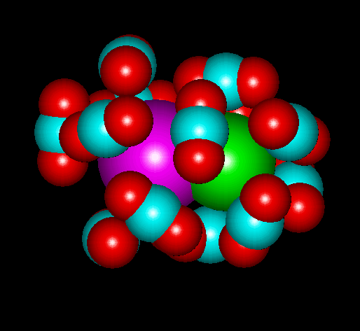
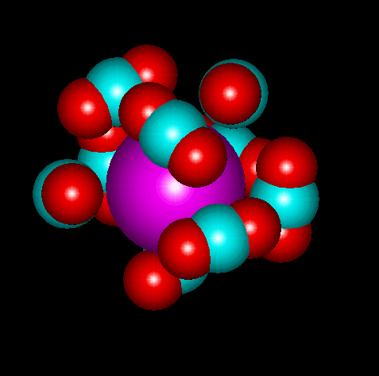
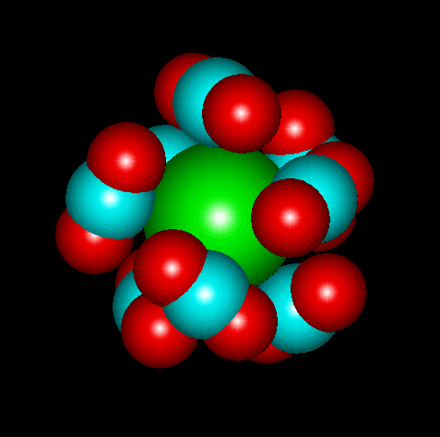
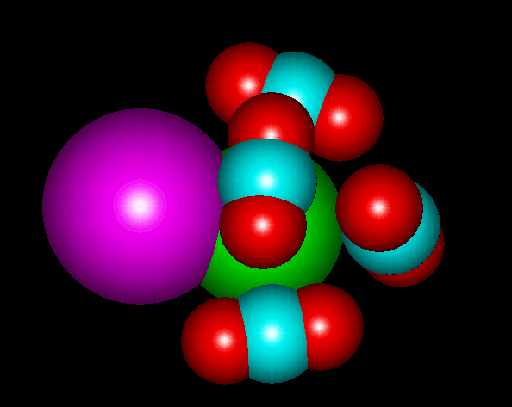
Introduction
Photo-induced and solvent induced charge transfer processes are very common in biological systems, solar cells, electrochemistry, etc.
How do we study and understand these processes?
Start from simple systems.
  photodissociation of a diatomic anion
  Effect of solvation of the photodissociation dynamics
What factors determine the product channels of an excited cluster and what can we learn from its photoproducts?
  Insight into the dynamics of the the dissociation process?
  Nature of the electronic states of the anion involved the dissociation process?
-
-
-
hν
-

Slide 5
General Model for Photodissociation - A Diatomic Anion
Triatomic anionic: Replace I or Br with CN
The role of the CN/CN– rotation on the product branching ratio
hν
T. Sanford, S-Y. Han, M. A. Thompson, R. Parson, and W. C. Lineberger, J. Chem. Phys. 122, 054307 (2005).

Slide 6
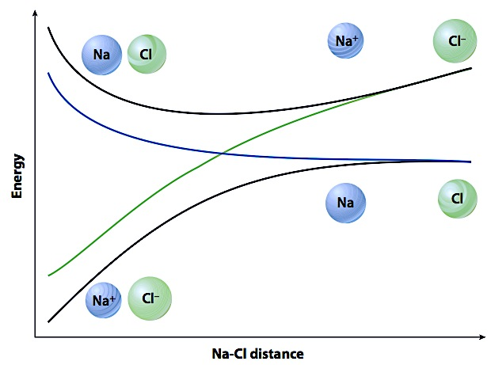
Adiabatic vs Diabatic Representation
Adiabatic - black curves
  Large change in charge character of the states
Diabatic - blue and green curves
  Small or no change in charge character of the states
T. V. Voorhis, T. Kowalczyk, B. Kaduk, L-P Wang, C-L Cheng, Q. Wu. Annu. Rev. Phys. Chem. 61, 149 (2010).

Slide 7


Replace I in IBr– with CN
θ = 0°
θ = 180°
Does the rotation of the CN/CN– affect the product branching ratio?

Slide 8
Photoexcitation Dynamics of 1-D Wave Packet
Excitation of BrCN– to ²Π_{1/2} state
Two possible outcomes for the dynamics:
The population evolve on the adiabatic state (solid blue curve)
The population evolve on the diabatic state (dashed green curve)
²Π_{3/2} /²Π_{1/2}
Br– + CN*
²Σ⁺
Br* + CN–
²Π_{1/2}
Br– + CN
²Π_{3/2}
Br + CN–
~100% Br– + CN is calculated implies the dynamics follows adiabatic path
diabatic coupling
x5
²Σ⁺
B. Opoku-Agyeman, A. S. Case, J. H. Lehman, WCL, ABM, J. Chem. Phys., 141, 084305 (2014).

Slide 9
Photoexcitation Dynamics of 1-D Wave Packet
Excitation of BrNC– to ²Π_{1/2} state
Two possible outcomes for the dynamics:
The population evolve on the adiabatic state (solid blue curve)
The population evolve on the diabatic state (dashed green curve)
²Π_{3/2} /²Π_{1/2}
Br– + NC*
²Σ⁺
Product branching ratio depends on orientation of the CN/CN–
Br* + NC–
²Π_{1/2}
Br– + NC
²Π_{3/2}
Br + NC–
~100% Br* + NC– is calculated implies the dynamics follows diabatic path
²Σ⁺
diabatic coupling
x5

Slide 10
When does the dynamics switch between adiabatic and diabatic?
Examine diabatic coupling terms as functions of the CN/CN– rotation at the point of crossing.
²Σ⁺
Turn on CN/CN– rotation… How will this affect the dynamics?
Br* + CN–
²Π_{1/2}
Br– + CN
V_{cross}
θ, degrees
x5
The two states cross in region of significant coupling when θ ≤ 120°
R_{cross}
diabatic coupling –purple lines
Notes:
R and Diabatic Coupling Terms as Functions of the CN/CN– Rotation at the Point of Crossing.
In ICN-: the two states cross in region of strong coupling for all values of theta
In BrCN-: the region were the state cross becomes progressively small until it becomes almost zero after 120 degrees.

Slide 11
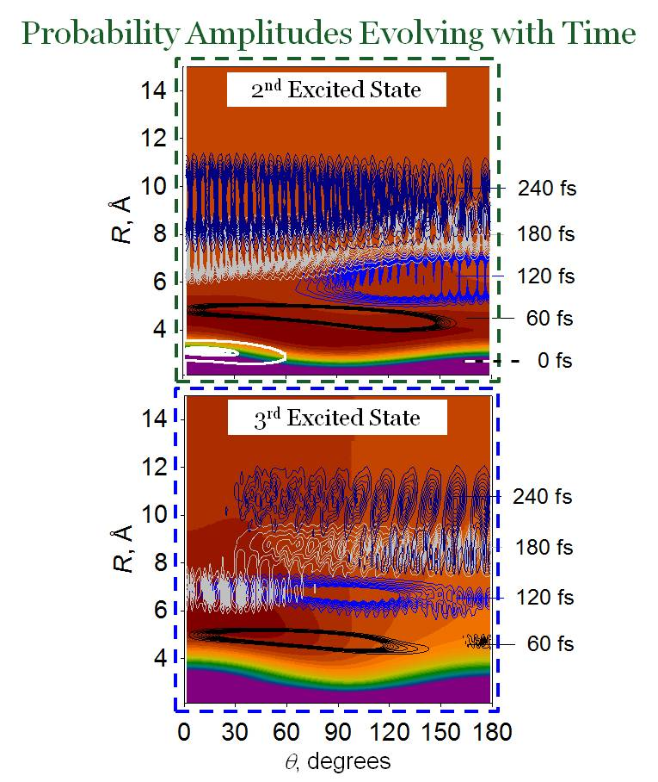
Photoexcitation Dynamics of Full Dimensional Wave Packet
Excitation to ²Π_{1/2} state
²Π_{3/2} /²Π_{1/2}
Br– + CN*
²Σ⁺
Br* + CN–
²Π_{1/2}
²Π_{1/2}
Br– + CN
²Π_{3/2}
Br + CN–
²Σ⁺
diabatic coupling
x5
The wave function delocalizes rapidly over all CN/CN– rotational angles

Slide 12
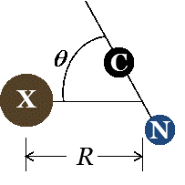
Photodissociation of ICN– and BrCN– following Visible Excitation
BrCN– ICN–
²Π_{3/2} / ²Π_{1/2}
²Π_{3/2} / ²Π_{1/2}
Br– + CN*
I– + CN*
²Σ⁺
²Σ⁺
=Br, I
What about solvation?
I*+ CN–
Br*+ CN–
Percent Branching
²Π_{1/2}
Br– + CN
²Π_{1/2}
I– + CN
²Π_{3/2}
 | % Br– (BrCN–) | % I– (ICN–)
Experiment | ~60 | ~95
Calculation | 51 | 97
% E_{rotation} | 31 | 32
Br + CN–
²Π_{3/2}
I + CN–
²Σ⁺
²Σ⁺
A. S. Case, E. M. Miller, J. P. Martin, Y Lu, L. Sheps, ABM, WCL, Angew. Chem. Int. Ed., 51, 2651(2012).
A. B. McCoy, Int. J. Quantum Chem., 113, 366 (2013).
J. P. Martin, A. S. Case, Q. L. Gu, J. P. Darr, ABM, WCL, J. Chem. Phys., 139, 064315 (2013).
B. Opoku-Agyeman, A. S. Case, J. H. Lehman, WCL, ABM, J. Chem. Phys., 141, 084305 (2014).

Slide 13
Experimental Photoproducts of ICN–(CO₂)_{n} Dissociation using 2.5 eV Photons
²Π_{3/2} / ²Π_{1/2}
I–
CN–
I– + CN*
²Σ⁺
ICN–
I*+ CN–
²Π_{1/2}
I– + CN
²Π_{3/2}
I + CN–
The branching depends on the number of CO₂ solvation
I–-based product decreases rapidly with increasing solvation
Recombined products, ICN–, are observed
²Σ⁺
J. P. Martin, A. S. Case, Q. L. Gu, J. P. Darr, ABM, WCL, J. Chem. Phys., 139, 064315 (2013).

Slide 14
Summary
Intra-molecular motions are important in charge transfer dynamics
Rotation of CN is important in the dissociation dynamics of BrCN– and ICN–
Solvation introduces a complexity in the dynamics and leads to formation of recombined products

Slide 15

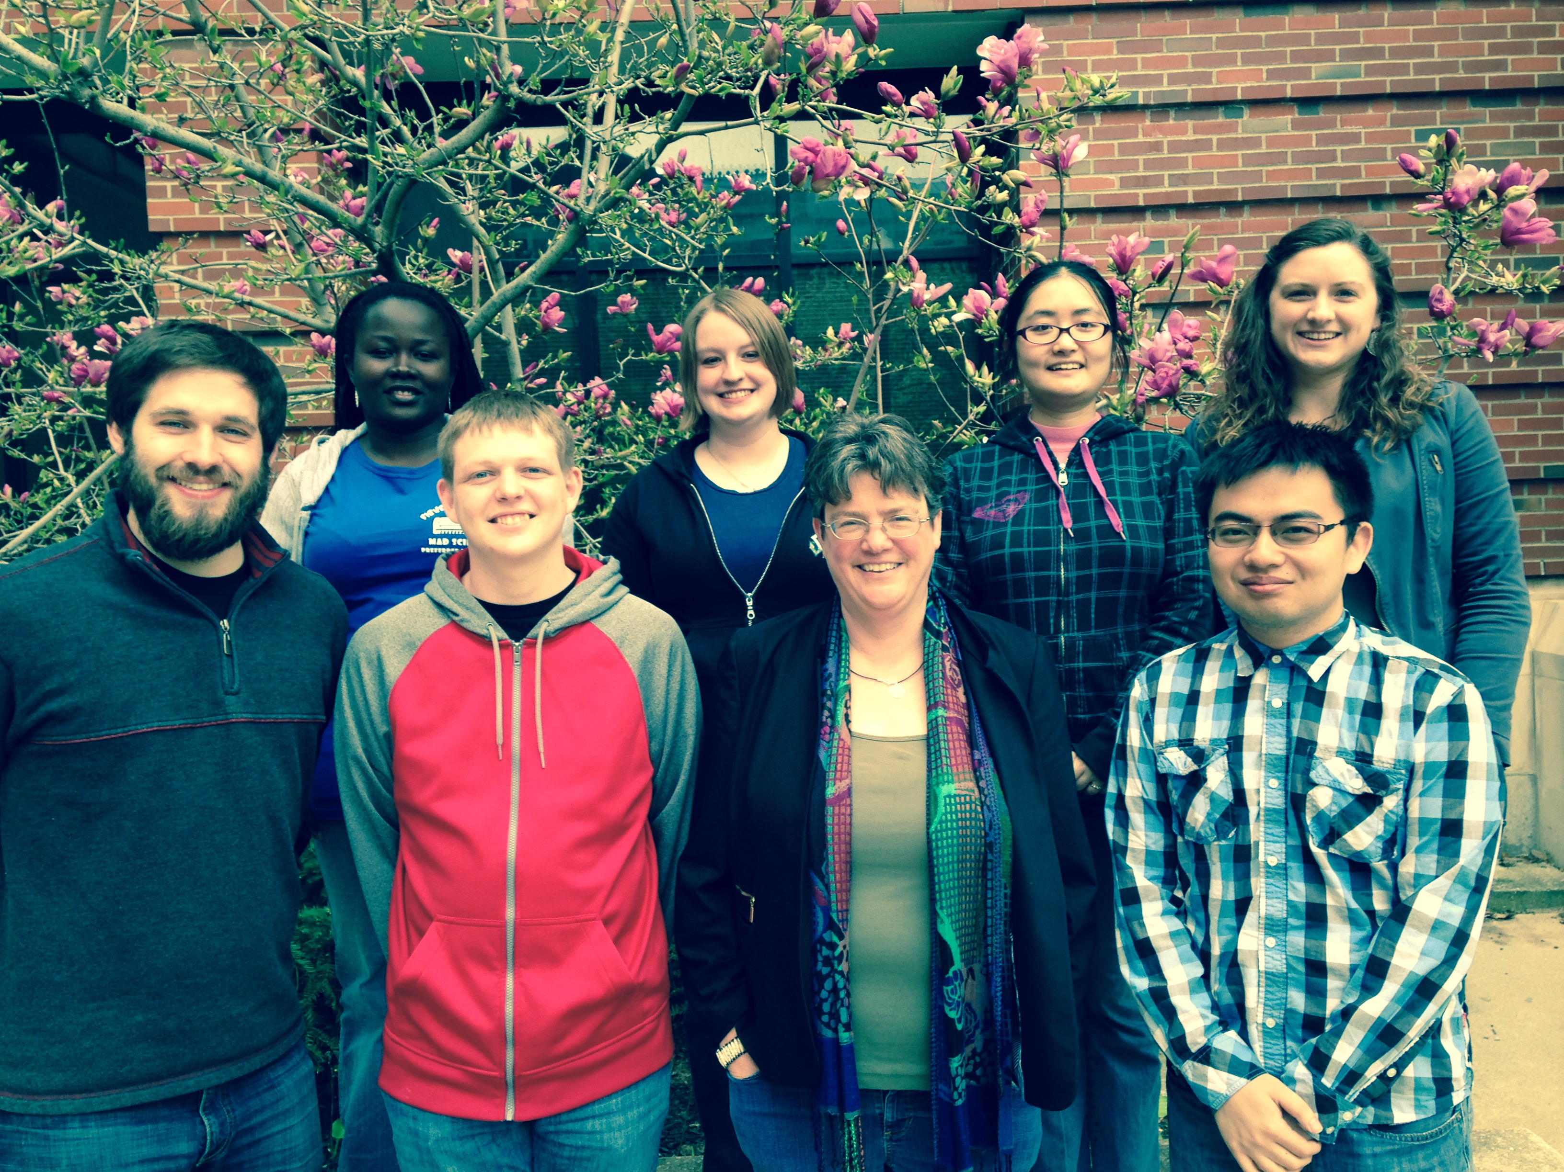




Acknowledgments
The McCoy Group
Collaborators:
Dr. W. Carl Lineberger
Dr. Amanda S. Case
Dr. Julia H. Lehman
Front: Jason E. Ford(B.Sc. 2015), Scott F. Garner, Dr. Anne B. McCoy, Meng Huang
Back: Bernice Opoku-Agyeman, Melanie L. Marlett, Zhou Lin(Ph.D. 2015) , Laura C. Dzugan
$$:

Slide 16
Photoexcitation Dynamics of Full Dimensional Wave Packet
Visible Excitation
 | BrCN– | ICN–
% CN– | 49 | 3
E_{available}, eV | 1.1 | 0.9
% E_{rotation} | 31 | 32
²Π_{3/2} /²Π_{1/2}
Br– + CN*
²Σ⁺
<θ>, degrees
Br* + CN–
²Π_{1/2}
Action Spectrum
Br– + CN
²Π_{3/2}
Br + CN–
²Σ⁺
x5
diabatic coupling
time, fs
Martin,…, ABM, WCL et al., J. Chem. Phys. 139, 064315 (2013).
B. Opoku-Agyeman, A. S. Case, J. H. Lehman, WCL, ABM, J. Chem. Phys. 141, 084305 (2014).

