Slide 1
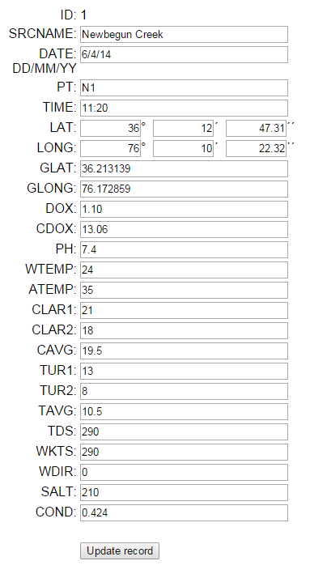
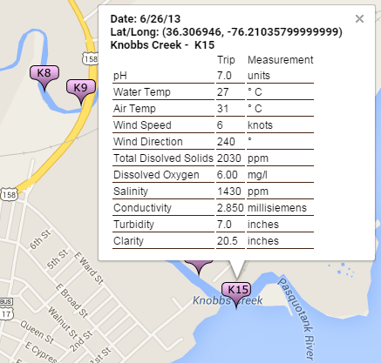
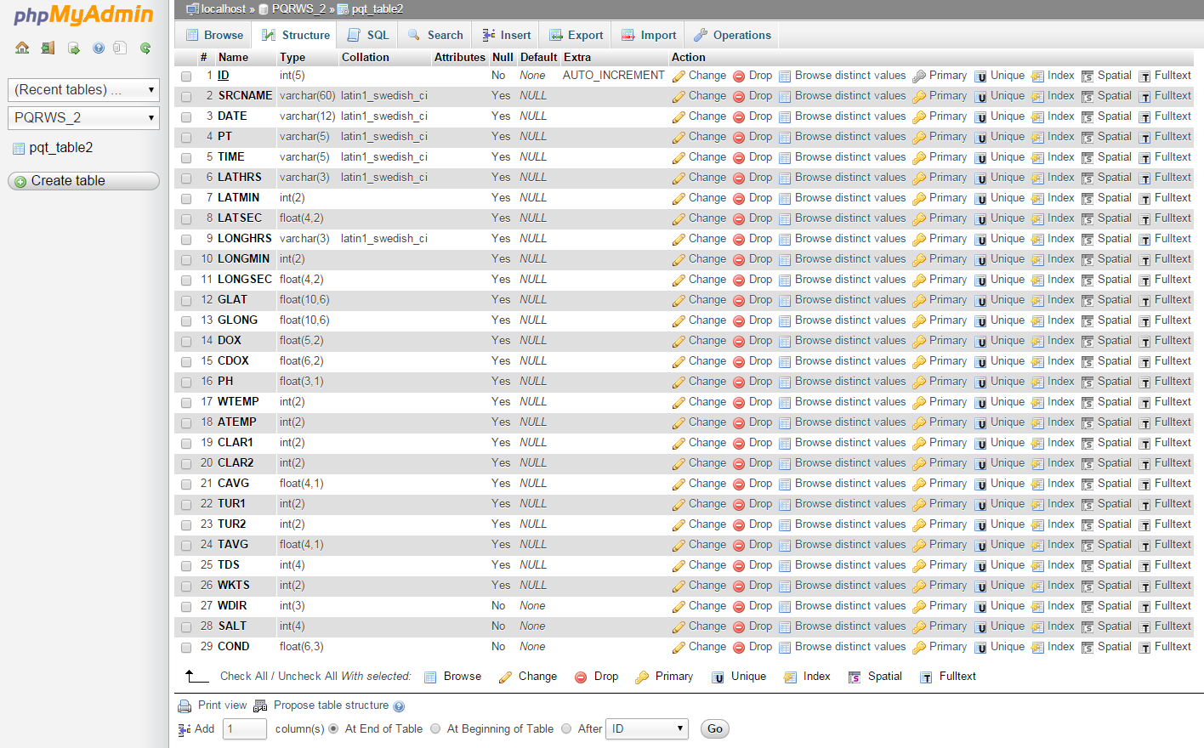
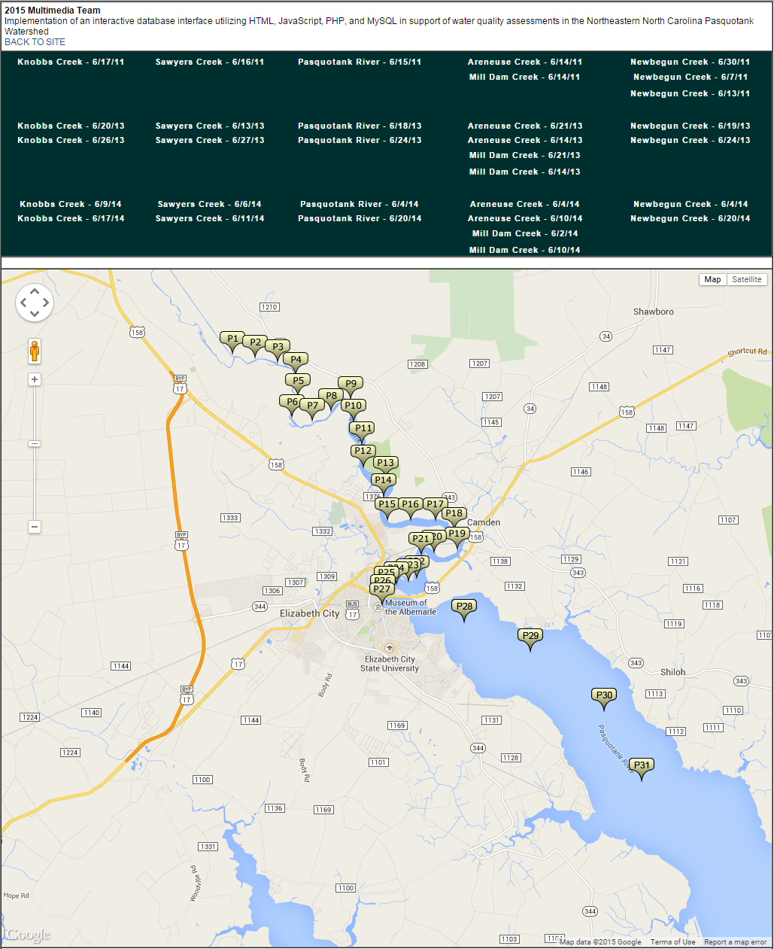
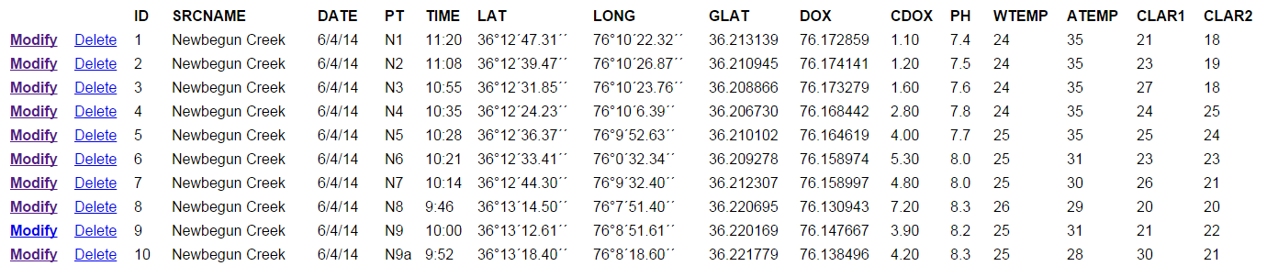
Implementation of an interactive database interface utilizing HTML, JavaScript, PHP, and MySQL in
support of water quality assessments in the Northeastern North Carolina Pasquotank Watershed
2013-2014 Multimedia Team :: Antonio Guion, Kathryne Burton, Hagen Hodgkins, Derek Morris Jr., Mentor Mr. Jeff Wood :: Center of Excellence in Remote Sensing Education and Research :: Elizabeth City State University :: Elizabeth City, North Carolina, USA
ABSTRACT
MATERIALS & METHODS
III. Visualization of Data
Overview
Once the database was established, the next step in the process was to create a visualization of the data in Google Maps. The basic steps are to pass the requested parameters to the database, convert the retrieved data into an XML format, apply the data to JavaScript variables, and then utilize Google Map functions to create points with the retrieved data onto a map. A screenshot of the current interface can be found in Fig. 8. The file can be viewed online at: http://nia.ecsu.edu/googleDOM_example.html.
XML Builder File
The requested data must be converted to an XML format in order that Google Maps can display it. This is accomplished by calling a separate file, in this project, the DOM_example.php file, which utilizes PHP and MySQL commands to import and format the data into XML format. The first step in building the XML file for Google Maps is to retrieve the PHP parameters passed in the URL link from the GoogleDom_example.html file. For this project the river/creek names and the testing dates are being passed to receive a limited number of point. This data is contained within the variables SRCNAME and DATE. The data are retrieved using the PHP command “$_GET” and then applying them to variables. The variables are used to form a MySQL statement to retrieve the data from the database. The statement takes the following format: "SELECT * FROM pqt_table2 WHERE DATE=%s AND SRCNAME=%s ORDER BY 'ID' ASC"
Once the data has been imported, it is processed through a loop function which echos out the data in XML format. An example of this XML file is found in Fig. 4 utilizing the following URL with PHP variables: “http://nia.ecsu.edu/dom_example.php?DATE=6/27/13&SRCNAME=Sawyers%20Creek”
This data is then passed back to the calling file, in this case, GoogleDOM_example.html, to create the map.
Google Maps Display file
The file GoogleDOM_example.html is used to display the selected records from the database in Google Maps. The file first creates the “load” function which will display the map with parameters such as zoom level, map type (“road map” in this case), and the map center coordinates as seen in Fig. 5. The next step is to retrieve the PHP variables attached to the URL as previously shown using the PHP “$_GET” function. These variables are then attached to the relative URL “DOM_example.php” which is then called to retrieve the data and format it in XML format as previously outlined.
The data is then assigned to JavaScript variables while looping through each record retrieved. The latitude and longitude data contained in the fields GLAT and GLONG are combined into one variable (point) to be used as a definition for the Google Maps marker location.
These variables are then combined with HTML code and placed into the variable HTML. This variable is used to populate the “information balloon” when a user clicks on a marker. An example of this is shown in Fig. 6. At the end of the variable assignment, the location of the marker graphic is placed into the variable “icon.” This location is a URL to a portable network graphic (PNG) file utilizing the variable PT.
A “listening event” is created so that the user can click on the marker to view the data for that location. This data is placed in the information balloon described above.
The GoogleDOM_example.html file has been formatted with links passing the needed variables for each research trip taken during the three years of research.
The Center of Excellence in Remote Sensing Education and Research (CERSER) has implemented three research projects during the summer Research Experience for Undergraduates (REU) program gathering water quality data for local waterways. The data has been compiled manually utilizing pen and paper and then entered into a spreadsheet. With the spread of electronic devices capable of interacting with databases, the development of an electronic method of entering and manipulating the water quality data was pursued during this project.
This project focused on the development of an interactive database to gather, display, and analyze data collected from local waterways. The database and entry form was built in MySQL on a PHP server allowing participants to enter data from anywhere Internet access is available. This project then researched applying this data to the Google Maps site to provide labeling and information to users. The NIA server at http://nia.ecsu.edu is used to host the application for download and for storage of the databases.
This project was built on water quality data gathered by the Summer Research Experience for Undergraduate teams during the summers of 2014, 2013, and 2011.
I. Software/Languages
There were several pieces of software utilized for the completion of this project. These ranged from a database management system (DBMS) to a graphical user interface (GUI) for developing basic and advanced web pages. Several languages were also brought together to store, manipulate, and visualize the data. A list of these tools follows:
● HTML ● Google Maps ● phpMyAdmin
● Dreamweaver ● PHP ● MySQL
● XML ● JavaScript
Figure 5 Load function in JavaScript
I. Database Formation
Combine Spreadsheets (Excel)
Research teams from 2011, 2013, and 2014 entered their data into Excel spreadsheets in order to create HTML files for analyzation and data visualization. These sheets varied slightly as new tests (turbidity) were added in 2013 and 2014. Units of measurement also had to be standardized before the files were combined (micro, milli). Wind direction measurements on calm days were entered as “0” or “calm” for several entries and were changed to a null entry to reflect the lack of direction. Once various issues were resolved, the five files (2013 and 2014 included two trips to each waterway), were compiled into one.
Database (phpMyADMIN)
Using phpMyADMIN, a graphical interface for MySQL, the database structure was created. A single table with 28 data fields and one key field was created. The fields were given their individual characteristics depending on the data they were to hold (text, integers, and floating decimals). The screenshot of the database structure can be seen in Fig. 1.
The next step was to import the data from the combined spreadsheets. The data was first exported from the Excel file into a text file in the Comma Separated Value (CSV) format. The CSV file was then opened in a text editor where the last paragraph mark was removed. This process was repeated many times in order to remove errors in the data that were found after the import.
Data Pages (Dreamweaver)
In order to view the data without the use of phpMyAdmin, a data display page was created using Dreamweaver (Fig. 2). This page displays the data within the database in table form ordered by the ID number of each record. The display page uses the connection file parameters to connect with the database.
Each record has two links, “Modify” and “Delete,” which enable the user to either modify the current record or delete it. The modify link takes the user to a form page that is prefilled with the current record (Fig. 3). The user can then save the modifications and is returned to the data display page. The delete link deletes the current record.
A Data Entry page was created in order that new records could be entered. The point and latitude/longitude positions can be entered ahead of the research trip to the waterway. The other data collected in the field can be entered through the modification of each record from the data view page.
Figure 3 Screenshot of data modification page
Figure 6 Information balloon with data
Results
The construction and implementation of the various files and databases was completed with minimal roadblocks. The compilation of the spreadsheets into a singular database proved to be a tedious task due to minor inconsistencies in the spreadsheets. Ensuring that the CSV files were in the correct format enabled the project to continue on smoothly.
The data show, modify, entry, and delete files were quickly developed due to the features within Dreamweaver. These visual features included database connection and form building, which made the process smoother. The DOM_example.php and the GoogleDOM_example.html files were more intricate due to the amount of hand coding that had to be done. Knowledge of PHP, JavaScript, and MySQL were greatly increased due to the amount of time spent in these languages. A programming tool used during this development was the echoing/printing of variable contents, which allowed the contents of variables to be followed during the process.
INTRODUCTION
The Summer Undergraduate Research Experience program sponsored by the Center of Excellence in Remote Sensing Education and Research (CERSER) at Elizabeth City State University has run three summers of water collection and analyzation in the Pasquotank Watershed. The 2011, 2013, and 2014 teams collected over 350 samples from the Pasquotank River and four tributaries. These samples included the following water tests: dissolved oxygen, turbidity, clarity, total dissolved solids (TDS), salinity, pH, and conductivity. Several pieces of this data have a direct correlation to sea level rise where coastal estuaries experiencing a rise in their levels show an increase in salt level indicators. Other data such as date, position, and time were also included in spreadsheets created by Microsoft Excel. The data was then coded into HTML to be displayed in Google Maps. Here the position was visually represented and the data was displayed in an information balloon.
The goals of this project were to combine and convert the spreadsheet data into a MySQL database, create data display, entry, and modification pages in PHP and HTML, and to finally provide a dynamic approach to the Google Maps display allowing users to select the data to be displayed. These goals will form the basis for continued refinement toward mobile development allowing data to be input in the field during collection.
Figure 1 Screenshot of the database structure
CONCLUSION
The creation of these files, along with the compilation of the spreadsheets, will enhance the ability of research students gathering data in the field to do so more accurately. The continued development of the visualization tool allows a greater ability to analyze the results and compare them with previous data.
Now that the framework has been laid for the data flow, further enhancements can be added to increase the amount of available data and how it is displayed. This will allow researchers to further track the effects of climate change on local watersheds.
Figure 2 Data show file created in Dreamweaver
ACKNOWLEDGEMENT
REFERENCES
We would like to acknowledge the assistance of Dr. Linda Hayden who has provided the funding and the opportunity for this projects completion.’
Extensive list of references available at:
Figure 8 Final product screenshot
Figure 4 DOM_example.php XML output

