Slide 1
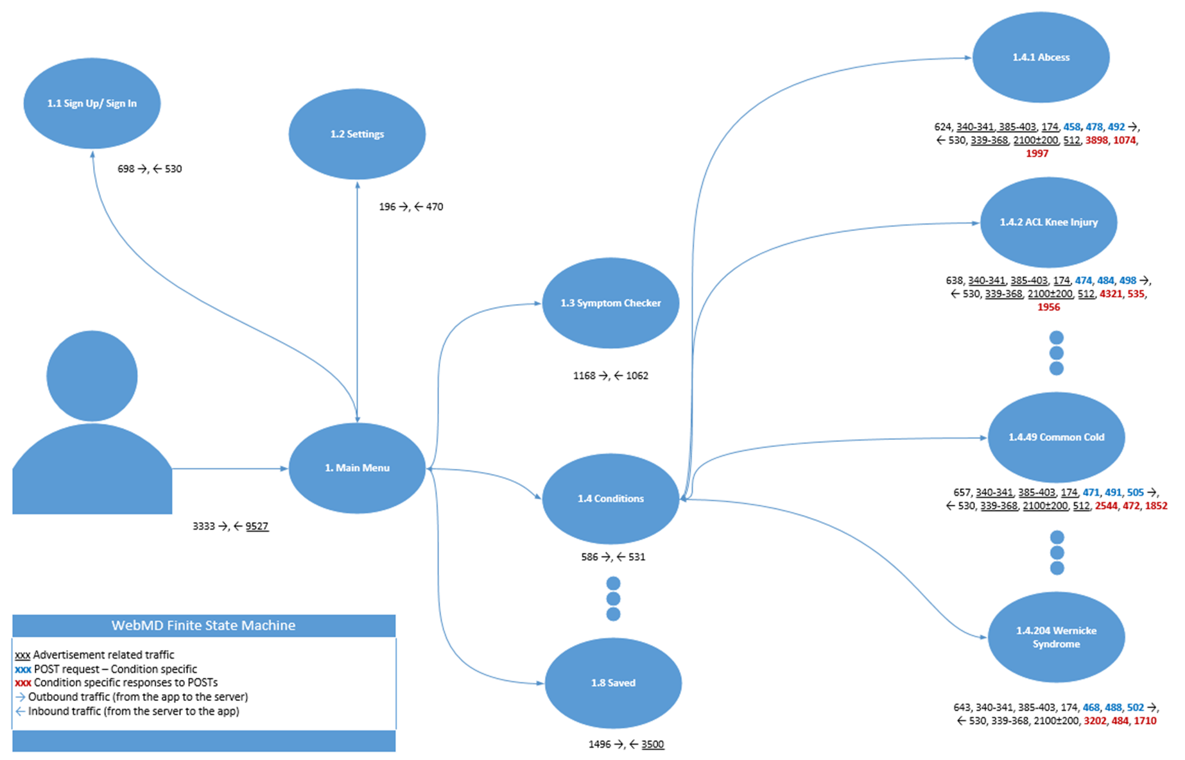
Analyzing the Security Infrastructure of the Android Operating System
2013-2014 REU TEAM :: Derek Morris Jr., Derrick Baines, Ashley Brown, Raquel Lawrence :: Summer Research Opportunity in Computing :: Elizabeth State University NC, Prairie View A&M University TX, Georgia Gwinnett College GA
abstract
methods
results
Smartphones are used for practically everything, from text messaging to email checking, social networks, navigation, and even managing health and banking. The design of the Android operating system is based on a set of unprotected shared resources, some of which are inherited from Linux. These unprotected shared resources, along with the extensive development of Android applications , such as Twitter, makes available a large amount of background information, which can potentially turn harmless resource sharing into serious privacy breaches In our study, we discovered that zero-permission applications can reveal a user’s identity or location through the following ways: the app’s network-data usage statistics, the public address resolution protocol, and the speaker status of the device. Because of the public resources available on Android, some of a user’s sensitive information can be discovered through the applications on their phones by a few inference techniques. Use of these techniques can reveal a user’s disease conditions, location and identity. One particular technique involves reading the data usage of a user’s Twitter application and creating a vector of time stamps of when the user tweets. Through this inference technique, more can be discerned about the user. To help combat the access of a user’s personal data, we have implemented a mitigation strategy. This strategy reduces the accuracy of the data captured by rounding up or down the actual number of bytes sent or received by the application to multiple integers before disclosing the value of the query process. The study reveals that highly sensitive data of smartphone user, such as his/her identity, interest condition, geo-location, driving route and more can actually be reliably inferred from researching popular apps.
Disease Inference
Install WebMD application from Google Play
Analyze WebMD app offline using Shark for Root app
Build detailed finite state machine (FSM)
Open WebMD app
Open malevolent app
Start the reader and go back to WebMD
Click on Conditions from the WebMD main menu
Select a condition
Malevolent app sends information to a remote location
Information is collected by a remote attacker who can analyze WebMD’s network traffic generated on victim’s device
Based on this information, the attacker can infer which condition(s) the user viewed
Identity
When the user’s tweets are detected, a sequence of timestamps is obtained that describe when the user’s tweets. This is then used to find out the Twitter ID from a public index of tweets. This index is accessed through Twitter’s public search API and can be called to search within a certain geo-location. To gather only relevant tweets, the phone’s geo-location is needed and formatted in a triplet consisting of the latitude, longitude and radius in the search API. To get the course location, the zero-permission application can use the browser and search an IP to location database to find the user’s location.
The zero-permission application can only send stealthily the timestamps it collects from Twitter when the phone screen dims out. This can happen minutes from when a user tweets. For each timestamp, we make use of the Twitter search API to search for the set of users who tweet in that area to discover the user’s identity.
Disease Conditions
The WebMD application is analyzed when it is offline using Shark for Root and built a detailed finite state machine (FSM) for it based on the payload lengths of TCP packets sent and received when the app switches from one screen to another. Every time a user clicks on a condition they are interested in, the app produces 4 GET requests and then 3 POST requests to retrieve the content for the condition.
Location
An application can easily detect existence of Wi-Fi connection and surreptitiously collect and send out the BSSIDs that are associated with the specific Wi-Fi connection. BSSID is a gateway’s MAC address and is location sensitive. An internal gateway’s MAC address does not appear to reveal much of a user’s sensitive information. However, companies today like Google and Navion collect BSSIDs of public Wi-Fi hotspots to use for disclosure of a user’s location to provide location-based services in the circumstance where GPS signals are weak. These companies compile the data collected into large database. Utilizing these databases available, a user’s location can be somewhat accurately discovered, but not every Wi-Fi hotspot can be found since these databases are not complete.
conclusions
Our study focuses on discovering vulnerabilities that exist in the Android operating system. We found that data could be discerned from Android public resources by an application with no permissions. This study exposes the risk of sensitive data of a smartphone user, such as their identity, disease conditions, geo-location, driving route being revealed. More information can be inferred from such resources by analyzing popular apps such as Twitter and WebMD used my millions of users everyday. Our research questions the design assumption made by Android developers on public resources. There is a need to resolve such privacy risks. Further presented is an initial design for mitigating the threats to public resources while still maintaining their availability and functionality.
objectives
references
The goal was to make every student have a good understanding and be prepared for top-level Android research:
Will read our provided materials and get familiar with Android development Environment.
Try to make a test app by playing with the environment.
Make a relatively complex app upon mentors' requirement.
Try to repeat WebMD and a Pileup attack described in the paper.
Make poster and present their work.
Xiaoyong Zhou, Soteris Demetriou, Dongjing He, Muhammad Naveed, Xiaorui Pan, XiaoFeng Wang, Carl A. Gunter, and Klara Nahrstedt. Identity, location, disease and more: Inferring your secrets from android public resources. In Proceedings of 20th ACM Confer- ence on Computer and Communications Security (CCS), November 2013.Objective 2
(2013, February 23). IKnowYourDisease. Video retrieved from https://www.youtube.com/watch?v=N7judhXCrv4
Acknowledgements
Xiaofeng Wang, Xiaoyoung Zhou, Indiana University

