Slide 1
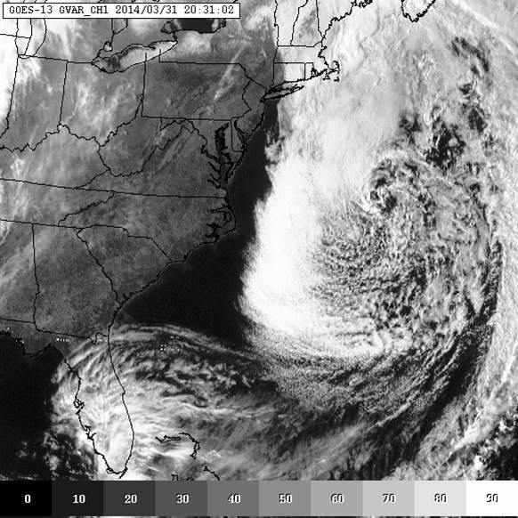
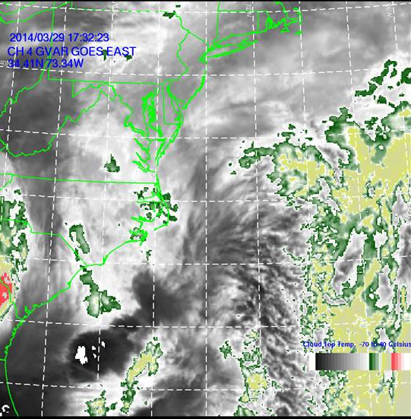
Update of the CERSER TeraScan Cataloguing System and the TeraScan Image Processing Scripts
Jefferson Ridgeway, Derek Morris Jr., Tori Wilbon
2014 Multimedia Team

Slide 2
Abstract
The Center of Excellence in Remote Sensing Education and Research (CERSER) on the campus of Elizabeth City State University is currently tasked with the responsibility of receiving remotely sensed data from orbiting National Oceanic and Atmospheric Administration (NOAA) Polar Operational Environmental Satellites (POES) and the Geostationary Operational Environmental Satellites (GOES). This data is collected by SeaSpace TeraScan systems installed in the CERSER labs in Dixon-Patterson Hall.
In 2005, the processing system underwent a major update due to a migration to a new operating system. A minor update was needed at this time to deal with a second operating system migration and display of the processed images on the CERSER web site. Since then, a second transfer to a new server was made in 2013. The cataloguing system went down at this time and was not repaired due to technical issues with the TeraScan system. The 2014 team corrected issues within the current server directory system and updated the data script to process images from the GOES-13 satellite received by the TeraScan system. Software and languages utilized for this task included ImageMagick, PHP, HTML, Dreamweaver, phpMyAdmin, and MySQL.
Along with this operating system update, a major script development was needed on the TeraScan processing equipment due to an upgrade in hardware. The ground station upgrades included a 3.7m X/L band, a 3.6m C band, and a 5.0m L band dishes, along with accompanying computing hardware. This new script processes both infrared and visible light images received from the GOES-13 satellite into the Tagged Image File (TIFF) Format.

Slide 3
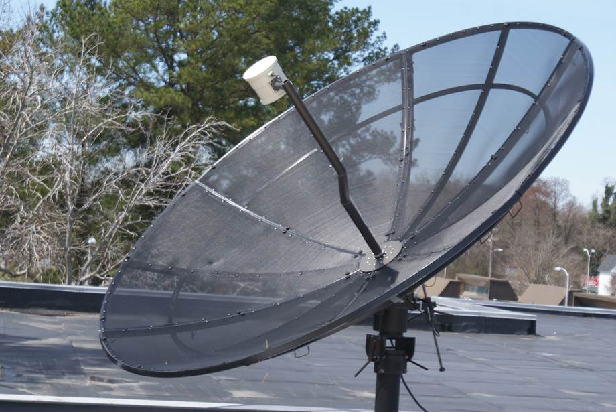
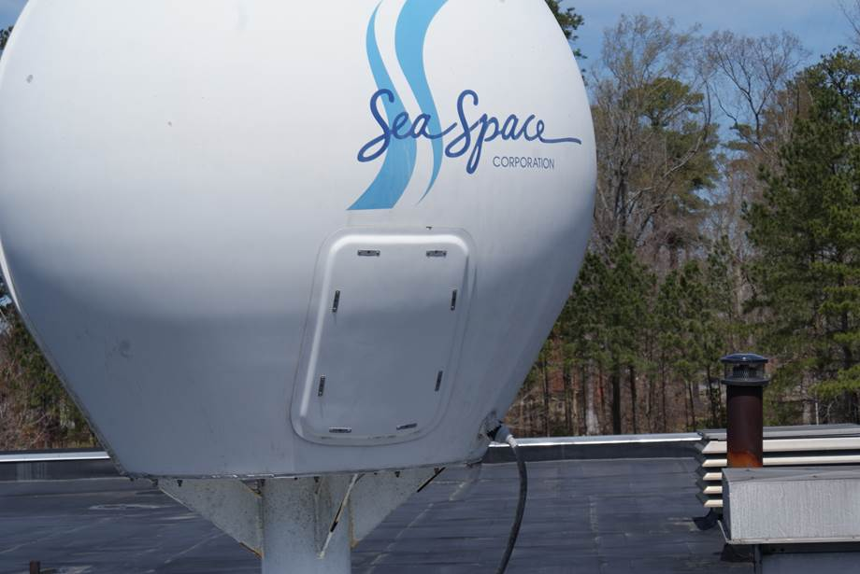
Goals
CERSER Script Failures
Modify/Develop TeraScan Script
Rewrite CERSER Processing Script
Notes:
Determine and repair the cause of the script failures on the CERSER server.
Develop TeraScan script that will process the satellite data into an image, provide overlay information, and place the completed image onto the server.
Rewrite the PHP processing script on the CERSER server to parse Geostationary Operational Environmental Satellite (GOES) information into a database and to execute commands to convert and resize the same image.

Slide 4
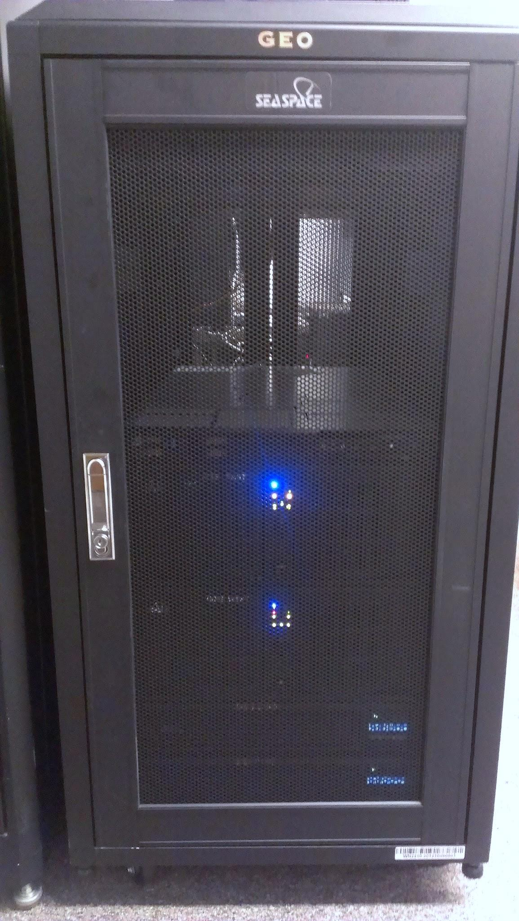
What is TeraScan?
Purpose
Satellite Data Reception
Satellite Frequency
L-Band
Wavelength Range (1 -2 GHz)
Notes:
a combination of hardware and software designed for automated reception of data from meteorological/environmental satellites and for processing data into images and data overlays.
Images and Overlays have a special format called TeraScan Data Format (TDF) and can be displayed using a GUI called TeraVision
Satellite data can be received from both hardware (TAC-92 receiver) and software (server) that is installed on the computer
The satellite data type that is used for this research is L-Band Data from the Geostationary Operational Environmental Satellites or (GOES) imager.
{insert picture of server}

Slide 5
TeraScan
6 Different Channels/Bandwidths:
Channel 1 (visible) - Cloud cover and surface features during the day
Channel 2 (Infrared) - Low cloud/fog and fire detection
Channel 3 (Infrared) - Upper-level water Vapor
Channel 4 (Thermal Infrared) - Surface or cloud top temperature
Channel 5 (Thermal Infrared) - Surface or cloud top temperature and low-level water vapor
Channel 6 (Thermal Infrared) - Carbon dioxide band: Cloud detection
Notes:
Channel 1 shows the “visible” spectrum which includes clouds and weather systems during the day by measuring reflected sunlight [5]. Channels 2 and 4 display the “infared” spectrum which shows the clouds and weather systems at night by measuring temperature [5]. Channel 3 displays the “water vapor” channel by measuring the moisture in the air [5]. In the past, the Center of Excellence in Remote Sensing Education and Research (CERSER) has focused on receiving data information from the POES rather than GOES. Recently, the hardware was installed to receive data information from both the GOES and POES. CERSER is able to receive the data information from GOES using the TeraScan TAC-92 receiver, which stores and processes incoming data to a Linux-based system.
SeaSpace supports TeraScan on two software platforms for its system: Sun Solaris and RedHat Linux. These software platforms are based on the UNIX operating system and consist of more than 500 command-line functions, daemons, reference files, a set of graphical user interfaces (GUIs), and TDFs [1]. Two of the GUIs that were used were TeraVision and TeraMaster. TeraVision was used for displaying and editing TeraScan data images and overlays. Some of the capabilities of TeraVision include the image enhancement via color palettes, convolution filters, histogram equalization, manipulation of the view area by panning and zooming, and the animation of a series of images (time/product looping) [3]. TeraMaster was used for viewing, creating, and modifying masters. A master, also known as an area of interest (AOI), a TeraScan dataset that defines an area of the earth’s surface in terms of map projection (shape), extents, and pixel resolution. A master has three purposes in Terascan: 1. A criterion for the schedule of satellite passes, 2. Establishing a smaller set of data from a whole pass for processing, and 3. A base map view is changed to an earth-located view of the data which is known as registration

Slide 6
TeraScan
Software platform on TeraScan: RedHat Linux
Graphical User Interface (GUI’s)
TeraVision
TeraMaster
Notes:
Channel 1 shows the “visible” spectrum which includes clouds and weather systems during the day by measuring reflected sunlight [5]. Channels 2 and 4 display the “infared” spectrum which shows the clouds and weather systems at night by measuring temperature [5]. Channel 3 displays the “water vapor” channel by measuring the moisture in the air [5]. In the past, the Center of Excellence in Remote Sensing Education and Research (CERSER) has focused on receiving data information from the POES rather than GOES. Recently, the hardware was installed to receive data information from both the GOES and POES. CERSER is able to receive the data information from GOES using the TeraScan TAC-92 receiver, which stores and processes incoming data to a Linux-based system.
SeaSpace supports TeraScan on two software platforms for its system: Sun Solaris and RedHat Linux. These software platforms are based on the UNIX operating system and consist of more than 500 command-line functions, daemons, reference files, a set of graphical user interfaces (GUIs), and TDFs [1]. Two of the GUIs that were used were TeraVision and TeraMaster. TeraVision was used for displaying and editing TeraScan data images and overlays. Some of the capabilities of TeraVision include the image enhancement via color palettes, convolution filters, histogram equalization, manipulation of the view area by panning and zooming, and the animation of a series of images (time/product looping) [3]. TeraMaster was used for viewing, creating, and modifying masters. A master, also known as an area of interest (AOI), a TeraScan dataset that defines an area of the earth’s surface in terms of map projection (shape), extents, and pixel resolution. A master has three purposes in Terascan: 1. A criterion for the schedule of satellite passes, 2. Establishing a smaller set of data from a whole pass for processing, and 3. A base map view is changed to an earth-located view of the data which is known as registration

Slide 7
Data Processing in TeraScan
Configuration Directory
batch.ingest
gvarin
gvar.local
GOES VARiable Format
(GVAR) data
Notes:
Batch.ingest files within the configproc directory specifies for ingest function(s) to be run by run_ingest, including gvarin, which makes whole pass gvar datasets. Gvar.local specifies remapping of the whole pass datasets to the Local Master [6]. Gvarin reads GOES VARiable Format (GVAR) data directly from application shared memory when reception is live [9]. GVAR is the data transmission format used with the new generation of GOES meteorological satellites [10].

Slide 8
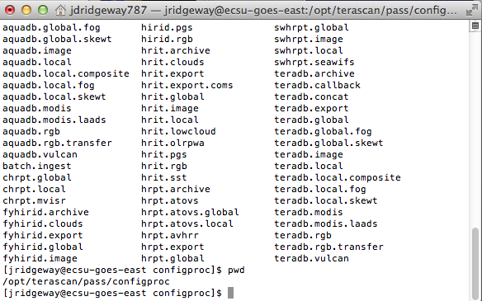
TeraScan Modification Script

Slide 9
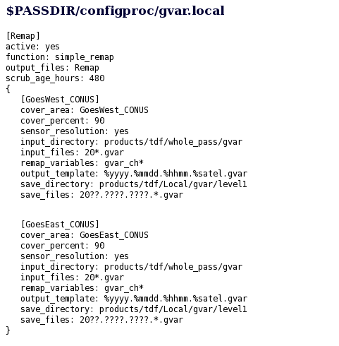
Data Processing in TeraScan
Notes:
Data processing is carried out according to configuration files located in $PASSDIR/configproc. The processes to be run are set as "active" in those files [6].

Slide 10
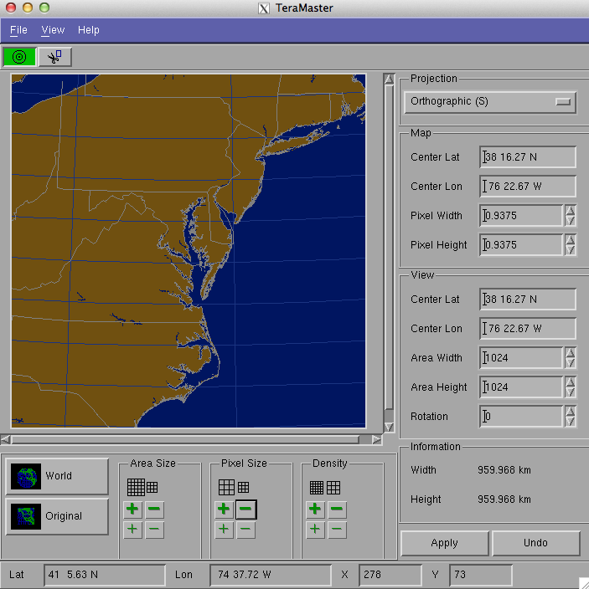
Area Of Interest
Terminal
login to TeraScan Server
launchpad
TeraMaster
create an area of interest (AOI) or Master
save AOI
Notes:
In order to initiate the process, the terminal window in their PC or Mac must first be opened. After opening the terminal window, the user has to enter into the TeraScan server. The user login information includes ssh (space) –Y(space) first initial last name@IP address to login into the TeraScan Server (first initial and last name should be together when typed). The server will the request that the user provide a password. After typing the correct password into TeraScan, the user should the type “launchpad” in their login and press enter. After typing “launchpad”, the menu to TeraScans GUIs should open. The user should select TeraMaster and create an area of interest (AOI) which includes increasing/decreasing the area size, pixel size, and density of the AOI. After creating a new master in TeraMaster, the user should go to “File” and “Save As” and then search for the newly created file and save it in their respective directory. Following that, the user should close TeraMaster and return to the terminal window.
In the terminal window, go to “configproc” and in the “configproc” directory change the parameters to match the AOI that was created using TeraMaster. Save the changes in the “configproc” directory. Then go to “launchpad” and click on TeraVision. In TeraVision go to “File” and “Open Data Shelf”. In “Open Data Shelf” go to “Edit Data Library” and go to “New” under Shelves. In “New” find the “configproc” directory in which the images will be saved when a pass is made. Name your new Data Shelf and save it. After saving, go back to “File” and “Open Data Shelf” and click on the new Data Shelf and select images according to what time is desired. After selecting the respectable images, choose the desired channels and once the image(s) are on the TeraVision window, you can edit the images by adding Layers, borders, Grid Overlays, etc. Then click on the Save Icon and Save the image as desired. Then exit TeraVision and exit the terminal window.

Slide 11
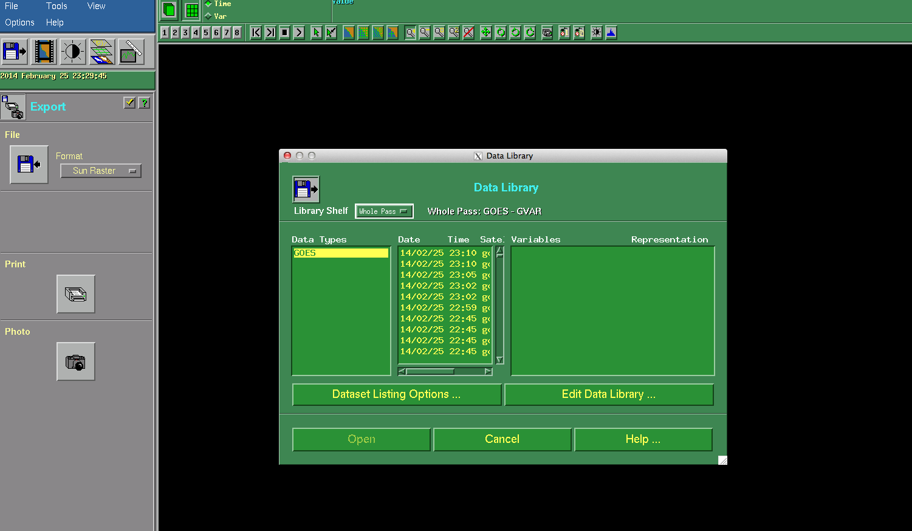
Modifying Configuration File
Script
configproc
function
parameters
TeraVision

Slide 12
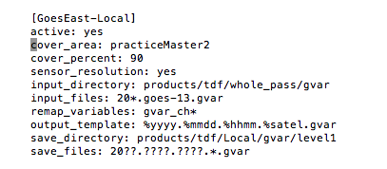
TeraMaster Modifications

Slide 13
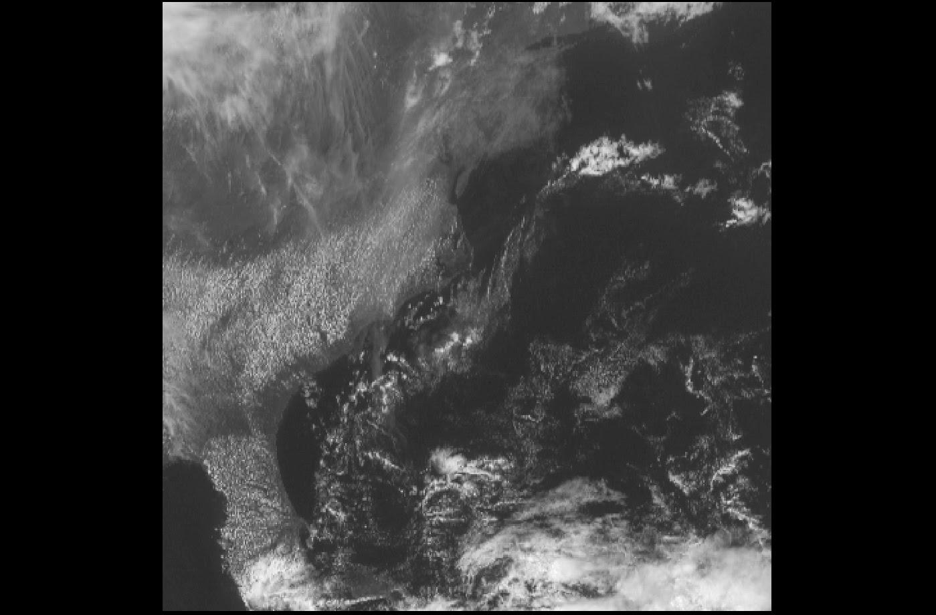
TeraVision Images
Naked Channel 1 April 13 2014 18:15:49

Slide 14
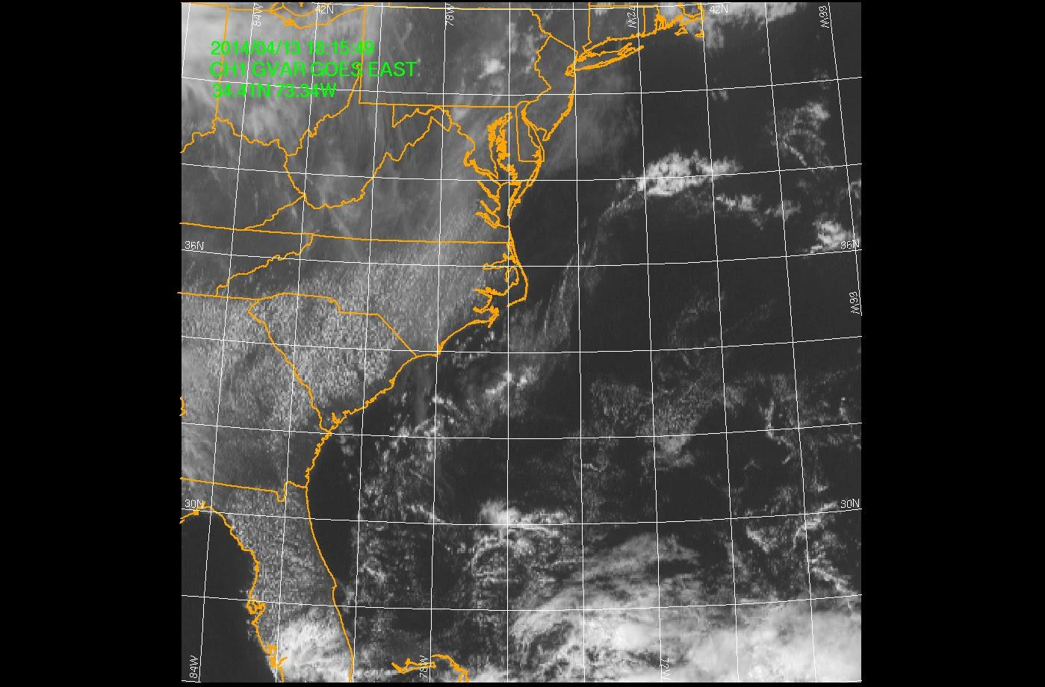
TeraVision Images
Channel 1 April 14 2014 18:15:49

Slide 15
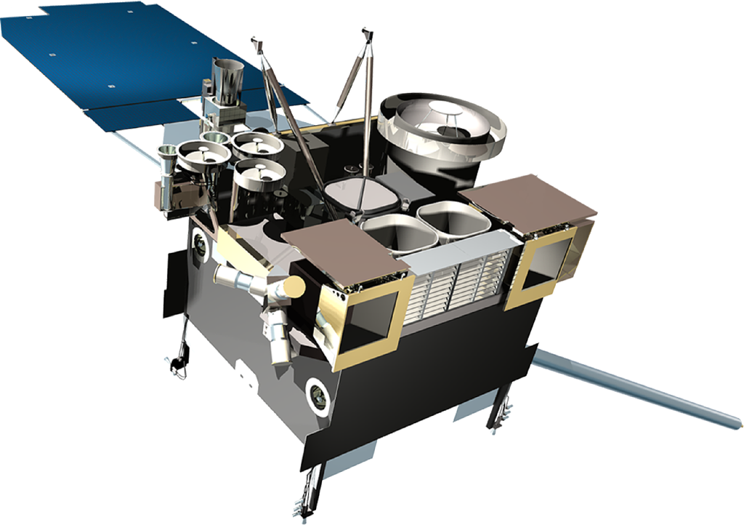
CERSER Server Script Failures
Update of the database
GOES data
Directory Permissions
Picture Archives Directory
Notes:
Since there was new satellite hardware and software added this year, the script for the database that was redesigned back in 2011 needed to be updated in order to process the new satellite information being received. It was found that the permissions of the directories on the CERSER server were modified to READ ONLY when the files were migrated to the new server. The directory permissions that were on the CERSER server needed to be changed from READ ONLY to READ & WRITE so the images can be processed.
A remote computer located in Lane Hall gave access to the CERSER server in the E.V. Wilkins Computing Center. To change the directory permission first right click on the directory and select GET INFO. Scroll to the SHARING & PERMISSIONS section and change each privilege from READ ONLY to READ & WRITE. This procedure was performed on all the directories in the picture archives directory. This action allowed the script to modify and copy images to these directories.

Slide 16
Server Side Script
Languages used:
PHP
MySQL
HTML
First used Active Server Page (ASP)
Was rewritten when switched from Windows to Macintosh
Notes:
Once it was determined that a PHP script was functional on the CERSER server the processing script could now be modified. The languages used in the script are PHP, MySQL, and HTML. The scripted was first developed in 2006 as an Active Server Page (ASP) on a Windows based server. When the server pages were migrated to a Macintosh server in 2010, the script was rewritten using PHP and MySQL.
In 2013 TeraScan processing hardware and software were upgraded to receive GOES satellite data. The ground station upgrades included a 3.7m X/L band, a 3.6m C band, and a 5.0m L band antenna’s, along with accompanying computing hardware. The goal of this project was to update the CERSER script to process images received from the GOES imager by the TeraScan system. This script involved parsing the title into the CERSER database and then copying and resizing the original image.
The new satellite is called the Geostationary Operational Environmental Satellite (GOES). The satellite an imaging sensor with five channels. The channels are used to describe what kind of image is being portrayed on the database.

Slide 17
PHP
Introduction
Project Use
Notes:
PHP Hypertext Preprocessor (PHP) is an open source language that is widely used around the world; its main use is scripting languages [15]. PHP is used to make web pages interactive, enter information into databases, and many other uses. It can be used as a calculator to determine what day it is or it can also be used in the execution of math equations. PHP is also used to collect information from users and create graphics using the Graphics Draw (GD) Library [18].
PHP was used in this project to construct and execute MySQL commands for the database operations and to execute ImageMagick operations via a command line. PHP is processed by the server and generates Hypertext Markup Language (HTML) to be delivered back to the client.

Slide 18
MySQL
Introduction
Project Use
Notes:
My Structured Query language (MySQL) is an Open Source SQL database management system developed, distributed, and supported by Oracle Corporation [20]. A database is a structured collection of data; it may be anything from a simple shopping list to a picture gallery or the vast amounts of information in a corporate network. To add, access, and process data stored in a computer database, you need a database management system such as MySQL Server. Since computers are very good at handling large amounts of data, database management systems play a central role in computing, as standalone utilities, or as part of other applications.
MySQL is used in this project to insert records into the TeraScan database from within the PHP script. Record parameters are gathered into variables and then combined into a MySQL statement to store information about the image being processed. It is also utilized to retrieve records from the database to be displayed through the CERSER website.

Slide 19
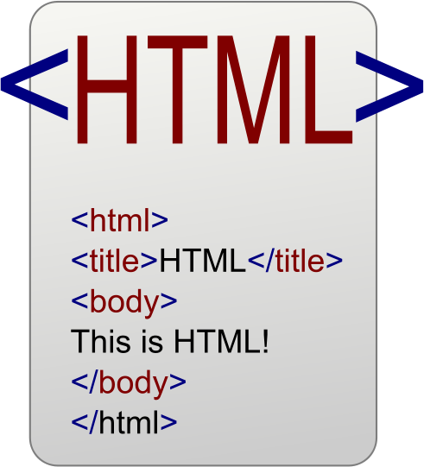
HTML
Introduction
Project Use
Notes:
Hypertext Markup Language (HTML) is a computer language used to create web pages that can be on the internet or sent via email. This language uses codes called “tags” that tells web browsers and email programs how to display text, graphics and design. In this project HTML was used because PHP returns HTML to the browser.
HTML was created by Tim Berners- Lee who was helped by CERN, an organization in Switzerland.

Slide 20
Dreamweaver
Introduction
Project Use
Notes:
Adobe Dreamweaver is a software that has to be purchased; it is used to create web pages, interactive web pages and to interact with databases. Dreamweaver allows you to write in scripting languages such as PHP and JavaServer Pages. This software also uses server-side scripting languages such as JavaScript [27]. The company that first released Adobe Dreamweaver was Allaire Systems, a computer company in Minnesota, in December of 1997. In 2001 the company Macromedia bought out Allaire, and Macromedia was bought out by Adobe in 2005. Before Adobe bought Dreamweaver it went through revisions [28].
In this project Adobe Dreamweaver was used to build the TeraScan database using the PHP language and to document this project.

Slide 21
phpMyAdmin
Introduction
Project Use
Notes:
phpMyAdmin is an open source software that is written in PHP. phpMyAdmin helps operations such as MySQL [25]. Frequently used operations that can be performed through the graphical interface include managing database, tables, columns, relations, indexes, users, and permissions. The ability to directly execute any SQL statement is also available.
This software is installed directly on the server and accessed via the internet utilizing a sign-on and password to manipulate and create databases. The application can access and control several databases at one time making it useful for managing data for a single website.
phpMyAdmin was utilized in this project to build and maintain the TeraScan database. Fields and tables within the previously established database were created and modified utilizing this online tool. Actual data can also be modified, created, and deleted from within phpMyAdmin.

Slide 22
ImageMagick
Introduction
Project Use
Notes:
ImageMagick is a software that allows the user to create, modify, and/or convert images. This software allows you to resize, distort, and adjust the color of an image. ImageMagick is controlled by command lines making it useful for different languages such as MagickWand for PHP (PHP) or Magick++ (C++) [13].
In this project ImageMagick was used to convert the image from TIFF to JPEG format. It was also used to resize, copy, and rename the image files. The directories that it copied the images to were actual, medium,low,and thumbnail.

Slide 23
ICal
Introduction
Project Use
Notes:
The calendar application is known as iCal in Mac OS X and earlier operating system releases. iCal provides tools to keep track of schedules, engagements, reminders, and other important events. This project utilized iCal to trigger the scripts used to process the TeraScan images on a daily basis.

Slide 24
Parse Title to Database
Title being used for database
36 characters 2014.0302.2001.goes-13.gvar_ch3.tiff
“substr” a PHP function
Notes:
The title of the image holds the information needed for the database. Image date, time, type of satellite, the channel and the file extension are all found in the title. The GOES image titles have 36 characters including periods and underscores (example: 2014.0302.2001.goes-13.gvar_ch3.tiff). The position of these characters is critical to parsing the elements into the correct database fields. The title is broken down by the following positions:
Characters Data
1-4 Year
6-7 Month
8-9 Day
11-14 Time (Z)
16-22 Satellite Name
24-31 Product (band)
32-36 File Extension (.tiff)
The PHP script shown in Figure ?? parses the title into variables utilizing the “substr” command. This command has the form “substr ( string $string , int $start [, int $length ] )” where $string is the input string, $start is the integer for the starting character in the string, and $length is the integer for the total number of characters. It must be remembered that the starting integer starts counting at “0” for the first character in the string.
In the script shown, the title of the file has been previously placed into the PHP variable “$satName.” The script first tests if the image is from the GOES imager by comparing characters 16-19 [substr($satName, 15, 4)] to the string “goes”. If they are equal, then the script proceeds to parse the title.
The first image element to be entered into the database is the satellite name found in line 70 of Figure ??. The process then converts the date into the format MM/DD/YYYY utilizing the PHP concatation “.” (period). The time is then placed into the variable $cnvrtTime with the character “z” added to denote the time zone.
The final parsing element is the $product variable. The script checks the character located at position 30 to identify which band of the imager was used to develop the satellite image. The options along with the text string to be inserted into the database are as follows:
Option Text String
“1” Channel 1 Visible 0.52-0.72 mm
“2” Channel 2 Infrared 3.78-4.03 mm
“3” Channel 3 Vapor 6.47-7.02 mm
“4” Channel 4 Upper Vapor 10.2-11.2 mm
“S” Sea Surface Temperature
Once the file title is parsed into the assorted variables, the variables are combined into an SQL statement (line 107-108, Figure ??) and placed into the variable “$query”. The variable is then written to the screen using the “echo” command for viewing by the developer. This step can be removed, but was left in as a feedback mechanism for the script.
The next step is to execute the SQL statement using the PHP command mysql_query() (Line 114). This will place the variables into the appropriate fields of a new database record in the “images” table. The results of this query are placed into the variable “$result” so that any failures can be displayed to the user.

Slide 25
Parse Title to Database
2014.0305.1531.goes-13.gvar_ch1.tiff
Characters Data
1-4 Year
6-7 Month
8-9 Day
11-14 Time(Z)
16-22 Satellite Name
24-31 Product (band)
32-36 File Extension (.tiff)

Slide 26
Checking for GOES Image
”IF” statement looks for “goes” starting at position 15.
2014.0305.1531.goes-13.gvar_ch1.tiff
Notes:
The title of the image holds the information needed for the database. Image date, time, type of satellite, the channel and the file extension are all found in the title. The GOES image titles have 36 characters including periods and underscores (example: 2014.0302.2001.goes-13.gvar_ch3.tiff). The position of these characters is critical to parsing the elements into the correct database fields. The title is broken down by the following positions:
Characters Data
1-4 Year
6-7 Month
8-9 Day
11-14 Time (Z)
16-22 Satellite Name
24-31 Product (band)
32-36 File Extension (.tiff)
The PHP script shown in Figure ?? parses the title into variables utilizing the “substr” command. This command has the form “substr ( string $string , int $start [, int $length ] )” where $string is the input string, $start is the integer for the starting character in the string, and $length is the integer for the total number of characters. It must be remembered that the starting integer starts counting at “0” for the first character in the string.
In the script shown, the title of the file has been previously placed into the PHP variable “$satName.” The script first tests if the image is from the GOES imager by comparing characters 16-19 [substr($satName, 15, 4)] to the string “goes”. If they are equal, then the script proceeds to parse the title.
The first image element to be entered into the database is the satellite name found in line 70 of Figure ??. The process then converts the date into the format MM/DD/YYYY utilizing the PHP concatation “.” (period). The time is then placed into the variable $cnvrtTime with the character “z” added to denote the time zone.
The final parsing element is the $product variable. The script checks the character located at position 30 to identify which band of the imager was used to develop the satellite image. The options along with the text string to be inserted into the database are as follows:
Option Text String
“1” Channel 1 Visible 0.52-0.72 mm
“2” Channel 2 Infrared 3.78-4.03 mm
“3” Channel 3 Vapor 6.47-7.02 mm
“4” Channel 4 Upper Vapor 10.2-11.2 mm
“S” Sea Surface Temperature
Once the file title is parsed into the assorted variables, the variables are combined into an SQL statement (line 107-108, Figure ??) and placed into the variable “$query”. The variable is then written to the screen using the “echo” command for viewing by the developer. This step can be removed, but was left in as a feedback mechanism for the script.
The next step is to execute the SQL statement using the PHP command mysql_query() (Line 114). This will place the variables into the appropriate fields of a new database record in the “images” table. The results of this query are placed into the variable “$result” so that any failures can be displayed to the user.

Slide 27
Storing Satellite Name
Parsing the satellite name
2014.0305.1531.goes-13.gvar_ch1.tiff
Notes:
we have a variable called “sat” that are going to fill the function “substr”, that has a parameter function “satname” and holds the title filename. it starts counting at char 15, six spaces over to get the satellite name.

Slide 28
Storing Reformatted Date
Parse and reformat the date into month/day/year
2014.0305.1531.goes-13.gvar_ch1.tiff
Notes:
“$cnvrtDate” stores the satName character 5 - 6 (month) /
reformating the date / month/year

Slide 29
Storing Time
Parsing the Greenwich Mean Time (GMT)
2014.0305.1531.goes-13.gvar_ch1.tiff
Notes:
we have a variable called “cnvrtTime” that are going to fill the function “substr”, that has a parameter function “satname” and holds Zulu time. it starts counting at char 10, four spaces over to get Zulu time.

Slide 30
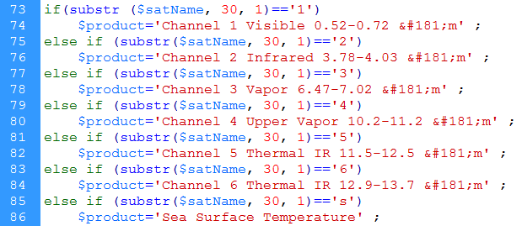
Storing the Product
Parsing the product from the image title
Notes:
The title of the image holds the information needed for the database. Image date, time, type of satellite, the channel and the file extension are all found in the title. The GOES image titles have 36 characters including periods and underscores (example: 2014.0302.2001.goes-13.gvar_ch3.tiff). The position of these characters is critical to parsing the elements into the correct database fields. The title is broken down by the following positions:
Characters Data
1-4 Year
6-7 Month
8-9 Day
11-14 Time (Z)
16-22 Satellite Name
24-31 Product (band)
32-36 File Extension (.tiff)
The PHP script shown in Figure ?? parses the title into variables utilizing the “substr” command. This command has the form “substr ( string $string , int $start [, int $length ] )” where $string is the input string, $start is the integer for the starting character in the string, and $length is the integer for the total number of characters. It must be remembered that the starting integer starts counting at “0” for the first character in the string.
In the script shown, the title of the file has been previously placed into the PHP variable “$satName.” The script first tests if the image is from the GOES imager by comparing characters 16-19 [substr($satName, 15, 4)] to the string “goes”. If they are equal, then the script proceeds to parse the title.
The first image element to be entered into the database is the satellite name found in line 70 of Figure ??. The process then converts the date into the format MM/DD/YYYY utilizing the PHP concatation “.” (period). The time is then placed into the variable $cnvrtTime with the character “z” added to denote the time zone.
The final parsing element is the $product variable. The script checks the character located at position 30 to identify which band of the imager was used to develop the satellite image. The options along with the text string to be inserted into the database are as follows:
Option Text String
“1” Channel 1 Visible 0.52-0.72 mm
“2” Channel 2 Infrared 3.78-4.03 mm
“3” Channel 3 Vapor 6.47-7.02 mm
“4” Channel 4 Upper Vapor 10.2-11.2 mm
“S” Sea Surface Temperature
Once the file title is parsed into the assorted variables, the variables are combined into an SQL statement (line 107-108, Figure ??) and placed into the variable “$query”. The variable is then written to the screen using the “echo” command for viewing by the developer. This step can be removed, but was left in as a feedback mechanism for the script.
The next step is to execute the SQL statement using the PHP command mysql_query() (Line 114). This will place the variables into the appropriate fields of a new database record in the “images” table. The results of this query are placed into the variable “$result” so that any failures can be displayed to the user.

Slide 31
Parse Product to Database
Products
Option Text String
“1” Channel 1 Visible 0.52-0.72 μm
“2” Channel 2 Infrared 3.78-4.03 μm
“3” Channel 3 Vapor 6.47-7.02 μm
“4” Channel 4 Upper Vapor 10.2-11.2 μm
“5” Channel 5 Thermal IR 11.5-12.5 μm
“6” Channel 6 Thermal IR 12.9-13.7 μm
“S” Sea Surface Temperature

Slide 32
Inserting Record into Database
MySQL Query
Notes:
Once the file title is parsed into the assorted variables, the variables are combined into an SQL statement (line 111, Figure ??) and placed into the variable “$query”.
The next step is to execute the SQL statement using the PHP command mysql_query() (Line 117). This will place the variables into the appropriate fields of a new database record in the “images” table. The results of this query are placed into the variable “$result” so that any failures can be displayed to the user.

Slide 33
Resize/Rename/Copy IMG
ImageMagick
Converted TIFF files to JPEG format
Resized images
Copy images into four directories:
Actual
Medium
Low
Thumbnail
Notes:
The next group of operations involves resizing, renaming, copying, and converting the TeraScan images from TIFF to JPEG formats. PHP is used to execute command line instructions to the graphic program ImageMagick. This section of code was not modified during this project, but a brief overview of the operation follows.
Figure ?? shows the code that transfers the record id to the variable $lastID. The function “mysql_insert_id()” is the PHP code that retrieves the record id. The $lastID will be the new name for the record. When a record is inserted into the database the key id is automatically created. There is no record that has the same key id.
Figure ?? is the section of code required to manipulate the various images produced by the TeraScan system. These processes use a command line execution of modules found in the open source graphic program ImageMagick. This program has many capabilities such as resizing, flipping, rotating, distorting, and transforming images.
The first step in this process is assigning the current name of the TeraScan image and its location to the variable $orgFile. Using the $lastID variable is used to assign the new title for the converted files in line 135 of Figure ?? to the variable $newFile. These variables are written to the screen for confirmation in line 138.
The first is to copy the TeraScan image from the “original” directory to the “actual” directory with its new title derived from the variable $lastID (lines 144-146). The parameters for each of these steps is placed into the variable $cnvrt and then used in the PHP function exec() which is used to execute command line instructions.
ImageMagick is the basic of this code in figure ??; it starts the resizing/renaming/copying of the images. ImageMagick runs off the command line and PHP executes the command line. PhP is used to obtain the data and substring (substr()). ImageMagick convert images to a tiff to TIFF as shown in line 144 on figure ?? or the images will be converted to a TIFF to JPEG which that is also shown on figure?? lines 148-154. After these images are being converted the script decides what categories it is going to be in: actual, medium, low, thumbnail. The process will go on until the directory is empty; there is a while loop to perform the images to be removed from the original.
ImageMagick was the first step with resizing/ renaming/ copying the image. It is used because ImageMagick can run off command line and PHP executes command line. ImageMagick converts images with extensions with TIFF to JPEG. After the images are converted the script places and resizes the image into four categories actual, medium, low and thumbnail. The script also renamed the images to add them into the directories of actual, medium, low and thumbnail. This process continues until the directory of original is empty, a while loop was used to remove the images from original. There was nothing needed to be done to the script for resizing, renaming and copying image.

Slide 34
Resize/Rename/Copy IMG
Renaming image:
$lastID as variable
“mysql_insert_id()” PHP function
Use $lastID to rename the new file
Notes:
The next group of operations involves resizing, renaming, copying, and converting the TeraScan images from TIFF to JPEG formats. PHP is used to execute command line instructions to the graphic program ImageMagick. This section of code was not modified during this project, but a brief overview of the operation follows.
Figure ?? shows the code that transfers the record id to the variable $lastID. The function “mysql_insert_id()” is the PHP code that retrieves the record id. The $lastID will be the new name for the record. When a record is inserted into the database the key id is automatically created. There is no record that has the same key id.
Figure ?? is the section of code required to manipulate the various images produced by the TeraScan system. These processes use a command line execution of modules found in the open source graphic program ImageMagick. This program has many capabilities such as resizing, flipping, rotating, distorting, and transforming images.
The first step in this process is assigning the current name of the TeraScan image and its location to the variable $orgFile. Using the $lastID variable is used to assign the new title for the converted files in line 135 of Figure ?? to the variable $newFile. These variables are written to the screen for confirmation in line 138.
The first is to copy the TeraScan image from the “original” directory to the “actual” directory with its new title derived from the variable $lastID (lines 144-146). The parameters for each of these steps is placed into the variable $cnvrt and then used in the PHP function exec() which is used to execute command line instructions.
ImageMagick is the basic of this code in figure ??; it starts the resizing/renaming/copying of the images. ImageMagick runs off the command line and PHP executes the command line. PhP is used to obtain the data and substring (substr()). ImageMagick convert images to a tiff to TIFF as shown in line 144 on figure ?? or the images will be converted to a TIFF to JPEG which that is also shown on figure?? lines 148-154. After these images are being converted the script decides what categories it is going to be in: actual, medium, low, thumbnail. The process will go on until the directory is empty; there is a while loop to perform the images to be removed from the original.
ImageMagick was the first step with resizing/ renaming/ copying the image. It is used because ImageMagick can run off command line and PHP executes command line. ImageMagick converts images with extensions with TIFF to JPEG. After the images are converted the script places and resizes the image into four categories actual, medium, low and thumbnail. The script also renamed the images to add them into the directories of actual, medium, low and thumbnail. This process continues until the directory of original is empty, a while loop was used to remove the images from original. There was nothing needed to be done to the script for resizing, renaming and copying image.

Slide 35
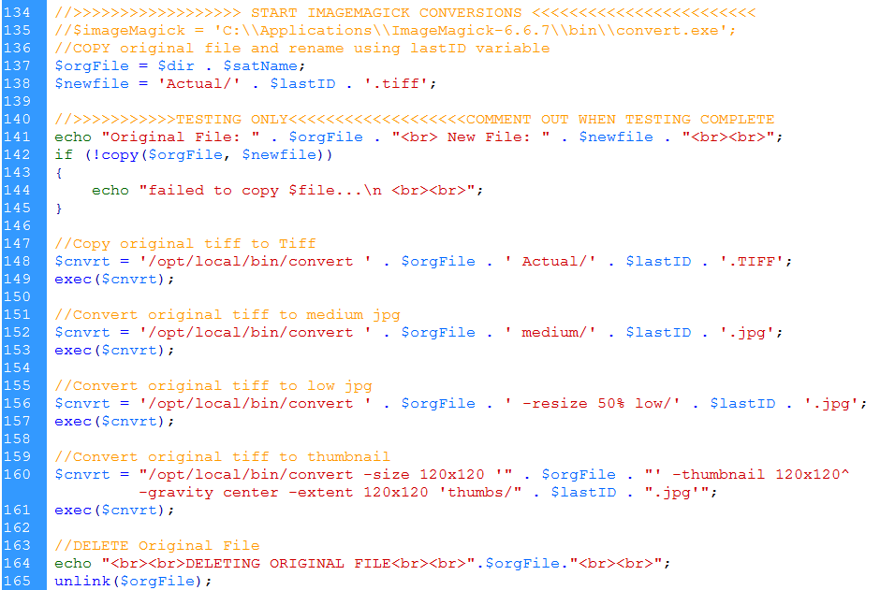

Slide 36
Results
Images are able to process
Permissions were changed:
Images can be modified for database
Parsing of title is successful
Resizing, Renaming, and Copying of images is still successful.
Notes:
-TS
Images are able to be processed using both TeraVision and the UNIX script. In TeraVision, the user is able to let the images are able to have borders, layers, Grid Overlays, etc. In the script, each time a pass comes in and is converted into data, the batch.ingest takes the pass and cleaves it to match the parameters of the picture in the gvar.local directory, which includes the cover_area, input files, the save directory, and etc.
- Server/ Script
After changing the permissions of the picture archives directories on the CERSER server in E.V. Wilkins Computing Center, the images can now be modify to be used in the database. The images are now able to process and to be displayed on the database. The information from parsing the title of the images are now being put into the database. The code in the script for resizing/ renaming/ copying the image is still working and the images are able to be viewed closer when clicked on in the database.

Slide 37
Conclusion
Able to use GUI’s to modify/develop script in TeraScan
Production of images, even though they are low in resolution
Daily Automated Process was not completed
To process and finalize images to send from TeraScan server to CERSER server
Images from TeraScan are reduced in size
PHP is still a functioning language to process TeraScan produced images.
Notes:
Images can be successfully processed however, there are other goals that were not met. After changing the parameters in the script to modify the images to match the AOI, there needs to be a way to let the images be sent to the CERSER server in order so that CERSER can get the images automatically from the TeraScan server, instead of having to manually send the files from the TeraScan server to the CERSER server. There needs to be a daily automated process written the script to receive processed and finalized images from the TeraScan server to send to the CERSER server. Also, there needs to be an increase of image size with the images being received and processed through the script in TeraScan.
Overall the database is a success and there have not been anymore problems with the images transition from the satellite to E.V. Wilkins Computing Center to the database. All the problems have been fixed and the goals have been completed. The images are coming in and the information that was taken from the title are all correct. The next time working on this project; it would be nifty to use Java.

Slide 38
Future Work
To accomplish a daily automated process of images from the TeraScan server to the CERSER server
To increase the image size of the pictures in the script and have a script that will connect from the TeraScan server to the CERSER server.
Add channels to TeraScan software
Rewrite script to add the NOAA satellite information.
When other channels are added to the GOES.
Notes:
In the future, we hope to accomplish a daily automated process of images from the TeraScan server to the CERSER server. Also, we hope to increase the image size of the pictures in the script and have a script that will connect from the TeraScan server to the CERSER server.
- Rewriting Script to re add the NOAA satellite information.
- When other channels are added to the GOES.

Slide 39
Acknowledgements
Dr. Linda Hayden
Andrew Brumfield
Seaspace

Slide 40
Demonstration
http://cerser.ecsu.edu/

Slide 41
Questions

