Slide 1
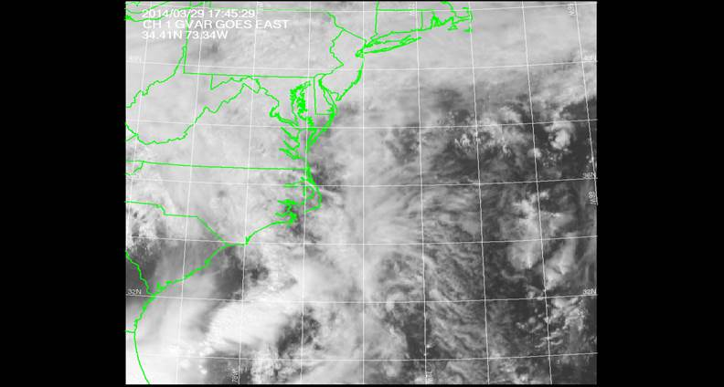
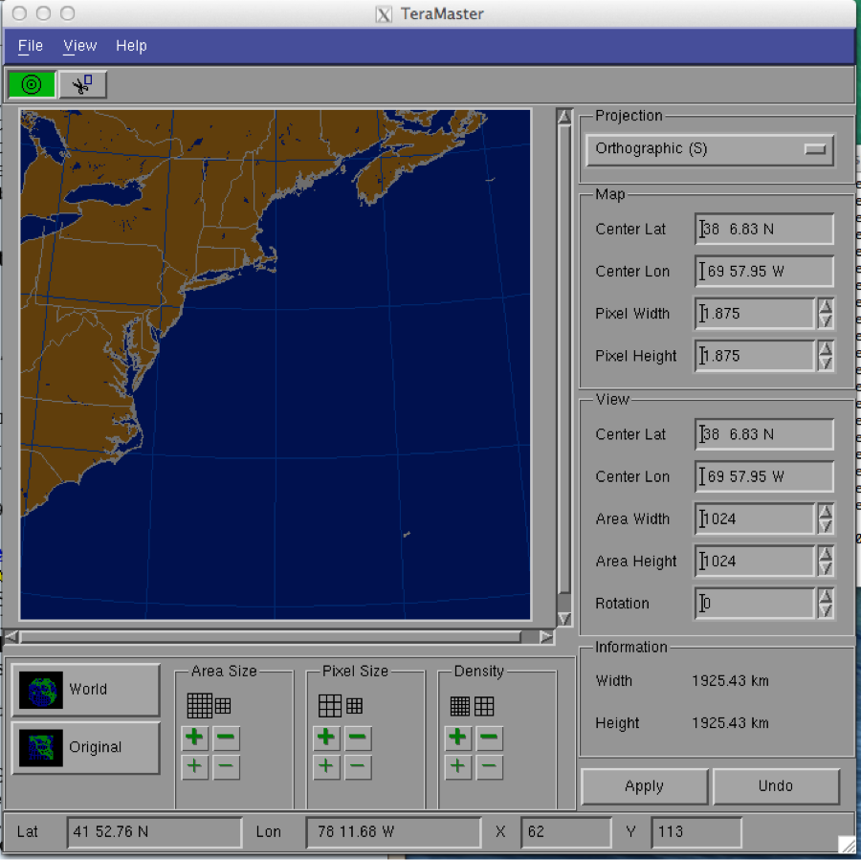
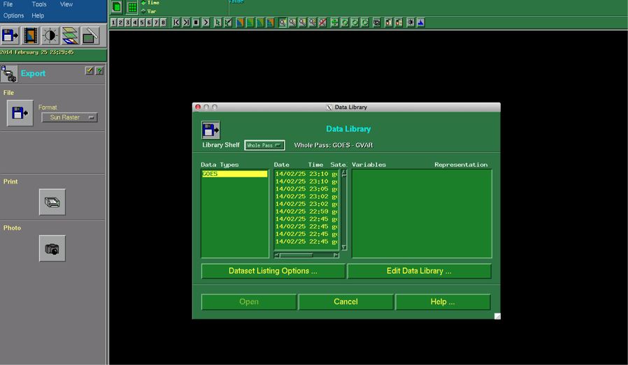
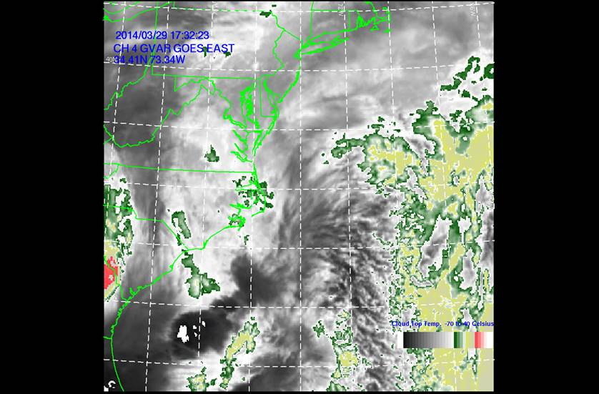
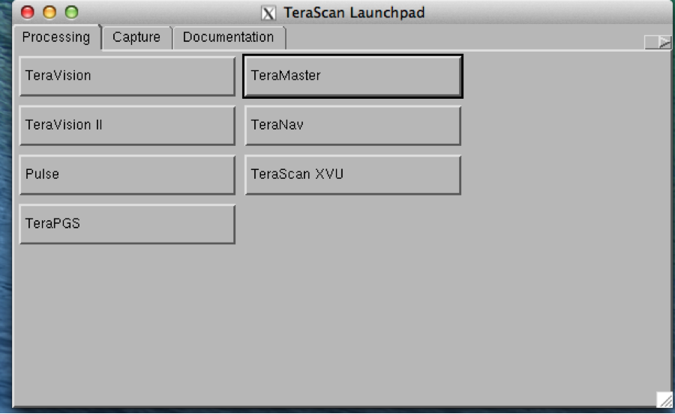
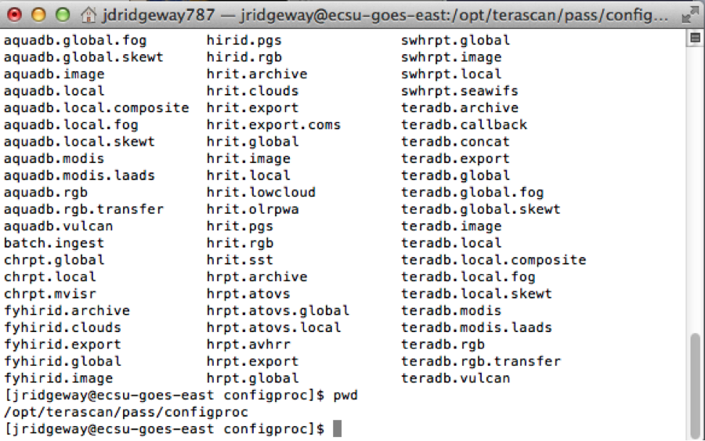
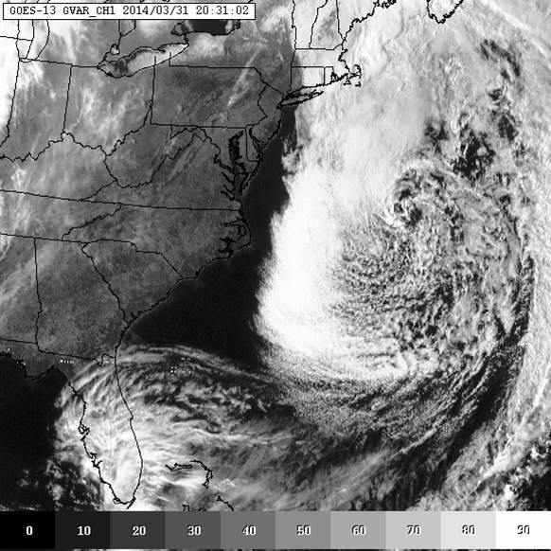
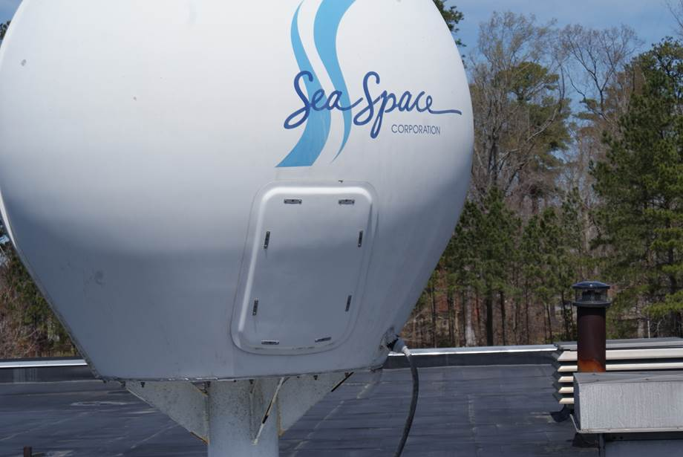
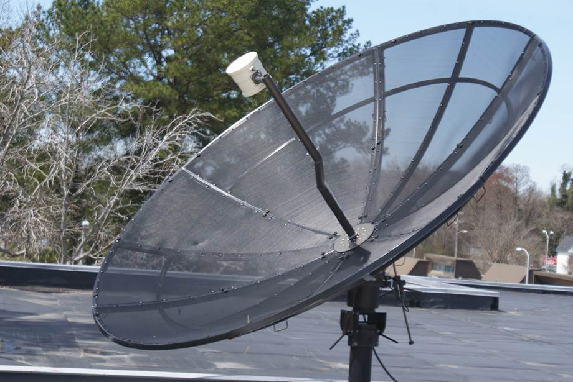
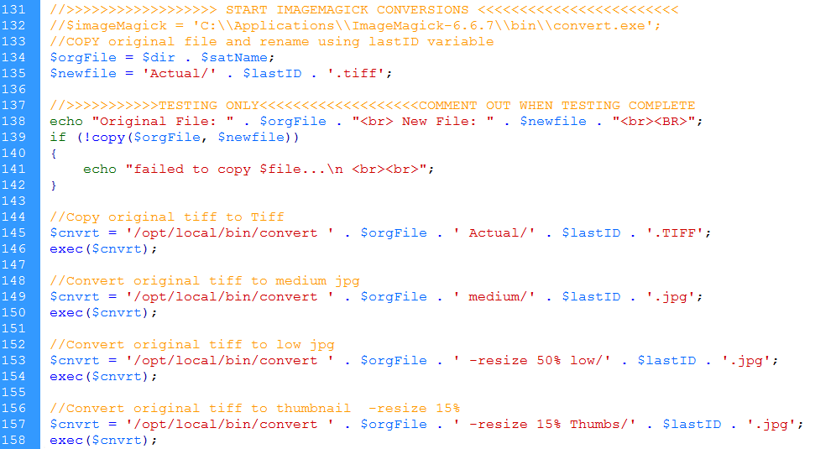
Update of the CERSER TeraScan Cataloguing System and the TeraScan Image Processing Scripts
2013-2014 Multimedia Team :: Derek Morris Jr., Jefferson Ridgeway, Tori Wilbon :: Center of Excellence in Remote Sensing Education and Research :: Elizabeth City State University :: Elizabeth City, North Carolina, USA
Abstract
The Center of Excellence in Remote Sensing Education and Research (CERSER) on the campus of Elizabeth City State University is currently tasked with the responsibility of receiving remotely sensed data from National Oceanic and Atmospheric Administration (NOAA) Polar Operational Environmental Satellites (POES) and Geostationary Operational Environmental Satellites (GOES). This data is collected by SeaSpace TeraScan systems installed in the CERSER labs in Dixon-Patterson Hall.
In 2005, the processing system underwent a major update due to a migration to a new operating system. A minor update was needed at this time to deal with a second operating system migration and display of the processed images on the CERSER web site. Since then, a second transfer to a new server was made in 2013. The cataloguing system went down at this time and was not repaired due to technical issues with the TeraScan system. The 2014 team corrected issues within the current server directory system and updated the data script to process images from the GOES-13 satellite received by the TeraScan system. Software and languages utilized for this task included ImageMagick, PHP, HTML, Dreamweaver, phpMyAdmin, and MySQL.
Along with this operating system update, a major script development was needed on the TeraScan processing equipment due to an upgrade in hardware. The ground station upgrades included a 3.7m X/L band, a 3.6m C band, and a 5.0m L band dishes, along with accompanying computing hardware.
This project implemented new script on the TeraScan and CERSER servers. This new script processes both infrared and visible light images received from the GOES-13 satellite into the Tagged Image File (TIFF) Format. Keywords- GOES, TeraScan, ImageMagick, Macintosh OSX, MySQL, PHP, Remote Sensing
Goals
This research project had three goals for this academic year tasking:
Determine and repair the cause of the script failures on the CERSER server.
Develop TeraScan script that will process the satellite data into an image, provide overlay information, and place the completed image onto the server.
Rewrite the PHP processing script on the CERSER server to parse Geostationary Operational Environmental Satellite (GOES) information into a database and to execute commands to convert and resize the same image.
Methodology
TeraScan Modification Script
Used GUI TeraMaster to make a master Area of Interest (AOI)
Modified the configproc file parameters
Binary is converted to the TeraScan Data Format(TDF)
Enter Configproc then go to gvar.local
CERSER Server Script Failures
2011 script needed to be updated
Change directory permissions to READ & WRITE
Serverside Script
PHP, MySQL, HTML (1st developed in 2006 as ASP script)
Upgrade of TeraScan equipment 2013
Process images received from GOES imager by TeraScan
Parse Title to Database
Title holds information need for database
Date, time, type of satellite, channel, extension
GOES file titles have 36 characters
Use variables use substr commands
Time is in Zulu
Resize/Rename/Copy IMG
Change TIFF to JPEG formats
Uses graphic program ImageMagick
Mysql_insert_id() retrieves the record id
Used to rename the image by using only the keyid name
Results
-TS
Images are able to be processed using both TeraVision and the UNIX script. In TeraVision, the user is able to let the images are able to have borders, layers, Grid Overlays, etc. In the script, each time a pass comes in and is converted into data, the batch.ingest takes the pass and cleaves it to match the parameters of the picture in the gvar.local directory, which includes the cover_area, input files, the save directory, and etc.
- Server/ Script
After changing the permissions of the picture archives directories on the CERSER server in E.V. Wilkins Computing Center, the images can now be modify to be used in the database. The images are now able to process and to be displayed on the database. The information from parsing the title of the images are now being put into the database. The code in the script for resizing/ renaming/ copying the image is still working and the images are able to be viewed closer when clicked on in the database.
NOAA GOES Channel 3 Vapor, ECSU
NOAA GOES Channel 1 Visible, ECSU
Creating a new Data Shelf in TeraVision
An Area of Interest made using the GUI TeraMaster
Conclusion
Images can be successfully processed however, there are other goals that were not met. After changing the parameters in the script to modify the images to match the AOI, there needs to be a way to let the images be sent to the CERSER server in order so that CERSER can get the images automatically from the TeraScan server, instead of having to manually send the files from the TeraScan server to the CERSER server. There needs to be a daily automated process written the script to receive processed and finalized images from the TeraScan server to send to the CERSER server. Also, there needs to be an increase of image size with the images being received and processed through the script in TeraScan.
Overall the database is a success and there have not been anymore problems with the images transition from the satellite to E.V. Wilkins Computing Center to the database. All the problems have been fixed and the goals have been completed. The images are coming in and the information that was taken from the title are all correct. The next time working on this project; it would be nifty to use Java.
TeraScan Launchpad Server which includes all of the TeraScan GUIs
NOAA GOES Channel 4 Upper Vapor, ECSU
In the terminal window, under the configproc directory
Process GOES Satellite Info
Option Text String
“1” Channel 1 Visible 0.52-0.72 mm
“2” Channel 2 Infrared 3.78-4.03 mm
“3” Channel 3 Vapor 6.47-7.02 mm
“4” Channel 4 Upper Vapor 10.2-11.2 mm
“S” Sea Surface Temperature
References
Luke, Autumn. Bly, Patrina. “Redesign of CERSER Cataloguing System for TeraScan Processed Images.” Internet: http://nia.ecsu.edu/ur/1011/teams/mmt/mmt1011-paper.pdf , n.d. [Mar. 12, 2014].
Cristy. "ImageMagick History. "Internet: http://www.imagemagick.org/www/history.html, n.d.[Feb. 11, 2014]
Tyssen, Anthony. "Examples of ImageMagick Usage(Version 6)." Internet: http://www.imagemagick.org/Usage/, Nov. 30, 2012 [Feb. 11, 2014]
"Convert, Edit, and Compose Images." Internet: http://www.imagemagick.org/, n.d. [Feb. 11,2014]
John, Michael S. "ImageMagick-some cool things you can do with it!" Internet: http://ubuntuvideocast.com/2012/05/25/imagemagick-some-cool-things-you-can-do-with-it/, May 25, 2012 [Feb. 11, 2014]
Chapman, Stephen. "What Is JavaScript?" Internet: http://javascript.about.com/od/reference/p/javascript.htm, n.d. [Feb. 13, 2014]
"JavaScript Introduction." Internet: http://www.w3schools.com/js/js_intro.asp, n.d. [Feb. 13, 2014]
Kindig, Alexis. "What Is JavaScript Used For? "Internet: http://www.ehow.com/facts_4882979_what-javascript-used.html, Apr. 2, 2009 [Feb. 13, 2014]
"Who Invented JavaScript." Internet: http://wanttoknowit.com/who-invented-javascript/, Aug. 8, 2012 [Feb. 13, 2014]
“What is PHP?” Internet: http://php.net/manual/en/intro-whatis.php, n.d. [Feb. 14, 2014]
Grubb, Kristen. “What Does PHP Stand For?” Internet: http://www.brighthub.com/internet/web-development/articles/62713.aspx, Aug. 3, 2012 [Feb. 14, 2014]
“History of PHP” Internet: http://php.net/manual/en/history.php.php, n.d. [Feb. 14, 2014]
Bradley, Angela “What is PHP Used For?” Internet: http://php.about.com/od/phpbasics/qt/what_is_php_used_for.htm, n.d. [Feb. 14, 2014]
“Help saving MySQL” Internet: http://monty-says.blogspot.com/2009/12/help-saving-mysql.html, Dec. 12,2009 [Mar. 25, 2014]
“1.3.1. What is MySQL?” Internet: http://dev.mysql.com/doc/refman/4.1/en/what-is-mysql.html, n.d. [Mar. 25, 2014]
“Dreamweaver system requirements” Internet: http://web.archive.org/web/20090517002426/http:/kb2.adobe.com/cps/191/tn_19124.html, n.d. [Mar. 25, 2014]
“Adobe Completes Acquisition of Macromedia” Internet: www.adobe.com/aboutadobe/pressroom/pressreleases/pdfs/200512/120505AdobeAcquiresMacromedia.pdf, Dec. 5, 2005 [Mar. 25, 2014]
“Learn to build dynamic websites and web applications” Internet: www.adobe.com/devnet/dreamweaver/application_development.html, n.d. [Mar. 25, 2014]
“Dreamweaver/ About Dreamweaver sites” Internet: help.adobe.com/en_US/Dreamweaver/cs/using/WS753df6af718a350a5601124413168b2b12f-8000.html, n.d. [Mar. 25, 2014]
“phpMyAdmin-About” Internet: www.phpmyadmin.net/home_page/about.php, n.d. [Mar. 25, 2014]
“PhpMyAdmin Tutorial” Internet: www.siteground.com/tutorials/phpmyadmin/, n.d. [Mar. 25, 2013]
Place SQL Query into the $query variable
Transfer record id to the variable $lastID
NOAA GOES Channel 1 Vapor, ECSU
NOAA POES Receiving antenna on top of Dixon-Patterson Hall, ECSU
Future Work
To accomplish a daily automated process of images from the TeraScan server to the CERSER server
To increase the image size of the pictures in the script and have a script that will connect from the TeraScan server to the CERSER server.
To rewriting Script to re add the NOAA satellite information.
When other channels are added to the GOES.
Characters Data
1-4 Year
6-7 Month
8-9 Day
11-14 Time (Z)
16-22 Satellite Name
24-31 Product (band)
32-36 File Extension (.tiff)
Acknowledgement
- Dr. Linda Hayden
- Andrew Brumfield
- Seaspace
NOAA GOES Receiving antenna on top of Dixon-Patterson Hall, ECSU
Copy original file, rename using lastID variable

