Slide 1
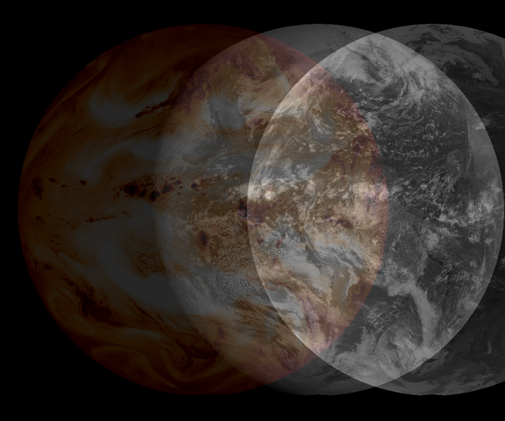
SeaSpace Terascan GOES Multispectral Animations

Slide 2
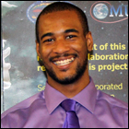
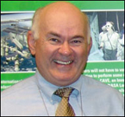
GOES System Talent Team
Kathryne Burton
Elizabeth City State University
Micheal Cobb
Elizabeth City State University
Andrew Brumfield
Technical Mentor
Elizabeth City State University
James Headen
Elizabeth City State University
Khaliq Satchell
Elizabeth City State University
Dr. Malcolm LeCompte
Team Mentor
Elizabeth City State University

Slide 3
Abstract
Installation of the two SeaSpace Terascan Geostationary Operational Environmental Satellite (GOES) receivers in July, 2013 provides ECSU’s CERSER laboratory with a capability to capture and generate the most current image data available of the Earth’s Western Hemisphere environment. The data is provided in an operational mode defined by the limitations of the GOES scanning imaging system. The GOES system operations are scheduled by the National Oceanic and Atmospheric Administration (NOAA) to provide various obligated environmental products, primarily to support numerical meteorological prediction services to different regions of the Western Hemisphere. A principal advantage of any remote sensing system located in Geostationary orbit lies in the ability to create ‘loops’ or animations that reveal changes that occur in the Earth’s environment.

Slide 4
What is TeraScan?
TeraScan is a software designed to process data from satellites and turning it into images.
Environmental satellites
Meteorological satellites

Slide 5
TeraScan Data Format (TDF)
Unique to TeraScan
Allows data to be viewed in TeraScan
Ability to convert into picture products of various styles
Easy to share through network

Slide 6
TeraScan System Compatibility
Geostationary Satellites
L-Band Transmittance
Polar-Orbiting Satellites
L/S Band Transmittance
X-Band Transmittance

Slide 7
What can TeraScan do with received data?
Creates Images
Produces Data Products
Mathematical Data Interpretations
Survey Particular Areas

Slide 8
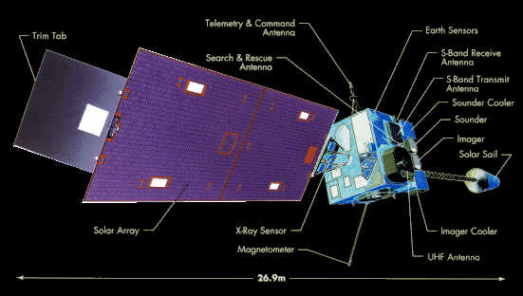
What is GOES?
Geostationary Satellite System
Operated by the United States National Environmental Satellite, Data and Information Service (NESDIS)

Slide 9
TeraMaster

Slide 10
Configproc

Slide 11
TeraVision Data Shelf

Slide 12
Animation

Slide 13
Results

Slide 14
Future Work
We will combine a GOES east and Goes West data to produce a composite image between the two.

