Slide 1
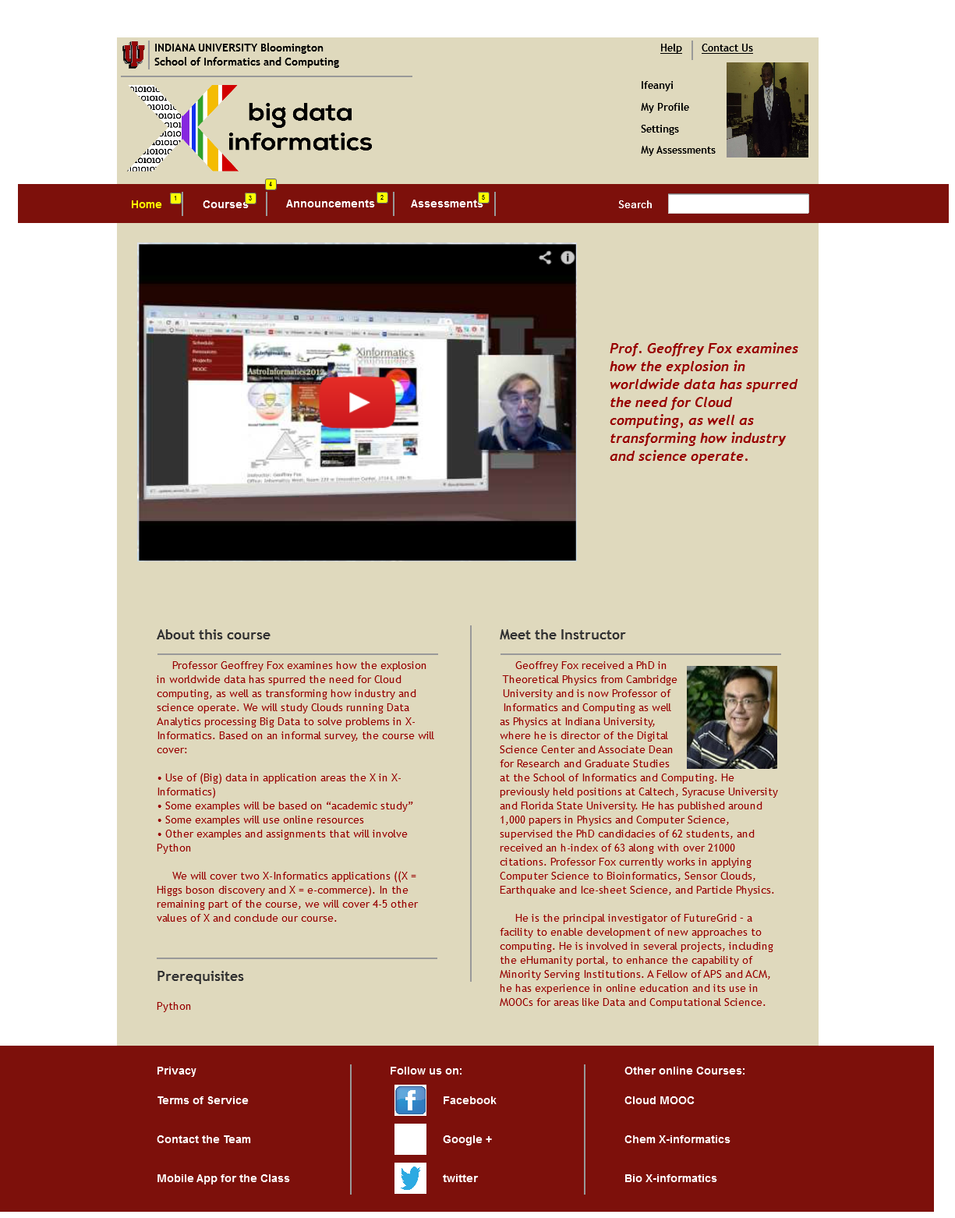
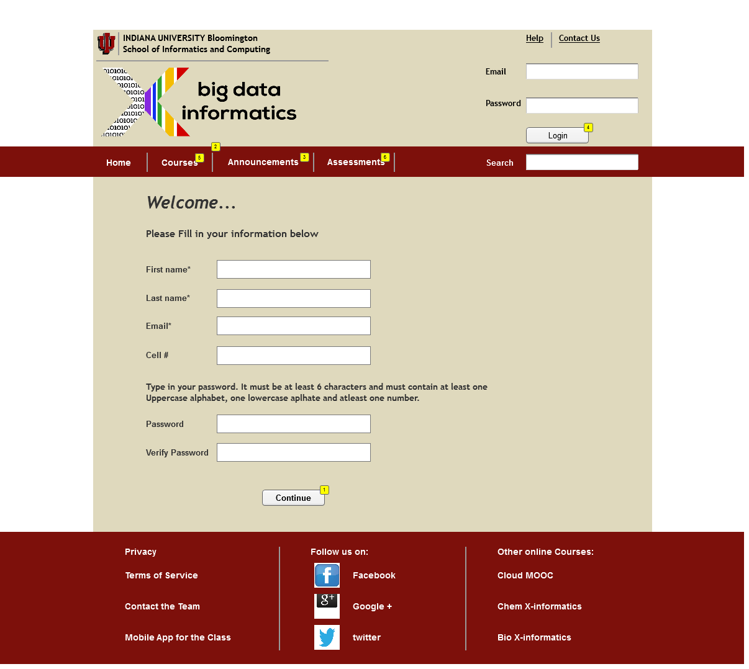
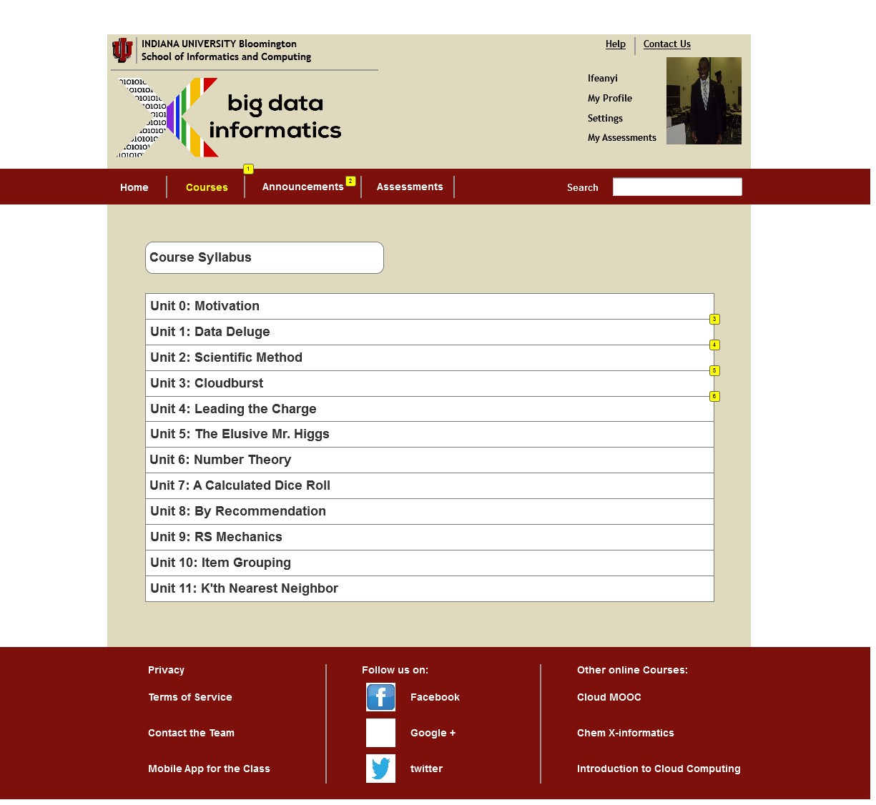
Big Data X-Informatics MOOC: Research into increasing the efficacy of this Massive Open Online Course
Ya’Shonti Bridgers (ECSU) Ifeanyi Onyenweaku (MVSU) Mentor: Siddharth Maini (IUB) Geoffrey Fox (IUB)
.
1. Abstract
3. Procedures3
5. Future Work
Big Data X-informatics is a course that had been available to students, during the Spring 2013 classes by Indiana University, School of Informatics and Computing. It is to be available for the fall 2013 classes Therefore; we were to create features that will improve the interaction between its educational content and its users (students and professors).
On that account, we made surveys on other online educational MOOCs. These surveys gave us the opportunity to observe features of these sites, that enabled effective communication between the different calibers of students and the online courses, and features that did otherwise.
Our findings enabled us to create new features or modify old features that will enhance student-site interactivity. Finally, having gained knowledge, about visual design and educational pedagogies, from design articles .We used AXURE to create the near perfect wireframe, with the observed features, that will interact effectively with the student; hence, catalyzing efficient learning.
Predisposition
Research
Insights
Prototype
Feedback
With the information gathered, new features we initiated and designs of the individual pages created it will enable others to look further into an effective method of enabling easy but efficient interactivity between the user (student and professors) and the educational content of the online course.
.
4. Results
Home Page Enrollment Page
2. Introduction
6. Acknowledgements
In our world today, online learning has become a rising trend in the world of education. This trend has instigated the creation of numerous Massive online courses (MOOC), for students all around the world, by different institutions. However, as the trend continues to grow, the question of how to effectively communicate the educational content of a course to its students, as it would be in traditional classes, comes up. Hence, the core of this research is to find the best way to make the course, Big Data X-informatics MOOC, more effective for its users (students and professors).
First and foremost I would like to thank the National Science Foundation (NSF) . I would like to thank my mentor Siddharth Maini and P.I. Geoffrey Fox. Also I would like to thank the School of Informatics at Indiana University Bloomington. Also recognize the program director Miss. Lamara Warren.
Course Page Lesson Page

