Slide 1
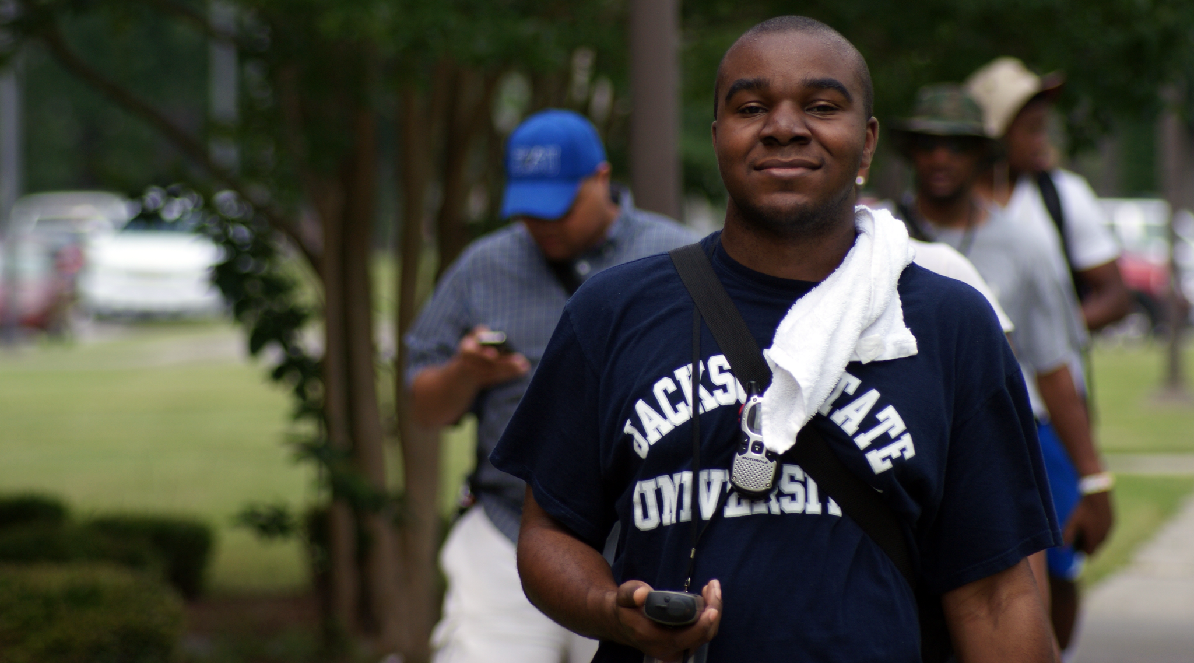
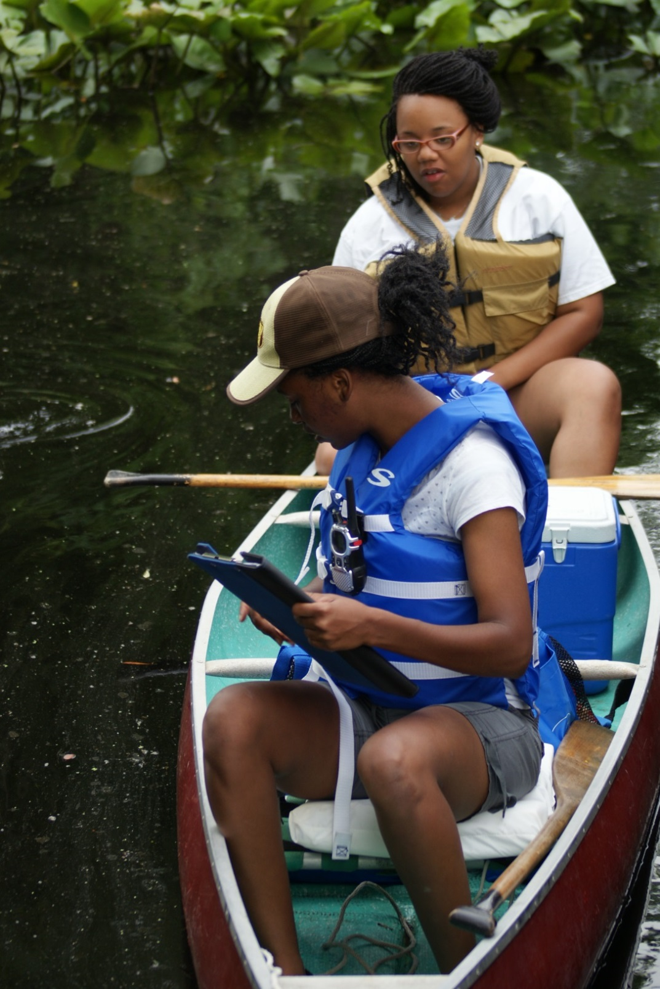
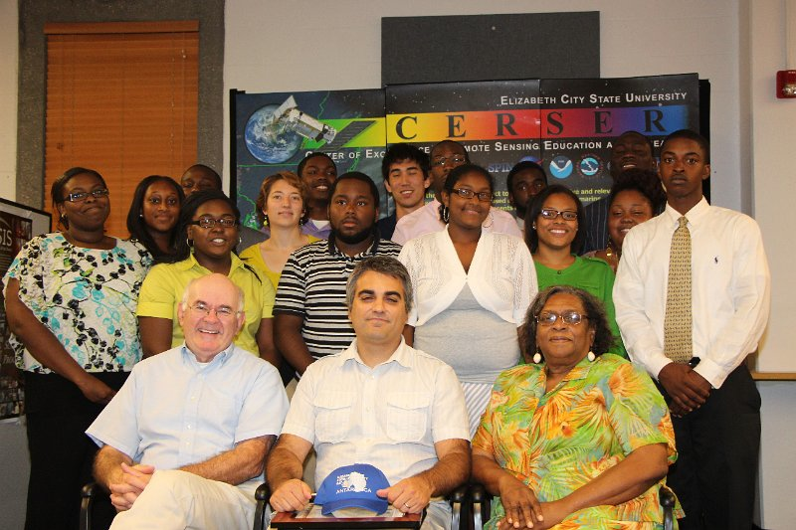
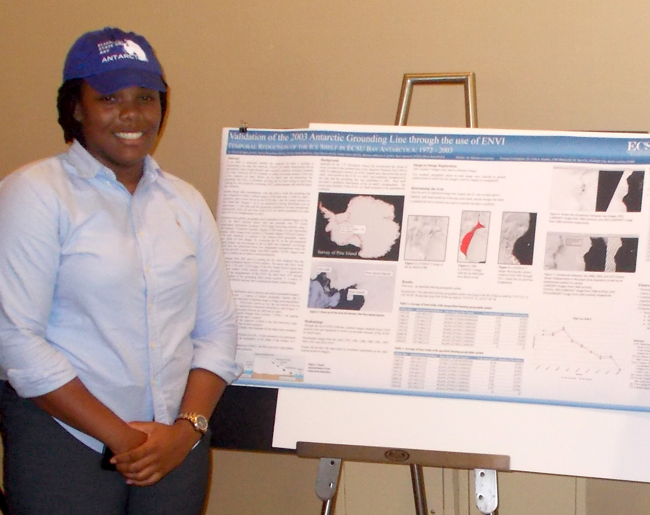
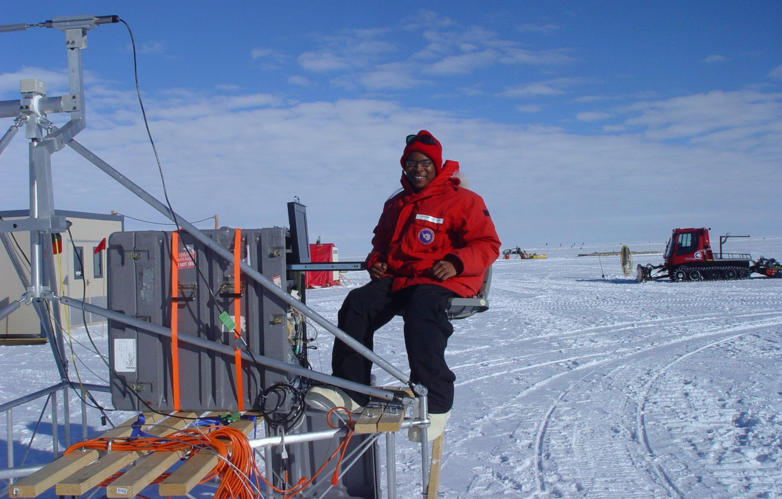
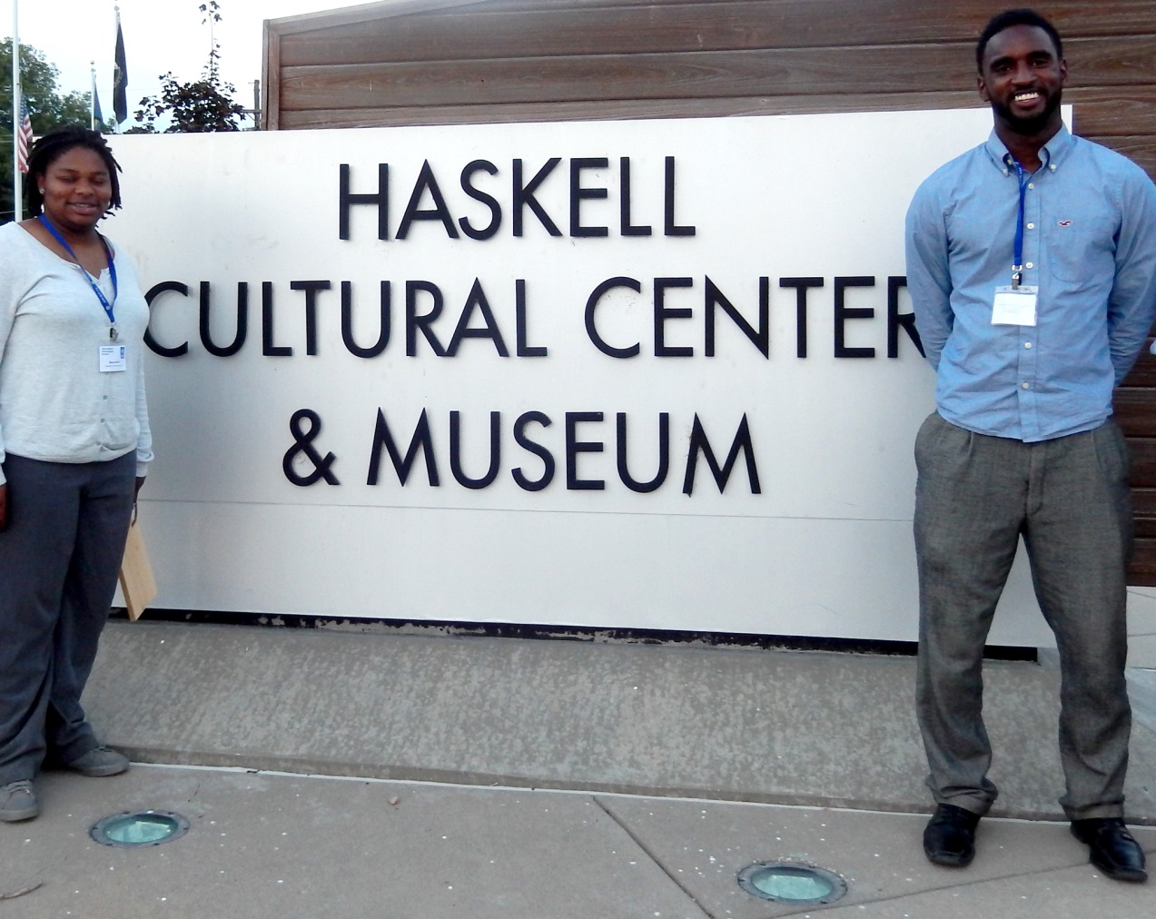
DoD grant # 64708-EL-REP NSF REU grant ANT-0944255 CReSIS - NSF FY 2005-108CM1
Challenges and Solutions of Running an REU: Increasing Diversity
Linda Bailey Hayden: Elizabeth City State University Darryl Monteau: University of Kansas Peter Burkett: Pennsylvania State University Darnell Johnson: Elizabeth City State University Andrea Lawrence: Spelman College
Minority Professional Organizations (MPOs) have long been committed to mentoring and nurturing the professional development of underrepresented students. They provide a rich source of expertise and commitment.
Consider Partnership with these Minority Professional Organizations
National Association of Black Geologists and Geophysicists (NABGG)
Advancing Hispanic/Chicano and Native Americans in Science (SACNAS)
The Association of Computer and Information Science/Engineering Departments at Minority Institutions (ADMI)
National Society of Black Physicists (NSBP)
National Association of Mathematicians (NAM)
National Society of Black Engineers (NSBE)
National Organization for the Professional Advancement of Black Chemists and Chemical Engineers (NOBCChE)
National Alliance of Black School Educators (NABSE)
National Technical Association, Inc. (NTA)
National Institute of Science (NIS)
Building involvement in polar activities by minority communities required actively reaching out to them, and ensuring that research and activities have relevance to their specific interests.
Existing community agencies and activities can be a vehicle for numerous and repeated exposures on their home ground. Locating these agencies and local needs will involve physically going to communities and exploring possibilities face-to-face
Identifying ways to encourage minorities in their involvement in polar science and emphasize its relevance to them and their communities, and to develop local connections
Connect through professional minority associations.
Encouragement and recognition for involvement in science and research can have a major impact.
It is important not to set the level so high at the beginning that people without a strong background are intimidated and therefore unwilling to participate.
http://www.ldeo.columbia.edu/res/pi/polar_workshop/strategies/communities.html
Arctic and Antarctic
REU Demographics
Seek MSI and MPO Partnership Opportunities... Not Just Recruitment Opportunities!!

