Slide 1
ED14B-03 Engaging Minority University STEM Education Professors in the Science of Climate Change: Recruitment, Implementation, Evaluation, and Dissemination LINDA B. HAYDEN; Stephen R. Hale; Darnell Johnson 4:30 PM - 4:45 PM Monday, December 09, 2013 CONTROL ID: 1799263

Slide 2
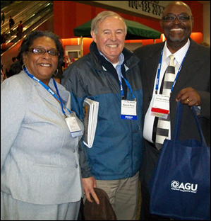
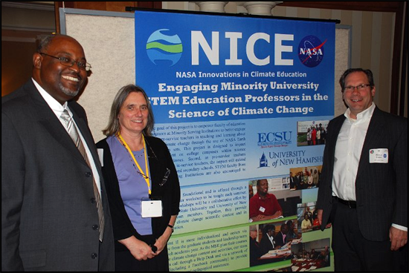
ECSU/UNH/NASA NICE
Elizabeth City State University (ECSU) has joined with the University of New Hampshire (UNH) under the NASA Innovations in Climate Education (NICE) program to empower faculty of education programs at Minority Serving Institutions (MSIs) to better engage their pre-service teachers in teaching and learning about global climate change through the use of NASA Earth Observation data sets.

Slide 3
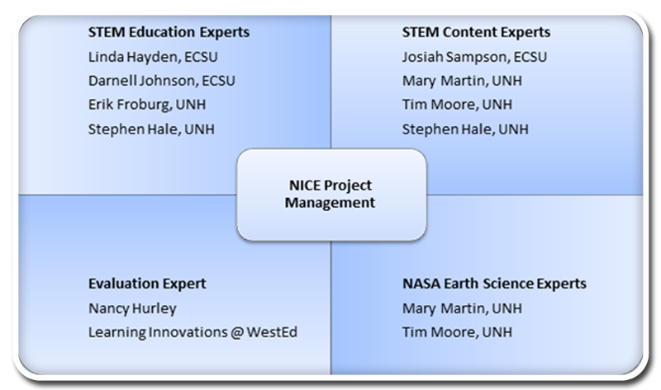
Management Structure
To address the interdisciplinary nature of global climate change education, our team includes experts in STEM education, STEM content, and NASA Earth science research.

Slide 4
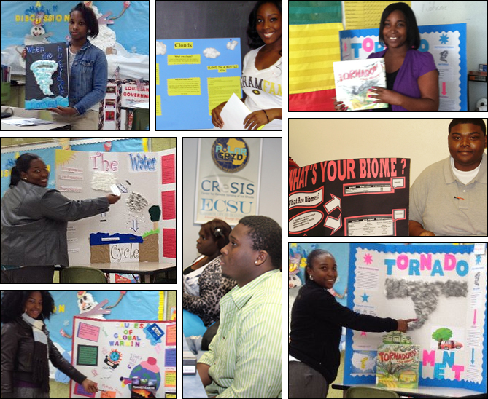
Project Goals
This project is designed to impact teaching first, on college campuses within science education classes. Second, as pre-service teachers transition into in-service teachers the impact will extend to elementary and secondary classrooms.
Our goal is to empower faculty of education programs at Minority Serving Institutions to better engage their pre-service teachers in teaching and learning about global climate change through the use of NASA Earth Observation data sets.

Slide 5
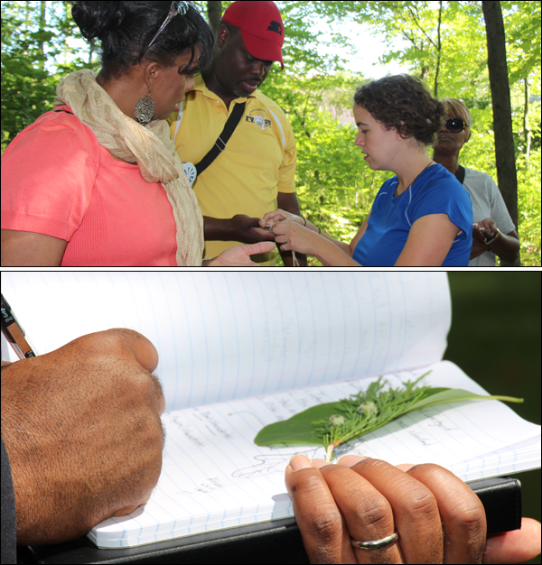
This presentation documents the efforts to:
Recruit two cohorts of STEM education faculty from MSIs
Implement the program
Evaluate the program
Disseminate the program

Slide 6
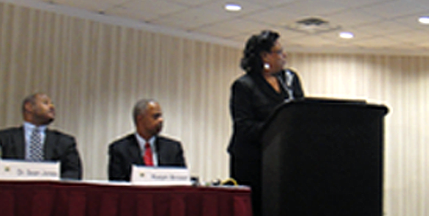
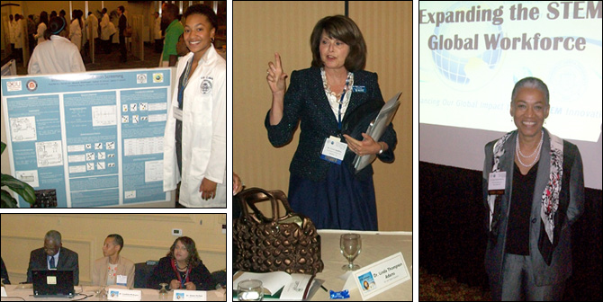
Recruitment
To date, 34 faculty from over a dozen MSIs have participated in the summer workshops. Recruitment efforts have focused on interactions with faculty in campus and conference settings. This has included the Johnson C. Smith University STEM Conference and the Annual Minority Serving Institutions Technical Assistance and Capacity Conference.

Slide 7
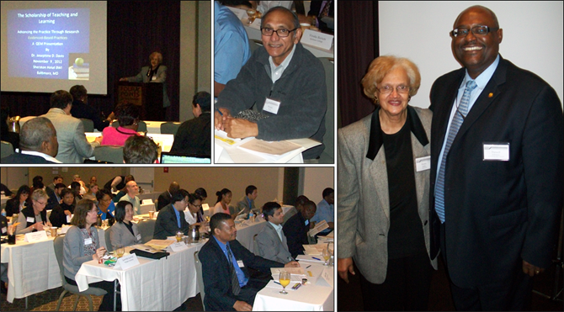
Recruitment
A recruitment trip for cohort 2 was also made to the Quality Education for Minorities (QEM) Network Workshop on Evidence-Based STEM Instructional Strategies in Baltimore, MD.
Dr. Darnell Johnson is pictured on the right with QEM Network President Dr. Shirley McBay.

Slide 8
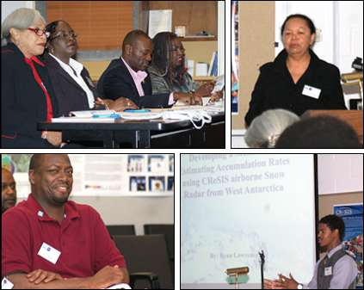
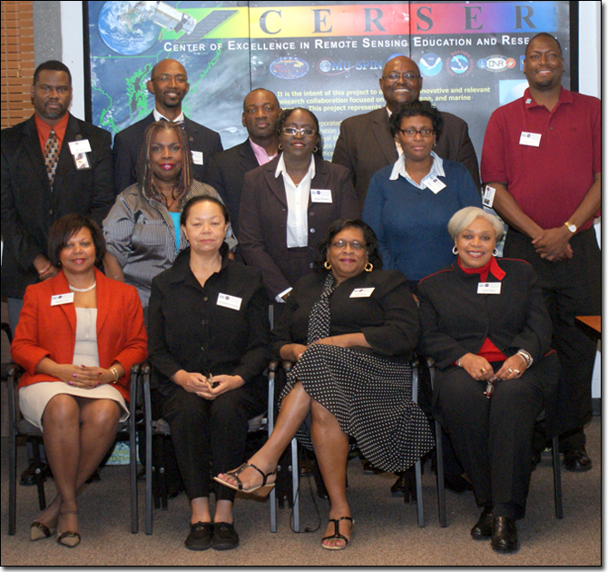
Orientation: Climate Change Workshop
November 9-10, 2011, representatives from MSIs and area schools attended a Climate Change Workshop at the Center of Remote Sensing Education and Research (CERSER) at ECSU. One section of the workshop involved a presentation by Gloria Brown-Simmons who trains teachers for participation in the Global Learning and Observations to Benefit the Environment (GLOBE) Program. Participants were also taken on a tour of NASA Langley's Research Center.

Slide 9
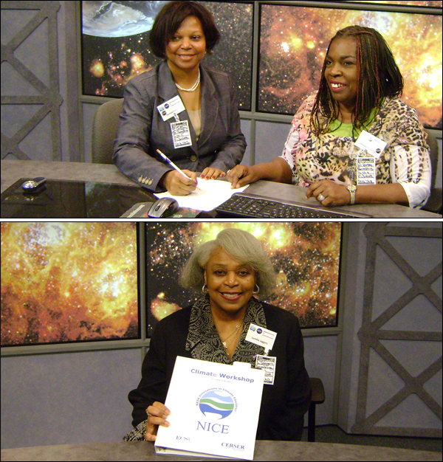
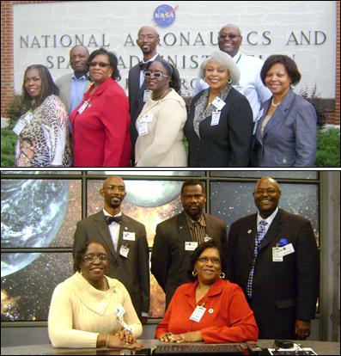
Orientation: NASA Langley
NASA Innovation in Climate Education (NICE) Introduction and Overview of NASA Education Resources Roger Hathaway - LARC Education Director NASA Langley Research Center Strategic Relationships Office of Education
Welcome: Robert Star - LE&RN Program Manager
Overview of NASA AEROspace Education Services Project (AESP) via Skype - Brandon Hargis - AESP
Overview of NASA Learning Education Research Network (LE&RN) - Dr. Robert Start - LE&RN Program Manager
Overview of NASA Digital Learning Network (DLN) - Karen Long – DLN Program Manager
NASA NICE Program - Andrea Gyer - NASA NICE Education Program Manager

Slide 10
Implementation
The primary implementation mechanism was a one-week summer workshop conducted each year. ECSU hosted the first summer workshop and UNH hosted the second workshop. During each workshop, faculty had an opportunity to engage in activities using NASA Earth Observation data sets. Faculty benefited from engaged instruction and interaction with scientists who routinely use these data sets in their professional practice. This provided a comprehensive learning environment ensuring the transfer of skills in utilizing NASA data sets and tools in climate change education from researcher to science educator to pre-service STEM teacher.

Slide 11
Implementation
The faculty conducted field work that emphasized place-based pedagogy. They worked with NASA satellite imagery from the MODIS and SeaWiFS sensors, and discussed the challenges and approaches to integrating all or some of the lessons into their courses.

Slide 12
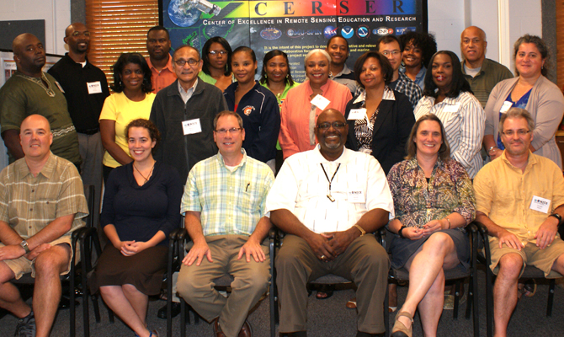
2012 Workshop @ ECSU
A one-week workshop for Minority Serving Institution Instructors (MSII) was held August 6-10, 2012, on the campus of ECSU. Sixteen participants were identified to participate in the summer of 2012. These faculty represented 11 universities:
Morgan State University Delaware State University Grambling State University Johnson C. Smith University Norfolk State University Jackson State University | Hampton University St. Augustine's College Virginia State University | Elizabeth City State University Mississippi Valley State University

Slide 13
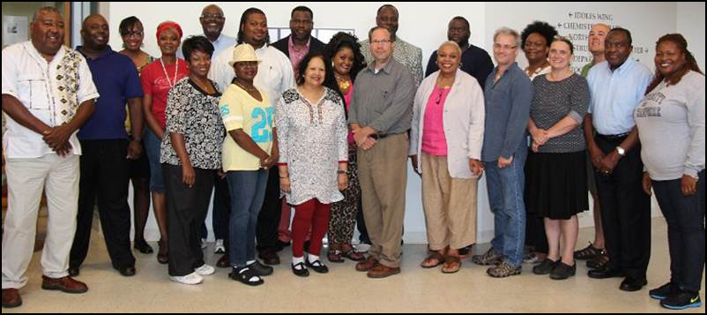
2013 Workshop @ UNH
A workshop for MSII was held July 29 - August 2, 2013, on the campus of UNH. Seventeen MSI STEM Education faculty were involved in the one-week workshop. Faculty conducted fieldwork that emphasized place-based pedagogy. They worked with an ecological model in STELLA that utilizes authentic inputs from historical and future climate scenario parameters, with NASA satellite imagery from the MODIS and SeaWIFS sensors, and discussed challenges and approaches to integrating all or some of the lessons into their courses. These faculty represented 10 universities:
Talladega College
Delaware State University
Grambling State University
Fort Valley State University
Alcorn University
Tuskegee University
Tougaloo College
Alabama A&M University
Virginia Union University
Elizabeth City State University
Texas Southern University

Slide 14
Program Evaluation
Program Evaluation efforts, led by Learning Innovations at WestEd, included formative and summative evaluations related to the outcomes of the project. Evaluators worked with project staff to create a logic model that clearly articulated a theory of action for the project. Included in the evaluation model were online questionnaires and focus group protocols. There exists evidence to show that the MSI faculty who participate in the workshop are using the information learned to engage their pre-service teachers in teaching and learning about global climate change through the use of NASA Earth Observation data sets.
Interest in Climate-Related Topics
Please indicate your current INTEREST in each Climate related topic
5 pt scale: 5=very interested; 1= not at all interested | PRE - # of resp | PRE MEAN | POST - # of resp | POST MEAN
Components of climate | 15 | 4.4 | 12 | 4.8
Connection between climate and weather | 14 | 4.6 | 12 | 4.7
Representing and interpreting climate data | 14 | 4.2 | 12 | 4.8
Climate change | 14 | 4.6 | 12 | 4.7
Earth’s energy balance | 13 | 4.2 | 11 | 4.5
Relationship of continental masses and oceans with climate | 14 | 4.0 | 12 | 4.3
Feedback loops | 10 | 3.8 | 11 | 4.1

Slide 15
Evaluation by WestEd
One hundred percent of respondents indicated they would recommend attendance at a future Engaging Minority Faculty in the Science of Climate Change workshop, for example:
“The presenters were very knowledgeable and provided excellent resources and materials. They also provided opportunities for involvement and interaction. I thoroughly enjoyed the field experiences on the boat and in the forest.”

Slide 16
Evaluation by WestEd
“My expectations were met. I was unaware of some of the concepts taught, but I enjoyed learning.”
“Most importantly, workshop participants had opportunities to observe changes in the "woods," take and examine samples from depths of the Atlantic Ocean, and - equally important - the faculty presenters are extremely knowledgeable of global changes and they presented materials [to use] in the classroom.”
Comfort Level Teaching Climate Related Topics
How would you rate your comfort level to teach each Climate related topic if you were asked to in the coming academic year 2013-2014
5 pt scale: 5=very interested; 1= not at all interested | PRE - # of resp | PRE MEAN | POST - # of resp | POST MEAN
Components of climate | 14 | 2.7 | 12 | 4.1
Connection between climate and weather | 14 | 2.7 | 12 | 4.3
Representing and interpreting climate data | 14 | 2.6 | 12 | 4.1
Climate change | 14 | 2.8 | 12 | 4.1
Earth’s energy balance | 14 | 2.5 | 12 | 3.7
Relationship of continental masses and oceans with climate | 14 | 2.4 | 12 | 3.8
Feedback loops | 12 | 2.3 | 12 | 3.4

Slide 17
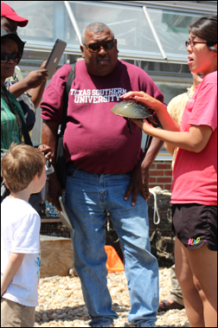
Challenging Aspects of the Workshop
The most challenging aspects noted by focus group participants relating to the workshop included the pace and level of participation, the relevance of the content, and variations in the presentation styles of facilitators.
When one participant claimed he wouldn’t be able to use much of what was covered, especially Giovanni, another stated: “I can use all the material in some way; I have to go back in and see what is most meaningful and how it fits.” And from another: “The terrestrial stuff … circumference, rates … I can pull that and align it to the standards.”

Slide 18
Presentation Styles
Focus group participants discussed what they saw as differences in presentation styles of educators and scientists. They indicated this was a common but unfavorable occurrence because, as one stated: “Scientists don’t typically have training to instruct and thus do not always have the expertise to get a lesson across”. Participants suggested that including teaching faculty from the UNH campus would have engaged them with the educator’s perspective.

Slide 19
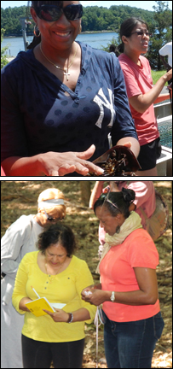
Reflections/Recommendations
The observation conducted during the 2013 workshop revealed a group of engaged participants who appreciated the opportunities to delve into the various content areas, conduct field experiments, and observe pedagogical strategies modeled by project staff and facilitators. The 16 participants clearly expressed during focus groups their understanding of the project and its goals and objectives. They seemed to especially value the connections they made with peers from other university settings, scientists and project staff at UNH, as well as the stimulating discussions that arose concerning the challenges of bringing back the content to pre-service teachers. Another advantage for the participants was the presentations made by colleagues with strategies they could take home and use in their classrooms.

Slide 20
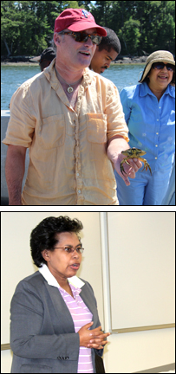
Reflections/Recommendations
The group apparently consisted of mostly the right people as one participant at the end of a focus group stated (and others agreed): “I’d like to personally thank [staff] for putting together such an outstanding group. I’ve made some friends and colleagues … and [scientists] … who I hope will last the rest of my life.” Interestingly, staff also mentioned the well-balanced group and the higher level conversations that occurred in comparison to last year. They wondered if something different had been done in the recruitment process. One stated: “You can tell by the language they’re using … they’re in tune with the cutting edge research in their field. Last year [we] didn’t get that sense … [they] never had a conversation like the one [today] … last year there were more skeptics who went off on tangents.”

Slide 21
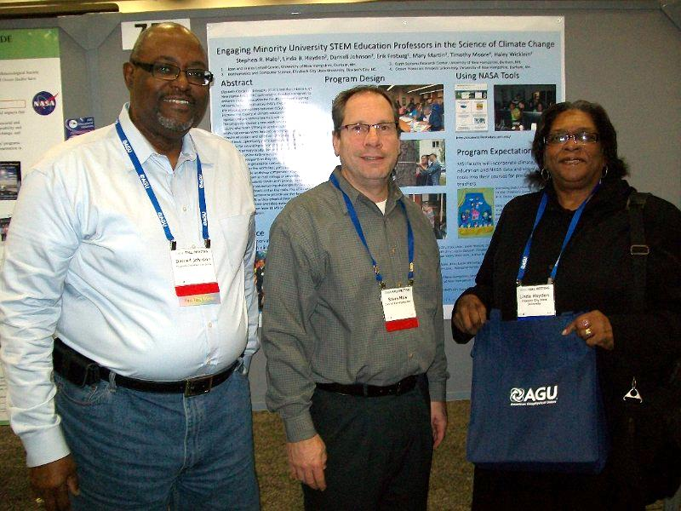
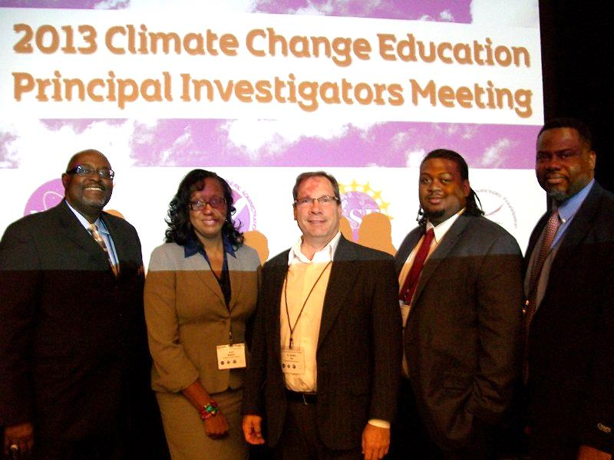
Dissemination
AGU 2012 POSTER
AGU 2013 ORAL and 2 POSTERS
Climate Change Education PI Meeting Posters
Project Website http://nia.ecsu.edu/nice/

Slide 22
Dissemination @ AGU 2013
1:40 PM
Friday, December 13, 2013
“The NASA Innovations in Climate Education Project:
Instructional Strategies for Expanding Climate Change Concepts
within Reading/Literacy Skills”
Loretta J. Walton-Jaggers; Darnell Johnson; Linda B. Hayden; Stephen R. Hale
CONTROL ID: 1798359 ED53A-0625

Slide 23
Dissemination @ AGU 2013
1:40 PM
Wednesday, December 11, 2013
“NASA NICE Climate Change Education”
Kaiem Frink; Sherry Crocker; Willie Jones, III; Sophia S. Marshall; Dujari Anuradha; Kalota Stewart-Gurley; Ervin M. Howard; Edward Hill; Edwinta Merriweather
CONTROL ID: 1796056 ED33C-0780

Slide 24
Dissemination @ AGU 2013
4:30 PM - 4:45 PM
Monday, December 09, 2013
“Engaging Minority University STEM Education Professors in the
Science of Climate Change: Recruitment, Implementation and Evaluation”
Linda B. Hayden; Stephen R. Hale; Darnell Johnson
CONTROL ID: 1799263 ED14B-03

