Slide 1
Construction of a University Navigational Mobile Application
Group Members: Patrina Bly, Robyn Evans, Nadirah Cogbill
Group Mentor: Jeff Wood

Slide 2
Abstract
The 2011–2012 Mobile Database Team created a campus navigational mobile web application for the campus of Elizabeth City State University. The application provides the students and visitors with an up-to-date campus map that has the capabilities to generate walking directions.
To accomplish this task, the team first gathered historical data and specifications for the forty-six buildings located on the campus. This information was then stored into a database using MySQL and PHP that was accessed by the application. Next, the team updated the map using Google Map Maker. The new map provides users with an aerial view of the campus displaying the buildings, roads, and parking lots. The final step was the creation of the actual application.
The application was created using a jQuery template and HTML5. The application obtains the user’s latitude and longitude coordinates from their mobile device before directing them to the map via Google Maps. From here, using the stored coordinates, the application is able to generate walking directions to the user’s building of choice. Users also have access to the information recorded in the created database.

Slide 3
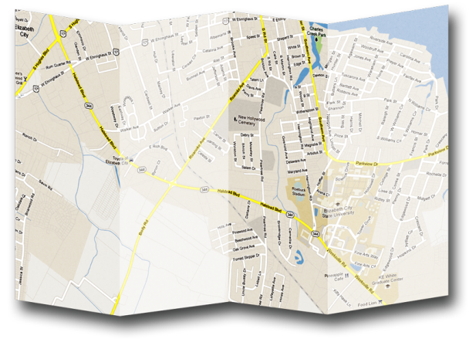
Introduction
Notes:
Overview
The Center of Excellence in Remote Sensing Education and Research (CERSER) is part of several national and international research projects involving undergraduate and graduate students participating in remote sensing research. The movement-taking place in computer visualization of data towards handheld mobile devices has led to the development of smaller applications. This project seeks to break into this development by creating a compact mashup of local building information with a map service to create an informative navigational aid to students and visitors.
Project Goal
The final goal of this project was to create an application so users could quickly locate information and directions to specific buildings on the campus of Elizabeth City State University (ECSU) using mobile devices.
Several tasks needed to be accomplished to support this goal and were achieved through the collaboration of two research teams. The first task was to construct databases along with forms to gather information regarding each building to be used in the project. The next was to create the map of the University to be displayed in the map service Google Maps. This involved the deletion of incorrect data and the creation of roads, buildings, sidewalks, and other features of the campus. The final task was to bring the data and map together in a site allowing users to access both. The second research group was to take this product a step further to provide walking directions from a user’s position to the desired building on campus.

Slide 4
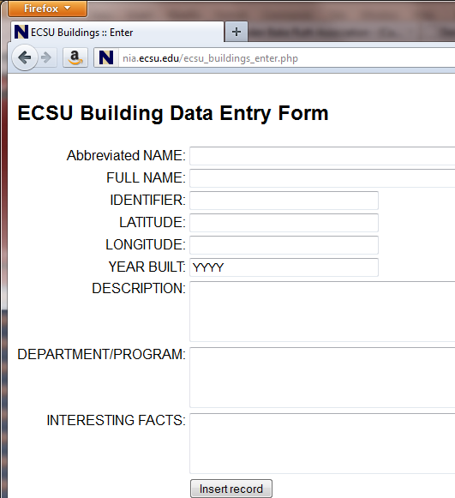
Database Fields
ID: An auto-generated field used as the “key” field
Full Name: The official name of the building
Abbreviated Name: The unofficial name commonly used by students, faculty, and staff
Identifier: The group of letters is used by the Registrar’s office for class schedules
Latitude: The latitude of the building
Longitude: The longitude of the building
Year Built: The year the original building was built
Description: What is located in the building and the building attributes such as AC, laundry, hours, etc.
Departments/Programs: Departments and programs located within the building
Facts: General information about the building and its history

Slide 5
ID Field
Key Field
Auto-generated

Slide 6
Identifier Field
Letter abbreviations
Appear on class schedules

Slide 7
Latitude/Longitude Field
Google Maps Lab “Lat/Lng Marker”
Interact with Google Maps Services

Slide 8
Data Sources
Year Built, Full Name, Descriptions, Departments/Programs, Facts
Student Handbook
Director of Design and Construction
Facilities Data Management System
University of North Carolina Data Additions Validations Edits (DAVE)

Slide 9
Database Construction
phpMyAdmin
MySQL
Adobe Dreamweaver

Slide 10
Displaying Database

Slide 11
The Campus Map
Google Maps
Google Map Maker

Slide 12
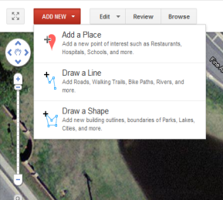
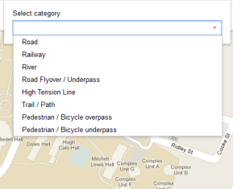
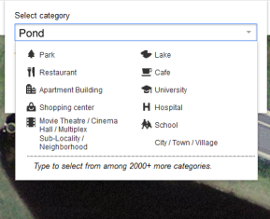
Creating Features
Add New
Draw a Line
Draw a Shape
Categories

Slide 13
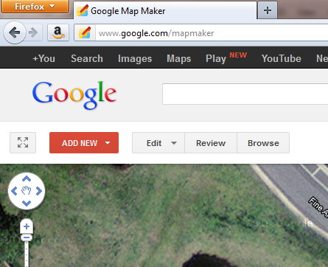
Map Maker
Google.com/mapmaker
Click Add New

Slide 14
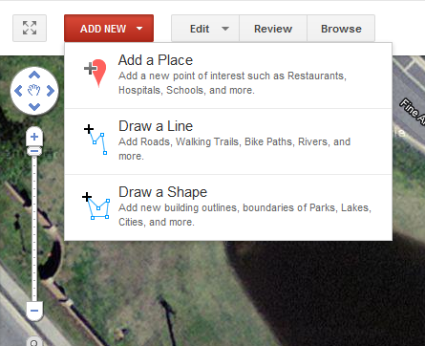
Map Maker
Draw a Shape

Slide 15
Map Maker
Select “Boundary” or “Building”

Slide 16
Map Maker
Type in a category

Slide 17
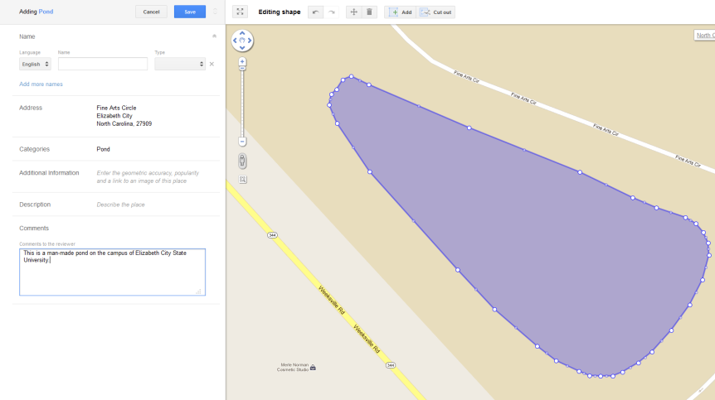
Map Maker
Draw the shape
Add Attributes

Slide 18
Review Process
Make
Submit
Review
Publish
Revise

Slide 19
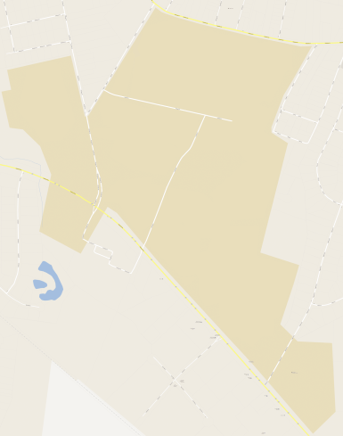
Before and After

Slide 20
HTML5
What is HTML5
Benefits/Handicaps
Use within the Application
Notes:
serialization is the process of converting a data structure or object state into a format that can be stored
HTML5
HTML5 is the fifth revision of HTML and was released in 2004 as a study of contemporary HTML implementations and deployed content.
Purpose is to amplify the web’s core strengths of interactivity and connectivity as well as to:
Define a single language that can be written as a combination of HTML and XML syntax.
Define detailed processing models to foster interoperable implementations.
Improve markups for documents.
Introduce markup and APIs for emerging idioms, i.e. web applications.
Basically HTML5’s goal is to bring the power of the desktop and the vibrancy of multimedia experience to the web on your mobile device.
The ABI Research group has projected that at least forty-four billion apps will be downloaded by 2016 with seventy-nine percent of mobile developers integrating HTML5 within their apps. Developers will either use HTML5 entirely to create apps or create “hybrid apps,” applications that combine HTML5 features—enhanced animations and transitions—with performance oriented abilities of native apps to achieve the best individual user experience across phones, tablets, desktops, and even kiosks.
Benefits of HTML5:
There are no direct benefits of HTML5
Some indirect benefits include:
Faster process time
the ability to pick up more relevancy/entity information
ability to display a higher quality Search Engine Results Page (SERP) listing;
Handicaps of HTML5:
The man downside to HTML5 comes with the type of device your app users own.
Newer device/browsers will support HTML5 better than older formats. Therefore, if the majority of your apps users are using an older browser, then HTML5, or rather specific features, may not be fully/properly supported.
The latest version of HTML introduced new features that have enabled developers to create apps and websites with the capabilities of desktop applications. The apps built on the new platform have the ability to reach a broader audience using a variety of devices.
HTML5 within the Mobile Application
Within the actual application that was created, HTML5’s built-in Geo-location API allows mobile device’s geographic location to become available to a web application. Beforehand this would have been retrieved using JavaScript. The 2011 – 2012 Database Team focused on this portion of the research.
Released in 2006, jQuery is a cross-browser JavaScript Library that was designed to simplify HTML scripting. jQuery branched from JavaScript and is composed of different functions/tags developers can use to create a custom template for applications’ specific needs. It is free and open sourced under the second version of the GNU General Public License.
Similar to JavaScript, jQuery is used to help with the interaction, effects, and functionality of development code. Its syntax is designed to make it easier to navigate a document, select DOM elements, create animations, handle events, and more. The library also allows developers to create plug-ins and abstractions for low-level interaction and animation, advanced effects and high-level, theme-able widgets.
The simplicity of jQuery’s syntax allows developers to create high quality applications with a minimum amount of code. Some common effects achieved with jQuery include drop down menus, drag and drop elements, animations, and form validation. The language is also harmonious with other coding languages, i.e. PHP, JSP, and CGI.
Benefits of jQuery include: small file size; compatibility to all popular web browsers and other coding languages; and it supports all version of CSS

Slide 21
jQuery
What is jQuery?
Benefits
Notes:
jQuery was released in 2006 and is a cross-browser JavaScript Library that was designed to simplify HTML scripting. It branched from JavaScript and is composed of different functions/tags developers can use to create a custom template for applications’ specific needs
Like JavaScript, it is used to help with the interaction, effects, and functionality of development code.
Its syntax is designed to make it easier to navigate a document, select DOM elements, create animations, handle events, and more.
The simplicity of jQuery’s syntax allows developers to create high quality applications with a minimum amount of code. Some common effects achieved with jQuery include drop down menus, drag and drop elements, animations, and form validation.
Benefits
The language is also Benefits of jQuery include: small file size; compatibility to all popular web browsers, harmonious with other coding languages, i.e. PHP, JSP, and CGI; and it supports all version of CSS

Slide 22
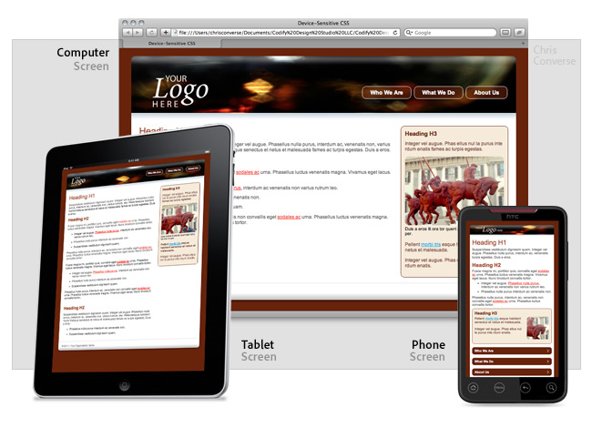
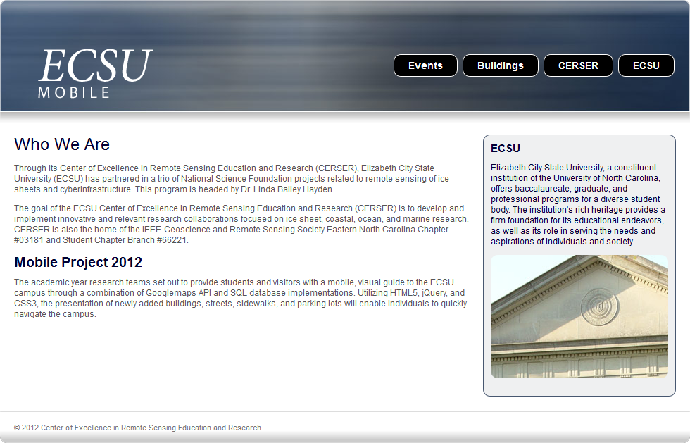
jQuery Template
Notes:
For our application we used a jQuery template designed by Chris Converse of the Codify Design Studio.
The template uses a combination of jQuery, HTML5, and CSS3.
So HTML5 can run properly, the template used by our application has a reference to a Google-powered JavaScript file, html5shiv JavaScript that is compatible with older versions of Internet Explorer.
The script has a built-in conditional comment that is understood by all versions of Internet Explorer and is only called when using Internet Explorer 8 or an earlier version.
Features of the template include:
absolute positioning
float properties
CSS sprites
varied image compression
the ability to activate and deactivate absolute positioning
The template also uses CSS to upload imagery based upon the screen size of the device being used.
Because most devices support images of 140ppi resolution or better, developers can use images that are very small in size without changing the integrity of the original image. These images then adjust to fit accordingly to the screen of the device and/or browser window.

Slide 23
Results
http://nia.ecsu.edu/mobile/
Notes:
For our application we used a jQuery template designed by Chris Converse of the Codify Design Studio.
The template uses a combination of jQuery, HTML5, and CSS3.
So HTML5 can run properly, the template used by our application has a reference to a Google-powered JavaScript file, html5shiv JavaScript that is compatible with older versions of Internet Explorer.
The script has a built-in conditional comment that is understood by all versions of Internet Explorer and is only called when using Internet Explorer 8 or an earlier version.
Features of the template include:
absolute positioning
float properties
CSS sprites
varied image compression
the ability to activate and deactivate absolute positioning
The template also uses CSS to upload imagery based upon the screen size of the device being used.
Because most devices support images of 140ppi resolution or better, developers can use images that are very small in size without changing the integrity of the original image. These images then adjust to fit accordingly to the screen of the device and/or browser window.

Slide 24
Future Work
Repair and complete ECSU Campus
Update campus buildings
Add ECSU Links
CReSIS Data Integration
Notes:
The mobile application now has a foundation on which enhancements and refinements can be added. One of the first tasks to be accomplished should be the completion of the campus maps in Google Maps. There are sidewalks and new buildings to be added along with the correction of misplaced or unconnected sidewalks and roads.
The next improvement to the application would be the addition of links to frequently used campus web sites. These would include Email, Banner, Blackboard, and other needed information. While these pages are not currently set up for mobile devices, some, such as Blackboard, are moving quickly to mobile display of their sites and information.
Another program improvement would be the addition of data from the Center for the Remote Sensing of Ice Sheets (CReSIS). This would enable researchers to access visualizations from mobile devices. This would entail reformatting current visualization sites to the CSS3 style sheet used in this project. This format would make ice sheet data more readily available to a wider range of users from scientists to students.

Slide 25
References
UNC Data Additions Validations Edits, https://apps.northcarolina.edu/dave/wayf.php, retrieved from the World Wide Web on November 4, 2011
Google Maps Help, http://support.google.com/maps/?hl=en, retrieved from the World Wide Web on November 14, 2011
N. Cogbill, M. Seymore Research and Implementation of Data Submission Technologies in Support of CReSIS Polar and Cyberinfrastructure Research Projects at ECSU, http://nia.ecsu.edu/ur/0910/teams/mmt/mmt0910paper.pdf, retrieved from the World Wide Web on January 3, 2012
UNC Facilities Inventory & Utilization, http://www.northcarolina.edu/ira/fac_util/, retrieved from the World Wide Web on February 4, 2012
C. Converse, “Dreamweaver templates: Customizable starter design for multiscreen development | Adobe Developer Connection”, 11 July 2011, http://www.adobe.com/devnet/dreamweaver/articles/dw-template-media-queries.html, retrieved from the World Wide Web on January 4, 2012

Slide 26
Acknowledgments
The database team will like to acknowledge our mentor Jeff Wood for his continuous help and support with this research
We would also like to acknowledge Dr. Linda B. Hayden

Slide 27
Questions???

