Slide 1
Survey to detect long-term variability in Pine Island Bay Coastal Ice using Archived Landsat Imagery
Team Members:
Ya’Shonti Bridgers
Ryan Lawrence
Michael Jefferson Jr.
Glenn Michael Koch
Team Mentor:
Dr. Malcolm Lecompte

Slide 2
Overview
Abstract
Background
Methodology
Results
Conclusion
Future Research

Slide 3
Abstract
In the 2003 Antarctic Surface Accumulation and Ice Discharge project, the Pine Island Bay Region was identified as an area to exhibit rapid changes potentially due to climate warming.
Utilizing the 2003 Antarctic Surface Accumulation and Ice Discharge basal stress boundary vector file, we surveyed the Pine Island Bay region from 100° West longitude to 112° West longitude to determine the accuracy of the grounding line and detect significant changes over multi-decadal time intervals.
Exelis Visualization Information Solutions’ ENVI image processing software was used to co-register Landsat Muti-Spectral Scanner and Thematic Mapper images. Images prior to 2003 were co-registered with circa 2003 Landsat Ehanced Thematic Mapper used to created the 2003 Antarctic Surface Accumulation and Ice Discharge basal stress boundary. The survey yielded the possibility of one significant change in the placement of the basal stress boundary and instances of relatively minor basal stress boundary misplacement (or retreat) and evolutionary coastal ice retreat.

Slide 4
Key Terms
Landsat: The Landsat Program is a series of earth-observing satellites jointly managed by NASA and the USGS
ENVI: ITT Visual Information Solutions ENVI product family provides a variety of software solutions for processing and analyzing geospatial imagery
Glacier: a large, slow moving mass of ice resting on land that formed from an accumulation of snow over time
Ice-Shelf: a thick mass of ice that is still attached to a glacier but floats on water
Basal Stress Boundary (BSB): the boundary between “grounded” ice resting on land and any associated floating ice comprising a retaining ice shelf

Slide 5
Background
In 2011, ECSU students observed the gradual reduction of an ice shelf in Pine Island Bay when comparing Landsat images spanning the years 1972 to the shelf’s ultimate disappearance by January 17, 2003. The ice shelf was located within ECSU Bay at 73.945° South Latitude and 102.390 West Longitude lies on the Canisteo Peninsula. These observations suggested the Pine Island Bay coastal ice morphology were exhibiting long term changes possibly due to processes related to global climate change. The presence of other similar instances of long term change along the roughly 1000 km extent of the Pine Island Bay coastline was surveyed between 100° West Longitude to 112° West Longitude.
Notes:
In 2011, ECSU students observed the gradual reduction of an ice shelf in Pine Island Bay when comparing Landsat images spanning the years 1972 to the shelf’s ultimate disappearance by January 17, 2003. The ice shelf was located within ECSU Bay at 73.945° South Latitude and 102.390 West Longitude lies on the Canisteo Peninsula. These observations suggested the Pine Island Bay coastal ice morphology were exhibiting long term changes possibly due to processes related to global climate change. The presence of other similar instances of long term change along the roughly 1000 km extent of the Pine Island Bay coastline was surveyed between 100° West Longitude to 112° West Longitude.
“Research by the U.S. Geological Survey has documented the retreat of every ice front in the southern part of the Antarctic Peninsula from 1947 to 2009”
For an enhanced understanding of Earth’s climate changes, as well as the polar regions, which are capable of contributing significantly to global sea-level change, these studies are of vital importance.

Slide 6
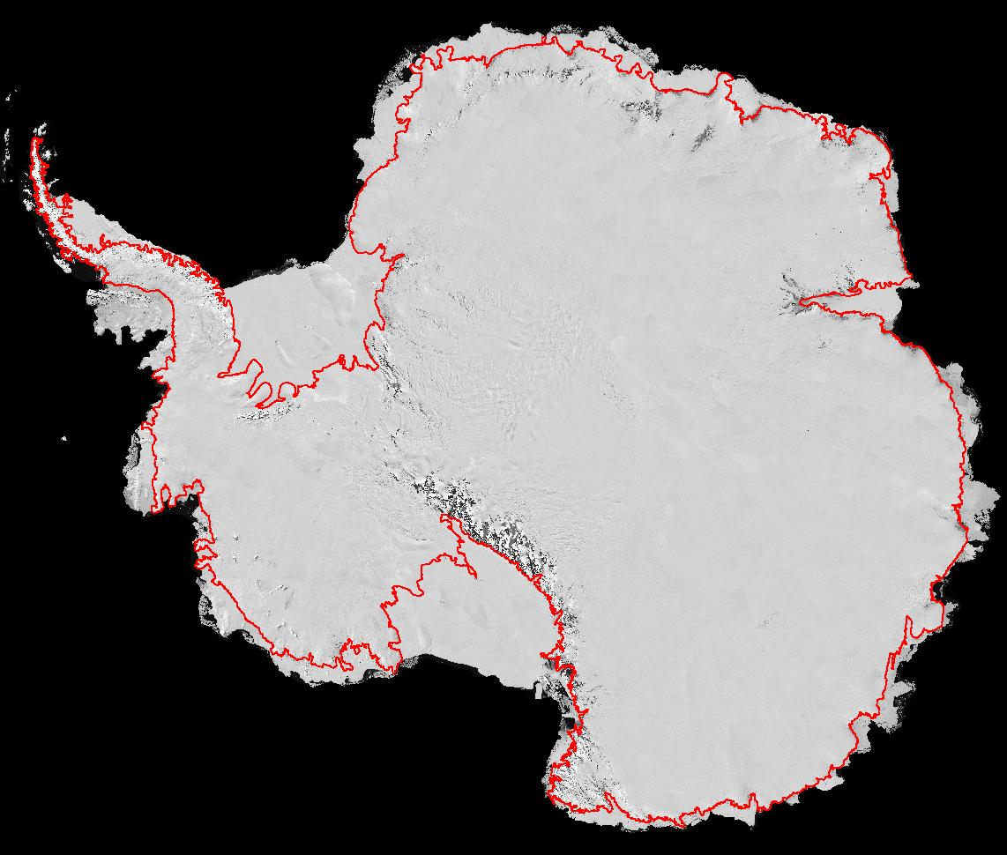
Survey of Pine Island Bay
Pine Island Bay
(100° West Longitude - 112° West Longitude)

Slide 7
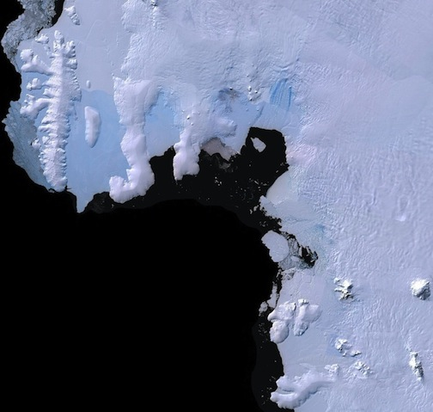
Survey Points of Change in Pine Island Bay
“ECSU Bay”
- points of change found during the survey

Slide 8
Methodology
Landsat images of the study area were obtained from the LIMA website and the USGS GLoVIS archives. The images were selected using the following criteria: 1) spatially covered study area 2) clarity (< 20% cloud cover) and 3) age.
Available images were downloaded from the years 1973 - 2012.
The ASAID BSB text file was edited to specifically encompass the Pine Island Bay periphery.
The edited BSB vector file was overlain on all Landsat images, providing a reference for determining temporal variation.
MSS pixel size, shape and spatial resolution differed from that of later TM instruments. Early MSS and TM images were also poorly registered geographically. Early MSS and TM images were co-registered and resized (warped) to circa 2003 ETM+ reference images using ENVI software.

Slide 9
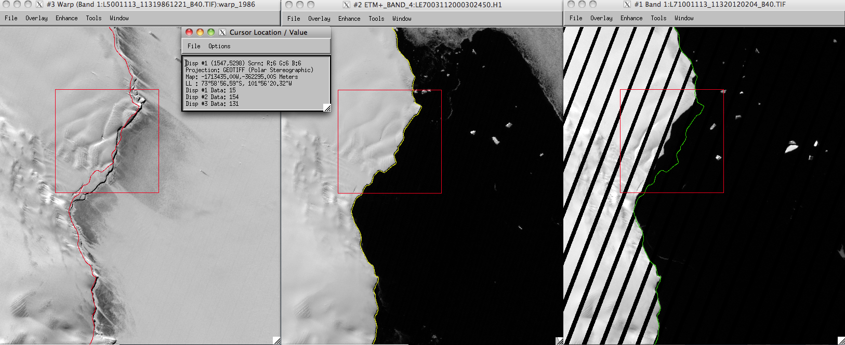
Results
Figure 1. The sequence of images (1986; 2003; 2012) in the vicinity of 73°58’56.59”S, 101°56’20.32”W depicts the possible misplacement of the 2003 ASAID BSB over an ice-shelf, and possible retreat of an pre-existing ice-shelf.

Slide 10
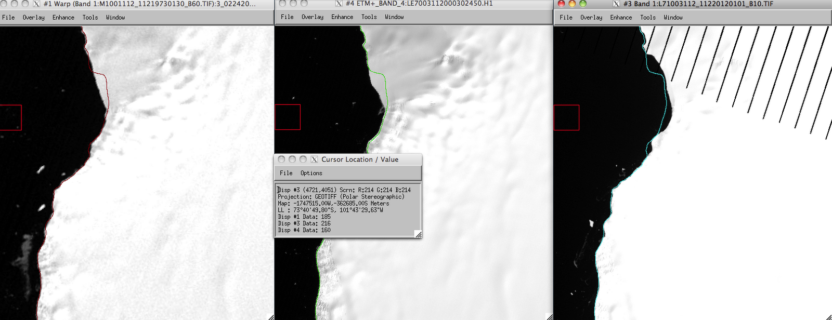
Figure 2. The sequence of images (1973; 2003; 2012) in the vicinity of 73°40’49.80”S, 101°43’29.63”W depicts the possible misplacement of the 2003 ASAID BSB over an ice-shelf, and possible retreat of an pre-existing ice-shelf.

Slide 11
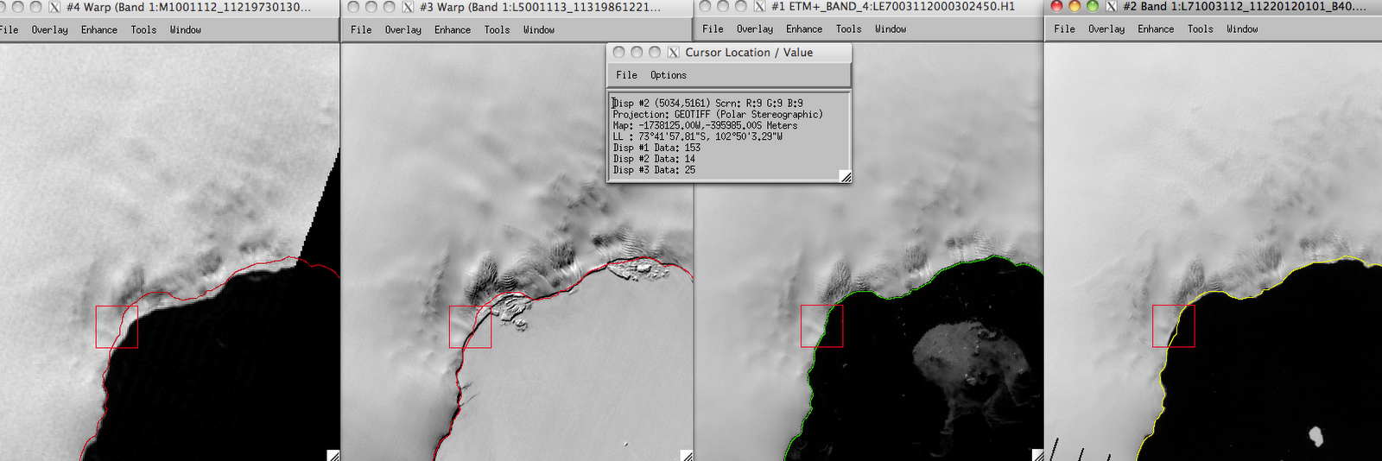
Figure 3. The sequence of images (1973; 1986; 2003; 2012) in the vicinity of 73°41’57.01”S, 102°50’3.29”W appears to depicts the possible dissipation of an pre-existing ice-shelf, as well as possible evolutionary coastal ice retreat.

Slide 12
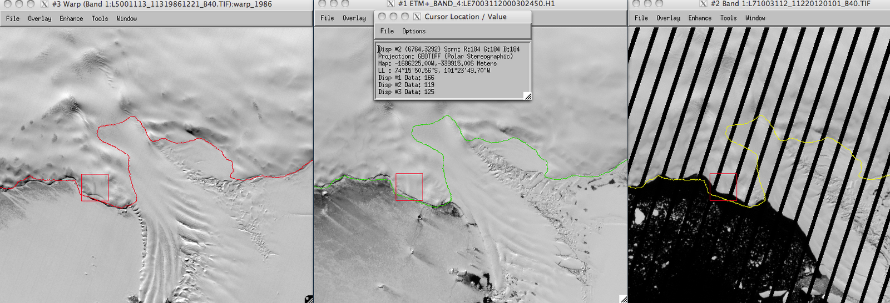
Figure 4. The progression (1986; 2003; 2012) at 74°15’50.56”S, 101°23’49.70”W shows a possible misplacement of the 2003 ASAID BSB and evolutionary coastal ice erosion.

Slide 13
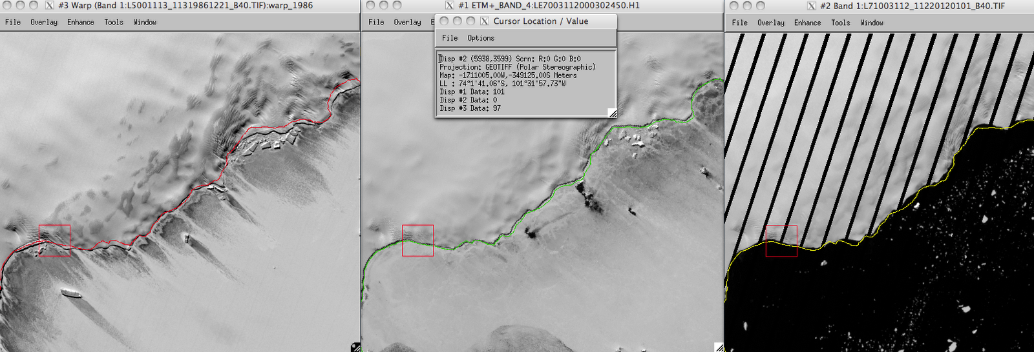
Figure 5. The progression (1986; 2003; 2012) in the vicinity of 74°1’41.06”S, 101°31’57.73”W shows evolutionary coastal ice erosion.

Slide 14
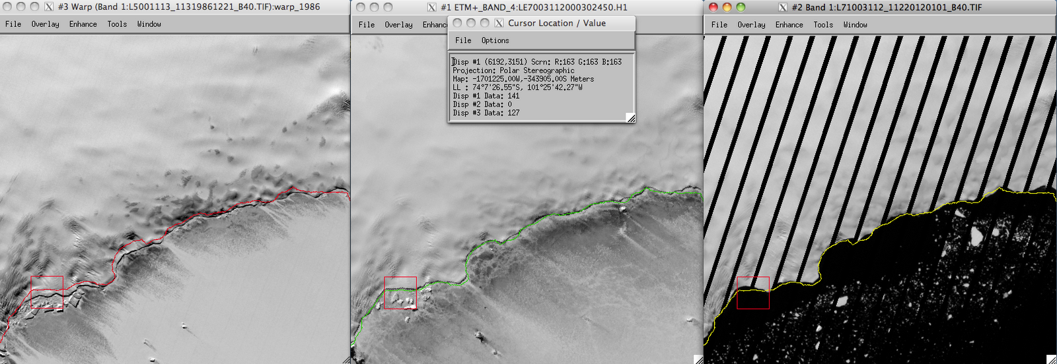
Figure 6. The illustration (1986; 2003; 2012) at 74°7’26.55”S, 101°25’42.27”W shows the possibility of coastal ice-cliff retreat, which leaves the BSB off-shore (sea-ward).

Slide 15
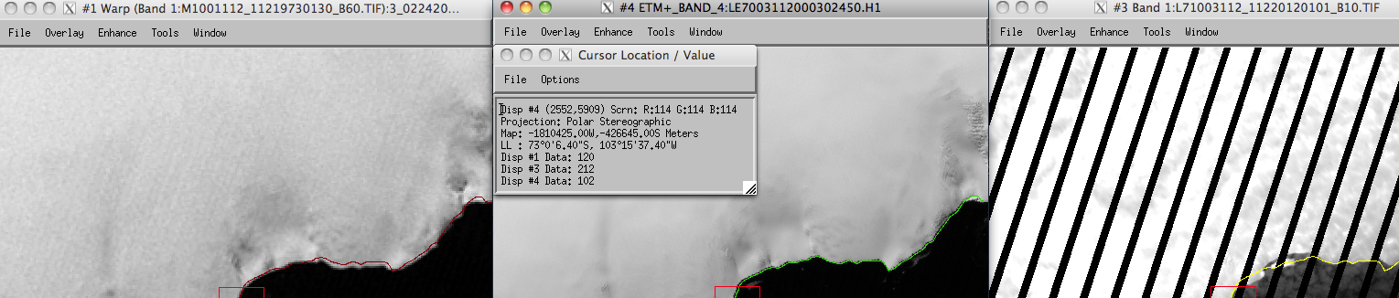
Figure 7. The image progression (1973; 2003; 2012) in the vicinity of 73°0’6.40”S, 103°15’37.40”W shows

Slide 16
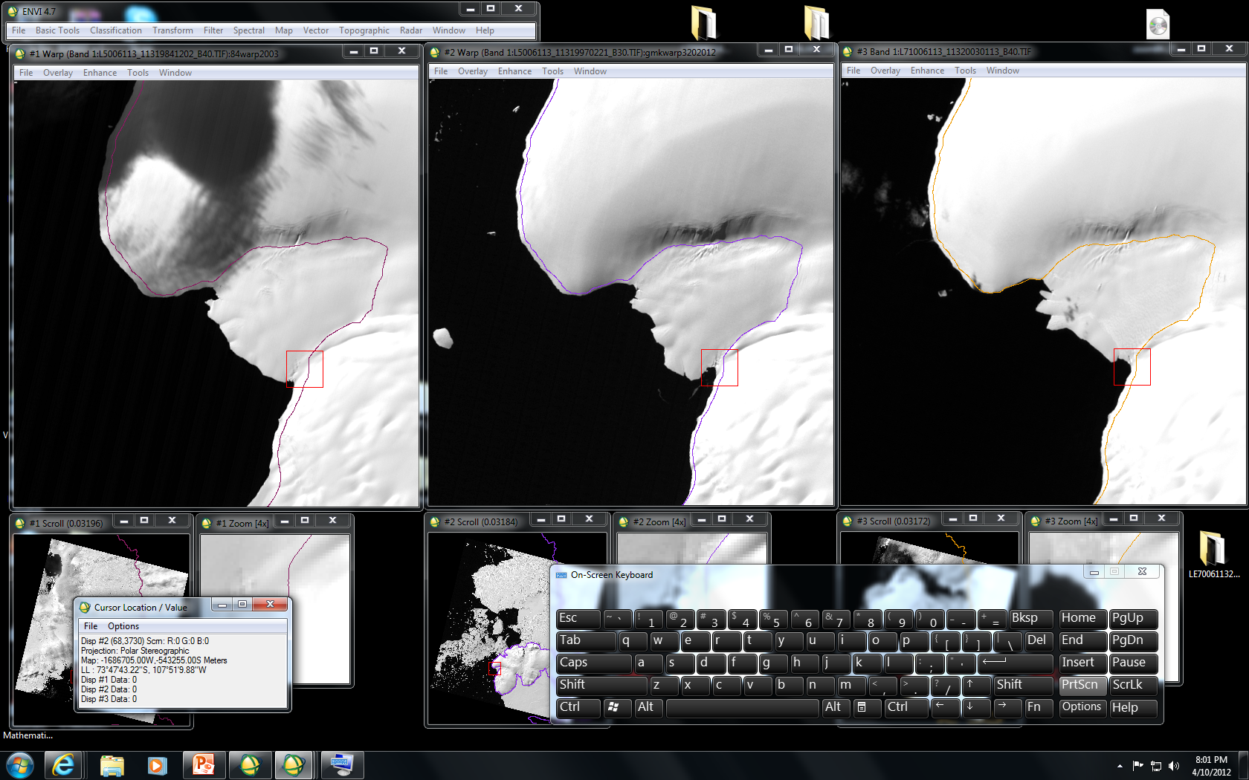
Figure 8. The sequence of images (1984; 1997; 2003) at 74°179.57”S, 110°50’42.14”W appears to show the evolutionary melting of ice-shelf leading edge.

Slide 17
Conclusion
The survey yielded:
1) The possibility of one significant change in the placement of the BSB
2) Instances of relatively minor BSB misplacement (or retreat) and evolutionary coastal ice retreat.

Slide 18
Future Work
Conduct measurements for the survey areas that resulted in an apparent ice-shelf reduction
Investigate the Antarctic Peninsula in the vicinity of the Larsen Ice-Shelf

Slide 19
References/Acknowledgements
  GloVis: glovis.usgs.gov
  LIMA: lima.usgs.govs
  ENVI: http://www.ittvis.com/language/en-us/productsservices/envi.aspx
  The Landsat Program: http://landsat.gsfc.nasa.gov/
  Dr. Robert Bindshadler, Glaciologist at NASA Goddard

