Slide 1
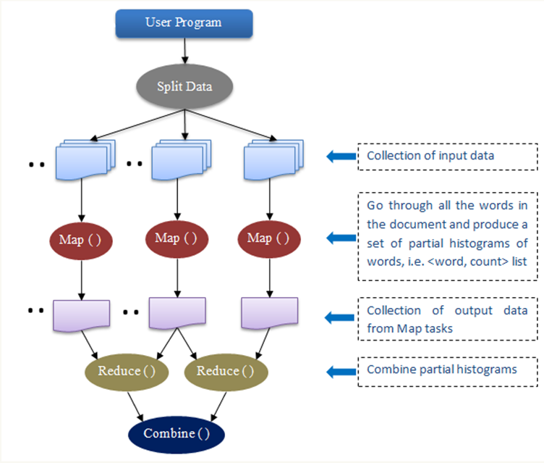
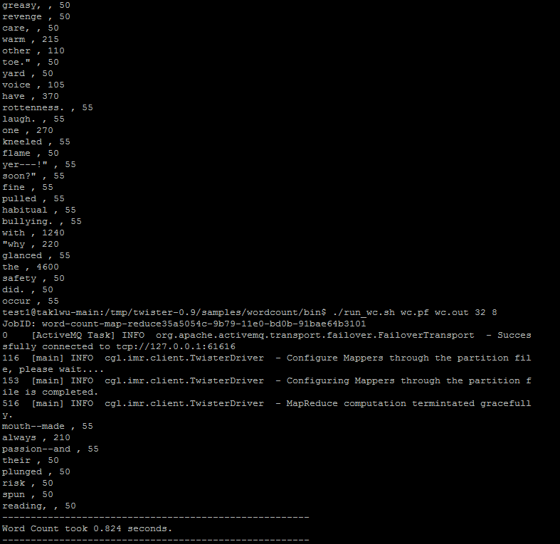
Members: Joyce Bevins and Autumn Luke
Mentors: Thilina Gunarathne, Stephen Wu, and Bingjing Zhang
Abstract
MapReduce
The primary focus of this research project was to analyze the attributes of MapReduce frameworks for data intensive computing and to compare two different MapReduce frameworks, Hadoop and Twister. MapReduce is a data processing framework that allows developers to write applications that can process large sets of data in a timely manner with the use of distributed computing resources. One of it’s main features is the ability to partition a large computation in to a set of discrete tasks to enable of parallel processing of the computation. Google, the most popular search Engine on the internet, uses MapReduce to simplify data processing on it’s large clusters. We analyze the performance of Hadoop and Twister using the Word Count application and compare the scalability and efficiency of the two frameworks for this particular application.
Map reducing has two stages:
1)The map function separates out data to be processed. It splits the input data to different computer nodes and process the split data. The partial result is generated.
2)The reduce function performs analysis on that data. It merges the split data. In other words it merges the partial result to generate a final result.
Twister Framework
Execution
1. Input 2. split 3. map 4. shuffle 5. Reduce 6. Result
Input reader
Map function
Partition function
Compare/Sort function
Reduce function
Output writer
Twister Flow Chart
Results
Future Work
Our group is testing the accuracy of Twister and Hadoop, two MapReduce frameworks, by running both Word Count applications. First we tested the framework of Twister by increasing the input data size to observe the difference in time it takes to complete the WordCount application. The average execution time was computed and recorded.
Future work will include performing the same performance test using Hadoop Word Count application. After three runs are successfully completed for the Hadoop framework, an average will be calculated and compared with the average of Twister. This will enable us to decipher which MapReduce framework can be utilized most efficiently for the WordCount application.

