Slide 1
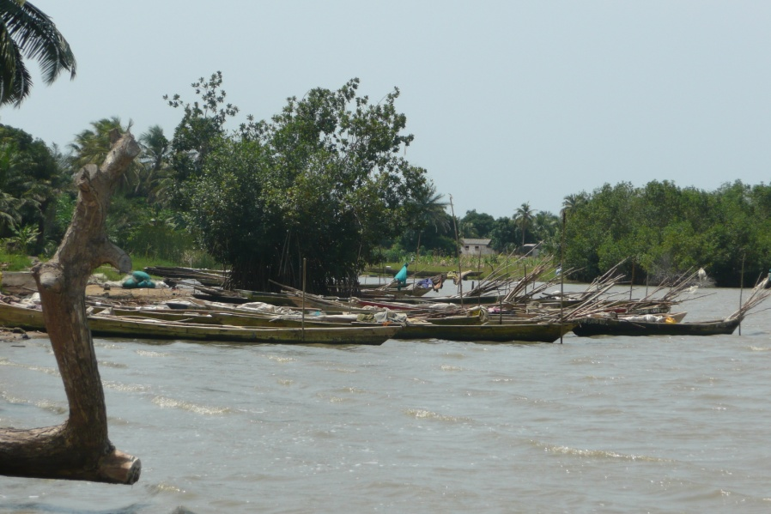
CANOE FRAME SURVEY USING QUICKBIRD IMAGERIES
CANOE FRAME SURVEY USING QUICKBIRD IMAGERIES
BY
OWUSU GEORGE FORDAH
1O245640
BY
OWUSU GEORGE FORDAH
10245640

Slide 2
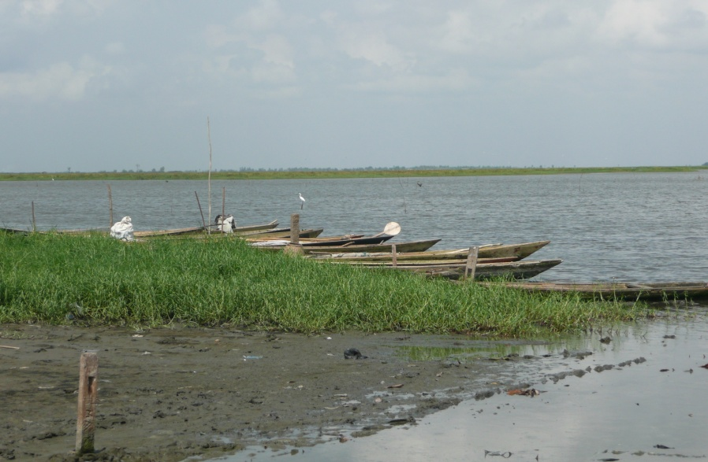
INTRODUCTION
Over the past years carrying out an effective control of fishing activities has become essential to guarantee a sustainable exploitation of sea resources.(ie estimating fishing effort)
Traditional reconnaissance can be time consuming and expensive (e.g MFRD spends 1-2 months to counts canoes along the 550km stretch Ghana’s coastline)
Satellite-based imageries provides a powerful surveillance capability which can be utilized in canoe frame surveys
Canoes scattered along the beach area

Slide 3
METHODOLOGY
The imagery covers part of central region.
The area itself, is one of the largest fishing area and covering an area of approximately 20,000 km² is economically important in terms of fisheries
An adjusted Quickbird image ( data used)

Slide 4
APPROACH
Shape measurement
analysis
Threshold
Preprocessing Gray Image [isolating of beach area]
Conversion of Image in Binary
Canoe detection
Original Quickbird Image
Obtaining Result
Flowchart of the developed routine

Slide 5
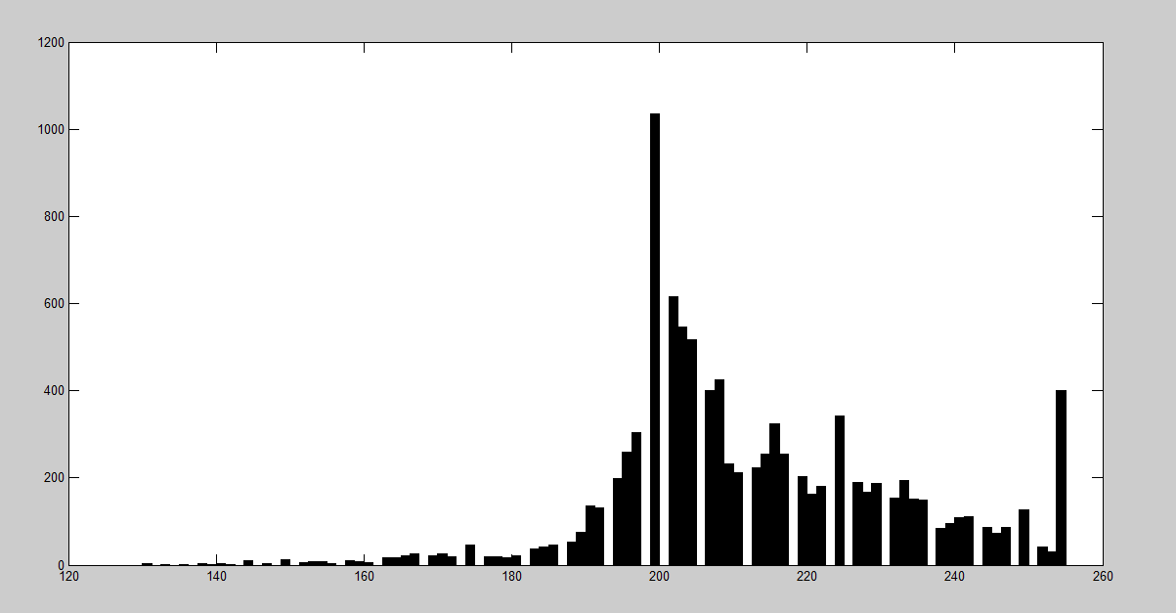
THRESHOLDING
Thresholding is the simplest method of image segmentation. From a grayscale image, it can be used to create binary images (Shapiro, et al. 2001:83).
Images in grayscale have digital numder (DN)
The histogram method used shows the pixel distribution through which the threshold could be obtained.
Histogram showing pixel distribution

Slide 6
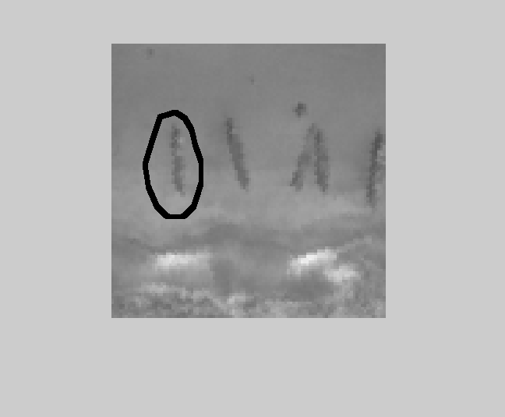
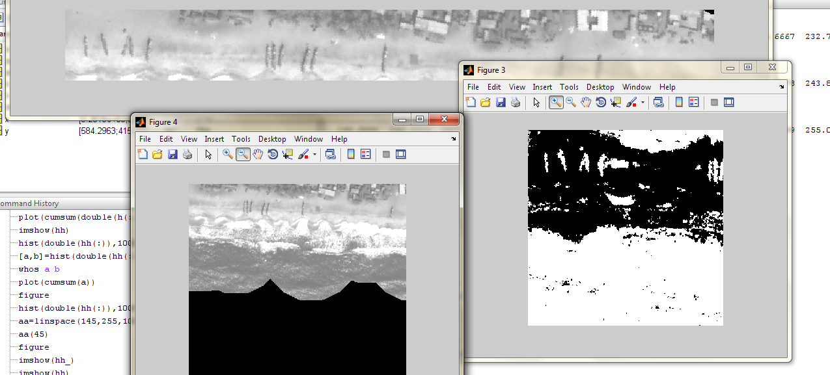
GRAYSCALE TO BINARY IMAGE
Canoe
The binary image
1:100,1:100 window of the gray image

Slide 7
REFERENCE
Amador, K., Bannerman, P., Quartey, R. and Ashong, R. 2006. Ghana Canoe Frame Survey. Information Report Number 34. Marine Fisheries Research Division. Ministry of Fisheries. Ghana.
Anon (2001) Report on the (2001) Ghana Canoe Framework Survey, Marine Fisheries Research Division Tema Ghana
Anon (2000). Ghana Living Standard Survey Report of the Fourth Round. Accra Ghana. Statistical Service Publication Accra Ghana.
Anon (1998) Report on the 1997 Ghana Canoe Framework Survey, Marine Fisheries Research Division Tema Ghana
FAO. 2007. Ghana Fishery Country Profile (available at: wwiaw.fao.org/fi/website/FISearch.do?dom=country)
Koranteng, K A (1980) Trawl, Survey of Demersal Fish Stock 1990/81 Program Of Fisheries Research And Utilization Branch (FKRUB) Tema, Ghana.
Koranteng, K A (1984) A Trawling Survey Of Ghana, Cacaf/Tech,84/03 Dakar, Senegal: CECAF Project (FAO).
Satia, B. P. (1993) Ten Years Of Integrated Development of Artisanal Fisheries in W/A. Integrated Development Of Artisanal Fisheries Technical Report No 50, Cononou, Benin . IDAF Program (FAO)

