Slide 1
MAPPING OF OIL SLICKS FROM SYNTHETIC APERTURE RADAR (SAR) IMAGERIES BY AMADI A. SEFAH-TWEREFOUR
Bachelor of Science Undergraduate Dissertation
Department of Oceanography and Fisheries
University of Ghana, Legon-Ghana

Slide 2
OVERVIEW
Background
Synthetic Aperture Radar (SAR)
Methodology
Some results

Slide 3
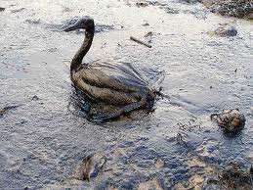
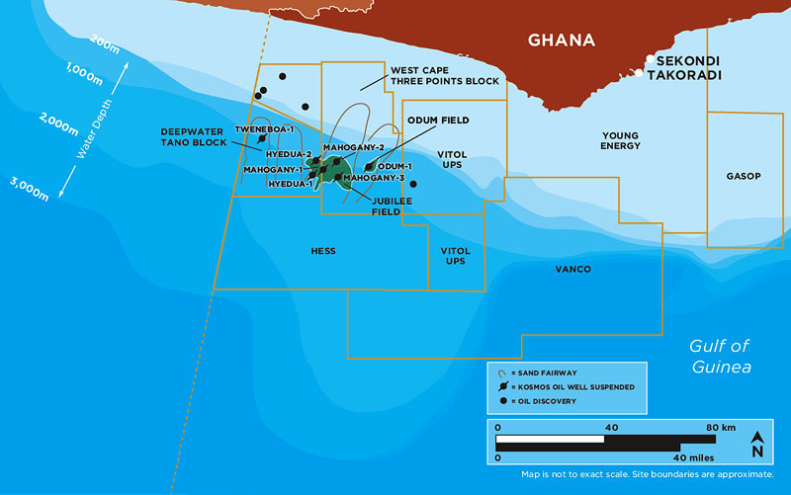
BACKGROUND
Introduction
Increasing energy needs of humans related to increased oil exploration and exploitation
Oil spills originate from rigs and tankers
Objective
Develop oil spill detection algorithms for known regions
To develop algorithms for oil spill mapping
Justification
Oil in Ghana
Facilitation of response
time to protect
coastal resources
and ecosystems

Slide 4
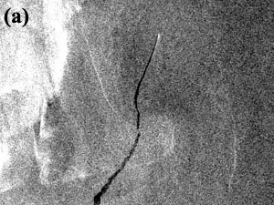
SYNTHETIC APERTURE RADAR (SAR)
Why SAR sensors in oil spill monitoring?
Microwave radiation –data capture in cloudy areas
Active sensing
Yet high resolution imageries
Mechanism of operation of SAR
Use of back scattering of capillary
waves (Bragg scattering mechanism)
(Uboupin et al, 2008)
Sea surface roughness responsible
for backscattering (Assilzadeh
and Gao, 2008)

Slide 5
METHODOLOGY
MATLAB – Image processing software used
Acquisition and development of new skills
SAR DATA
TEXTURE ANALYSIS
SCALING
THRESHOLDING
GAMMA FILTER
SCALING
UNSUPERVISED CLASSIFICATION
CONTOUR CREATION
OIL SPILL OUT PUT VECTOR
Assilzadeh and Gao, 2008

Slide 6
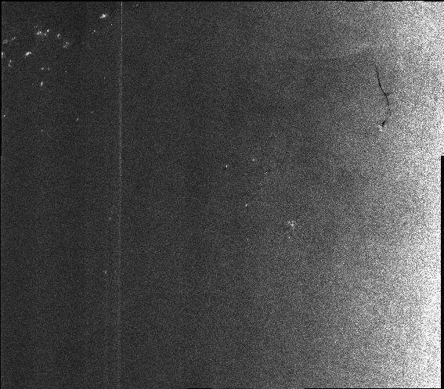
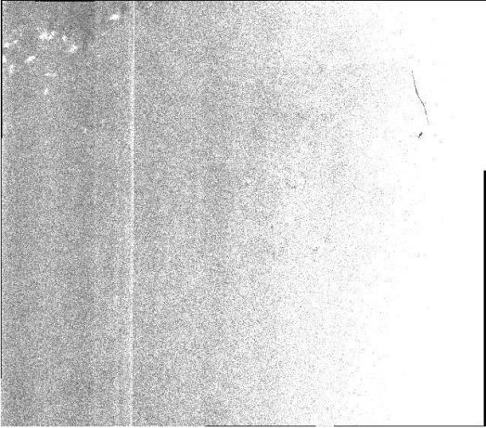
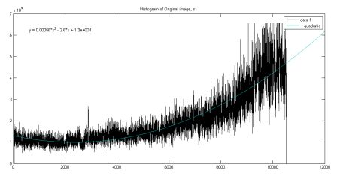
SOME RESULTS
Original image (s1)
Binary image (s1*(m/std))
Binary image (s1>mean(s1))
Plot of s1

Slide 7
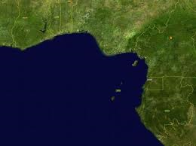
CHALLENGE
Unavailability of data from the Gulf of Guinea Region
Single spill image from region so far, being used
Gulf of Guinea
Region

Slide 8
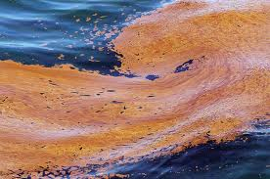
THANK YOU!

