Slide 1
The effect of Sea Surface Temperature on the Wind Speeds of Major Hurricanes of 2005, a Reexamination of Satellite Remote Sensing Data
Mentor: Dr. Jinchun Yuan
Members: Jean Bevins, Cedric Hall, Ashley Basnight, Nicholas Tabron

Slide 2
Overview
Introduction
Controversy
Abstract
Reexamination
Process and data
Collecting Data from NASA
Places data in Microsoft Excel
Sorting data and Calculating
Creating Charts
Analyzing and Relations
Results
References
Questions

Slide 3
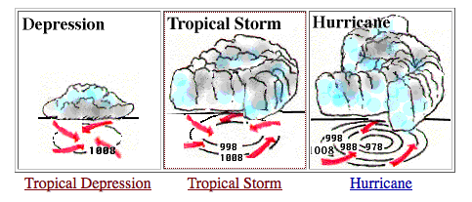
Introduction
In 2005, the hurricane season in the Atlantic was the most dynamic season, so much so that it surpassed preceding records in history. The impact of these storms left over 3,000 deaths and record damages of approximately 130 billion (US) dollars. The First Storm formed on June 8th of 2005, and the last storm ended January 6, 2006
Tropical Depression - TD
Tropical Storm – TS
Categories – 1,2,3,4,5

Slide 4
Controversy
The Effect of Sea Surface Temperature on the strength of Hurricanes
has been very controversial for some time. Many theories and atmospheric models all predicted a stronger hurricane at higher Sea Surface temperature. However, field observations of sea surface temperature and wind speed yielded inconclusive or contradicting results.

Slide 5
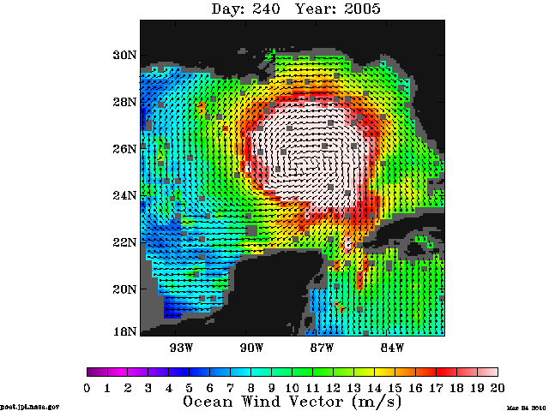
Abstract
The effect of Sea Surface Temperature on the Wind Speeds of Major Hurricanes of 2005, a Reexamination of Satellite Remote Sensing Data

Slide 6
Process
Collect Data from NASA hurricane satellite website
Place data from “data viewer” into excel
Sort data
Create graphs
Analyze correlations

Slide 7
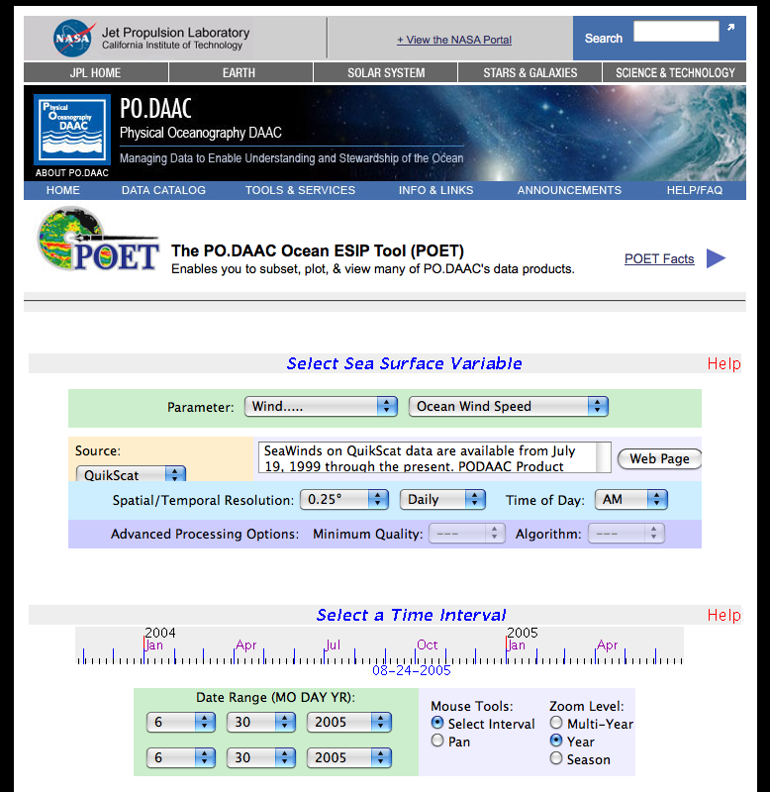
Using Resources
Using the NASA Website (http://Poet.jpl.NASA.gov) we were able to insert specific data from each hurricane

Slide 8
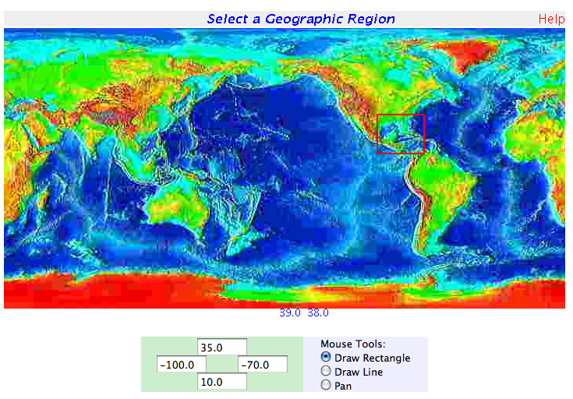
Using Resources

Slide 9
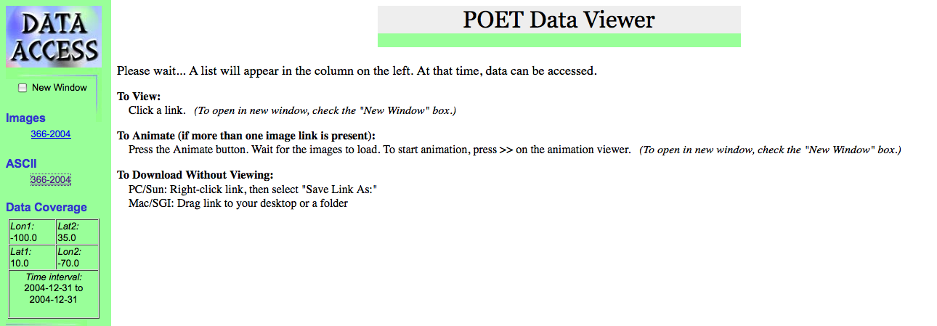
Poet Data View

Slide 10
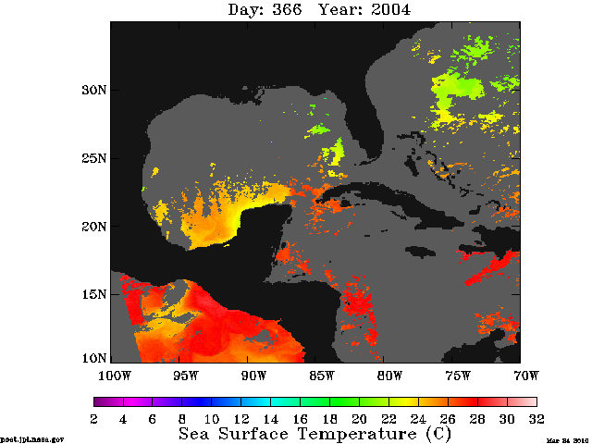
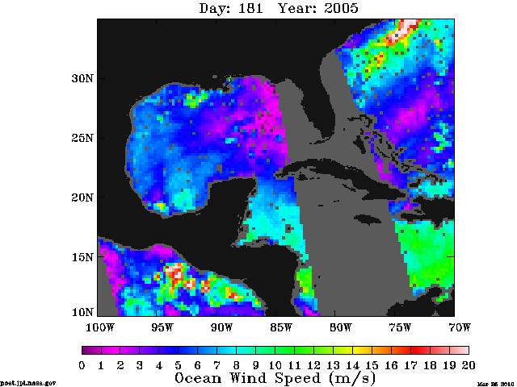
Poet Data View (Photo)
Temperature
Wind Speed

Slide 11
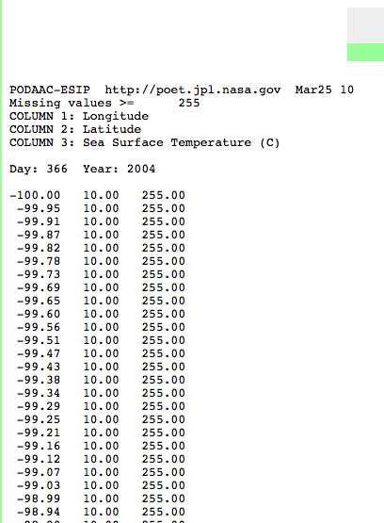
ASCII Chart
The American Standard Code for Information Interchange

Slide 12
Data in Excel
Placing data in Excel
Text File
Replacing 255’s
Sort
Look for Highest Wind Speed

Slide 13
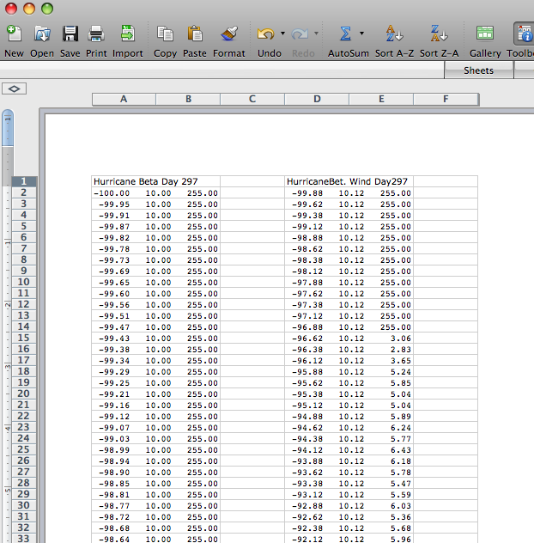
Data in Excel

Slide 14
Calculations
Calculating The Distance:
Formula
=sqrt((x2-x1)^2+(y2-y1)^2)
=sqrt((x2-$x$1)^2+(y2-$y$1)^2)

Slide 15
Creating Graphs
Take the data of the highest wind speed, then the distance, temperature, longitude, and latitude (which was sorted from the smallest to largest) and place them in a separate excel document. Next, you create the graph, wind speed being the y axis, and sea surface temperature being the x axis. This is done for every hurricane of 2005. Placing all of the final data together from each storm, will accumulate the final correlations analyze.

Slide 16
Graphs

Slide 17
Problems
Copying and pasting data into Excel was time consuming.
Replacing invalid data

Slide 18
Results
Based on the Final Correlation graph,
Higher wind speed only occurs in higher temperatures. In areas with lower temperature, high wind speed doe not occur. Thus supporting the belief that sea surface temperature is not a primary factor in hurricane formation.

Slide 19
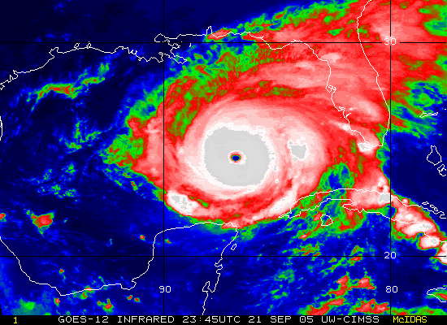
References
NASA
National Hurricane Center
Increasing Destructiveness of tropical cyclones over past 30 years – Kerry Emanuel
Sea-Surface temperatures and tropical cyclones in the Atlantic Basin – Patrick J. Micheals
Changes in Tropical Cyclone Number, Duration, and Intensity in a Warming Environment
NHC preliminary summary of 2005 wind speed and death

Slide 20
Questions

