Slide 1
Research and Implementation of Data Submission Technologies in Support of CReSIS Polar and Cyberinfrastructure Research Projects at ECSU Nadirah Cogbill, Matravia Seymore Mentor: Jeff Wood Principal Investigator: Dr. Linda B. Hayden 1704 Weeksville Road, Box 672 Elizabeth City, North Carolina 27909
Undergraduate Research Experience Multimedia Team 2009-2010
March 25, 2010

Slide 2
Abstract
The Center of Excellence in Remote Sensing Education and Research (CERSER) on the campus of Elizabeth City State University often has a requirement for the collection of information from various individuals and institutions in support of the CReSIS and CyberInfrastructure research projects. This information may be of a general nature such as registrations or surveys, but may also contain sensitive information such as Social Security numbers.
The 2009-2010 Multimedia Team researched strategies and software needed to build general and secure data submission forms and implement them on the servers utilized by CERSER. This investigation involved commercial as well as open-source approaches. The end product was a data collection capability and procedures for form developers to follow.
Notes:
CERSER is part of several national and international research projects involving undergraduate and graduate students involved in remote sensing research. The Center often has a need to gather information quickly from individuals both locally and remotely as well as the task of gathering data from remote sensors and research experiments.

Slide 3
Center of Excellence in Remote Sensing Education and Research
Overview
Notes:
CERSER is part of several national and international research projects involving undergraduate and graduate students involved in remote sensing research. The Center often has a need to gather information quickly from individuals both locally and remotely as well as the task of gathering data from remote sensors and research experiments.

Slide 4
Data Collection
Overview
Notes:
A form allows users to input and submit data whether it is in print or by the Internet.
This project focused on three areas of data collection: printed forms, local server developed forms, and remote server forms.
Several applications and languages were used in this project to create various database formats.

Slide 5
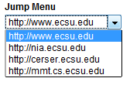
Form Elements
Label
Text Field
Textarea
Check Box
List Menu
Jump Menu
Radio Button
Hidden Field
Button
Notes:
Label – Identifies what a certain form element is used for
Text Field - Used for gathering text data from the user in a single line
Textarea – Employed to collect text data from the user when multiple line inputs are required or may be possible
Check Box – Used with yes or no questions or multiple selections
Radio Button – Much like Check boxes, but one selection can be made when used as a group
List Menu - Display a large number of options and allow the user to select one or more
Jump Menu - Drop down menus that redirect the viewer to a URL when an option is selected
Hidden Field – For passwords and other data that may be secure
Button – Utilized to submit or reset a form

Slide 6
Google Docs
Presentations, spreadsheets, and form applications
Save and share online

Slide 7
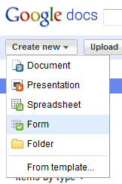
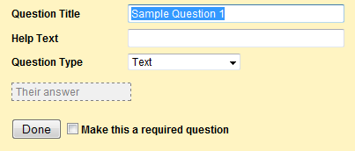
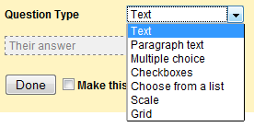
Form Development Procedure
Create a Google account and sign-in
Select “Documents”
Select “Create New” > “Form”
Select question type
Enter question
Required?
Add item
Done
Notes:
Create an account with Google if an account does not already exist and sign in.
A refreshed Google page will appear with more options. Click the last option “more” at the top left hand side. The “more” option will provide a drop down menu. Scroll down and click “Documents”.
The Google docs window will appear. On the left hand side of the page, Click “Create new”. A drop down will appear. Scroll down and select “Form”.
A window will appear titled “Untitled Form”. Just underneath that will be an option that allows you to fill in the “Question Title”. Type in the question.
To enter the “Question Type” click on the drop down menu and a list of options will be presented. Choose the question type.
There is an option that allows for making the question required. Check the box and a red star will be presented with the question. This notifies the user that the question is required.
The “Done” button is selected when the form is complete.

Slide 8
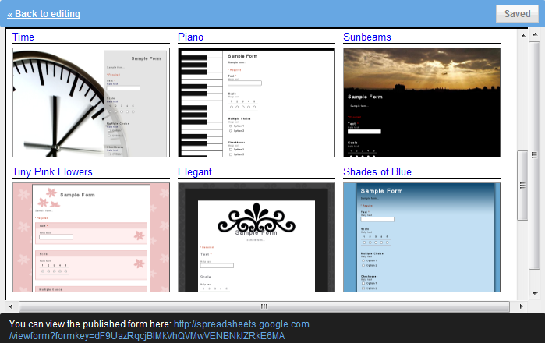
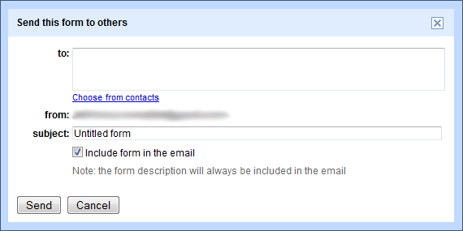
Form Development Procedure
Themes
Email
Notes:
At the very top of the page is a link that permits the developer to apply a template to make the form professional in appearance.
Once the information portion is complete, you can fill out the form in order to test that everything works. Once testing is done, click “Email this form” on the right hand side of the window.
A pop-up window will appear on the screen “send this form to others”. Add in all the recipients you wish to send the form to. Once all recipients are included, select the “Send” button.

Slide 9
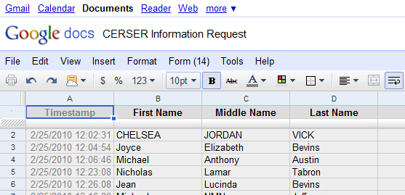
Form in Use
Form Fill-in
View submitted data
Notes:
After a link to the form is emailed to the recipients, the recipients then click on the link and complete the form.
Once they have completed the form, the submit button is selected which sends the information to a spreadsheet in Google docs. The developer can then view the submitted data and the date/time the user submitted their data.

Slide 10
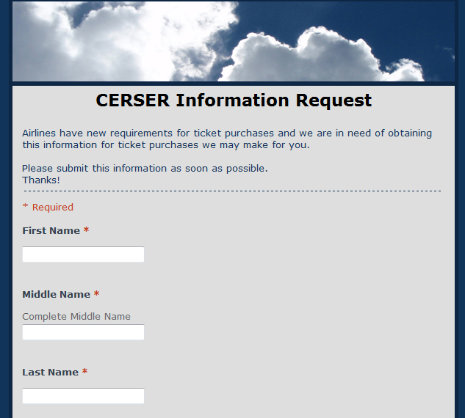
Prototype
CERSER Information Request
Notes:
The team created a form titled “CERSER Information Request”.
This form included both required and non-required fields. Presented inside of this form were two types of questions. The question types used were “Text” and “Choose from a List”.
The form asked the recipients general questions like their first, middle, and last name, date of birth, and both their cell and home phone numbers.
The data was collected within one day of notifying the students and given to the office personnel in need of it.

Slide 11
Web Based Forms
Dreamweaver
PHP
phpMyAdmin
SQL
Notes:
A second method of gathering data from the web is to utilize a combination of tools implementing a form that can store gathered data into variety of database formats.
For this project the team utilized a combination of Dreamweaver, PHP: Hypertext Preprocessor (PHP), phpMyAdmin, and Structured Query Language (SQL).
PHP and Dreamweaver file development took place on the development platform and was then uploaded to the server.
SQL databases were created directly on the server utilizing the open source application phpMyAdmin

Slide 12
PHP Overview
Dreamweaver Overview
Website Development
JavaScript, ASP, PHP, CSS, ColdFusion
Adobe CS4 Creative Suite
WYSIWYG
PHP: Hypertext Preprocessor
Restrictions
C, Java, and Perl
Embedded
Notes:
Adobe Dreamweaver is an application utilized in developing web sites.
Dreamweaver is used on both the Macintosh and Windows operating systems and supports tools such as JavaScript, PHP, and CSS.
The version utilized for this project is part of the Adobe CS4 Creative Suite which includes Adobe software such as Illustrator, Photoshop, and Flash.
Dreamweaver is based on a What-You-See-Is-What-You-Get (WYSIWYG) design in that a developer can create code while using an interface that appears much like a word processing application. A developer can view the code while they are developing in WYSIWYG mode or they can develop a page by coding directly in a separate view.
----------------------------------------------------------------------------------------------------------------------
PHP: Hypertext Preprocessor (PHP) is a general-purpose scripting language originally developed to create dynamic, personal home pages, thus the “PHP” acronym.
PHP is embedded into HTML and interpreted by a PHP processor module located on a server. Once the file is processed, it returns the generated HTML page back to the client (browser) hiding scripting, calculations, data calls, and other code implementations from the user.

Slide 13
phpMyAdmin Overview
SQL Overview
Structured Query Language
Compatibility
SEQUEL > SQL
Query
PHP: Hypertext Preprocessor
Browser Interface
Operations
Notes:
SQL is a computer language designed to create and manipulate databases.
This language is compatible with all major operating systems and includes data query and update, schema creation and modification, and data access regulation.
SQL was developed in the early 1970’s at IBM where it was used to manipulate and retrieve data in their database product.
----------------------------------------------------------------------------------------------------------------------
phpMyAdmin is a web based application created to perform administration tasks for the database application MySQL.
Through a browser interface, phpMyAdmin executes SQL statements from graphical interface selections.
The ability to directly enter SQL statements is also available. The operations most used with phpMyAdmin are managing the components of the SQL software such as databases, tables, fields, indexes, and database permissions.

Slide 14
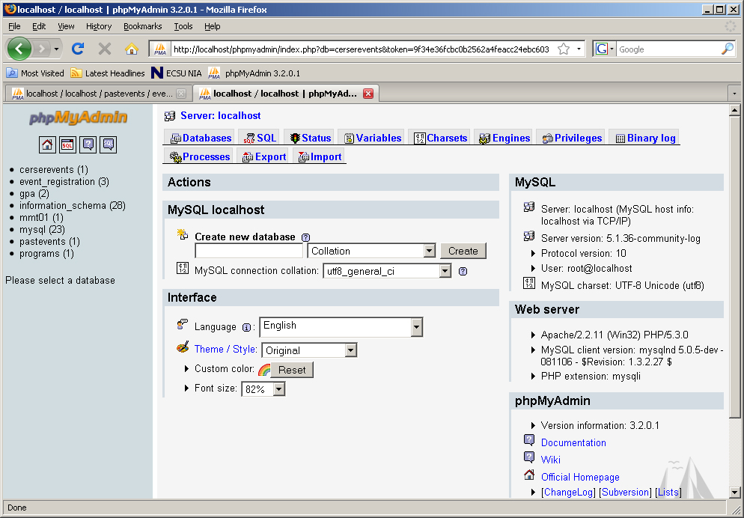
Database Creation
phpMyAdmin
Create Database
Notes:
SQL database creation takes place on the web site server using the phpMyAdmin application.
Enter the name for the new database and select “Create”
The SQL window will display the statement used to create the database and the database will appear to the left with a notation that there are no tables present.

Slide 15
Table
Table Entry
Notes:
Enter the desired name for the table. There can be more than one table in a database.
Enter the number of fields taking into account that one field will be needed as a key field.
The key field is unique and is normally automatically incremented with each new record. Select “Go” once the entries are made.

Slide 16
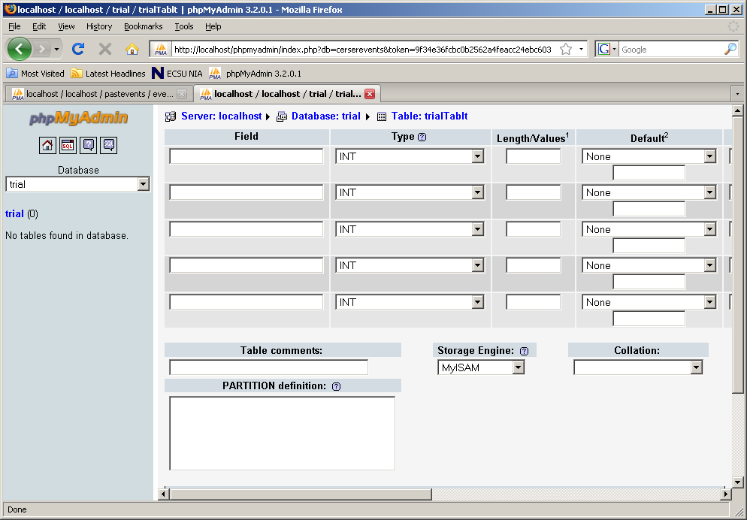
Table Fields
Table Fields
Notes:
The next step is to enter the parameters (field name, type, length, etc…). The field name is entered first.

Slide 17
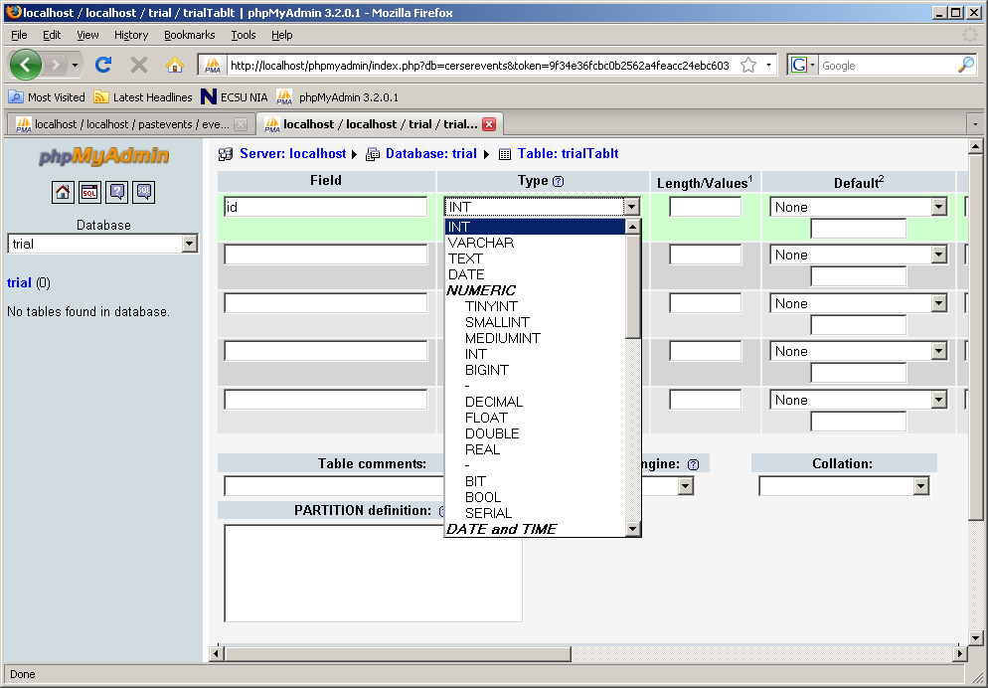
Field Types
INT
VARCHAR
TEXT
Notes:
The selection of a field type depends on the type of data entered and the length required to store it.
INT fields will contain integers while VARCHAR and TEXT fields can contain any character. The difference being the amount of storage space allotted for each. (TEXT is larger than VARCHAR)

Slide 18
ID Field
Name
Type
Length
Index
Auto-Increment
Notes:
In the case of the “id” field, the name, type (INT), length (4), index (PRIMARY), and auto-increment selections were made.
Primary make this a unique field that cannot be duplicated in any record. Auto-increment will increase each time a new record is added.

Slide 19
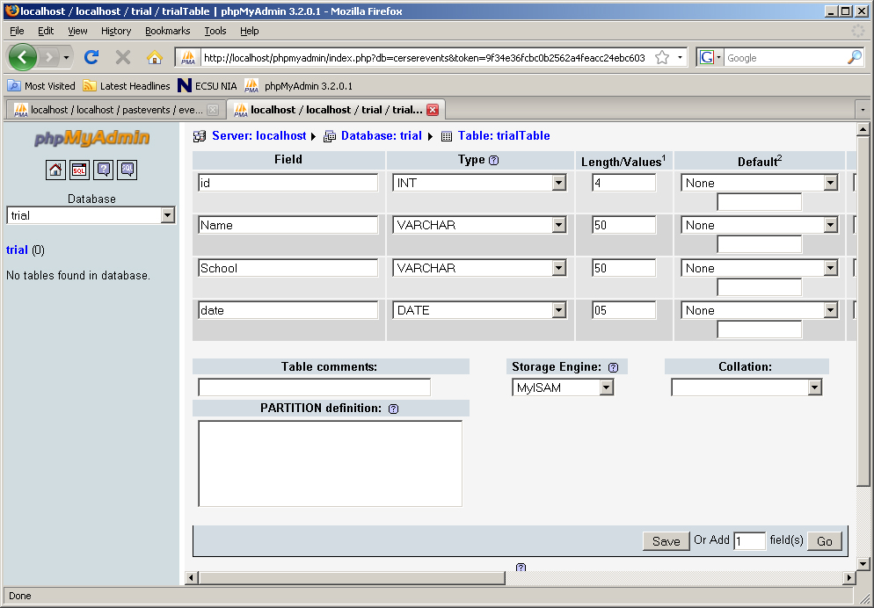
Remaining Fields
Enter Values
SQL
Notes:
Enter the field name, type, and length values for the remaining fields in the table and select save.
The SQL creation statements are displayed along with the table structure of fields and modification selections. These selections allow you to modify, delete, or add fields as needed to the table.

Slide 20
User
User Name
Host
Password
Notes:
The final step is to create the user privileges for the database by selecting the “Privileges” tab.
Here the new user name, host (in this case localhost), and passwords are entered.

Slide 21
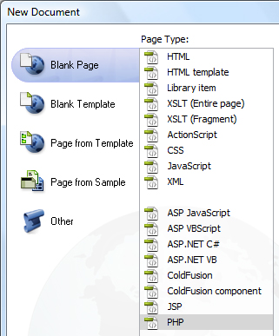
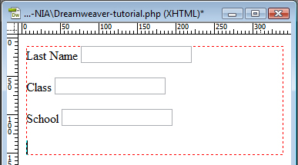
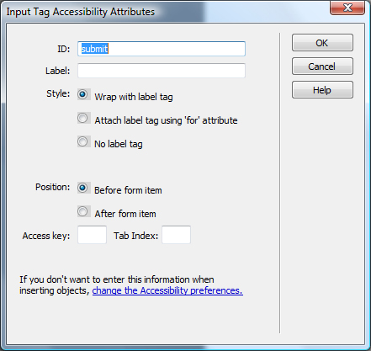
Form Creation
New File
New Form
Elements
Options
Button
Notes:
Creating forms in Dreamweaver is a two procedure process: 1. Create the form for data entry 2. Create the page to view data from the database. Dreamweaver utilizes the database created above in phpMyAdmin to create links between form fields and database fields. The steps shown below create a basic form utilizing PHP code to create connections to the database on the server.
Create a new PHP file in Dreamweaver by selecting File>New>PHP
Select Insert>Form>Form to insert the form container which will appear as a box with a dashed border
Next insert the desired fields into the form container. Ensure the “ID” field matches your database field name. The “Label” field will appear to the user to identify what must be entered into the field.
Select the inserted field to view the options palette for that field.
Continue inserting fields needed and modifying as needed
Insert a button and fill in the “ID”, but leave the “Label” blank

Slide 22
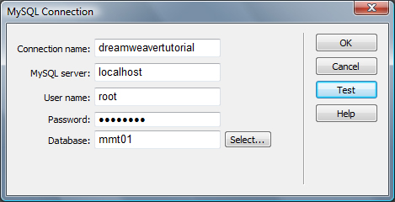
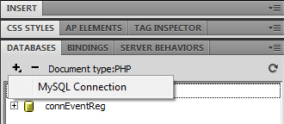
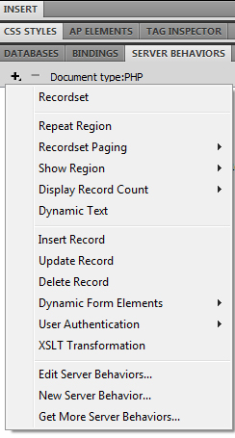
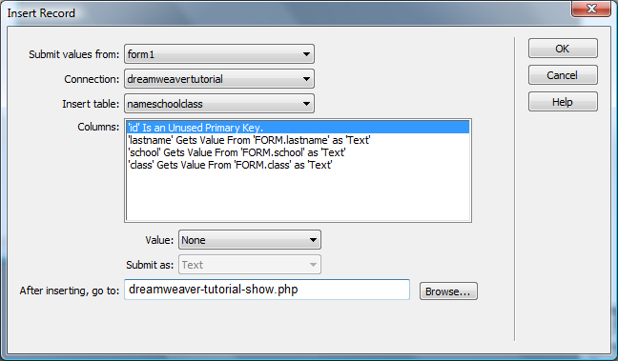
Database Connection
New File
New Form
Elements
Options
Button
Notes:
The Next step is to establish a connection with the server. Select the “DATABASES” tab from the palettes on the right side of the window. Then select the “+” sign and MySQL.
Give the connection a name, place "localhost" in the MySQL server field, then fill in the user name and password that you created in phpMyAdmin.
Then press the "Select" button to retrieve a database.
Press "Test" to ensure the connection works.
Check that all entries are correct and press "OK“
Now select the “SERVER BEHAVIOR” tab from the palettes on the right side of the window and select the “+” symbol and then “Insert Record”
Select the connection previously connected and the name of the table should be shown and the values should match in the columns window.
In the "After inserting, go to:" field place the name of the file that the browser will go to after the submit button is pressed and select "OK".
The entry form is now complete with the PHP code being created by Dreamweaver. Save the file and close it.

Slide 23
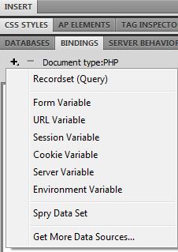
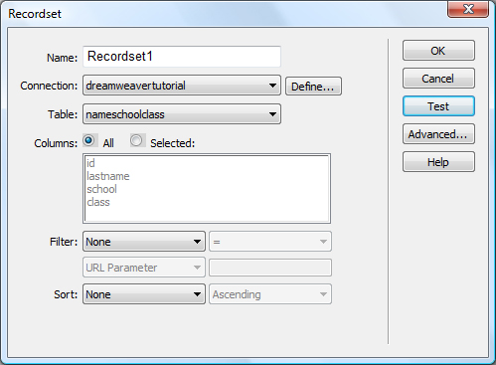
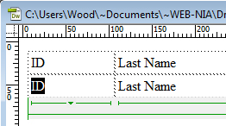
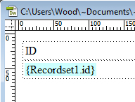
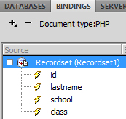
Display File
Create Table
Select Recordset
Connect to DB
Notes:
The next step is to create a file to display the entries made in the previous form. Create a new PHP file in Dreamweaver by selecting File>New>PHP
Insert a table with two rows and the number of columns equal to the number of fields in the database. Fill in the cells in both rows with the names of the database fields.
Now select the “BINDINGS” tab from the palettes on the right side of the window and select the “+” symbol and then “Recordset (Query)”
Select the appropriate connection from the pull-down menu. If needed, you could filter and sort the recordset from this window.
Select test to view the database contents.
Turn Recordset1 down to view the fields
Select “ID” in row 2, column 1 of the table in the design window.
Drag the ID lightning icon from the recordset to ID in the table. ID will change to “{Recordset1.id}”.
Do the same for the remaining cells in row two of the table.

Slide 24
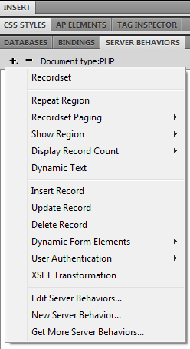
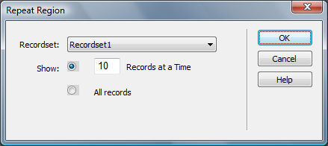
Show More
Select Row
Repeat Region
Notes:
This file will now show one record in the database. To show more first select the <TR> tag of the row containing the recordset.
Now select the “SERVER BEHAVIOR” tab from the palettes on the right side of the window and select the “+” symbol and then “Repeat Region”.
You can select a set number of records to display or all of the records can be displayed. Then Select “OK”.
Save the file and upload the two files created, along with the “connections” directory to the server.
The files are now ready for use.

Slide 25
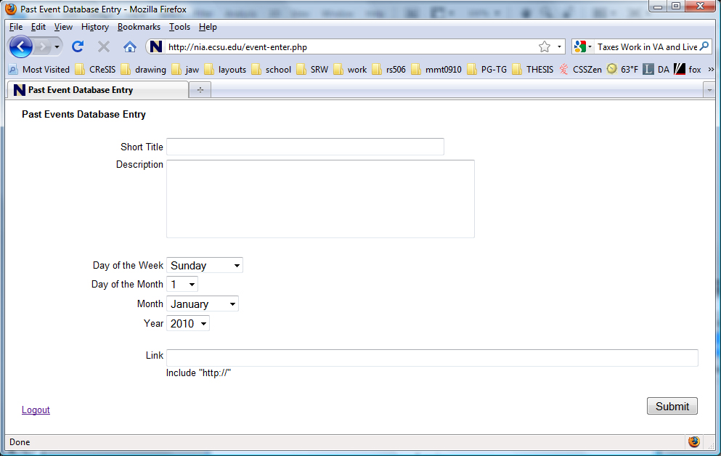
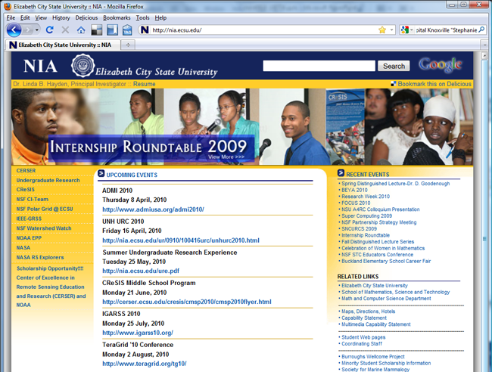
Prototype
Upcoming Events
Notes:
To test the procedure in the last section a database was established to hold the upcoming events in the CERSER program. These events had not been appearing in some browsers due to their incompatibility with the XML files in use.
An entry form, with a password script from a third-party, was developed so that the events could be updated with any accessible browser. A database display file was also created to view the entered item and other database records.
Though the database worked as intended and is in use by the NIA web site, there are several are several enhancements that are needed and will be discussed in future work.

Slide 26
Adobe LiveCycle Designer
Postscript Document Files (PDF)
Templates
Field Properties
Notes:
Adobe LiveCycle Designer is an application that creates documents and forms as a part of the Adobe Creative Suite.
LiveCycle Designer is a designing tool for the productions of XML forms, which are presented as a PDF or HTML files.
LiveCycle Designer uses templates to speed development.
Allows a developer to add or remove fields or whole sections of a form, show a help dialog box, add attachments, change a field's color, and create many more actions.

Slide 27
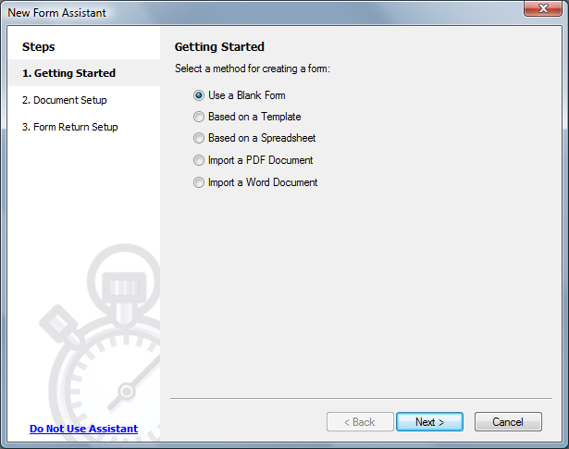
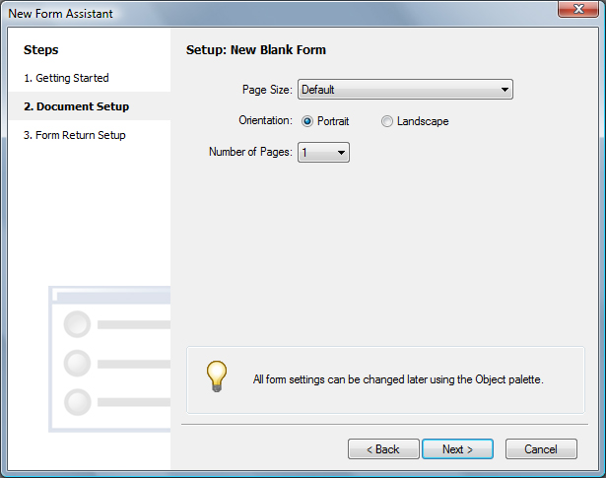
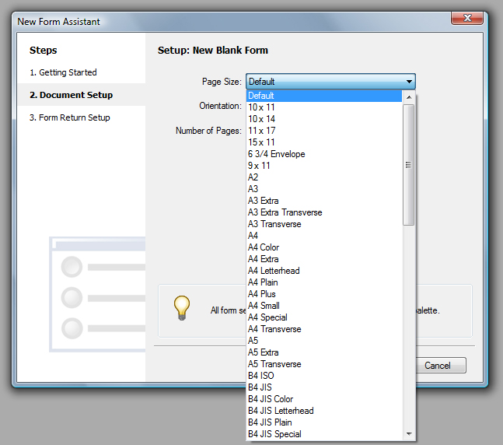
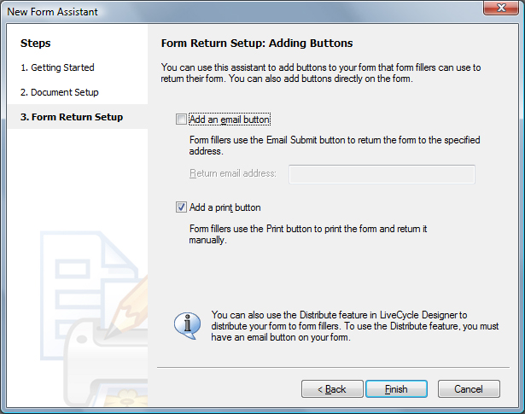
Creating a Form
New Form
Templates
Field Properties
Notes:
Open LiveCycle Designer
Select “New Form” from the opening window
The “New Form Assistant” is displayed to aid your first steps. Start by selecting “Blank Form” and press “Next”.
The second screen of the assistant gives the choice of paper size, orientation, and number of pages.
Other page size choices can be made by selecting the Page Size pull-down menu. Select “Default for now and then “Next”
The next screen displays the choices for how the data will be submitted. The “Email” selection allows the user to forward the data in an XML format. This form will be printed though only the print check box should be selected and then select “Finish”.

Slide 28
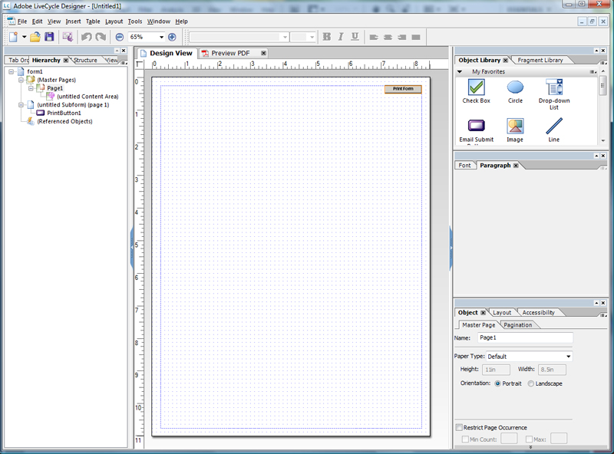
Palettes
Object Library
Formatting
Hierarchy
Notes:
You are now presented with a blank page. The hierarchal format of the document is presented on the left while object and formatting palettes are on the right.
The “Object Library” is located at the top right hand corner of the screen. It contains the common elements found on a form. These objects are added to the form by dragging them to the design view.
Underneath the Object Library are the formatting palettes. These palettes include the Font, Paragraph, Object, Layout, and Accessibility palettes.
Located at the top left hand corner is the “Hierarchy” palette. The Hierarchy palette is pictorial depiction of the objects in the Design View.

Slide 29
Form Title
Object Library
Notes:
To create a title, drag the Text Object from the Object Library to the Design View. Enter and format your title.
To create a text field, drag the Text Field Object from the Object Library to the Design View. Edit the field label and expand/contract the field to the desired size.

Slide 30
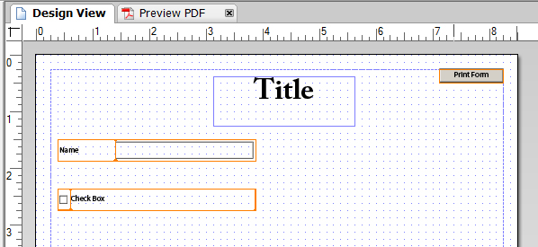
Check Box
Object Library
Notes:
The next item to add will be a checkbox. To insert a checkbox, drag the Checkbox Object from the Design Library to the Design View. Edit the field label.
Including another Checkbox Object directly underneath the first Checkbox Field will result in producing a Checkbox Group.
Continue inserting elements needed for your form.

Slide 31
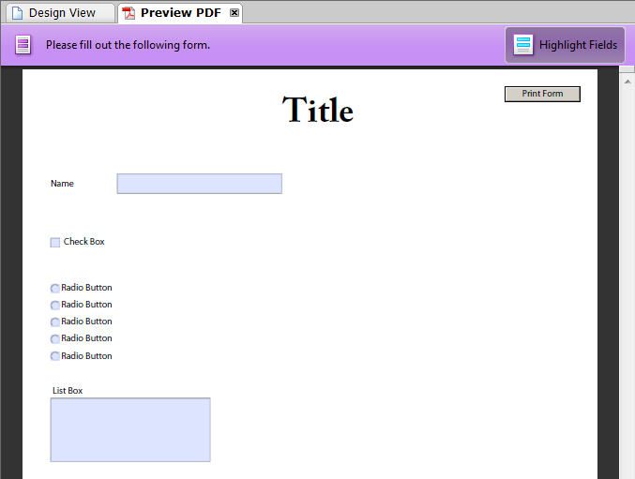
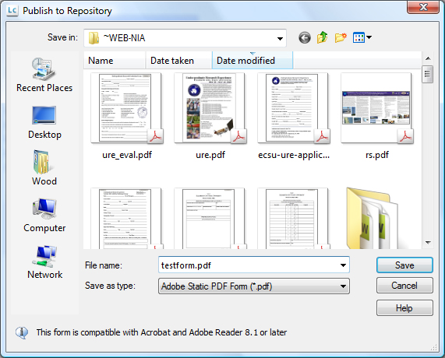
Preview and Publish
Preview
Publish
Notes:
Once the form is completed, the developer can select the Preview PDF tab above the design window.
If the form is correct, select File>Publish to Repository to save the file in PDF format in the desired directory.

Slide 32
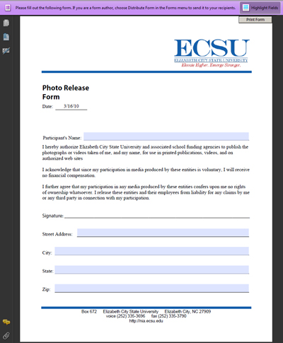
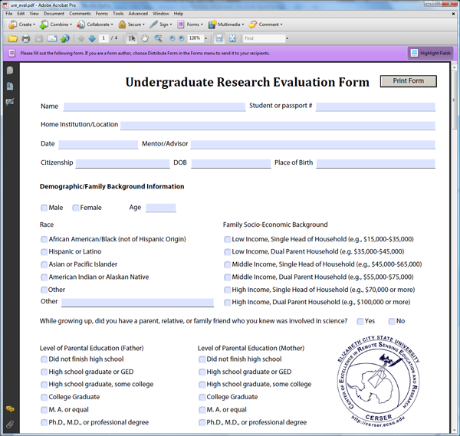
Prototypes
URE Evaluation Form
Photo Release Form
Notes:
Two forms were revised and created with Adobe LiveCycle Design. The first was the Undergraduate Research Experience Evaluation Form. This is a form currently under development for students completing the ECSU URE program. It was designed to be completed inside Adobe Acrobat Reader and printed. This form is located at http://nia.ecsu.edu/ure_eval.pdf for development purposes only.
The second form was a revision of the CERSER Photo Release form. This form is utilized to obtain permission to make use of photos of individuals taken during CERSER activities for promotional activities. This form had previously been developed in Microsoft Word to be printed and completed by hand. The revision allows for the form information to be keyed in and then printed or printed and filled out.

Slide 33
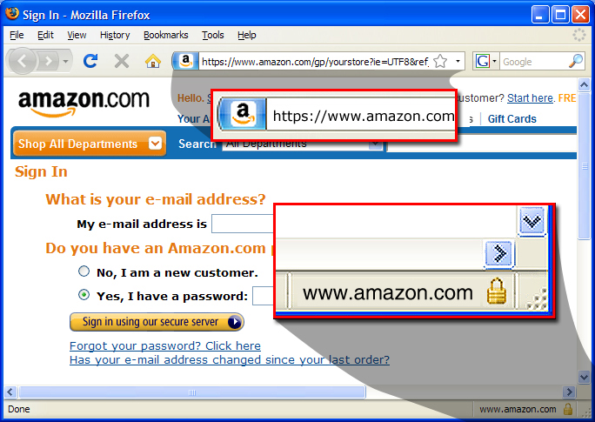
Hypertext Transfer Protocol Secure
Security
Eavesdropping and Man-in-the-Middle
Identifying
Notes:
Hypertext Transfer Protocol Secure (HTTPS) is a combination of the Hypertext Transfer Protocol with a secure protocol to provide encryption and secure identification of the server.
HTTPS is designed to encrypt data transferred via the internet, thereby preventing eavesdropping and man-in-the-middle attacks.
Most implementations of the HTTPS protocol involve online purchasing or the exchange of private information. Accessing a secure server often requires some sort of registration, login, or purchase. Web browsers such as Internet Explorer and Firefox display a padlock icon to indicate that the website is secure and the URL address will begin with “https://”.

Slide 34
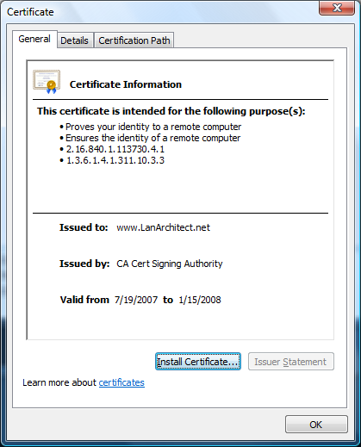
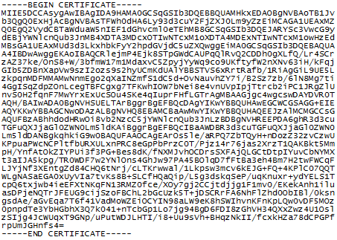
HTTPS Implementation
Security
Certificates
Identifying
Notes:
The effectiveness of HTTPS can be limited by poor implementation of browser or server software or a lack of support. HTTPS secures data as it travels between the server and the client, once the data is decrypted at its destination; it is only as secure as the host computer.
The administrator of a web server must first create a public key certificate, an electronic document using a digital signature which identifies an individual or an institution, for the HTTPS web server. When a user accesses the secure site the certificate is downloaded thereby ensuring any further transactions between the server and the client will be encrypted.
Certificates are obtained from a digital authority and range in cost from $10 to $1500 per year and must be renewed upon expiration.
Standard forms over a quick and easy method of collecting data, but the limited security of the transmission prohibits the collection of sensitive information such as Social Security Numbers, birth dates, and family information. Properly installed, HTTPS can secure this information.
While HTTPS was researched during this project, further research will be needed to fully implement a secure server.

Slide 35
Conclusion
LiveCycle
Google Docs
Dreamweaver, PHP, SQL
Notes:
Data submission capabilities were researched during this project for online and print formats.
The Adobe LiveCycle Design was found to be the most capable when developing printable forms. The learning curve is steep though to utilize the full capabilities of the software.
To gather a small amount of non-sensitive information quickly, the Google Docs form was the quickest to develop and deploy. Formatting of the form was limited and integration with program themes (CERSER, PolarGrid, Watershed Watch, etc…) would not be possible.
The development of forms utilizing the combination of Dreamweaver, PHP, and SQL is a versatile method, but requires a higher level of skill sets to complete. This type of form is versatile and can be coupled with a secure server to provide secure capabilities of data gathering. It can also be implemented within current framework styles of a site.

Slide 36
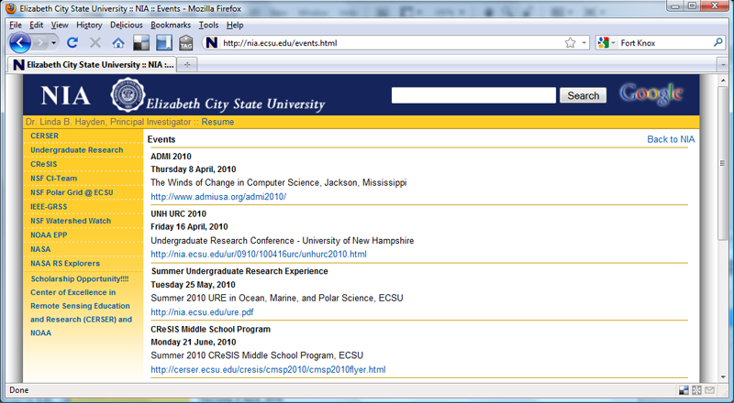
Future Work
Secure Server
Upcoming Events Database Modifications
File Submission
Notes:
Future Work
A. Secure Server
The next step in this development progression should be to build a secure server. This will allow currently used printable forms to collect sensitive data such as birth dates and Social Security numbers. Server platforms will need to be researched, server applications tested, and security certificates obtained to execute this step.
B. Database Modifications for Upcoming Events
The currently developed database for the CERSER upcoming events will need to be enhanced to allow for the deletion and modification of individual records. These modifications will need to be performed from within Dreamweaver and be secured to prevent intrusion.
C. File Submission
The submission of files is a significant part of data collecting. The uploading of files though PHP scripting should be researched along with safeguards to prevent incorrect file types from being uploaded.

