Slide 1
Creating a Program in Mat Lab to Classify CRISM Data
Members
Joyce Bevins, Justin Deloatch, and MyAsia Reid
Mentor
Dr Eric Akers

Slide 2
OVERVIEW
Abstract
Key Words
CRISM Background
Frequently asked Questions about Mars
Purpose of CRISM?
Goals of CRISM
“Follow the water”
Instrument Overview
Classifying data (observations)
Database
Process to Classify
Downloading and Saving
Kitoto
Future Research
References

Slide 3
ABSTRACT
For years many people have had questions concerning Mars atmosphere climate, and surface. If water had ever existed on Mars and if so where and when did the water occur? Is Mars suitable for life? Can there be human exploration and colonization on Mars? NASA uses it’s high tech seeking instrument known as CRISM (The Compact Reconnaissance Imaging Spectrometer for Mars) to trace the past and present water on Martian Mars to try and answer these questions that have yet to be fully answered. The CRISM instrument is sent to Mars to take images of Mars surface in search for minerals that may indicate that water is present.
The 2009-2010 undergrad Research team primary focus was to create a program using map lab that will classify CRISM data in a shorter time frame than what it will take to classify by hand. The CRISM research consisted of manually classifying images from Mars and placing them into excel’s data base, downloading images and storing them into Kitoto’s server so that the program can read and return results of the overall images and mineral images. These images can be classified as excellent, fair, poor, and absent. The classification of each image will show whether there is a lot, little, or no water in each kind of mineral. The five minerals are oxidized iron minerals, mafic mineralogy, hydroxylated silicates, bound water and CO2 water. The images that show the most signs of water in certain areas on Martian will be examined more closely. Currently, the CRISM team working is on creating this program in Mat Lab.

Slide 4
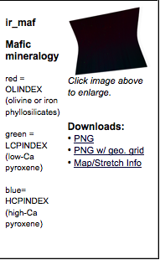
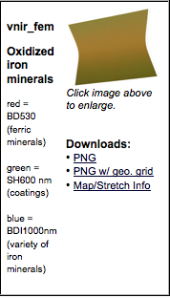
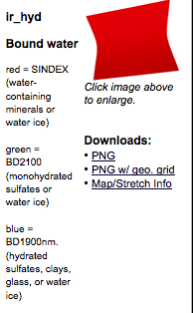
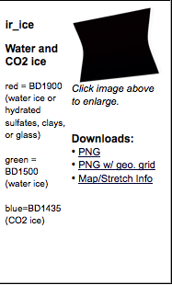
Key Words
Mineral
(Reflectance) spectroscopy
Oxidized iron minerals
Mafic mineralogy
Hydroxlated sillicates
Bound water
Kitoto

Slide 5
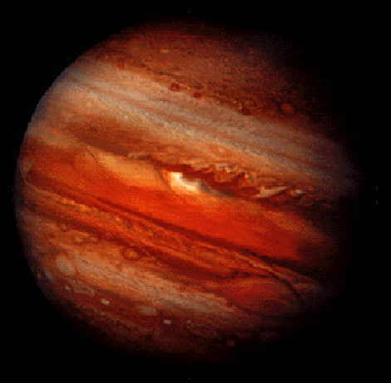
CRISM Background
Frequently asked questions about Mars
Is Mars environments suitable for life?
If water was once present on Mars did it leave any clues”?
If there was water on Mars, how did it affect Mars Surface?
Can there be human exploration and colonization on Mars?
How is Mars atmosphere different from Earths?
When and where did the water occur?

Slide 6
CRISM Background
Purpose
The Compact Reconnaissance Imaging Spectrometer
for Mars (CRISM) is one of NASA’s high-tech
Detectives seeking traces of past and present water on
Martian surface.” CRISM uses the saying “Follow the water” which is a method used for tracing and studying minerals that indicate liquid. By using this method of studying minerals in search for water, CRISM will be able to answer questions that many have been asking for years.
Note: Mars’ liquid water may evaporate but that does not mean that it disappears. CRISM is still able to trace minerals such as iron Oxides, carbonates,
Sulfates and other minerals on Mars.

Slide 7
CRISM Background
CRISM four goals:
Find the spectral finger prints of minerals that form in liquid water.
Measure the changing amounts of water and other volatiles in the atmosphere and as polar ices.
Map geology, composition and layering of the surface features.
Help locate Martian resources that could provide local support for eventual human exploration and colonization.

Slide 8
CRISM Background
Follow the Water

Slide 9
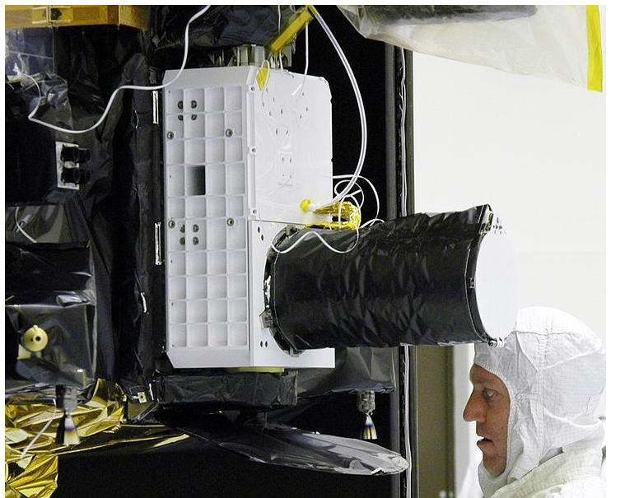
Instrument OVERVIEW
CRISM
Is a Visible-infrared imaging spectrometer with a scannable field of view.
Covers wave lengths from 0.362 to 3.92 microns at 6.55 nanometer/channel .
This allows CRISM team to identify a broad range of minerals on the Martian surface.

Slide 10
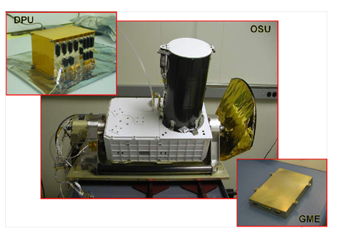
Instrument OVERVIEW
CRISM Consist of Three Boxes
Optical Sensor Unit (OSU)
The optics,
Gimbal,
Focal planes,
Cryocoolers,
Radiators,
Focal plane electronics.
Gimbal Motor Electronics (GME)
Commands and powers the gimbal
Analyzes data from angular position encoder in a feedback loop.
Data Processing Unit (DPU)
Accepts and processes commands from the spacecraft.
Accepts and processes data from the OSU and Communicates it to the spacecraft.

Slide 11
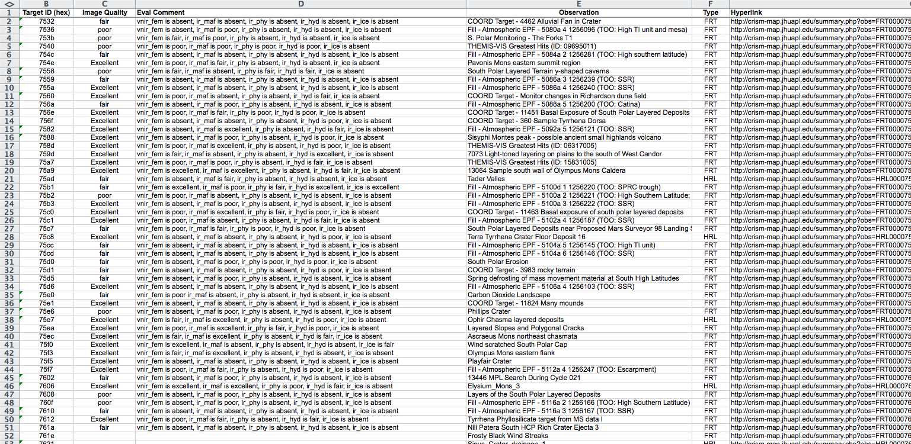
Data Base

Slide 12
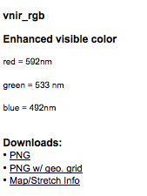
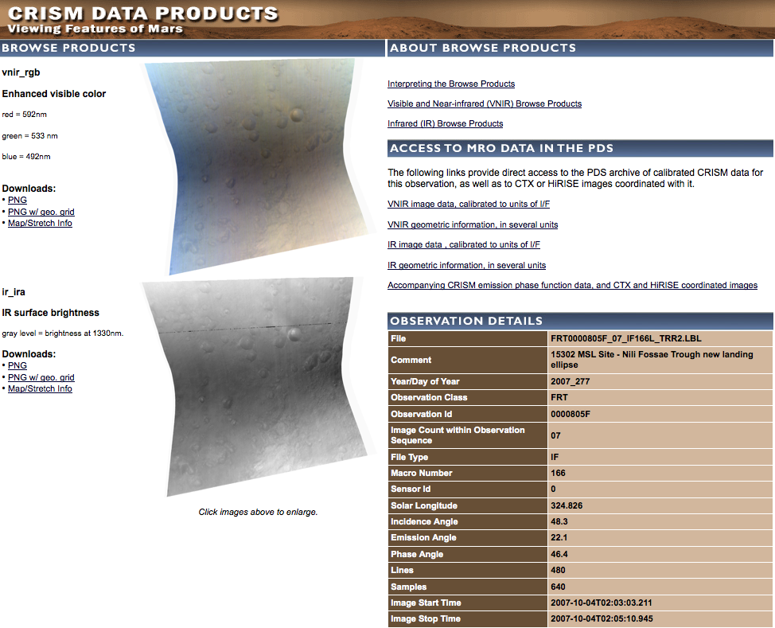
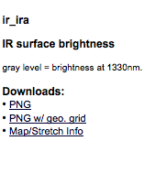
Classifying
Main Image
Top Image:
Bottom Image:

Slide 13
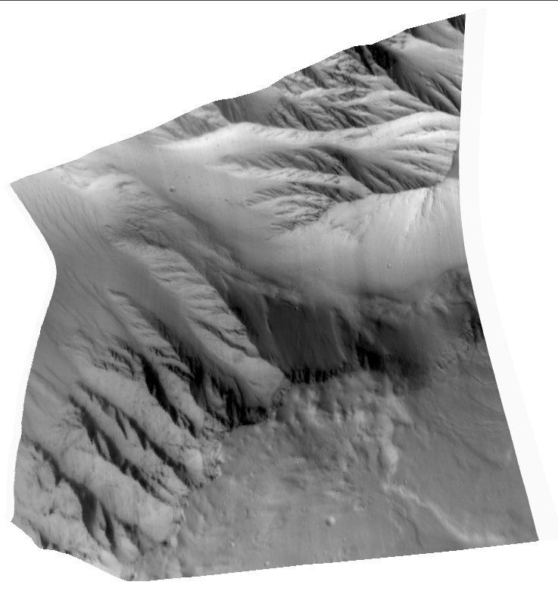
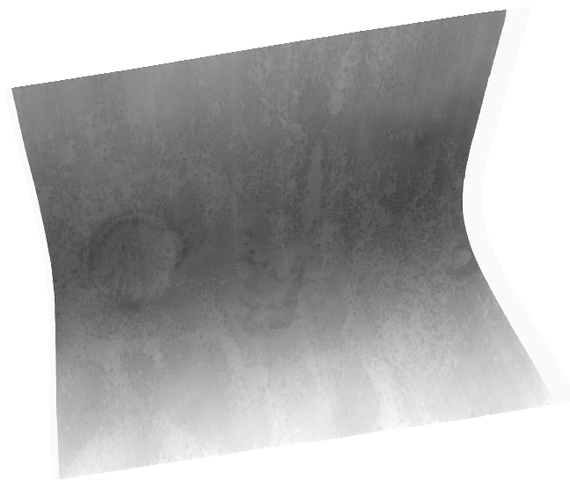
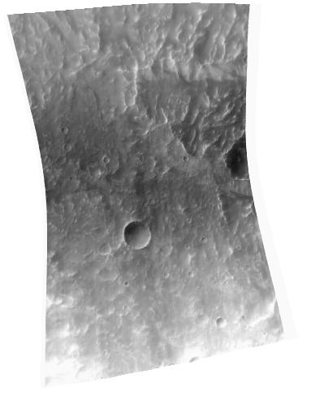
Classification
Excellent
Fair
Poor
Absent
Excellent
Fair
Poor
Absent
Excellent
Fair
Poor
Absent
Excellent
Fair
Poor
Absent

Slide 14
Classifying Images (Minerals )
Each Image has a IR Derived Product:
Vnir-fem Oxidized Iorn minerals
Ir_maf Mafic mineralogy
Ir_phy Hydroxylated Silicates
Ir_hyd Bound water
Ir_ice Water and CO2 Ice

Slide 15
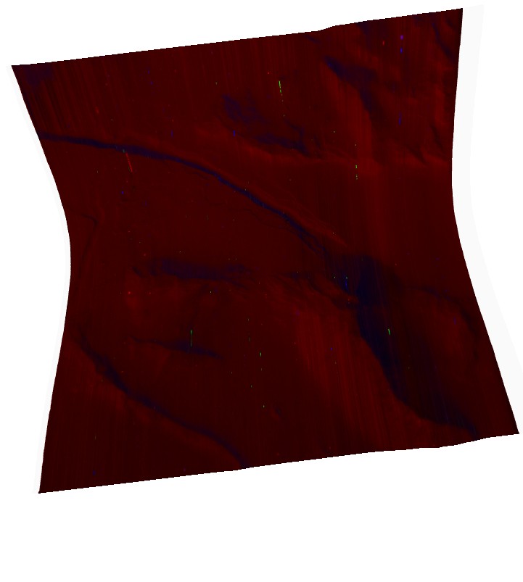
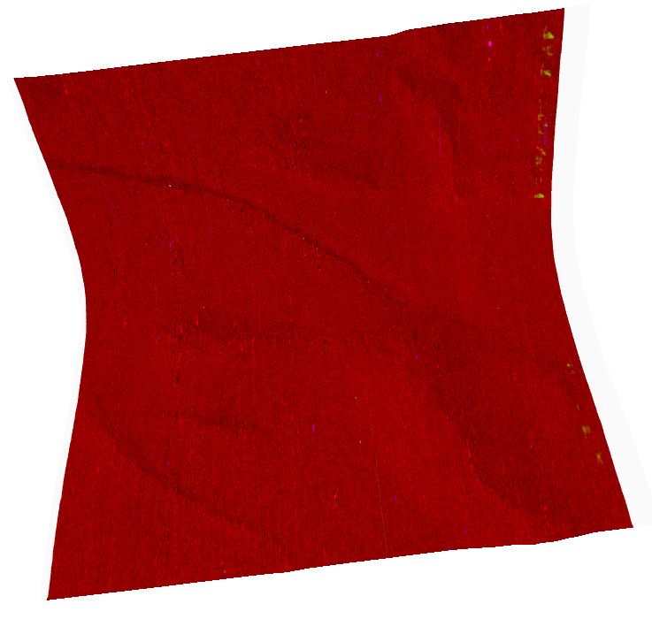
Classification
Vnir-fem
Oxidized
Iron minerals
Ir_phy
Hydroxylated
silicates
Ir_ice
Water and CO2 Ice
If all five minerals have something
present other than “Absent” then the
Closer scientist are to finding answers
regarding Mars.
Ir_maf
Mafic mineralogy
Ir_hyd
Bound water

Slide 16
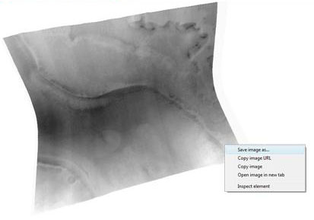
Downloading IMAGES
Click on a link
Guide you to the webpage
Enlarge the picture
Save it to a destination
Repeat steps

Slide 17
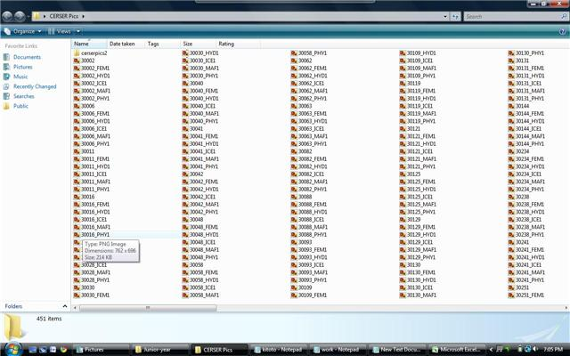
Moving Images into Kitoto
Directory of saved pictures

Slide 18
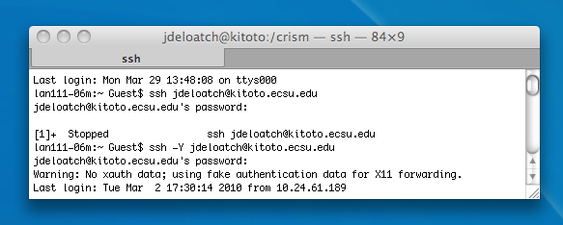
Moving Images into Kitoto
Logging into Kitoto

Slide 19
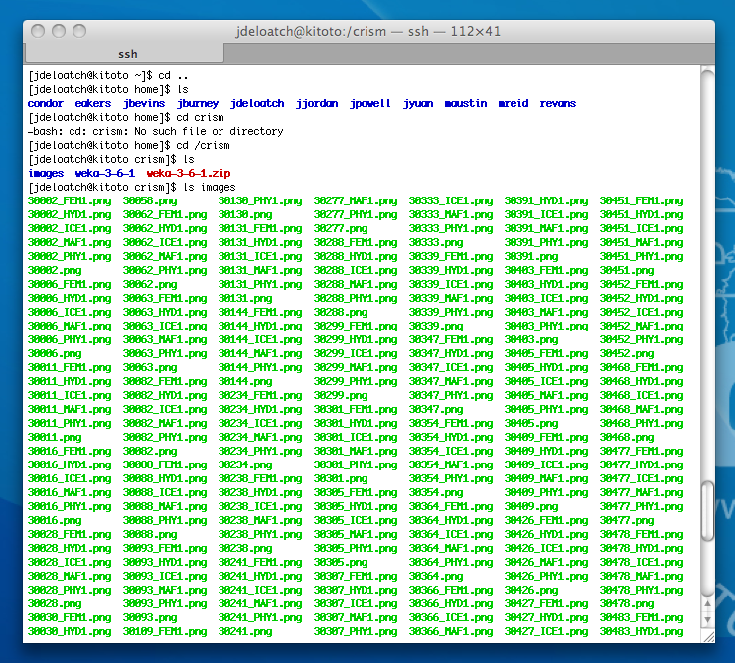
Moving Images into Kitoto
Change directory to home
List all files in that directory
Change directory to crism
List files in crism
List files in images

Slide 20
Future Research
Create a program that will read the files from kitoto and classify CRISM images
automatically instead of being done by hand.
The data that we have classified will be sent to CRISM Researchers and NASA to use in future research to understand Mars atmosphere, where and when did the water on Mars occur, if Mars is suitable for life and if there can be human exploration on Mars.

Slide 21
REFERENCES
JHU.APL Webmaster. CRISM Compact Reconnaissance Imaging Spectrometer for Mars. March 15 2010 from http://crism.jhuapl.edu/.
Jim Wilson. NASA http://www.nasa.gov

