Slide 1
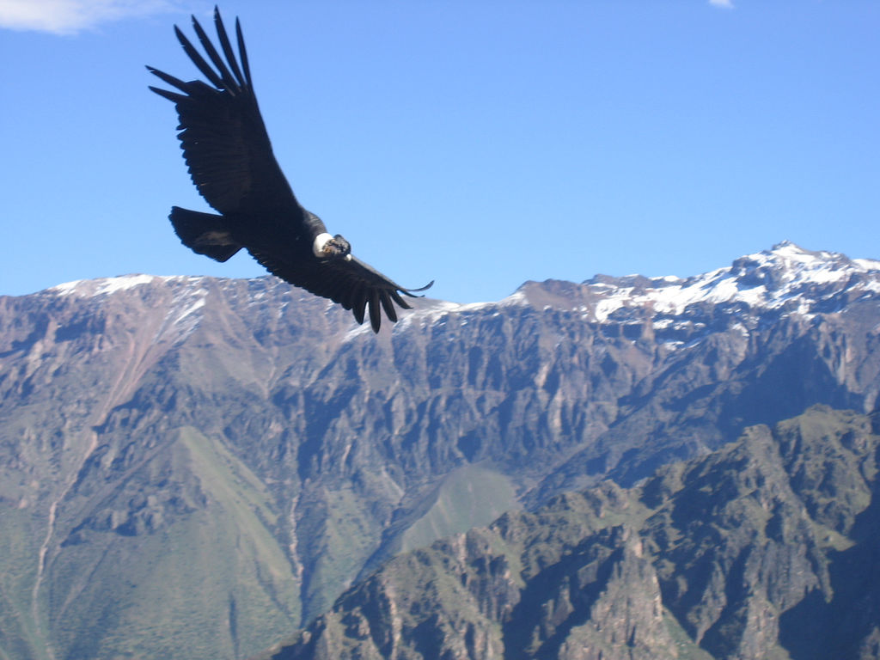


Implementation of a Static Condor Cluster
2008-2009 Polar Grid Team
Mentor: Je'aime Powell
Vernon T Brown Jr.
Michael Jefferson Jr.
Chelsea Vick

Slide 2
Overview
Abstract
What is a Cluster
Cluster Uses
Physical Implementation
Installation Process
Future Expansion
Questions

Slide 3
Abstract
The 2008 – 2009 Polar Grid team focused on the permanent installation of a Condor-based test cluster. Network topography, naming schemes, user management, and compatibility concerns were the primary foci of the implementation. The machines targeted were the SunFire V480 management server and several SunBlade 150 workstations as workers all running Solaris 10 as the primary operating system. The Condor High Throughput Computing software was utilized as a scheduler for jobs submitted to the server and then distributed to the workers.

Slide 4

What is a Cluster
Uses multiple computers to process data
  We use a distributive computing system.

Slide 5
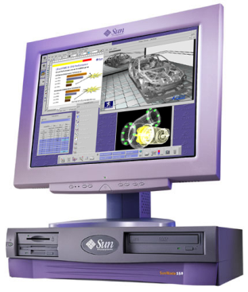
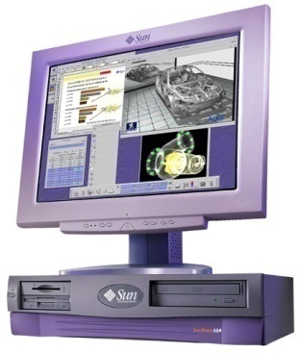
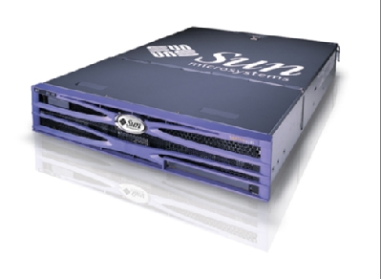



Distributive Computing Cluster

Slide 6

Cluster Uses
Process imagery
Distribute data-intensive jobs
Polar Grid Condor team GNUPlot
  Jobs will be submitted in java or C++
  To expedite plotting processing
In-house cluster training

Slide 7
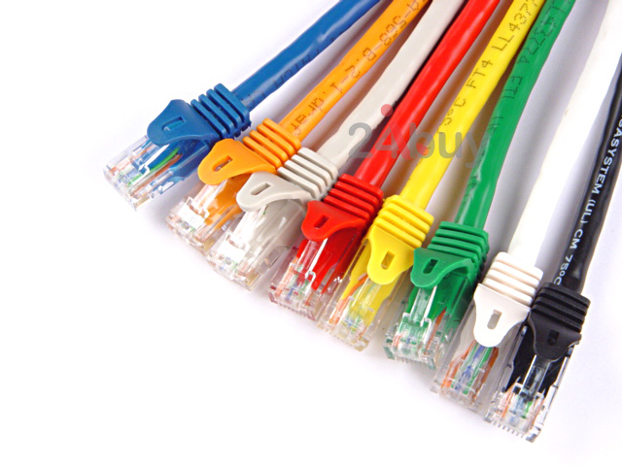
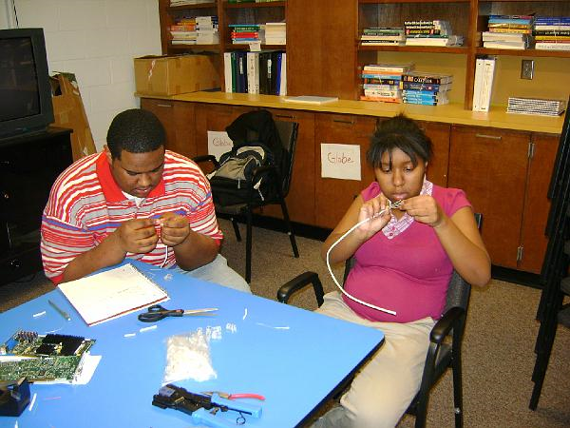
Physical Implementation
Created 16 networking Cat 6e cables
Color code
  white orange, orange, white green, blue, white blue, green, white brown, brown

Slide 8
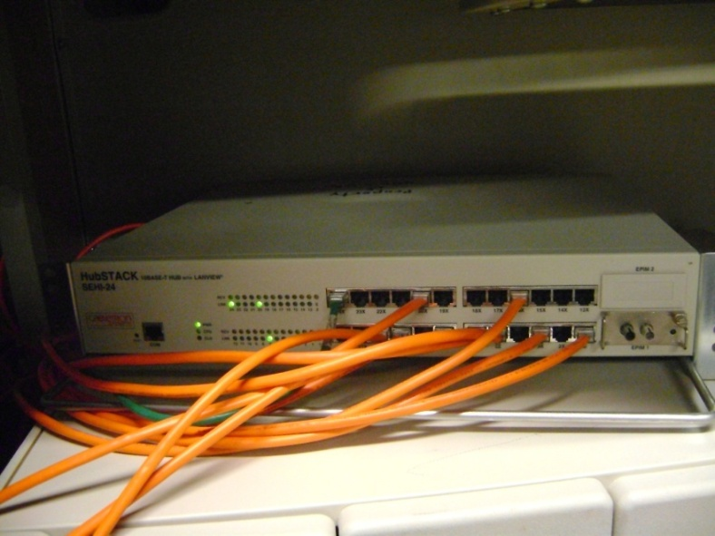
Hubstack 10 SEHI 24
Hub
  Provided by Elizabeth City State University Network Services
  Used to connect several computers
  Data is broadcasted to every computer connected to the hub, only the correct computer accesses information.

Slide 9
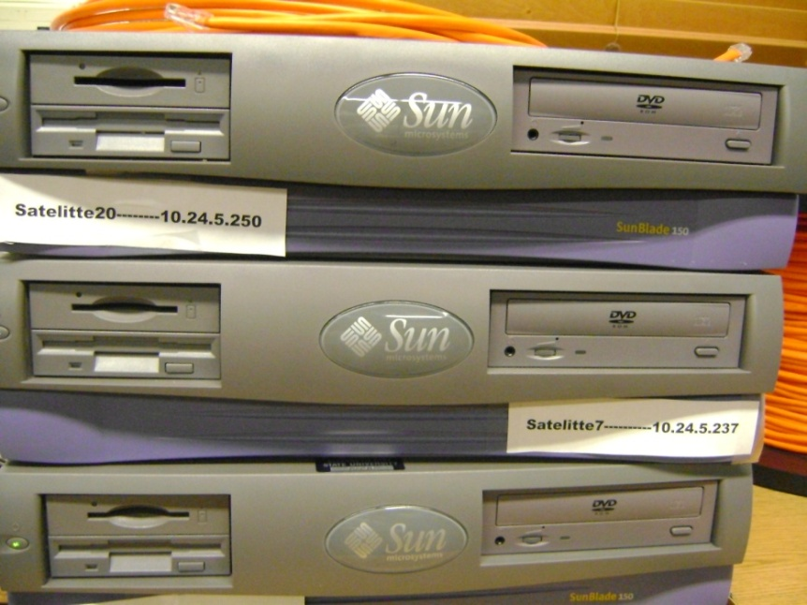
Sun Microsystem
Sunfire V480(Antarctica)
11 Sunblade 150 (satellites 1-20)
  64 bit workstation
  550 mhz processor UltraSparc IIi
  128 mb RAM
  20 Gigabyte HD

Slide 10

Installation Process
Ubuntu 7.10 Server (SPARC edition)
  Linux based
  Open source
Static IP addresses
  20 reserved IP addresses 10.24.5.231-250
Host name
  Satellite 1-20
  Antarctica

Slide 11
Commands Used
Setenv
  Used to alter the boot device
Sudo
  Assumes administrative privileges
Useradd
  Adds user
Passwd
  Creates a user password
Halt
  Halts all system processes

Slide 12
Commands Used (continued)
Apt-get
  Used to install packages and updates
Nano
  Text editor
Ssh
  Remotely access computers

Slide 13
Package Installation
Open SSH
  Secure shell
  telnet alternative
  Encrypted
G++
  C++ compiler
Javacc
  Allowed machines to compile Java languages

Slide 14
Ubuntu Condor Installation
  Condor installation unsuccessful
    Source code compiling produced the error “INCOMPATIBLE PLATFORM“
      Linux with a sparc processor is not supported by Condor
  Solution
    Solaris is supported in this implementation of Condor

Slide 15

Solaris 10
  Solaris 10
    Unix based Operating system
    Supported by Sun Microsystems
    Supports Sparc and X86/64 processors
    Condor compatible
    Java based Graphical User Interface

Slide 16
Solaris Condor Installation
  Downloaded application from internet
  Extracted it using the (tar -xvf condor-7.2.1-solaris29-Sparc-dynamic.tar.gz) command
  Started installation
  We altered condor_config file to make computers accessible to the server
  Condor_master started Condor process
  Condor_status checked the computers in the pool

Slide 17
Condor Pooling Error
  Check condor running processes
    ps -ef | egrep condor
      condor_master
      condor_schedd
      condor_startd
  Pooling error
    Computers were not adding themselves to the pool
  Solution
    Manually start the Condor_startd process

Slide 18
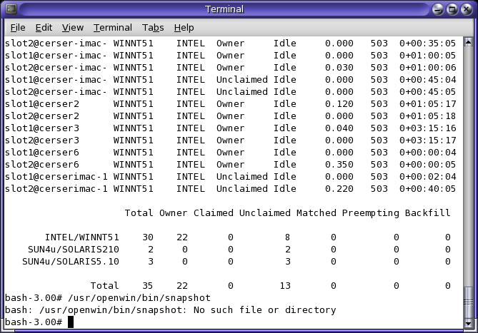
Operational Condor Cluster

Slide 19
Future Expansion
  Expand to 20 static computers
  Create cluster training guide
  Add cluster management applications
  Change Hub to a Switch
  Streamline processor intensive projects
  Enable Intranet web status

Slide 20

Questions?

