Slide 1
Oceanography Team 2008-2009
Variations of inherent optical properties of seawater on a transect from Elizabeth City to the Real Time Albemarle Sound Observing Station
Mentor: Dr. Yuan
Members: Monique Harris, Lee Smalls Jr., Justin Deloatch

Slide 2
Abstract
Variations of inherent optical properties of seawater on a transect from Elizabeth City to the Real Time Albemarle Sound Observing Station
The optical properties of seawater can be classified into two categories: apparent and inherent optical properties. While inherent optical properties (IOP) depend only on water, its dissolved and particulate components, apparent optical properties (AOP) depend on both IOP and environmental light field. Consequently, the determination of IOP of aquatic environment is essential for characterizing both seawater components and underwater light fields. Additionally, IOP of seawater determines remote sensing reflectance and it is an important factor for developing and calibration of remote sensing algorithms. Albemarle Sound is a coastal environment with a unique colored dissolved organic matter (CDOM) and particulates that are poorly documented. Specifically, the spatial variation of the concentrations of CDOM and particulates and their bio-optical properties are poorly known. We propose to conduct a field sampling and laboratory study of water samples of Albemarle Sound. Specifically, we have: (1). conduct vertical profiles of temperature, salinity and dissolved oxygen at selected stations along a transect from Elizabeth City to the Real-Time Albemarle Sound Observing Station; (2). collect surface water samples along the transect for studying the bio-optical properties; (3). determine the absorption spectrum of CDOM and particulate material; (4) compare the absorption spectrums of Albemarle Sound samples to that of from other regions.

Slide 3
Process
Collect water samples from Albemarle Sound
Measure the absorption spectrum of filtered and unfiltered water samples.
Import the data to a program that could understand that format
Manipulate the data so we could see the data
Notes:
This is an overview of what we did.

Slide 4
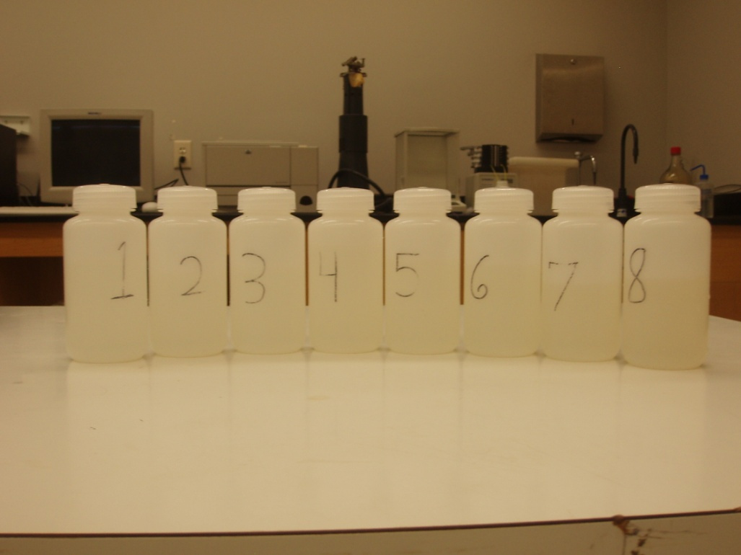
Samples
Samples from Albemarle Sound
Eight Samples from different latitude and longitude.
Notes:
We collected 8 samples form the albemarle sound and at each spot we gathered the longitude and latitude of each sample.

Slide 5
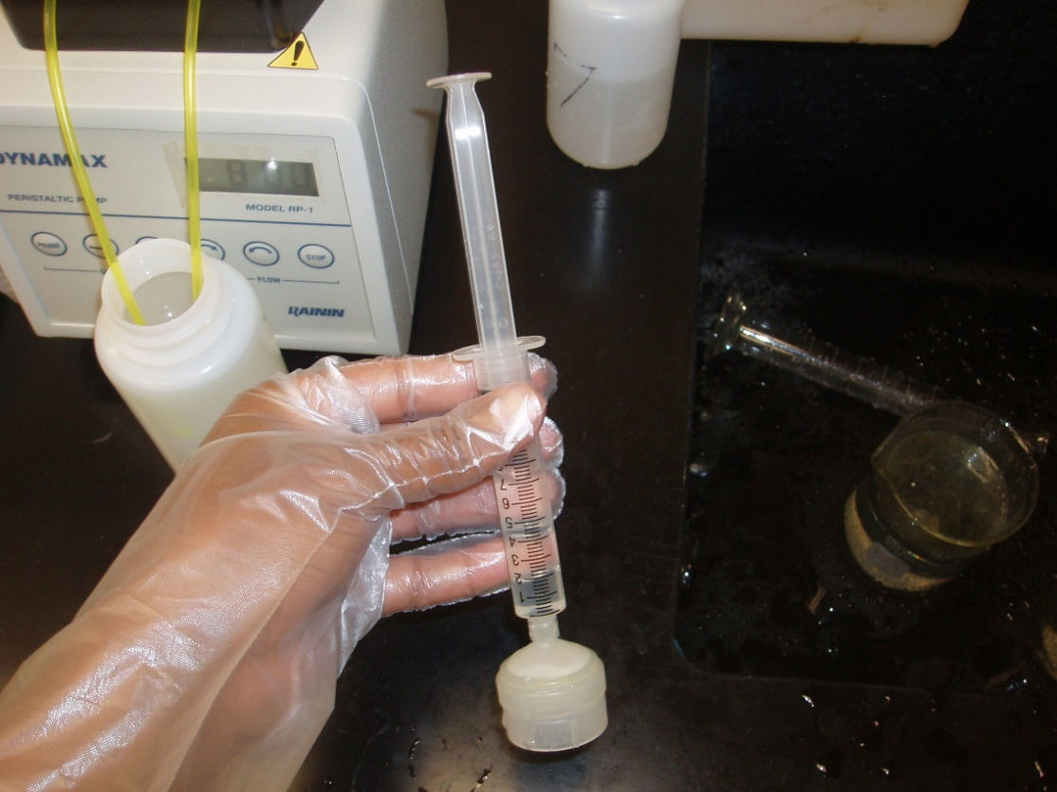
First Steps
Each sample was filtered using a syringe with a filter inserted

Slide 6
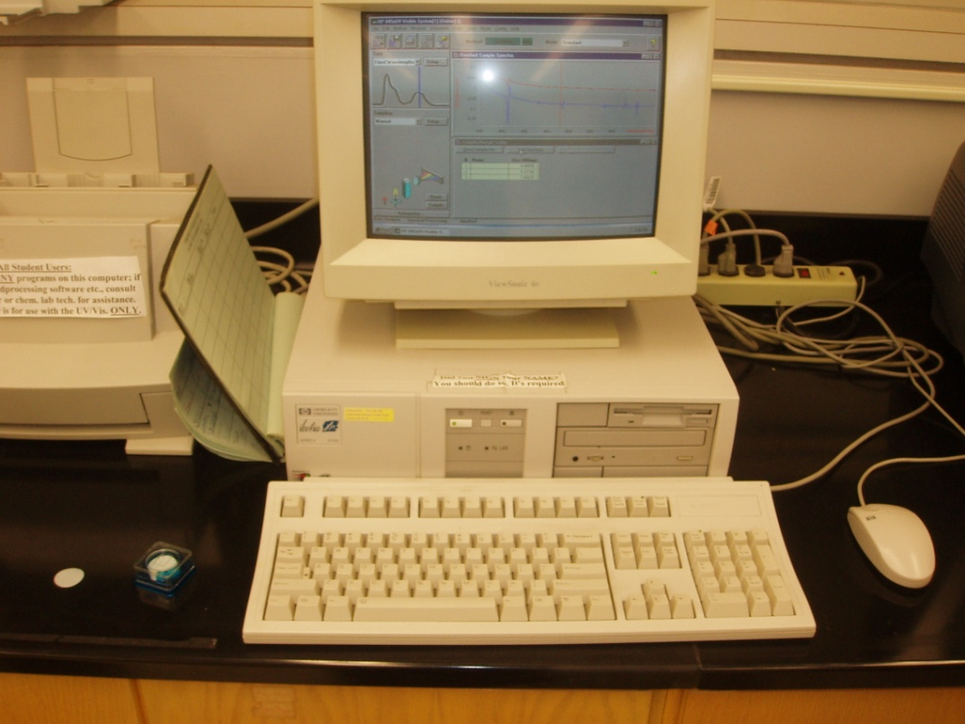
Instruments
Windows 95
Import the data
Export the data
Floppy disc (to transfer the Comma Separated Values(CSV) files)

Slide 7
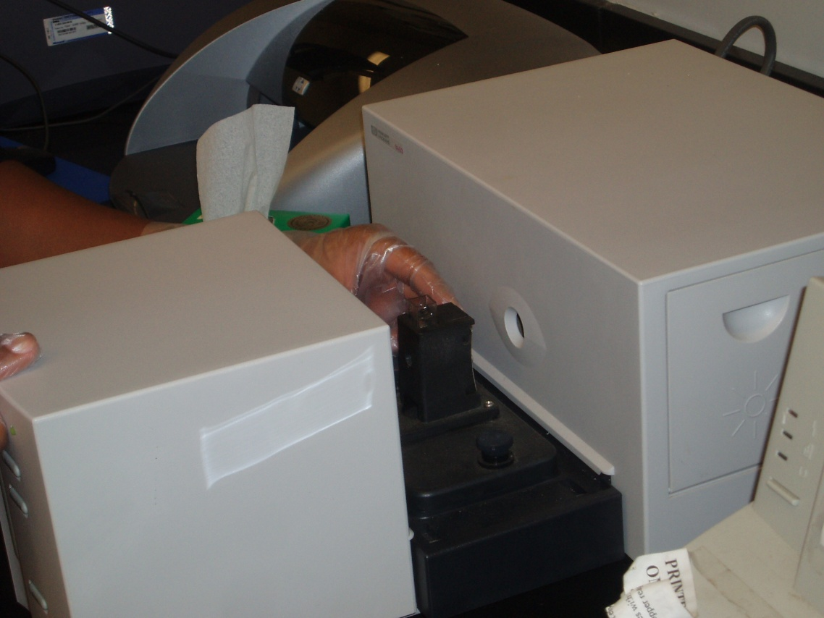
Instruments
Spectrophotometer
Analyzes the water sample

Slide 8
Method
There were 49 animals in all and 100 legs. How many were chickens and rabbits where their in all?
This results in a pair of linear equations
x+y=49
2x+4y=100

Slide 9
Microsoft Excel- Results
Sample 1

Slide 10
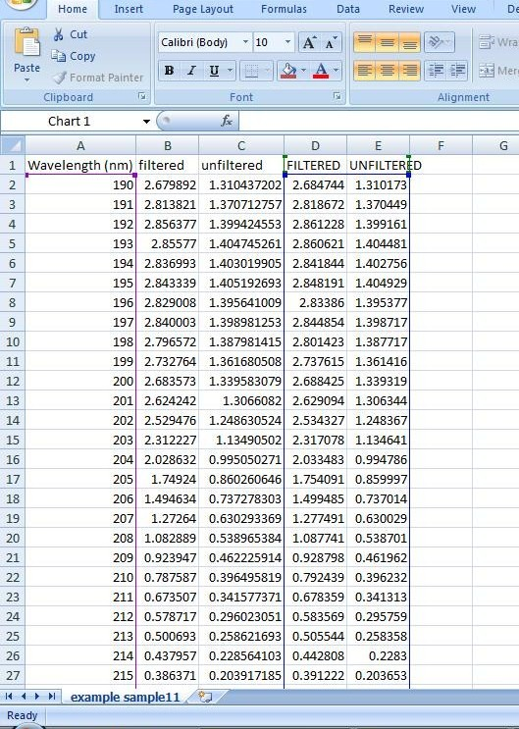
Microsoft Excel- Data
Table of data

Slide 11
Pure Water

Slide 12
Chlorophyll a

Slide 13
Amazon Dissolved Organic Carbon(DOC)

Slide 14
Graphs
How much Chl a, DOC, and POC?
This will result in a equation at each wavelength and a total of hundreds of equations.

Slide 15
Graphs
How much Chl a, DOC, and POC?
This will result in a equation at each wavelength and a total of hundreds of equations.

Slide 16
Graphs
How much Chl a, DOC, and POC?
This will result in a equation at each wavelength and a total of hundreds of equations.

Slide 17
Graphs
How much Chl a, DOC, and POC?
This will result in a equation at each wavelength and a total of hundreds of equations.

Slide 18
Results
Sample | chl a | POC (sample2) | DOC
1 | 4.0000E-04 | 2.4982E-01 | 3.1558E-03
2 | 8.0000E-04 | 7.3122E-01 | 6.9529E-03
3 | 3.7600E-04 | 2.7370E-03 | 9.7173E-01
4 | 6.0000E-04 | 6.6800E-01 | 1.1767E-02
5 | 4.0000E-05 | 9.9593E-01 | 0.0000E+00
6 | 2.8000E-03 | 0.0000E+00 | 1.6712E-03
7 | 0.0000E+00 | 4.5465E-01 | 1.7516E-02
8 | 3.9274E-03 | 2.0288E+00 | 6.2201E-03

Slide 19
Future Works
Interpolate all the data into same wavelengths interval.
Figure out how much Chlorophyll a, Pure Water, Dissolved Organic Carbon(DOC), Particulate Organic Carbon (POC), was in the samples from the spectrum from the absorbance of the water samples that we retrieved from the Albemarle Sound.

Slide 20
Questions?

