Slide 1
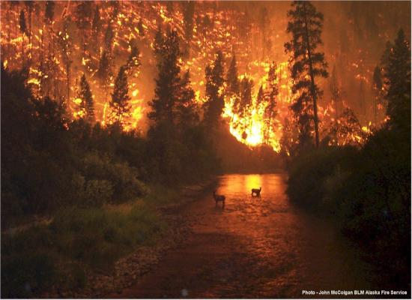
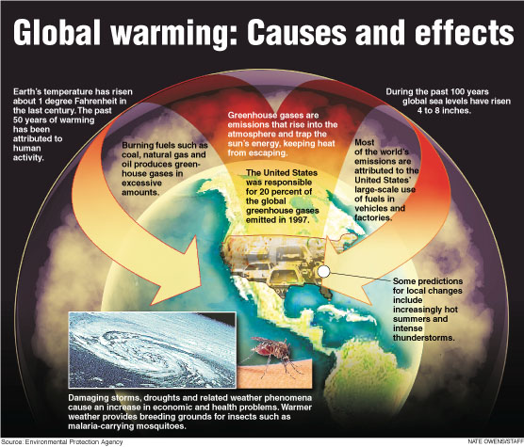
An Investigation of possible effects of global warming on forest fires in Kentucky from 1945 to 2004
?

Presented by:
Samuel J. Ivy Kevin Wingfield Ashley J. Sullivan Morehouse College Morehouse College Spelman College
Jamika Baltrop Amanda Eure
Elizabeth City-State University Winston-Salem State University

Slide 2
Abstract
This investigation seeks to find a relationship between the frequencies of forest fires with acreage burned effecting the state of Kentucky and the factors of global warming. Under global warming, we focus on the components climate change and precipitation rate in hopes of establishing this relationship. In delving deeper into the effects of forest fires, or wildfires, we explore a mathematical model offered as a solution to optimally contain these disasters while minimizing the costs of resources and eventually recovery.

Slide 3
Introduction
Each year millions of wild land globally are consumed by forest fire
Causes damages to harvesting and residential areas while conflicting high financial burdens to state and federal governments
According to Science, global warming is thought to be a catalyst for forest fires
There’s a concern to reduce the minimize forest fires.

Slide 4
Approach to Solving
Regression Analysis:
ANOVA
Differential Inclusions

Slide 5
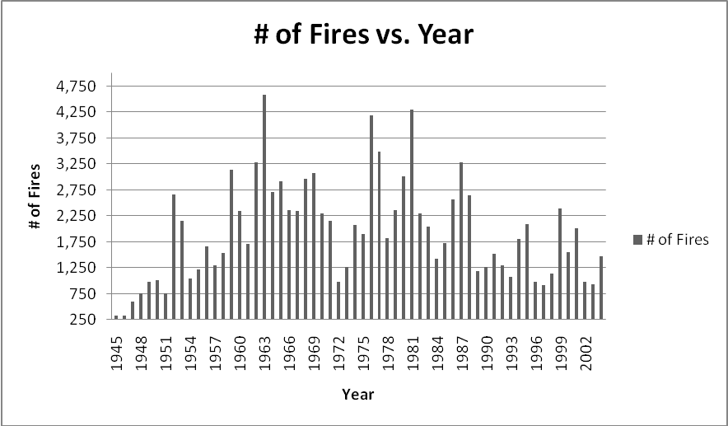
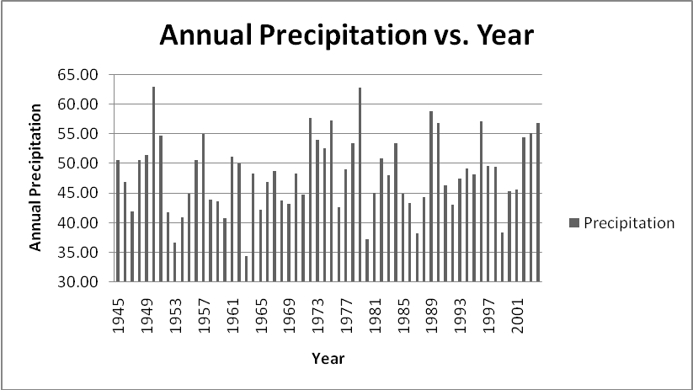
Graphical Representation
Figure 1: The visualization shows a change of the number of fires in Kentucky, ranging from 330 to 4,600 over the years of 1945 – 2004. The peak over this 60 year period was in 1963 with 4,579 fires. However, the smallest number of fires occurred in 1946 with 331 fires.
Figure 2: The visualization shows changes of annual precipitation in Kentucky, ranging from 34 to 63 inches over the years 1945 – 2004. The peak over this 60 year period was in 1950 with a precipitation of 62.93. However, the smallest amount of precipitation occurred in 1963 at 34.45.

Slide 6
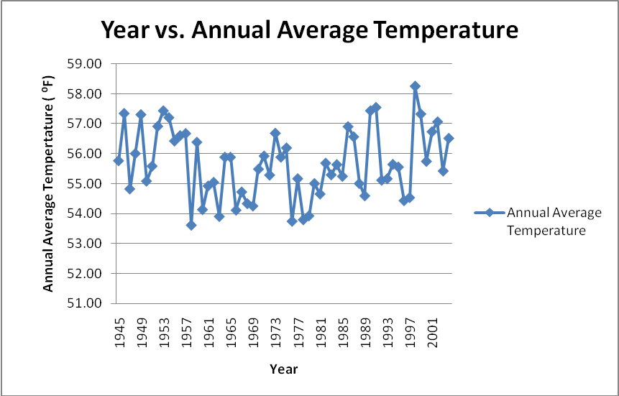
GR (continued)
Figure 3: The visualization shows change of the annual average temperature, ranging from approximately 54 ⁰F- 58 ⁰F over the years of 1945-2004. The peak over this 60 year period was in 1998 where the annual average temperature was 58.25 ⁰F and the lowest is 53.61 ⁰F in 1958.

Slide 7
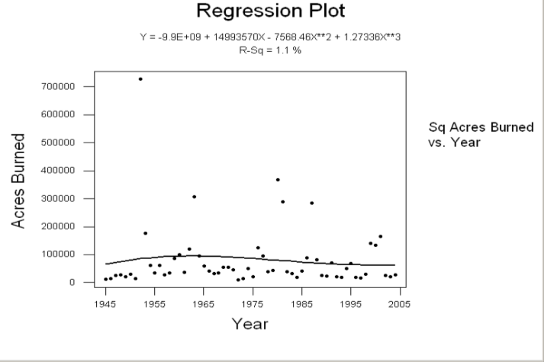
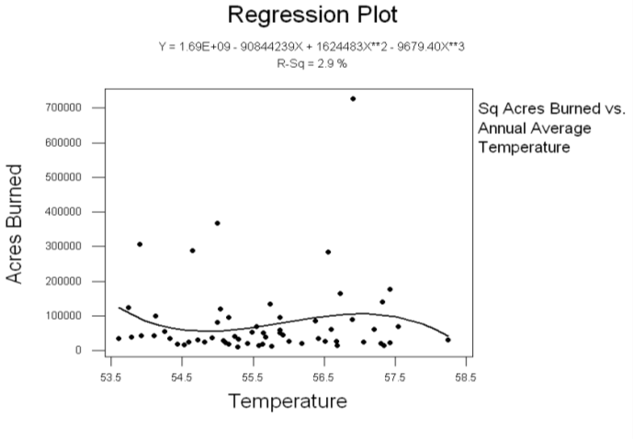
Regression Analysis
Figure 4: A cubic function of sq. acres burned over the years 1945-2005.
Figure 5: A cubic function of sq. acres burned as a function of temperature.
Results: Fig. 5 & Fig. 6 shows no correlation with the number of sq. acres burned

Slide 8
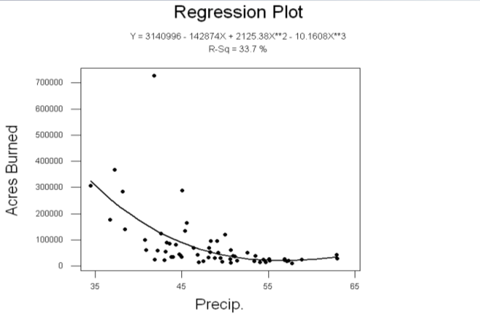
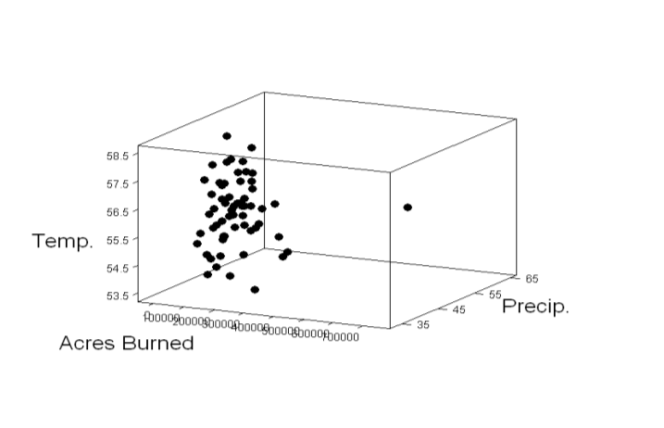
RA (continued)
Figure 6: A cubic function of the number of sq. acres burned as a function of the annual precipitation.
Figure 7: A 3-D scatter plot with the number of sq. acres burned along the y-axis, annual precipitation on x-axis and annual average temperature on the z-axis.
Results: Negative correlation between the number of sq. acres burned and annual precipitation. showed that a correlation exists but temperature does not play a role in the number of sq. acres

Slide 9
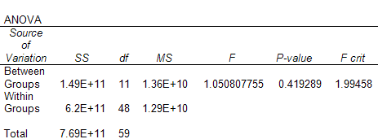
ANOVA
Table 1: The output from the Data Analysis tool in Excel with five year period as a factor.
Table 2: The output from the Data Analysis tool in Excel with the precipitation levels.
Results: no significant difference between average acreage burned across 12 5-yr periods

Slide 10
T-test
t-Test: Two-Sample Assuming Unequal Variances
 | Low Precipitation | Medium Precipitation
Mean | 157732.4706 | 59550.62
Variance | 32538046481 | 3.32E+09
Observations | 17 | 29
Hypothesized Mean Difference | 0
df | 18
t Stat | 2.179936306
P(T<=t) one-tail | 0.021391344
t Critical one-tail | 1.734063592
t-Test: Two-Sample Assuming Unequal Variances
 | Medium Precipitation | High Precipitation
Mean | 60247.33 | 21884.54
Variance | 3.22E+09 | 65812096
Observations | 30 | 13
Hypothesized Mean Difference | 0
df | 32
t Stat | 3.618309
P(T<=t) one-tail | 0.000505
t Critical one-tail | 1.693889
Table 3: The output from the Data Analysis tool in Excel.
Table 4: The output from the Data Analysis tool in Excel.
Results: There exists a significant difference between the average acreage burned across the 3 precipitation levels

Slide 11
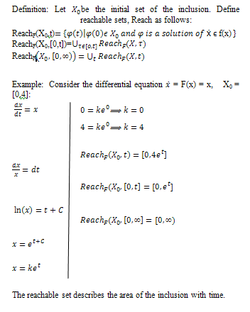
Differential Inclusions
A differential inclusion takes on the form
where F: ² ² is a set valued function
Moreover,
where F is Lipschitz with Lipschitz constant k: That is

Slide 12
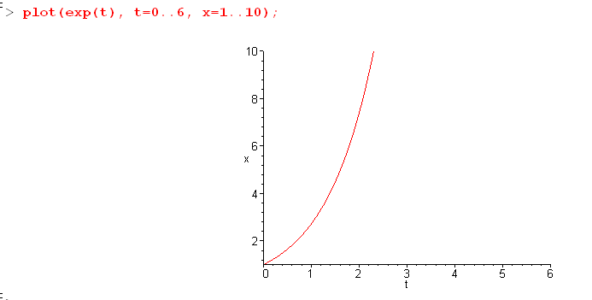
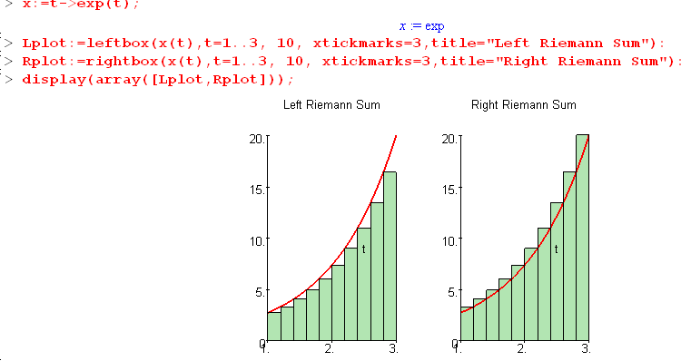
DI (continued)
Figure 8: The solution to the example.
Figure 9: The graph of the reachable set using Riemann Sum.

Slide 13
DI (Fire Containment)
Assume fire can be contained.
Then a controller can construct a “wall” or one dimensional rectifiable curve that can reduce the size of affected area.
Let block strategy  be defined as where R(t) is the set reached by trajectories of differential inclusion at any given time 

Slide 14
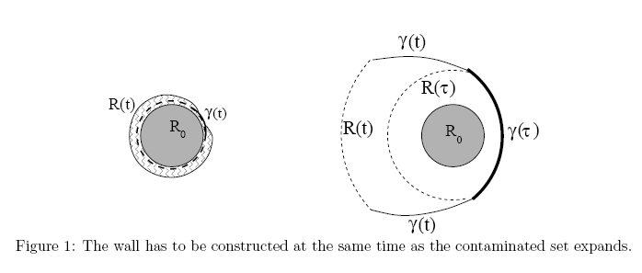
DI (Fire Containment)
Figure 10: The left diagram shows the construction of the wall at the same time the contaminated set R₀ expands. The right diagram takes into account additional area in time τ > 0 for wall construction.

Slide 15
DI (Fire Containment)
Observations:
Theorem 1. For the system described above, assume
for some ’>2 and every ². Then, for every bounded initial set R₀, there exists r > 0 and an admissible strategy  such that , for all t 0.
If there exists an optimal strategy , then at every point of a free arc there exists a corresponding vector oriented in the direction of outer normal to the minimal time function, and the vector’s curvature is proportional to cost.
Let there be an optimal strategy . By constructing two boundary arcs originating from the same point P in opposition directions with respect to the front of the fire and assuming that the contaminated region is encircled by walls, than this strategy is not optimal.

Slide 16
Conclusion
High temp has relationship with frequency of forest fires & the amount of acres burned
There’s a relationship between precipitation & the number sq. acreage burned
There’s a significant difference between the average acreage burned across 3 precipitation levels.
There exists a relationship between global warming and forest fires.

Slide 17
Acknowledgments
Dr. Luttamaguzi, our faculty mentor
Dr. Johnny Houston, Institute Director
Dr. Farrah Chandler, Associate Director
Other faculty and peers

