Slide 1
Numpy
Charlie Dey Director, Training and Professional Development
charlie@tacc.utexas.edu

Slide 2
Monte Carlo
Pi

Slide 3
Sequential Algorithm
A Monte Carlo algorithm for approximating π uniformly generates the points in the square [-1, 1] x [-1, 1]. Then it counts the points which lie in the inside of the unit circle.

Slide 4
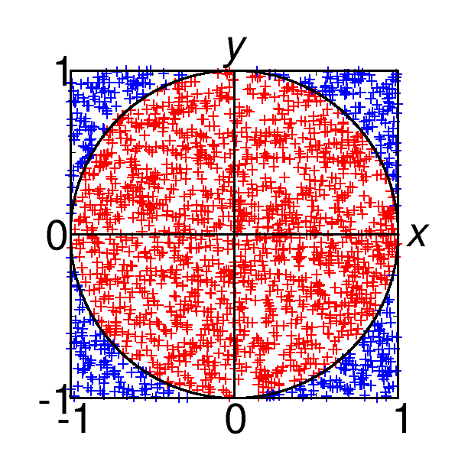
Sequential Algorithm
A Monte Carlo algorithm for approximating π uniformly generates the points in the square [-1, 1] x [-1, 1]. Then it counts the points which lie in the inside of the unit circle.

Slide 5
Sequential Algorithm
An approximation of π is then computed by the following formula:

Slide 6
Algorithm
double approximatePi(int numSamples) { float x, y; int counter = 0; for (int s = 0; s != numSamples; s++) { x = random number between -1, 1; y = random number between -1, 1;
if (x * x + y * y < 1) { counter++; } } return 4.0 * counter / numSamples; }
Let's code this in Python, Google to see what command in Python produces a random number

Slide 7
Linear Algebra
Applications
Matrices in Engineering, such as a line of springs.
Graphs and Networks, such as analyzing networks.
Markov Matrices, Population, and Economics, such as population growth.
Linear Programming, the simplex optimization method.
Fourier Series: Linear Algebra for functions, used widely in signal processing.
Linear Algebra for statistics and probability, such as least squares for regression.
Computer Graphics, such as the various translation, rescaling and rotation of images.

Slide 8
Linear Algebra
Linear algebra is about linear combinations.
Using math on columns of numbers called vectors and arrays of numbers called matrices to create new columns and arrays of numbers.
Linear algebra is the study of lines and planes, vector spaces and mappings that are required for linear transforms.

Slide 9
Linear Algebra
Linear algebra is the mathematics of data.
Matrices and vectors are the language of data.
Let's look at the following:
y = 4 * x + 1
describes a line on a two-dimensional graph

Slide 10
Linear Algebra
Linear algebra is the mathematics of data.
Matrices and vectors are the language of data.
Let's look at the following:
y = 0.1 * x1 + 0.4 * x2 y = 0.3 * x1 + 0.9 * x2
line up a system of equations with the same form with two or more unknowns

Slide 11
Linear Algebra
Linear algebra is the mathematics of data.
Matrices and vectors are the language of data.
Let's look at the following:
1 = 0.1 * x1 + 0.4 * x2 3 = 0.3 * x1 + 0.9 * x2
line up a system of equations with the same form with two or more unknowns

Slide 12
Linear Algebra
Linear algebra is the mathematics of data.
Matrices and vectors are the language of data.
Let's look at the following, Ax = b :
5 = 0.1 * x1 + 0.4 * x2 + x3 10 = 0.3 * x1 + 0.9 * x2 + 2.0 * x3 3 = 0.2 * x1 + 0.3 * x2 - .5 * x3
ls there a x1, x2, x3 that solves this system?

Slide 13
Linear Algebra
Gaussian Elimination
The goals of Gaussian elimination are to make the upper-left corner element a 1
use elementary row operations to get 0s in all positions underneath that first 1
get 1s for leading coefficients in every row diagonally from the upper-left to lower-right corner, and get 0s beneath all leading coefficients.
you eliminate all variables in the last row except for one, all variables except for two in the equation above that one, and so on and so forth to the top equation, which has all the variables. Then use back substitution to solve for one variable at a time by plugging the values you know into the equations from the bottom up..

Slide 14
Linear Algebra
Gaussian Elimination, Rules
You can multiply any row by a constant (other than zero).
You can switch any two rows.
You can add two rows together.

Slide 15
Linear Algebra
Transpose
A defined matrix can be transposed, which creates a new matrix with the number of columns and rows flipped.
This is denoted by the superscript “T” next to the matrix.
An invisible diagonal line can be drawn through the matrix from top left to bottom right on which the matrix can be flipped to give the transpose.

Slide 16
Linear Algebra
Inversion
Matrix inversion is a process that finds another matrix that when multiplied with the matrix, results in an identity matrix.
Given a matrix A, find matrix B, such that AB or BA = In.
The operation of inverting a matrix is indicated by a -1 superscript next to the matrix; for example, A^-1. The result of the operation is referred to as the inverse of the original matrix; for example, B is the inverse of A.

Slide 17
Linear Algebra
Trace
A trace of a square matrix is the sum of the values on the main diagonal of the matrix (top-left to bottom-right).

Slide 18
Linear Algebra
Determinant
The determinant of a square matrix is a scalar representation of the volume of the matrix.
The determinant describes the relative geometry of the vectors that make up the rows of the matrix. More specifically, the determinant of a matrix A tells you the volume of a box with sides given by rows of A.
— Page 119, No Bullshit Guide To Linear Algebra, 2017

Slide 19
Linear Algebra
Matrix Rank
The rank of a matrix is the estimate of the number of linearly independent rows or columns in a matrix.

Slide 20
Linear Algebra - Matrix Arithmetic
Matrix Addition
Two matrices with the same dimensions can be added together to create a new third matrix.
C = A + BC[0,0] = A[0,0] + B[0,0]
C[1,0] = A[1,0] + B[1,0]
C[2,0] = A[2,0] + B[2,0]
C[0,1] = A[0,1] + B[0,1]
C[1,1] = A[1,1] + B[1,1]
C[2,1] = A[2,1] + B[2,1]

Slide 21
Linear Algebra - Matrix Arithmetic
Matrix Subtraction
Similarly, one matrix can be subtracted from another matrix with the same dimensions.
C = A - B
C[0,0] = A[0,0] - B[0,0]
C[1,0] = A[1,0] - B[1,0]
C[2,0] = A[2,0] - B[2,0]
C[0,1] = A[0,1] - B[0,1]
C[1,1] = A[1,1] - B[1,1]
C[2,1] = A[2,1] - B[2,1]

Slide 22
Linear Algebra - Matrix Arithmetic
Matrix Multiplication (Hadamard Product)
Two matrices with the same size can be multiplied together, and this is often called element-wise matrix multiplication or the Hadamard product.
It is not the typical operation meant when referring to matrix multiplication, therefore a different operator is often used, such as a circle “o”.
C = A o B C[0,0] = A[0,0] * B[0,0] C[1,0] = A[1,0] * B[1,0] C[2,0] = A[2,0] * B[2,0] C[0,1] = A[0,1] * B[0,1] C[1,1] = A[1,1] * B[1,1] C[2,1] = A[2,1] * B[2,1]

Slide 23
Linear Algebra - Matrix Arithmetic
Matrix Division
One matrix can be divided by another matrix with the same dimensions.
C = A / B C[0,0] = A[0,0] / B[0,0] C[1,0] = A[1,0] / B[1,0] C[2,0] = A[2,0] / B[2,0] C[0,1] = A[0,1] / B[0,1] C[1,1] = A[1,1] / B[1,1] C[2,1] = A[2,1] / B[2,1]

Slide 24
Linear Algebra - Matrix Arithmetic
Matrix-Matrix Multiplication (Dot Product)
Matrix multiplication, also called the matrix dot product is more complicated than the previous operations and involves a rule as not all matrices can be multiplied together.
One of the most important operations involving matrices is multiplication of two matrices. The matrix product of matrices A and B is a third matrix C. In order for this product to be defined, A must have the same number of columns as B has rows. If A is of shape m × n and B is of shape n × p, then C is of shape m × p.
— Page 34, Deep Learning, 2016.

Slide 25
Linear Algebra - Matrix Arithmetic
Matrix-Matrix Multiplication (Dot Product)
a11, a12
A = a21, a22
a31, a32
b11, b12
B = b21, b22
a11 * b11 + a12 * b21, a11 * b12 + a12 * b22
C = a21 * b11 + a22 * b21, a21 * b12 + a22 * b22
a31 * b11 + a32 * b21, a31 * b12 + a32 * b22

Slide 26
Numerical Linear Algebra, Two Different Approaches
Solve Ax = b
Direct methods:
Deterministic
Exact up to machine precision
Expensive (in time and space)
Iterative methods:
Only approximate
Cheaper in space and (possibly) time
Convergence not guaranteed

Slide 27
Iterative Methods
Choose any x₀ and repeat
until
or until
Notes:
Vector norm.

Slide 28
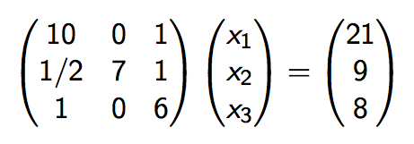
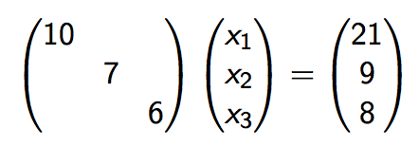
Example of Iterative Solution
Example system
with solution (2,1,1)
Suppose you know (physics) that solution components are roughly the same size, and observe the dominant size of the diagonal, then
might be a good approximation: solution (2.1, 9/7, 8/6)

Slide 29
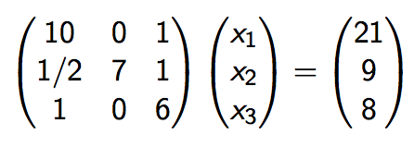
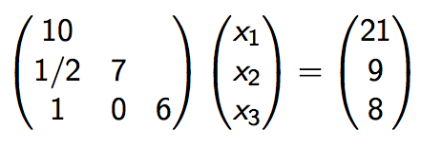
Iterative Example
Example system
with solution (2,1,1)
Also easy to solve:
with solution (2.1, 7.95/7, 5.9/6)

Slide 30
Iterative Example
Instead of solving we solved
Look for the missing part: , then
Solve again and update .
Two decimals per iteration. This is not typical
Exact system solving: O(n³) cost; iteration: O(n²) per iteration. Potentially cheaper if the number of iterations is low.

Slide 31
Abstract Presentation
To solve Ax = b; too expensive; suppose K ≈ A and solving Kx = b is possible
Define Kx₀ = b, then error correction x₀ = x + e₀, and A(x₀ - e₀) = b
so Ae₀ = Ax₀ - b = r₀; this is again unsolvable, so
Kẽ₀ and x₁ = x₀ - ẽ₀
Now iterate: e₁ = x₁ - x, Ae₁ = Ax₁ - b = r₁ et cetera

Slide 32
Error Analysis
One step
Inductively:
Geometric reduction (or amplification!)
This is 'stationary iteration': every iteration step the same. Simple analysis, limited applicability

Slide 33
Computationally
If A = K -N
then Ax = b ⟹ Kx = Nx + b ⟹ Kx_{i+1} = Nx_{i} + b
(because Kx = Nx +b is a "fixed point" of an iteration)
Equivalent to the above, and you don't actually need to form the residual

Slide 34
Choice of K
The closer K is to A, the faster the convergence
Diagonal and lower triangular choice mentioned above: let A = D_{A} + L_{A} + U_{A}
be a splitting into diagonal, lower triangular, upper triangular part, then
Jacobi method: K = D_{A} (diagonal part),
Gauss-Seidel method: K = D_{A} + L_{A} (lower triangle, including diagonal)
SOR method:
Notes:
SOR: Successive Over Relaxation

Slide 35
Jacobi in Pictures

Slide 36
Jacobi Method
Given a square system of n linear equations:
where:

Slide 37
Jacobi Method
Then A can be decomposed into a diagonal component D, and the remainder R:

Slide 38
Jacobi Method
The solution is then obtained iteratively via
The computation of x_{i}^{(k+1)} requires each element in x^{(k)} except itself. Unlike the Gauss–Seidel method, we can't overwrite x_{i}^{(k)} with x_{i}^{(k+1)}, as that value will be needed by the rest of the computation. The minimum amount of storage is two vectors of size n.

Slide 39
Jacobi Method
Algorithm.
Choose your initial guess, x[0]
Start iterating, k=0
While not converged do
Start your i-loop (for i = 1 to n)
sigma = 0
Start your j-loop (for j = 1 to n)
If j not equal to i
sigma = sigma + a[i][j] * x[j]_{k}
End j-loop
x[i]_{k} = (b[i] – sigma)/a[i][i]
End i-loop
Check for convergence
Iterate k, ie. k = k+1

Slide 40
What about the Lower and Upper Triangles?
If we write D, L, and U for the diagonal, strict lower triangular and strict upper triangular and parts of A, respectively,
then Jacobi’s Method can be written in matrix-vector notation as
so that

Slide 41
GS in Pictures

Slide 42
Gauss-Seidel
K = D_{A} + L_{A}
Algorithm:
for k = 1, ... until convergence, do:
for i = 1 ... n:
Implementation:
for k = 1, ... until convergence, do:
for i = 1 ... n:
Ax=b => (D_{A}+L_{A}+U_{A})x=b
(D_{A} +L_{A})x^{k+1}= -U_{A}x^{k} + b {D_{A}}_{ii}=a_{ii} {U_{A} or L_{A}}_{ij}=a_{ij} i≠j

Slide 43
Gauss-Seidel Method
Given a square system of n linear equations:
where:

Slide 44
Gauss-Seidel Method
The system of linear equations may be rewritten as:

Slide 45
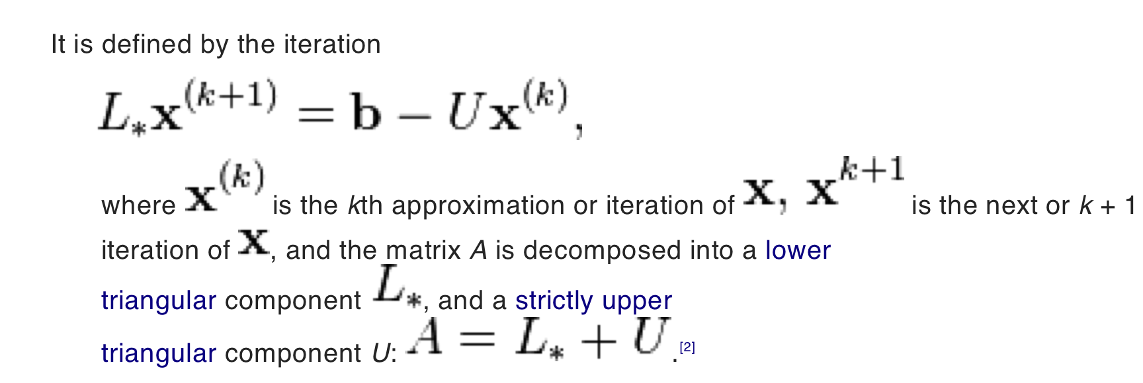
Gauss-Seidel Method
Which gives us:

Slide 46
Gauss-Seidel Method
Algorithm:
Choose your initial guess, theta[0]
While not converged do:
Start your i-loop (for i = 1 to n)
sigma = 0
Start your j-loop (for j = 1 to n)
If j not equal to i
sigma = sigma + a[i][j] * theta[j]
End j-loop
theta[i] = (b[i] – sigma)/a[i][i]
End i-loop
Check for convergence
iterate

Slide 47
Stopping Tests
When to stop converging? Can size of the error be guaranteed?
Direct tests on error e_{n} = x - x_{n} impossible; two choices
Relative change in the computed solution small:
Residual small enough:
Without proof: both imply that the error is less than some other

Slide 48
Python - NumPy
"Numerical Python"
open source extension module for Python
provides fast precompiled functions for mathematical and numerical routines
adds powerful data structures for efficient computation of multi-dimensional arrays and matrices.

Slide 49
NumPy, First Steps
Let build a simple list, turn it into a numpy array and perform some simple math.
import numpy as np cvalues = [25.3, 24.8, 26.9, 23.9] C = np.array(cvalues) print(C)

Slide 50
NumPy, First Steps
Let build a simple list, turn it into a numpy array and perform some simple math. vs.
print(C * 9 / 5 + 32)
fvalues = [ x*9/5 + 32 for x in cvalues] print(fvalues)

Slide 51
NumPy, Cooler things
import time size_of_vec = 1000 def pure_python_version(): t1 = time.time() X = range(size_of_vec) Y = range(size_of_vec) Z = [] for i in range(len(X)): Z.append(X[i] + Y[i]) return time.time() - t1
def numpy_version(): t1 = time.time() X = np.arange(size_of_vec) Y = np.arange(size_of_vec) Z = X + Y return time.time() - t1

Slide 52
NumPy, Cooler things
Let's see which is faster.
t1 = pure_python_version() t2 = numpy_version() print(t1, t2)

Slide 53
NumPy, Multi-Dimension Arrays
A = np.array([ [3.4, 8.7, 9.9], [1.1, -7.8, -0.7], [4.1, 12.3, 4.8]]) print(A) print(A.ndim)
B = np.array([ [[111, 112], [121, 122]], [[211, 212], [221, 222]], [[311, 312], [321, 322]] ]) print(B) print(B.ndim)

Slide 54
NumPy, Multi-Dimension Arrays
The shape function:
x = np.array([ [67, 63, 87], [77, 69, 59], [85, 87, 99], [79, 72, 71], [63, 89, 93], [68, 92, 78]]) print(np.shape(x))

Slide 55
NumPy, Multi-Dimension Arrays
The shape function can also *change* the shape:
x.shape = (3, 6) print(x)
x.shape = (2, 9) print(x)

Slide 56
NumPy, Multi-Dimension Arrays
A couple more examples of shape:
x = np.array(42) print(np.shape(x)) B = np.array([ [[111, 112], [121, 122]], [[211, 212], [221, 222]], [[311, 312], [321, 322]] ]) print(B.shape)

Slide 57
NumPy, Multi-Dimension Arrays
indexing:
F = np.array([1, 1, 2, 3, 5, 8, 13, 21])
# print the first element of F, i.e. the element with the index 0
print(F[0])
# print the last element of F
print(F[-1])
B = np.array([ [[111, 112], [121, 122]], [[211, 212], [221, 222]], [[311, 312], [321, 322]] ]) print(B[0][1][0])

Slide 58
NumPy, Multi-Dimension Arrays
slicing:
A = np.array([ [11,12,13,14,15], [21,22,23,24,25], [31,32,33,34,35], [41,42,43,44,45], [51,52,53,54,55]])
print(A[:3,2:])
print(A[3:,:])

Slide 59
NumPy, Multi-Dimension Arrays
function to create an identity array
np.identity(4)
Notes:
The identity array is a square array with ones on the main diagonal.

Slide 60
NumPy, By Example
The example we will consider is a very simple (read, trivial) case of solving the 2D Laplace equation using an iterative finite difference scheme (four point averaging, Gauss-Seidel or Gauss-Jordan). The formal specification of the problem is as follows. We are required to solve for some unknown function u(x,y) such that ∇2u = 0 with a boundary condition specified. For convenience the domain of interest is considered to be a rectangle and the boundary values at the sides of this rectangle are given.
def TimeStep(self, dt=0.0): """Takes a time step using straight forward Python loops.""" g = self.grid nx, ny = g.u.shape dx2, dy2 = g.dx**2, g.dy**2 dnr_inv = 0.5/(dx2 + dy2) u = g.u err = 0.0 for i in range(1, nx-1): for j in range(1, ny-1): tmp = u[i,j] u[i,j] = ((u[i-1, j] + u[i+1, j])*dy2 + (u[i, j-1] + u[i, j+1])*dx2)*dnr_inv diff = u[i,j] - tmp err += diff*diff return numpy.sqrt(err)

Slide 61
NumPy, By Example
The example we will consider is a very simple (read, trivial) case of solving the 2D Laplace equation using an iterative finite difference scheme (four point averaging, Gauss-Seidel or Gauss-Jordan). The formal specification of the problem is as follows. We are required to solve for some unknown function u(x,y) such that ∇2u = 0 with a boundary condition specified. For convenience the domain of interest is considered to be a rectangle and the boundary values at the sides of this rectangle are given.
def numericTimeStep(self, dt=0.0): """Takes a time step using a NumPy expression.""" g = self.grid dx2, dy2 = g.dx**2, g.dy**2 dnr_inv = 0.5/(dx2 + dy2) u = g.u g.old_u = u.copy() # needed to compute the error. # The actual iteration u[1:-1, 1:-1] = ((u[0:-2, 1:-1] + u[2:, 1:-1])*dy2 + (u[1:-1,0:-2] + u[1:-1, 2:])*dx2)*dnr_inv return g.computeError()

Slide 62
NumPy, Exercise
Jacobi
Algorithm. * Find D, the Diagonal of of A : diag(A)
* Find R, the Remainder of A - D : A - diagflat(A) * Choose your initial guess, x[0] * Start iterating, k=0 * While not converged do * Start your i-loop (for i = 1 to n) * sigma = 0 * Start your j-loop (for j = 1 to n) * If j not equal to i * sigma = sigma + a[i][j] * x[j][k] * End j-loop * x[i]k = (b[i] – sigma)/a[i][i] : x = (b - dot(R,x)) / D * End i-loop * Check for convergence * Iterate k, ie. k = k+1

Slide 63
Questions? Comments?

