Slide 1
Python - Loops and Iteration

Slide 2
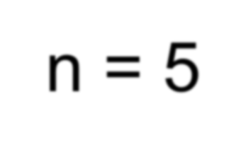
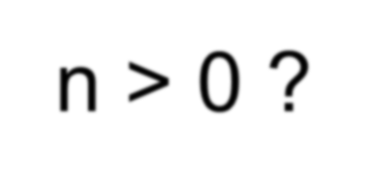
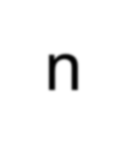
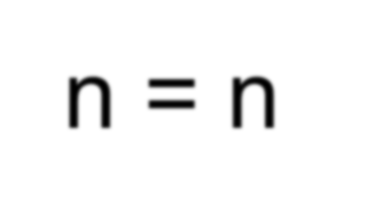
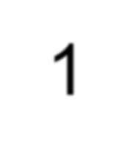
Repeated Steps
n = 5
No
Yes
Program:
Output:
n > 0 ?
print n
n = 5
while n > 0 : print n
n = n – 1 print 'Blastoff!' print n
5
4
3
2
1
Blastoff!
0
n = n -1
print 'Blastoff'
Loops (repeated steps) have iteration variables,
which change each time through a loop. Often these iteration variables go through a sequence of numbers.

Slide 3
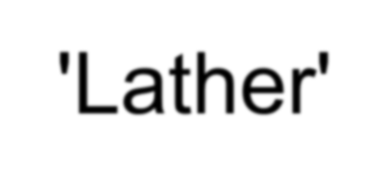
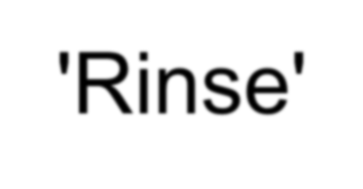
An Infinite Loop
n = 5
No
Yes
n > 0 ?
print 'Lather'
print 'Rinse'
n = 5
while n > 0 : print 'Lather’ print 'Rinse'
print 'Dry off!'
print 'Dry off!'
What is wrong with this loop?

Slide 4
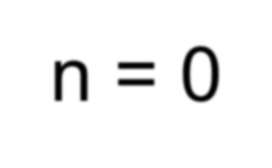
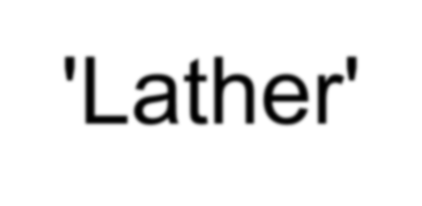
Another Loop
n = 0
No
Yes
n > 0 ?
print 'Lather'
print 'Rinse'
n = 0
while n > 0 : print 'Lather’ print 'Rinse'
print 'Dry off!'
print 'Dry off!'
What does this loop do?

Slide 5
Breaking Out of a Loop
-- The break statement ends the current loop and jumps to the
statement immediately following the loop
while True:
line = raw_input('> ')
if line == 'done' :
break print line
print 'Done!'
> hello there hello there
> finished
finished
> done
Done!

Slide 6
Breaking Out of a Loop
-- The break statement ends the current loop and jumps to the
statement immediately following the loop
while True:
line = raw_input('> ')
if line == 'done' :
break print line
print 'Done!'
> hello there
hello there
> finished Finished
> done
Done!

Slide 7
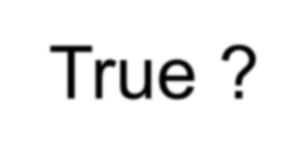
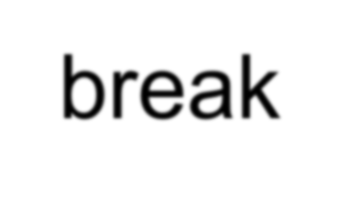
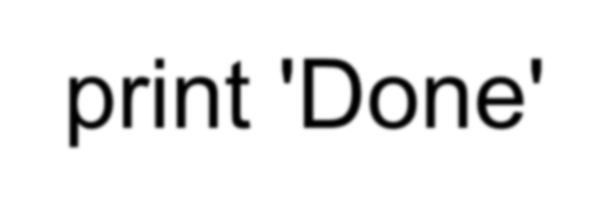
while True:
line = raw_input('> ') if line == 'done' :
No
Yes
True ?
break print line
print 'Done!'
....
break
...
print 'Done'

Slide 8
Finishing an Iteration with
continue
-- The continue statement ends the current iteration and jumps to the top of the loop and starts the next iteration
while True:
line = raw_input('> ') if line[0] == '#' :
continue
if line == 'done' : break
print line
print 'Done!'
> hello there hello there
> # don't print this
> print this! print this!
> done
Done!

Slide 9
Finishing an Iteration with
continue
-- The continue statement ends the current iteration and jumps to the top of the loop and starts the next iteration
while True:
line = raw_input('> ') if line[0] == '#' :
continue
if line == 'done' : break
print line
print 'Done!'
> hello there hello there
> # don't print this
> print this! print this!
> done
Done!

Slide 10
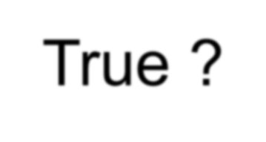
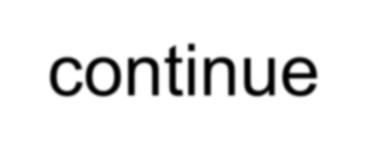
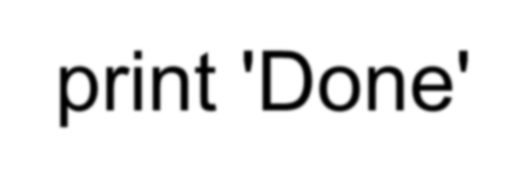
No
True ?
Yes
while True:
line = raw_input('> ’) if line[0] == '#' :
continue
if line == 'done' : break
print line
print 'Done!'
....
....
continue
...
...
print 'Done'

Slide 11
Indefinite Loops
-- While loops are called "indefinite loops" because they keep going
until a logical condition becomes False
-- The loops discussed so far are pretty easy to examine to see if
they will terminate or if they will be "infinite loops“

Slide 12
Definite Loops
-- Often there is a list of items in a file - effectively a finite set of
things
-- Write a loop to run for each of the items in a set using the Python
for construct
-- These loops are called "definite loops" because they execute an exact number of times
-- "definite loops iterate through the members of a set"

Slide 13
A Simple Definite Loop
5
4
3
2
1
Blastoff!
for i in [5, 4, 3, 2, 1] : print i
print 'Blastoff!'

Slide 14
A Definite Loop with Strings
friends = ['Joseph', 'Glenn', 'Sally'] for friend in friends :
print 'Happy New Year:', friend
print 'Done!'
Happy New Year: Joseph Happy New Year: Glenn Happy New Year: Sally Done!

Slide 15
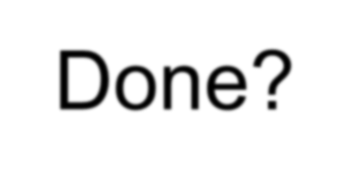
A Simple Definite
Loop
No
Yes
Done? Move i ahead
5
4
3
2
1
Blastoff!
for i in [5, 4, 3, 2, 1] : print i
print 'Blastoff!'
print i
print 'Blast off!'
Definite loops (for loops) have explicit iteration
variables that change each time through a loop.
These iteration variables move through the sequence or set.

Slide 16
Looking at In...
-- The iteration variable “iterates” though the sequence (ordered set)
-- The block (body) of code is executed once for each value in the sequence
-- The iteration variable moves through all of the values in the sequence
Five-element sequence
Iteration variable
for i in [5, 4, 3, 2, 1] :
print i

Slide 17
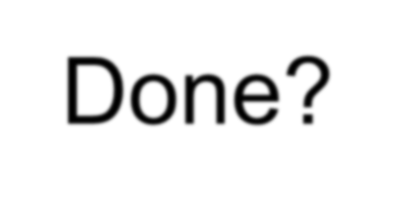
No
Yes
-- The iteration variable “iterates”
though the sequence (ordered set)
Done? Move i ahead
print i
-- The block (body) of code is executed once for each value in the sequence
-- The iteration variable moves through all of the values in the sequence
for i in [5, 4, 3, 2, 1] :
print i

Slide 18
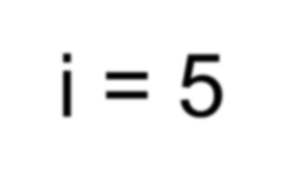
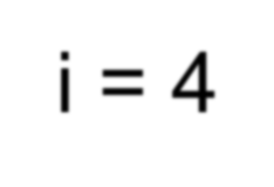
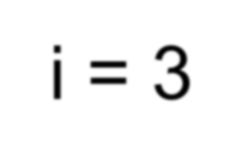
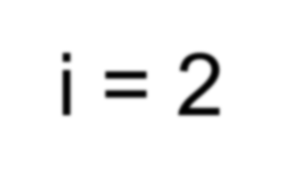
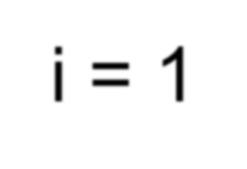
print i
i = 5
No
Yes
Done? Move i ahead
i = 4
print i
print i
i = 3
print i
i = 2
for i in [5, 4, 3, 2, 1] : print i
print i
i = 1
print i

Slide 19
The Loop: What We Do in Loops
Note: Even though these examples are simple, the
patterns apply to all kinds of loops

Slide 20
Making “smart” loops
Set some variables to initial values
for thing in data:
Look for something or do something to each entry separately, updating a variable.
Look at the variables.

Slide 21
Looping through a Set
$ python basicloop.py Before
9
41
12
3
74
15
After
print 'Before'
for thing in [9, 41, 12, 3, 74, 15] : print thing
print 'After'

Slide 22
What is the Largest Number?

Slide 23
What is the Largest Number?
4 1
1 2
7 1
4 5
3
9
-13 4174
largest_so_far

Slide 25
Counting in a Loop
zork = 0
$ python countloop.py
print 'Before', zork
for thing in [9, 41, 12, 3, 74, 15] :
zork = zork + 1
print zork, thing print 'After', zork
Before 0
1 9
2 41
3 12
4 3
5 74
6 15
After 6
To count how many times we execute a loop we introduce a counter variable, which starts at 0 and we add one to it each time through the loop

Slide 26
Summing in a Loop
$ python countloop.py
zork = 0
Before 0
9 9
50 41
62 12
65 3
139 74
154 15
After 154
print 'Before', zork
for thing in [9, 41, 12, 3, 74, 15] :
zork = zork + thing
print zork, thing print 'After', zork
To add up a value we encounter in a loop, we introduce a sum variable that starts at 0 and we add the value to the sum each time through the loop

Slide 27
Finding the Average in a Loop
count = 0
sum = 0
print 'Before', count, sum
for value in [9, 41, 12, 3, 74, 15] : count = count + 1
sum = sum + value
print count, sum, value
print 'After', count, sum, sum / count
$ python averageloop.py
Before 0 0
1 9 9
2 50 41
3 62 12
4 65 3
5 139 74
6 154 15
After 6 154 25
An average just combines the counting and sum
patterns and divides when the loop is done

Slide 28
Filtering in a Loop
print 'Before’
for value in [9, 41, 12, 3, 74, 15] : if value > 20:
print 'Large number',value
print 'After'
$ python search1.py Before
Large number 41
Large number 74 After
We use an if statement in the loop to catch / filter the
values we are looking for.

Slide 29
Search Using a Boolean
Variable
$ python search1.py
found = False
Before False
False 9
False 41
False 12
True 3
True 74
True 15
After True
print 'Before', found
for value in [9, 41, 12, 3, 74, 15] : if value == 3 :
found = True
print found, value print 'After', found
To search and know if a value was found - a variable starts at False and is set to True as soon as the value is found

Slide 30
What is the Smallest Number?
4 1
1 2
7 1
4 5
9
3
-1
smallest_so_far

Slide 31
What is the Smallest Number?
4 1
1 2
7 1
4 5
9
3
None 9 3
largest_so_far

Slide 32
Finding the smallest value
smallest = None print 'Before’
for value in [9, 41, 12, 3, 74, 15] :
if smallest is None :
smallest = value elif value < smallest :
smallest = value
print smallest, value print 'After', smallest
$ python smallest.py Before
9 9
9 41
9 12
3 3
3 74
3 15
After 3
Determine a smallest variable -- The first time through the loop smallest
is None so the first value to be the smallest

Slide 33
The "is" and "is not" Operators
smallest = None print 'Before’
for value in [3, 41, 12, 9, 74, 15] :
if smallest is None : smallest = value
elif value < smallest : smallest = value print smallest, value
print 'After', smallest
-- Python has an "is" operaror that
can be used in logical expressions
-- Implies 'is the same as'
-- Similar to, but stronger than ==
-- 'is not' also is a logical operator

