Slide 1
Python - Functions

Slide 2
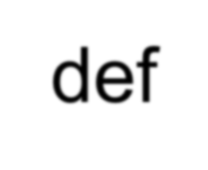
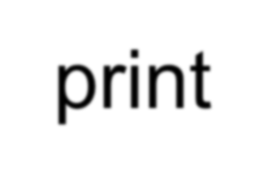
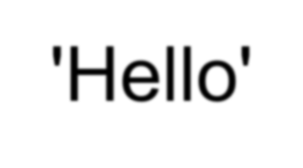
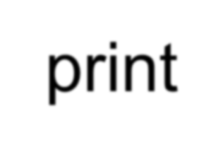
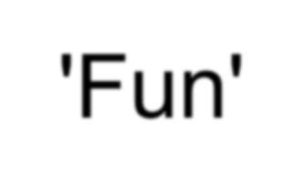
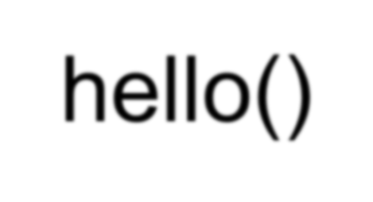
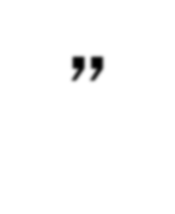
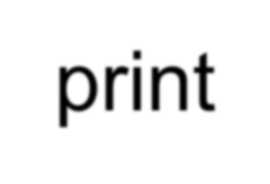
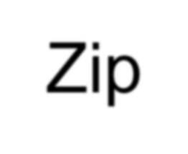
Stored (and reused) Steps
def
hello():
Program:
print 'Hello' print 'Fun'
Output:
def hello(): print 'Hello’ print 'Fun’
Hello Fun Zip Hello Fun
hello()
hello() print 'Zip’ hello()
print “Zip”
hello()
These reusable pieces of code are called “functions”.

Slide 3
Python Functions
-- There are two kinds of functions in Python
-- Built-in functions, which are provided by Python - raw_input(), type(), float(), int() ...
-- Functions, which are user-defined
-- Built-in function names treated as “new” reserved words

Slide 4
Function Definition
-- In Python, a function is reusable code, which takes arguments(s) as input does some computation and then returns a result(s)
-- Define a function using the def reserved word
-- Call/invoke the function by using the function name, parenthesis and arguments in an expression

Slide 5
Argument
big = max('Hello world')
Assignment
'w'
Result
>>> big = max('Hello world')
>>> print big w
>>> tiny = min('Hello world')
>>> print tiny
‘ ‘

Slide 6
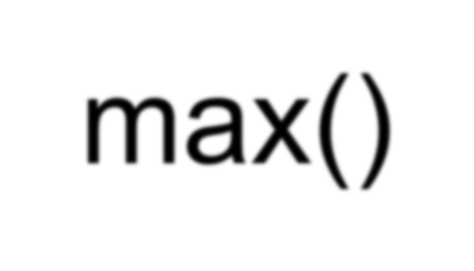
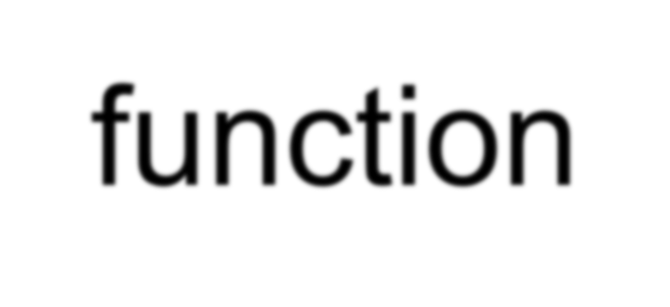
Max Function
>>> big = max('Hello world')
>>> print big
'w'
A function is reusable code, which takes some input and produces an output
max() function
“Hello world” (a string)
‘w’
(a string)

Slide 7
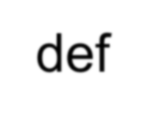
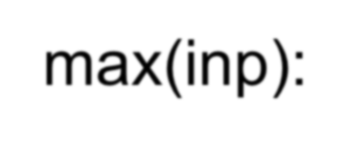
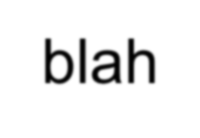
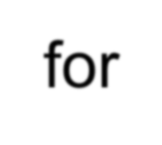
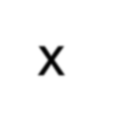
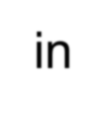
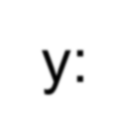
Max Function
>>> big = max('Hello world')
>>> print big
'w'
A function is reusable code, which takes some input and produces an output
def max(inp): blah
blah
for x in y: blah blah
“Hello world” (a string)
‘w’
(a string)

Slide 8
Type Conversions
>>> print float(99) / 100 0.99
>>> i = 42
>>> type(i)
<type 'int'>
>>> f = float(i)
>>> print f 42.0
>>> type(f)
<type 'float'>
>>> print 1 + 2 * float(3) / 4 - 5
-2.5
>>>
-- In an integer and floating point in an expression, the integer is implicitly converted to a float
-- You can control this with the built in functions int() and float()

Slide 9
String
Conversions
>>> sval = '123'
>>> type(sval)
<type 'str'>
>>> print sval + 1
Traceback (most recent call last): File "<stdin>", line 1, in <module>
TypeError: cannot concatenate 'str' and 'int'
>>> ival = int(sval)
>>> type(ival)
<type 'int'>
>>> print ival + 1
124
>>> nsv = 'hello bob'
>>> niv = int(nsv)
Traceback (most recent call last):
File "<stdin>", line 1, in <module>
ValueError: invalid literal for int()
-- Use int() and float() to convert between strings and integers
-- An error will occur if the string does not contain numeric characters

Slide 10
Building our Own Functions
-- To create a new function, the def keyword is used followed by
optional parameters in parenthesis
-- Indent the body of the function
-- This defines the function but does not execute the body of the
function
def print_lyrics():
print "I'm a student at ECSU, and I'm okay.” print 'I sleep all night, and I work all day.'

Slide 11
print_lyrics():
print "I'm a student at ECSU, and I'm okay." print 'I sleep all night, and I work all day.'
x = 5
print 'Hello'
def print_lyrics():
print "I'm a student at ECSU, and I'm okay.” print 'I sleep all night, and I work all day.'
Hello
Yo 7
print 'Yo' x = x + 2 print x

Slide 12
Definitions and Uses
-- Once a function is defined, we can call (or invoke) it as many
times
-- This is the store and reuse pattern

Slide 13
x = 5
print 'Hello'
def print_lyrics():
print "I'm a student at ECSU, and I'm okay.”
print 'I sleep all night and I work all day.'
print 'Yo' print_lyrics() x = x + 2 print x
Hello Yo
I'm a student at ECSU, and I'm okay. I sleep all night and I work all day.
7

Slide 14
Arguments
-- An argument is a value passed to the function as its input when the function is called
-- Arguments direct the function to do different kinds of work when called different times
-- Arguments are placed in parenthesis after the name of the
function
big = max('Hello world')
Argument

Slide 15
Parameters
>>> def greet(lang):
...
...
...
...
...
...
...
if lang == 'es':
print 'Hola’ elif lang == 'fr':
print 'Bonjour’
else:
print 'Hello’
>>> greet('en')Hello
>>> greet('es')Hola
>>> greet('fr')Bonjour
>>>
-- A parameter is a variable, which is used in the function definition as a “handle” to allow the function to access the arguments for a particular function invocation

Slide 16
Return Values
-- Often a function will take arguments, do some computation and return a value to be used by the that function called it; this is supported by the return keyword
def greet():
return "Hello”
Hello Glenn Hello Sally
print greet(), "Glenn”
print greet(), "Sally"

Slide 17
>>> def greet(lang):
Return Value
...
...
...
...
...
...
if lang == 'es': return 'Hola’ elif lang == 'fr':
return 'Bonjour’ else:
return 'Hello’
... >>> print greet('en'),'Glenn’ Hello Glenn
>>> print greet('es'),'Sally’
Hola Sally
>>> print greet('fr'),'Michael’ Bonjour Michael
>>>
-- A “fruitful” function is one that produces a result (or return value)
-- The return statement ends the function execution and “sends back” the result of the function

Slide 18
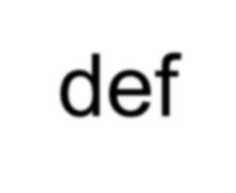
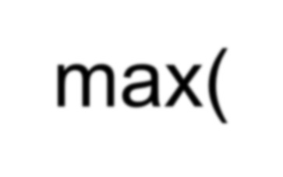
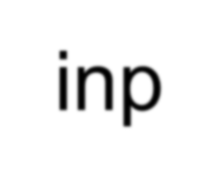
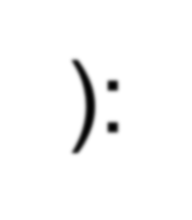
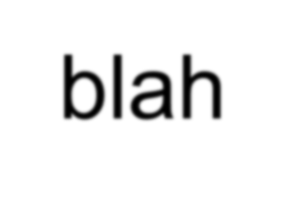
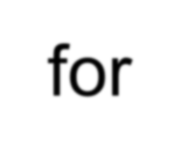
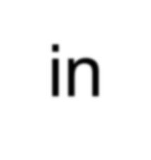
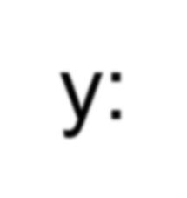
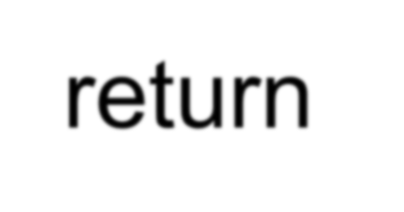
Arguments, Parameters, and
Results
>>> big = max('Hello world')
>>> print big
'w'
“Hello world” Argument
Parameter
def max(inp): blah
blah
for x in y: blah blah
return ‘w’
‘w’
Result

Slide 19
Multiple Parameters /
Arguments
-- More than one parameter in the function
definition can be defined
def addtwo(a, b): added = a + b return added
x = addtwo(3, 5)
print x
-- To do this, simply add more
arguments when the function is called
-- The number and order of arguments
and parameters are matched

Slide 20
Void (non-fruitful) Functions
-- If a function does not return a value, it is called a "void" function
-- Functions, which return values are called "fruitful" functions
-- Void functions are "not fruitful"

Slide 21
To function or not to function...
Organize your code into “paragraphs” - capture a complete thought
and “name it”
Don’t repeat yourself - make it work once and then reuse it
If something gets too long or complex, break up logical chunks and
put those chunks in functions
Make a library of common stuff that you do over and over - perhaps
share this with your friends...

Slide 22
Exercise
Rewrite your pay computation with time-and-a- half for overtime and create a function called computepay which takes two parameters ( hours and rate).
Enter Hours: 45
Enter Rate: 5.15
Pay: 281.00
281.00= 40 * 5.15 + 5 * 15

