Slide 1
Analyzing Long-Term Drought Effects on Land Surface Temperature and Vegetation Using National Oceanic Atmospheric Administration Satellite’s Data
Cornelius Holmes,
Derek Morris Jr.

Slide 2
Abstract
Analyzing the effects of Drought in the Northeastern North Carolina area with NOAA satellite products to determine a correlation between Land Surface Temperature and Vegetation. The Palmer Drought Severity Index (PDSI) data sets for summer 2002 -2013, provided by the State Climate Office of North Carolina NC CRONOS database, provided evidence that since 2007 the northern coastal plain of North Carolina has been experiencing a long-term summer drought. Summer is defined as the months between late June to late September.
Utilizing Elizabeth City State University’s (ECSU) 1.5m L-band SeaSpace ground station the team received live Advanced Very High Resolution Radiometer (AVHRR) imagery from NOAA polar orbiting satellites each day for the month of June. The primary goal of this research was to observe the correlation between land surface temperature (LST) and Normalized Difference Vegetation Index (NDVI) due to long-term drought using NOAA satellite data. In the month of June 2016, the team collected imagery data through the SeaSpace© TeraScan® system and produced LST and NDVI. Various GPS locations were selected in Northeastern North Carolina of different biomes such as swamp lands, grasslands, and farmlands. The team collected and utilized data in the areas of Camden County, Gates County, Pasquotank County, and Perquimans County. Using the SeaSpace Graphical User Interface (GUI) Teravision®, The data points of each product at the various biome locations were analyzed for daily and weekly averages.
Using the GPS locations found in United States Geological Survey (USGS) of the swamps lands, grasslands, and farmlands were entered and saved as survey points in TeraVision’s GUI. All of the passes in the month of June that were received and processed into LST and NDVI products at the direct broadcast ground station at ECSU were loaded into TeraVision. The values were then extracted from each of the points and evaluated by their biome specific location for LST and NDVI. With Excel the team conducted analysis for daily trends, regional trends, biome trends, and weekly trends.
Notes:
Advance

Slide 3
Team Members
Cornelius Holness Derek Morris Jr.

Slide 4
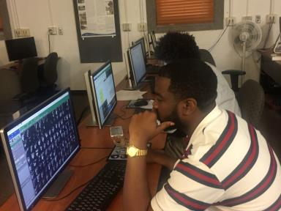
Overview
Objective
Purpose
NOAA Satellites
TeraScan at ECSU/TeraVision
Methodology
Analysis
Results
Future Work
Notes:
We want to analyze why this is happening.

Slide 5
Objective
The primary goal of this research was to observe the correlation between land surface temperature (LST) and Normalized Difference Vegetation Index (NDVI) due to long-term drought using NOAA satellite data.

Slide 6
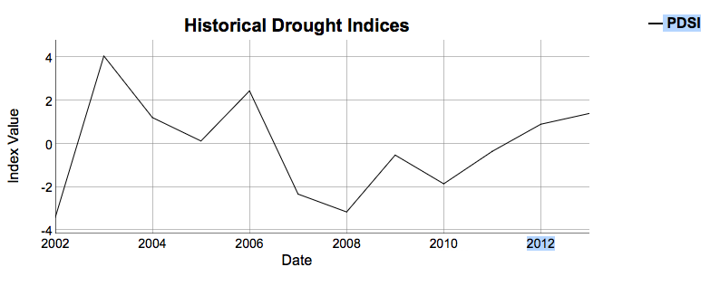
Purpose
http://climate.ncsu.edu/climate/drought/historical
Notes:
This chart shows the drought 2007-2013
The purpose of our research is to produce the methods on analyzing the correlation between LST and Vegetation index and the drought season in different biomes.

Slide 7
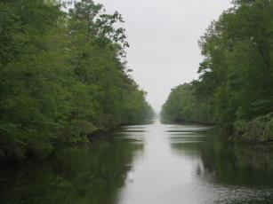
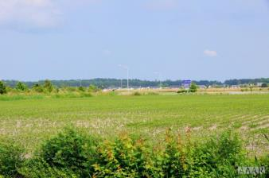
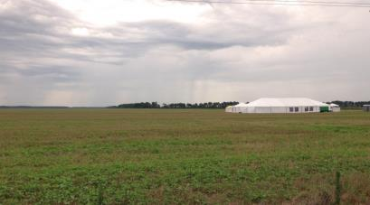
Biomes
Grassland
Farmland
Swamps
Notes:
We wanted biomes specific data point instead of composite averaged value from random gps location. Such as the last method on a top similar to this.

Slide 8
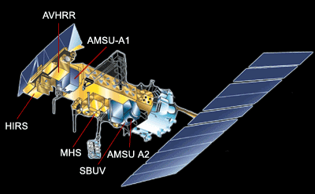
NOAA Satellites
NOAA
NOAA-15, 18, 19
Polar Orbiting
Notes:
Very high repeat period.
Used for The NOAA Satellite and Information Service provides timely access to global environmental data from satellites and other sources to monitor and understand our dynamic Earth. We manage the Nation's operational environmental satellites and deliver data and information services such as Earth system monitoring and official assessments of the environment.
NOAA-18 Launched on May 20, 2005 into a 470-nmi afternoon orbit.
NOAA-15

Slide 9
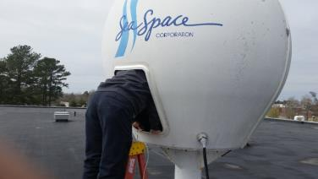
TeraScan at ECSU
Combination of hardware and software designed for automated reception of data from meteorological and environmental satellites
1.5 meter L-Band receiving station was install in 2002
Major update in 2014
TREX-processor
Teravault-storage
Notes:
Major update was the TREX and Teravolt
Terascan is a combination of hardware and software designed for automated reception of data from meteorological/environmental satellites and for processing the data into images and data overlays. Images and overlays are of a special format called TeraScan Data Format (TDF) and can be displayed with the TeraScan GUI TeraVision. These data files can be used to produce images in various formats. Different types of satellite data can be received from both the hardware and software that is installed on the computer. These satellite data types include: X Band Data from Polar Orbiting Satellites, L/S Band Data from Polar Orbiting Satellites, and L Band Data from Geostationary Satellites.

Slide 10
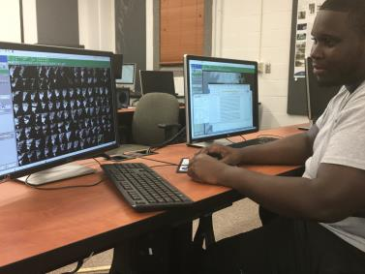
TeraVision
GUI used to manipulate any information
Notes:
Graphical User Interface (GUI) that is a part of TeraScan, in which the images, in the form of TDF, can be manipulated by the user to include annotations, overlays, image enhancement of different parts of the image

Slide 11
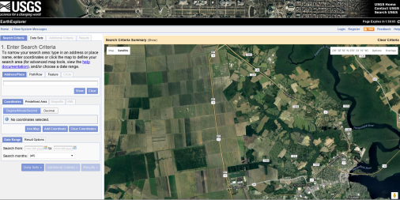
Methodology
GPS Coordinates: .Lat: 36° 19' 34" N, Lon: 076° 21' 47" W Farmland decimal: Lat36.326111
Notes:
Earth Explorer was utilized to distinguish each biome.
latitude and longitude points were converted to decimal format enabling TeraScan/TeraVision to extract values at that location.
Archived passes for June from the processed folder.

Slide 12
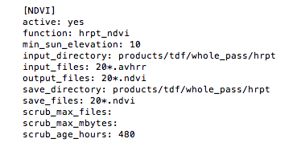
Scripts/Products

Slide 13
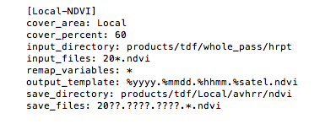
Scripts/Cover Area
Notes:
Raw data are processed into products and the products are registered to the cover area.

Slide 14
Archives

Slide 16
TeraScan
Notes:
We opened the archived passes with TeraScan and imported the GPS locations.
With this tool “survey” we were able to extract the values of LST and NDVI for each of those passes.

Slide 20
Results

Slide 21
Analysis
Pasquotank County grassland NDVI and LST graphs
Farmland biomes vegetation an LST
County averages of LST

Slide 22
Future Work
Find an alternative way to automate the data points using Python programming software.
Notes:
Make text coordinates based on each county and biome
Convert the txt files into tdf. Then the tdf files are made into point files.
Test point files for accuracy.
Find errors within the point files because they were null
Next is to find a way to automate
Catalog current data as shown above in the graph.

Slide 23
Acknowledgements
Dr. Linda Hayden for the research opportunity that was made possible through the CERSER program.
Mr. Andrew Brumfield for his guidance, contributions, and help with completing this research.

Slide 24
Questions?

