Slide 1
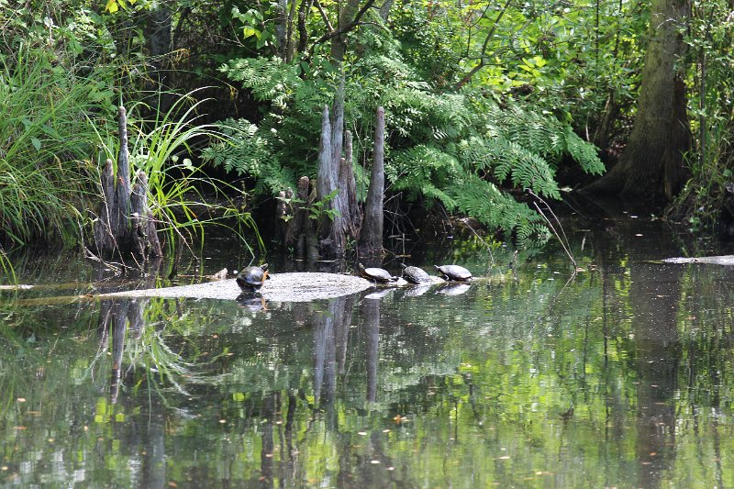
A Corresponding Study of Water Quality Evaluation of the Pasquotank Watershed in Northeastern North Carolina

Slide 2
2015 Water Quality Research Team
Jamal Stevenson
Ricky Dixon
Jeffrey Wood
Mentor
Steffi Walthall
Raveen McKenzie

Slide 3
Abstract
The Pasquotank River Watershed covers over 450 square miles and is located in the Coastal Plain of northeastern North Carolina. It flows from the Great Dismal Swamp at the Virginia/North Carolina border into the Albemarle Sound. The watershed is part of the Albemarle-Pamlico Estuarine System, the second largest system in the United States after the Chesapeake Bay Estuary and provides a transition between spawning grounds and the waters of the Albemarle Sound. Forested swamp wetlands border much of the waterways. Increased agricultural and urban development has greatly affected water quality during recent years.
The 2015 Research Experience for Undergraduates Pasquotank River Watershed Team completed various tests along the tributaries and the river itself, adding to the previously gathered data from 2011, 2013, and 2014. The test points were derived during the 2011 Summer Watershed Team research project with four points added during the 2014 summer project. Results were compared with previous readings for analysis. Streams tested were the Newbegun Creek, Knobbs Creek, Areneuse Creek, Mill Dam Creek, and Sawyers Creek. These streams, along with the river, cover a large area of the watershed and provide a wide variety of shore development from swampland and farmland to industrial development.

Slide 4
Abstract
In-house tests on this year’s samples continued to include pH, salinity, total dissolved solids, and conductivity. Air/water temperature, dissolved oxygen, wind speed/direction, and turbidity/clarity measurements were taken in the field. The results from these readings were placed into an online database where they are correlated to the location of the sample using Google Maps®.
Analysis tools were developed in order to compare the data from all years for any variations or similarities. Excel spreadsheets were developed to look more closely at individual points and tests for each point. Past projects have used a general analysis of the entire stream to determine water quality. Steps were also made to research the development of an online graphing tool for analyzing the data at individual points over several years. Test results collected were added to a database developed during the 2014-2015 academic year at Elizabeth City State University. This database was connected to a data visualization page utilizing Google Maps®.

Slide 5
Abstract
The results show that there were variations for the individual water quality scores, but the overall water quality score for all the tested water sources remained at a comparable level from previous years. Mill Dam Creek rose above the previous three scores of 48 (2011), 47 (2013), and 49 (2014) and achieved a medium water quality score of 57. Areneuse Creek improved in water quality with a medium water quality score of 60. Sawyers Creek became the lowest scoring waterway tested at 35. Knobbs Creek decreased from previous years with a water quality score of 42. For a fourth consecutive testing year, Newbegun Creek fell within the medium water quality range with a score of 65. Pasquotank River rose from the previous testing year’s score of 35 but still remained within the bad water quality range with a score of 45. The Lower Pasquotank remained the highest scoring tributary for a second consecutive year with a score of 85.

Slide 6
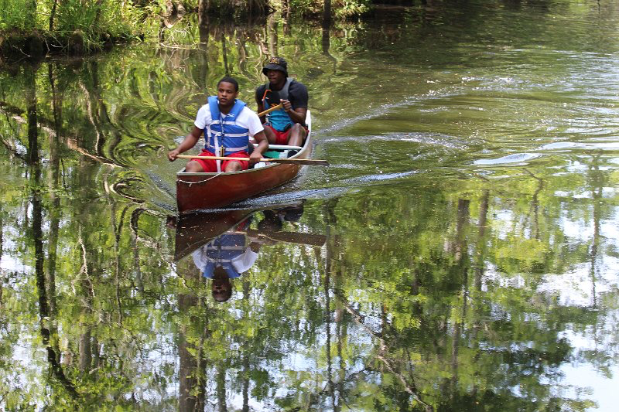
Methodology
Field Testing
Lab Testing
Data Visualization
Water Quality Index
Notes:
1. The canoe, or boat and kayak was launched into the water and loaded with all the gear needed such as paddles, test equipment, and data recording equipment. All of the test equipment was secured to the platforms in case of accidents. At each test point, field tests were done to obtain dissolved oxygen, clarity, turbidity, wind speed, wind direction, air temperature, water temperature, and water samples.
2. After collecting data from each waterway, in-house tests were done to obtain the pH, conductivity, salinity, and total dissolved solids readings from the water samples of each testing point.
3. Data was entered into Google Drive Excel sheets. These spreadsheets were used for recording the data in field and laboratory testing. The data was also used in Microsoft Excel spreadsheets to compare using visual graphs and analyze in detail each point with each test.
4. This online data visualization would be utilized for comparisons of a specific test factor of a specific waterway for the four years of water testing. This visualization would be placed on the team’s webpage as a reference for analyzing the data.
5. After all the data was collected, averages from both trips of the tested waterways were taken, and certain factors were utilized to obtain the water quality index score.

Slide 7
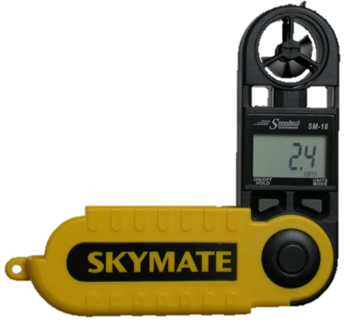
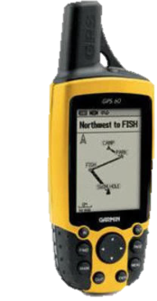
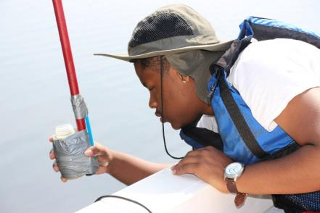
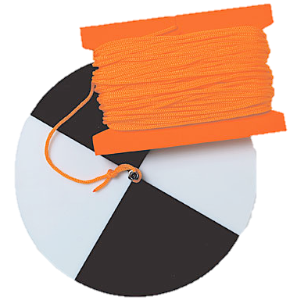
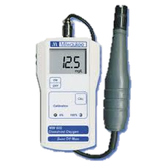
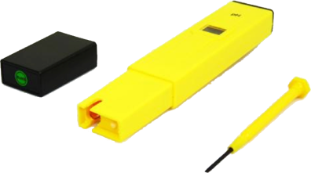
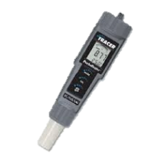
Test Equipment
Mercury Thermometer
MW600 Dissolved Oxygen Meter
Garmin GPSMAP 60CSx (GPS)
Secchi disk
Skymate Wind Meter
Tracer Pocket Tester
Aquarium Testing Unit
Notes:
1. The Mercury thermometer is used to measure water temperature in degrees Celsius. The thermometer is lowered into the water at a depth of three feet for approximately one minute to allow the thermometer to settle and obtain an accurate temperature. The thermometer is then brought up, along with the water sample, and the reading is taken.
2. The Tracer Pocket Tester is a self-calibrated tester that measures conductivity, salinity, and total dissolved solids (TDS). Salinity determines the saltiness of the water and is measured in parts per million. Conductivity is the measure of the water’s capability of passing electrical flow and is measured in Siemens (mho). TDS measures all the dissolved solids in the water and is measured in parts per million (ppm).
3. The MW600 Dissolved Oxygen Meter is an instrument used to measure dissolved oxygen in water. This device is calibrated at two points, 100% saturation air and 0% oxygen solution. Before using it in water, remove the plastic cap to exposes the membrane. Set the membrane in the water at a depth of three feet. Give the device time to reach a stable reading for dissolved oxygen. This may take within three to five minutes. When the reading is given, place the plastic cap back on, so the meter will reset back to the neutral setting.
4. The latitudes and longitudes of each point of each waterway were loaded into the Garmin GPSMAP 60CSx, a handheld Global Positioning System (GPS) device, from the Garmin BaseCamp software.
5. The Aquarium Testing Unit is an instrument used to measure pH, which is determining whether it is acidic or basic. pH readings range from 0.0 (acid) to 14.0 (base). The pH levels from 0.0 to 6.9 are considered acidic, from 7.1 to 14.0 are considered basic, 7 is considered neutral.
6. The secchi disk is a two sided disk, one with quartered sides of black and white and the other being entirely black. Turbidity is measured used the whole black side and clarity is measured using the quarterly black and white side.
7. The Skymate Wind Meter is an anemometer that was used to measure wind speed and determine the air temperature. The wind speed is measured in knots and the air temperature is measured in degrees Celsius.

Slide 8
Software Applications
Google Drive
Dreamweaver
Microsoft Excel
Google Maps
Notes:
Google Drive is an application that allows people to store and share files online. This application was used for compiling documents and spreadsheets. Those shared files were necessary for analysis and the final report.
2. Adobe Dreamweaver is a software application for designing web pages. This application provides a what-you-see-is-what-you-get (WYSIWYG) interface to create and edit web pages in a user- friendly environment. It allowed the use of HTML, JavaScript, and program editors to display the research that was done as well as the results.
3. Microsoft Excel is a spreadsheet program included in the Microsoft Office suite of application. Spreadsheets present tables of values arranged in rows and column that can be manipulated mathematically. This program was utilized to input data collected from field and in- house testing, for comparisons, analysis, averaging, and identifying trends through charting. It was also used to calculate the Water Quality Index Scores for each waterway.
4. Google Maps is a mapping application provided by Google that can be embedded into a site by using the Google map asset and Google Map Application Programming Interface. This application is used to get specific locations, which also allow for a variety of features to display the specific location. Google Maps was used to display test points and data collected from each point.

Slide 9
Analysis Tools
Excel File
Water Quality Evaluation
Notes:
An excel file was created in order to analyze the data from each individual point. This allowed the team to see variations in the data for further analysis. Also, to the right is an example of the data entry from trip 1 of Areneuse Creek using Google Maps.

Slide 10
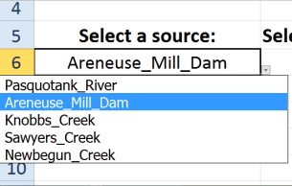
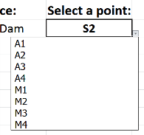
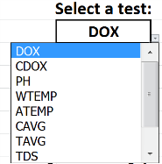
Excel
Source
Point
Test
Notes:
Here are the three pull down bars in which the user can select the source, point, test they want to see data from.

Slide 11
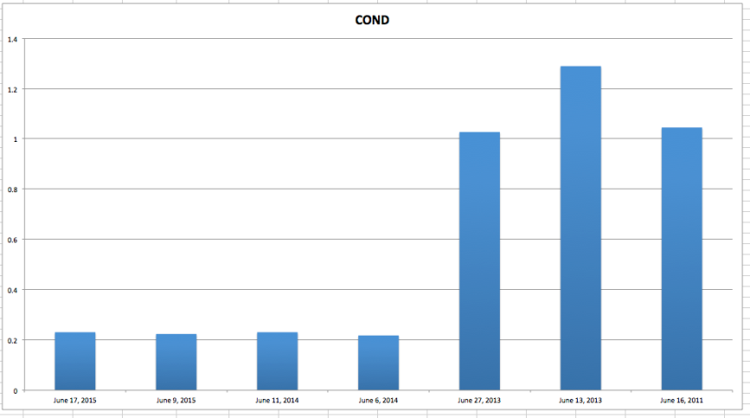
Excel
Notes:
Here is an example of the chart in which the information will be displayed. The x axis displays the date while the y axis displays the data. These along with the title will change with each test and data point.

Slide 12
Excel
IF [(logical_test,value_if_true,value_if_false)]
INDEX [(array, row_num, [column_num])]
MATCH [(lookup_value,lookup_array,match_type)]
HLOOKUP [(lookup_value,table_array,row_index_num,range_lookup)]

Slide 13
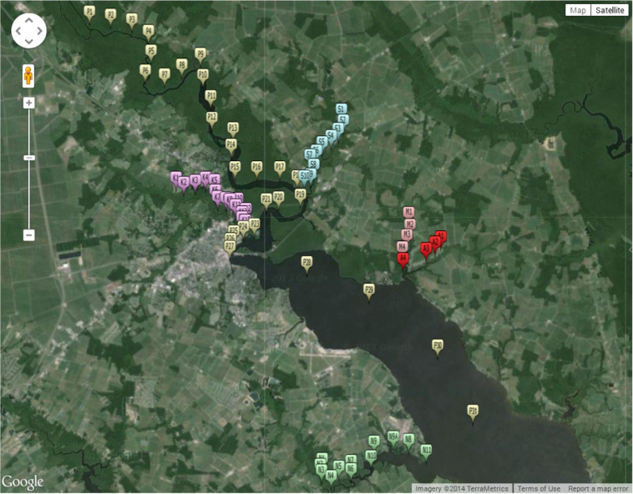
Variations
Notes:
It was shown from these charts that each point that was near Pasquotank shared similar pH readings. Another correlation that was seen that the lower Pasquotank and the mouth of the Newbegun Creek had similar readings for total dissolved solids, salinity, and conductivity. Also, the overall readings for total dissolved solids, salinity, and conductivity have decreased from the previous testing years. The rain during nights before testing may have affected the readings because rain dilutes the salt in the water by mixing the freshwater with the salinity of the waterways. This also made an impact on the Lower Pasquotank, which is a key indictor in sea level rise.

Slide 14
Online Data Visualization
Notes:
This is a basic bar graph, which is an example of how the online data visualization would look. This graph was coded in JavaScript through highcharts, which is an online application that consist of interactive JavaScript charts and whose template was in jsFiddle which is an online template that allows for coding in JavaScript, HTML, and CSS. jsFiddle and highcharts are both open source applications. The next step in creating this tool will be connecting the JavaScript based file to the online database using PHP Hypertext Preprocessor (PHP) and MySQL. This would allow researchers to identify trends at specific points from the web browser versus the Excel file created during this project.

Slide 15
Water Quality Evaluation
Water Quality Index Calculator
Notes:
The Water Quality Index Calculator is an excel spreadsheet that was used to determine the water quality score for each waterway tested. An entered factor from a test will multiply to its respective weight factor and display a subtotal. The more test results entered, the more accurate the water quality score would be. If there is an empty space for the other test, the calculator will generate neutral results and multiply each with their respective weight factor to get neutral subtotals. The subtotals are added together to get the water quality index score. The testing factors that were used for the water quality index calculator were pH, percent saturation for dissolved oxygen, and NTU units for turbidity. The water quality index ranges from 0 to 100. The scale is classified as the following: 0 to 25 is very bad, 25 to 50 is bad, 50- 70 is medium, 70-90 is good, and 90 to 100 is excellent.

Slide 16
Water Quality Index Scores
Water Quality Index Score Range
0 to 25 = Very Bad
25 to 50 = Bad
50 to 70 = Medium
70 to 90 = Good
90+ = Excellent
Notes:
The overall water quality for all the waterways combined remained at a comparable level. Mill Dam Creek increased in its water quality score and went from a bad water quality score in the high 40’s for the testing years of 2011, 2013, and 2014 to a medium water quality score. Areneuse Creek, along with Mill Dam Creek, has reached its highest point of the four testing years and reached the medium water quality score range. Sawyers Creek was the lowest scoring waterway tested during this research and from the medium water quality score range to a bad water quality. Knobbs Creek also obtained its lowest water quality index score of the four testing years. NewBegun Creek fell between the two previous testing years of 2014 and 2013 with a medium water quality score. The Pasquotank River increased from the 2014 testing year but remained at a bad water quality score. This is the second year that the Lower Pasquotank has been tested. It remained constant in the good water quality range and remained the highest scoring waterway tested.

Slide 17
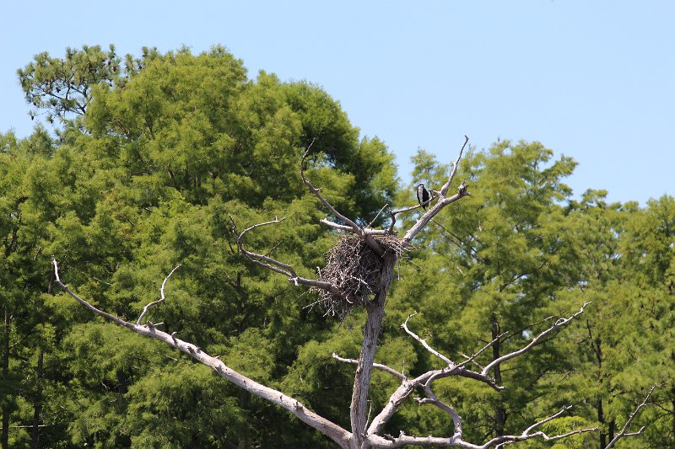
Conclusion
Water Quality Index
Excel file
Notes:
The excel file proved to be very helpful as it showed the variations in the data. The overall Water Quality Index (WQI) score of the Pasquotank Watershed was calculated by using the Water Quality Index Calculator and remained at a comparable level from previous testing years. Mainly due to their dissolved oxygen and pH readings, the lowest score came from Sawyers Creek, and the highest score came from the Lower Pasquotank.

Slide 18
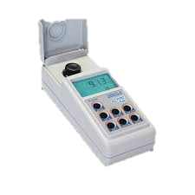
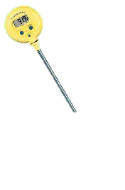
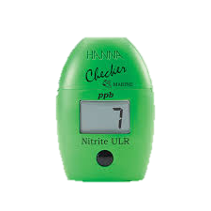
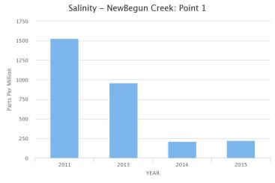
Future Works
Control Company VWR Waterproof Thermometer
Portable Turbidity Meter and Bentonite Check Meter
Online Data Visualization
Additional Tests
Nitrate
Change of Water Temperature
Notes:
For future works, we recommend the Control Company VWR Waterproof Thermometer because it would be able to provide a more accurate reading compared to the subjective readings from the Mercury thermometer. The same applies for the Portable Turbidity Meter and Bentonite Check Meter, and it also minimizes stray light and color interference when measuring clarity and turbidity. The online data visualization should represent a basic graph that displays a data point and test over the number of years tested. This should be done with a MySQL, which is a popular open-source database. For the nitrate test, the HI764 Marine Ultra Low Range Checker HC Device is recommended for measuring nitrate. Another test that can be added without adding new test equipment is the change of water temperature. This measures the difference in temperature between the beginning of a tributary and the end. This, along with the nitrate test, would increase the accuracy of the water quality index score for each waterway tested.

Slide 19
Acknowledgements
We would like to acknowledge Dr. Linda Hayden for her leadership of the Research Experience for Undergraduates (REU) program, Mr. Lee Hayden for his assistance with the boat, Center for Remote Sensing of Ice Sheets (CReSIS) and the National Science Foundation (NSF) for their funding of this program, and the REU staff for their daily assistance.

Slide 20
Questions???

